Slide 1
Pastoral Theology Update
Spectator
One who looks on or watches events from a distance
Participant
One who puts him or herself wholly into an event

Slide 2
Two parts…
A pastoral theology update:
  How did we become a Church of spectators?
  What is the “theology of participation?”
10 strategies
  To become more participatory

Slide 3
Resources you may want…
Go to the website:
SpeakingOfGod.org
Scroll down to the Pax Christi link
on the home page
and click on it

Slide 4
Question
What happened at your baptism?
When have you known
that Christ is calling you?

Slide 5
How did we become spectators
in the Church?

Slide 6
The early Church
Folks encountered Christ
Baptism empowered everyone
  To accomplish the ministry of Jesus
    The poor, the sick, and the wounded
    Immigrants and strangers
    Neighbors & those in our household
Eucharist gathered us as one Body
  100% participatory!

Slide 7
The early Church
We gathered in homes for liturgy
And chose leaders as needed
  Including priests and bishops
  Leaders were “servants”
Being baptized cost us something
  Often it cost our very life
  But at least it meant following Jesus with love, mercy, and commitment

Slide 8
The early Church
For 300 years
  Strong, enthusiastic faith
    So strong that we would die for it
  The belief that Jesus walks with us
  Baptism: I have been called into the Way of Jesus
    Well beyond “the parish” in the wider world
No one was a spectator

Slide 9
Things begin to change…
Under Constantine in the 300s
  He saw the Church as politically useful
  So he lavished privilege on the clergy
  And built enormous basilicas
    Liturgical roles were restricted to clergy at the
    Synod of Laodicea in 363 (canon 19)
The shape of the building is important
  Clergy up front | laity at the back

Slide 10
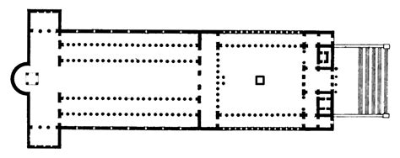
A Basilica in the 4th Century
Where the liturgy
occurred
Where the monks sat
Where the people stood

Slide 11
A new point of view for the Faithful:
They’re in there doing the sacred things.
We’re out here watching.
We’re all the Church and we have a few clergy among us.
They’re the Church and we’re just members.

Slide 12
A new understanding of authority:
Synods always included the Faithful
But after the shift of clerical status under Constantinian legislation:
  They were still held but now called “Synods of Bishops”
  All other people were mere spectators
  “Only the hierarchy knows what is good for the Church.”

Slide 13
Likewise, Holiness
The Holy Ones:
  Monks & religious women
  Priests and bishops
The rest of us:
  Merely baptized
  Marry, work, attend worship, obey the Church, give money, try to live decently

Slide 14
A New Phenomenon
We ordained at huge celebrations that involved the entire diocese
But we baptized at the back of the Church after Mass in a “private” ceremony
What does that tell us?

Slide 15
And here’s where this landed
Father says Mass.
Father knows theology.
Father interprets Scripture.
Father runs the parish.
Father makes the decisions.
Father ministers.
Father has a vocation.
We pray, pay, and obey

Slide 16
Spectators in the Church
This went on for more than 1600 years
Until the early 1960s
  Reform movements popped up
  But were always put down
The clergy “were the Church”
  Their word was final

Slide 17
It took an Ecumenical Council to turn this ship around!
And may I say?
We’ve only just begun!

Slide 18
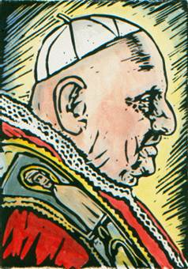
Pope John XXIII
We must shake off the imperial dust that has accumulated on the throne of St. Peter since Constantine.
Notes:
These are the words of Pope John telling how those 17 cardinals responded to his announcement. A light moment in the presentation.

Slide 19
Vatican II
1962-1965
All the bishops in the world + the Pope
  They lived in small communities
  All over the City of Rome
Representatives from all the Christian churches in the world
  The first time in 1000 years we all sat down together

Slide 20
Vatican II
Jews and other world religions
450 Theologians
Thousands of men and women religious
Thousands more lay people
1000 reporters!
The world was watching

Slide 21
How the hall was organized
2500 square meters
2905 seats
  Cardinals
  Patriarchs
  2440 Council Fathers
  200 theologians
  130 Protestant guests & observers
  And a staff of priests who lived in Rome
John XXIII took a personal hand in organizing this

Slide 22
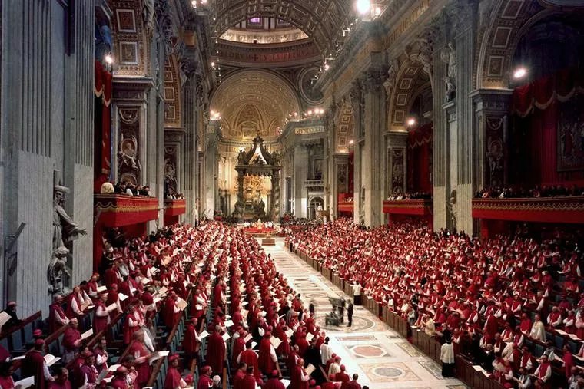

Slide 23
Behind the seating area
3 First Aid stations
22 lavatories
High security measures
  Fear of Communists
Italian coffee vendors
  With pastries!
  For 3000 people every day!
  The bishops were huge fans of this!
Oh, and did I mention the cigars?

Slide 24
Council procedures
Latin would be the language
Voting was by punch card
Speakers were given 10 minutes
  But had to submit ahead in writing
  In Latin
The Pope was not in the Hall
No women or lay people in the Hall

Slide 25
How did this work?
Amazingly, the Holy Spirit took over
Those speeches in Latin
Translated two days before they were given
Delivered to all those bishops living around the City of Rome.

Slide 26
Evening parties
Evening lectures on the next day’s topics
  Everyone was welcomed into these events
“Illegal rooftop parties” followed
  Vino & Bruschetta
  Deep conversation about the pastoral implications of each topic
  Including priests, lay folks, religious, seminarians, theologians, & non-Catholics

Slide 27
The Voting
Liturgy
  2147-4
The Church
  2151-5
Divine Revelation
  2344-6
The Church in the Modern World
  2309-75

Slide 28
The crowds of faithful
The crowds in the piazza
Praying and singing
  Veni Creator Spiritus
  Conversion was in the air
The whole church mingled together
The People of God were present even if not invited…

Slide 29
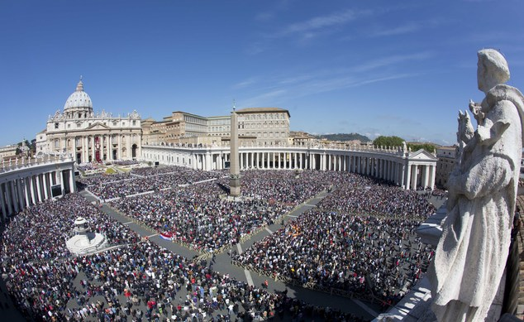

Slide 31
Turning Points
at Vatican II

Slide 32
Baptism restored
Turning Point #1
Not merely becoming a “member”
Baptism makes us participants in Christ’s own priesthood
  We are sent by Christ himself
  Not by the leaders of the Church
“The baptized…are consecrated as a holy priesthood.”
— Lumen Gentium #10 (The Constitution on the Church)

Slide 33
Baptism and ordination
When a priest visits the sick,
Feeds the poor,
Makes peace with his “enemies,”
Or tends an aging parent,
He’s carrying out his baptismal priesthood!
We’re all called to do that!

Slide 34
You can’t just “let Father do it”
Or even worse: “We help Father…”
The bottom line is that Father can carry out his ordained ministry
But he can’t carry out the ministry of the 600 baptized people sitting in the pews

Slide 35
We are sent
It’s not about creating “active parishes”
But about being sent into the world
Where will you be this afternoon?
  Or on Monday morning?
  The world around us is where ministry unfolds

Slide 36
To whom are we sent?
Reconcile with someone in your family
Care for an aging parent
Help feed the hungry
Serve on a city council
Advocate for immigrants & visitors
Live with love and mercy
And a hundred other ways…

Slide 37
The mission of the Church
Is not to create busy and active parishes!
It is to pick up where Jesus left off
  To love the world around us
  To heal, teach, and befriend

Slide 38
Salvation restored
Turning Point #2
Salvation is not a supernatural transaction simply handed to us by Jesus
  Jesus showed us how to die
We participate in the dying and rising
  We “take up our cross…”
  Romans 6: If we have died with Christ, we shall also live with him…

Slide 39
Participation restored
Turning Point #3
#14: Full, conscious and active participation in the liturgy is the Christian person's “right and duty by reason of their baptism.”
#48: the faithful are not to be present at Eucharist as “strangers or silent spectators.”

Slide 40
The Liturgy document
Called for full, active, conscious participation of the faithful (#14)
  16 times!
  Huge impact on Catholic self-identity
    Far more important than the Decree on the Laity, for example
  Participation became a theme of the whole Council culminating in this:
    We are the People of God

Slide 41
The People of God restored
Turning Point #4
Chapter 2 of the Constitution on the Church
  God has always loved us as a “people’’
    We may live in Minnesota
    But we belong to our parish
Who else belongs to this people?
  Other Christians (LG 13-16)
  Jews and all people of good faith
  Even those who believe in no God whatsoever…

Slide 42
The Call to Holiness restored
Turning Point #5
Chapter 5 of The Church
  All are called (#40-41)
  Another theme of the Council
The way to holiness is love
We participate in the mission of Christ when we practice love

Slide 43
How We Speak of God restored
Turning Point #6
Before the Council
At the Council
God is above us
God reveals truths
God commands
God is a law giver and judge
We believe and obey
God is with us
God reveals God’s own self to us
God calls and invites
God is the author of our being and companion
We encounter, respond, & participate
We move from knowing things about God
to living in relationship with God

Slide 44
God invites | We respond
“The invisible God, out of the abundance of divine love,
speaks to men and women as friends and lives among us,
so that God may invite and take us
into fellowship with Godself.”
— Dei Verbum #2 (The Constitution on Divine Revelation)

Slide 45
Question
To whom or what
are you being called?

