Slide 1
Stepping Back
& Setting the Stage
The Educational Vision
of Vatican II

Slide 2
Resources from today
Go to the website:
SpeakingOfGod.org
Scroll down to the St Mary’s University link at the bottom of the home page
and click on it

Slide 3
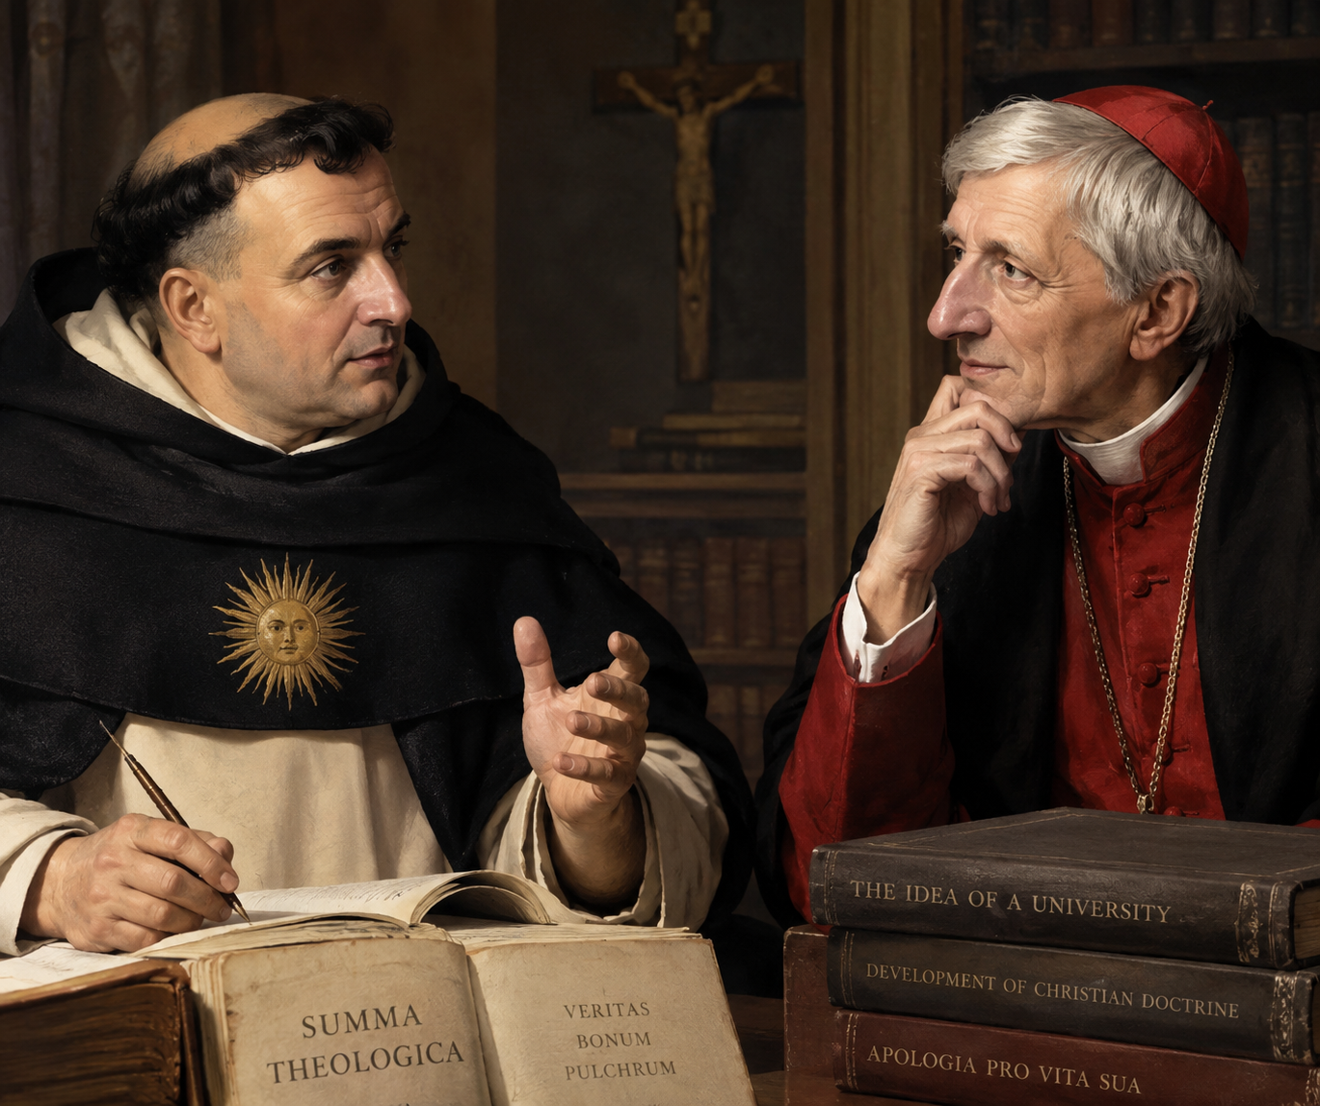
Co-patrons of Catholic Education
Thomas
Aquinas
John Henry
Newman

Slide 4
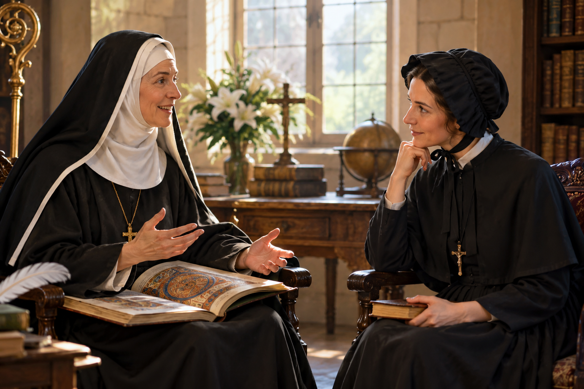
My Nominations for co-Patrons
Hildegard
of Bingen
Elizabeth
Ann Seton

Slide 5
A quick look ahead
Brief overview of Vatican II itself
  How the Council deliberated
  Its major turning points in self-understanding
4 Principles for Catholic Education
  These 5 become our North Star
  Recently emphasized by Pope Leo

Slide 6
Church history
325
1517
1869-70
JC
Constantine…
Today
The
Founding
Period
The
Imperial
Period
The Reformation
Council of Trent
The
Reform
Period
Carolingian reforms
Lateran Councils
Vatican I
“Encounter
with Jesus”
Good news!
Abba is waiting
with open arms
Enthusiastic
faith!
All the baptized
participated in ministry
Baptism with no formation
Laity were “members of the Church”
Ever-larger basilicas
Minimum “obligations” – the threat of Hell
Laity became spectators in the Church

Slide 7
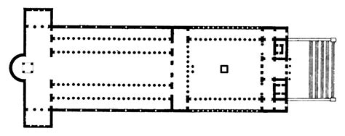
A Basilica in the 4th Century
Where the liturgy
occurred
Where the monks sat
Where the people stood

Slide 8
It took an Ecumenical Council to turn this ship around!

Slide 9
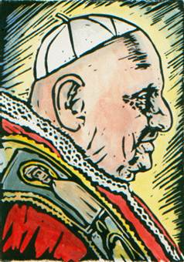
Pope John XXIII
We must shake off the imperial dust that has accumulated on the throne of St. Peter since Constantine.
Notes:
These are the words of Pope John telling how those 17 cardinals responded to his announcement. A light moment in the presentation.

Slide 10
Vatican II
1962-1965
All the bishops in the world + the Pope
  They lived in small communities
  All over the City of Rome
Representatives from all the Christian churches in the world
  The first time in 1000 years we all sat down together

Slide 11
Vatican II
Jews and other world religions
450 Theologians
Thousands of men and women religious
Thousands more lay people
1000 reporters!
The world was watching

Slide 12
How the hall was organized
2500 square meters
2905 seats
  Cardinals
  Patriarchs
  2440 Council Fathers
  200 theologians
  130 Protestant guests & observers
  And a staff of priests who lived in Rome
John XXIII took a personal hand in organizing this

Slide 13
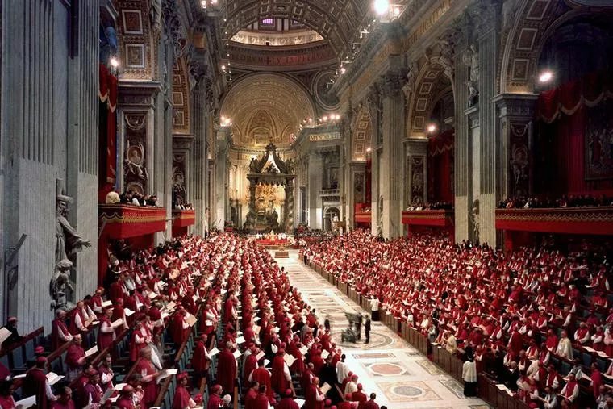

Slide 14
Behind the seating area
3 First Aid stations
22 lavatories
High security measures
  Fear of Communists
Italian coffee vendors
  With pastries!
  For 3000 people every day!
  The bishops were huge fans of this!
Oh, and did I mention the cigars?

Slide 15
Council procedures
Conducted in Latin
Voting by punch card
Speakers were given 10 minutes
  But had to submit ahead in writing
  In Latin
The Pope was not in the Hall
No women or lay people in the Hall

Slide 16
How did this work?
Amazingly, the Holy Spirit took over
Those speeches in Latin
Translated two days before they were given
Delivered to all those bishops living around the City of Rome.

Slide 17
Evening “parties”
Evening lectures on the next day’s topics
  Everyone was welcomed into these events
“Illegal rooftop parties” followed
  Vino & Bruschetta
  Deep conversation about the pastoral implications of each topic
  Including priests, lay folks, religious, seminarians, theologians, & non-Catholics

Slide 18
The crowds of faithful
The crowds in the piazza
Praying and singing
  Veni Creator Spiritus
  Conversion was in the air
The whole church mingled together
The People of God were present even if not invited…

Slide 19
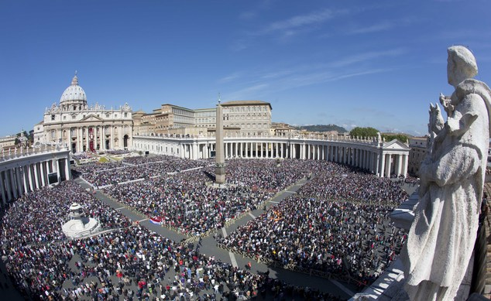

Slide 21
The Voting
Liturgy
  2147-4
The Church
  2151-5
Divine Revelation
  2344-6
The Church in the Modern World
  2309-75

Slide 22
Turning Points
at Vatican II

Slide 23
Baptism restored
Turning Point #1
Not merely becoming a “member”
Baptism makes us participants in Christ’s own priesthood
  We are sent by Christ himself
  Not by the leaders of the Church
“The baptized…are consecrated as a holy priesthood.”
— Lumen Gentium #10 (The Constitution on the Church)

Slide 24
Baptism
Before the Council:
  We are “baptized Catholics”
  Protestants were often “re-baptized”
After the Council:
  We are baptized into Christ
  We follow him, die with him, and rise with him

Slide 25
Baptism and ordination
When a priest visits the sick,
Feeds the poor,
Makes peace with his “enemies,”
Or tends an aging parent,
He’s carrying out his baptismal priesthood!
We’re all called to do that!

Slide 26
You can’t just “let Father do it”
The priesthood is tremendously important to the Church
But Father can only carry out his ordained ministry
He can’t carry out the ministry of the 600 baptized people sitting in front of him each Sunday

Slide 27
The Council didn't primarily elevate lay people by saying:
“Lay people should be allowed to do more things in Church.”
It went much deeper:
“You have been joined to Christ.”

Slide 28
Your work in Schools
It’s pastoral work
An essential part of our mission
You aren’t on the sidelines
But at the heart of all we do
Your ministry of leadership flows from your baptism

Slide 29
Eucharist restored
Turning Point #2
The Source of our lives as Catholic Christians
  Nothing we do is more important
  Not even education
    Catechism 1324
    Liturgy doc 10 & Church doc 11
The Summit of each week
  As we live our baptized ministry

Slide 30
Source & Summit of our lives
The Eucharist is the summit because we bring our lives to the table.
It is the source because we take Christ's life from the table back into the world.
And this is where you come in…

Slide 31
Daily liturgy at the Council
Daily Eucharist in various rites of the Church
  Not all of them use Latin!
  Not all of them had celibacy!
  They didn’t all look alike or talk alike!
  But Christ was still present
  The pastoral power of liturgy was demonstrated to all

Slide 32
Participation restored
Turning Point #3
#14: Full, conscious and active participation in the liturgy is the Christian person's “right and duty by reason of their baptism.”
#48: the faithful are not to be present at Eucharist as “strangers or silent spectators.”

Slide 33
The Liturgy document
Called for full, active, conscious participation of the faithful (#14)
  16 times!
  Huge impact on Catholic self-identity
    Far more important than the Decree on the Laity, for example
  Participation became a theme of the whole Council culminating in this:
    We are the People of God

Slide 34
Participation
From the doc on Liturgy #14
Gives the goal of the entire Council:
The full and active participation
by all the people
is the aim to be considered
before all else…

Slide 35
Deep Augustinian Resonance
“You are the body of Christ” (St Paul in 1 Corinthians 12:27)
“We become what we receive.” (St Augustine quoted by Pope Leo, June 24 2026)
The measure of participation at Eucharist is not simply what happens during Mass,
but what happens to us because we were there.

Slide 36
So it’s not merely participation at Mass
It’s participation in the “ministry of Jesus in today’s world.”
  To love the outcast
  To welcome the stranger
  To treat the least of our sisters and brothers as we would Christ
This is not easy.

Slide 37
Conscience restored
Turning Point #4
We begin with this tremendous and amazing reality:
God is speaking to us individually
Through scripture & liturgy of course
But also:
  Nature & beauty, music & art
  The embrace of a loved one
  The quiet of our hearts
Notes:
Scripture
Pope John XXIII said that, of course, we believe that the words of Scripture do not change. We believe that they contain what God is revealing to us. But while Scripture itself does not change, what it demands of us changes in every generation. Our task is to peer into the texts and ask what God calls us to be and do in today’s world and church.
The Lord’s Cross
When we speak of meditating on the Lord’s Cross, we return to the central and ancient kernel of faith, the Paschal Mystery. We are called to practice the art of self-giving love, to learn to die to ourselves out of love for others. We are called, in the words of Scripture, to carry our own crosses. But what does this mean practically for us? Here is where an accompanist can help us understand the deep meaning of this Cross in our own daily lives.
The Gifts of the Holy Spirit
The Catechism of the Catholic Church (#1831) lists the seven gifts as follows:
Wisdom: It is the capacity to love spiritual things alongside material ones and to see them all as holy.
Understanding: This gift teaches us how to live as followers of Christ. A person with understanding is not confused by the conflicting messages in our culture about the right way to live.
Counsel (right judgment): With the gift of counsel/right judgment, we know the difference between right and wrong, and we choose to do what is right. A person with right judgment avoids sin and lives out the values taught by Jesus Christ.
Fortitude (courage): With the gift of fortitude/courage, we overcome fear and take risks as a follower of Jesus Christ. A person with courage is willing to stand up for what is right in the sight of God, even if it means accepting rejection, verbal abuse, or physical harm.
Knowledge: With the gift of knowledge, we understand the presence of God. With this gift we know that light is stronger than darkness; that love overcomes hate; and that fear is driven out by love.
Piety (reverence): With the gift of piety/reverence, we have a deep desire to connect with God and turn our hearts to Christ.
Fear of the Lord (wonder and awe): With the gift of fear of the Lord/wonder and awe, we are aware of the tremendous power of God’s love. We honor God because of God’s endless forgiveness and love for us, which brings a sense of awe into our hearts. Such awe is the beginning of wisdom.
The advice of others and the ministry of the Church
These go hand in hand and comprise the heart of accompaniment.

Slide 38
The Church in Modern World #16
Our Catechism #1776
Deep within our conscience we discover a truth
  That comes from God
  And which we must obey.
Its voice calls us to love and do good
  It sounds in our hearts at the right moment....
We have in our heart a truth inscribed by God....
  Our conscience is our most secret core and sanctuary.
  There we are alone with God whose voice echoes in our depths.

Slide 39
Discernment restored
Turning Point #5
What God is saying in conscience
Scrutinize the “signs of the times”
  What is God saying about today’s issues?
Discern your gifts for ministry
  Not just “helping Father”
Discern together in synodality
Listen to God in prayer

Slide 40
Christ at the Center
The Council re-centered the Church’s understanding of herself in Christ
The Constitution on the Church
  Not: The Church is the light of nations
  But: Christ is the light of nations

Slide 41
Decree on Mission Activity
Not:
The Church has a mission.
But more profoundly:
Christ's mission has a Church.

Slide 42
The mission of the Church
Turning Point #6
And therefore, of Catholic schools
Is not merely to “educate”
But to help our students know Christ
Pope Saint John Paul II
So in our schools: we invite everyone into communion with Christ

Slide 43
Christocentric ecclesiology
We often teach only
  Information about God
    Moral codes
    Dogma and doctrine
Instead:
Invite and welcome students into
  A loving encounter with Jesus
  Conversion of our hearts to love

Slide 44
The conversion of the bishops
Turning Point #6
What is revealed by God is not doctrine
  Not canon law nor even a moral code
What is revealed is God’s own self
  In the person of Jesus
  “God chose to reveal himself…” (DV 2)
Out of the abundance of his love,
  God speaks to us as friends
  And lives among us… (DV 2)

Slide 45
Restored at Vatican II
Baptism
Eucharist
Participation of the Faithful
The role of one’s Conscience
Discernment of the Signs of the Times
Christo-centric view of the Church

Slide 46
Principles for Catholic education
that flow from
Vatican II

Slide 47
1 Participation
Catholic education should be “participatory”
  Students aren’t mere “spectators”
  Sitting in the classroom
  Watching their teacher perform
Participation is how students grow to their human fullness

Slide 48
1 Participation
This requires that our pedagogy leads to that
How do you form and train your faculty to invite & draw out the participation of the students?

Slide 49
2 Formation of conscience
Catholic education should help students learn to hear that inner voice
Calling them to become servants of the poor
  To do what is good and avoid evil
This is how students grow to their full human potential

Slide 50
2 Formation of Conscience
We learn to discern what God is saying to us in the depths of our conscience
It’s not enough to “lay down the law”
How do you form your students to hear their inner calling?

Slide 51
Teach discernment
Not: “What are we supposed to do?”
Instead:
  What does the Gospel say?
  What does my inner voice tell me?
  Who will be affected by my decision?
  What does love require?

Slide 52
3 Christ at the Center
Catholic education can help students and staff know Jesus
We learn to walk with him in everyday life
And this is the core of faith
This is how students become faithful for life

Slide 53
3 Christ at the Center
Pastoral work is what helps people encounter Jesus
It can occur in many ways & places
How does your school help both students and staff to draw closer to Jesus?

Slide 54
4 Liturgy is Essential
If you filled your schools to capacity
And had all the money you needed…
But you had no liturgy…
How does liturgy shape and direct your school program?

Slide 55
Liturgy:
The school of Christian Life
We learn who we are.
  We are the Body of Christ, gathered and loved by God.
We learn how to live.
  We practice listening, gratitude, reconciliation, self-offering, and love.
We learn why we are sent.
  We become Christ's presence in the ordinary circumstances of life.
Vatican II: Doc on Liturgy 7, 10, 14, 48

Slide 56
The Challenge
How do you form and train your faculty to invite & draw out the participation of the students?
How do you form your students to hear their inner calling?
How does your school help both students and staff to draw closer to Jesus?
How does liturgy shape and direct your school program?

