Slide 1
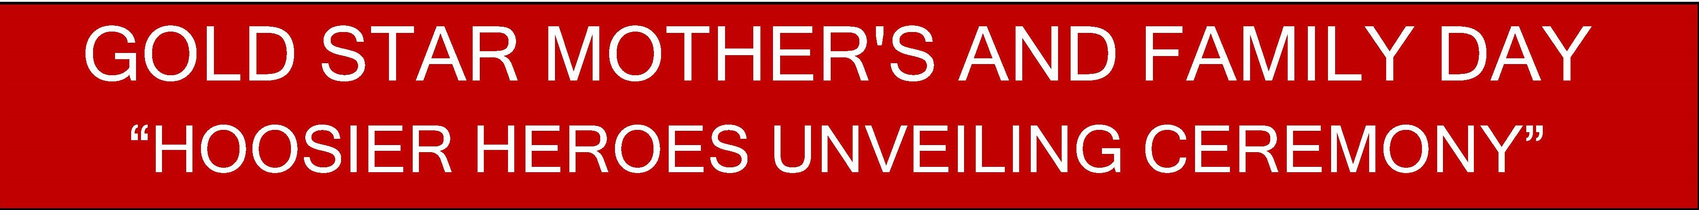
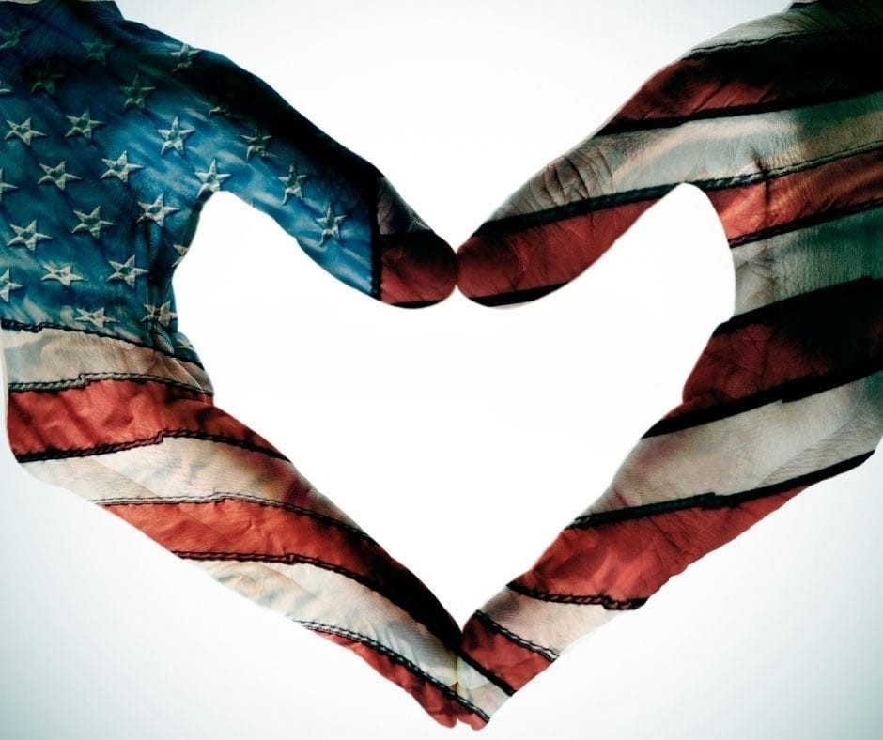

“ROLL CALL CEREMONY”
for 201 HOOSIER HEROES to
LOVE, HONOR and REMEMBER

Slide 2
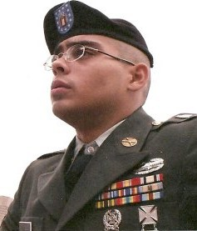
Army National Guard
Specialist
Rex E. Agness Jr.
Lebanon
Age 23
Served In US
2-17-2009

Slide 3
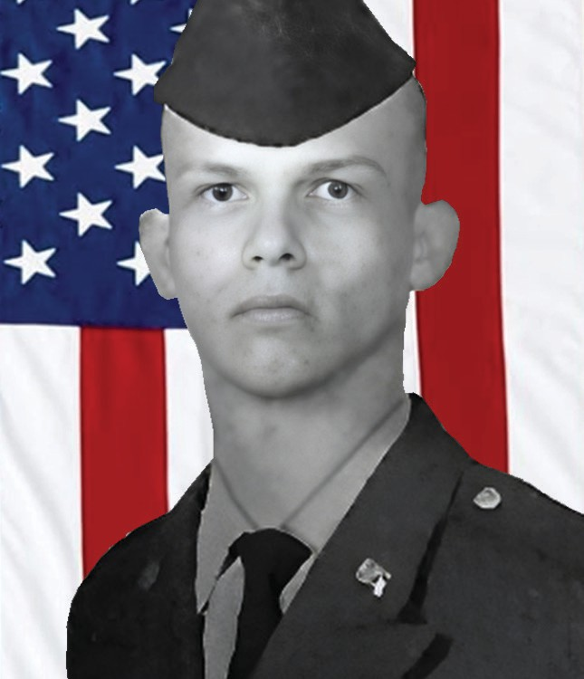
Army
Specialist
Ronald D. Allen Jr.
Mitchell, IN
Age 22
Served In Iraq
8/25/2003

Slide 4
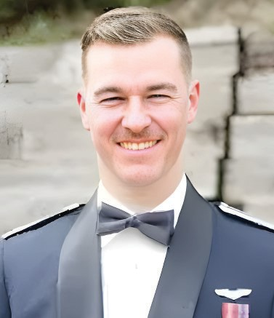
Air Force
Lieutenant
Scott W. Ames Jr.
Pekin, IN
Age 21
Served In US
2/19/2021

Slide 5
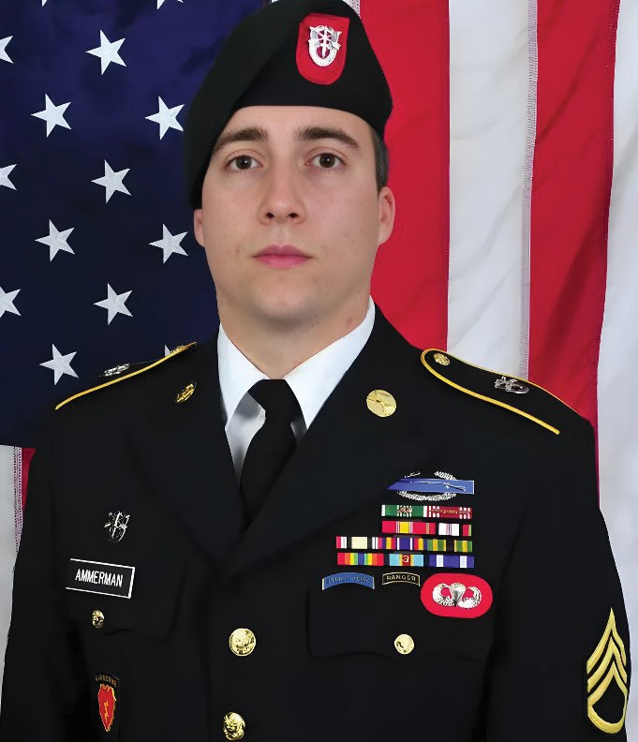
Army
Staff Sergeant
Matthew R. Ammerman
Noblesville, IN
Age 29
Served In Afghanistan
12/3/2014

Slide 6
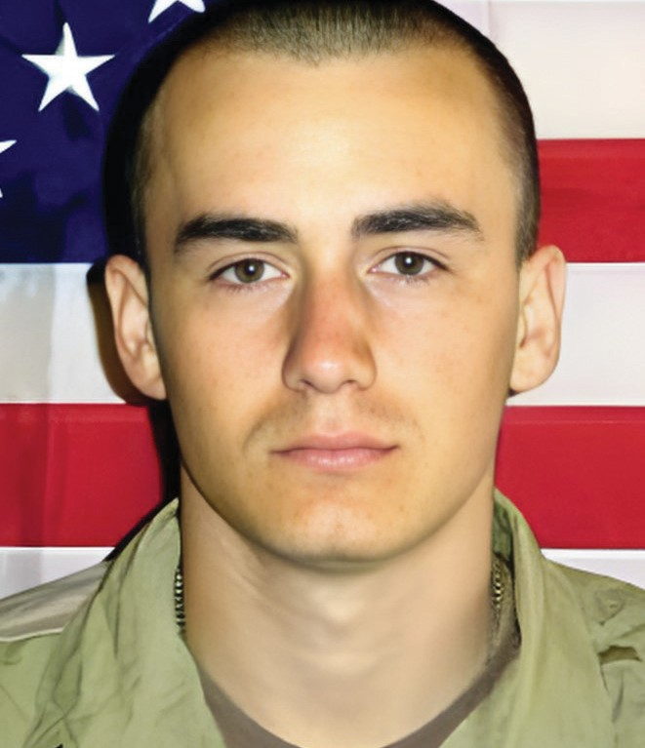
Army
PFC
John D. Amos II
Valparaiso, IN 4/4/2004 Age 20
Served In Iraq

Slide 7
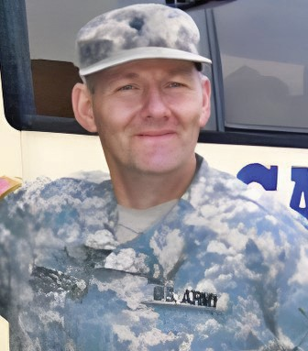
Army
Specialist
Paul E. Andersen
South Bend, IN 1/10/2009 Age 49
Served In Iraq

Slide 8
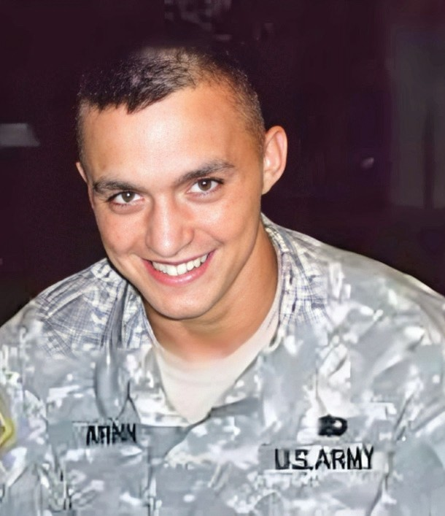
Army
Specialist
Jared S. Arnn
Booneville, IN
9/28/2008
Age 21
Served In US

Slide 9
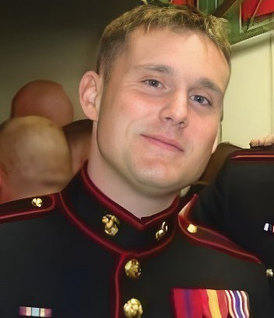
Marines
Sergeant
Bradley W. Atwell
Kokomo, IN
9/15/2012
Age 27
Served In Afghanistan

Slide 10
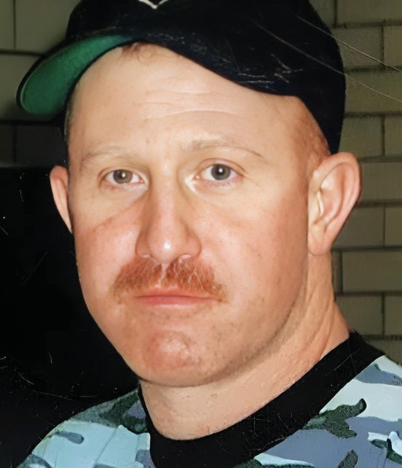
Marine Corps Reserve
Sergeant
Brock A. Babb
Evansville, IN 10/15/2006
Age 40
Served In Iraq

Slide 11
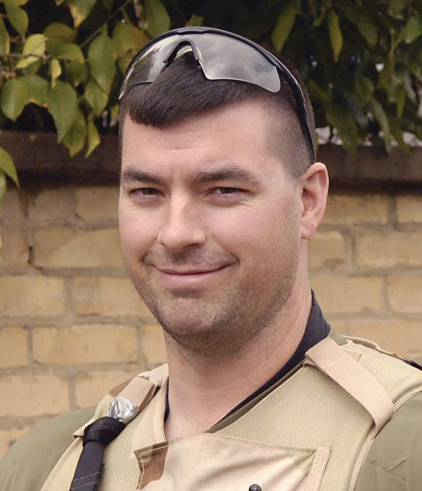
Air Force
Technical Sergeant
Ryan A. Balmer
Mishawaka, IN 6/5/2007
Age 33
Served In Iraq

Slide 12
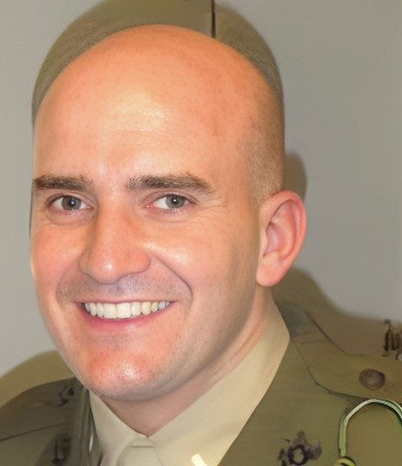
Marines
1st Lieutenant
Brandon A. Barrett
Marion, IN 5/5/2010
Age 27
Served In Iraq

Slide 13
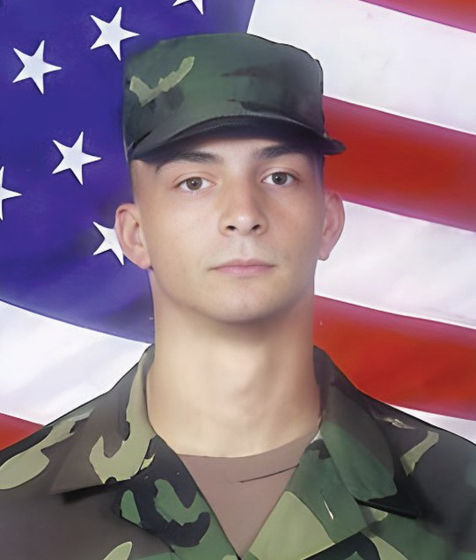
Army
Corporal
Nathaniel S. Baughman
Monticello, IN 7/17/2006
Age 23
Served In Iraq

Slide 14
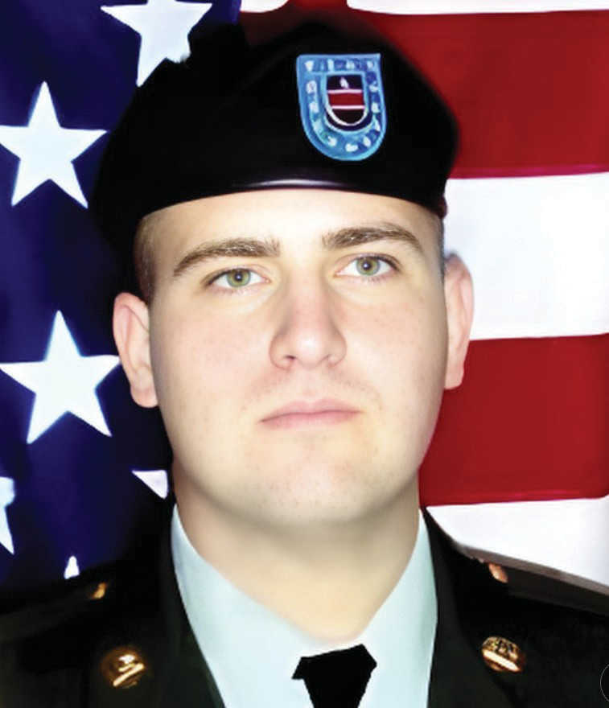
Army
Corporal
Jason J. Beadles
La Porte, IN 4/12/2007
Age 22
Served In Iraq

Slide 15
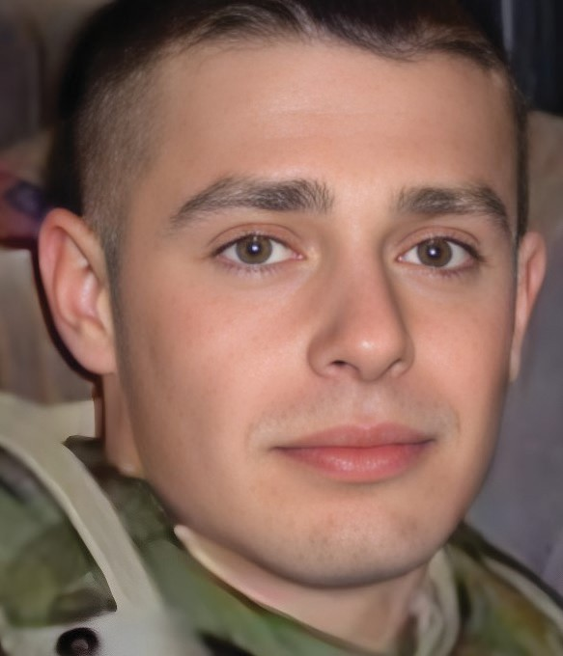
Army
Staff Sergeant
Michael A. Bechert
New Castle, IN 6/14/2007
Age 24
Served In Iraq

Slide 16
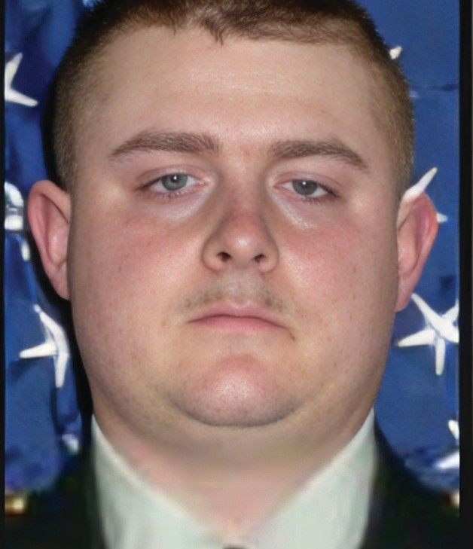
Army National Guard
Staff Sergeant
Brock A. Beery
Noblesville, IN 3/23/2006
Age 30
Served In Iraq

Slide 17
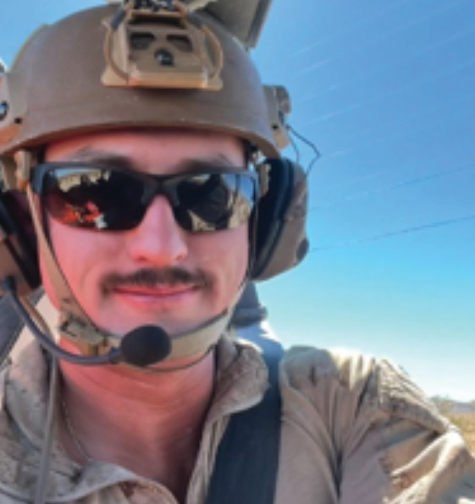
Marines
Staff Sergeant
Jerry L.Betzold
Avon
7-28-2024
Age 26
Served In US

Slide 18
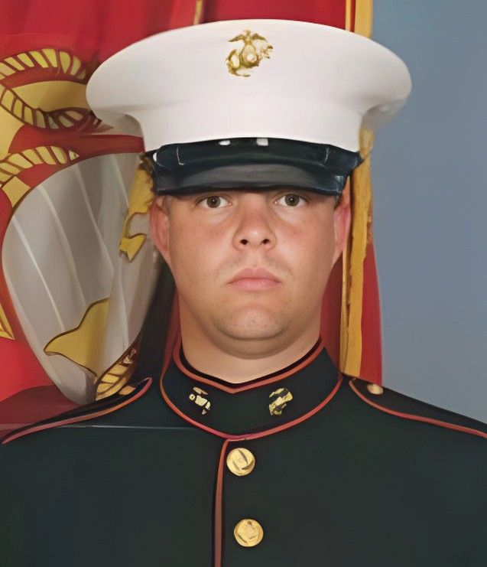
Marines
Lance Corporal
Joshua H. Birchfield
Westville, IN 2/19/2010 Age 24
Served In Afghanistan

Slide 19
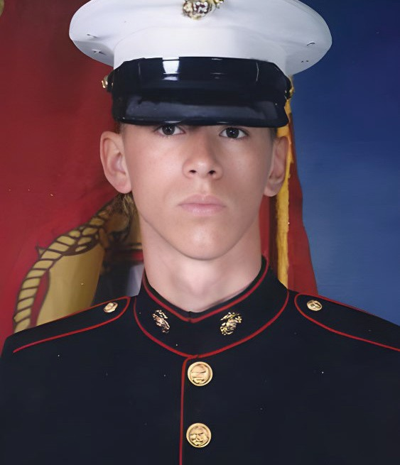
Marines
Corporal
John C. Bishop
Columbus, IN 9/8/2010 Age 25
Served In Afghanistan

Slide 20
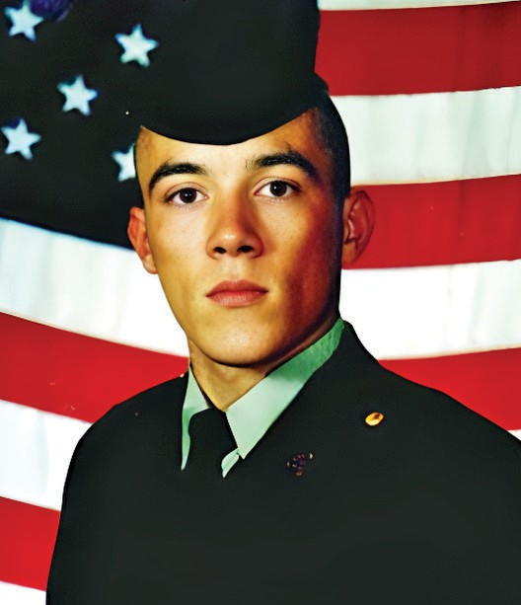
Army
Sergeant
Jarrod W. Black
Peru, IN 12/12/2003
Age 26
Served In Iraq

Slide 21
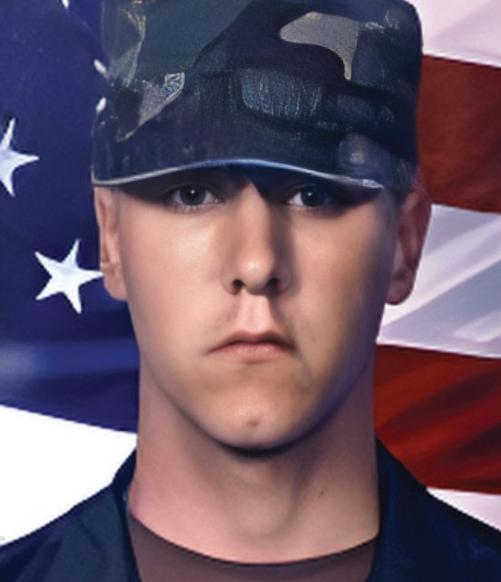
Army
Corporal
Jonathan F. Blair
Fort Wayne, IN 11/19/2005
Age 21
Served In Iraq

Slide 22
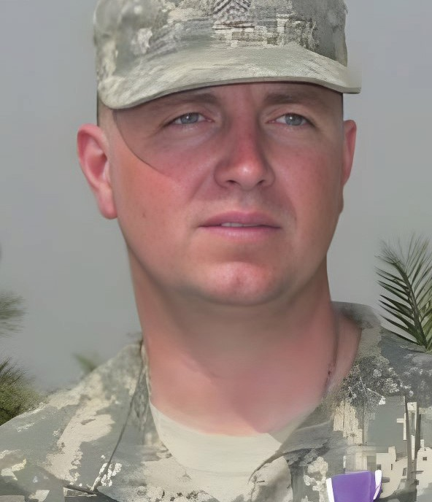
Army National Guard
Staff Sergeant
Richard A. Blakley
Avon, IN
6/6/2006
Age 34
Served In Iraq

Slide 23
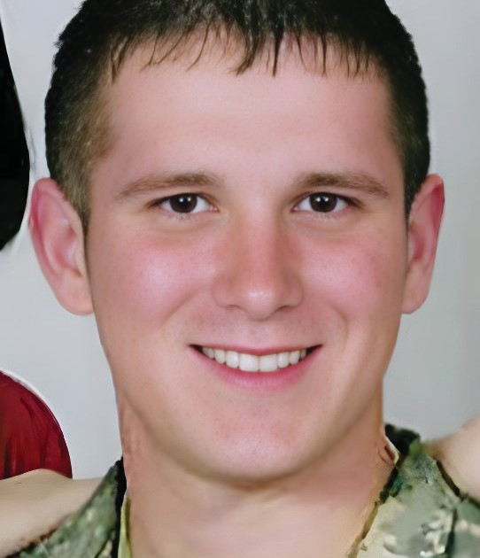
Army
Specialist
Clinton C. Blodgett
Pekin, IN 5/26/2007
Age 19
Served In Iraq

Slide 24
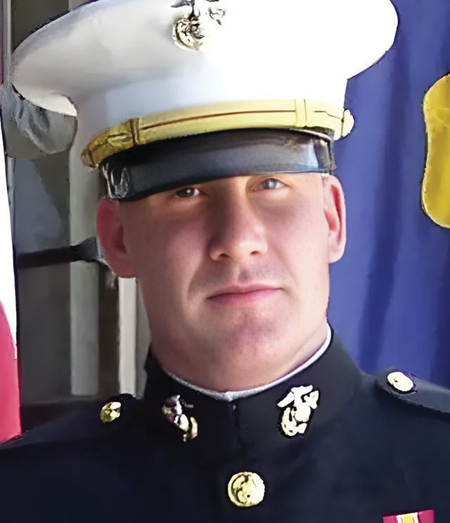
Marines
1st Lieutenant
Shaun M. Blue
Munster, IN 4/16/2007
Age 25
Served In Iraq

Slide 25
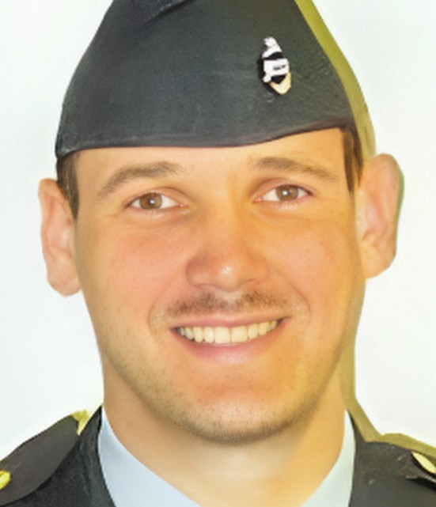
Army National Guard
Sergeant 1st Class
Craig A. Boling
Elkhart, IN 7/8/2003
Age 38
Served In Iraq

Slide 26
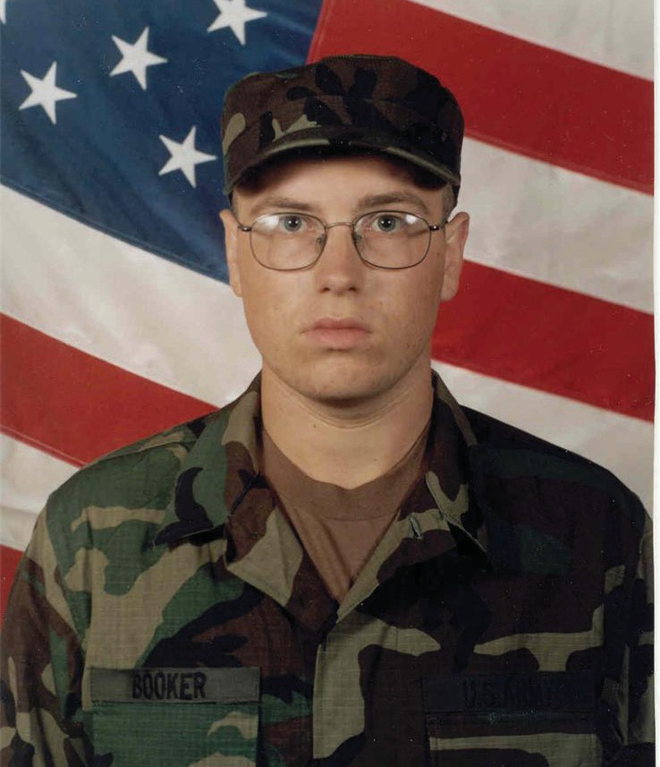
Army
Sergeant
Kenneth R. Booker
Vevay, IN
11/14/2007
Age 25
Served In Iraq

Slide 27
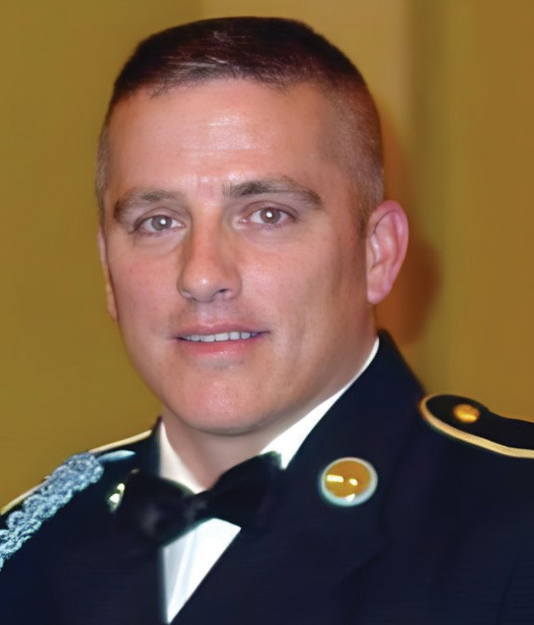
Army
Sergeant 1st Class
Collin J. Bowen
Marion, IN
3/14/2008
Age 38
Served In Afghanistan

Slide 28
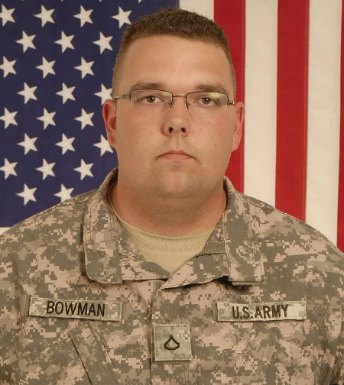
Army
Specialist
Brian R. Bowman
Crawfordsville, IN
1/3/2010
Age 24
Served In Afghanistan

Slide 29
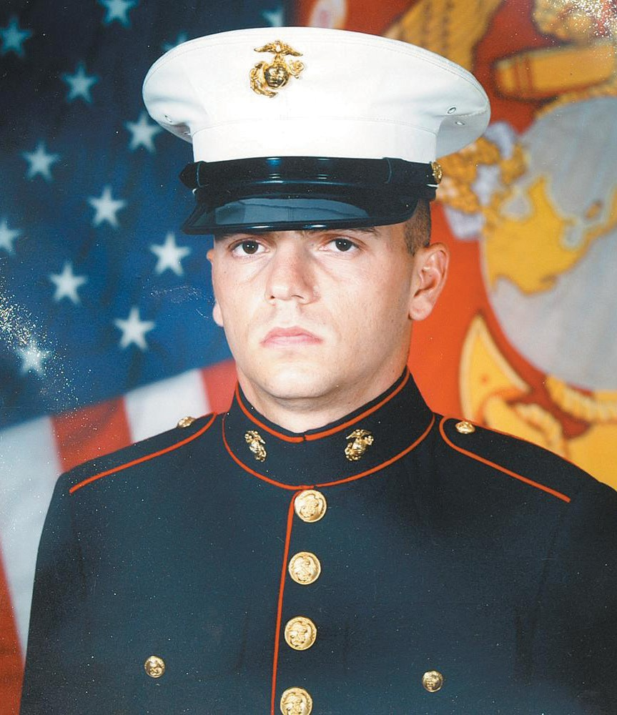
Marines
Lance Corporal
James G. Brown
Owensville, IN
11/2/2006
Age 20
Served In Iraq

Slide 30
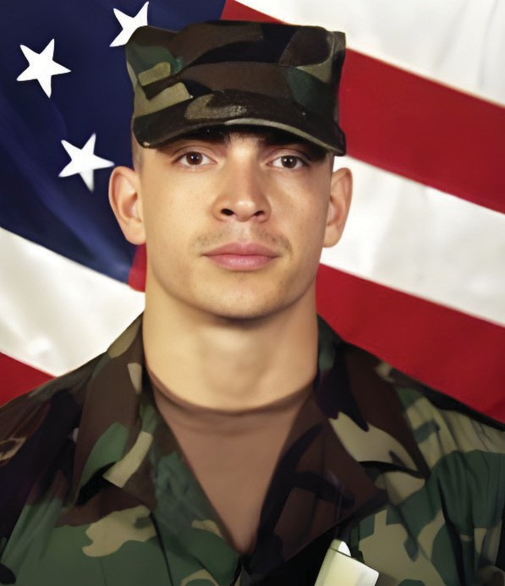
Army
Specialist
Roy R. Buckley
Portage, IN
3/22/2003
Age 24
Served In Iraq

Slide 31
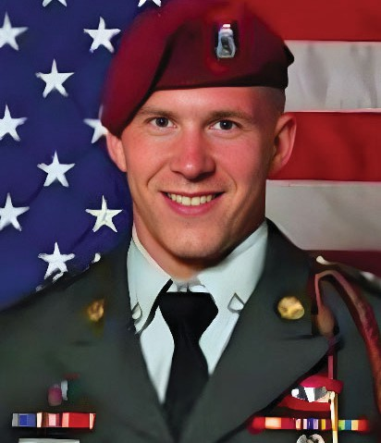
Army
Specialist
James A. Butz
Porter, IN 9/28/2011
Age 21
Served In Afghanistan

Slide 32
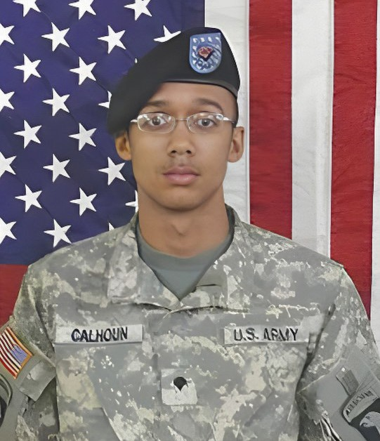
Army
Sergeant
Marvin R. Calhoun Jr.
Elkhart, IN 9/21/2010
Age 23
Served In Afghanistan

Slide 33
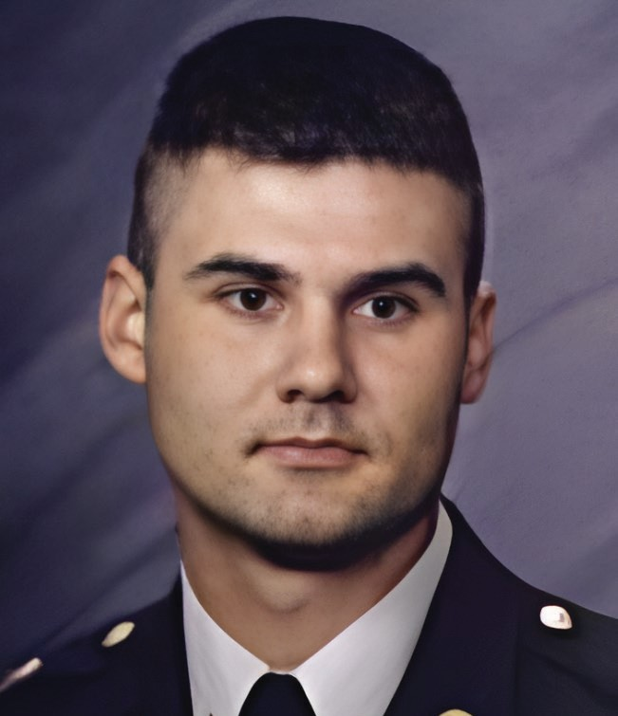
Army
Specialist
Curtis A. Carter
Lafayette, IN
2/27/2002
Age 25
Served In Kuwait

Slide 34
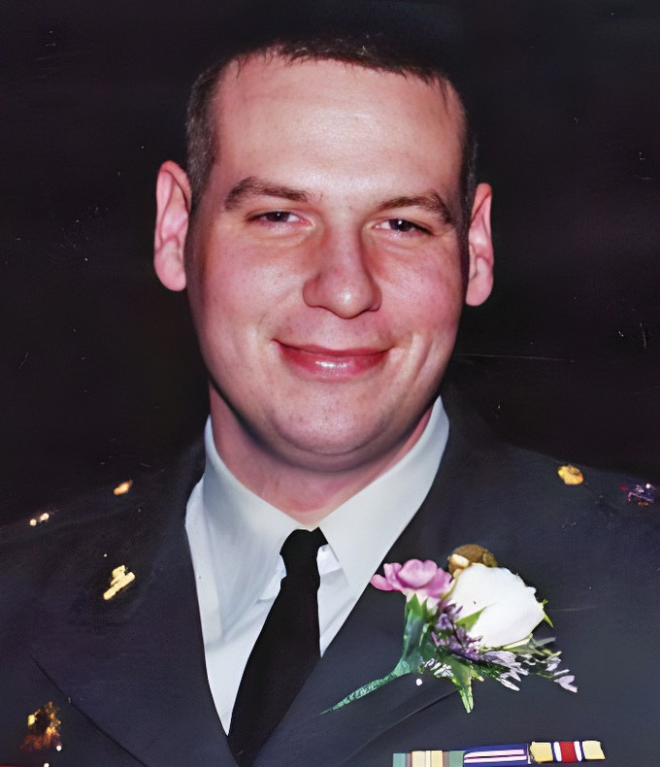
Army
Sergeant
Gerald J. Cassidy II
Lebanon, IN
9/21/2007
Age 32
Served In Iraq

Slide 35
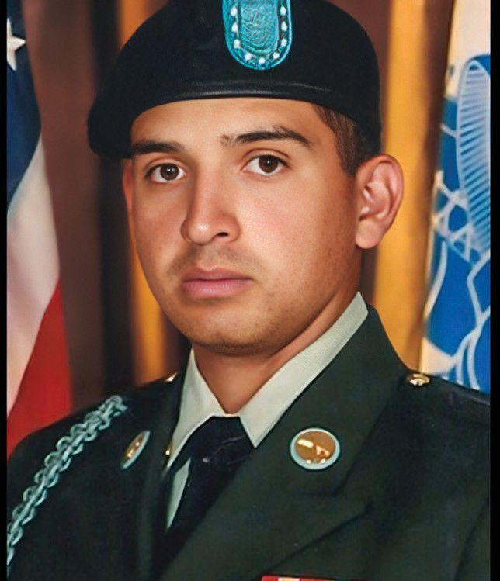
Army
Specialist
Ricardo Cerros Jr.
Franklin, IN
10/8/2011
Age 24
Served In Afghanistan

Slide 36
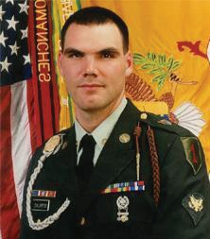
Army
Sergeant
Kyle W. Childress
Terre Haute, IN 1/21/2005 Age 29
Served In Iraq

Slide 37
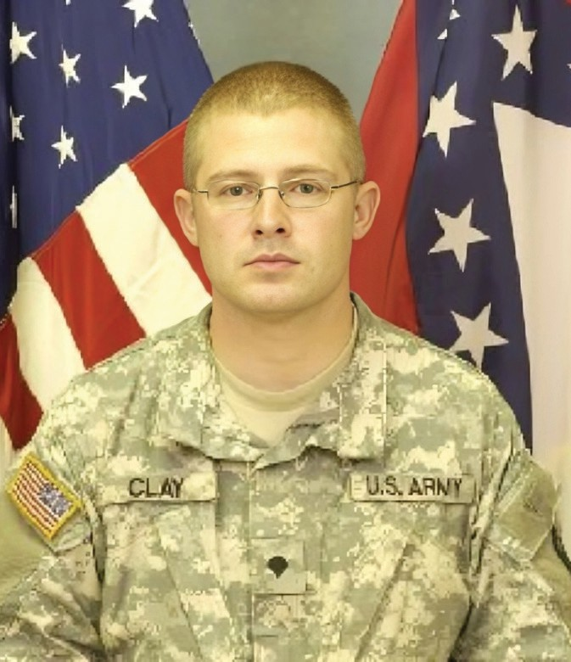
Army National Guard
Specialist
James M. Clay
Indianapolis, IN 11/13/2008 Age 25
Served In Iraq

Slide 38
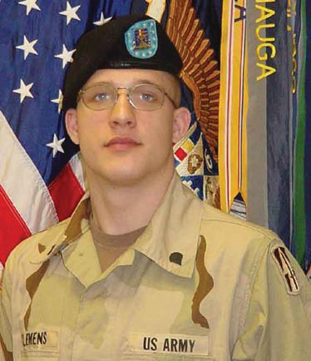
Army National Guard
Specialist
Brian M. Clemens
Kokomo, IN
2/7/2003
Age 19
Served In Kuwait

Slide 39
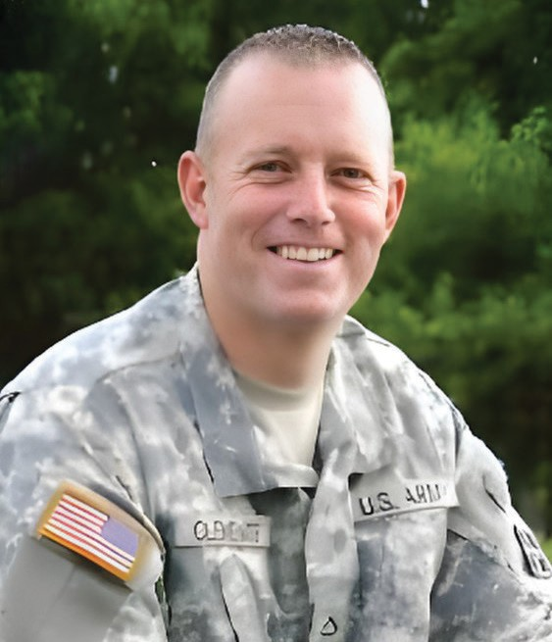
Army
Specialist
Chad D. Clements
Huntington, IN
8/30/2010
Age 26
Served In Afghanistan

Slide 40
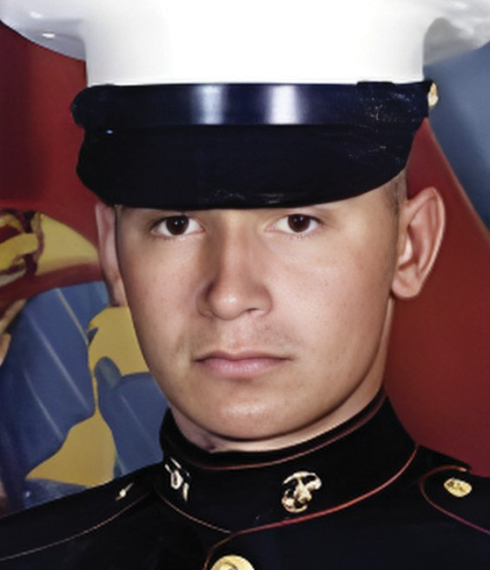
Army
Sergeant
Robert E. Colvill Jr.
Anderson, IN
7/8/2004
Age 31
Served In Iraq

Slide 41
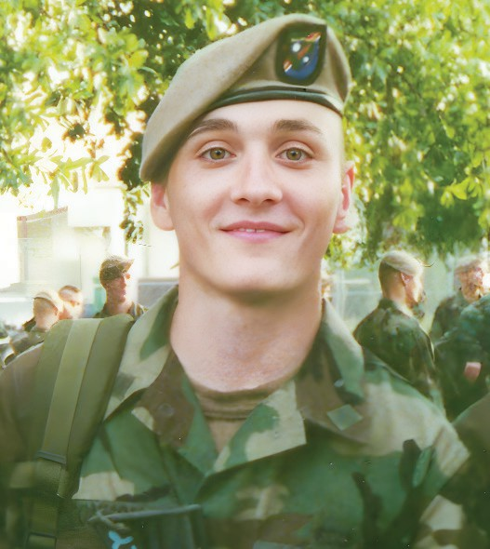
Army
Corporal
Matthew A. Commons
Fort Wayne, IN
3/4/2002
Age 21
Served In Afghanistan

Slide 42
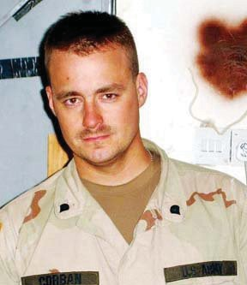
Army
Specialist
Jeffrey W. Corban
Elkhart, IN
10/15/2005
Age 30
Served In Iraq

Slide 43
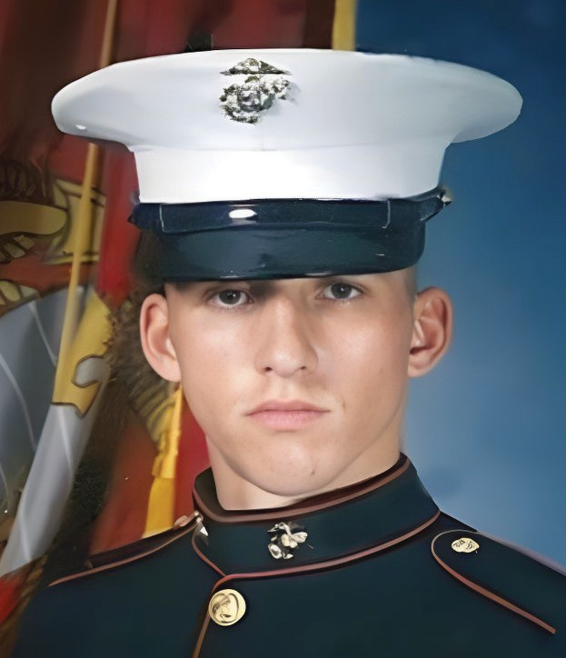
Marines
Lance Corporal
Layton B. Crass
Richmond, IN 6/14/2008
Age 22
Served In Afghanistan

Slide 44
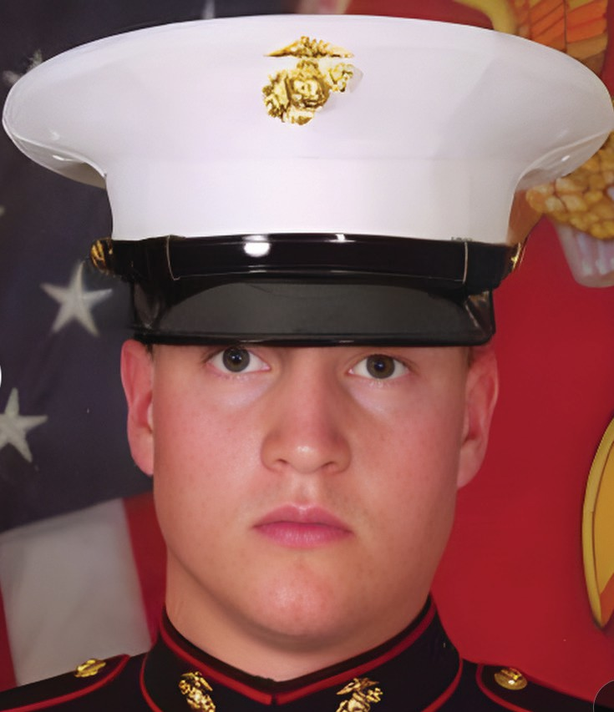
Marines
Lance Corporal
William H. Crouse IV
Angola, IN 12/21/2010
Age 22
Served In Afghanistan

Slide 45
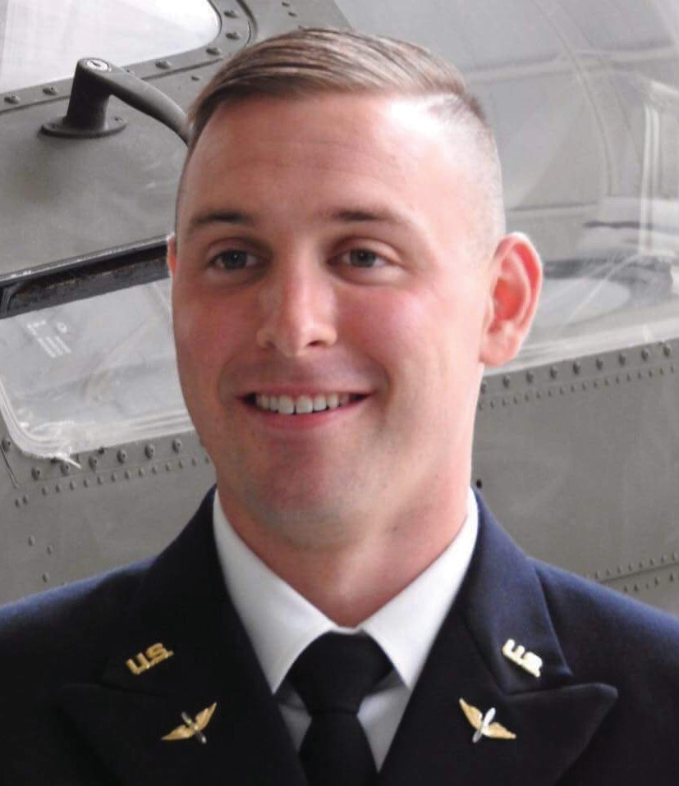
Army
1st Lieutenant
Clayton R. Cullen
Bicknell, IN
Age 25
Served In US
1/20/2018

Slide 46
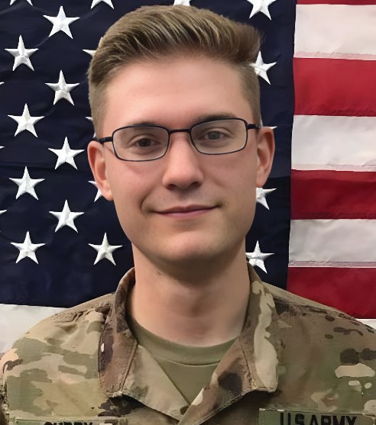
Army
Sergeant
Christopher W. Curry
Terre Haute, IN 5/4/2020 Age 23
Served In Iraq

Slide 47
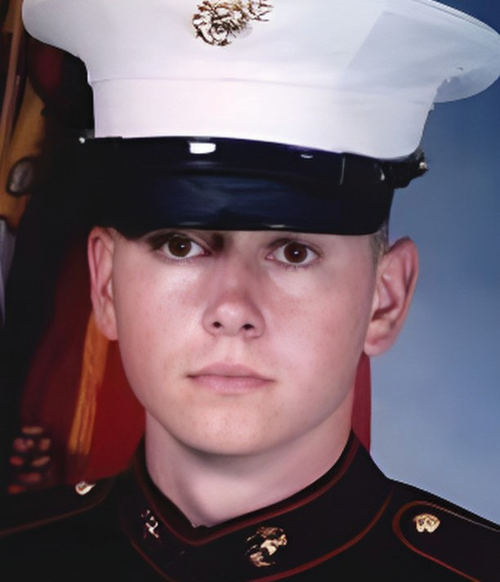
Marines
Lance Corporal
James R. Davenport
Danville, IN 11/22/2006 Age 20
Served In Iraq

Slide 48
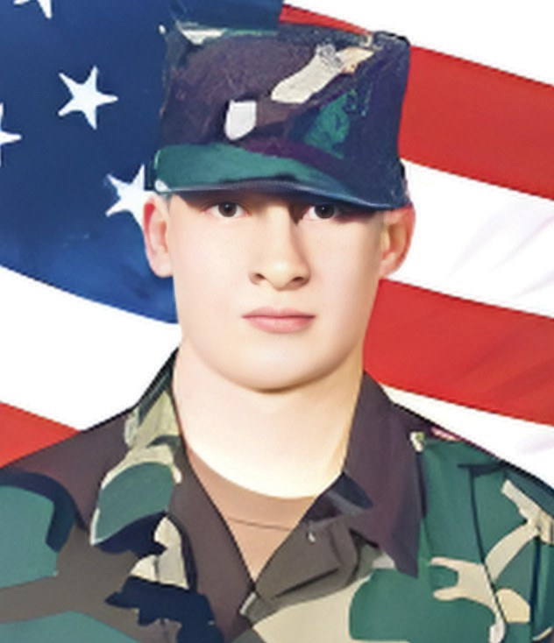
Army
PFC
Darren A. Deblanc
Evansville, IN 4/29/2005 Age 20
Served In Iraq

Slide 49
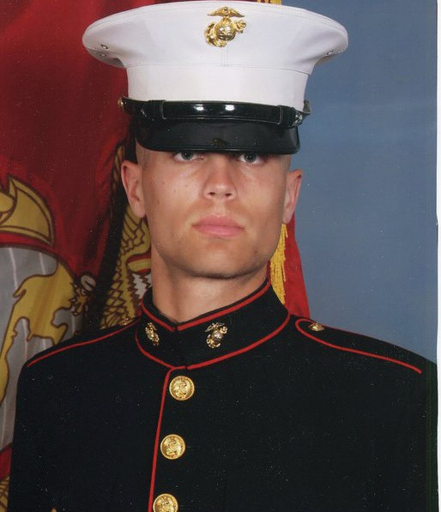
Marines
Corporal
Daane A. Deboer
Valparaiso, IN
6/25/2010
Age 24
Served In Afghanistan

Slide 50

Army
Private
Cory R. Depew
Beech Grove, IN 1/4/2005
Age 21
Served In Iraq

Slide 51

Army
PFC
Stephen P. Downing II
Waverly, IN 10/28/2004
Age 30
Served In Iraq

Slide 52

Army
Staff Sergeant
Jeremy W. Doyle
Indianapolis, IN 8/18/2005
Age 24
Served In Iraq

Slide 53

Army
Staff Sergeant
Michael D. Elledge
Brownsburg, IN 3/17/2008
Age 41
Served In Iraq

Slide 54

Army
Command Sergeant
Steven W. Faulkenburg
Huntingburg, IN
11/9/2004
Age 45
Served In Iraq

Slide 55

Army
Sergeant
James D. Faulkner
Clarksville, IN 9/8/2004
Age 23
Served In Iraq

Slide 56

Army National Guard
Specialist
Arronn D. Fields
Terre Haute, IN 5/21/2012
Age 27
Served In Afghanistan

Slide 57

Army National Guard
Captain
Michael T. Fiscus
Milford, IN 3/26/2005
Age 36
Served In Afghanistan

Slide 58

Army
Chief Warrant Officer
William T. Flanigan
Indianapolis, IN
7/2/2006
Age 37
Served In Afghanistan

Slide 59

Army National Guard
Specialist
Joseph A. Ford
Knox, IN 5/10/2008
Age 23
Served In Iraq

Slide 60

Army
Specialist
Matthew C. Frantz
Lafayette, IN 1/20/2006
Age 23
Served In Iraq

Slide 61

Marines
Lance Corporal
David K. Fribley
Warsaw, IN 3/23/2003
Age 26
Served In Iraq

Slide 62

Army National Guard
Sergeant
Armand “Luke” Frickey
Mooresville, IN 1/6/2005
Age 20
Served In Iraq

Slide 63

Army
Petty Officer 1st Class
Nathan J. Frigo
Kokomo, IN
10/17/2006
Age 23
Served In Iraq

Slide 64

Army Reserve
Specialist
Luke P. Frist
Brookston, IN 1/5/2004
Age 20
Served In Iraq

Slide 65

Army
Staff Sergeant
William R. Fritsche
Martinsville, IN
7/27/2007
Age 23
Served In Afghanistan

Slide 66

Army
Specialist
Carter “CJ” Gamble
Brownstown, IN 6/22/2007
Age 24
Served In Iraq

Slide 67

Army
Specialist
Zachariah J. Gonzalez
Indianapolis, IN 7/31/2007
Age 23
Served In Iraq

Slide 68

Air Force
Senior Airman
Ashton L. M. Goodman
Indianapolis, IN
5/26/2009
Age 21
Served In Afghanistan

Slide 69

Marines
Lance Corporal
Torrey S. Gray
Indianapolis, IN 4/11/2004
Age 19
Served In Iraq

Slide 70

Army
Sergeant
Dale R.Griffin
Terre Haute, IN
10/27/2009
Age 29
Served In Afghanistan

Slide 71

Marines
PFC
Deryk L. Hallal
Indianapolis, IN 4/5/2004
Age 24
Served In Iraq

Slide 72

Army
Private
Jesse M. Halling
Indianapolis, IN 6/7/2003
Age 19
Served In Iraq

Slide 73

Army
PFC
Nicholas S. Hartge
Rome City, IN 5/14/2007
Age 20
Served In Iraq

Slide 74

Army
Specialist
Adam J. Harting
Portage, IN 7/25/2005
Age 21
Served In Iraq

Slide 75

Army
Chief Warrant Officer 2
Brian D. Hazelgrove
Edinburgh, IN 1/23/2004
Age 29
Served In Iraq

Slide 76

Army
Sergeant
David M. Heath
LaPorte, IN 8/16/2004
Age 30
Served In Iraq

Slide 77

Army
Sergeant
Paul M. Heltzel
Frankton, IN 03/15/2005
Age 39
Served In Iraq

Slide 78

Army
Sergeant
Gary M. Henry
Indianapolis, IN 8/4/2008
Age 34
Served In Iraq

Slide 79

Army
PFC
Shawn D. Hensel
Logansport, IN 8/14/2007
Age 20
Served In Iraq

Slide 80

Army
Corporal
Joseph M. Hernandez
Hammond, IN
1/9/2009
Age 24
Served In Afghanistan

Slide 81

Army National Guard
Specialist
Brett M. Hershey
Martinsville, IN 3/26/2005
Age 23
Served In Afghanistan

Slide 82

Army National Guard
Master Sergeant
Michael T. Hiester
Bluffton, IN 3/26/2005
Age 33
Served In Afghanistan

Slide 83

Army Reserve
Specialist
Joshua Lee Hill
Fairmount, IN 3/12/2006
Age 24
Served In Afghanistan

Slide 84

Marines
Lance Corporal
Eric Hillenburg
INpolis, IN
12/23/2004
Age 21
Served In Iraq

Slide 85

Marines
Lance Corporal
Hunter D. Hogan
Norman, IN
6/23/2012
Age 21
Served In Afghanistan

Slide 86

Army
PFC
Christopher E. Hudson
Carmel, IN
3/21/2004
Age 21
Served In Iraq

Slide 87

Army
Staff Sergeant
Travis K. Hunsberger
Goshen, IN
6/27/2008
Age 24
Served In Afghanistan

Slide 88

Army
Sergeant
Jonathon M. Hunter
Columbus, IN
8/2/2017
Age 23
Served In Afghanistan

Slide 89

Army
Specialist
Nicholas R. Idalski
Crown Point, IN
Age 23
Served In Iraq
6/21/2005

Slide 90

Army
Sergeant
Jamie D. Jarboe
Frankfort, IN 3/21/2012 Age 27
Served In Afghanistan

Slide 91

Army
Sergeant 1st Class
Barry E. Jarvis
Tell City, IN 11/29/2010 Age 36
Served In Afghanistan

Slide 92

Army National Guard
Specialist
William A. Jeffries
Evansville, IN
3/31/2003
Age 39
Served In Spain

Slide 93

Army
Sergeant
Phillip C. Jenkins
Decatur, IN
9/7/2010
Age 26
Served In Iraq

Slide 94

Army
PFC
Joshua L. Jetton
Goshen, IN 6/20/2011
Age 21
Served In Afghanistan

Slide 95

Army
PFC
Jason Johns
Terre Haute, IN 2/21/2007
Age 19
Served In Afghanistan

Slide 96

Army
Sergeant
Rickey E. Jones
Kokomo, IN
2/22/2006
Age 21
Served In Iraq

Slide 97

Army
Sergeant
Christopher N. Karch
Indianapolis, IN
8/11/2010
Age 23
Served In Afghanistan

Slide 98

Army Reserve
Specialist
Chancellor A. Keesling
Indianapolis, IN
6/19/2009
Age 25
Served In Iraq

Slide 99

Army
Sergeant
Chad L. Keith
Batesville, IN 7/7/2003
Age 21
Served In Iraq

Slide 100

Army
Staff Sergeant
Matthew A. Kimmell
Paxton, IN
10/11/2005
Age 30
Served In Iraq

Slide 101

Army National Guard
Staff Sergeant
Bradley D. King
Marion, IN 4/2/2007
Age 27
Served In Iraq

Slide 102

Army
PFC
David Austin Kirkpatrick
Upland, IN
4/27/2007
Age 20
Served In Iraq

Slide 103

Army
Sergeant
Jabraun S. Knox
Fort Wayne, IN
5/18/2012
Age 23
Served In Afghanistan

Slide 104

Army
Corporal
Johnathan A. Lahmann
Richmond, IN
12/10/2007
Age 21
Served In Iraq

Slide 105

Army
Sergeant
Justin M. Lane
Warsaw, IN 5/6/2013
Age 28
Served In Iraq

Slide 106

Army
Sergeant
Randall R. Lane
Gary, IN
9/13/2013
Age 43
Served In Afghanistan

Slide 107

Army
PFC
Richard P. Langenbrunner
Fort Wayne, IN
4/17/2007
Age 19
Served In Iraq

Slide 108

Army
Staff Sergeant
Mark A Lawton
Warsaw, IN 9/29/2003
Age 41
Served In Iraq

Slide 109

Marines
Sergeant
James S. Lee
Mount Vernon, IN
4/6/2005
Age 26
Served In Afghanistan

Slide 110

Army National Guard
Specialist
Brian J. Leonhardt
Merrillville, IN 1/6/2012
Age 21
Served In Afghanistan

Slide 111

Marines
Captain
Brian S. Letendre
Indianapolis, IN
5/3/2006
Age 27
Served In Iraq

Slide 112

Army
Staff Sergeant
Roy P. Lewsader Jr.
Clinton, IN
6/16/2007
Age 36
Served In Afghanistan

Slide 113

Army
Warrant Officer
William L. Loffer
Fort Wayne, IN
6/22/2004
Age 26
Served In US

Slide 114

Army National Guard
Staff Sergeant
David L. Loyd
Valparaiso, IN 9/5/2003
Age 44
Served In Iraq

Slide 115

Marines
Corporal
Eric Lueken
Dubois, IN 4/22/2006
Age 23
Served In Iraq

Slide 116

Army Reserve
Staff Sergeant
Steven G Martin
Fairmont, IN 7/1/2004
Age 39
Served In Iraq

Slide 117

Army
Staff Sergeant
Kenneth K. McAninch
Logansport, IN
10/21/2010
Age 28
Served In Afghanistan

Slide 118

Army
Specialist
William J. McClellan
New Castle, IN
11/6/2008
Age 22
Served In Iraq

Slide 119

Army
Specialist
Donald R. McCune
Mishawaka, IN 8/5/2004
Age 20
Served In Iraq

Slide 120

Army
Captain
Timothy I. McGovern
Not reported yet, IN
10/31/2007
Age 28
Served In Iraq

Slide 121

Marines
Staff Sergeant
Eric A. McIntosh
Indianapolis, IN
4/2/2006
Age 29
Served In Iraq

Slide 122

Army
Private
Robert L. McKinley
Kokomo, IN 7/8/2003
Age 23
Served In Iraq

Slide 123

Army
Corporal
Antoine J. McKinzie
Indianapolis, IN 3/21/2006
Age 25
Served In Iraq

Slide 124

Army National Guard
Command Sergeant Major
Jeffery A. McLochlin
Rochester, IN
7/5/2006
Age 45
Served In Afghanistan

Slide 125

Marines
Sergeant
Jeremy R. McQueary
Columbus, IN
2/18/2010
Age 27
Served In Afghanistan

Slide 126

Army National Guard
Specialist
Jonathan D. Menke
Madison, IN
8/4/2008
Age 22
Served In Iraq

Slide 127

Army National Guard
Staff Sergeant
Jonathan M. Metzger
Indianapolis, IN
1/6/2012
Age 32
Served In Afghanistan

Slide 128

Army National Guard
Sergeant
Brian K. Miller
Pendleton, IN
8/2/2008
Age 37
Served In Iraq

Slide 129

Army
Staff Sergeant
Frederick L. Miller Jr.
Hagerstown, IN
9/20/2003
Age 27
Served In Iraq

Slide 130

Army Reserve
Specialist
Christopher T. Monroe
Kendallville, IN
10/25/2005
Age 19
Served In Iraq

Slide 131

Army
Sergeant
Robert J. Montgomery Jr.
Scottsburg, IN
5/22/2007
Age 29
Served In Iraq

Slide 132

Army
Sergeant 1st Class
Marcus V. Muralles
Shelbyville, IN
6/28/2005
Age 33
Served In Afghanistan

Slide 133

Army
PFC
Robert W. Murray
Westfield, IN 4/28/2005
Age 21
Served In Iraq

Slide 134

Army
PFC
Zachary R. Nordmeyer
Indianapolis, IN
2/23/2009
Age 21
Served In Iraq

Slide 135

Army
Staff Sergeant
David P. Nowaczyk
Dyer, IN 4/15/2012
Age 32
Served In Iraq

Slide 136

Army
Sergeant
Kyle B. Osborn
Lafayette, IN 9/13/2012
Age 26
Served In Iraq

Slide 137

Army National Guard
Staff Sergeant
Paul Pabla
Fort Wayne, IN 7/3/2006
Age 23
Served In Iraq

Slide 138

Army
PFC
Shawn D. Pahnke
Shelbyville, IN
6/16/2003
Age 25
Served In Iraq

Slide 139

Army
Staff Sergeant
Kevin M. Pape
Fort Wayne, IN
11/16/2010
Age 30
Served In Afghanistan

Slide 140

Army National Guard
Specialist
Christopher A. Patterson
Indianapolis, IN
1/6/2012
Age 20
Served In Afghanistan

Slide 141

Army
Sergeant
Nicholas J. Patterson
Rochester, IN
9/10/2007
Age 24
Served In Iraq

Slide 142

Army
Specialist
Brian H. Penisten
Fort Wayne, IN
11/2/2003
Age 28
Served In Iraq

Slide 143

Army
PFC
Luis A. Perez
East Chicago, IN
8/27/2004
Age 19
Served In Iraq

Slide 144

Army National Guard
Specialist
Sergio E. Perez Jr.
Crown Point, IN 7/16/2012
Age 21
Served In Iraq

Slide 145

Army
Private
Jonathan R. Pfender
Evansville, IN
12/30/2005
Age 22
Served In Iraq

Slide 146

Army
Corporal
Willard M. Powell
Evansville, IN
8/16/2007
Age 21
Served In Iraq

Slide 147

Army National Guard
Sergeant
Joseph E. Proctor
Indianapolis, IN 5/3/2006
Age 38
Served In Iraq

Slide 148

Navy
Petty Officer
Jason Profitt
Charleston, IN
3/17/2003
Age 23
Served In Red Sea

Slide 149

Army
Corporal
Cody A. Putnam
Lafayette, IN 4/12/2007
Age 22
Served In Iraq

Slide 150

Army
PFC
Josh A. Ramsey
Hanna, IN 12/12/2004
Age 19
Served In Iraq

Slide 151

Marines
Sergeant
John K. Rankel
Speedway, IN 6/7/2010
Age 23
Served In Afghanistan

Slide 152

Navy
Hospitalman
Benjamin D. Rast
South Bend, IN 4/6/2011
Age 23
Served In Afghanistan

Slide 153

Marines
Sergeant
Duane R. Rios
Griffith, IN
4/4/2003
Age 25
Served In Iraq

Slide 154

Army
Staff Sergeant
Kristopher D. Rodgers
Howe, IN
8/16/2008
Age 29
Served In Afghanistan

Slide 155

Army
Staff Sergeant
Jonathan Rojas
Hammond, IN 10/3/2006
Age 27
Served In Iraq

Slide 156

Marines
Lance Corporal
David J. Sanchez
Fort Wayne, IN 5/11/2006
Age 22
Served In Iraq

Slide 157

Marines
Corporal
Humberto A. Sanchez
Logansport, IN
8/26/2021
Age 22
Served In Afghanistan

Slide 158

Army
Specialist
Gregory P. Sanders
Hobart, IN 3/24/2003
Age 19
Served In Iraq

Slide 159

Navy
Seaman Apprentice
Shayna A. Schnell
Tell City, IN 10/1/2007
Age 19
Served In Iraq

Slide 160

Marine Corps Reserve
Corporal
Aaron L. Seal
Elkhart, IN 10/1/2006
Age 23
Served In Iraq

Slide 161

Army
PFC
Anthony P. Seig
Sunman, IN 9/9/2006
Age 19
Served In Iraq

Slide 162

Army
1st Lieutenant
Neale M. Shank
Fort Wayne, IN 3/31/2007
Age 25
Served In Iraq

Slide 163

Army
PFC
Justin B. Shoecraft
Elkhart, IN
8/24/2010
Age 28
Served In Afghanistan

Slide 164

Army
PFC
David N. Simmons
Kokomo, IN 4/8/2007
Age 20
Served In Iraq

Slide 165

Army
PFC
Steven F. Sirko
Portage, IN 4/17/2005
Age 20
Served In Iraq

Slide 166

Army National Guard
Corporal
Darrell L. Smith
Otwell, IN 11/23/2003
Age 28
Served In Iraq

Slide 167

Marines
Lance Corporal
Matthew R. Smith
Anderson, IN 5/10/2003
Age 20
Served In Iraq

Slide 168

Army
Specialist
Scott D. Smith
Indianapolis, IN
6/17/2011
Age 36
Served In Afghanistan

Slide 169

Army
Staff Sergeant
James P. Snyder
Nappanee, IN 5/10/2008
Age 48
Served In Iraq

Slide 170

Army National Guard
PFC
Norman K. Snyder
Carlisle, IN
3/26/2005
Age 21
Served In Afghanistan

Slide 171

Marines
Corporal
Jordan L. Spears
Memphis, IN 10/1/2014
Age 21
Served In Iraq

Slide 172

Army
PFC
Nathan E. Stahl
Highland, IN 9/21/2004
Age 20
Served In Iraq

Slide 173

Marines
Sergeant
Morgan W. Strader
Danville, IN 11/12/2004
Age 23
Served In Iraq

Slide 174

Army
Specialist
Joseph A. Strong
Lebanon, IN
12/26/2006
Age 21
Served In Iraq

Slide 175

Army
Corporal
Sascha Struble
Martinsville, IN
4/6/2005
Age 20
Served In Afghanistan

Slide 176

Marines
Corporal
Gregory S. Stultz
Brazil, IN
2/19/2010
Age 22
Served In Afghanistan

Slide 177

Marines
Lance Corporal
James E. Swain
Kokomo, IN
11/15/2004
Age 20
Served In Iraq

Slide 178

Army National Guard
Specialist
Robert J. Tauteris Jr.
Hamlet, IN 1/6/2012
Age 44
Served In Afghanistan

Slide 179

Army National Guard
Specialist
Nicholas A. Taylor
Berne, IN 7/16/2012
Age 20
Served In Afghanistan

Slide 180

Marines
Lance Corporal
Alec R. Terwiske
Dubois, IN
9/3/2012
Age 21
Served In Afghanistan

Slide 181

Marines
Corporal
Lance M. Thompson
Marion/Upland, IN
11/15/2004
Age 21
Served In Iraq

Slide 182

Marines
Captain
Matthew J. Tomkiewicz
Ft. Wayne
Age 27
Served In Arctic Circle
3-19-2022

Slide 183

Army
Staff Sergeant
Marvin Lee Trost III
Goshen, IN
12/5/2004
Age 28
Served In Iraq

Slide 184

Army
Specialist
Augustus J. Vicari
Lowell, IN 7/29/2011
Age 22
Served In Afghanistan

Slide 185

Army
Sergeant
Tristan M. Wade
Indianapolis, IN 3/22/2013
Age 23
Served In Afghanistan

Slide 186

Army
PFC
James A. Waters
Cloverdale, IN 7/1/2011
Age 21
Served In Afghanistan

Slide 187

Army
Specialist
Andrew R. Weiss
Lafayette, IN
5/3/2007
Age 28
Served In Iraq

Slide 188

Marines
Lance Corporal
Andrew F. Whitacre
Bryant, IN
6/19/2008
Age 21
Served In Afghanistan

Slide 189

Army
Specialist
Raymond L. White
Elwood, IN 11/12/2004
Age 22
Served In Iraq

Slide 190

Marines
Corporal
Donte J. Whitworth
Noblesville, IN 2/28/2009
Age 21
Served In Iraq

Slide 191

Army
Specialist
Michael J. Wiesemann
North Judson, IN
5/29/2004
Age 20
Served In Iraq

Slide 192

Army
PFC
David A. Wilkey Jr.
Elkhart, IN 6/18/2007
Age 22
Served In Iraq

Slide 193

Army
Staff Sergeant
Jesse L. Williams
Elkhart, IN 12/17/2013
Age 30
Served In Afghanistan

Slide 194

Marines
Corporal
Bryan S. Wilson
Otterbein, IN
Age 22
Served In Iraq
12/1/2004

Slide 195

Marines
Sergeant
Jeannette L. Winters
Gary, IN
Age 25
Served In Pakistan
1/9/2002

Slide 196

Marines
Lance Corporal
Joshua E. Witsman
Covington, IN 5/30/2012 Age 23
Served In Afghanistan

Slide 197

Army
PFC
Brett E. Wood
Spencer, IN 9/9/2011 Age 19
Served In Afghanistan

Slide 198

Army
Corporal
Ryan A. Woodward
Fort Wayne, IN 9/8/2007
Age 22
Served In Iraq

Slide 199

Army
Specialist
Christopher S. Wright
Fort Wayne, IN
8/19/2010
Age 23
Served In Afghanistan

Slide 200

Army
Sergeant
Jeremy R. Wright
Shelbyville, IN 1/3/2005
Age 31
Served In Iraq

Slide 201

Army
Private
Kelly Youngblood
Shelbyville, IN 2/18/2007
Age 19
Served In Iraq

Slide 202

Marines
Lance Corporal
Scott A. Zubowski
Manchester, IN 11/12/2005
Age 20
Served In Iraq

