Slide 1
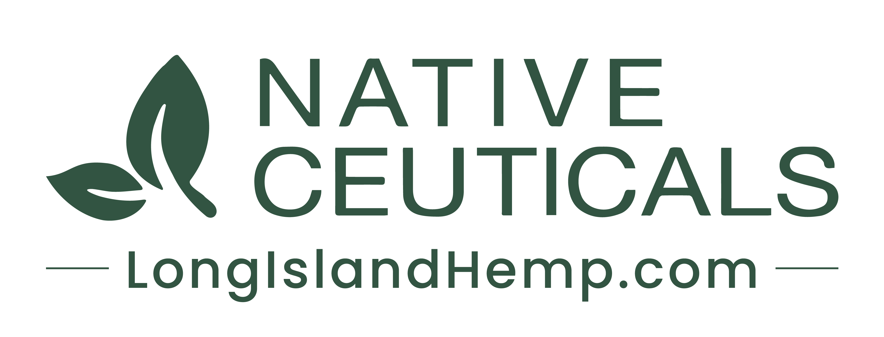

Slide 2
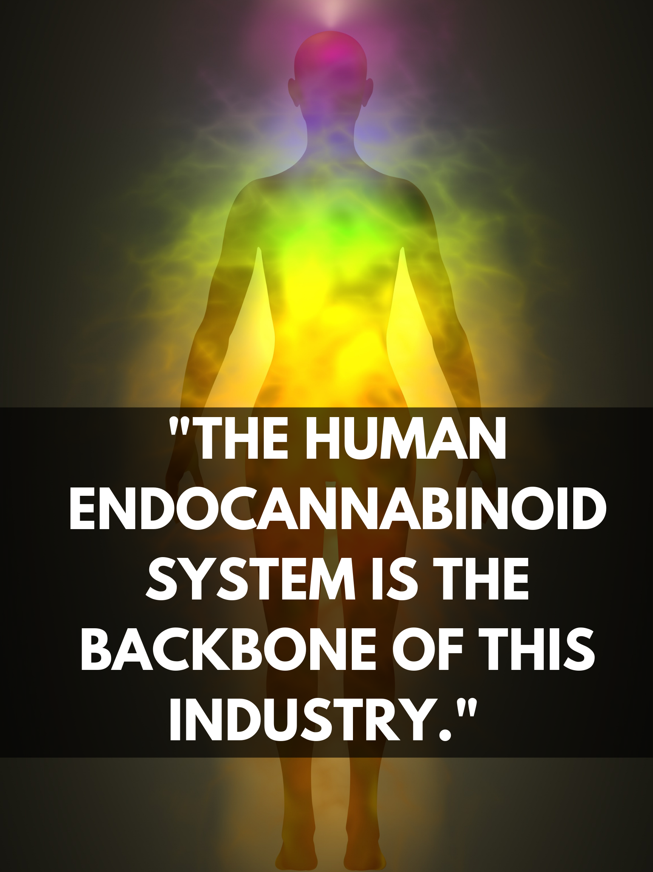
THE SCIENCE IS HERE
Native Ceuticals offers holistic solutions to the most common ailments that plague millions of people and pets throughout the United States each and every year.

Slide 3
WHO WE ARE
USA’s premier Hemp-based company
Offer Wholesale and Retail Model through multiple channels
Woman-owned
Pinpoint focused on solving issues with anxiety, pain, gut issues, mood and so much more.
Philanthropic
Having a positive impact on the serious opioid issue across Long Island
Entire operations are based in the USA - American workforce
Licensed by the NYS Office of Cannabis Management
Member of CANY & LICC, HIA-LI, and Whoggga
Offer Fulfillment and Warehouse services

Slide 4
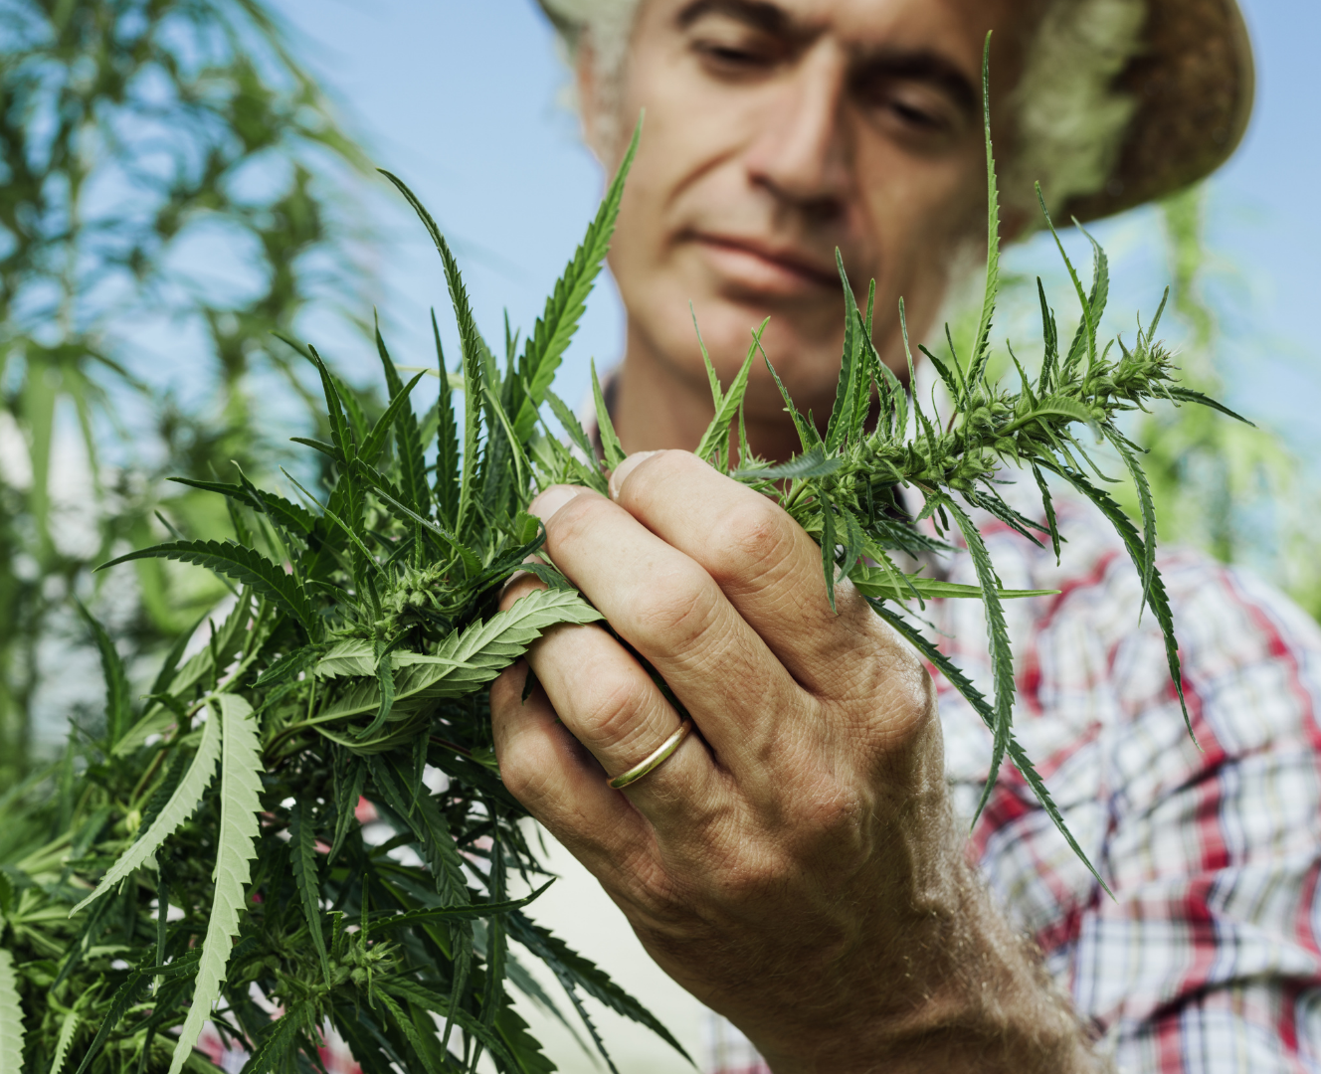
WHO WE ARE
Unlike most CBD companies, we never add chemicals or preservatives to our formulations.
Only the purest and highest quality products hit our shelves and your homes.

Slide 5
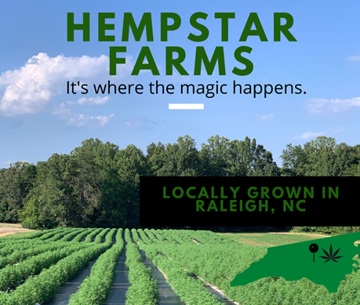
SEED TO SHELF
We pride ourselves on our “seed to shelf” business model which allows us to assure the quality of our products through each phase of production. Farmed ourselves in North Carolina, we start with only the best cannabis strains.
Our professionally processed oils are then sent for third-party testing to ensure the highest concentrations of cannabinoids and the absence of any residual solvents, molds, or pesticides.
These extra steps are taken not only to ensure we are providing the highest quality products, but more importantly to make sure they are safe for our customers.

Slide 6

AWARDS AND MEDIA ATTENTION

Slide 7
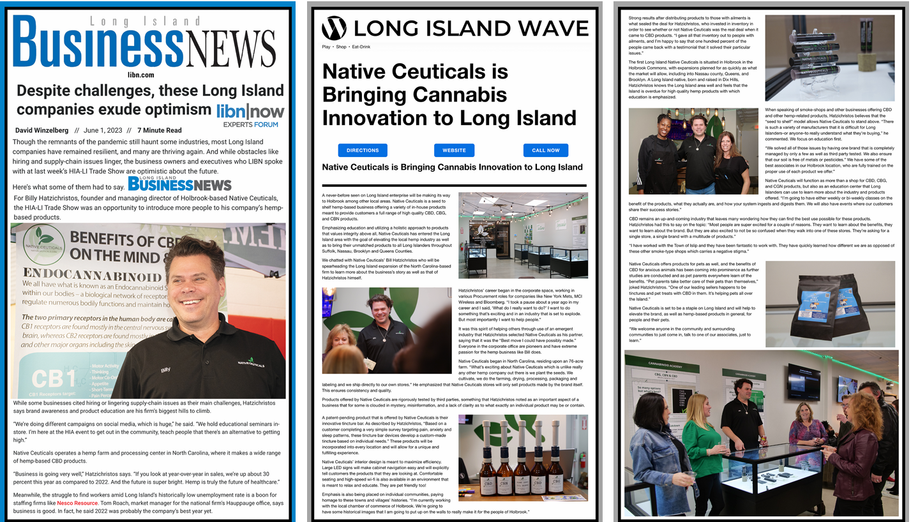
AWARDS AND MEDIA ATTENTION

Slide 8
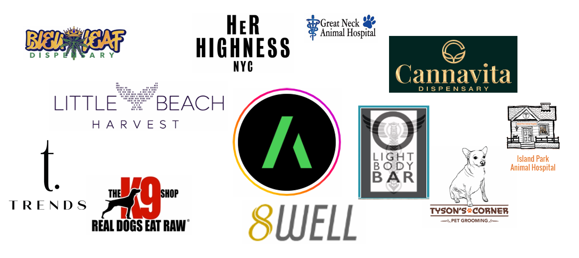
SNAPSHOT of CURRENT CUSTOMERS

Slide 9
OUR CUSTOMERS TELL ALL
“Stopped in to look for a natural solution for my mom’s knee inflammation. The drops I purchased are working wonders for her… Thank you to the staff for bringing her some comfort without the heavy meds!
“High quality, excellent products. Focus is unbelievable, high energy drive and clear mind. I look forward to trying the CBN for sleep. I recommend their products, well worth it.”
“...Was looking in particular for tincture for gut support. Got me what i needed and educated me on it….”

Slide 10
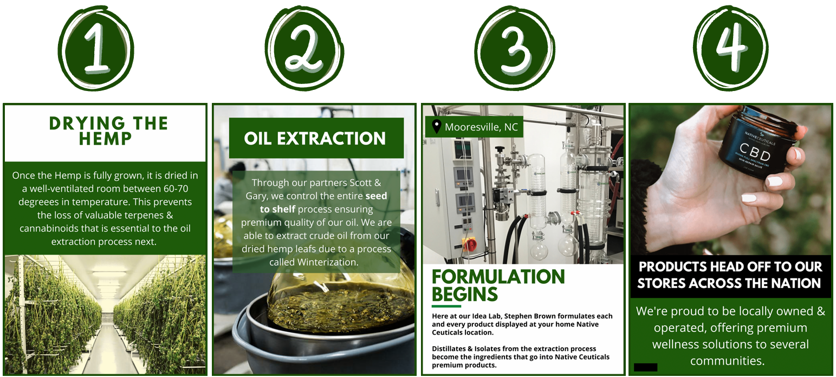
OUR PROCESS

Slide 11
CANNABINOIDS
Types of Cannabinoids
Phytocannabinoids – Found in cannabis plants (e.g., CBD, THC, CBC, CBG, CBN).
Endocannabinoids – Naturally produced by the body (e.g., anandamide, 2-AG).
Synthetic Cannabinoids – Lab-made versions, often used in research or medicine.

Slide 12
CANNABINOIDS
How Cannabinoids Work
They interact with CB1 and CB2 receptors in the body;
  CB1 Receptors – Mainly in the brain and nervous system (affecting mood, memory, pain).
  CB2 Receptors – Mostly in the immune system (affecting inflammation, pain response).
Some cannabinoids (like THC) bind directly to these receptors, while others (like CBD & CBC) work indirectly to enhance the ECS's natural function.

Slide 13
THE SCIENCE IS HERE
Research suggests that CBC may promote neurogenesis—the growth of new brain cells—particularly in the hippocampus, a region associated with memory and learning. This could have implications for neurodegenerative diseases like Alzheimer’s and dementia.

Slide 14
PROMISING STUDIES
How CBC May Support Brain Health:
Neurogenesis: CBC has been found to support the survival of neural stem progenitor cells, which are crucial for brain regeneration.
Anti-Inflammatory Effects: Chronic inflammation is a major contributor to neurodegenerative diseases, and CBC has demonstrated strong anti-inflammatory properties.
Enhanced Brain Signaling: CBC interacts with TRPV (transient receptor potential vanilloid) channels, which are linked to neuroprotection and cognitive function.
Potential Synergy with Other Cannabinoids: CBC works well alongside CBD and THC, contributing to the entourage effect, which may enhance its neuroprotective potential.

Slide 15
HOW TO USE?
How to Use CBC for Brain Health
Look for High-CBC Products – CBC is typically found in smaller amounts in full-spectrum hemp extracts.
Combine with CBD & Other Cannabinoids – The entourage effect suggests that CBC works best when combined with CBD, CBG, and even low levels of THC.
Consistency is Key – Like other cannabinoids, CBC may take time to show noticeable effects. Regular use over weeks or months is often needed.
Dosage & Form – CBC can be taken in oils, tinctures, softgels, or gummies. Dosing depends on your body, but starting low (e.g., 10-20mg per day) and adjusting as needed is a good approach.
Monitor Effects – Track any cognitive changes, memory improvement, or brain fog reduction over time to assess effectiveness.

Slide 16
LIONS MANE
Neuroprotection & Dementia Prevention
May Slow Alzheimer’s & Dementia – Studies suggest it helps prevent beta-amyloid plaque buildup, which is linked to neurodegenerative diseases.
Repairs Nerve Damage – Shown to support nerve regeneration, potentially aiding conditions like Parkinson’s & Multiple Sclerosis (MS).

Slide 17
CoQ10
Brain Health & Cognitive Function
Acts as a neuroprotective antioxidant, protecting brain cells from oxidative stress.
May reduce brain fog and improve memory.
Studies suggest it could help slow neurodegeneration in conditions like Alzheimer’s and Parkinson’s.

Slide 18
GINKGO BILOBA
Brain Health & Cognitive Function
Improves Memory & Focus – Often used to support cognitive function, especially in aging individuals.
May Help Prevent Dementia & Alzheimer’s – Studies suggest it can slow cognitive decline by increasing blood flow to the brain.
Reduces Brain Fog – Helps with mental clarity and sharp thinking.

Slide 19
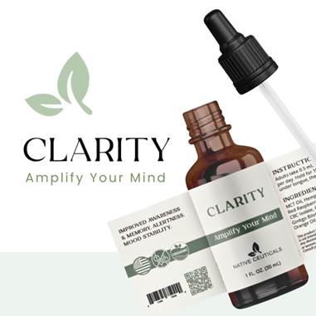
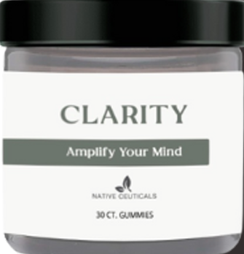
NEW CBC PRODUCTS!
CBC is here!
Embark on a transformative journey with our ‘Clarity’ Tincture. This botanical fusion combines the power of CBC Isolate, CBD Isolate, and B-Caryophyllene with natural elements. Gain clarity of mind with Ginkgo Biloba, Lions Mane Mushroom Extract and CoQ10, harness your energy with MCT Coconut Oil, and stabilize your mood with Sweet Orange and Red Raspberry Essential Oil. ‘Clarity’ seamlessly integrates into your daily routine for holistic well-being, and the potential benefits include decreased anxiety, procrastination, and loss of focus.
CLARITY TINCTURE
CLARITY GUMMIES
CBC, CBD
Decrease Anxiety
Gain Focus
CBC, CBD
Stabilize Mood
Gain Focus
CoQ10
Lion’s Mane

Slide 20
PRODUCT LINE UP

Slide 21



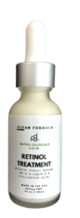

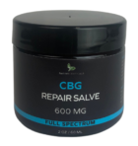
SKIN CARE
CLEANSER
DAY CREAM
NIGHT CREAM
RETINOL
SUNSCREEN
REPAIR SALVE
Smooth & Brighten
Chemical Free
Endocrine Disrupter Free
Wrinkle Reduction
Chemical Free
Collagen Enhancement
Toning
Rejuvenating
Younger, Healthier Looking Skin
SPF 25+
Chemical Free
Protects Against UVA and UVB
Full-spectrum
CBG
Brightening
Sun Protection
Fine Line and Wrinkle Reduction

Slide 22
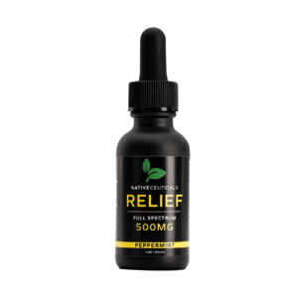
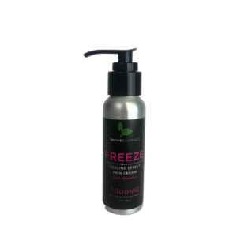
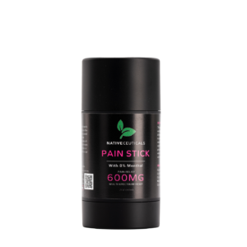
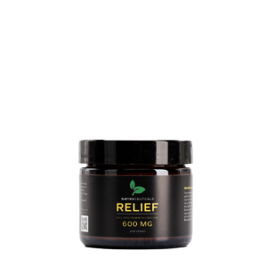
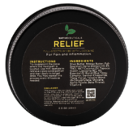
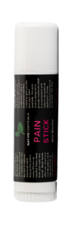
PAIN MANAGEMENT
PAIN RELIEF SALVE
RELIEF TINCTURE
FREEZE CREAM
PAIN STICK
CBD & Lidocaine
Fast Acting &
Long Lasting
< 0.3% THC
Pain and Stress
Natural or Peppermint Flavor
THC Free
CBD & Menthol
Fast Acting &
Long Lasting
THC Free
CBD & Menthol
Maximum
Pain Relief

Slide 23
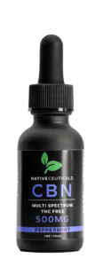
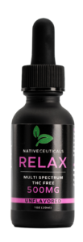
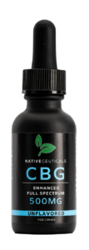
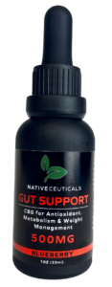
TINCTURES
SLEEP
RELIEF
RELAX
FULL SPECTRUM
GUT SUPPORT
< 0.3% THC
Pain and Stress
Natural or Peppermint Flavor
THC Free
Anxiety
Natural or Peppermint Flavor
THC Free
Sleep and Anxiety
Great for Menopause
< 0.3% THC
Gut Support, Mood Enhancement, Focus
THC Free
Digestion and Metabolism
Blueberry Flavor

Slide 24
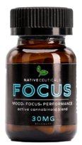
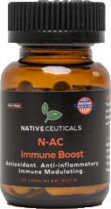
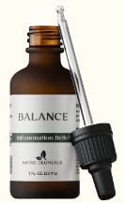
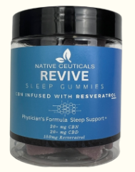
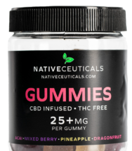
INGESTIBLES
FOCUS
IMMUNITY
FULL SPEC
CBD
REVIVE
THC Free
Uplift Mood
Memory Support & Alertness
THC Free
Antioxidant
Kidney & Liver Detoxing
CBD, Turmeric, Boswellia, Ashwagandha
Tranquility
THC Free
Tropical Flavors
Infused, Not Sprayed
THC Free
CBN + Resveratrol
Antioxidant Support

Slide 25
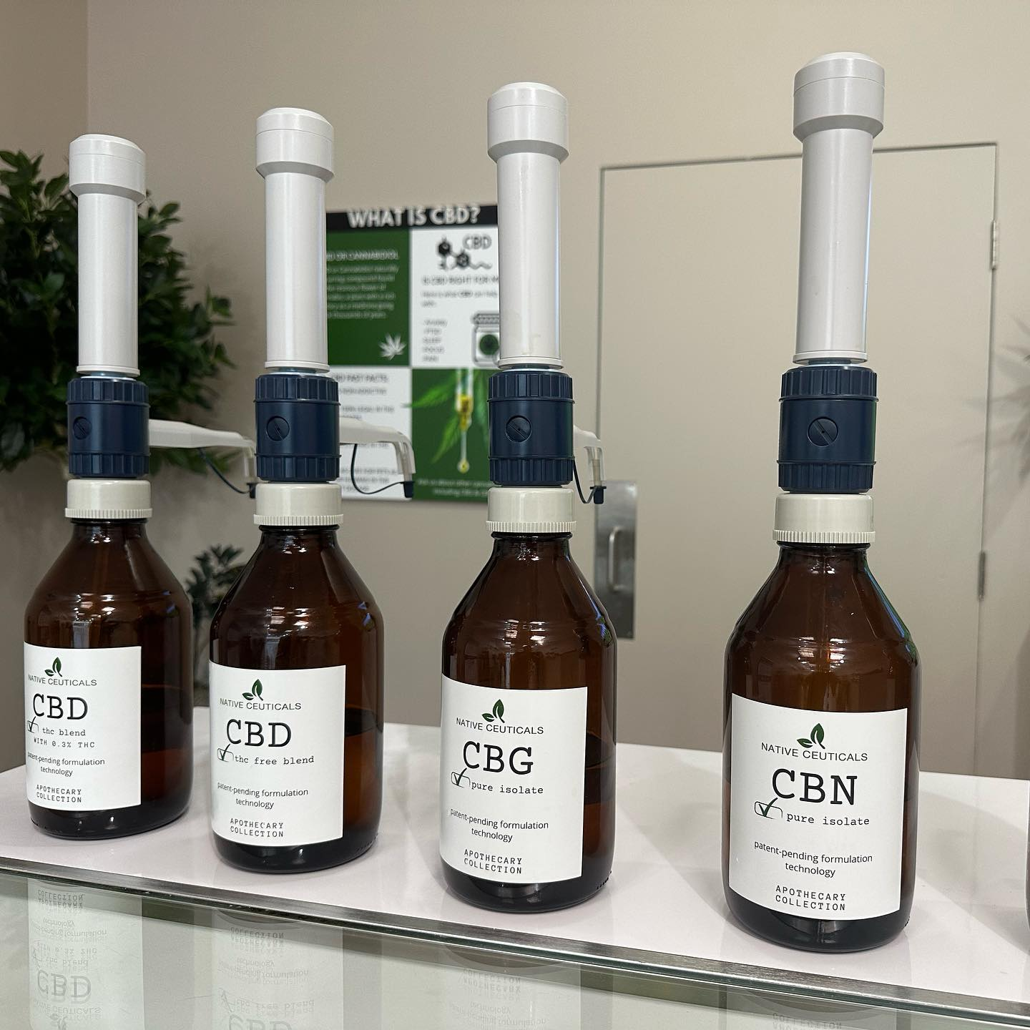
PATENT PENDING!
Imagine a Custom Tincture
Native Ceuticals has developed a brand new fully customized patent-pending process designed to formulate a 100% custom tincture made up of a unique and personalized blend of distillates, isolates and terpenes creating the best solution for each individual’s needs.
Our team will either ship your custom formulation directly to your door or hand it off to you on-site at a participating Native Ceuticals location.
This is a custom blended and personalized product that is made specific for you.
CUSTOM TINCTURES
CBC, CBD, CBG
With or Without THC
High Margins

Slide 26
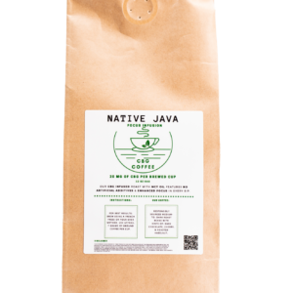
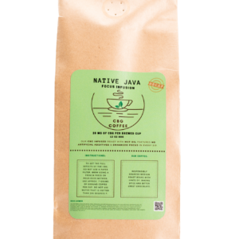
JAVA
REGULAR
DECAF
THC Free
Medium Roast
Clarity and Gut Health
THC Free
Medium Roast
Clarity and Gut Health

Slide 27
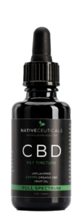
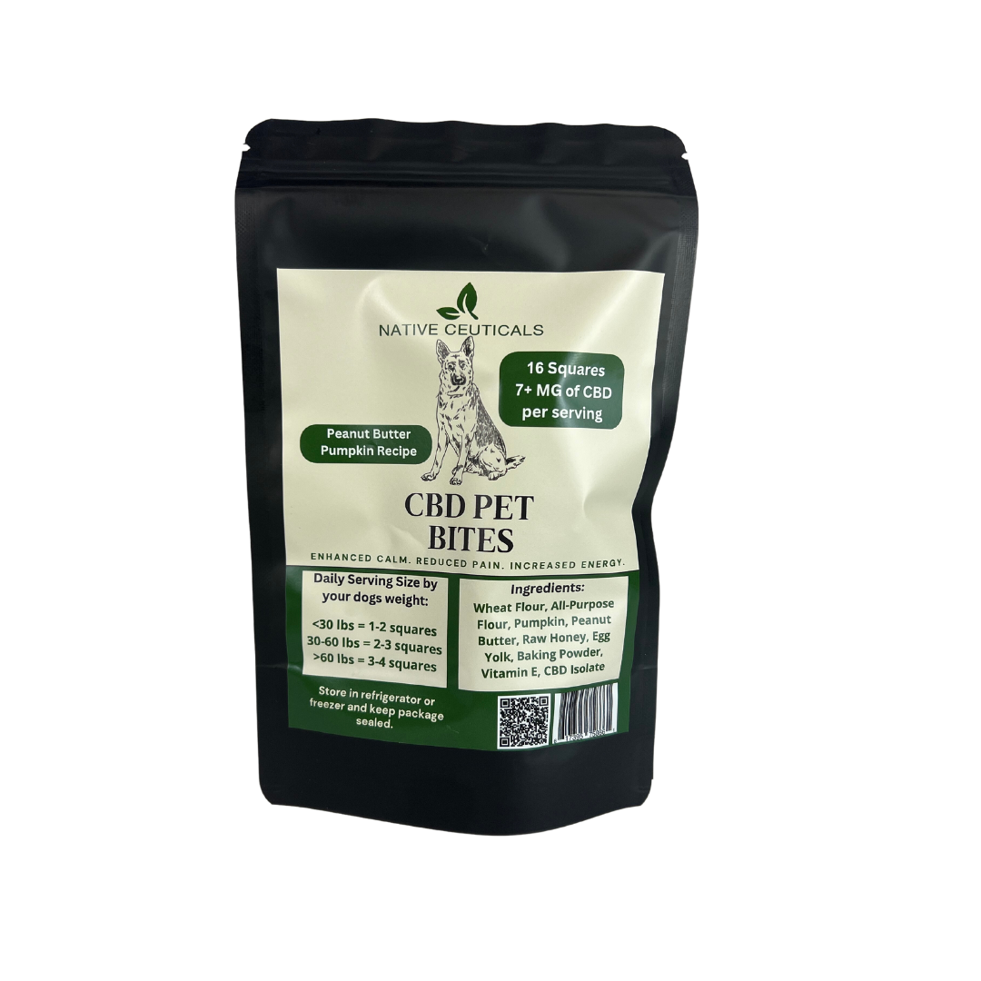
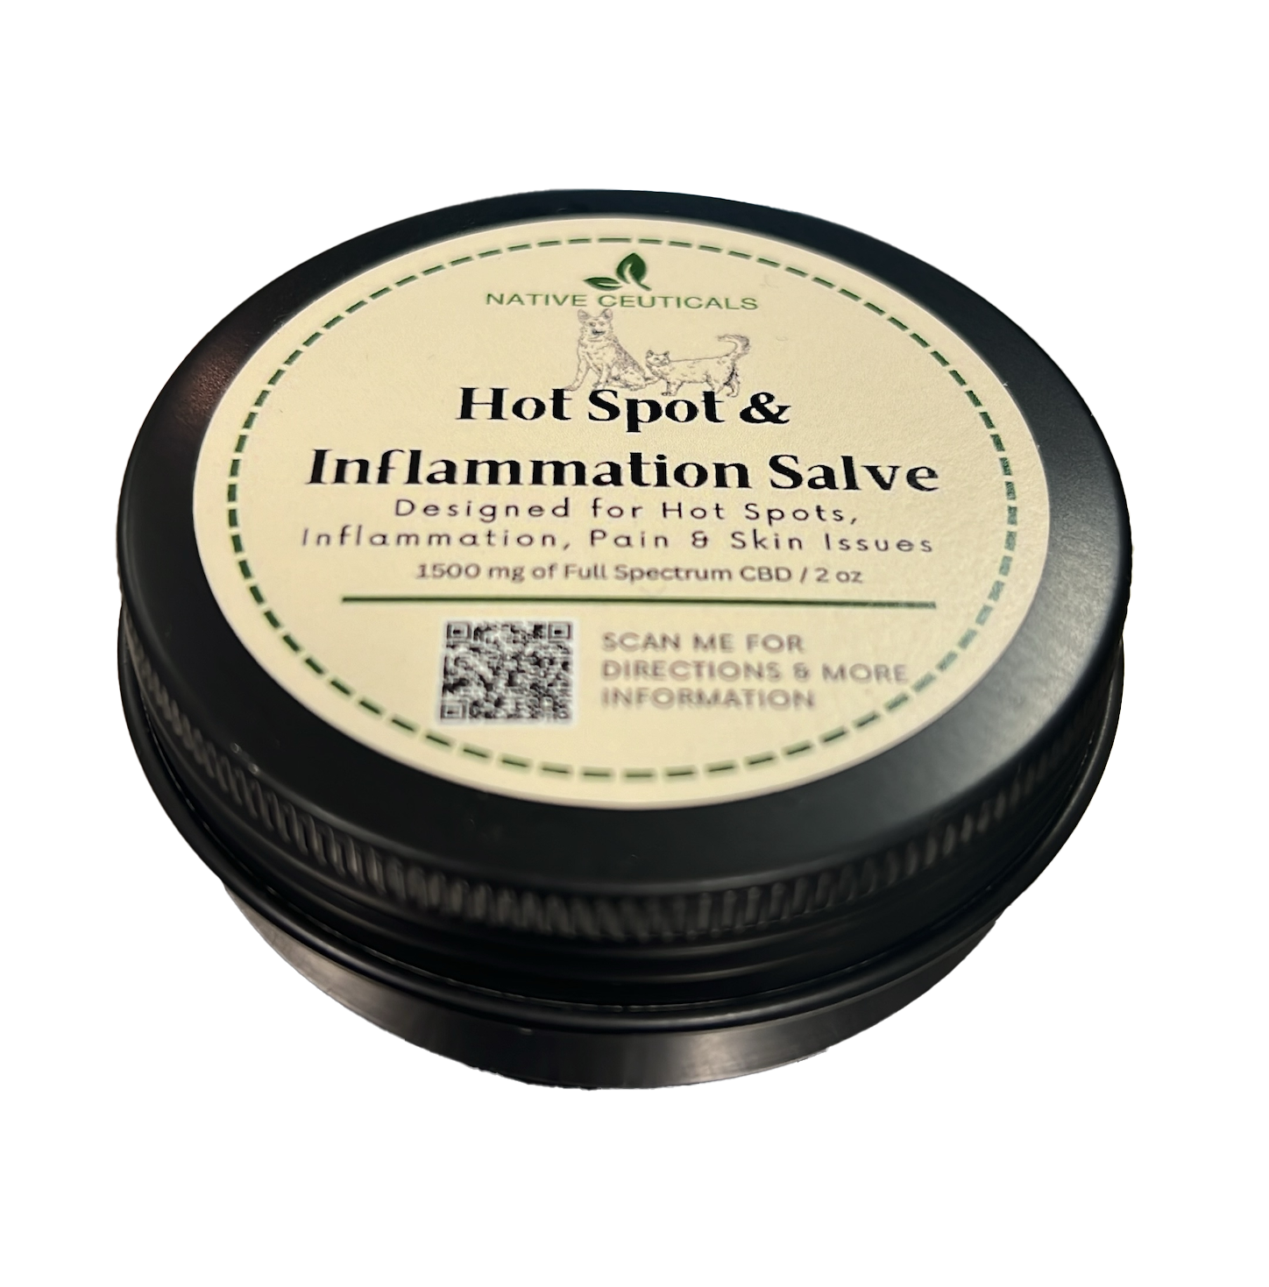
PET PRODUCTS
TINCTURE
DOG TREATS
HOT SPOT TREATMENT
Calming
Chronic Anxiety Relief
Great for All Animals
Calming
Situational Anxiety Relief
Peanut Butter Pumpkin Flavor
CBD Infused
Nose, Paw, Hot Spot
Great for All Animals

Slide 28
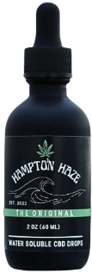
WATER SOLUBLE
Hampton Haze
Refined Relaxation
CBD Based
Mix with Any Drink

Slide 29
OTHER OFFERINGS
White Labeling available
THCA Isolate
CBD Isolate
CBD Flower
Fulfillment Services
Warehousing
Always Free Consultation

Slide 30


