Slide 1

Week 2: Wholesaling Real Estate
Dive into the wholesaling process and how to get started

Slide 2
What is Wholesaling?
• Wholesaling is a strategy to profit by assigning property contracts without owning the property.
• You act as a middleman between the seller and the buyer.
• Ideal for beginners with little capital or experience.

Slide 3
How Wholesaling Works
1. Find a motivated seller or distressed property.
2. Negotiate and secure a purchase agreement.
3. Assign the contract to an investor or buyer.
4. Close the deal and earn your assignment fee.

Slide 4
Finding Motivated Sellers
• Look for individuals facing foreclosure, job loss, or relocation.
• Utilize 'Driving for Dollars' to locate distressed properties.
• Use online platforms, auctions, and public records to identify leads.
Lofty
https://ilfls.com/free-daily-auction-lists/cook
https://www.pasco.realforeclose.com/
Investerlift.com
Forewarn
Facebook Investor Pages
Fetch
Cold Calling

Slide 5
Identifying Real Estate Exit Strategy
Wholesalers are our friends
Most wholesalers don’t list traditional real estate. They usually have cold callers calling and some people might want to sell traditionally, and they will refer it out to a traditional real estate agent.
Types of Strategy when talking to a potential seller:
Traditional list
Wholesale
Investor Buy

Slide 6
Identifying Distressed Properties
• Look for overgrown lawns, boarded windows, or vacant homes.
• Check property records for unpaid taxes or liens.
• Use tools like Zillow (FSBO), Redfin, PropStream, Remine, Realist for property searches.

Slide 7
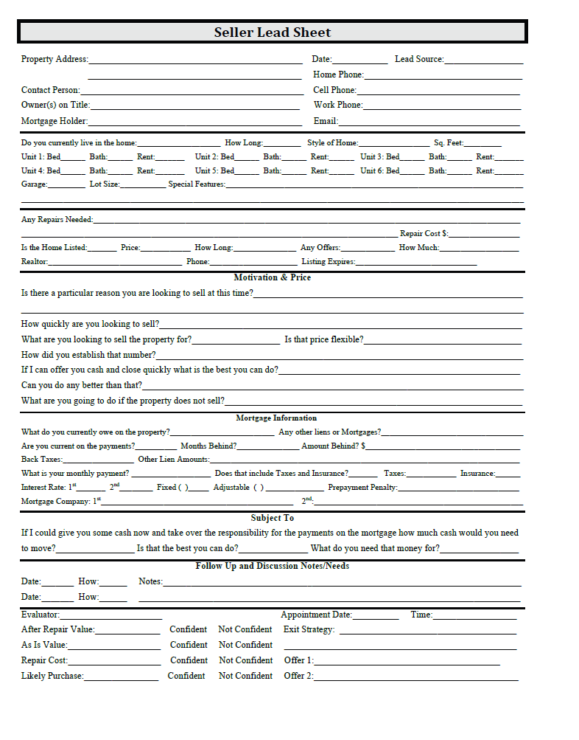
Seller Lead sheet

Slide 8
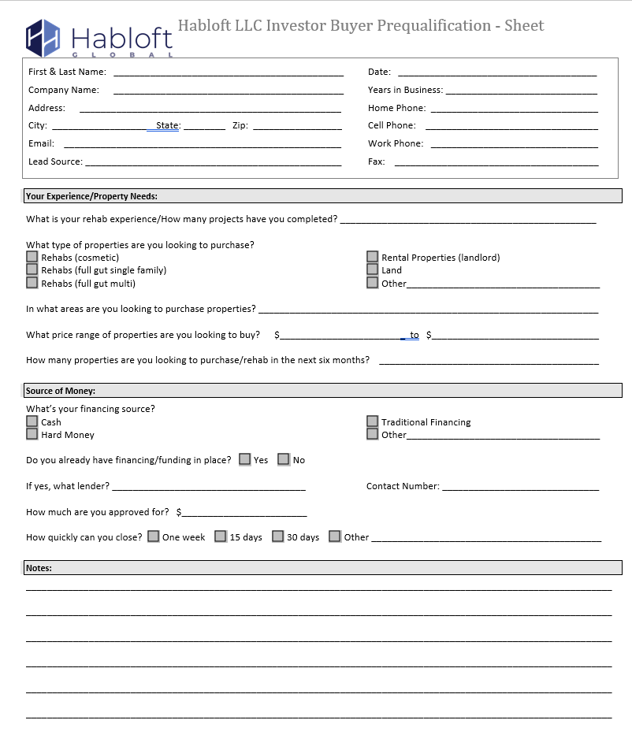
Finding buyers

Slide 9
Assigning Contracts & Closing the Deal
• Assign the purchase contract to a buyer for an assignment fee.
• Ensure all parties agree to the terms in the contract.
• Work with a title company to facilitate a smooth closing.
• Collect your assignment fee at closing.

Slide 10
Activities
1. Practice finding leads in your local market.
2. Role-play a conversation with a motivated seller.
3. Share your findings and strategies with the group.

Slide 11
Q&A and Wrap-Up
• Recap key takeaways from today’s session.
• Open floor for questions and discussion.
• Homework: Find one motivated seller lead to present next class.

