Slide 1
Basics of SEO
Last updated By Alicia King Anderson
1 April 2021

Slide 2
What is SEO?
Search Engine Optimization (SEO) is the process of improving the visibility of a website or a web page in search engines via the "natural" or un-paid search results.
As Search Engine Result Pages (aka SERPs) get more complicated, so too, does the work of optimizing for the various pieces of the search result.
Notes:
Why do users search google (trust the results)
Our job to tell Google they can trust our results for the questions users ask
Point to: Organic listings, paid listings, image searches (and other multimedia callouts)

Slide 3
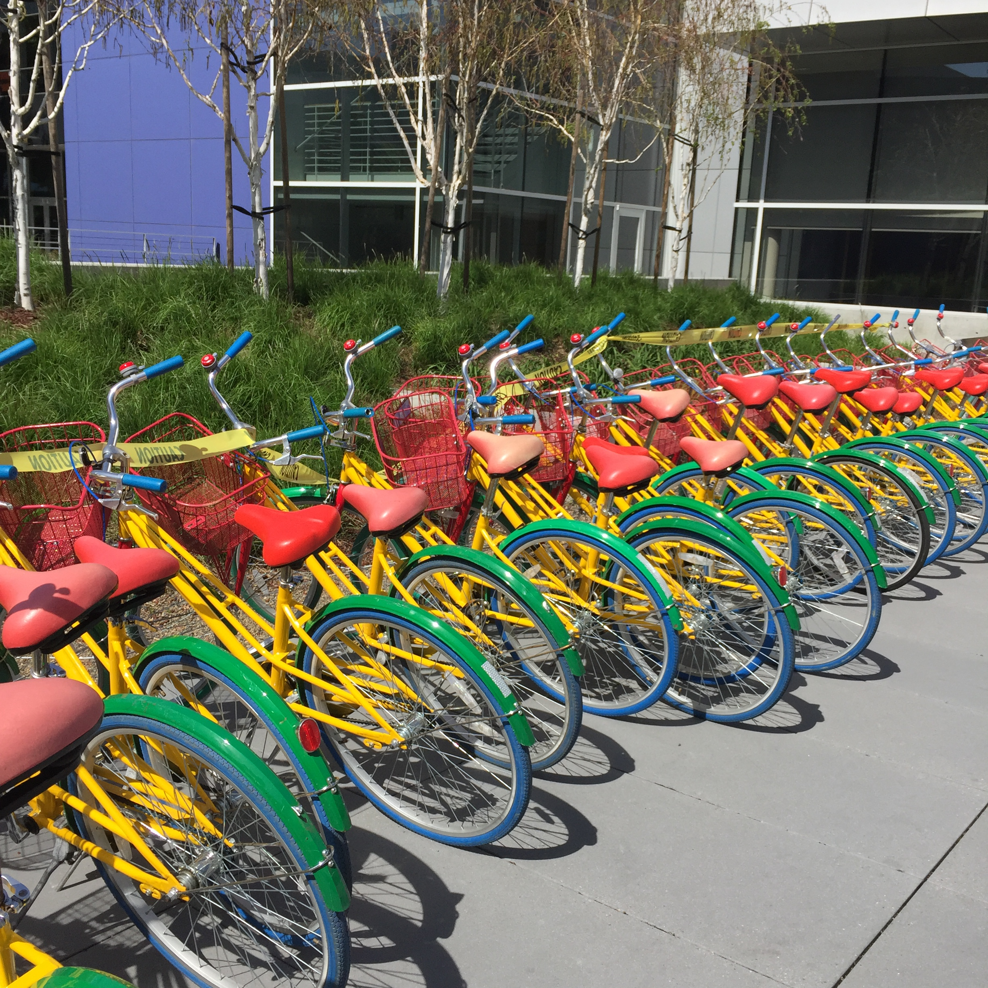
Why Does it Matter?
It’s a traffic source of sweet, sweet clicks that are:
Organic
Sustainable
Holistic
Long-term
“fishing where the fish are”

Slide 4
Pairing Answers with Questions and Ensuring Google can Understand it
Technical
Content
Data / Analysis

Slide 5
Pairing Answers With Questions
Keyword Research
Content Strategy
User intent
Contextual Relevance
Best Practices
Competitive Analysis
Targeting SERP Features
Content
Activities

Slide 6
Ensuring Robots Can Find & Understand Those Answers
Crawlability
Robots Directives
Indexation
Link Flow
Usability
Accessibility
Redirect management
Pagespeed
Best Practices
Targeting SERP Features
Technical
Activities

Slide 7
Investigating and Communicating Results
Investigating shifts in traffic
Interpreting disparate data sets
Test design and test measurement
Communicating priorities of work
Reporting results of efforts
Data / Analysis Activities

Slide 8
Entry-Level & Free Tools For SEO
Lighthouse Chrome Extension
Pagespeed Insights
Google Search Console
Screaming Frog
SEMRush Free Trial
Searchmetrics Free Trial
Google Trends
The Search Results Page itself
Google Analytics
Google Search Console
Google Trends
SEMRush, Searchmetrics Free Trials

Slide 9
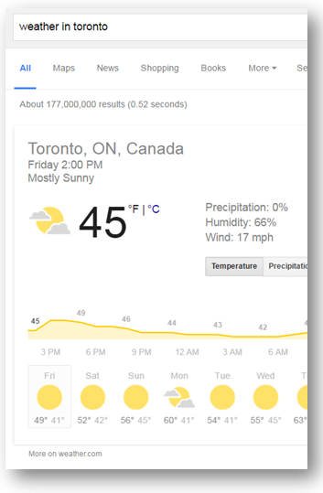
“We Want to Be the Star Trek Computer…”
They don’t really want to serve 10 blue links
Follow the money:
Ads - SEM, Doubleclick
Keeping users on Google’s pages
Keep them coming back

Slide 10
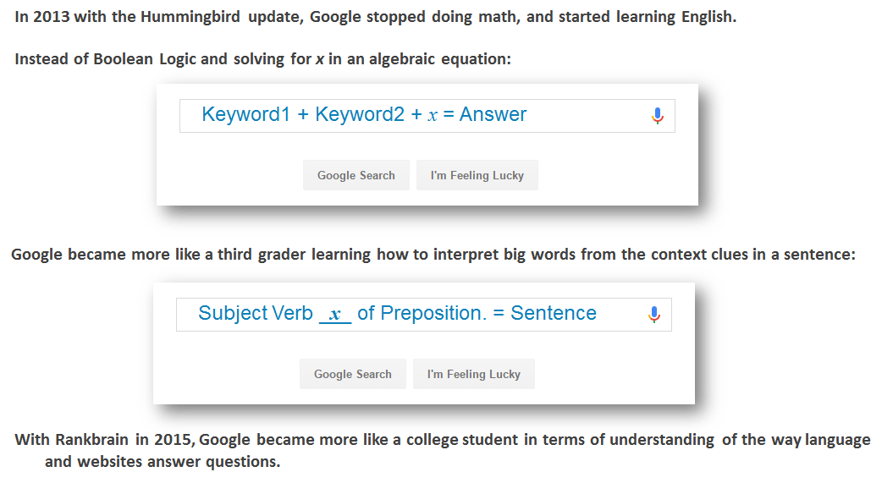
How Google Understands User Queries

Slide 11
Disambiguation

Slide 12
How Does Google Decide Which Answer Is First?
15% of search terms every day are unique - never been seen before.
It depends on who is asking the question
It depends upon which question they are asking and how they asked it
It depends upon what else is going on in the world of that topic
It depends on the topic as a whole and which sites generally have good answers about this particular topic
It depends upon what a complete answer should be for this question
It depends on whether the sites answering the question are reputable, user-friendly, technically sound, and how users interact with them

Slide 13
Googlebot SKIMS your webpages
It is common knowledge that most of us don’t read websites word for word. We skim. So does the Googlebot.
The easiest way to identify which parts of your web copy matter the most to SEO is to think about the page in the order in which most human beings will “skim” content!
The biggest text at the top of the page - the title of the article
The opening sentence / lede
The first paragraph, article abstract or summary at the top of the page
Any content that is visible without scrolling when you first land on the page
Anything in bulleted lists
Anything in bold – most importantly things that separate the sections of the text
Diagrams / images / visuals & their captions
Body copy!

Slide 14
Brainstorm Time!
If you are writing an article about Indian Cuisine, what are your keywords?
What are the topics you have to cover?
What is the customer intent for queries like this:
First time trying Indian food
Indian cuisine what should I order
What does Indian food taste like
Is Indian food spicy
What spices in Indian food
How do you meet those users’ intents?

Slide 15
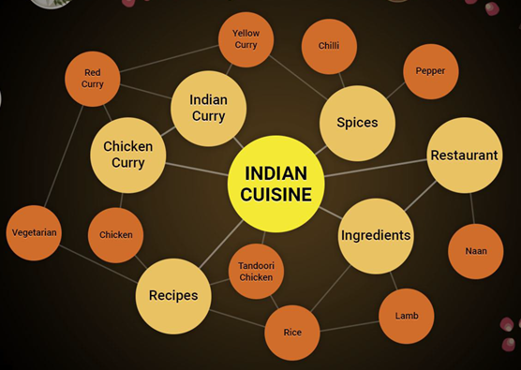
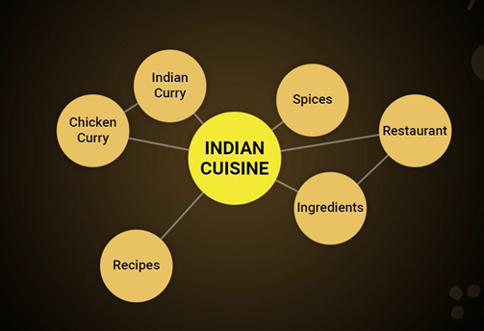
Google Cheats Off The Winner’s Pages
Google knows what the best answers to a question look like.
Ranks #1
Ranks #8

Slide 16
Word Jumbling
Using the words shown to the left and the words you brainstormed, write a few sentences (200 words max) for the user who wants to know what to order the first time they go out for Indian cuisine.
What is the title of this piece?
What would you link it to?
What would be the next topic?

Slide 17
You’re “Doing SEO” Every Day
You are writing the answer to a question that someone is going to ask a search engine.
Keep your target users and their intentions in mind
Remember to put the important parts in “skimmable” spots on the page
Keyword research provides the words for the jumble, but doesn’t help you write it
Try to answer the question completely (if that means linking off to another page on your site, that’s great, too!)

Slide 18
When Should We Call for SEO help?
Content planning and identifying new topics to create or revise
Site restructuring, changing URLs, removing URLs
Site redesign or recoding

Slide 19
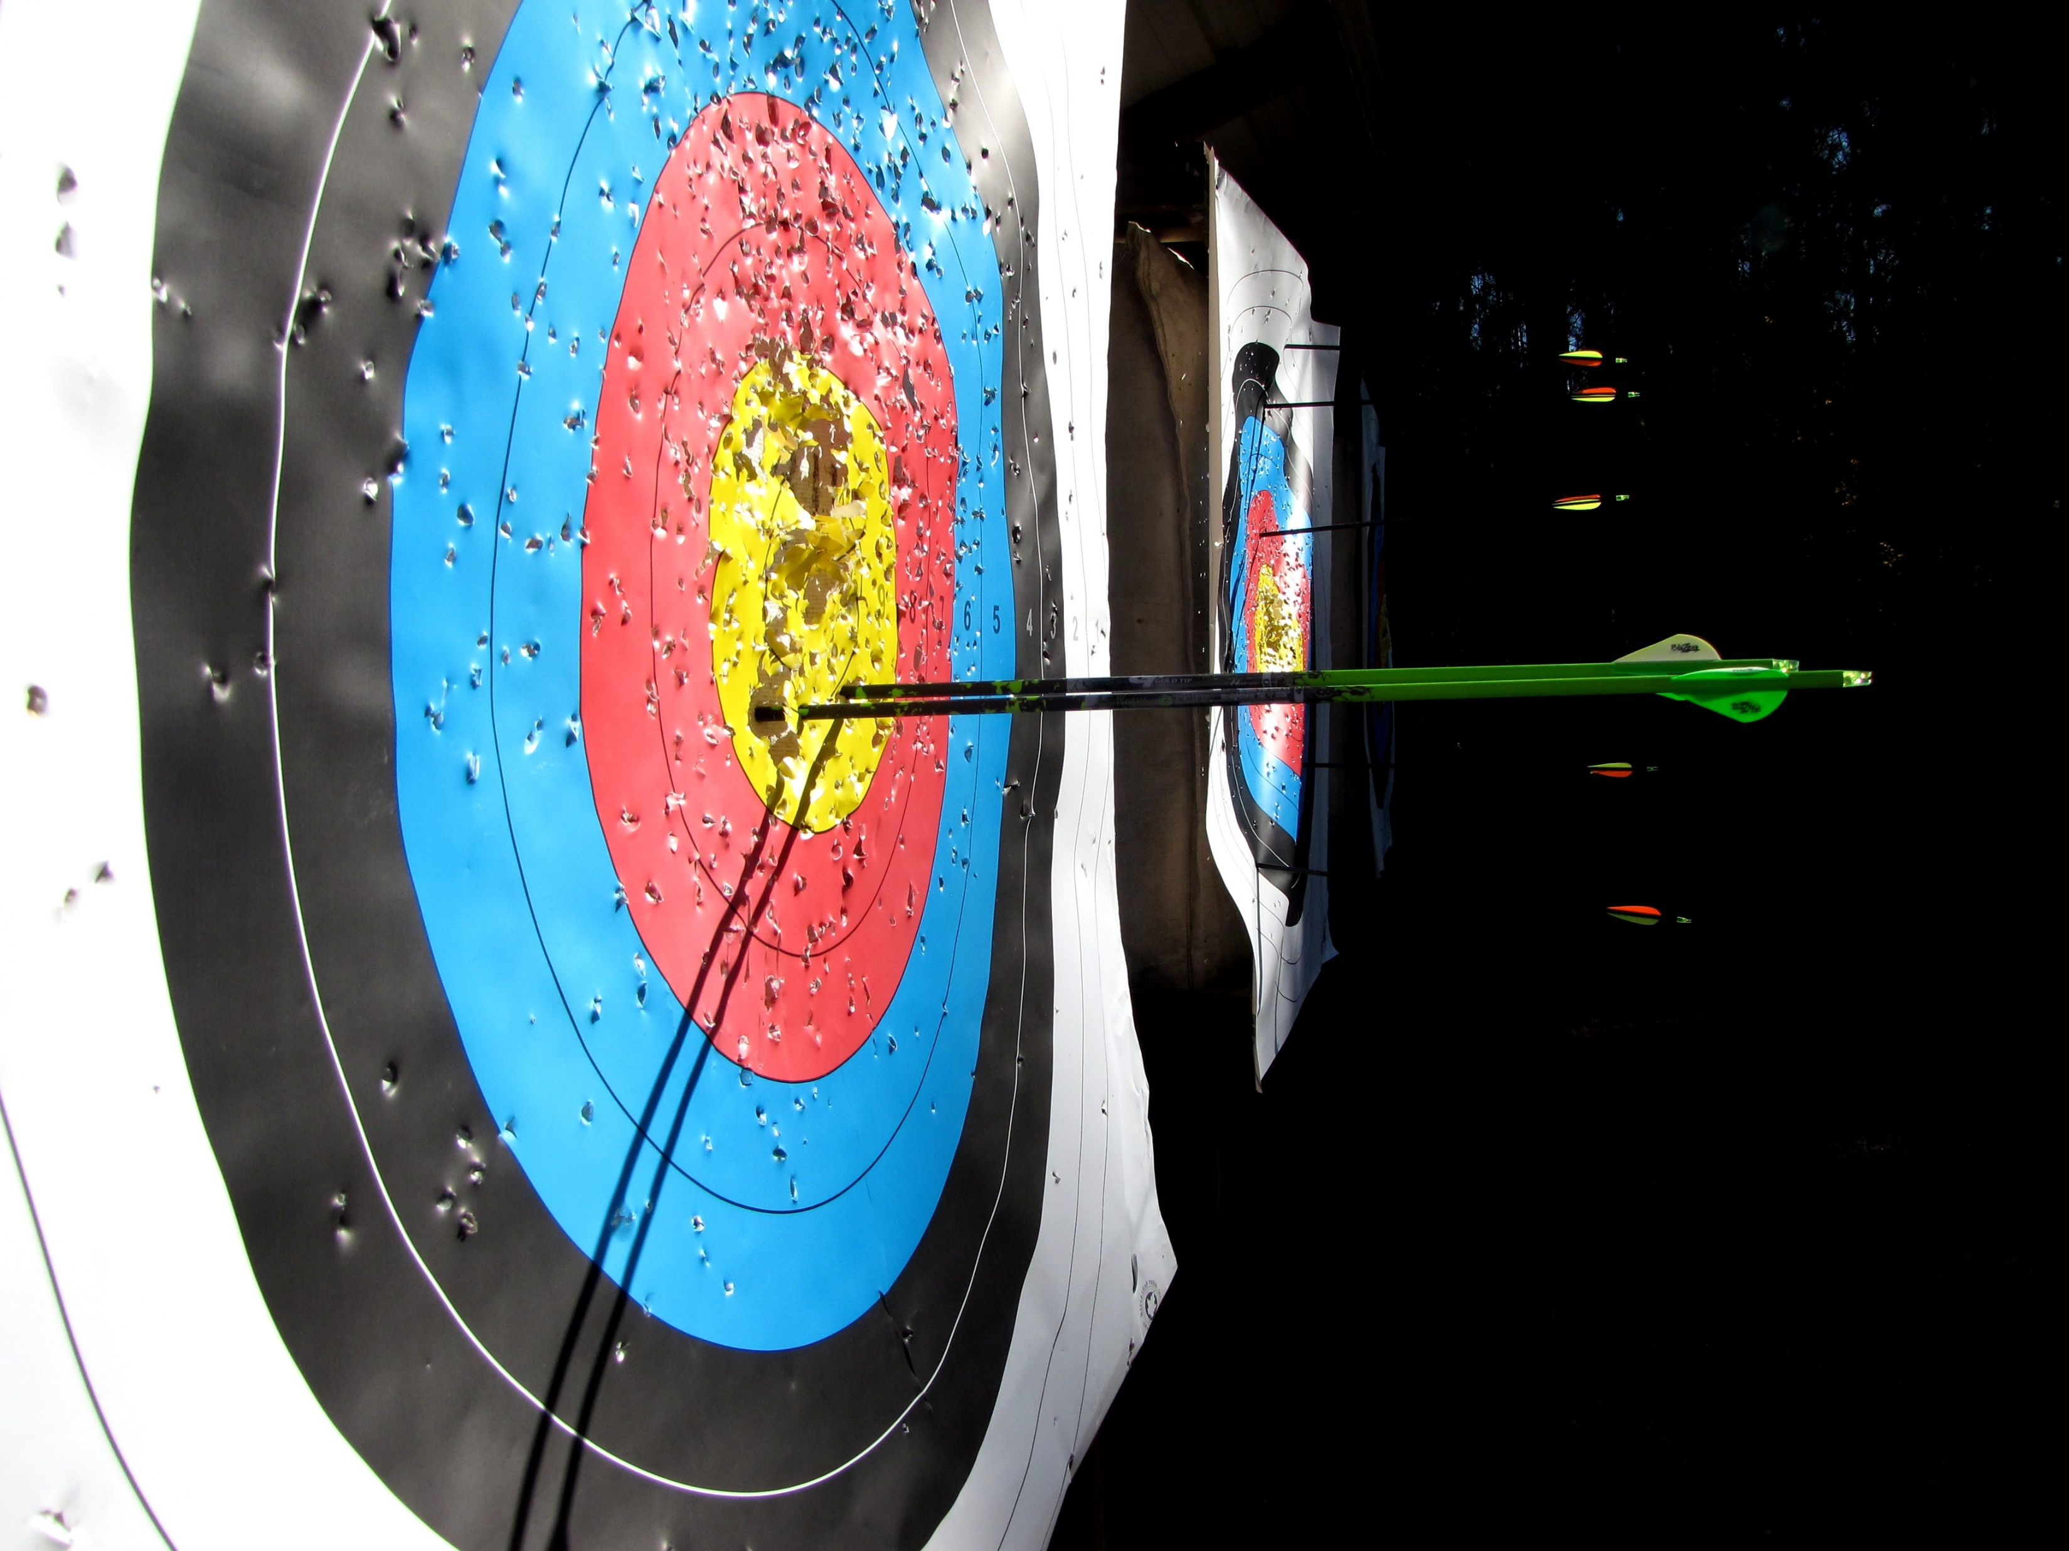
Thanks!

Slide 20
Key Takeaways
SEO is a holistic set of best practices that span most aspects of a website, and anyone who updates a site has the ability to impact organic search engine rankings and traffic.
Google is focused on determining then meeting the user’s need as quickly as possible.
Google’s list of best practices are the best way to avoid long-term risk.
Keyword research is available (and necessary) to learn the broad topics that people are searching for. This allows us to optimize landing pages where people are looking for a particular piece of information. “Fishing where the fish are.”
Providing clear context clues on every page and between the pages of a site is a priority

Slide 21
Relevant Tools and resources
Latest version of Search Quality Evaluator Guidelines
Updated SEO periodic table of ranking signals
Google Webmaster Central Blog
Google “SEO Starter Guide”
Google Trends

