Slide 1
Webinar: February 24, 2021 02:00 PM EST
Claiming Your Portion of the $6+ Billion Visa/Mastercard Settlement
Specialized Subscription, Membership and Event Professionals are members of this class and entitled to claim a portion of the $6+ Billion Settlement.
This webinar will explain what you need to know in order to file a claim and your options for filing.

Slide 2
Visa/MasterCard Class Action Settlement & Recovery
Workshop: What You Need To Know
Background and Current Status of Settlement
What does this mean for Merchants? Who is eligible?
Brownstone Recovery Group’s Advantages
History and Experience
No Up-front Fees
No Statement or Data Requirements
Services cover ALL MIDs for eligible businesses - open or closed.
Merchant Enrollment Process:
On-line, easy to complete, non-obtrusive
Recovery Estimates and Realities
Timing
Questions & Answers

Slide 3
Quick Summary - VISA/MasterCard Class Action Settlement
BACKGROUND:
The original case was about unfair practices related to interchange fees. [Payment Card Interchange Fee and Merchant Discount Antitrust Litigation - MDL No. 1720].
The lack of competition meant steadily rising fees and no competitive alternatives.
Both parties originally agreed to settle for more than $7 billion dollars. After lengthy discussions and dozens of separate agreements, the Judge has approved the Settlement.
ELEGIBILITY:
Any Merchant that accepted Visa or MasterCard between January 1, 2004, and January 24, 2019 is eligible to participate in the Settlement but must register to be included.
UPDATE:
On December 13, 2019, the Court agreed that despite any reservations expressed during the last Fairness Hearing (November 7, 2019), the proposed settlement is "Fair and Adequate". By clearing the remaining administrative issues from the case, the Judge/Court can move forward with declaring a claim form (enrollment) deadline and publishing the official claim form details. We were prepared to move forward in early 2020 when COVID-19 impacted the process.
We see these announcements as confirmation that the Case is now firmly in the "Payment Phase"

Slide 4
WHY IS THIS GREAT FOR THE MERCHANTS?
It is their money – they were overcharged
“Found Money” – payouts only to those who apply
Brownstone makes it easy to understand payments
Uncomplicated enrollment – elegant process
No fear of data loss or exposure
No fees upfront – 100% contingency based
Once enrolled, no need for additional data or work
Brownstone covers all the EIN and related Merchant ID (MID) numbers for each client regardless of volume.
All funds to be disbursed but only to enrolled Merchants. Strong potential for “Second Checks” issued to Merchants that participate in the Settlement.

Slide 5
WHAT ARE THE MERCHANTS’ OPTIONS?
OPTION 1: Do nothing and not receive their share of the Settlement. Merchants must register to participate in this class action and receive compensation.
OPTION 2: File and calculate their own claim(s) by working with the appointed Settlement Administrator. Contact detail and additional information regarding the no-cost assistance, Merchants can visit www.paymentcardsettlement.com. Claim Forms are not yet available. Note: There is no requirement to file with a third-party provider – it is 100% their choice.
OPTION 3: Retain Brownstone Recovery Group to work on their behalf to help them recover their share of the Settlement. Brownstone’s areas of expertise are interchange fees and Class Action settlements and we focus on the Merchants’ claims (including all EIN and MID numbers) while they focus on their business.

Slide 6
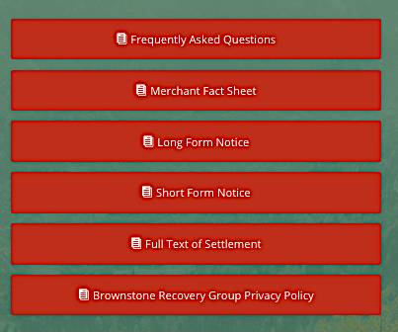
Brownstone Recovery Group Web Site
https://brownstonerecovery.com

Slide 7
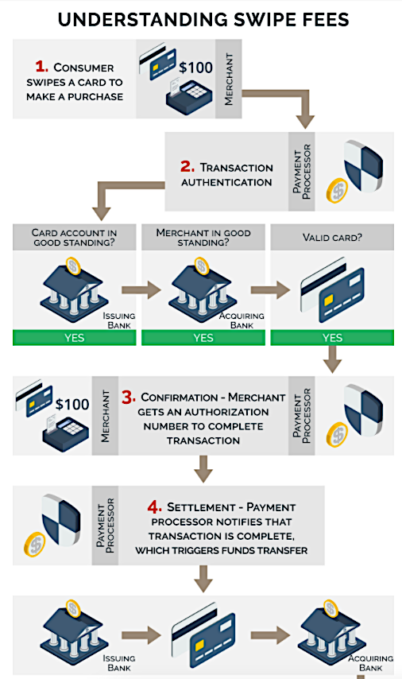
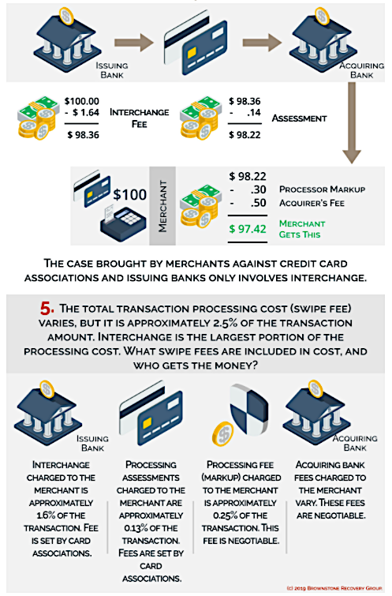
Brownstone Recovery Group Web Site
https://brownstonerecovery.com

Slide 8
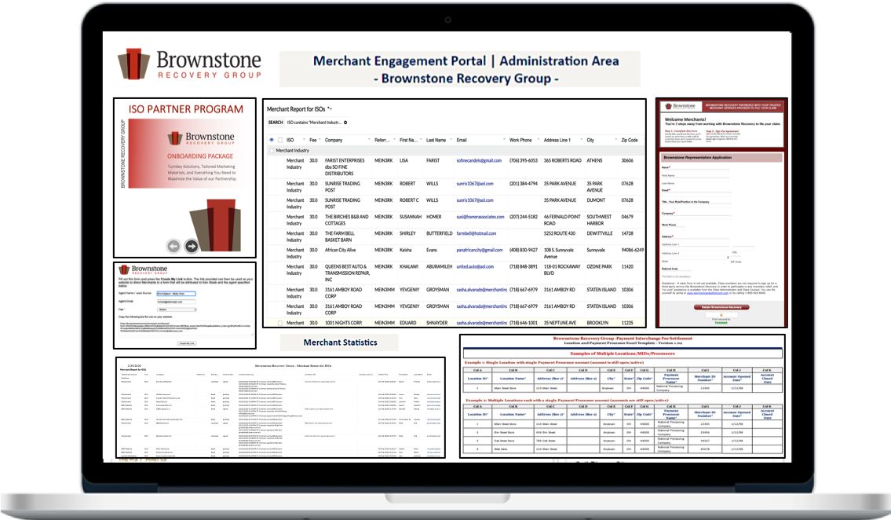
BROWNSTONE’S DIFFERENTIATORS Focus on the Merchants: Education, Options, and Streamlined Process
STEP 1
STEP
2
STEP
3
STEP 4
STEP 5
ENROLLMENT:
Complete Simple Form by clicking on URL sent by DealersEdge:
www.dealersedge.com/brownstone
EIN & SIGNATURE
Based on your form, Brownstone will return an Agreement for you to input your EIN (Tax ID Number) and sign electronically.
No statements/data
or fees needed.
CONFIRMATION: Brownstone will send you a copy of the Agreement that confirms Claim participation, EIN(s) & MID(s) for maximum recoveries.
CONFIDENCE:
Continue running your business as usual with the comfort of knowing you are participating, and that Brownstone is monitoring the Case and will deliver formatted files (Claims) and review data with Claims Administrator ASAP.
PAYMENT
Claims Administrator disburses funds for approved claims to Brownstone for confirmation and Merchant payment.

Slide 9
VISA/MasterCard Interchange Fee Class Action Settlement
Brownstone Recovery Group - Disclaimers on Estimates
Assumptions:
Merchant has been processing this estimated amount as an annual average for recent portion of the Settlement Period (1/2004 – 1/2019).
There is not a factor applied for the number of years the Merchant processed during the Settlement Period.
The Merchant paid the Interchange Fees directly and/or was billed monthly specifically for interchange fees
The amount paid from the settlement to each claimant will be based on their actual or estimated interchange fees attributable to Visa and Mastercard between January 1, 2004 and January 25, 2019.
Estimates are gross and do not include third-party fees.
The amount of money each Authorized Claimant will receive from the settlement fund depends on the money available to pay all claims, the total dollar value of all valid claims filed, the cost of class administration and notice, applicable taxes on the settlement fund and any other related tax expenses, attorneys’ fees and expenses, and money awards to the Rule 23(b)(3) Class Plaintiffs for their representation of merchants in MDL 1720, which culminated in the Class Settlement Agreement, all as approved by the Court.
Class members will have the opportunity to challenge the data used to calculate their settlement figure if they disagree with the data.

Slide 10
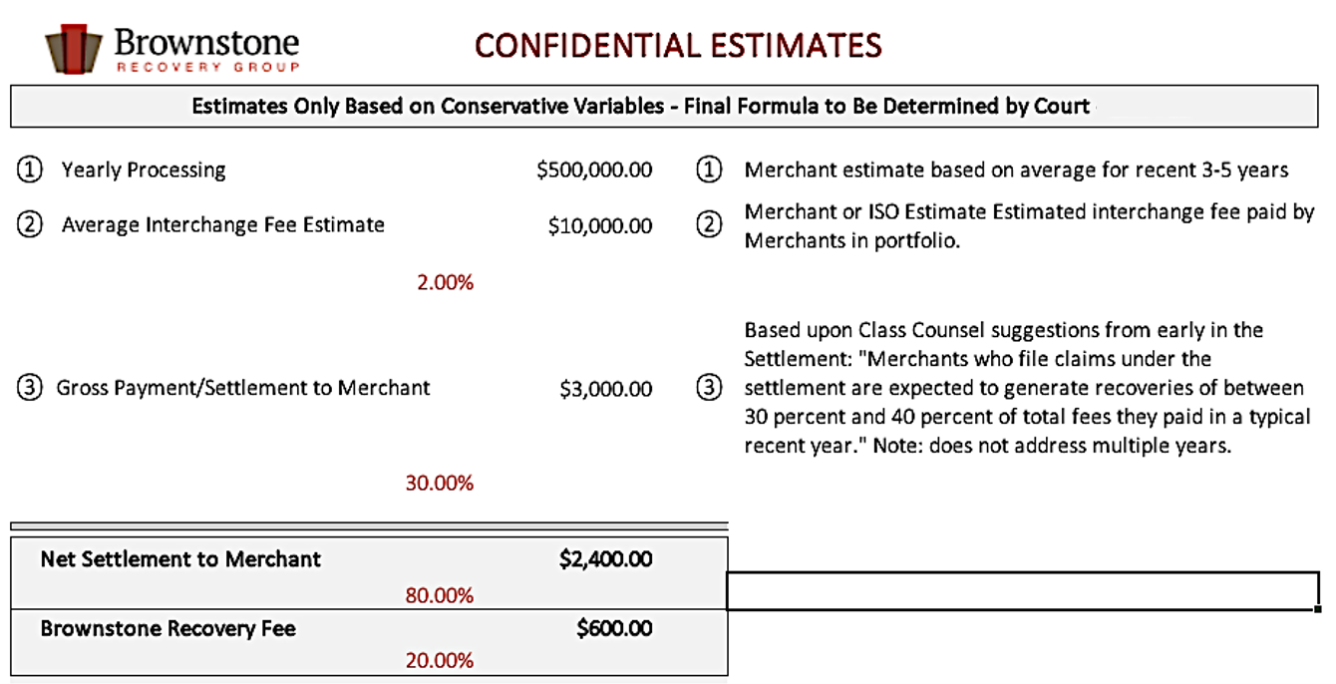
VISA/MasterCard Interchange Fee Class Action Settlement
Brownstone Recovery Group “Ballpark Estimates
See Disclaimers on Estimates

Slide 11
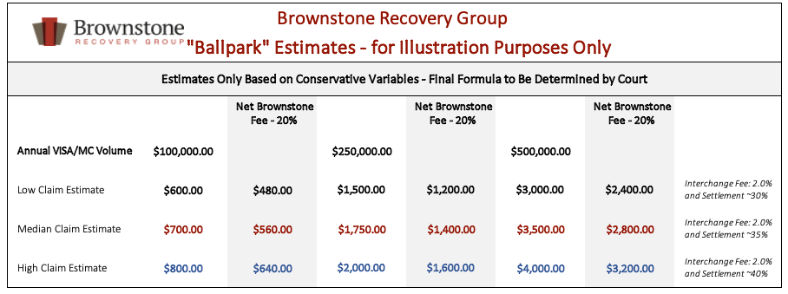
VISA/MasterCard Interchange Fee Class Action Settlement
Brownstone Recovery Group “Ballpark Estimates
See Disclaimers on Estimates

Slide 12
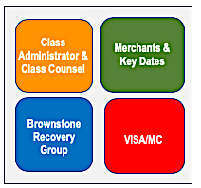
VISA/MasterCard Interchange Fee Class Action Settlement
(Payment Card Interchange Fee and Merchant Discount Antitrust Litigation (MDL No. 1720)
TIMELINE & SIGNIFICANT EVENTS
Original Lawsuit filed by Merchants against VISA & MasterCard (and over 30 Banks)
Brownstone Recovery Group (BRG) Settlement Services is formed by combining talents and platform
BRG upgrades enrollment & customer service systems
BRG expands ISO Programs with industry-leading revenue sharing
Over 150 of largest Merchants Opt-out of Settlement for private compensation (no impact on Settlement funds)
BRG provides case status/customer service support for enrolled Merchants; serving as conduit for details and recovery of funds
Walmart and Home Depot lose appeal
Start of
“Payment Phase”
15 Year Settlement Period
January 1, 2004 – January 25, 2019
COVID-19 Lockdown Begins in US
January 1,
2005
October
2012
2013
2015 - 2016
June 30,
2016
November
2016
November
2016
September
2018
July 23,
2019
November 7,
2019
December 13,
2019
January
2020
TBD
TBD
Exclusions / Objections Deadline
SQL-AIM Database (aka Visa Transactional Database)
Court appoints
Separate Counsel for Merchants (Rule 23(b)(2)
Court appoints
Administrator:
Epiq Class Action and Claims Solutions
Courts to set deadline for enrollment & final payment formula.
Court is expected to limit
the processing time before payments.
At start, > 16 million Eligible Merchants
in Class; US Government & Banks are Excluded
Deadline to Object/Excluded from Settlement; > 900 Merchants Opt-out
Final Fairness Hearing
Settlement Agreement Reached
New Settlement: Second Circuit Court reverses Class Certification, vacates Settlement, remands litigation back to District Court
New Settlement approved between $5.56 and $6.26 billion.
Court grants final approval of Settlement: Declared “Fair & Adequate”
Epiq mails 26-page outline to 16 million Merchants
Final amount impacted by 1) Interest earned in Trust 2) $700 million for Exclusions 3) $523 million for Attorney Fees 4) $40.0 million for Expenses 5) $950,000 incentives to Class Representatives
Epiq to send sales volumes and interchange fee estimates to registered Merchants (Agents). 30-day response window to challenge estimates. Confirmation numbers to be sent for each accepted filing.
Notes:
12

Slide 13
PRIMARY REASONS FOR NOT FILING FOR SETTLEMENT SHARE
(Payment Card Interchange Fee and Merchant Discount Antitrust Litigation (MDL No. 1720)
Confirm that they are still in business. Many recovery firms have gone out of business or ordered by the court to cease representing class members due to false or misleading communications.
"Not aware of the opportunity"
Most Merchants aren’t – that is why we reached out.
“I may have signed up with another 3rd party but have not heard from them”
"The process is complicated, and I do not have time to file the claim"
Exactly why working with Brownstone makes sense! They do the work and you focus on your business.
Not true for this Settlement: the case is approved and in the “Payment Phase”. Deadline for filing and final formula for payout are pending.
Class Members can file themselves when form is available www.paymentcardsettlement.com or by calling 1-800-625-6640.
The forms can be complicated and rejected for errors . Brownstone provides a turnkey solution:
Experience that ensures proper enrollment and fair settlement.
Best-in-class data controls and security
Simplified enrollment process.
"These things never pay out. Only big banks and law firms get paid"
"I think I can do it myself and save the fee”
ISO Partner Program
"I don't have to do anything - they will just send me a check"
"I am concerned about personal and business data exposure"
Not true – Do nothing – get nothing. To participate, you must register with the Administrator or through a 3rd Party.
No upfront fees (100% contingent on recovery)
No requirements to submit statements or financial history.

Slide 14
SITUATION: Previous Enrollment but Agent Has Disappeared
Merchants may have signed up with an agent years ago but have not heard from them in some time, cannot remember their name/contact information, or find an active website.
Several boutique firms initially offered similar services but with limited experience/details:
Many were service companies gathering Merchant data as the basis for temporarily lowering credit card fees;
Some were small departments inside law or accounting firms (little to no direct experience);
Most dropped settlement products as the Case dragged on and the filings became more complicated than originally thought.
It is very important that the Merchants determine if their early appointment is with a company that is still in business and able to properly submit their claims. If you cannot confirm your status, please enroll with Brownstone Recovery to make certain you are registered ahead of any cutoffs and assured of steady communications on the Case proceedings.
If the Claims Administrator receives multiple applications with the same EIN or MIDs, they will contact the Merchant to decide which one to honor. The claim(s) will not be paid twice, and duplicate submissions will not invalidate your entitlement to recovery.
Be safe by being certain that you are enrolled with a qualified, experienced firm.

