Slide 1
NJMP Lightning
Track Map Racing Line Guide

Slide 2
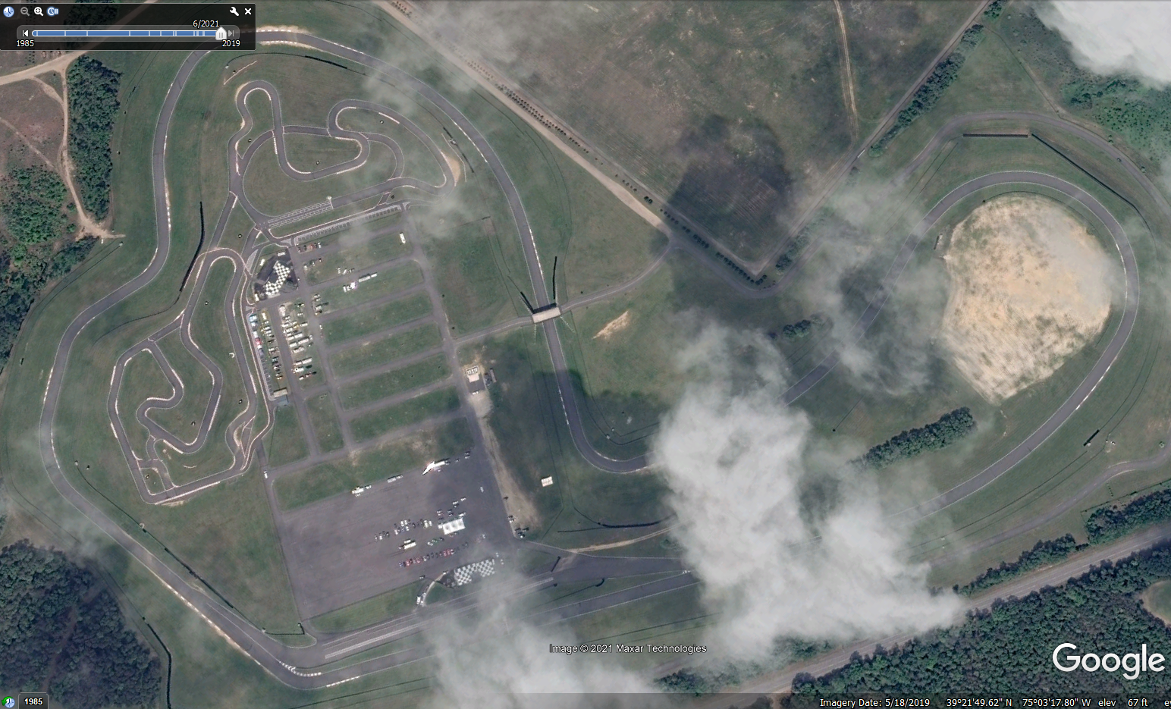

Slide 3
Preliminary Preparation
Always take a quick walk around the car to make sure everything looks right before getting in. Check lug nut, hood pins, wing, etc.
Once up to the grid, take 30 seconds to relax, and run a quick lap in your head. Always check brake pedal travel and steering wheel before rolling into the hot pit.
40mph on Pit Lane, controlled entry into the "chute" and out on track.
First lap is always a sighting lap, drive a perfect line at reduced speed. The goal here is to identify any issues with the track or the car before coming up to speed. You should start your hot laps about 1/2-3/4 through your second lap.
Work on consistency. You should be in exactly the same place at every entry and exit if traffic allows. This is easy to critique in your videos.
Test your brakes around start/finish!
Crisp, committed wheel inputs.

Slide 4
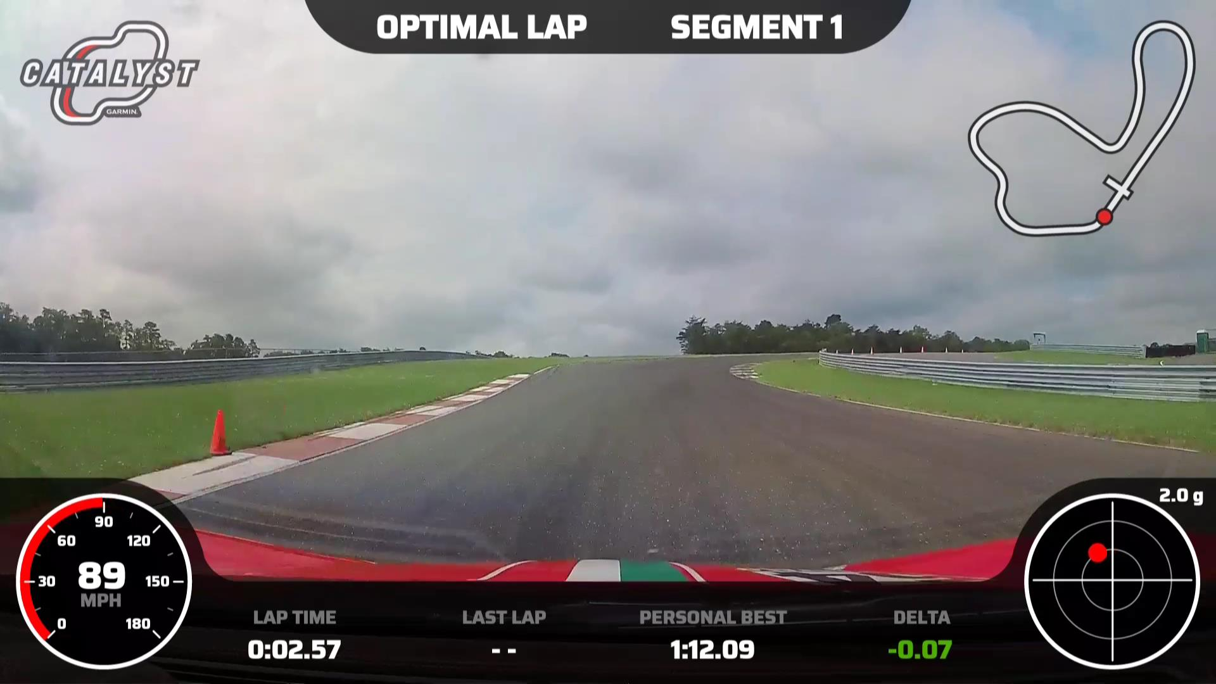
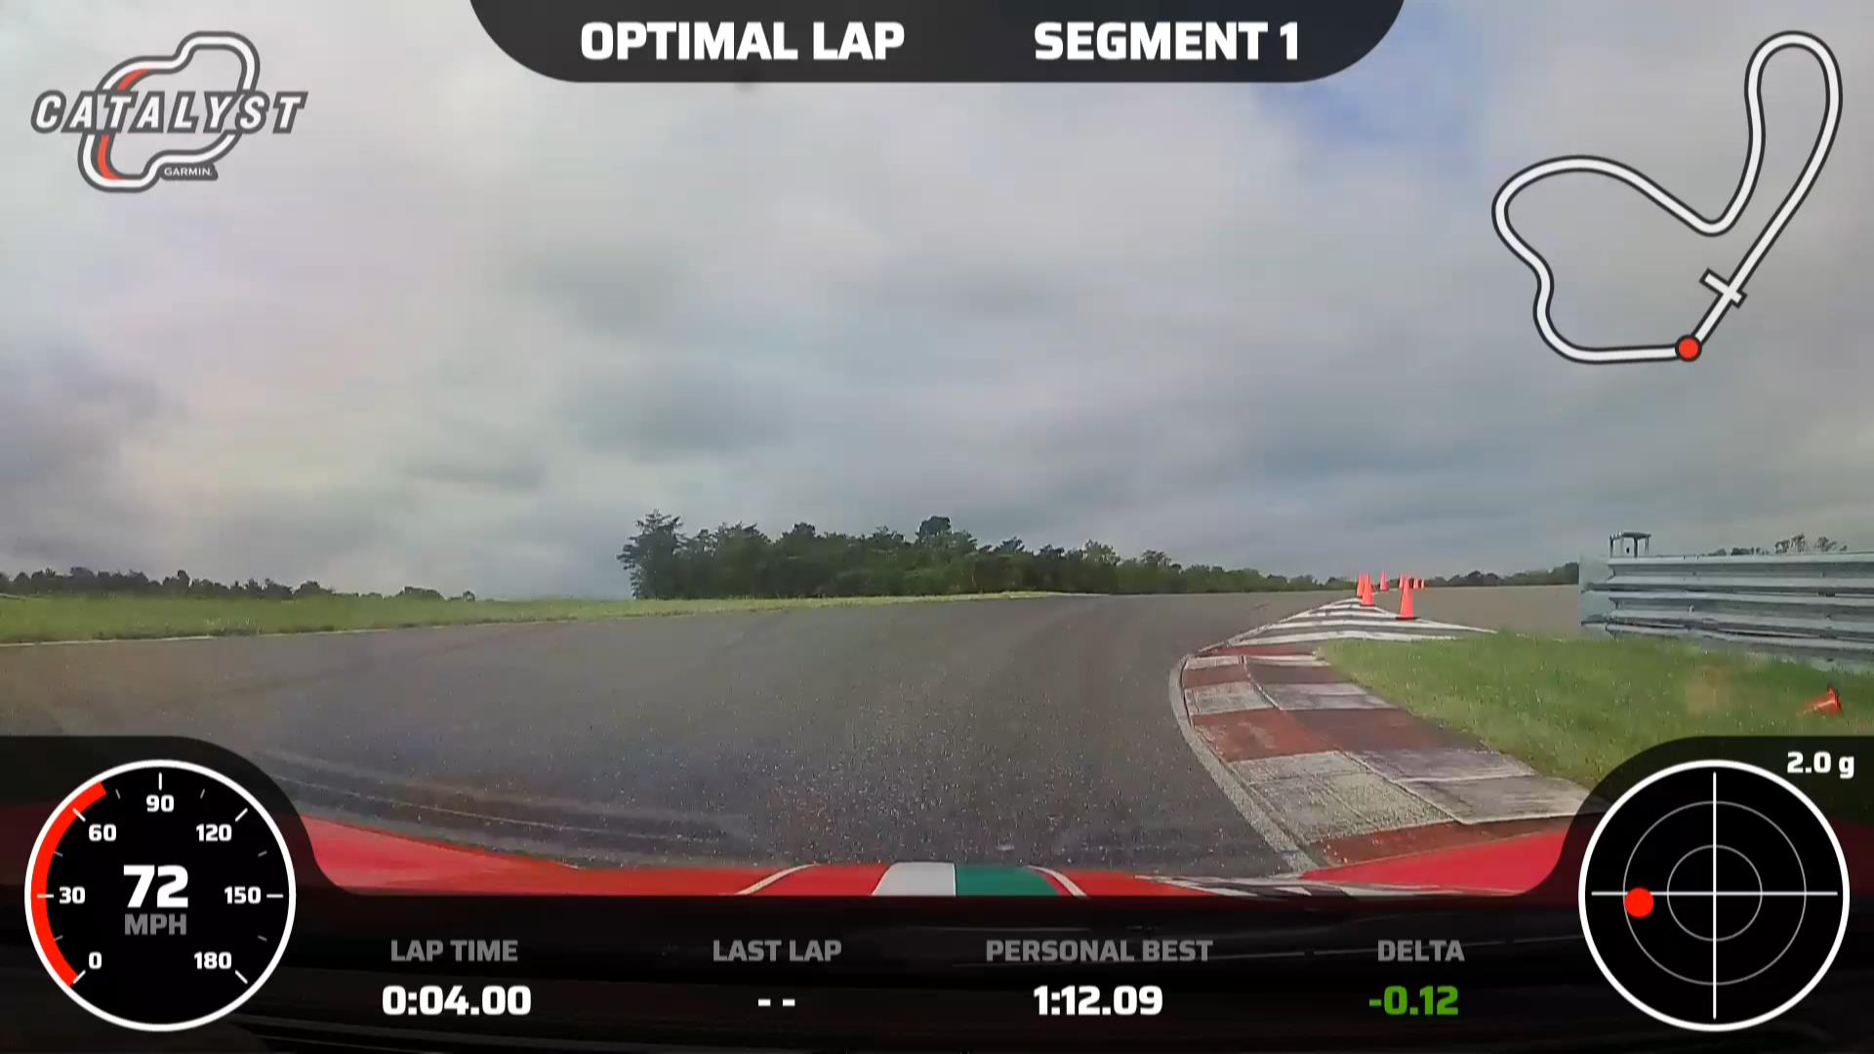
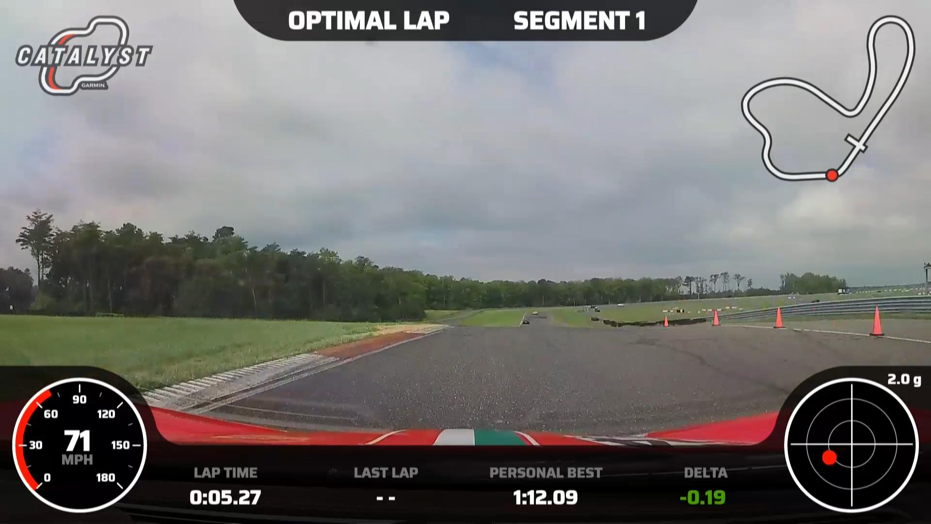
T1:
Far left into the brake zone.
Tight apex no curb.
Reduce steering angle over the top of the crest.
Track out far left.

Slide 5
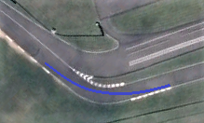

Slide 6
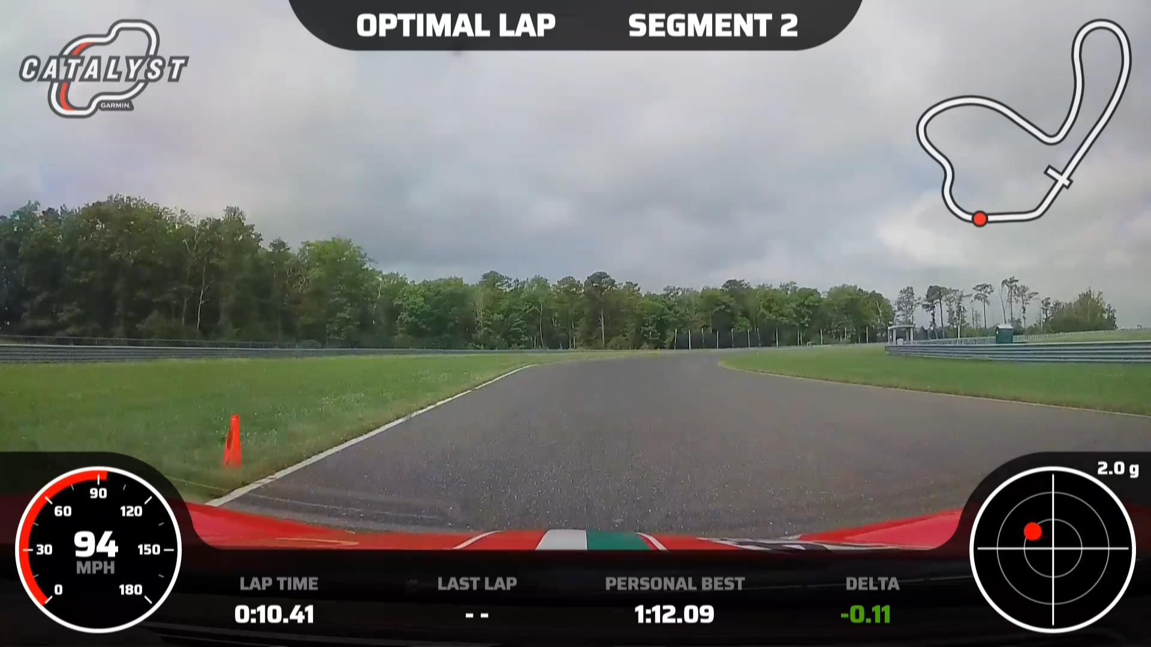
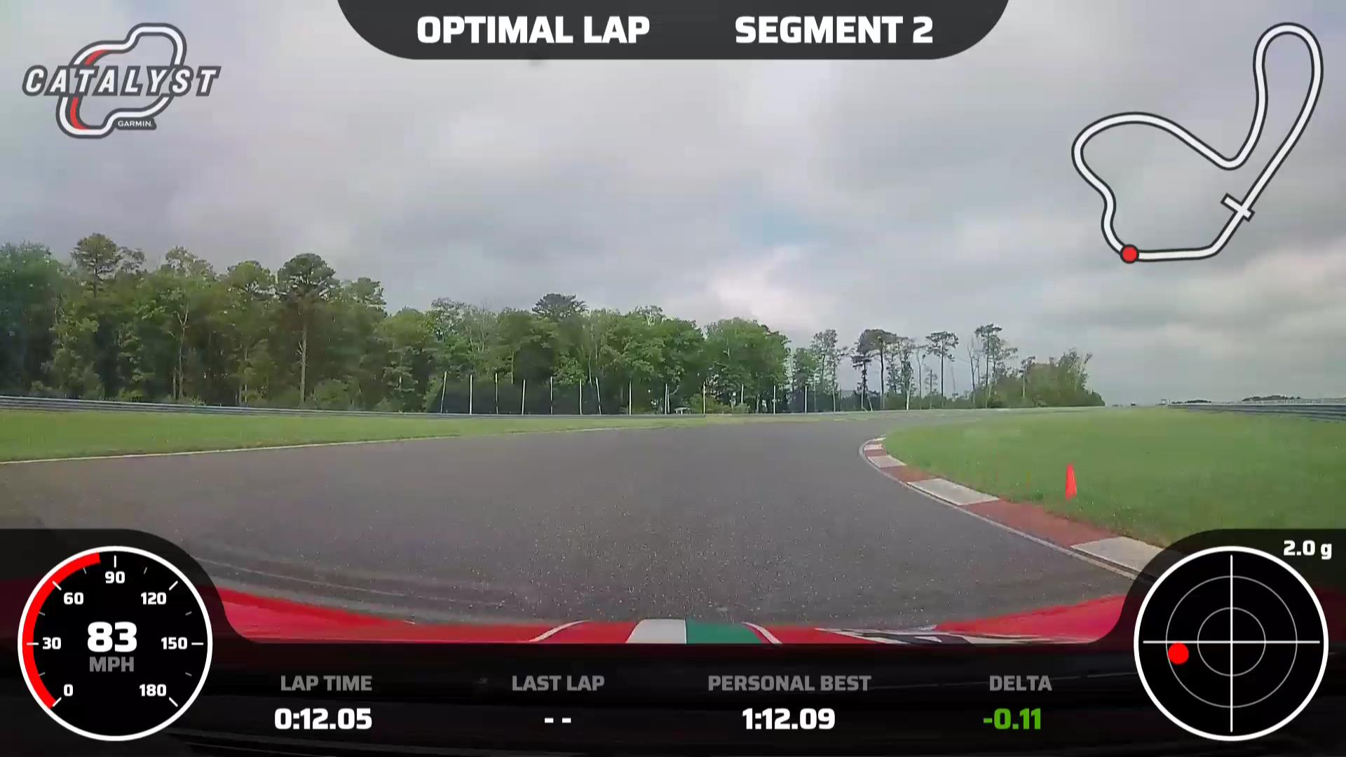
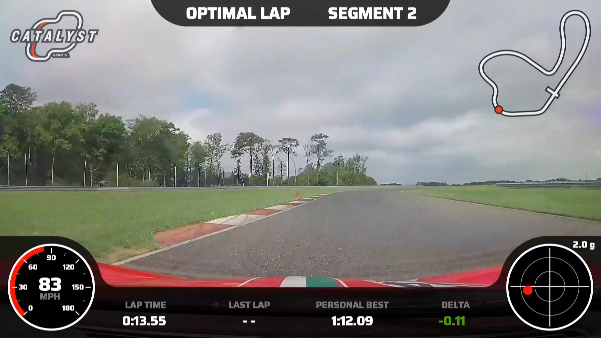
T2:
Light braking
No apex
Exit to start of T3 entry curbing

Slide 7
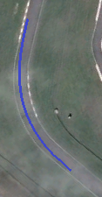

Slide 8
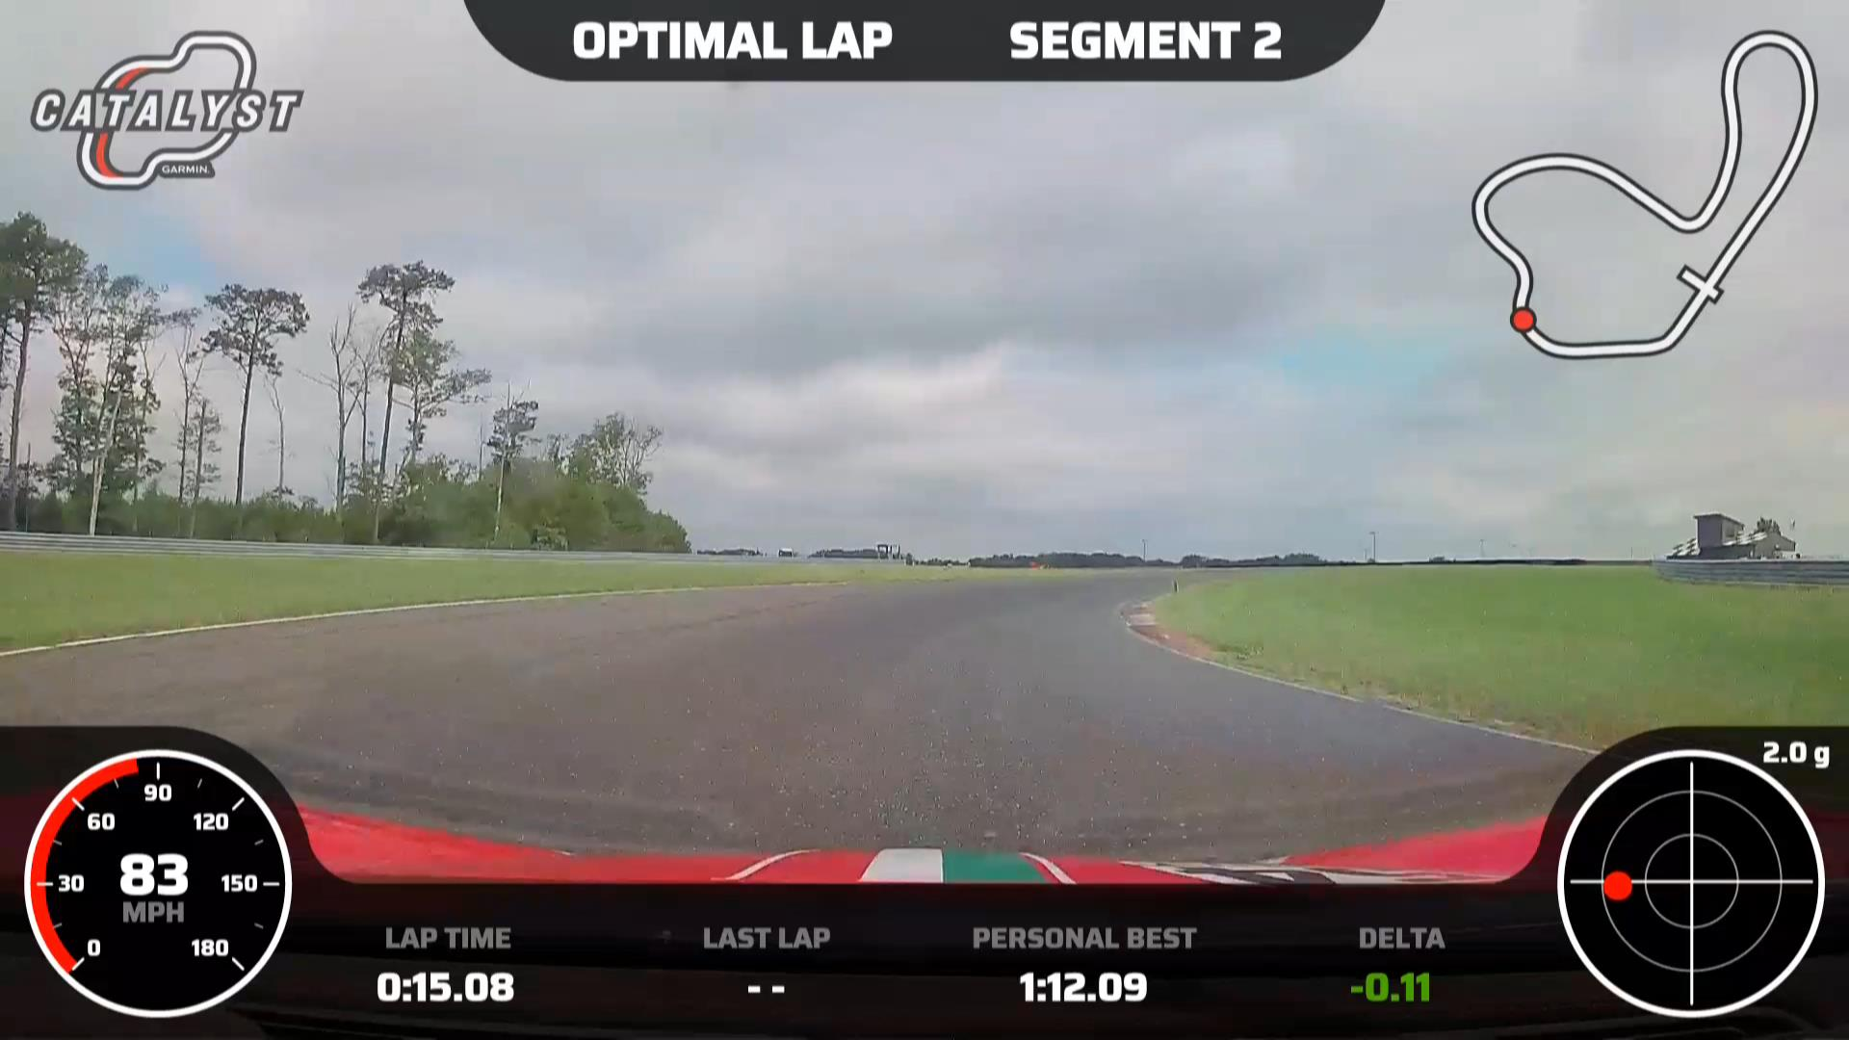
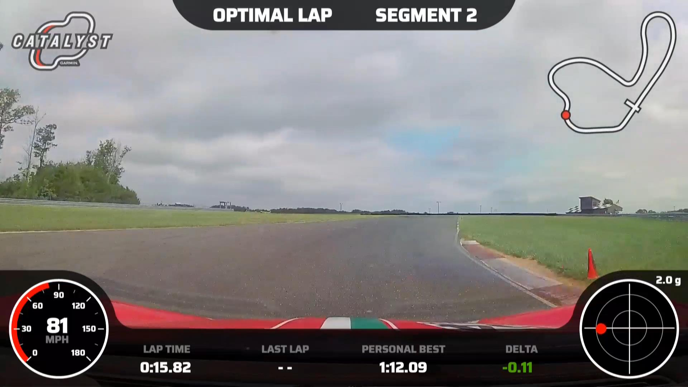
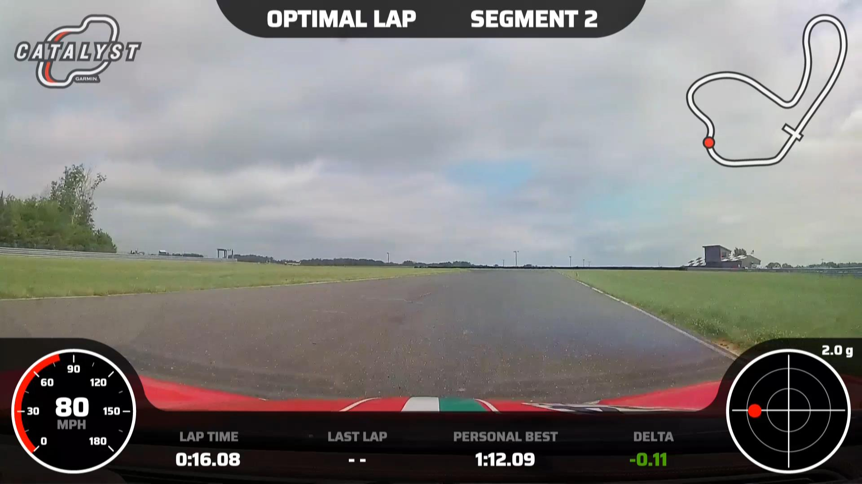
T3:
Tight Apex
Track right for T4
Fast transition into T4
Carry speed from T3 entry thru T4

Slide 9
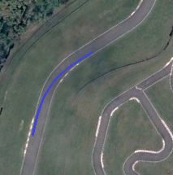

Slide 10
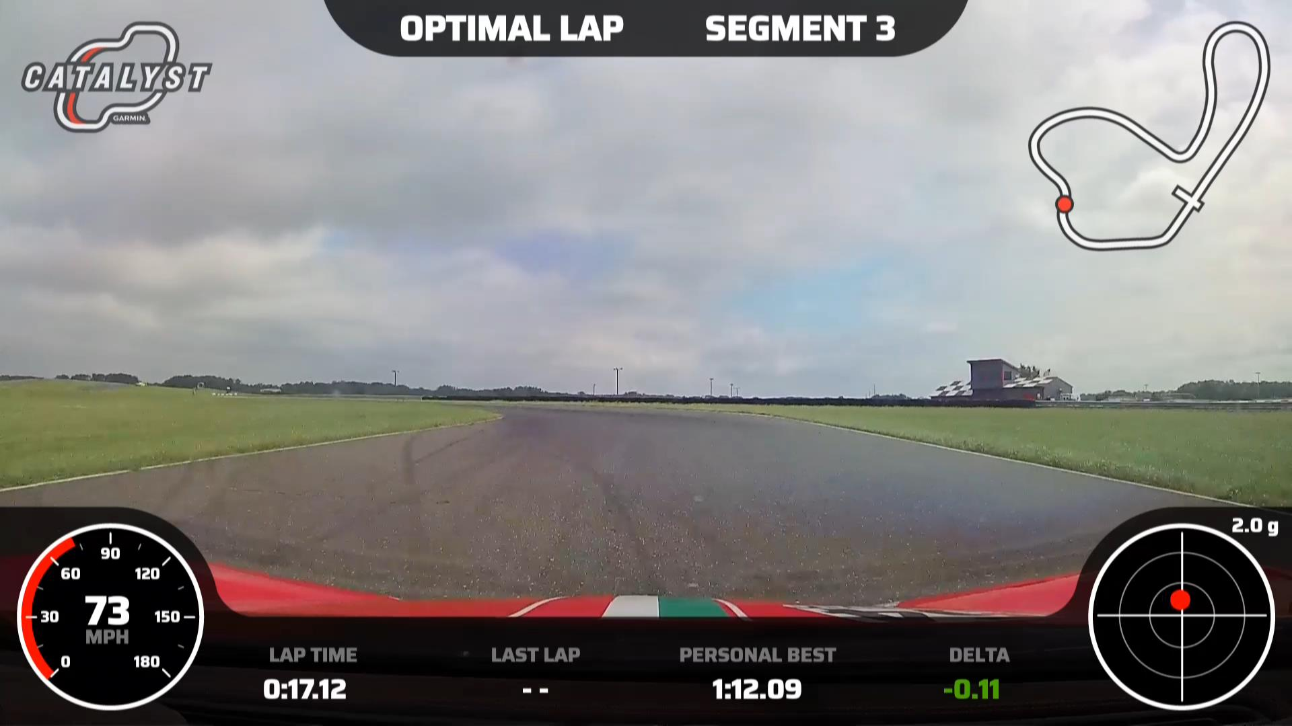
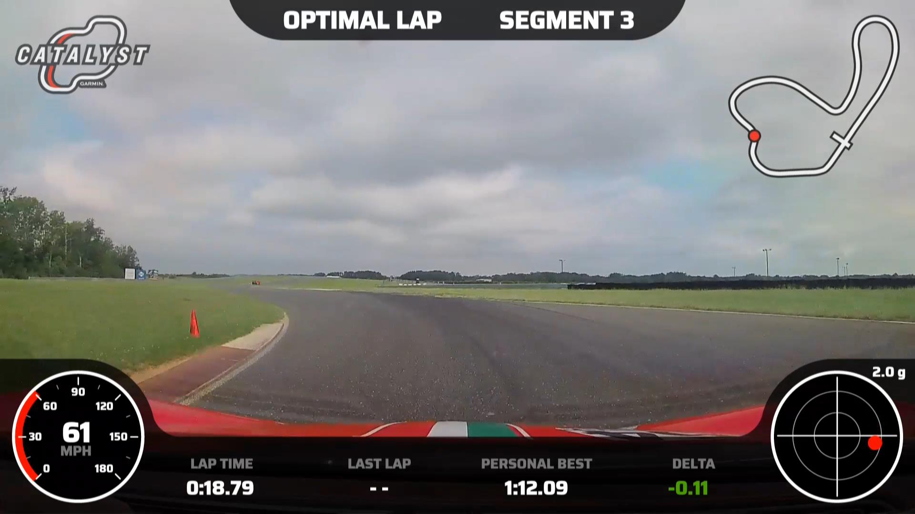
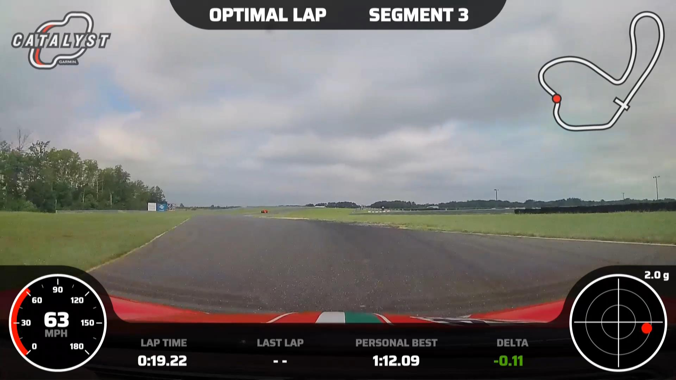
T4:
Tight apex
Then straight and throttle to T5 entry cone.

Slide 11
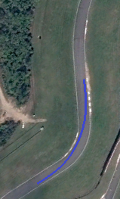

Slide 12
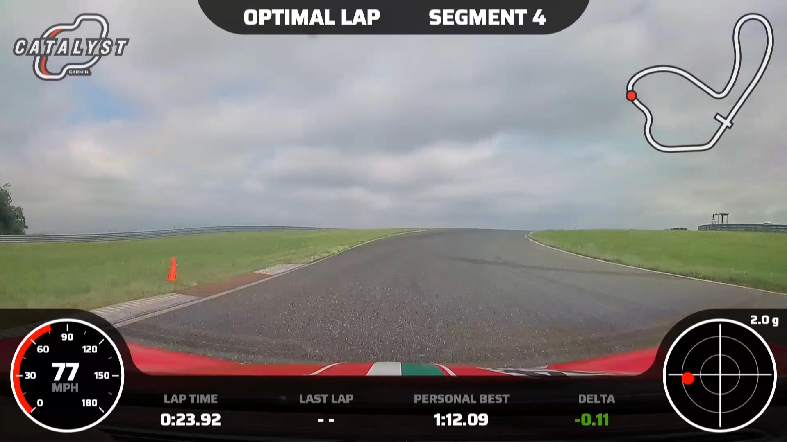
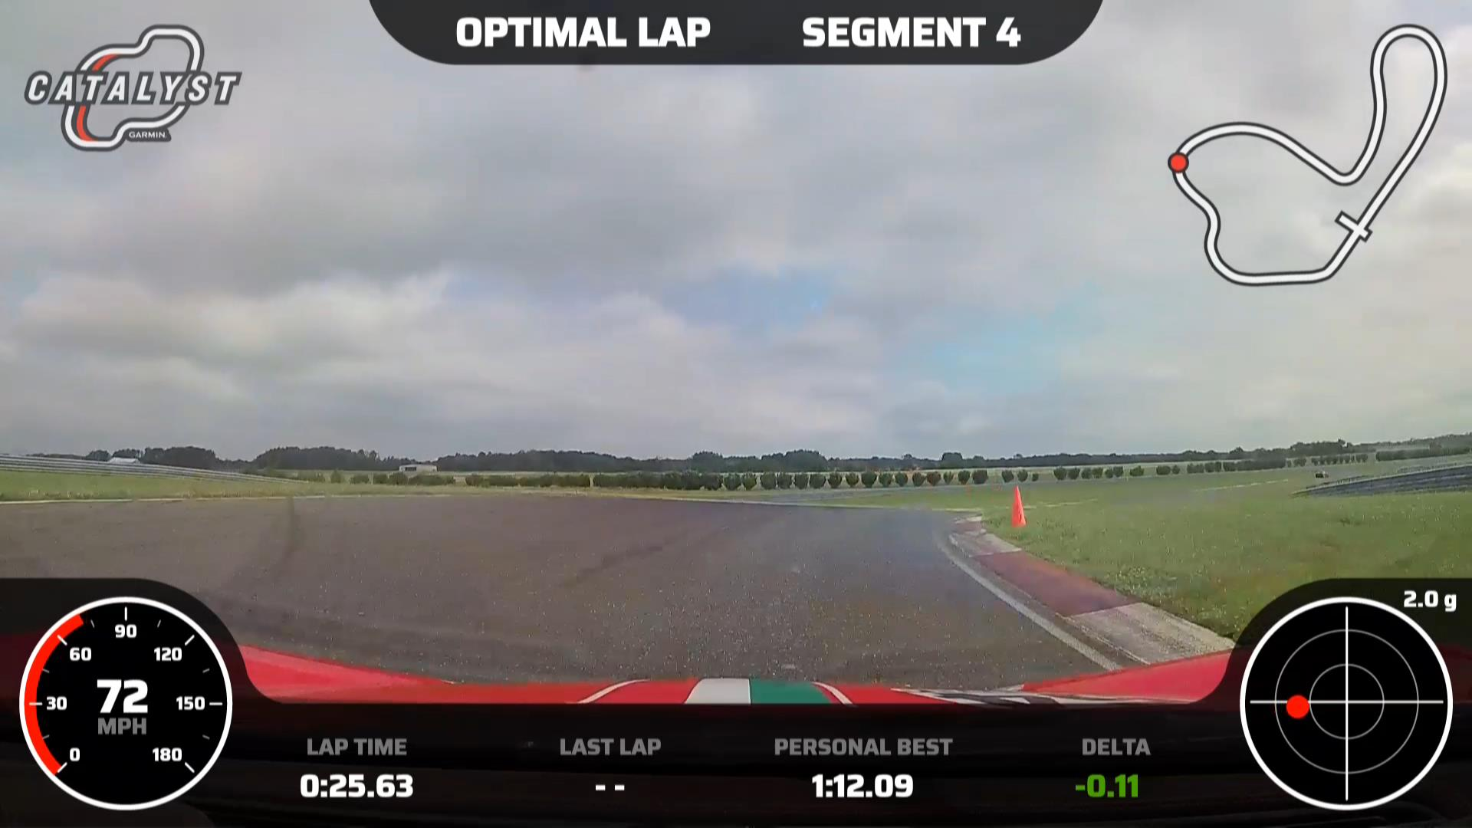
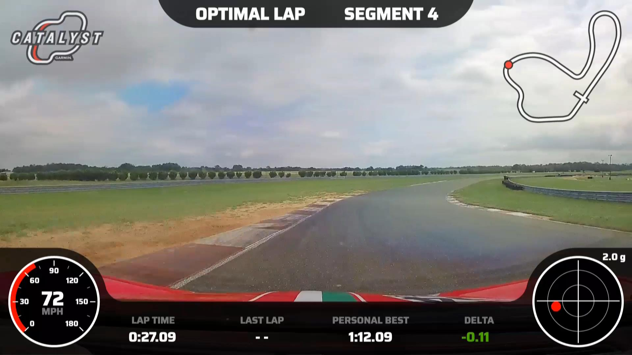
T5:
Aggressive braking and turn in on uphill
Tight apex
Reduce steering over the top of crest
Then smooth throttle application to track out

Slide 13
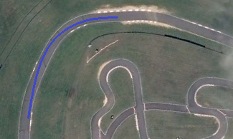

Slide 14
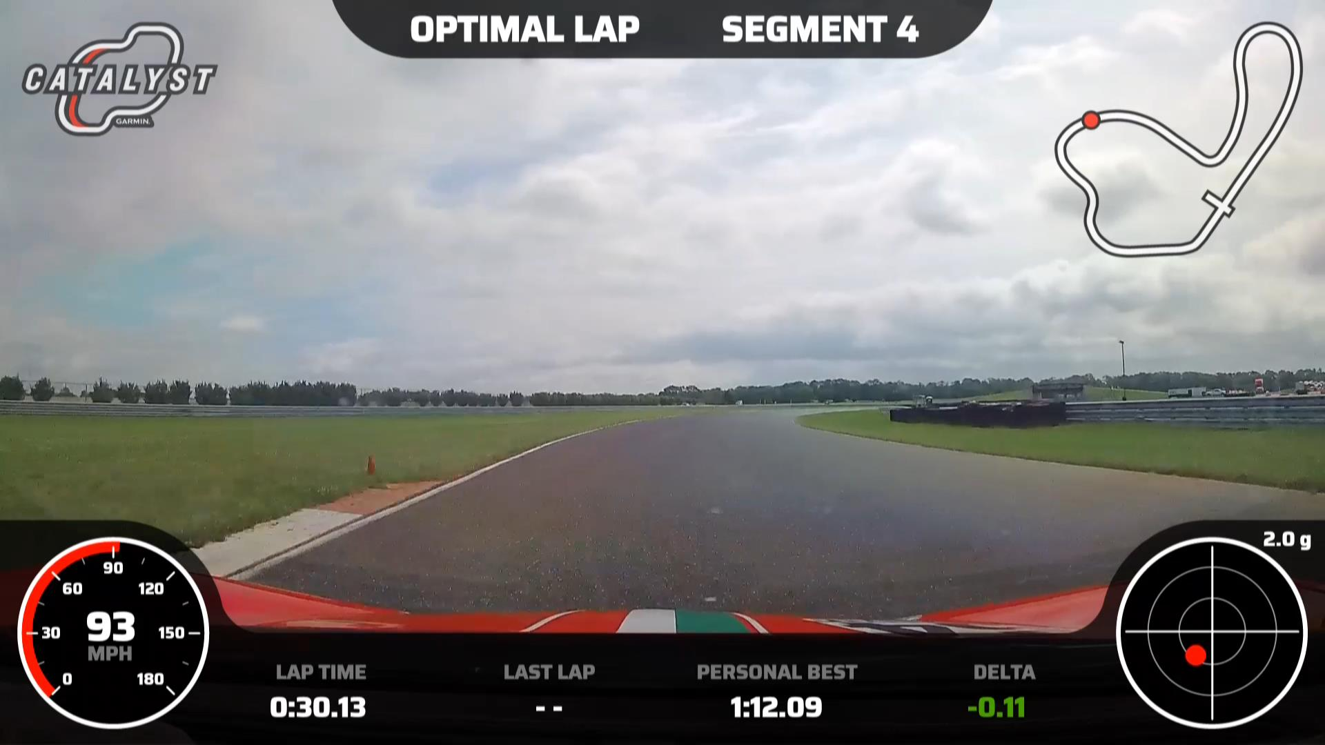
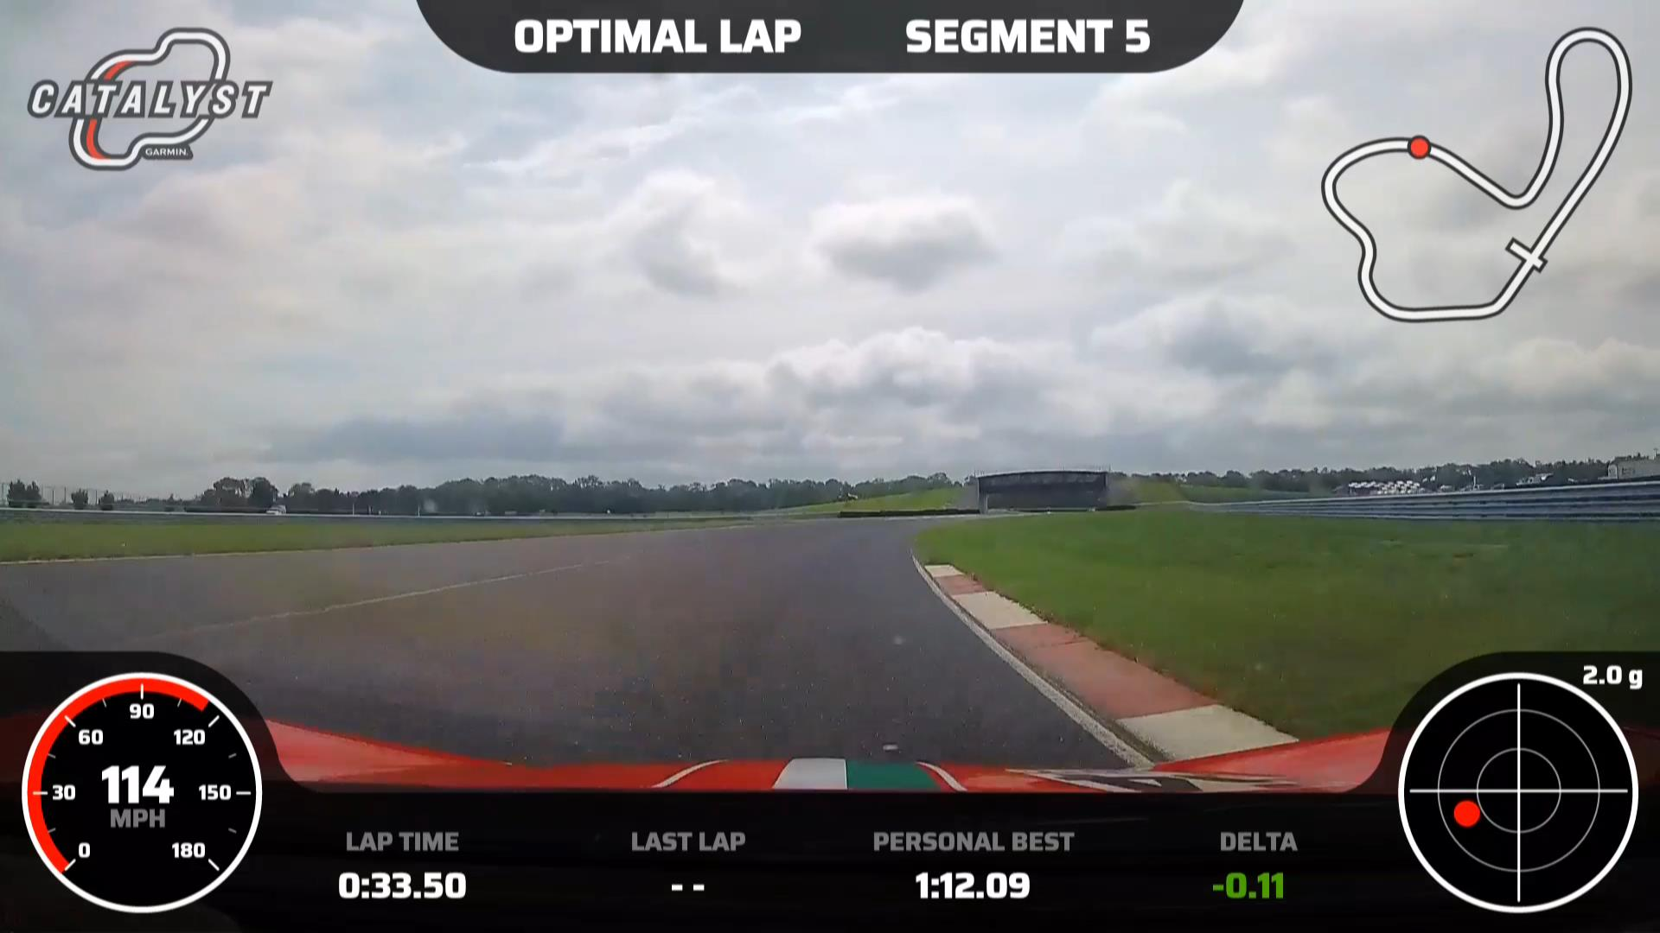
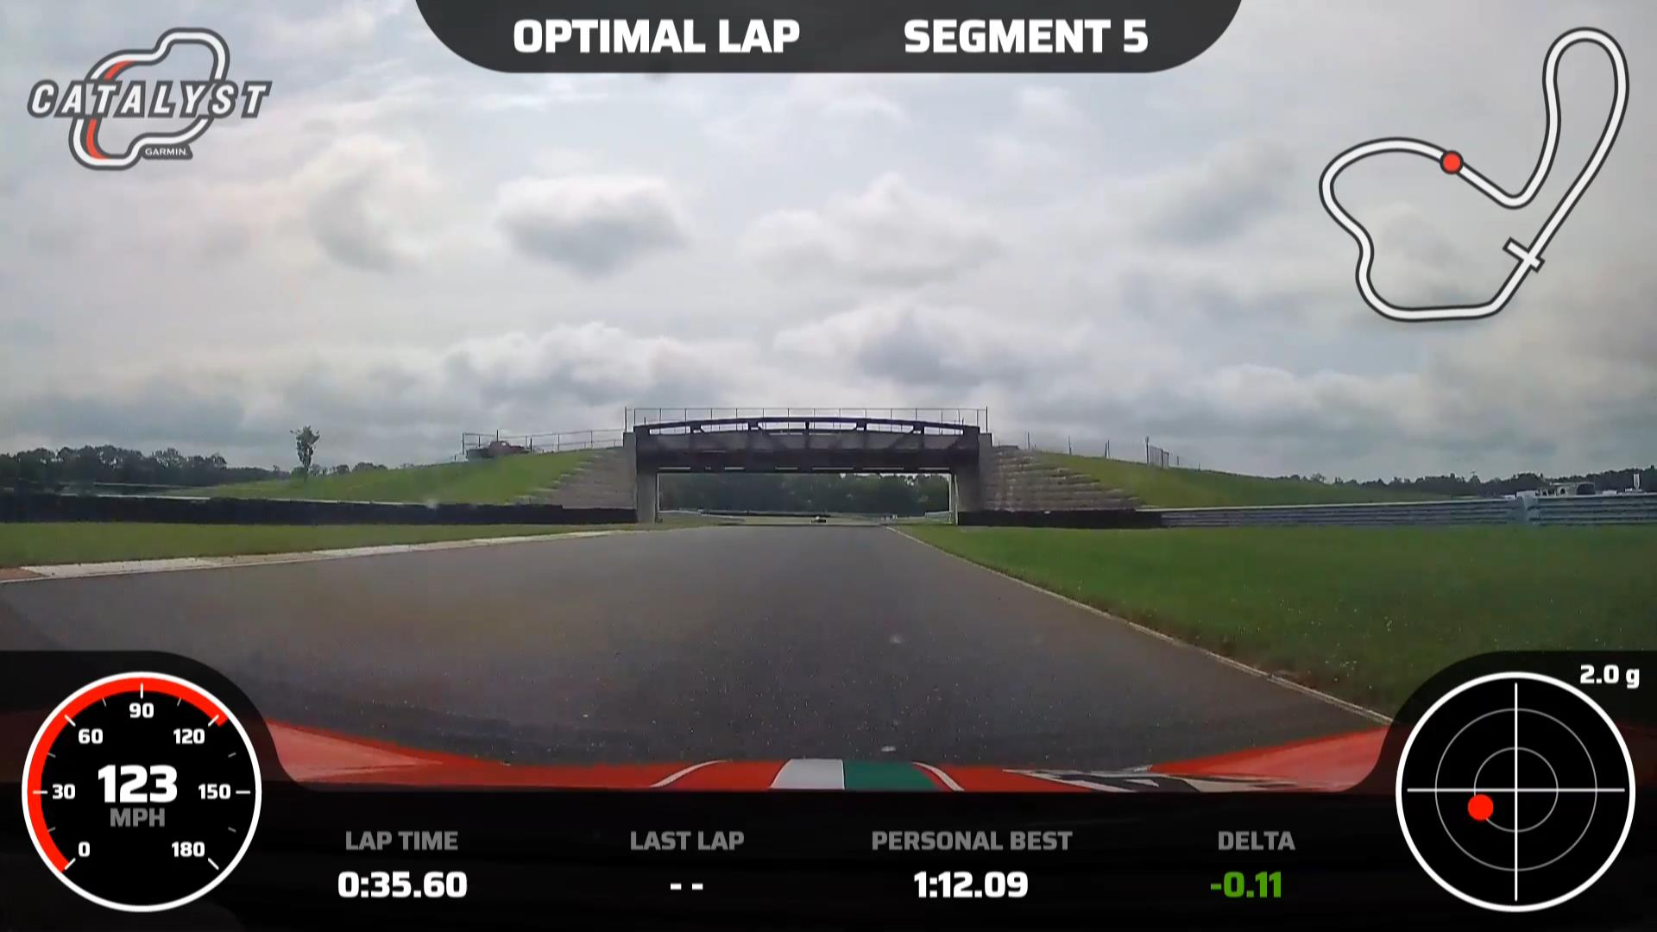
T6:
From T5 track out, back to right side of track
Give as much throttle as the car will take
Don’t rush the move back to the right, let the car drift right under throttle

Slide 15
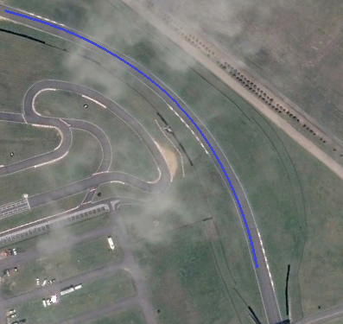

Slide 16
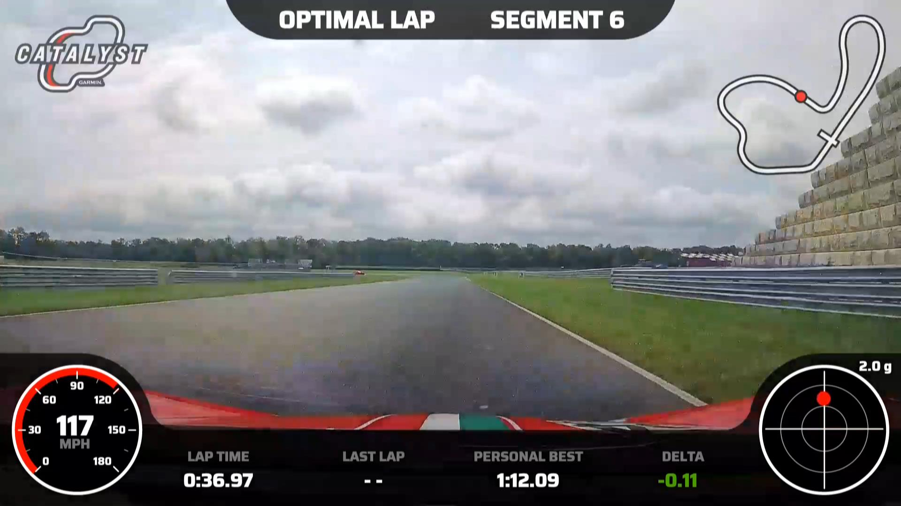
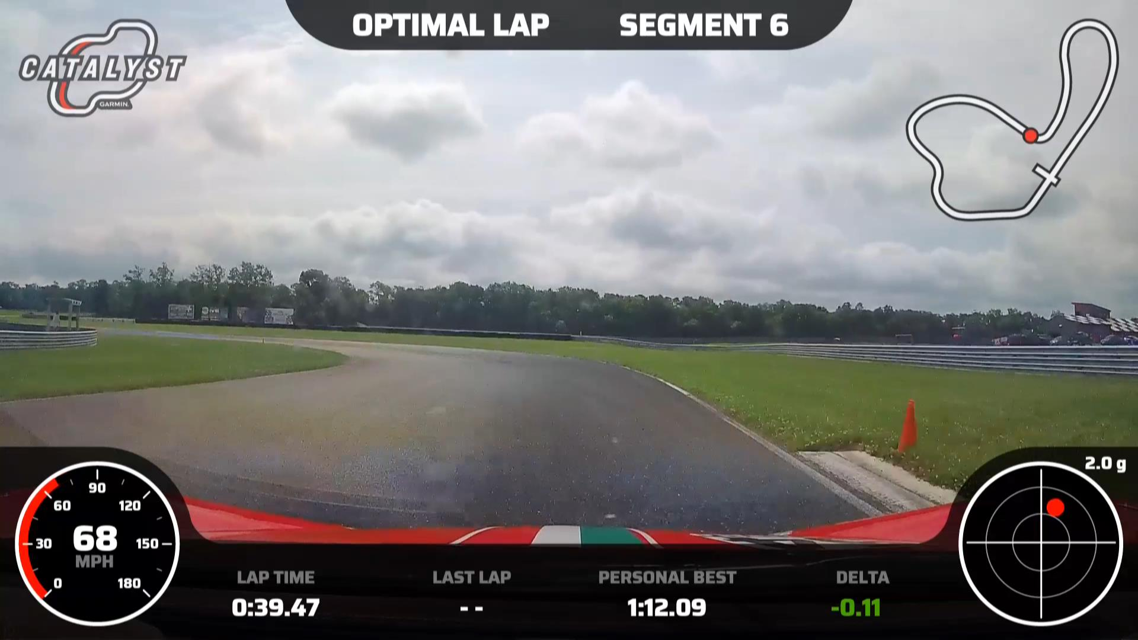
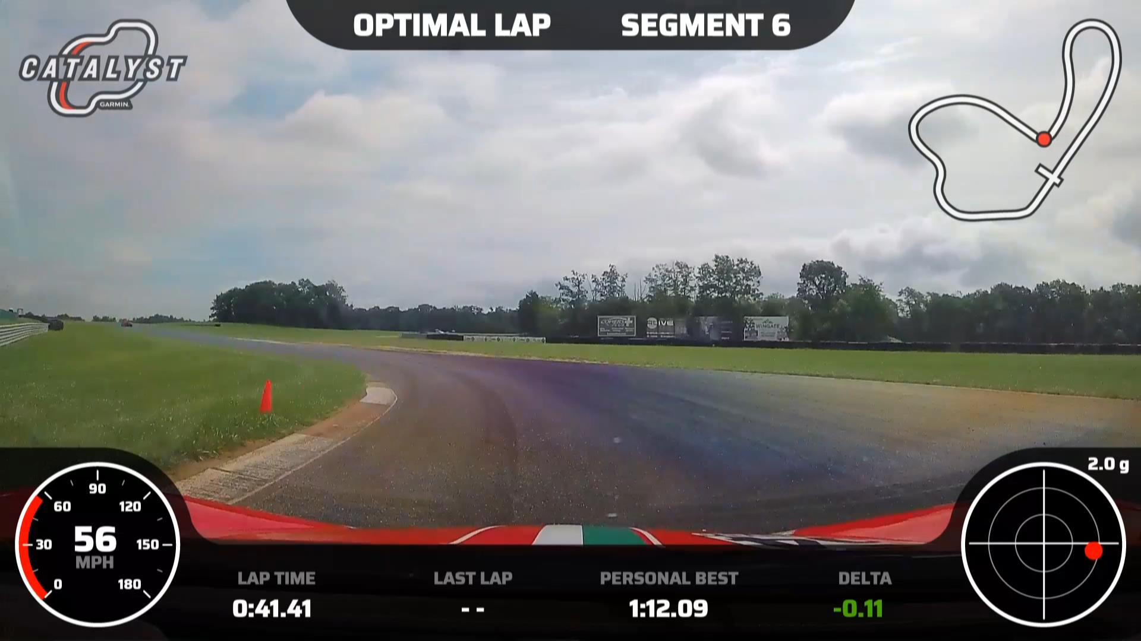
T7:
Heavy braking just past the bridge
Caution on right entry strip as it can pull you hard right
Tight apex
Smooth throttle

Slide 17
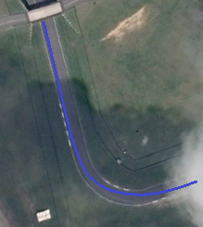

Slide 18
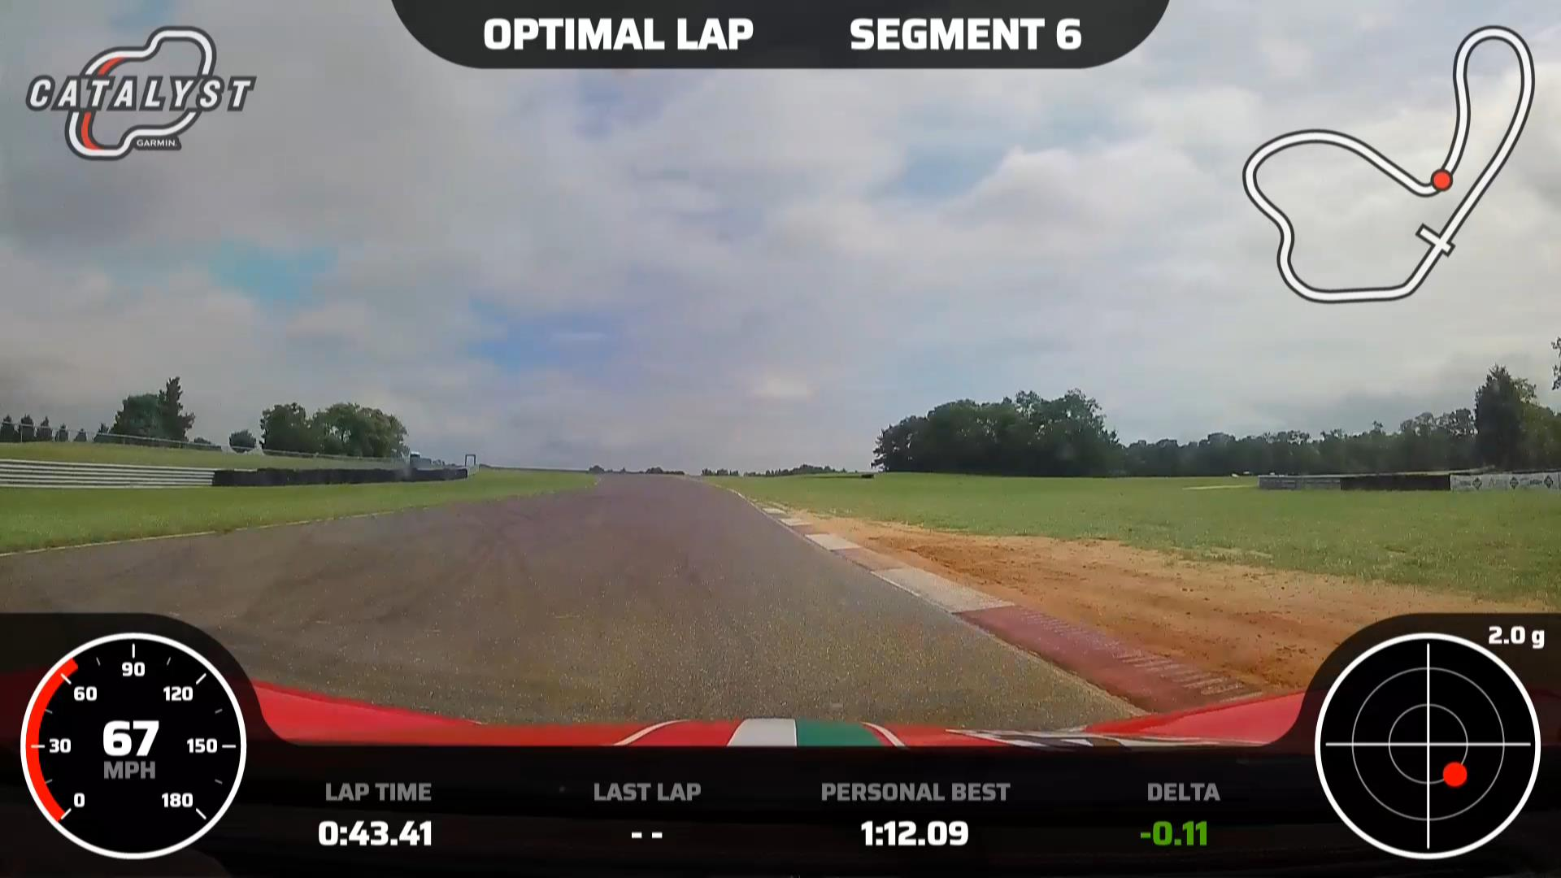
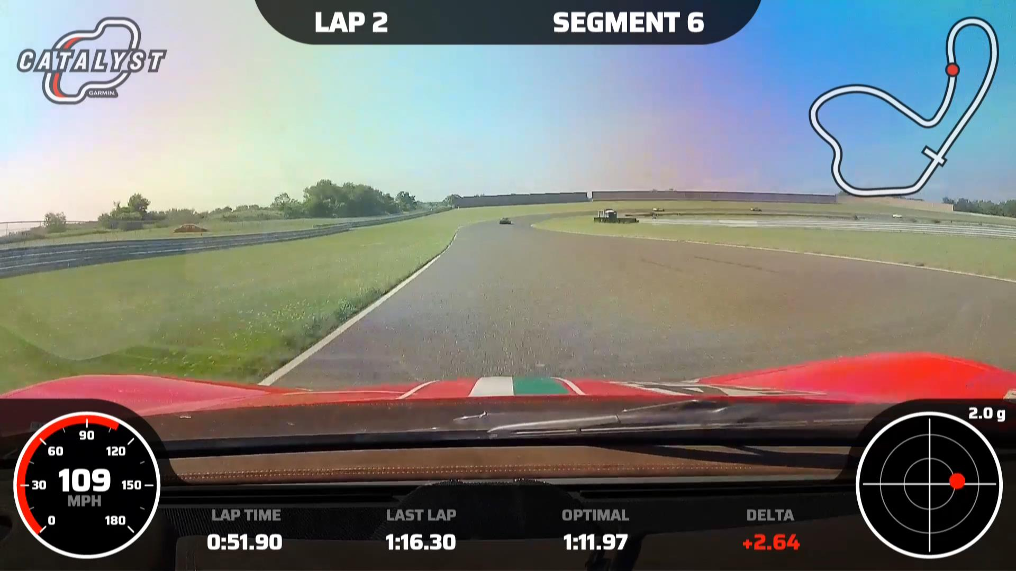
T8:
From T7 track out to dirt
Full throttle
Track left over hill

Slide 19
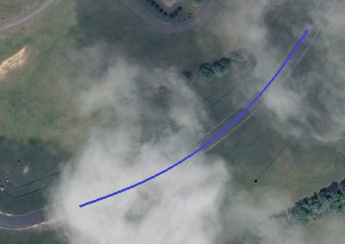

Slide 20
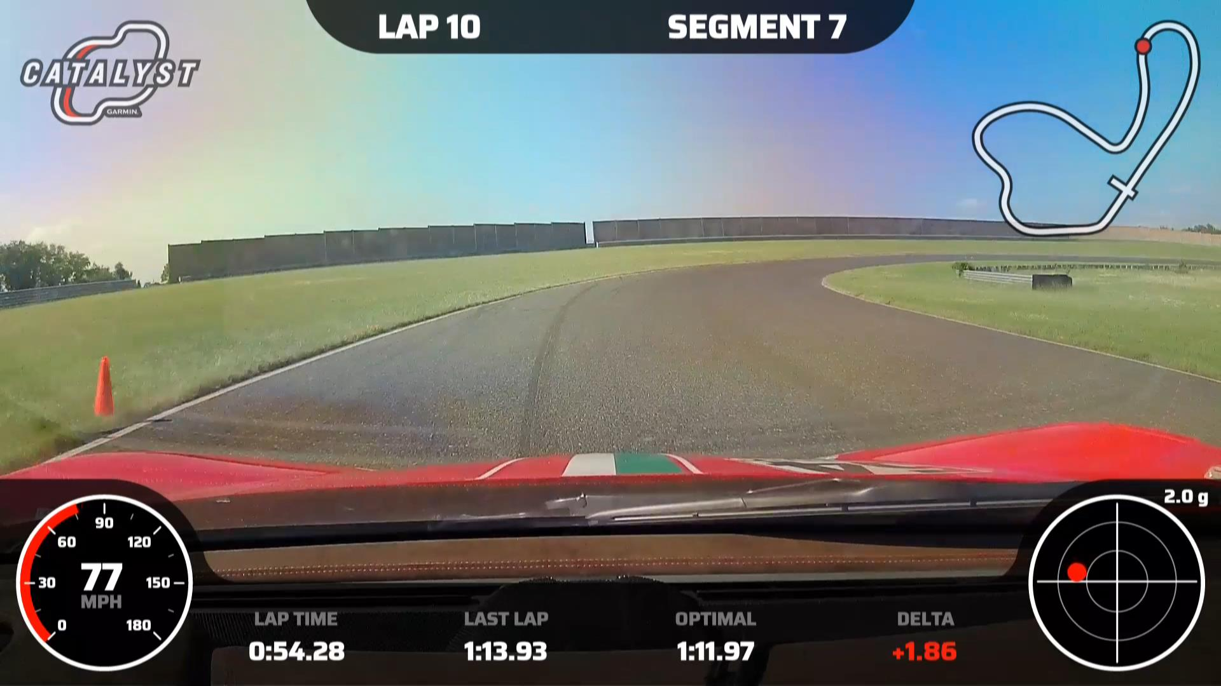
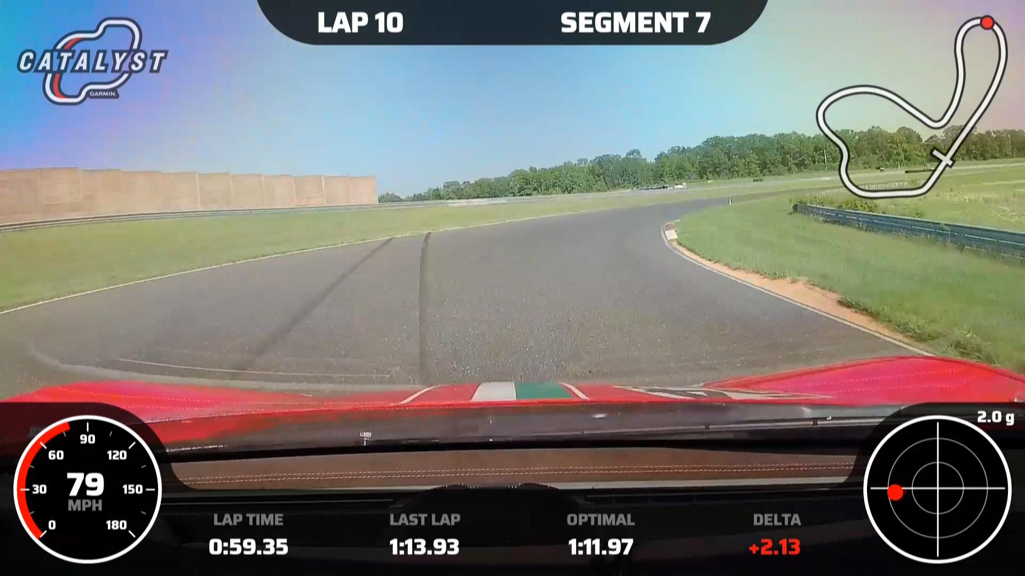
T9:
Wide left, last minute entry
Aggressive turn in at the white bar just before the cone
Upper-mid track in the bowl
Maintain smooth throttle control

Slide 21
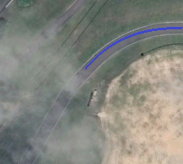

Slide 22
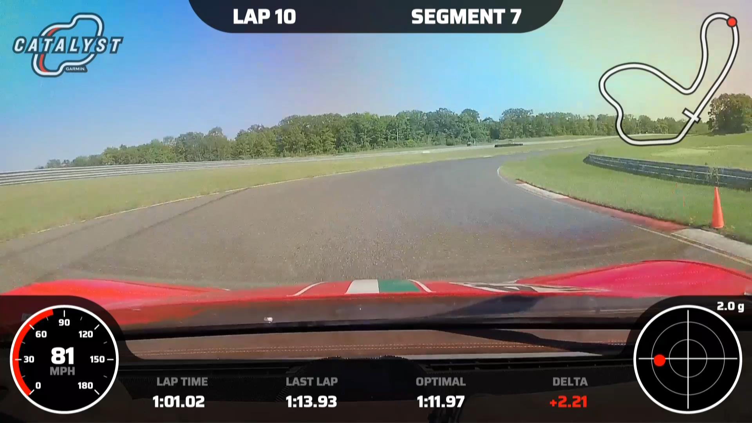
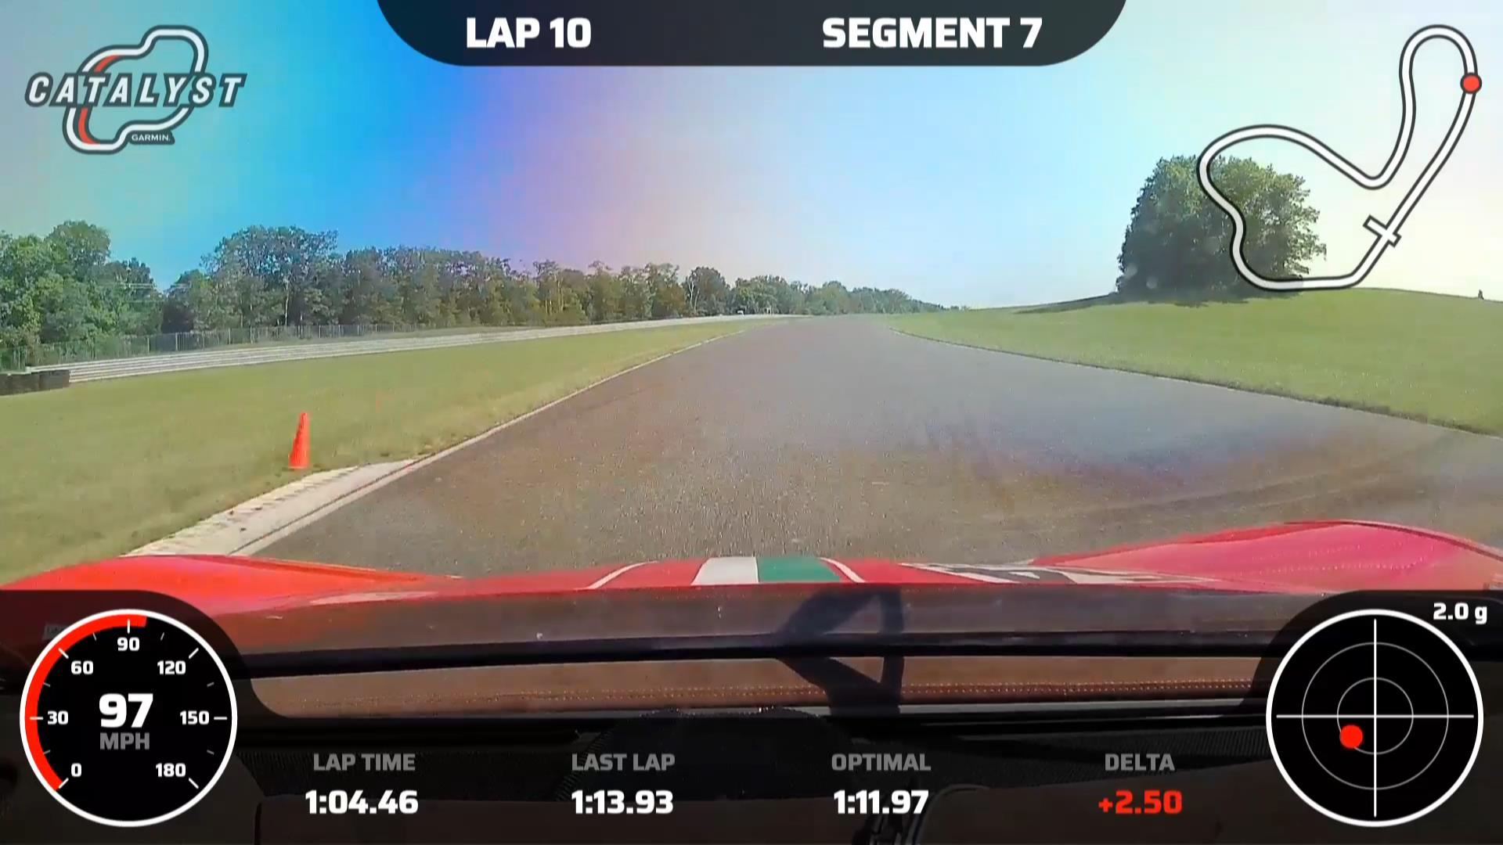
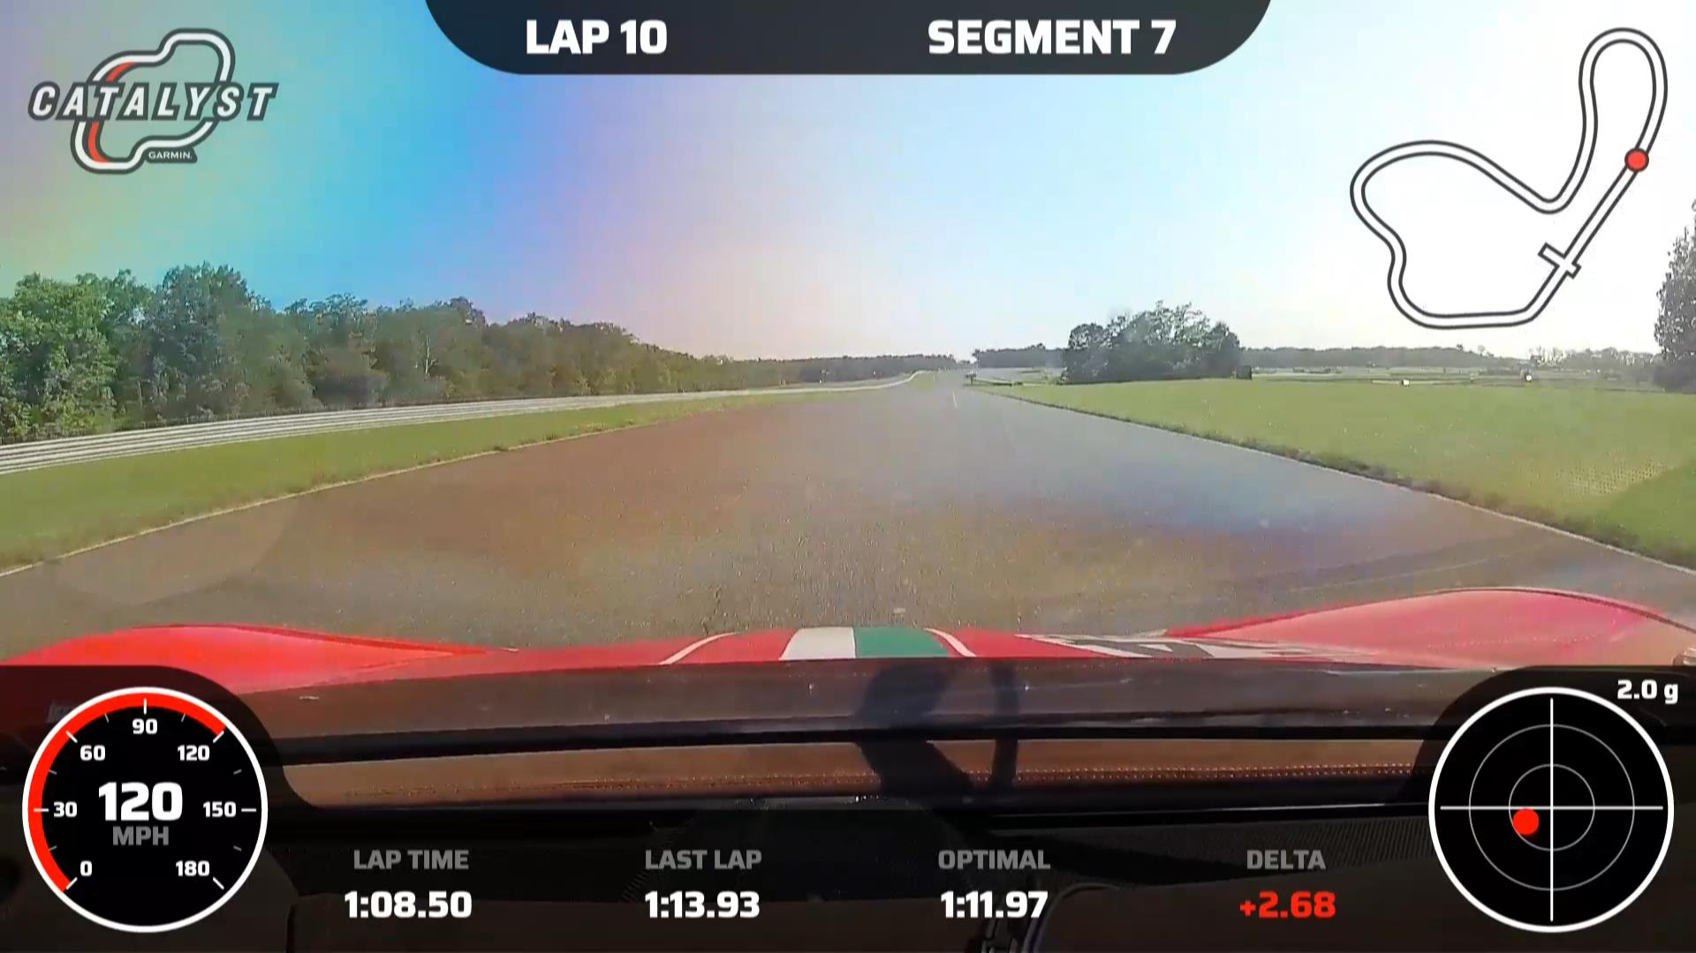
T10:
Upper-mid track until you can just about line up the culvert with the exit cone
Tight apex, then wide track out
Move right as you crest the hill onto the front straight
Test brakes before braking zone for T1

Slide 23
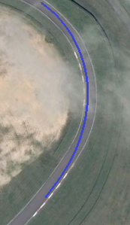

Slide 24
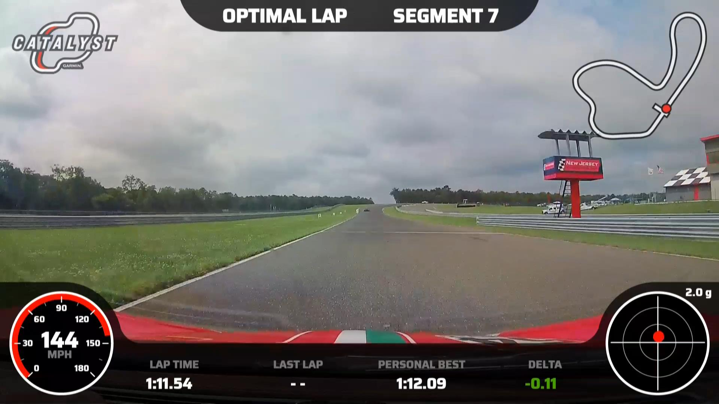
Start/Finish

Slide 25
