Slide 1
PMCF study in Czech Republic
Ongoing study using JETT PLASMA LIFT MEDICAL (with Plasma Pen) with silver applicator diameter 3 mm
Intended for mild to moderate dry eye disease
OSDI index before and after treatment is measured as an end-point
Follow up: 4 treatments once a week, and check-ups 1 week, 4 weeks and 12 weeks after the last treatment

Slide 2
Initial results – active treatment
Patient number | Age | Sex | OSDI index before treatment | OSDI index after 2nd treatment | OSDI index 1 week after last treatment | Pain score of treatment
1 | 45 | M | 21 | 9 | 9 | No pain
2 | 71 | F | 16 | 6 | 7 | No pain
3 | 76 | M | 23 | 11 | 10 | Little pain
4 | 76 | F | 21 | 12 | 11 | No pain
5 | 74 | F | 31 | 23 | 11 | No pain
6 | 81 | M | 30 | 23 | 11 | Little pain
7 | 88 | M | 32 | 25 | 22 | No pain
8 | 71 | F | 29 | 23 | 17 | No pain
9 | 62 | M | 34 | 28 | 20 | Little pain
10 | 73 | M | 29 | 18 | 16 | Little pain
11 | 77 | F | 25 | 20 | 18 | No pain
12 | 64 | F | 19 | 12 | 8 | No pain

Slide 3
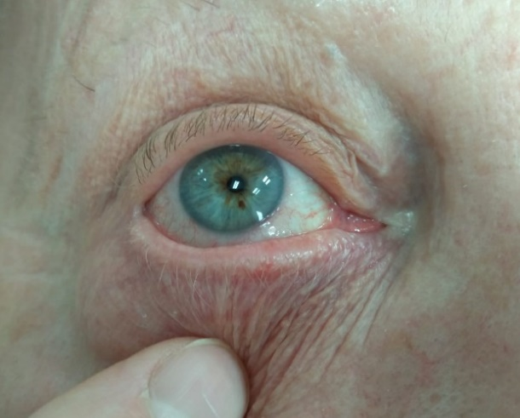
Photos – Patient no. 6
Before treatment 1 week after last treatment

Slide 4
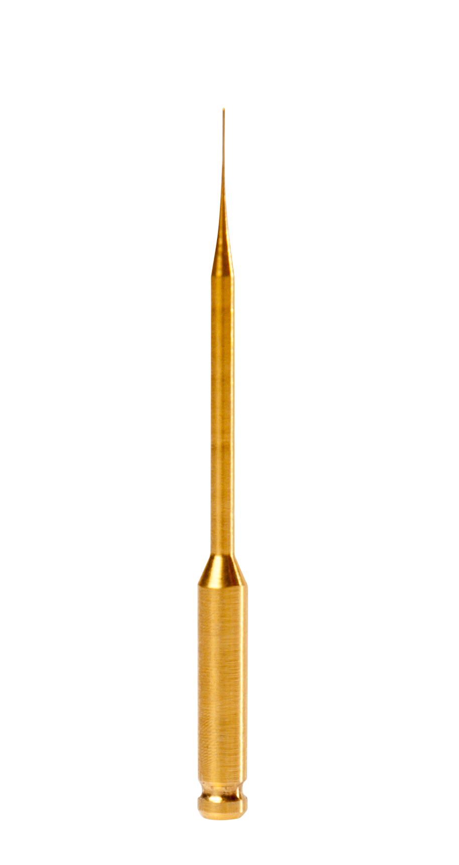
Treatment using golden applicators
Intended for moderate to severe dry eye disease
A case report results measured using the OCULUS Keratograph
EYE Left/Right | PRE-EXAMINATION | PRE-EXAMINATION | 7 DAYS AFTER | 14 DAYS AFTER | MONTH AFTER
BUT- tear film decay, total average
R | 12,55 |  | 17,96 | 14,79 | 18,11
L | 13,38 |  | 10,33 | 16,55 | 15,31
BUT - tear film decay, average
R | 5,71 |  | 7,98 | 6,73 | 8,94
L | 5,27 |  | 2,84 | 8,76 | 8,41
Lipid layer - thickness (the higher the better)
R | 13-15 |  | 30-50 | 30-50 | 50-80
L | 13-15 |  | 30-50 | 30-50 | 30-50

