Slide 1
Temptation

Slide 2
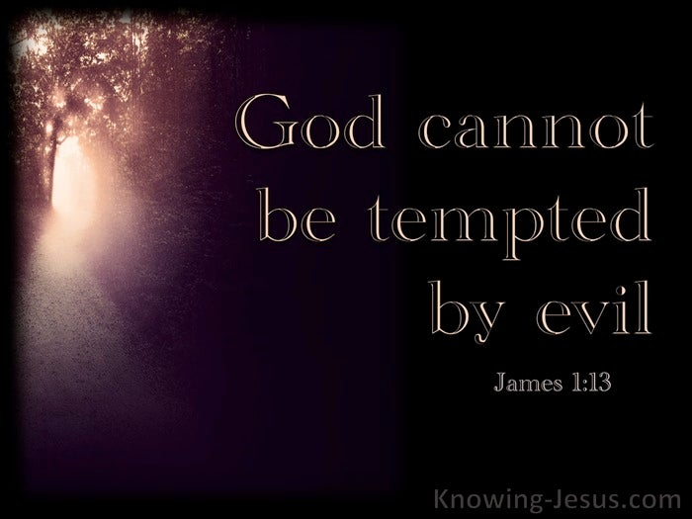
The Need for Holiness

Slide 3
Live to Please God 1 Thessalonians 4:1-8
1Furthermore then we beseech you, brethren, and exhort you by the Lord Jesus, that as ye have received of us how ye ought to walk and to please God, so ye would abound more and more. 2For ye know what commandments we gave you by the Lord Jesus. 3For this is the will of God, even your sanctification, that ye should abstain from fornication: 4That every one of you should know how to possess his vessel in sanctification and honour; 5Not in the lust of concupiscence, even as the Gentiles which know not God: 6That no man go beyond and defraud his brother in any matter: because that the Lord is the avenger of all such, as we also have forewarned you and testified. 7For God hath not called us unto uncleanness, but unto holiness. 8He therefore that despiseth, despiseth not man, but God, who hath also given unto us his holy Spirit.

Slide 4
Life is filled with Temptations.
Thankfully God promises to forgive when we confess it.
However, focusing on confession of sin instead of purity from sin is dangerous.
Ungodliness is like getting close to a wild animal to see if it will attack, rather than staying far away from it.
God desires for us to first of all, that we sin not.
1 John 2:1
Let’s work on making that a reality.

Slide 5
Understanding Temptations
The scriptures speak of two different kinds of temptation. Both are address in James 1. 1st in vv2-5 2nd in vv12-15
James 1:2-5
2My brethren, count it all joy when ye fall into divers temptations; 3Knowing this, that the trying of your faith worketh patience. 4But let patience have her perfect work, that ye may be perfect and entire, wanting nothing.
5If any of you lack wisdom, let him ask of God, that giveth to all men liberally, and upbraideth/reproaches not; and it shall be given him.

Slide 6
trying is define trails
1 Peter 1:6-7 Wherein ye greatly rejoice, though now for a season, if need be, ye are in heaviness through manifold temptations: 7That the trial/temptation of your faith, being much more precious than of gold that perisheth, though it be tried with fire, might be found unto praise and honour and glory at the appearing of Jesus Christ
This is everyday struggle and challenges:
When we love God in the struggles – God gives great rejoicing to us!
When we love God in everything – God is Praised, honored and glorified is us!

Slide 7
Good News from heaven

Slide 8
the second kind of temptaion
James 1:12-15
Blessed is the man that endureth temptation: for when he is tried, he shall receive the crown of life, which the Lord hath promised to them that love him.
13Let no man say when he is tempted, I am tempted of God: for God cannot be tempted with evil, neither tempteth he any man: 14But every man is tempted, when he is drawn away of his own lust, and enticed. 15Then when lust hath conceived, it bringeth forth sin: and sin, when it is finished, bringeth forth death.

Slide 9
Enticed: literally means bait This is everyday sinful baits

Slide 10
Both Kind of Temptations in scripture are use as tests intended to prove and improve one’s character.
Can you clearly differentiate between the two types of temptations?
For centuries people have discussed a perplexing question:
Why would God allow temptation? God could create people without sin.
1. Temptations offers a test of love.
2. There can be no genuine love without the freedom to choose.
Psalms 97:10Ye that love the LORD, hate evil: he preserveth the souls of his saints; he delivereth them out of the hand of the wicked.

Slide 11
A recent survey of Discipleship Journal readers ranked areas of greatest spiritual challenge to them:
1. Materialism. 2. Pride. 3. Self-centeredness. 4. Laziness. | 5. (Tie) Anger/Bitterness. 5. (Tie) Sensual lust. 7. Envy. 8. Gluttony. 9. Lying.

Slide 12
Survey respondents noted temptations were more potent when they had neglected their time with God (81 percent)
and when they were physically tired (57 percent). Resisting temptation was accomplished by prayer (84 percent),
By avoiding compromising situations (76 percent),
By Bible study (66 percent), and by being accountable to someone (52 percent).

Slide 13
In the Australian bush country grows a little plant called the "sundew."

Slide 14
It has a slender stem and tiny, round leaves fringed with hairs that glisten with bright drops of liquid as delicate as fine dew.
Woe to the insect, however, that dares to dance on it. Although its attractive clusters of red, white, and pink blossoms are harmless, the leaves are deadly.
The shiny moisture on each leaf is sticky and will imprison any bug that touches it.
As an insect struggles to free itself, the vibration causes the leaves to close tightly around it. This innocent-looking plant then feeds on its victim.

Slide 15
As an insect struggles to free itself, the vibration causes the leaves to close tightly around it. This innocent-looking plant then feeds on its victim.

