Slide 1
2020 UMPIRE CLINIC
Notes:
Welcome to our Umpire Clinic for 2020. We are in the midst of a changing environment in 2020. USA Softball MN is participating with the guidelines set forth in our state and country to help manage the spread of the virus by presenting an online umpire clinic. I’m in my den at home if you are wondering about the background. Bear with me as I am a self-taught Zoom user, which is the software used for this video. I believe we will be using this technology more in the future to get training material out to our umpires.

Slide 2
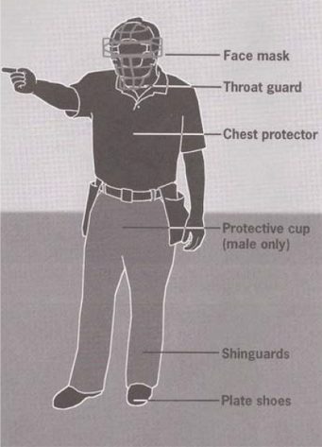
USA softball UMPIRE UNIFORM
USA powder blue or dark blue shirt
Heather gray umpire pants
USA umpire cap
Black belt
Black shoes
Black or dark socks
Dark blue or gray USA ball bag
Plate brush
Indicator
Flipping coin
Protective gear
Notes:
USA Softball uniform slide we’ve seen for decades. What I want to point out is that we have 1 chance to make a 1st impression. Let’s make it a good impression with a uniform that is the correct uniform and clean including shined shoes.

Slide 3
USA softball UMPIRE UNIFORM
The Board of Directors voted to rebrand the Amateur Softball Association of America to USA Softball beginning in 2017. What that means to us is another change is umpire uniforms (shirts, hats, ball bags). The old ASA uniform can be worn until 2020. If you go to a National Championship you may have partners that will wear the new logo. Partners need to dress alike on the field. As the national governing body, we are the only association that can claim USA Softball. With a return to the Olympics in 2020, the board wants to take advantage of the that association.
Notes:
Now in 2020 we must wear USA Softball shirts, hats and ball bags for State Tournament National Championship play. Local leagues may permit old ASA gear but under no circumstances do we want our umpires I competitors gear!

Slide 4
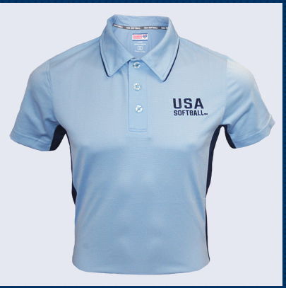
USA softball UMPIRE UNIFORM

Slide 5
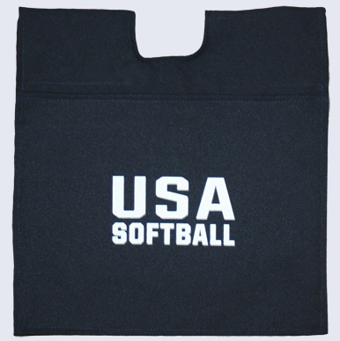
USA softball UMPIRE UNIFORM

Slide 6
2020 USA UMPIRE BENEFITS
Notes:
That concludes our umpire benefits section.

Slide 7
USA Softball plate mechanics topics
Pregame meeting with coaches
Stance / Slot = GPA
Signals
Ball / Strike
Timing
Trailing the batter runner
Positioning for calls on bases
Notes:
Here is our agenda for the Plate Mechanics section

Slide 8
USA Softball plate mechanics
Pregame meeting with coaches
Request lineup cards from each coach
Inspect for any inaccuracies
Verbally identify DP/Flex if being used
Return lineup card to respective coach for final check
Verbalize “these are official” when cards are returned
Notes:
List of items to cover in our pregame meeting

Slide 9
USA Softball plate mechanics
Pregame meeting with coaches continued
After confirming the lineups are official ask “are there any changes at this time?”
Review Special Rules: Time limit, Run Rule, Tiebreaker Rule
Go over behavior expectations – remind the coach they are responsible for their players and fans behavior
Coin Toss, if needed
Notes:
Additional pregame items

Slide 10
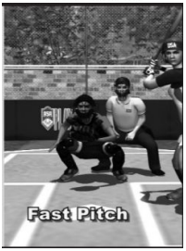
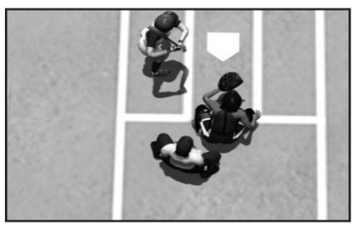
USA Softball plate mechanics
Good Pelvic Alignment (GPA):
The alignment o the plate umpire’s pelvis with the outside front corner of the plate.
Notes:
We want to be able to see the outside corner at the knees so we align in the slot with a heel/toe stance. In the fast pitch game being in the slot also keeps us out of the middle of the plate were most foul balls go straight back.

Slide 11
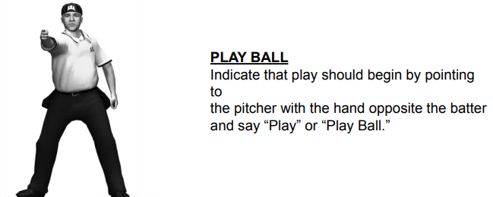
USA Softball umpire signals
Notes:
USA Softball Umpire Signals

Slide 12
USA Softball umpire signals

Slide 13
USA Softball umpire signals

Slide 14
USA Softball umpire signals

Slide 15
USA Softball umpire signals

Slide 16
USA Softball umpire signals

Slide 17
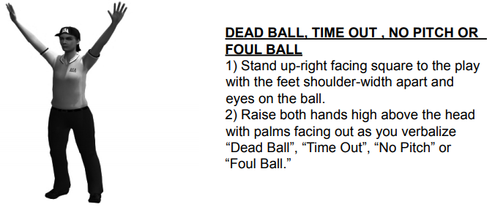
USA Softball umpire signals

Slide 18
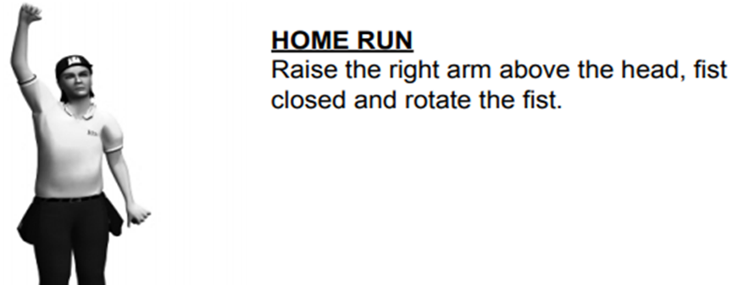
USA Softball umpire signals

Slide 19
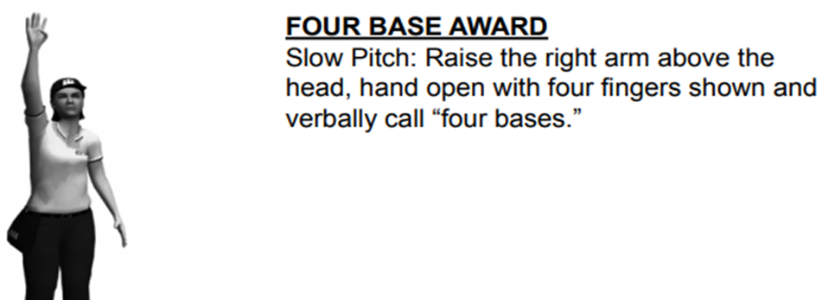
USA Softball umpire signals

Slide 20
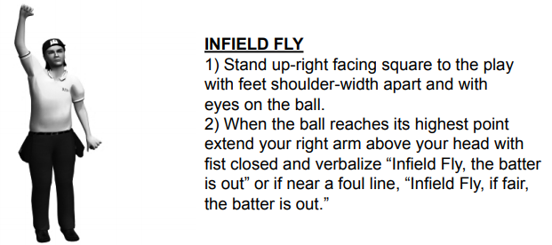
USA Softball umpire signals

Slide 21
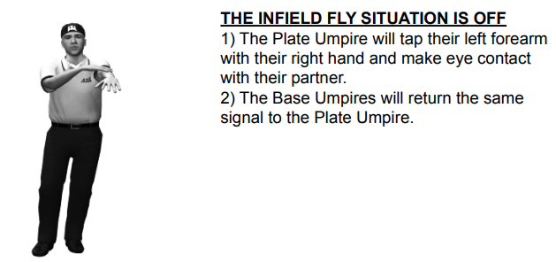
USA Softball umpire to umpire signals
Notes:
USA Softball umpire to umpire signals if you are fortunate enough to have a partner.

Slide 22
USA Softball umpire to umpire signals

Slide 23
USA Softball one umpire plate mechanics
Ground ball to the Infield
with No Runners on Base
Plate Umpire moves around catcher to the LEFT side into fair territory towards the pitching plate to get into a position with an angle at 1st base to be able to make a call on the batter runner.
Position yourself to get the best angle possible for the play at 1st base
Notes:
We have couple of scenarios with where we should be to try to get the best look at the play. We know in a 1 umpire game we are responsible for all calls. There may be times where we cannot see everything but we owe it to the teams to make an effort and move to a spot where we can see the best.

Slide 24
USA Softball one umpire plate mechanics
Ground ball to the Infield
with Runners on Base
Plate Umpire moves around catcher to the LEFT side into fair territory towards the pitching plate to get into a position to make a call at the base the play will be made at.
Position yourself for the play at the base using angle over distance philosophy.
Prioritize covering the base closest to home plate with multiple runners.
Make sure we always glance to see runners scoring touch home plate.
Notes:
Once the ball is hit we have many responsibilities

Slide 25
USA Softball one umpire plate mechanics
Hit to the Outfield
with No Runners on Base
Plate Umpire moves around catcher to the LEFT side into fair territory towards the pitching plate to get into a position to make a call at the base the play will be made at.
Be prepared to move towards 2nd or 3rd base if the hit turns into an extra base hit.
Know that we may not get as close to the base as we’d like to but do our best to get a good angle and then the best distance we can.
Notes:
Once the ball is hit we have many responsibilities

Slide 26
USA Softball one umpire plate mechanics
Hit to the Outfield
with Runners on Base and no play at home
Plate Umpire moves around catcher to the LEFT side into fair territory towards the pitching plate to get into a position to make a call at the base the play will be made at.
Move toward the base that the play will be made at, using angle over distance philosophy.
Prioritize covering the base closest to home plate with multiple runners.
Notes:
Once the ball is hit we have many responsibilities

Slide 27
USA Softball one umpire plate mechanics
Hit to the Outfield
with Runners on Base and possible play at home
Plate Umpire moves around catcher to the LEFT side approximately 15’ towards 3rd base along the line, in foul territory, commonly called the holding zone.
If no play is possible at home move toward the base that the play will be made at, using angle over distance philosophy.
Prioritize covering the base closest to home plate with multiple runners.
Make sure we always glance to see runners scoring touch home plate.
Notes:
Once the ball is hit we have many responsibilities

