Slide 1
Minnesota ASA Fast Pitch One and Two Umpire Training
2017 USA Softball Minnesota

Slide 2
TWO UMPIRE SYSTEM No Runners on Base
PLATE UMPIRE:
On infield, ground hits close to foul line, stay at home plate and make the call.
On infield hits, move up the first base line observing the play, and be prepared to help your partner.
FIELD UMPIRE
Basic position is 18 to 21 feet beyond first base in foul territory.
Responsible for batter-runner into third-base.

Slide 3
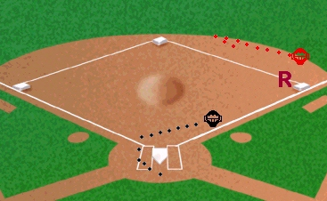
TWO UMPIRE SYSTEM Runner on First Base
PLATE UMPIRE:
On batted balls to the infield leave to the left of the catcher moving up first base line to observe the play, then fade toward third base to cover the advancing runner.
On steals where there is a wild throw at second base, pick up the runner advancing to third base, and be prepared to take the runner home.

Slide 4
TWO UMPIRE SYSTEM Runner on First Base
FIELD UMPIRE:
Take a position about halfway between first and second base and outside the base line. This position will normally place the umpire two or three steps behind and to the left side of the second baseman.
If the runner attempts to steal second, move toward the base staying behind the fielder. Should the throw be wild, move inside the base paths.

Slide 5
TWO UMPIRE SYSTEM Runner on First Base
FIELD UMPIRE:
On base hits to the outfield, immediately come inside the diamond, buttonhook and take the batter-runner all the way to third base.
On a double play, take two steps toward second base, follow the flight of the ball and move toward first base as the ball takes you into the play.
Has tag responsibility for runner at first base, and takes single runner all the way to third base after the catch.

Slide 6
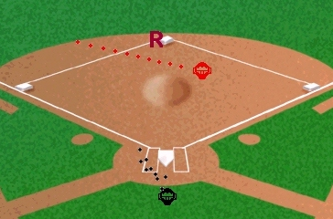
TWO UMPIRE SYSTEM Runner on SeconD Base
PLATE UMPIRE:
On hits, move toward third base. Be ready and in position to make a call by going down the left field foul line in foul ground. When about 15 feet from third base, quickly move into the infield for good position for the call.
If the first play is at first base, and there is a throw to third, the plate umpire has the call at third.

Slide 7
TWO UMPIRE SYSTEM Runner on SeconD Base
FIELD UMPIRE:
Take a position two or three steps behind and to the left of the shortstop. Be cautious so as not to interfere with the outfielders' view of the batter or play by the infielders.
On any ball hit to the infield, take the first throw unless it is to home plate. If the first throw is to first or second base, any subsequent throw to third base is covered by the plate umpire.

Slide 8
TWO UMPIRE SYSTEM Runner on SeconD Base
FIELD UMPIRE:
On all balls hit through the infield or to the outfield that you do not go out on, immediately come inside the diamond, buttonhook and take the batter-runner all the way to third base.
On routine fly balls to the outfield, move into infield to a position between the pitching rubber and base line. You are responsible for the tag-up of the runner, and after the ball is caught, follow the runner into third base.

Slide 9
TWO UMPIRE SYSTEM Runner on SeconD Base
FIELD UMPIRE:
See that the batter-runner touches first and second base. When the ball is in the outfield, take a position deep enough in the infield to allow movement for a play at either base.
On an attempted steal of third, move toward third base and be prepared for a call.

Slide 10
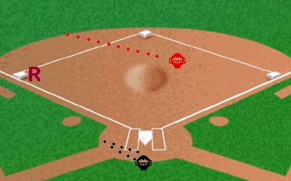
TWO UMPIRE SYSTEM Runner on THIRD Base
PLATE UMPIRE:
If a fly ball is hit, get out from behind home plate and line up the runner on third base and watch the tag-up.
On base hits, move toward third base, watching the runner. If the runner goes home, drift back toward home plate and watch the runner touch the plate.
Refer to the PLATE UMPIRE SECTION.

Slide 11
TWO UMPIRE SYSTEM Runner on THIRD Base
FIELD UMPIRE:
Take a position two or three steps behind and to the right of the shortstop. Be cautious so as not to interfere with the outfielders' view of the batter or play by the infielders.
If a ball is hit to the infield, wait until the fielder commits himself, then move quickly toward that base. Don't take your eyes off the ball.
Call all plays made on the first throw of the ball unless it is to home plate. Take the batter-runner into third base and see that all bases are touched.

Slide 12
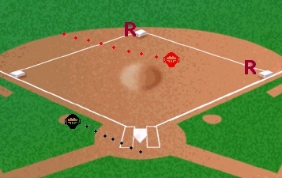
TWO UMPIRE SYSTEM Runner on First & Second Base
PLATE UMPIRE:
On base hits take lead runner into third base and home. On steals where there is a wild throw at second base pick up the runner coming into third base.
Be ready and in position to make a call at third base by going down the left field foul line in foul ground. When you are about 15 feet from third base quickly move into the infield for good position on the tag play.
On hits, move toward third base. If the lead runner comes home and there is no play made on him, drift toward third but watch the runner touch home plate.
Responsible for tag at second base.

Slide 13
TWO UMPIRE SYSTEM Runner on First & Second Base
FIELD UMPIRE:
Take a position two or three steps behind and to the left of the shortstop. Be cautious so as not to interfere with the outfielders view of the batter or play by the infielders.
On any ball hit to the infield, take the first throw unless it is to home plate. If the first throw is to first or second base, any subsequent throw to third base is covered by the plate umpire.

Slide 14
TWO UMPIRE SYSTEM Runner on First & Second Base
FIELD UMPIRE:
If the runner attempts to steal third, move toward the base to make the call.
On routine fly balls to outfield, move into infield to a position between pitching rubber and base line. You are responsible for the tag-up of the runner on first.
See that the runner and batter touch second and first base. When the ball is in the outfield, take a position deep enough in the infield to allow you to move in for a play at either base.

Slide 15
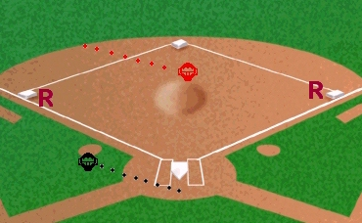
TWO UMPIRE SYSTEM Runner on First & Third Base
PLATE UMPIRE:
If a fly ball is hit, get out from behind home plate and line up the runner on third base and watch the tag-up.
On base hits, move toward third base. If the lead runner comes home and there is no play made on him, drift toward third but watch the runner touch home plate. If there is a play at home, move back to a position in the rear and left side of the right-handed batter's box.
If the play is at first base, watch the lead runner touch home plate, then go to third for a possible play on the second runner.

Slide 16
TWO UMPIRE SYSTEM Runner on First & Third Base
FIELD UMPIRE:
Take a position two or three steps behind and to the right of the shortstop. Be careful not to interfere with the outfielder's view of the batter or play by the infielders.
On any ball hit to the infield, take the first base unless it is to home plate. If the first throw is to first or second base, any subsequent throw to third base is covered by the plate umpire.

Slide 17
TWO UMPIRE SYSTEM Runner on First & Third Base
FIELD UMPIRE:
If a ball is hit to the infield wait until the fielder commits himself, then move quickly toward that base. Don't take your eyes off the ball.
On any ball hit to the infield, take the first throw unless it is to home plate. If the first throw is to first or second base, any subsequent throw to the third base is covered by the plate umpire.

Slide 18
TWO UMPIRE SYSTEM Runner on First & Third Base
FIELD UMPIRE:
On a base hit, get inside the infield quickly and watch the runner on first touch second base and be alert for a play at that base, take the batter-runner as far as third base and watch him touch each base.
On fly balls, get inside the infield quickly, buttonhook and line up the runner on first base. After checking the runner tag-up at first base, be prepared to take him into second and/or third base.

Slide 19
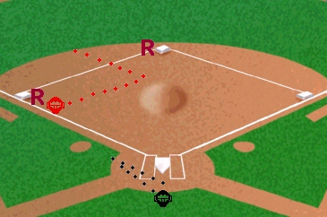
TWO UMPIRE SYSTEM Runner on Second & Third Base
PLATE UMPIRE:
If a fly ball is hit, line up the runner on third base and watch the tag-up.
On base hits, move toward third base. If the lead runner comes home and there is no play on him, drift toward third but watch the runner touch home plate. If there is a play at home, move back to a position in the rear and left side of the right-handed batter's box.
If the play is at first base, watch the lead runner touch home plate, then go to third for a possible play on the second runner.

Slide 20
TWO UMPIRE SYSTEM Runner on Second & Third Base
FIELD UMPIRE:
Take a position two or three steps behind and to the right of the shortstop. Be careful not to interfere with the outfielders view of the batter or the play by the infielders.
On any ball hit to the infield, take the first throw unless it is to home plate. If the first throw is to first or second base, any subsequent throw to third base is covered by the plate umpire.

Slide 21
TWO UMPIRE SYSTEM Runner on Second & Third Base
FIELD UMPIRE:
On fly balls, get inside the infield quickly, button hook and line up the runner on second base and take the runner to third base after the catch.
On all balls hit through the infield or to the outfield that you do not go out on, immediately come inside the diamond, button hook and take the batter-runner all the way to third base.

Slide 22
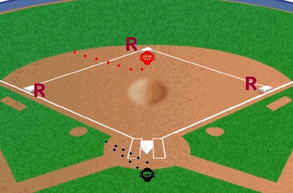
TWO UMPIRE SYSTEM Bases Loaded
PLATE UMPIRE:
If a fly ball is hit, get out from behind home plate and line up the runner on third base and watch the tag-up.
On base hits move toward third base in foul territory. If the lead runner comes home and there is no play made on him, drift toward third but watch the runner touch home plate. If there is a play at home, move back to a position at the rear and left side of the right-handed batter's box.

Slide 23
TWO UMPIRE SYSTEM Bases Loaded
PLATE UMPIRE:
If the play is at first base, watch the lead runner touch home plate, then go to third for a possible play on the second runner.
Refer to PLATE UMPIRE SECTION.

Slide 24
TWO UMPIRE SYSTEM Bases Loaded
FIELD UMPIRE:
Take a position two or three steps behind and to the right for the shortstop. Be careful not to interfere with the outfielder's view of the batter or play by the infielders
On any ball hit to the infield, take the first throw unless it is to home plate. If the first throw is to first or second base, any subsequent throw to third base is covered by the plate umpire.

