Slide 1
April Roundtable 2025 Roundtable Commissioners: Denise Williams Abby MacIntyre Shane Lege
Notes:
Welcome & Introductions

Slide 2
Opening: Order of the Arrow
Presentation of Colors
OA Chapter Update

Slide 3
Hot Topics:
Update to Guide to Advancement regarding Eagle
Letters of reference are kept confidential and are destroyed in accordance with Scouting America Advancement Policy at the Board of Review or Appeals Process.
BSA Fundraising Rules
Update on Uniforms
Arrowhead District Website and GroupMe
www.arrowheaddistrict.com
Notes:
In other words, the letters of reference required by Eagle Scout rank requirement 2, should be destroyed by the Eagle Board of Review if the scout successfully completes the board of review. If an appeal procedure is appropriate, the refences will remain a part of the Eagle package until the appeal process is completed.

Slide 4
Arrowhead District Camporee

Slide 5
Arrowhead Twilight Camp

Slide 6
Safety Moment: Health Forms
Don’t forget to complete your health forms for your units upcoming adventures!
Health Forms consist of Part A, B, & C

Slide 7
Membership Moment:
Recruit!
Recruit!
Recruit!
What is your plan?

Slide 8
Cub Scout Topic: Closing Out The Year!
Rank Advancement
Bridging
Summer Activities
Recruiting Plans for Next Year

Slide 9
Troop Topic: Troop Led Programs- How to Succeed

Slide 10
For upcoming events:
Go to www.arrowheaddistrict.com

Slide 11
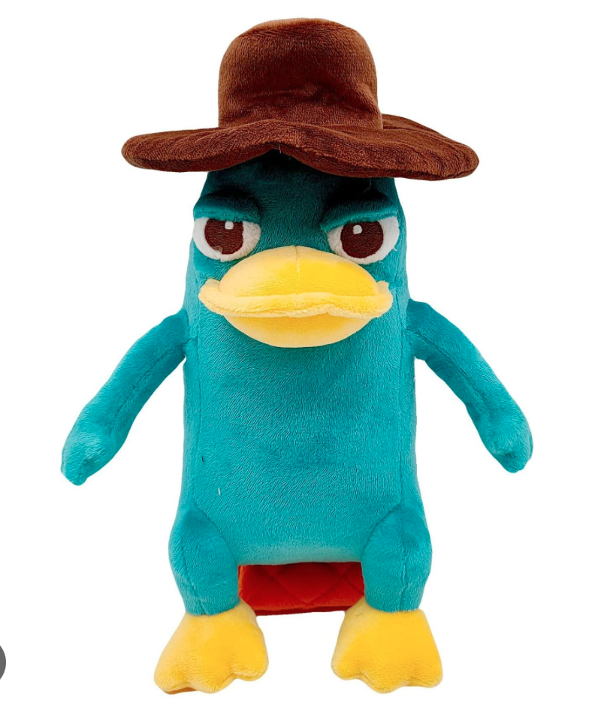
Help Arrowhead Pick a New Mascot:
What is your suggestion?

