Slide 1
Arrowhead District Meeting
February 6, 2025

Slide 2
Agenda
Staffing needs
District Chair
Finance Char
Nominating Committee
Program: Anjillyn Ray
District Banquet – March 6th
Wesley Methodist, 6pm start.
Awards all turned in.
Invitations
Program
District Pine Wood Derby – March 29th
Decatur Mall
District Camporee – April 11th
Day Camp – June 9th
Membership: Matthew Lawrance
Summer roundup
Fall school visits
Other recruiting locations?
Training: Henry Gilson
IOLS/Ballo needs
Merit Badge Councilor Registration
Advancement: Vacant
Merit Badge College
Finance: Vacant
No Scout Cards
Popcorn
Unit Fund Raising
Friends of Scouting
Unit Service: Commissioner Staff

Slide 3
Volunteer Insurance Coverage
Comprehensive General Liability Insurance
Provides primary general liability coverage for registered volunteer Scouters with respect to claims arising out of an official Scouting activity.
Automobile Liability Insurance
Provides coverage for volunteers as excess of a volunteer’s auto policy while involved in an Official Scouting Activity.
Chartered Organizations for Scouting Units
Provides primary general liability insurance coverage for all chartered organizations on file with the BSA for liability arising out of their chartering a traditional Scouting unit.
Accident and Sickness Coverage
Provides coverage for Scouts and registered leaders and furnishes reimbursement in case of death, accident, or sickness within policy amounts.

Slide 4
General Liability Insurance
Scouting America’s general liability policy provides coverage for a bodily injury or property damage claim that is made and arises out of an Official Scouting Activity.
The Guide to Safe Scouting contains a listing of Unauthorized and Restricted Activities.
Unauthorized activities are not considered Official Scouting Activities.
Volunteers (registered and unregistered), Units, Chartered Organizations and Local Councils are jeopardizing insurance converge for themselves and their organization by engaging in unauthorized activities.
Resources:
https://www.scouting.org/health-and-safety/safety-moments/insurance/
https://www.scouting.org/health-and-safety/gss/gss10/

Slide 5
Incident Reporting
Reporting Requirements
Within 24 hours
All Child Abuse Allegations
Within 72 hours
Serious Youth Protection Volitions, includes:
Violations to barriers of Abuse
Arrest for Crimes other than abuse
Membership Standards Infractions
Call Chris Green, the Arrowhead District Executive or J.T. Dabbs, the GAC Scout Executive.
If you can’t reach them, call 1-844-Scouts1

Slide 6
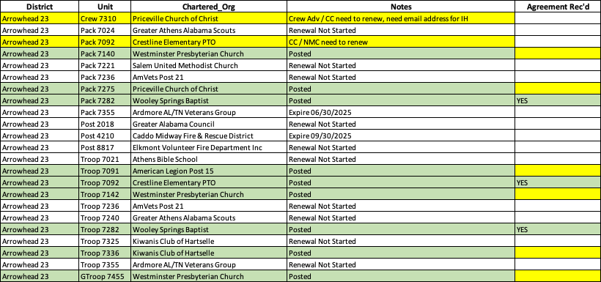
Re-Charter

Slide 7
Application Manager

Slide 8
Invitation Manager

Slide 9
Cub Scout Membership
Scouts BSA, Venturing, & Explorer Numbers Not Available

Slide 10
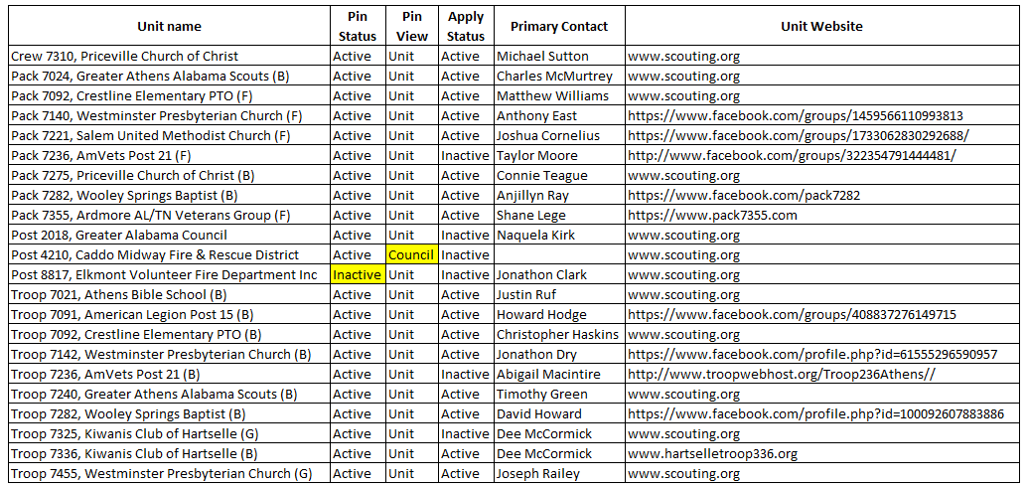
Membership Pin Status

Slide 11
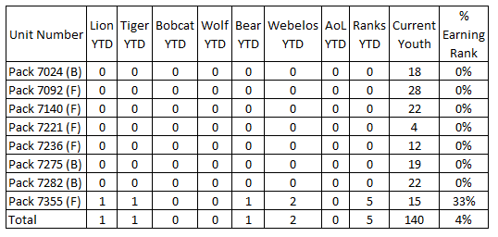
Advancement – Cub Scouts Ranks

Slide 12
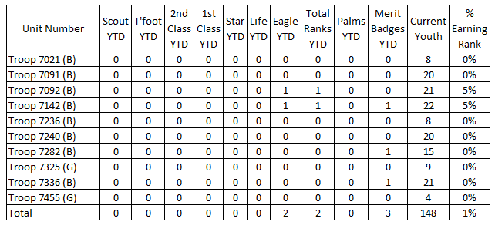
Advancement – Scouts BSA

Slide 13
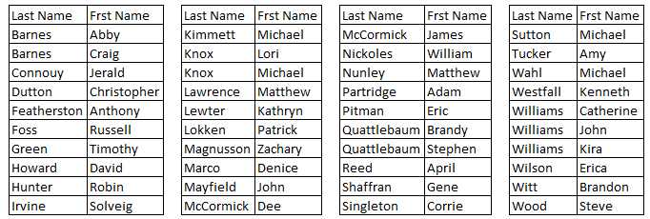
Merit Badge Counselors
STEM Counselors

Slide 14
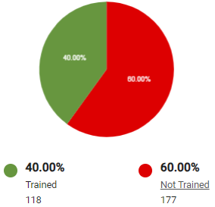
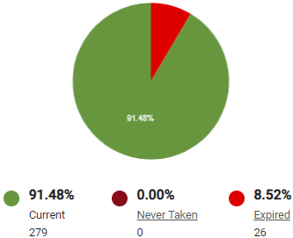
Training
Trained Leaders
YPT

Slide 15
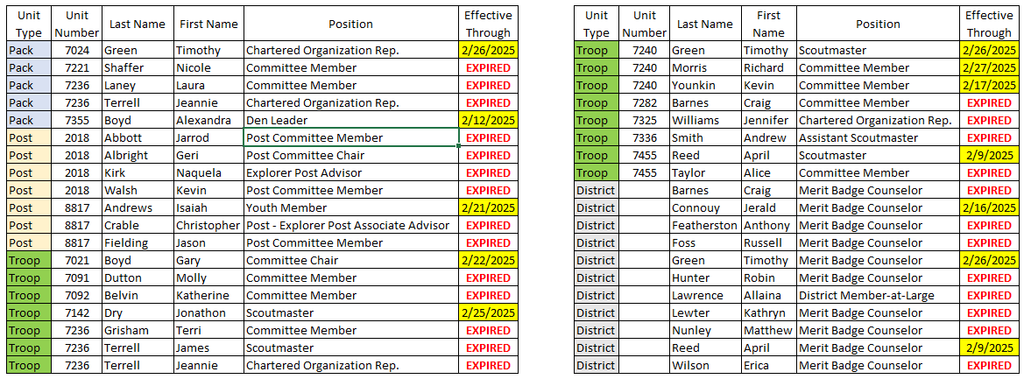
Expired / Expiring YPT

Slide 16
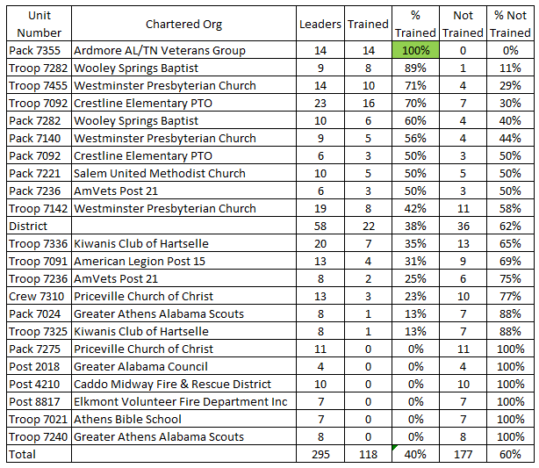
Training - LST

Slide 17
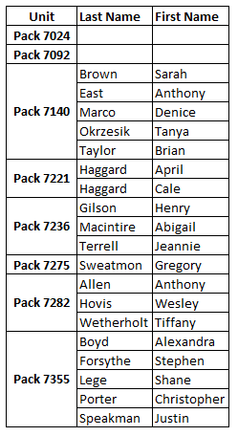
BALOO Trained
In order for your den or your entire Cub Scout Pack to have an outdoor activity or go camping, you must have someone complete the Basic Adult Leader Outdoor Orientation, also known as “BALOO”, training course.

