Slide 1

The New Vision for Arrowhead

Slide 2

Vision of Change
Our Vision for Arrowhead District
At Arrowhead District, we are one team with one purpose—delivering the very best Scouting experience for every youth we serve. Every decision we make should help more young people discover adventure, develop character, build leadership skills, and create memories that last a lifetime.
As we grow together, let's lead by the principles of the Scout Oath and Scout Law, supporting one another with positivity, respect, and a shared commitment to excellence.
When faced with opportunities or challenges, ask yourself:
Am I taking ownership?
Am I willing to be part of the solution and lead by example?
Am I putting Scouts first?
Does this decision provide the best possible experience for our youth, families, volunteers, and the Scouting mission?
Am I creating a positive impact?
Will my words, actions, and attitude strengthen our district and encourage others?
Am I showing respect?
Am I treating every volunteer, parent, youth, and community partner with kindness, courtesy, and understanding?
Am I communicating effectively?
Am I listening, sharing information clearly, and working collaboratively toward our common goals?
Am I committed to continuous improvement?
How can I help my unit, my fellow volunteers, my district, and myself become even better tomorrow than we are today?

Slide 3
Agenda
Housekeeping
Feedback Survey
Membership Recap
Goals
Recruitment
Upcoming Events
Popcorn
Interest in district level positions
New unit position descriptions

Slide 4
Housekeeping
Position specific training*
Youth safety training*
BALOO and IOLS Training
Update unit pin
Update Advancements
*see unit folder

Slide 5

Feedback Survey
Check the Facebook Page and the GroupMe for a clickable link.

Slide 6
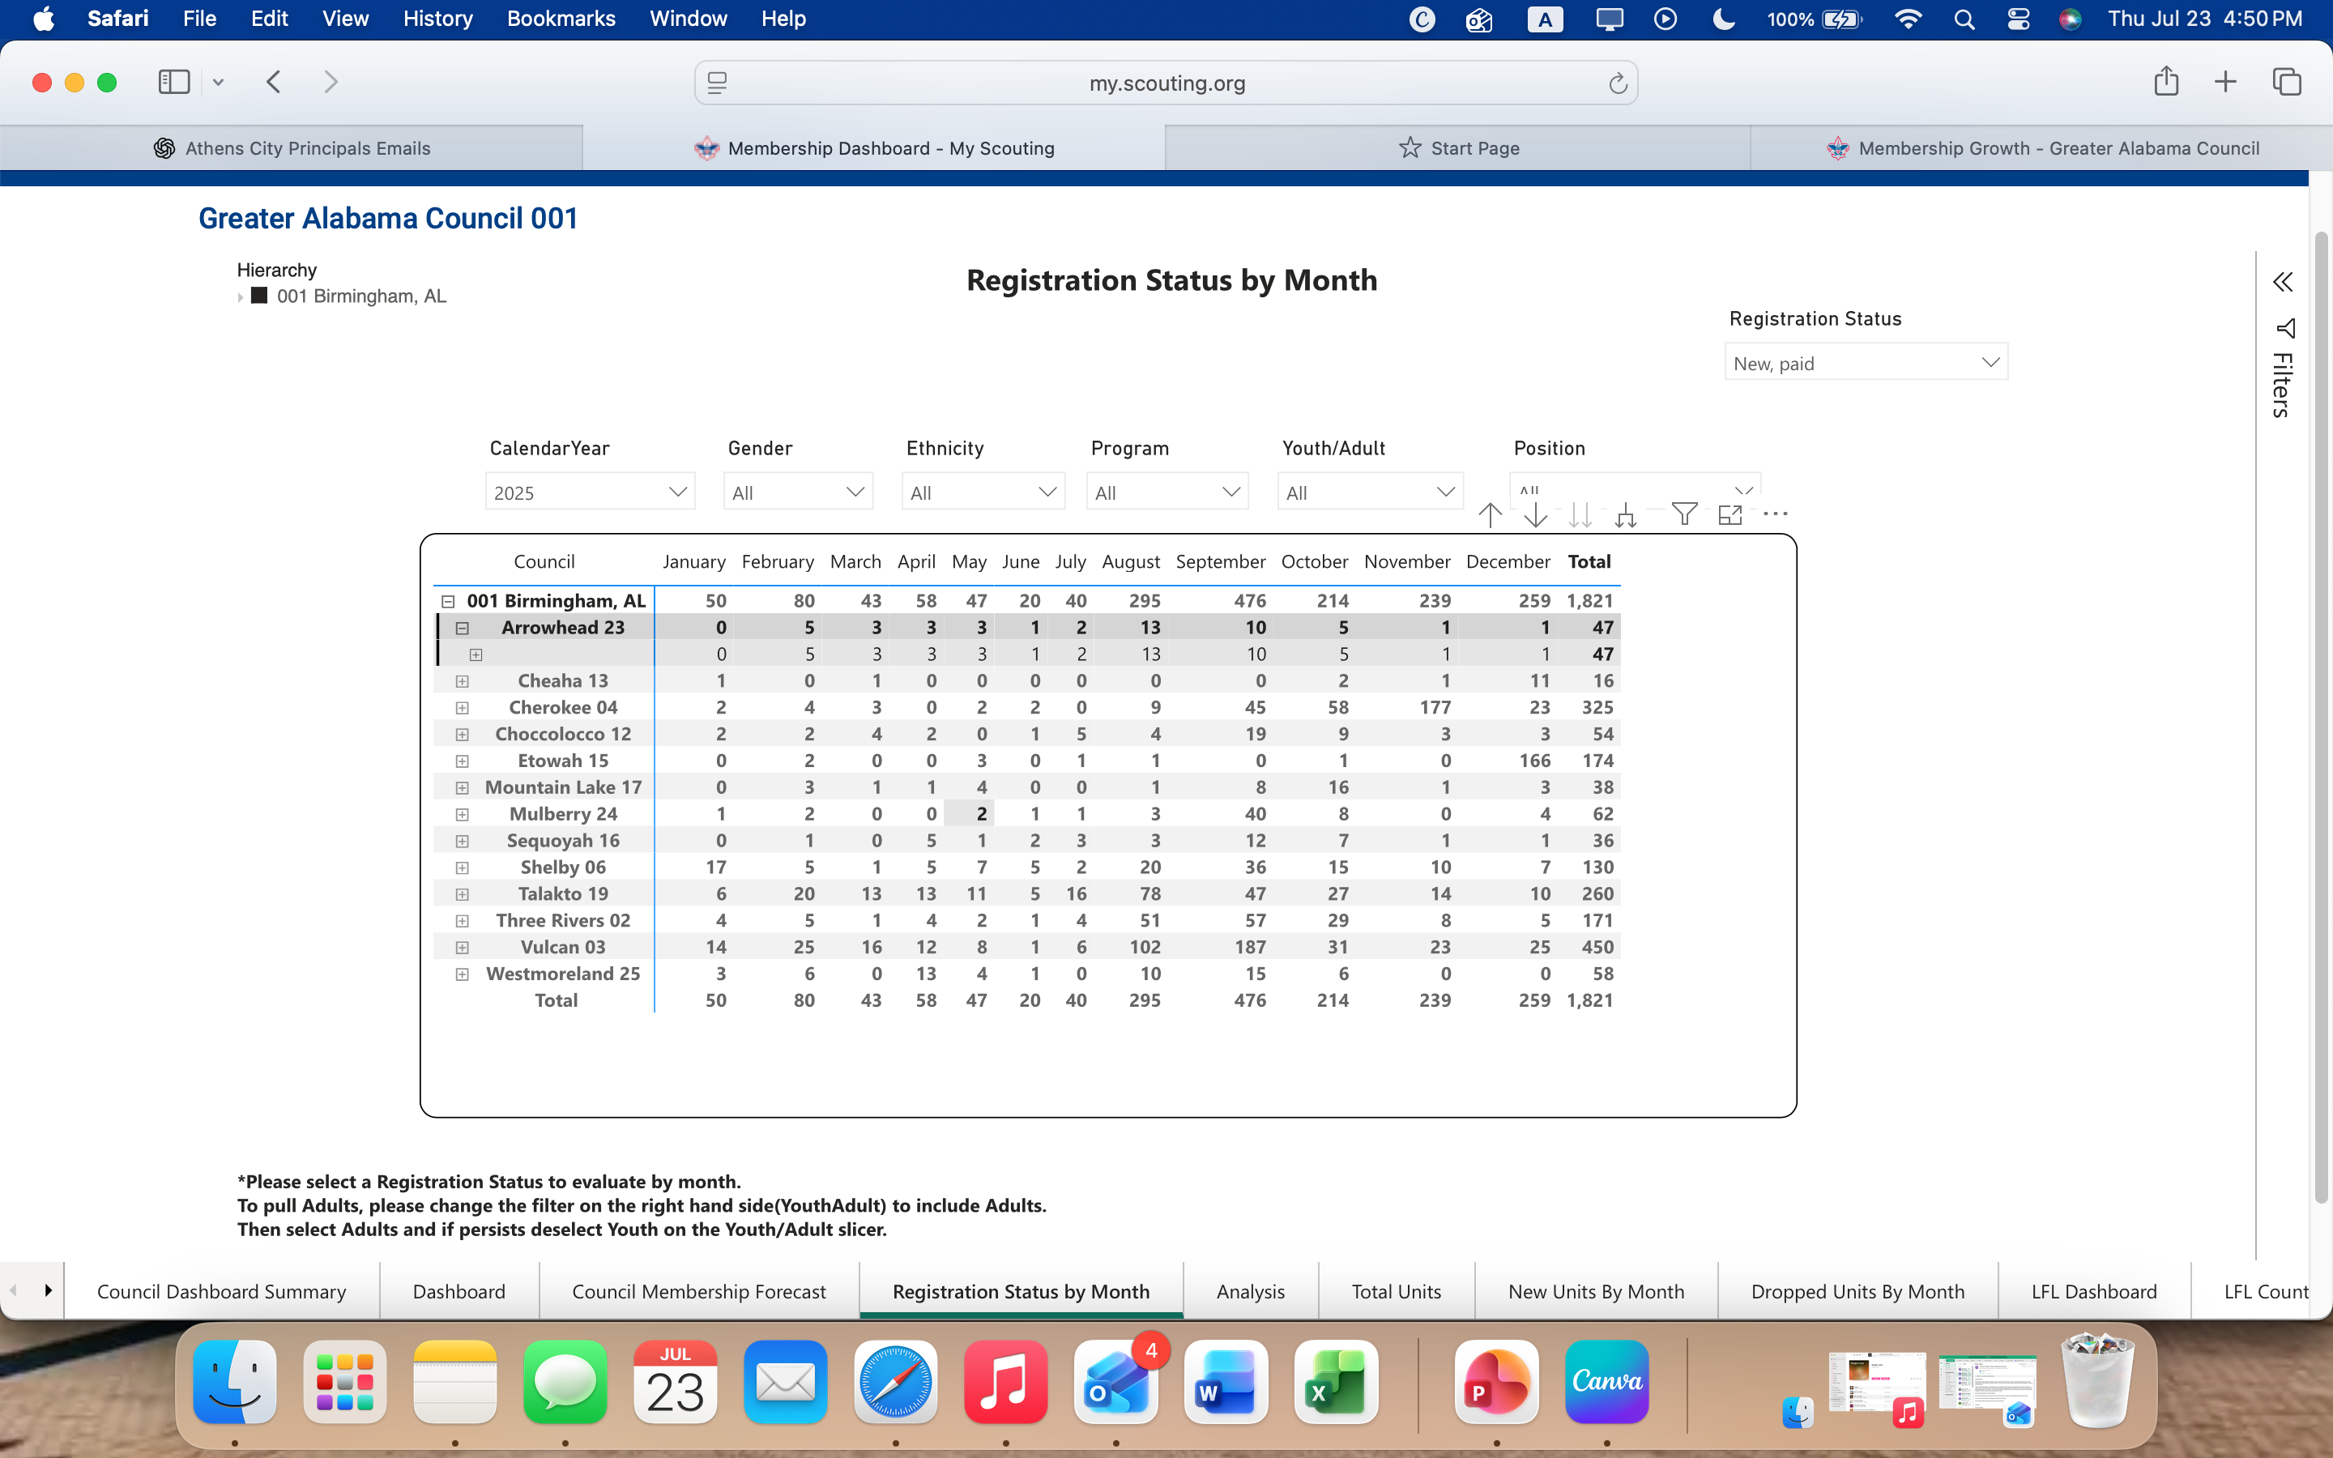
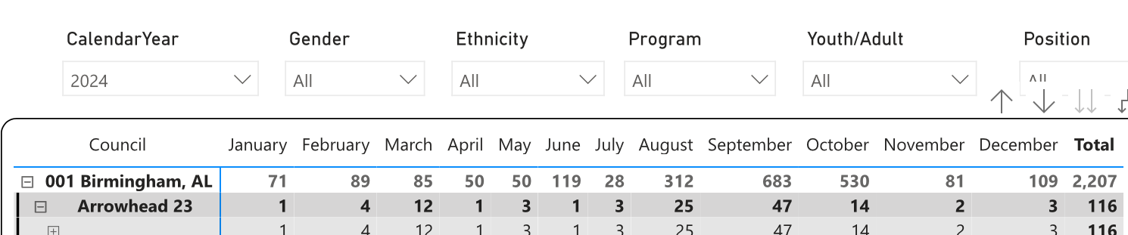
2025 VS 2024 Membership Recap
Recruiting new Scouts is one of the greatest opportunities we have to strengthen our units and ensure Scouting continues to thrive. In 2025, Arrowhead District welcomed 47 new Scouts. While that number was lower than we'd hoped, it gives us an opportunity to learn, grow, and work together.
We want to understand how we can better support you in recruiting new families and building stronger units. Your experiences and ideas are essential as we plan for the future.
Help us answer these questions:
What recruitment challenges did your unit experience?
What worked well that we can build upon?
What barriers kept families from joining?
What resources, training, or district support would have made recruiting easier?
How can Arrowhead District partner with your unit to make your next recruitment season the most successful yet?

Slide 7
Goals
Arrowhead District Goal
Current Membership: 240 Scouts
Growth Goal: Welcome 120 new Scouts
Target Membership: 360 Scouts
Together, we can reach more families, strengthen every unit, and give more youth the opportunity to experience the adventure and values of Scouting. Every Scout counts—and every volunteer makes a difference.
Our Goal
Grow Arrowhead District from 240 Scouts to 360 Scouts by working together, supporting one another, and making recruitment a district-wide effort.
Limestone County: 14 Scouts
Athens City: 40 Scouts
Morgan County: 14 Scouts
Decatur City: 40 Scouts
Hartselle City: 12 Scouts
Lawrence County is not a focus at this time.

Slide 8
Recruitment
🎉 Community Events
Community Scout Adventure Days
Festivals, fairs, and parades
Farmers Markets
Library programs
City or county celebrations
Holiday events and tree lightings
⛺ Hands-On Scouting Experiences
Fishing Days
Hiking Adventures
Rocket Launches
Pinewood Derby demonstrations
Archery demonstrations (where permitted)
Family Campfire Nights
Outdoor movie nights
Invite-a-Friend Pack meetings
📣 Community Awareness
Yard signs in high-traffic areas
Flyers at local businesses
Church and faith-based bulletins
Pediatricians and dental offices
Libraries and community centers
Parks and recreation facilities
Daycares and after-school programs
QR codes on posters linking directly to joining information
📱 Digital & Social Outreach
Community Facebook groups
Unit social media pages
Local event calendars
Email campaigns
Neighborhood apps (Nextdoor, etc.)
Short videos highlighting Scout adventures

Slide 9



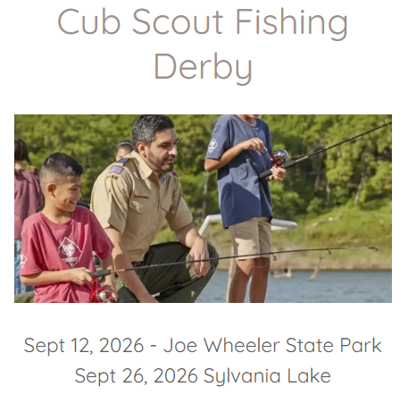




Upcoming Events
Check our website: https://arrowheaddistrict.com/

Slide 10

What does a District Volunteer actually DO?
Pick Your Superpower.
Scouting needs people who are good at different things.
People person? → Membership
Organizer? → Events
Encourager? → Volunteer support
Money person? → Finance
Adventure person? → Program
Relationship builder? → Community

Slide 11
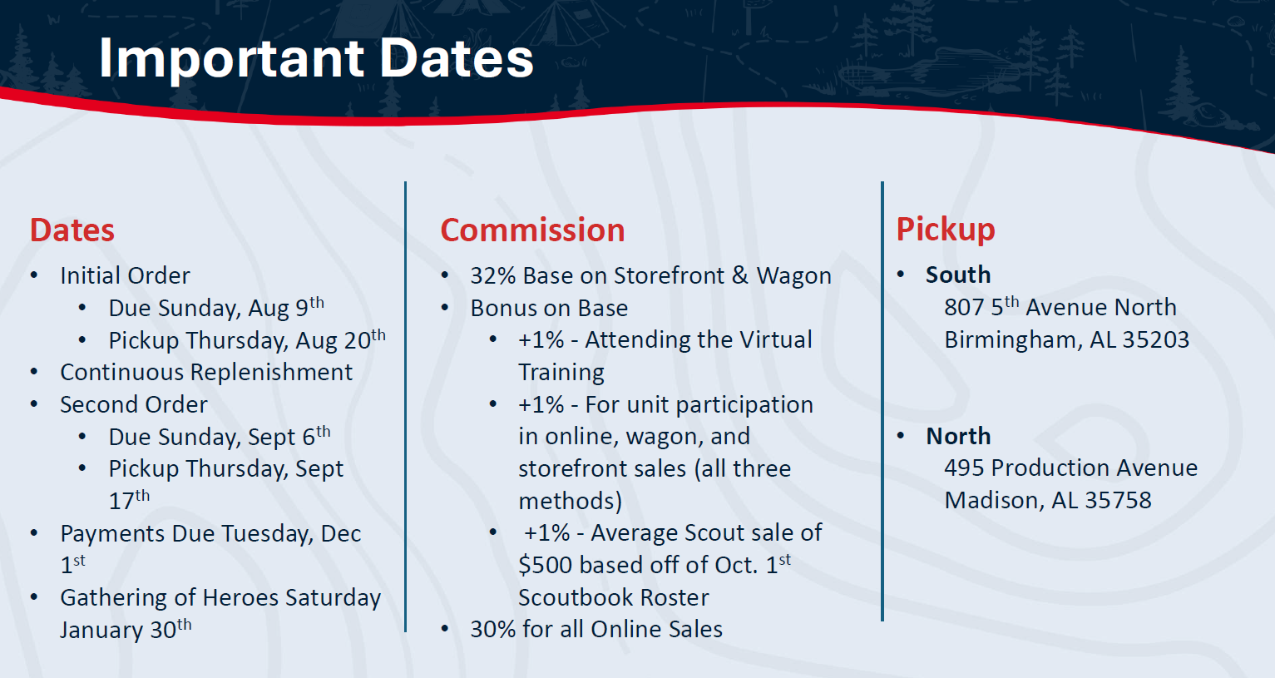
Popcorn

Slide 12
New Unit Family Helper
New Family Helper serves as the Primary point of contact for all new Scouting families during their first 90 days in the Pack Their responsibility is to ensure every new family feels welcomed, informed, connected, and engaged so they become active participants in the pack.
The New Family Helper focuses on retention rather than recruitment. Reports to Committee Chair, works closely With Cubmaster, Committee Chair, Den Leaders, Membership Chair, and Unit Commissioner.
Time Commitment- Attend Pack meetings regularly and communicate with new families as needed. Approximately 2-4 hours per month, depending on Pack growth.
Primary Responsibilities-
Welcome new families within 48 hours of registration.
Help new families through their first 90 days.
Help families build relationships.
Promote participation in meetings and activities.
Monitor engagement and follow up with families who may be disengaging.
Qualifications:
Friendly and approachable
Organized and dependable
Patient and encouraging
Strong communicator
Enjoys helping people

Slide 13
New Cub Scouts
Starting August 4, 2026 ending on October 21, 2026 the Council Office will be giving out free books to all NEW Cub Scouts.
To get the free books one assigned person from the unit will need to bring in the following:
Sign up night reporting sheet included in your packet and proof if new membership. (youth application or copy of the online registration.)
No books will be given without proof of membership and individual parents can not pick up books for their own child.

Slide 14
Don’t Forget!
It's a new era every time a Scout discovers what they're capable of.
Be the leader who helps them step into it.

