Slide 1
September
ROUNDTABLE

Slide 2

Order of the Arrow
September 11-13 Order of the Arrow fall induction
October 2-4 Coosa Lodge Fellowship

Slide 3

UPCOMING EVENTS
September 12 Fishing Derby Joe Wheeler Marina, Rogersville
September 25-27 Fish Camp at Camp Sequoyah
November 7 Fishing Derby in Huntsville, details to be announced

Slide 4

UPCOMING EVENTS
Cub Haunted at Camp Comer. October weekends starting the 9th
Cub Haunted at Camp Westmoreland October 16-17

Slide 5

October 10 Cooks Museum Scout Day 10:00-2:00

Slide 6

Scout Fest
November 13-15
Registration $50 per person until Sep. 15
Sep. 16 – Oct. 15 $70
Register with your best guess at attendance

Slide 7


UPCOMING EVENTS
December 12-14 Joy to the Woods
December 27-31 Winter Camp

Slide 8

February 27

Slide 9

It’s not the same old district pinewood derby. You don’t want to miss it.

Slide 10


May 22 Trash Pandas Scout Night
April 26-28 Full Throttle
Weekend at Sequoyah

Slide 11


Slide 12
Check out our webpage at arrowheaddistrict.com.
Believe it or not there are more events.
While you are checking out new things, you can join the arrowhead district facebook group and the arrowhead district GroupMe.

Slide 13
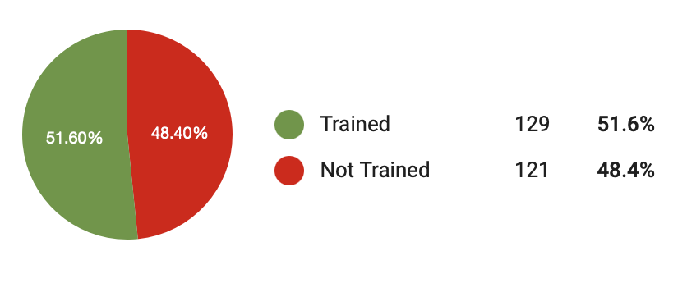
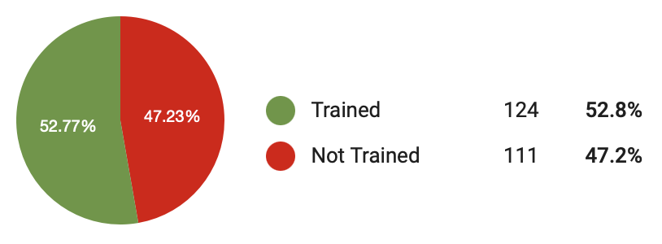
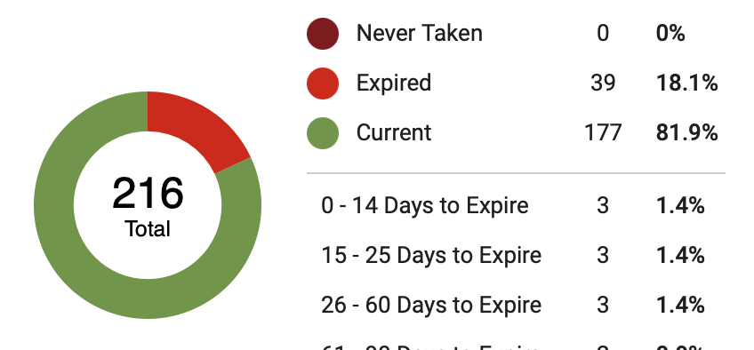
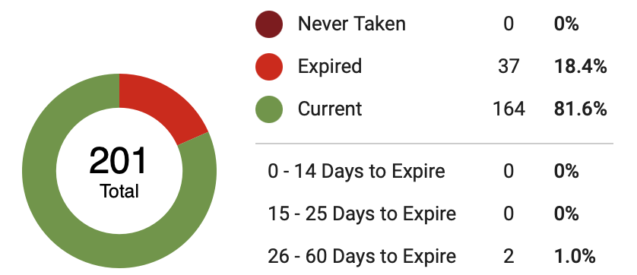
Position Specific Training
August
September
Safeguarding Youth Training
August
September

Slide 14

Training Opportunities
September 18-19 BALOO and IOLS training in Harvest
September 19-20 BALOO and IOLS training in Birmingham

Slide 15

2026 Wood Badge
September 25-27 first weekend
October 17-18 second weekend
2027 Wood Badge
March12-14 first weekend
April 3-4 second weekend

Slide 16

NYLT
January 16-18 first weekend
February 13-15 second weekend
University of
Scouting
February 27

Slide 17

Popcorn
September 6 popcorn final orders due
September 17 popcorn pickup
October 16 last day to return popcorn
December 1 popcorn payments due

Slide 18
Safety Moment
Bunk Beds

Slide 19
Membership Moment
Invite Teachers to Celebrations
https://www.scouting.org/wp-content/uploads/2023/10/Invite-Your-Teachers-to-Celebrations.pdf

Slide 20

Hot Topics
Changes to recharter and member renewal procedures
Changes to beascout.scouting.org more info at techhub.scouting.org

Slide 21
Scouts BSA Breakout Topic
Your Troop Committee
Minimum leaders for a troop include
Chartered Organization Representative
Scoutmaster
Troop Committee with at least 3 members

Slide 22
What is a troop committee?
The troop committee’s job is to support the scoutmaster and assistant scoutmasters by doing administrative and behind the scenes tasks.

Slide 23
A functioning committee needs
•Committee Chair
•Secretary
•Treasurer
•Advancement Coordinator
•Outdoor Activities Coordinator
•Training Coordinator
•Equipment Coordinator
•Membership Coordinator

Slide 24
Other committee responsibilities
Social Media
Friends of Scouting
Membership
Health & Safety
Transportation
Popcorn Kernel
Fundraising Chairman
Chaplain

Slide 25
There are also chores like
Picking up awards at the scout shop
Driving to camps
Bringing snacks
and so many others

Slide 26
Good news for small troops small size = each job is less work easier to have multiple jobs
good news for large troops
no max committee number
people can share jobs
you can make up new ones
Not enough help = burn out
More members = fewer responsibilities

Slide 27
Cub Scout Breakout Topic
Getting Parents Involved
BEFORE YOU START YOU HAVE TO MAKE A PLAN
Most parents of cub age children expect to volunteer with their child’s activities.
Most parents won’t volunteer on their own.
Not everyone can be a leader, but everyone can help.

Slide 28
It is extremely important to have a welcoming atmosphere
You should have a new member coordinator.
It is a new position.
Their job is to take care of the new families.
You want the friendliest person in the group.

Slide 29
Try holding a parent orientation meeting
At your recruitment notify parents of the date, time, and location of the orientation.
It should be 7-10 days after your recruitment event.
Remind new parents by personally contacting them. Try text, not email.
The agenda – Define what scouts is about, and explain what is ahead

Slide 30
Sample Agenda
-Welcome and Introduction
-Pack Structure
-Overview of the Program
-Where to get Supplies
-Pack Calendar/Communications
-Pack Finances
-Parent Participation(we’ll get to that)
-Applications
-Closing and Follow up

Slide 31
Need a new way to encourage
Parent Participation?
Before the meeting, make a list of tasks your pack needs someone to do. Include everything from leadership positions opening soon to bringing snacks.
Create sticky notes for each job. Each note needs a title, an explanation of the task, and a time commitment.
Don’t use scout jargon. New people don’t know what a den is. Say grade level or grade group. No acronyms.

Slide 32
Find a portable board to put your sticky notes on.
Ask the parents to take 2-4 before they leave. (It depends on the size of your group and what they pick.)
Record who takes what tasks.
Follow up with each person, probably by phone. You will want to explain the task more, answer questions, and give them the resources they need.
If someone backs out, put another sticky note on the board.

Slide 33
Corn Husker Council Family Talent Survey
https://www.cornhuskercouncil.org/file_download/inline/5135b8e3-5977-43ed-965f-b784b1982f68

