Slide 1


2026 Spring Camporee
Arrowhead and Westmoreland Districts
Leaders Guide
April 10-12, 2026
Camp Westmoreland
Camp Westmoreland Scout Reservation
520 Westmoreland Road, Florence, AL 35634

Slide 2
Spring Camporee
The Spring Camporee is being hosted Troop 7091 (Boys Troop) of Decatur, Alabama.
The camporee will be open to scouts and leaders in the BSA and Webelo/Arrow of Light (Unfortunately no Cub Scouts this time)
Camporee Contacts:
Michael Kimmet | District Commissioner | 256-426-8035 | michael.s.kimmet@gmail.com
Howard Hodge | Troop 91 Scout Master | 256-444-5834 | hphodge@yahoo.com
Rodney Siddall | Troop 91 Comm. Chair | 256-221-8031 | rsiddall3130@spacecamp.com
Jimmy Cai | Troop 91 Assistant Scoutmaster | 256-214-9676 | caistoragellc@gmail.com
The 2026 Spring Camporee Theme is “The Space Race”
Events will be based on the Space Race activities and other scouting games/events.
Scouts/Leaders will maintain the standards of Safe Scouting.
Any items that would have a safety concern or be a violation of Guide to Safe Scouting should be avoided. No oversized knives, dangerous weapons or firearms, including toy guns.
Camporee Location
The camporee will be held at Camp Westmoreland Scout Reservation: 520 Westmoreland Road, Florence AL 35634
Directions
Take AL-72 to west of Killen Shoals Creek Bride
Turn NORTH on Lauderdale County Road 27 / Bennett Road
Turn right onto Lauderdale Count Road 30 / Camp Westmoreland Road / St Florian Rd
Road will curve LEFT/North as Camp Westmoreland Road.
At end of road, turn right into Camp Westmoreland Gate and look for Check-in Shelter.
Tents/Shelters/Facilities
Troops should bring enough tents for all their participants. Some campsites may have BSA Wall Tents or walled shelters that the Troop can use if available, but these are not guaranteed.
Water is available in most campsites and the Dining Hall.
Bathhouse will be open with bathrooms and showers.
Garbage should be put in dumpster behind Dining Hall.

Slide 3
Registration
In order to register, use below JOT FORM:
Include the following information:
Troop Number
Point of Contact / Phone Number / Email
Number of Patrols Competing
Approximate Number of Scouts Attending
Approximate Number of Adults Attending
To help us plan accordingly please register no later than April 1st, 2026.
https://pci.jotform.com/form/260396805937166
Fees and Costs
Please pre-register at above JOT FORM with individual payment or per Troop/etc.
If you’ve not paid before arrival, please bring check to GAC for your group.
Scouts/Participants (Cub Scouts/Webelos/etc.) | $20
Adult Leaders | $20
Camporee Staff | $20
Additional Camporee patches (onsite only) | $5 each (bring cash)
Other various patches in District Trading Post | Cash, prices vary. Please bring $1’s and $5’s
Fees cover expenses such as insurance, site fees, program supply costs, recognition costs, the camp wide cracker barrel, and a collectable patch.
Safety Notes
Any items that would have a safety concern or be a violation of the Guide to Safe Scouting must be avoided.
No dangerous weapons. No firearms, including toy guns.
Troops should also have their first aid kit(s) and should handle minor first aid situations within camp. First Aid will be available onsite at the Med Lodge.
In case of severe weather, the dining hall will be used as the designated safe place.
Ground fires are permitted only in pre-existing fire rings. Units may provide camp stoves, back packing stoves, gas grills or other portable cooking capabilities. Above ground fires such as barrel halves or pan fires are acceptable, however, all ashes and debris must be taken out. Units will provide their own fuels and fire protection equipment. BSA fire safety standards will be enforced.

Slide 4
First Aid/Emergencies
Individual troops shall have First Aid kit(s) to handle minor first aid situations within camp.
First Aid will be available on site at:
Daytime – The Med Lodge located at the Dining Hall area.
Nighttime – First house (yellow) on left as you exit the camp entrance archway.
If Medic has left Med Lodge/First Aid Area, their contact info will be posted. In severe Emergencies, call 911 if needed, but send a Scout buddy pair to Medic Lodge Area to alert Camporee Medics of issue and incoming EMS personnel.
Medic Name and Contact
Josh Miles | 256-762-2004
This contact list is subject to change at camporee. If this occurs, updated contact information will be provided.
911 Address is: Camp Westmoreland,
520 Westmoreland Road, Florence AL 35634
Medical Information Form
Troops must have completed medical forms (Part A & B) along with copies of the front and back of insurance cards for all participants (youth and adults) attending the camporee.
Medications
Troops will be responsible taking care of any prescription medication required for youth participants.
Emergencies and Medical Care
Troops should be prepared to handle all non-emergency medical needs within their camps. This includes first aid for minor cuts, small blisters, etc. using your unit first aid kit. We will have a medical person at the Health Lodge for emergency needs.
If a non-emergency problem arises, such as illness that is beyond the scope of our medical technician(s) abilities, we will contact the unit leader. Unit leaders will be responsible to

Slide 5
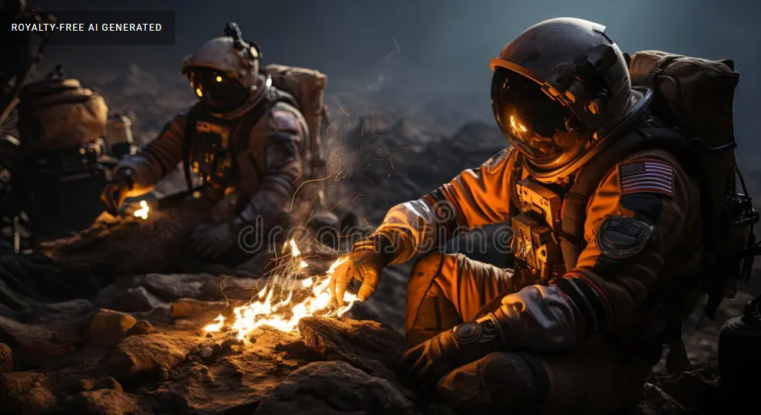
arrange for care and transport of the Scout to a medical facility. The parents or unit leaders must pay the costs of such care; the parents should file insurance claims.
In the event of an injury or illness requiring immediate medical attention, the care of your Scout will be provided by local emergency medical personnel, who may require the use of ground or air ambulance service at their discretion. All expenses associated with this additional treatment and/or emergency transportation is the responsibility of the Scout’s parents or guardians. The providers will directly bill the patient or other party; we will not make payments.
Weather Emergencies
Troops should go to Dinning Hall in the event of severe weather or a weather emergency.
Arrival, Parking, and Equipment
Upon arrival, units will be directed to their assigned campsite. The unit may TEMPORARILY drive vehicles down into the campsite to unload Scouts and equipment. One tow vehicle and trailer will be allowed to remain in the camping area.
Max Speed on Camp Roads: 10 MPH
Check-In
Since units may have diverse scheduling constraints, units may check in on Friday evening or Saturday morning. Friday night check-in at main gate, weather permitting. Saturday Morning Check-In at Dining Hall.
Check-Out
Units may check out after the Scouts Own Service on Sunday morning. Units are expected to police their campsites of trash, belongings, and other debris.
Units are responsible to dispose of their own trash in the dumpster behind the Dining Hall

Slide 6


Camporee Participant Requirements:
Minimum two-deep adult leadership is required
All adults in attendance must be current in Youth Protection Training
Current BSA medical forms for all participating youth and adults. Units will keep the forms. Part A and B only.
Roster of participating youth and adults, including points of contact in case of emergency. Units keep one copy and provide one copy to the camporee registrar at check-in. See the Troop Roster Form.
Payment of camporee fees. Checks or cash are acceptable. Checks should be made out to Greater Alabama Council.
Attend Scoutmaster/SPL Leader Meeting on Friday Night in conference room at main lodge.

Slide 7
Code of Conduct
Participation in this camporee requires only a few rules:
Youth Protection and Guide to Safe Scouting
The Scout Oath and Scout Law
Leave-No-Trace Ethics and the Wilderness Code
Fire Safety, Tote-n-Chip, and Cyber Chip
Follow applicable laws and restrictions. Use of open flames may be restricted based on local or state-wide weather restrictions.
Use of tobacco products within view of Scouts is prohibited by BSA rules. Adults needing to partake should retire to their vehicles.
Failure to comply with these rules may result in the individual or the unit being asked to leave the camporee event.
Leadership Meeting (Friday Night)
On Friday evening, all units need to send their Senior Patrol Leader and Scoutmaster to the leadership meeting. At this meeting, we will review the following:
Update of schedules and activities
Details of patrol competitions and games, including schedules and locations
Details on closing campfire participation and unit contributions, skits, etc.
Requests for OA elections and collection of callout rosters if not turned in at check in
Weather updates and safety review
Controlled Substances
Drug and alcohol laws will be strictly enforced according to the Scouting America standards and the laws of the State of Alabama. Scouting America’s policy is to provide a tobacco-free environment for all Scouting participants. Therefore, tobacco is not allowed in the presence of youth or in buildings. Tobacco use by adults (21 and over) is permitted only in the designated smoking area by the dumpsters near the dining hall. In accordance with longstanding policies of the BSA, no use or possession of illegal drugs, alcohol, or abuse of prescription drugs will be tolerated. Violations of the policy will result in immediate removal from camp property. In addition, use of illegal drugs will be reported to local law enforcement authorities.
Youth Protection Training Required for Adults
All registered Scouters listed on the unit adult roster at Camp Westmoreland must have a current Youth Protection Training Certificate. Certification is valid for two years and must be current through the Scouter’s entire time at camp. This requirement is to be verified by the Scoutmaster before camp.
Uniforms
Field Scout uniforms are encouraged to be worn during arrival and departure, color ceremonies, closing campfire, OA callout, and Scout’s Own. Activity uniforms may be

Slide 8



worn during patrol competitions, games, and other activities. Arrowmen are encouraged to wear their sashes when appropriate.
Photography and Social Media
We encourage Scouts to take pictures while at Camporee and share them on social media using the hashtag #BSAcamping. We will also be using a Facebook group page where pictures can be shared. Again, we encourage and stress the importance of the appropriate use of technology.
Challenge Competition
During your day of challenges, each patrol should pay attention to the staff and the challenge itself so you can vote on who you thought had the best staff and challenge. During dinner, each Patrol Leader will take a vote and decide which Challenge they should vote for at dinner later that night. At closing campfire, the results will be announced. The winning staff will be presented with an award for a job well done.
A Scout Is Reverent
Duty to God is part of Scouting. Camporee supports individual and unit needs for performing your duty to God. Scouts are encouraged to wear their full field uniform. Camporee offers a non-denominational, Christian-oriented, simple religious service. Units are invited to conduct their own services should they need special content. If any unit does not participate in a Scout’s Own, we request that they remain in their camp and maintain quiet so as not to disturb others.

Slide 9
Property or Equipment Damage
A Scout is Thrifty...all campsites and camp owned equipment will be inspected before checking in and out of camp. Any damages that occur will be assessed by the Camp Ranger
and must be paid prior to leaving camp. Damages include lost or damaged equipment, defacing tents or facilities, or damages to the natural environment. Please inform the host
troop of any damage you detect upon arrival.
Tents
Rips and tears per inch | $10.00
Writing on canvas each panel | $17.50
Destroying Waterproofing | Cost determined by Ranger
Tent Replacement | $500.00
Tarp Replacement | $125.00
Tent Platform and Picnic Tables
New Board replacement | Minimum $7.50
Ridge Pole | $25.00
Uprights | $12.50
Tie down rails and uprights | Cost determined by Ranger
Other Damage Fees
Permanent Structures | Determined by Case
Fire Extinguishers | $40.00
Environmental Damage
Damage to Live Trees | $20.00
Improper Disposal of Trash & Litter | $10.00

Slide 10

Events:
Schedule – See Schedule on last page of Guide
(Note: Events subject to personnel availability, weather, etc.)
2026 Camporee Games:
Scout Activities:
Satellite Launch The Soviet Union has just launched Sputnik, beating America at launching the first satellite. As a result of this crisis, NASA has just been created. The new NASA has selected your troop of Rocket Scientists to compete with other Rocket Scientist teams to rapidly advance America’s technology. Using only the items provided, you will design, fabricate and launch a test rocket. Scoring Criteria: NASA will award a lucrative contract based on: The overall distance the rocket is perceived to have traveled using NASA’s distance finders. (10 pts) The closeness of hitting the target area. (10 pts) The rocket staying in one piece (10 pts). Safety and Professionalism (20 points). Rockets can be dangerous. The scientists can have fun, but safety is always first. No horseplay. Listen to the instructions of the rocket range safety commanders. In the event of a tie, the troop demonstrating the best scout spirit will win.

Slide 11


Scout Activities:
Moon Buggy – Lunar Rock Collection Maze Scientists have developed a new “troop sized” Lunar Rover. Unfortunately, Lunar dust has obscured the windshield and the need for lunar windshield wipers was somehow overlooked. Fortunately, the Astronaut Troop left one member back at base who can serve as a navigator. This experience will test the Astronaut Troop’s teamwork, communication, and trust. The rover must avoid the steep canyon walls while picking up the lunar rock samples. The oxygen is limited and the sun is setting. The rover must return before the oxygen is depleted and the sun goes down. The rover is solar powered. Scoring Criteria: Scoring is based on: All lunar rocks collected (one point deducted for each rock missed) Time. Astronaut Troops will be ranked in order of time. Avoiding the walls. Minus one point for each contact (after the first one). In the event of a tie, the troop demonstrating the best scout spirit will win.

Slide 12
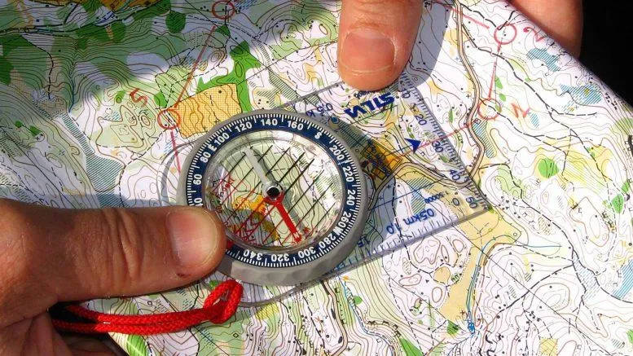
Scout Activities:
Interstellar Celestial Constellation Navigation. Orienteering - across the galaxy Orienteering: Orienteering for Scouts is an engaging outdoor challenge that combines navigation, problem- solving, and exploration. Scouts will start at a designated flag or marker and navigate a field using a map and coordinates to locate specific hidden checkpoints. Each checkpoint will have a unique marker or clue that they must collect or note to prove they’ve successfully reached it. The course will test their ability to use a compass, interpret maps, and plan routes, all while encouraging independence and critical thinking. The activity will be set in a clearly defined area to ensure safety while offering enough space for a meaningful challenge. Scouts will receive a briefing on how to read the map, use the compass, and interpret the coordinates. Scoring Criteria: Those who finish the course the fastest get a point and those who end up in the right ending spot gets a point Hint: The course will be shaped like a constellation. Name the constellation for an extra point. In the event of a tie, the troop demonstrating the best scout spirit will win.

Slide 13
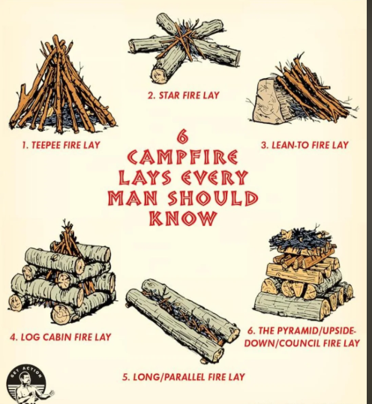
Stranded on an alien planet. The Scout’s spaceship has crashed on an alien planet much like Earth. Regrettably, the transponder appears to have been destroyed in the crash Build a fire to quickly signal the planetary orbiter your location. The fire must be able to burn through the rope provided in order for the heat signature to be seen from the orbiter. Fire Starting: Fire starting is a hands-on activity that teaches valuable survival skills, patience, and resourcefulness. Scouts will work to ignite a fire using a striker and their choice of starting materials: natural resources found around them, steel wool, or a cotton ball with Vaseline. The ultimate challenge is to build and sustain the fire long enough to burn through a small rope suspended above their fire pit. This activity not only builds practical skills but also fosters problem-solving and creativity as they explore the best ways to succeed with their chosen materials. Scoring Criteria: Items and Time - Scouts will have the options of using a cotton ball with Vaseline for 1 point, dryer lint for 2 points, or what they find for three points. Once they have selected their item of choice they then will be timed on how fast they can get the rope to burn apart. In the event of a tie, the troop demonstrating the best scout spirit will win.

Slide 14
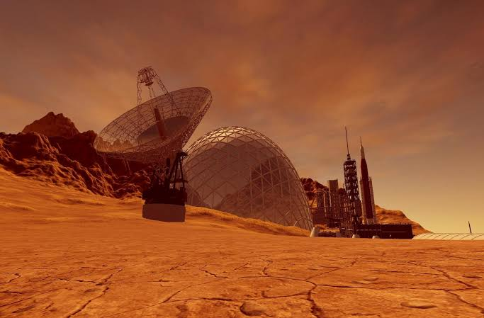
Martian Satellite Dish: On the evening before the troop’s departure from the planet Mars, a major Martian dust storm tips over the Martian Rocket and damages the thin plastic sheathing on the agricultural pod. All communication is lost with the orbiter. You need to communicate with the mother ship fast! The Astronaut troop will use the materials provided to build a satellite antennae mast. Scoring Criteria: Accuracy, height and time: You get one point for each lashing done correctly. The group with the fastest time to lash knots back gets 2 points. Troop with the highest mast gets two points. In the event of a tie, the troop demonstrating the best scout spirit will win.

Slide 15
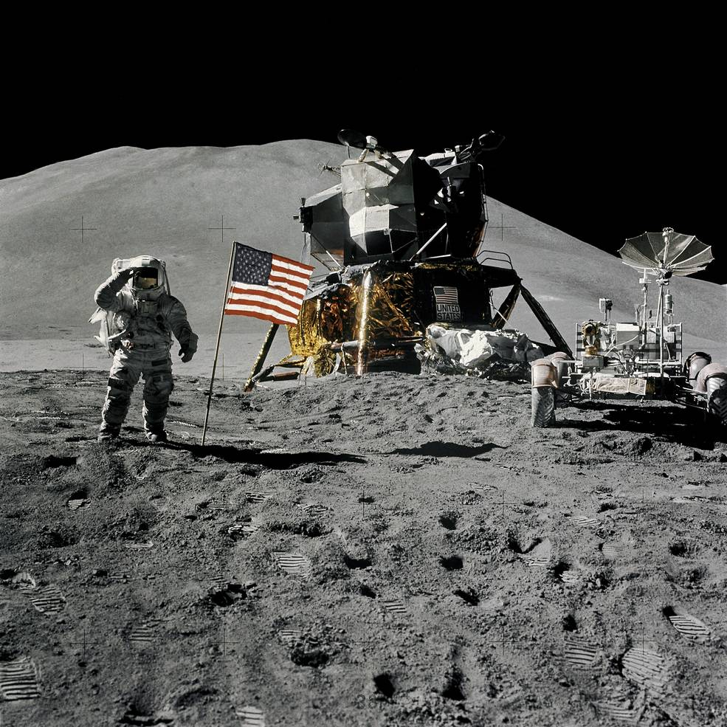
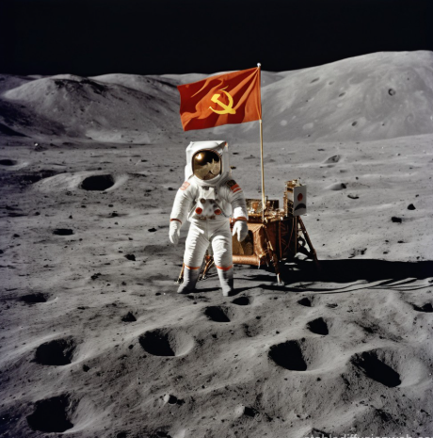


Capture the Flag on the Moon: The Eagle has landed! You and your troop of Astronauts have just raised your flag and preparing for the press conference, you hear chatter on the radio that indicates that on the other side of the crater another troop of Astronauts have just done the same!. You must capture their flag before the press conference starts so that your troop can have the honor of being the first scouts on the moon! Teams: Two teams, split into territories. The Field: The vast lunar surface, with designated bases (e.g., landing sites). The Flag: A visible object (like a small beacon or flag) placed in a designated, visible "flag zone" in each base. Tagging: Touch an opponent in their territory to capture them. Captured players go to jail (a designated spot or a time-out). Winning: Score by bringing the enemy flag to your base, potentially needing to hold it there for a set time or return your own flag if it's gone. Scoring Criteria: 1st Team to bring enemy flag back to Tranquility Base

Slide 16


Space Ball: Launch the projectile into the black hole. The smaller black holes score more points. Scoring Criteria: Top Score Wins

Slide 17
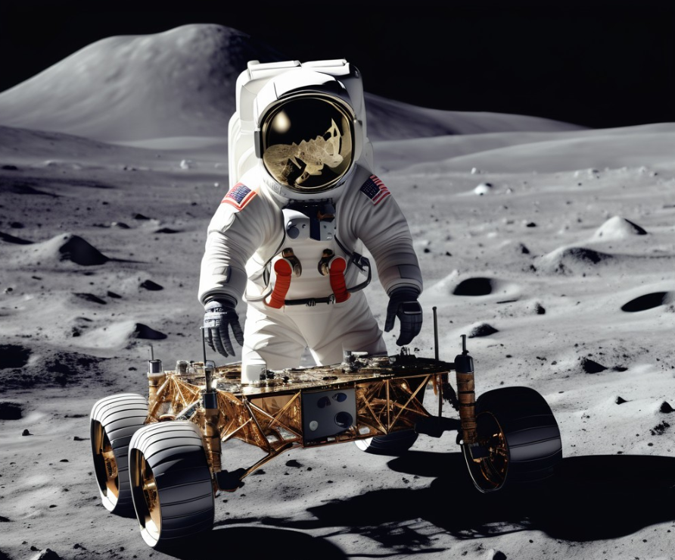
Building a Moon Rover: One of your Astronauts has tripped over a moon rock and suffered a leg injury. You need to use the items nearby to lash a moon rover together and carry the astronaut around the antenna and back to the spaceship. Scoring Criteria: Time Correct Lashings Wounded Astronaut does not fall off Rover

Slide 18
Camp-Wide Activities on Saturday Afternoon
Branding Station (Verify): Bring your gear and some spending money because you’ll have a chance to visit the Trading Post and the Branding Station during the event. At the Branding Station, you can make your gear extra special by getting it branded with unique Scouting designs—perfect for hats, leather items, or other personal gear. There will be no scoring for this. You will just need to bring some money and objects you may want branded
Trading Post: Bring your gear and some spending money because you’ll have a chance to visit the Trading Post and the Branding Station during the event. At the Trading Post, you can pick up some cool Scouting gear, fun souvenirs, or snacks to fuel your adventures. This is a great opportunity to take home something memorable from the day, so don’t forget to come prepared!
After games there will be two competitions Space Dutch oven cook off: cook a meal or dessert, your choice and make in your free time. Judges will be assigned to score the food, based on taste and space naming creativity. GaGa Ga-lactic Ball tournament - Non scored AstroScout Fun.
Hike: Walk to the lunar cemetery with a guide and learn some local history

Slide 19
Closing Campfire
Troops will meet in front of the Dining Hall to march to Campfire Arena.
The Order of the Arrow will conduct any Call Outs. Troop Leaders should ensure that the list of Scouts in their Unit being Called Out is provided to the adult representative prior to the Closing Campfire. Adults Candidates may be called out but must be Council Executive approved.
After call out, the closing/award campfire will start.
All troops are requested to participate with a skit or a song. Skits/songs must uphold
Scouting’s highest traditions and needs to be approved by the camporee SPL. Scouts will elect the winning skit via the loudest cheer.
Camporee Fellowship Cracker Barrel – Dinning Hall:
Troops will gather in the Dining Hall for Fellowship and Cracker Barrel after the Campfire.
The camporee will serve a Cracker Barrel but asks all troops to bring something to share (and any required serving utensils). This can be cookies, brownies, Dutch Oven cooked items, or any other kind of snacks.
Camporee will provide plates, utensils, and napkins for the Cracker Barrel.
Trading Post
There will be a small trading post open at the Cracker Barrel for extra camporee patches and
previous event patches. Items will be cash (or check) only. We will not be able to accept Credit Cards.
Patch Trading/Collection Display
A local Scouting VIP will be present with what is believed to be the world’s largest collection of Elvis related Scout paraphernalia. Feel free to trade your patch swag items with others.
Scouts Own
There will be a special service in the newly re-built Westmoreland Chapel on Sunday morning.

Slide 20
TROOP ROSTER
Name | Y/A | Emergency Contact Name | Emergency Contact Phone #
SM -

Slide 21

PATROL ROSTER
Patrol Name:
Troop Number
Name | Non- Swimmer | Beginner | Swimmer
*** Patrols are to carry their roster to all events. This form will be asked for before the patrol can participate in any waterfront event.

Slide 22
Campsite Inspection Form
Unit: Campsite:
SITE SELECTION AND TENT PLACEMENT (5 points total)
Takes advantage of ground slope, no ditching. Avoids insects, poison ivy, and obvious danger from overhead. | 0-5 points
SHELTER (10 points total)
Tents properly erected; trim, securely anchored. | 0-5 points
Cover for dining facilities properly erected; trim, securely anchored, provides for run-off of rain. | 0-5 points
FIRE, FIREWOOD, AND WOOD TOOLS (25 points total)
Fire site a safe distance from tents, etc.; adequately contained. (5 ft. radius cleared around fire) | 0–10 Points
Adequate fire buckets and/or other firefighting equipment available. | 0–10
Firewood protected from rain and dampness. | 0–5 Points
HEALTH AND SAFETY (60 points total)
Proper disposal of garbage. | 0–5 Points
Food adequately protected from contamination and spoilage. | 0–5 Points
Dish washing practices result in clean pots, plates, etc. | 0–5 Points
Cooking equipment stored off ground and clean. | 0–5 Points
Clean water is available. | 0–5 Points
Location of adequate first aid kit visible to all. | 0–10
Campsite is clean and in order. | 0–10
Personal equipment neat and stored properly. (uniform by patrol) | 0–10
Ground cloth under bed or tent; bedding is dry, rolled, folded or covered. | 0–5 Points
CAMP IMPROVEMENTS (30 points total)
U.S. and troop flags properly displayed. (U.S. Flag on the right side of the entrance to a person standing in the entrance facing out of camp.) | 0–10 Points
***Campsite improvements/campcraft. Created basically with natural material and put to practical use to make campsite more comfortable and convenient. Examples are built-up fireplace, utensil rack, pack rack, table, seat, boot scraper, fire bucket holder, tripod, wash basin, etc. | 10-20 Points
PATROL ORGANIZATION AND OPERATION (40 points total)
Evidence of separate patrol sites. Units with only one Patrol will be Leaders vs Scouts. | 0–10 Points
Patrol menu posted in Patrol site and kept dry. | 0–10
Patrol duty roster posted in patrol site and kept dry. | 0–10
***Theme items in camp (Space) | 0-10 Points
TOTAL POINTS possible (170)
18

Slide 23
































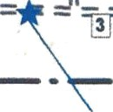




BSA Greater Alabama Council
Camp Westmoreland
Prepared by: John Buxton (266) 662-3160
tt
TomahapT‹
)(
Shawr*ee
-
Arapho
Map Legend
Activity Field
= • Unpaved Road
— - Old Road
- Trail
— Property Line
Bathhouse
^{A}'‹'>•^••*
Training Centered-
,
Structure Legend: 1 - Handicraft Lodge
1 2 - Trading Past 3 - Pump Houae
O 4 - Storage Building 1
5 - Stomge Budding 2
z
”
y* ■ OA Lodge
Building
Structure a Campsite
6 Landmarks
Scale in Feet(1 Inch - 500 Feet)
’Ranger
House
— Shore Line

Slide 24
2026 Fall Camporee Activities and General Schedule Friday, April 10, 2026
5:00-8:30 pm. Arrival and Check-In, Camp Set-up
9:00-9:20 pm. Camporee Staff Meeting in the Dining Hall
9:30-10:30 pm. Leader Meeting (SM, first ASM, and SPL required) in the Dining Hall
***Bring Leader’s Guide
11:00 pm. Taps, Quiet time
Saturday, April 11, 2026
6:30 am. Reveille
6:30-8:00 am. Breakfast and Clean-up, Late Arrival and Check-In available
8:30-8:45 am. Flags, Opening Ceremony, and Announcements
9:00-11:30 am. Unit Activities and Camp Inspections
11:30-1:00 pm. Lunch and Break
1:00-3:30 pm. Unit Activities
3:45-5:00 pm. Dutch Oven Competition, Gaga Ball Tournament, Gold Prospecting, Branding Station, Trading Post, Hike to Cemetery, Patch Trading (at trading post)
5:00 pm. Flags; Bring Dutch ovens for judging
5:15-7:00 pm. Dinner and Clean-up
7:30 pm. Meet at Dining Hall for Closing Campfire
8:00-9:30 pm. Closing Campfire, Awards, OA Induction Callouts
9:30 pm. (after Campfire) - Fellowship Cracker Barrel at Dining Hall
10:30 pm. Taps, Quiet Time
Sunday, April 12, 2026
6:30 am. Reveille
6:30-8:00 am. Breakfast and Clean-up
8:30-8:45 am. Flags, Announcements, and Closing Ceremony
9:00-9:15 am. Scout’s Own Service at Westmoreland Chapel
9:15 -11:30 am. Clean up, pack up, Check-out, and departure
20

