Slide 1
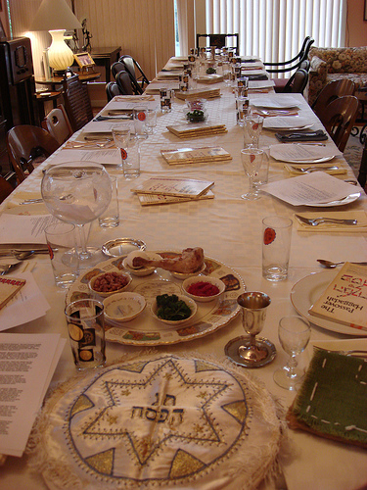
Yeshua in the Passover
Michael Natt
Developed by Dawn L. Uhrick
Adapted by Michael Natt

Slide 2
Leviticus 23:1-2
And the Lord spoke to Moses, saying, “Speak to the children of Israel, and say to them: ‘The feasts of the Lord, which you shall proclaim to be holy convocations, these are My feasts.

Slide 3
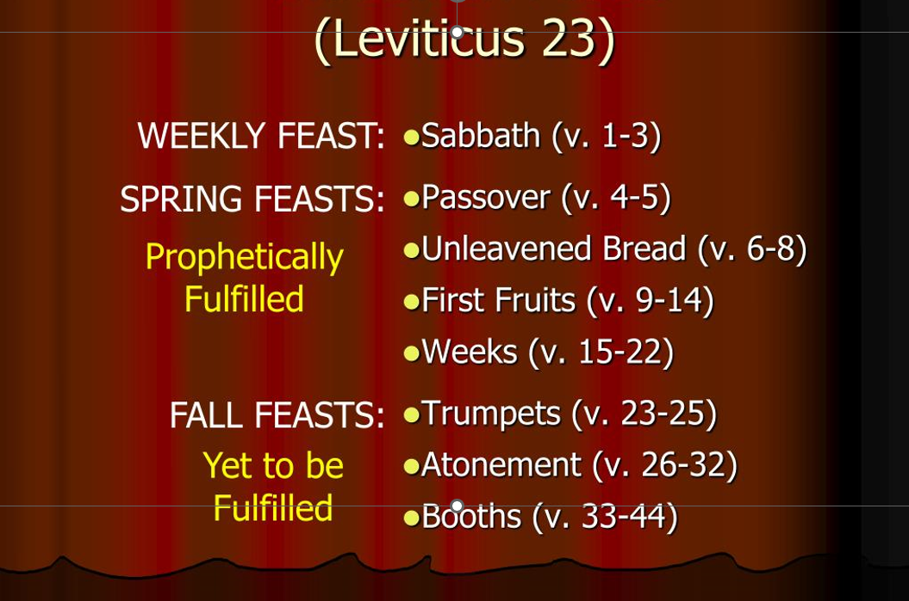
The Biblical Calendar

Slide 4
Exodus 12
Now the Lord spoke to Moses and Aaron in the land of Egypt, saying, ² “This month shall be your beginning of months; it shall be the first month of the year to you. ³ Speak to all the congregation of Israel, saying: ‘On the tenth of this month every man shall take for himself a lamb, according to the house of his father, a lamb for a household. ⁴ And if the household is too small for the lamb, let him and his neighbor next to his house take it according to the number of the persons; according to each man’s need you shall make your count for the lamb. ⁵ Your lamb shall be without blemish, a male of the first year. You may take it from the sheep or from the goats. ⁶ Now you shall keep it until the fourteenth day of the same month. Then the whole assembly of the congregation of Israel shall kill it at twilight.

Slide 5
Exodus 12
⁷ And they shall take some of the blood and put it on the two doorposts and on the lintel of the houses where they eat it. ⁸ Then they shall eat the flesh on that night; roasted in fire, with unleavened bread and with bitter herbs they shall eat it. ⁹ Do not eat it raw, nor boiled at all with water, but roasted in fire—its head with its legs and its entrails. ¹⁰ You shall let none of it remain until morning, and what remains of it until morning you shall burn with fire. ¹¹ And thus you shall eat it: with a belt on your waist, your sandals on your feet, and your staff in your hand. So you shall eat it in haste. It is the Lord’s Passover.
¹² ‘For I will pass through the land of Egypt on that night, and will strike all the firstborn in the land of Egypt, both man and beast; and against all the gods of Egypt I will execute judgment: I am the Lord. ¹³ Now the blood shall be a sign for you on the houses where you are. And when I see the blood, I will pass over you; and the plague shall not be on you to destroy you when I strike the land of Egypt.

Slide 6
Exodus 12
¹⁴ ‘So this day shall be to you a memorial; and you shall keep it as a feast to the Lord throughout your generations. You shall keep it as a feast by an everlasting ordinance. ¹⁵ Seven days you shall eat unleavened bread. On the first day you shall remove leaven from your houses. For whoever eats leavened bread from the first day until the seventh day, that person shall be cut off from Israel. ¹⁶ On the first day there shall be a holy convocation, and on the seventh day there shall be a holy convocation for you. No manner of work shall be done on them; but that which everyone must eat—that only may be prepared by you. ¹⁷ So you shall observe the Feast of Unleavened Bread, for on this same day I will have brought your armies out of the land of Egypt. Therefore you shall observe this day throughout your generations as an everlasting ordinance. ¹⁸ In the first month, on the fourteenth day of the month at evening, you shall eat unleavened bread, until the twenty-first day of the month at evening. ¹⁹ For seven days no leaven shall be found in your houses, since whoever eats what is leavened, that same person shall be cut off from the congregation of Israel, whether he is a stranger or a native of the land. ²⁰ You shall eat nothing leavened; in all your dwellings you shall eat unleavened bread.’ ”

Slide 7
In Each Generation
In each generation, they stand against us to destroy us, but the Holy One, blessed be He, rescues us from their hand.
In each and every generation, a person is obligated to see himself as if he left Egypt, as it is stated (Exodus 13:8).
So it shall be, when your son asks you in time to come, saying, ‘What is this?’ that you shall say to him, ‘By strength of hand the Lord brought us out of Egypt, out of the house of bondage (Exodus 13:14).

Slide 8
4 Aspects of Passover
Historically – The Passover in Exodus (Exodus 12:1-20)
Culturally – The Jewish Seder
Prophetically – The Messianic Fulfillment
The Last Supper – Yeshua’s Observance

Slide 9
Palm Sunday
Speak to all the congregation of Israel, saying: ‘On the tenth of this month every man shall take for himself a lamb, according to the house of his father, a lamb for a household. And if the household is too small for the lamb, let him and his neighbor next to his house take it according to the number of the persons; according to each man’s need you shall make your count for the lamb. Your lamb shall be without blemish, a male of the first year. You may take it from the sheep or from the goats. Now you shall keep it until the fourteenth day of the same month. Then the whole assembly of the congregation of Israel shall kill it at twilight. (Exodus 12:3-6)

Slide 10
Three Days and Three Nights
For as Jonah was three days and three nights in the belly of a huge fish, so the Son of Man will be three days and three nights in the heart of the earth (Matthew 12:40).
Tell the whole community of Israel that on the tenth day of this month each man is to take a lamb for his family (Exodus 12:3). – Palm Sunday
Take care of them until the fourteenth day of the month, when all the people of the community of Israel must slaughter them at twilight (Exodus 12:6). - Thursday
The resurrection: On the first day of the week, very early in the morning (Luke 24:1).

Slide 11
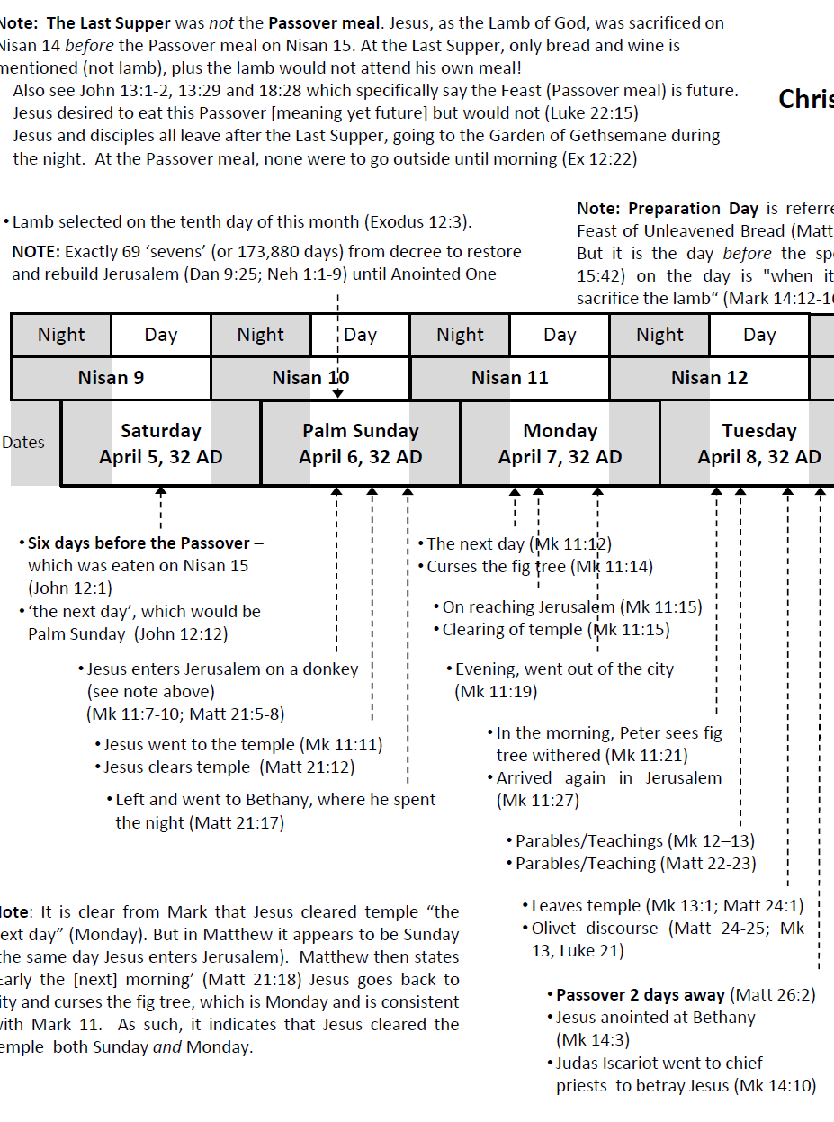

Slide 12
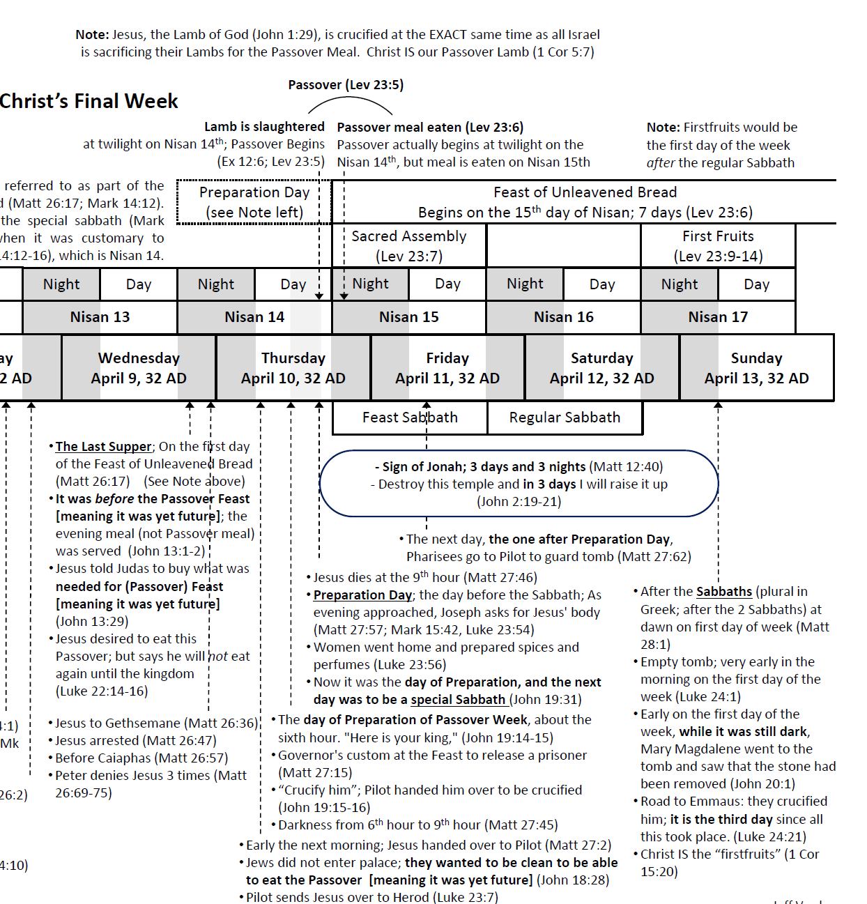

Slide 13
The Feast of Firstfruits
Bikkurim
Leviticus 23:9-14
The Feast of Firstfruits is celebrated on the first day after the Sabbath that occurs during the week-long Passover celebration.
The Feast of Firstfruits celebrates the first harvest of the year, and is a reminder of God's provision and sovereignty.
But now Messiah is risen from the dead, and has become the firstfruits of those who have fallen asleep (1 Corinthians 15:20).

Slide 14
Preparation
On the first day remove the yeast from your houses … Do no work at all on these days, except to prepare food for everyone to eat—that is all you may do (Exodus 12:15-16).
On the first day of the Feast of Unleavened Bread, the disciples came to Jesus and asked, "Where do you want us to make preparations for you to eat the Passover" (Matthew 26:17)?
“When the hour had come, He reclined at the table, and the apostles with Him. And He said to them, “I have earnestly desired to eat this Passover with you before I suffer; for I say to you, I shall never again eat it until it is fulfilled in the kingdom of God” (Luke 22:14-16).

Slide 15
Lighting Candles
Once the house and the participants are ceremoniously clean, the Passover begins with the woman of the house lighting the candles and praying this prayer:
Blessed art Thou, O Lord our God, King of the Universe, who has sanctified us with Thy commandments and invited us to kindle the festival lights
When Jesus spoke again to the people, he said, “I am the light of the world. Whoever follows me will never walk in darkness, but will have the light of life (John 8:12).

Slide 16
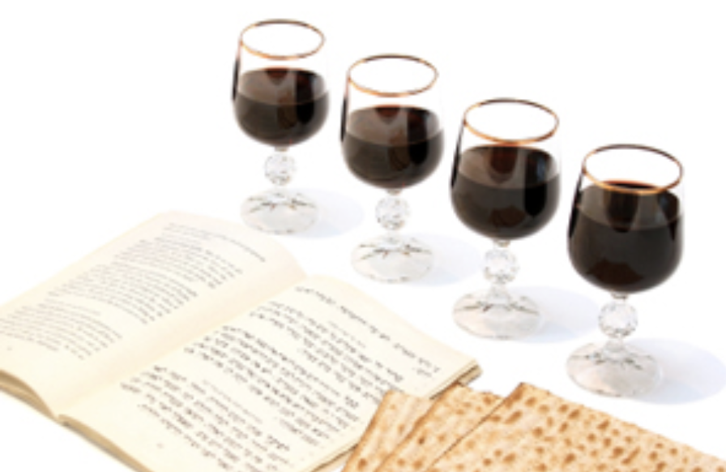
The Seder

Slide 17
Seder = Order
Haggadah = The Telling
“Therefore, say to the Israelites: ‘I am the Lord, and I will bring you out from under the yoke of the Egyptians. I will free you (deliver, save you) from being slaves to them, and I will redeem you with an outstretched arm and with mighty acts of judgment. I will take you as my own people, and I will be your God. Then you will know that I am the Lord your God, who brought you out from under the yoke of the Egyptians. And I will bring you to the land I swore with uplifted hand to give to Abraham, to Isaac and to Jacob. I will give it to you as a possession. I am the Lord’” (Exodus 6:6-8).

Slide 18
4 Cups Of Wine
Sanctification – Beginning of the Seder
Thanksgiving – After the Passover story is read
Redemption – After the afikomen is retrieved
Praise – When the hallel is sung

Slide 19
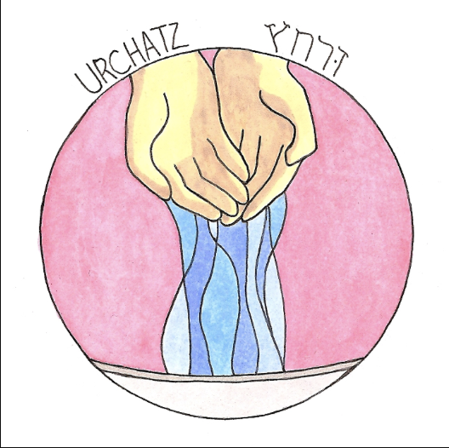
The First Washing of Hands
The Pharisees and all the Jews do not eat unless they give their hands a ceremonial washing, holding to the tradition of the elders (Mark 7:23).

Slide 20
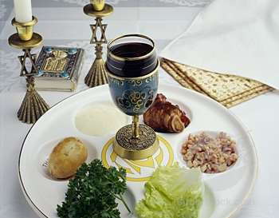
The Seder Plate

Slide 21
The Lamb
Each man is to take a lamb (Exodus 12:3).
Then Moses … said to them, "Go at once and select the animals for your families and slaughter the Passover lamb" (Exodus 12:21).
The next day John saw Jesus coming toward him and said, "Look, the Lamb of God, who takes away the sin of the world" (John 1:29)!
The lamb that was slain from the creation of the world (Revelation 13:8).

Slide 22
Fulfilled Prophecy (Down To the Bone)
Do not break any of the bones (Exodus 12:46).
These things happened so that the scripture would be fulfilled: "Not one of his bones will be broken” (John 19:36).

Slide 23
Parsley
Everyone takes a sprig of parsley and everyone dips it in the bowl of salt water.
The salt water reminds us that while our were in Egypt, we were slaves. The salt water reminds us of the bitterness and tears of our suffering and bondage.
The green parsley is used to represent growth. We remember that even in slavery, God faithfully caused us to grow into a nation.

Slide 24
Bitter Herbs
That same night they are to eat the meat roasted over the fire, along with bitter herbs, and bread made without yeast (Exodus 12:8).
Jesus answered, "It is the one to whom I will give this piece of bread when I have dipped it in the dish." Then, dipping the piece of bread, he gave it to Judas Iscariot, son of Simon (John 13:26).
One of them, the disciple whom Jesus loved, was reclining next to him (John 13:21).

Slide 25
Charoseth
We partake of the charoseth which reminds us of the clay and the mortar used by the Jewish slaves to make the bricks and build the cities.
Mortar (like cement) is known for its strength and endurance. Yet, the primary result of the hard work was that it taught the Jewish people to be strong and enduring in their faith. And the “more they were oppressed the more they proliferated.”
Charoseth is a mixture of ground apples, nuts and juice - all symbols of Jewish strength and virtue to teach us the lesson of endurance, how to withstand and grow through every challenge. Its sweetness symbolizes that the bitterness of slavery is tempered with the hope for a future.

Slide 26
Unleavened Bread
In the first month you are to eat bread made without yeast, from the evening of the fourteenth day until the evening of the twenty-first day. For seven days no yeast is to be found in your houses (Exodus 12:18-19).
The afikomen – 3 pieces of unleavened bread.
Get rid of the old yeast that you may be a new batch without yeast—as you really are. For Messiah, our Passover lamb, has been sacrificed. Therefore let us keep the Festival, not with the old yeast, the yeast of malice and wickedness, but with bread without yeast, the bread of sincerity and truth (1 Corinthians 5:7-8).

Slide 27
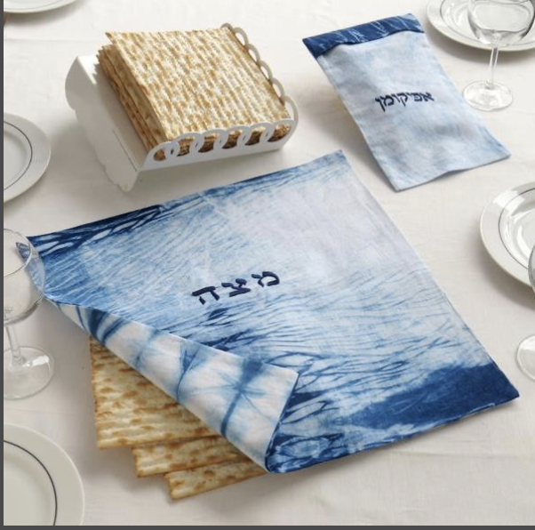
The Afikomen Is Hidden

Slide 28
The 4 Questions:
Ma Nishtanah: Why is this night different from all other nights!
On all other nights, we eat bread or matza. On this night, why do we eat only matza?
On all other nights, we eat all kinds of vegetables. On this night, why do we eat only bitter herbs?
On all other nights, we do not dip our vegetables even once. On this nights, why do we dip the twice?
On all other nights, we eat our meals sitting or reclining. On this night why do we eat only reclining?

Slide 29
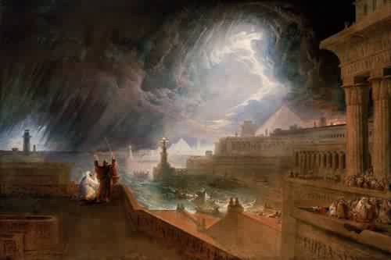
6. Sh’chin! Boils!
7. Barad! Hail!
8. Arbeh! Locusts!
9. Choshech! Darkness!
10. Makat B’chorot!
Death of the Firstborn!
The 10 Plagues:
1. Dahm! Blood!
2. Tz’fardeiyah! Frogs!
3. Ki-nim! Lice!
4. Arov! Flies!
5. Dever! Cattle Disease

Slide 30
Judgment Against Satan
On that same night I will pass through Egypt and strike down every firstborn—both men and animals—and I will bring judgment on all the gods of Egypt I am the LORD (Exodus 12:12).
And having disarmed the powers and authorities, he made a public spectacle of them, triumphing over them by the cross (Colossians 2:15).

Slide 31
Dayenu (It is enough for us!)
If the Lord had merely rescued us, but had not judged the Egyptians,
All: Dayenu!
If He had only destroyed their gods, but had not parted the Red Sea,
All: Dayenu!
If He had only drowned our enemies, but had not fed us with manna,
All: Dayenu!
If He had only led us through the desert, but had not given us the Sabbath, All: Dayenu!
If He had only given us the Torah, but not the land of Israel, All: Dayenu!

Slide 32
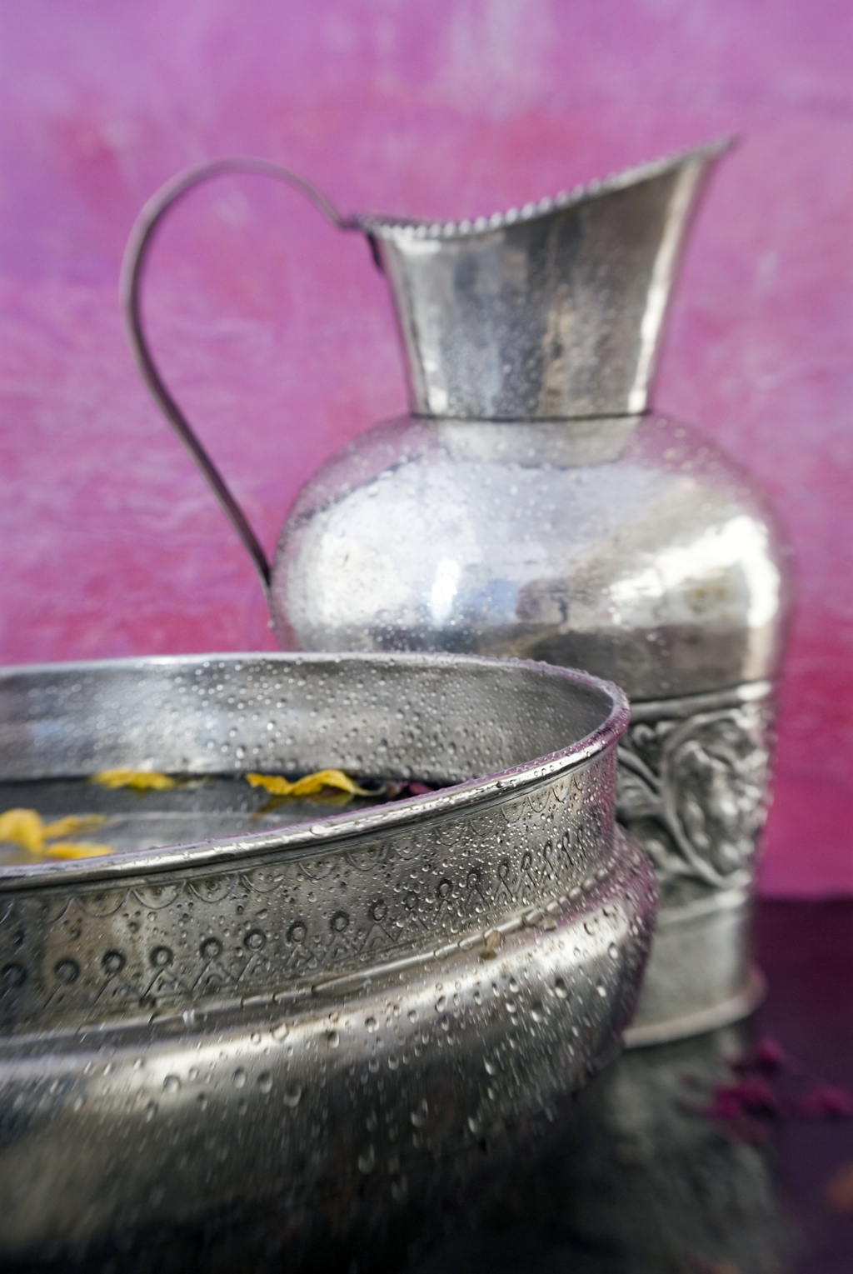
The Second Washing
After that, He poured water into a basin and began to wash His disciples’ feet, drying them with the towel that was wrapped around him … When He had finished washing their feet, He put on his clothes and returned to his place.
‘You call me ‘Teacher’ and ‘Lord,’ and rightly so, for that is what I am. Now that I, your Lord and Teacher, have washed your feet, you also should wash one another’s feet. I have set you an example that you should do as I have done for you’ (John 13:5, 12-15).

Slide 33
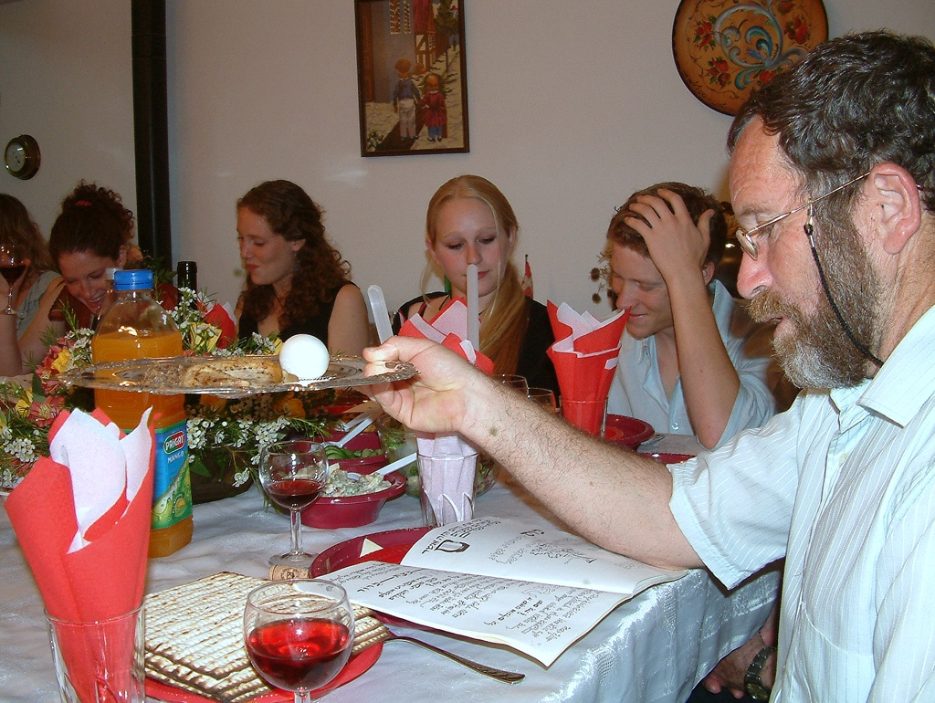

Slide 34
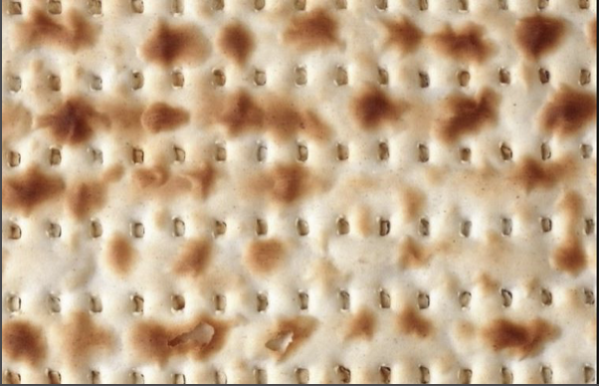
The Afikomen Returns! “I have Arrived!”
But He was wounded for our transgressions, He was bruised for our iniquities; the chastisement for our peace was upon Him, and by His stripes we are healed” (Isaiah 53:5).

Slide 35
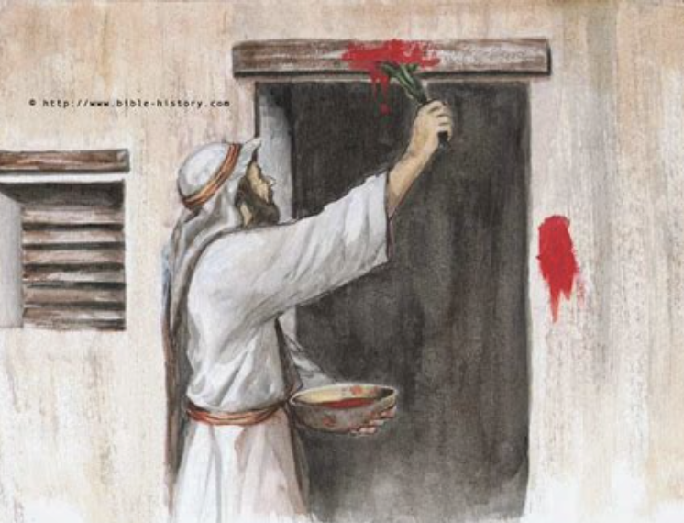
The Importance Of The Blood
Then they are to take some of the blood and put it on the sides and tops of the doorframes of the houses where they eat the lambs (Exodus 12:7).
The blood will be a sign for you on the houses where you are; and when I see the blood, I will pass over you. No destructive plague will touch you when I strike Egypt (Exodus 12:13).

Slide 36
The New Covenant
“Behold, the days are coming, declares the Lord, when I will make a new covenant with the house of Israel and the house of Judah, not like the covenant that I made with their fathers on the day when I took them by the hand to bring them out of the land of Egypt, my covenant that they broke, though I was their husband, declares the Lord. For this is the covenant that I will make with the house of Israel after those days, declares the Lord: I will put my law within them, and I will write it on their hearts. And I will be their God, and they shall be my people. And no longer shall each one teach his neighbor and each his brother, saying, ‘Know the Lord,’ for they shall all know me, from the least of them to the greatest, declares the Lord. For I will forgive their iniquity, and I will remember their sin no more (Jeremiah 31:31-34).

Slide 37
An Everlasting Ordinance
And as they were eating, Jesus took bread, blessed and broke it, and gave it to them and said, “Take, eat; this is My body.”
Then He took the cup, and when He had given thanks He gave it to them, and they all drank from it. And He said to them, “This is My blood of the new covenant, which is shed for many (Matthew 26:26-27).
So this day shall be to you a memorial; and you shall keep it as a feast to the LORD throughout your generations. You shall keep it as a feast by an everlasting ordinance (Exodus 12:14).

Slide 38
The Hallel
Psalm 113-118 - The Hallel
The stone the builders rejected has become the capstone (Psalm 118:22).
When they had sung a hymn, they went out to the Mount of Olives (Matthew 26:30).

Slide 39
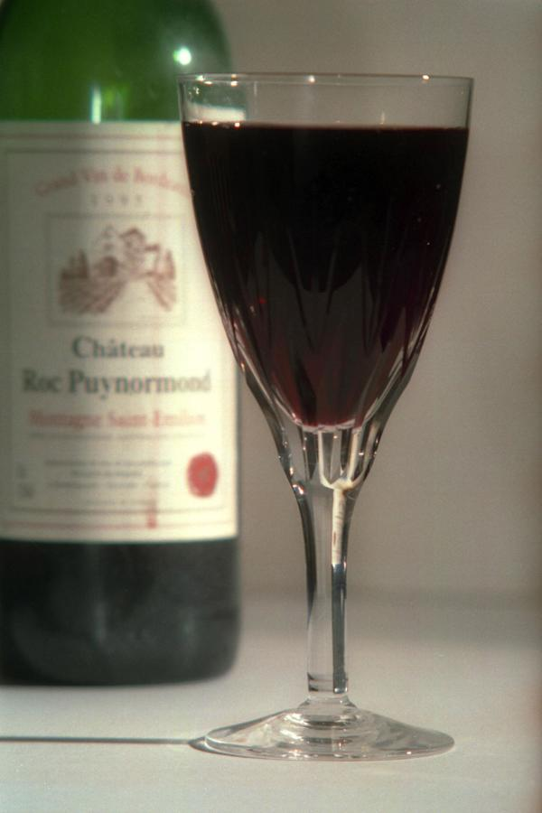
Elijah’s Cup
According to Scripture, before the Messiah returns, Elijah will appear
to proclaim His coming (Malachi 4:5).
We set a place at the table, along
with a cup of wine, in case this is the year that Elijah appears, heralding
the coming of the Messiah!

Slide 40
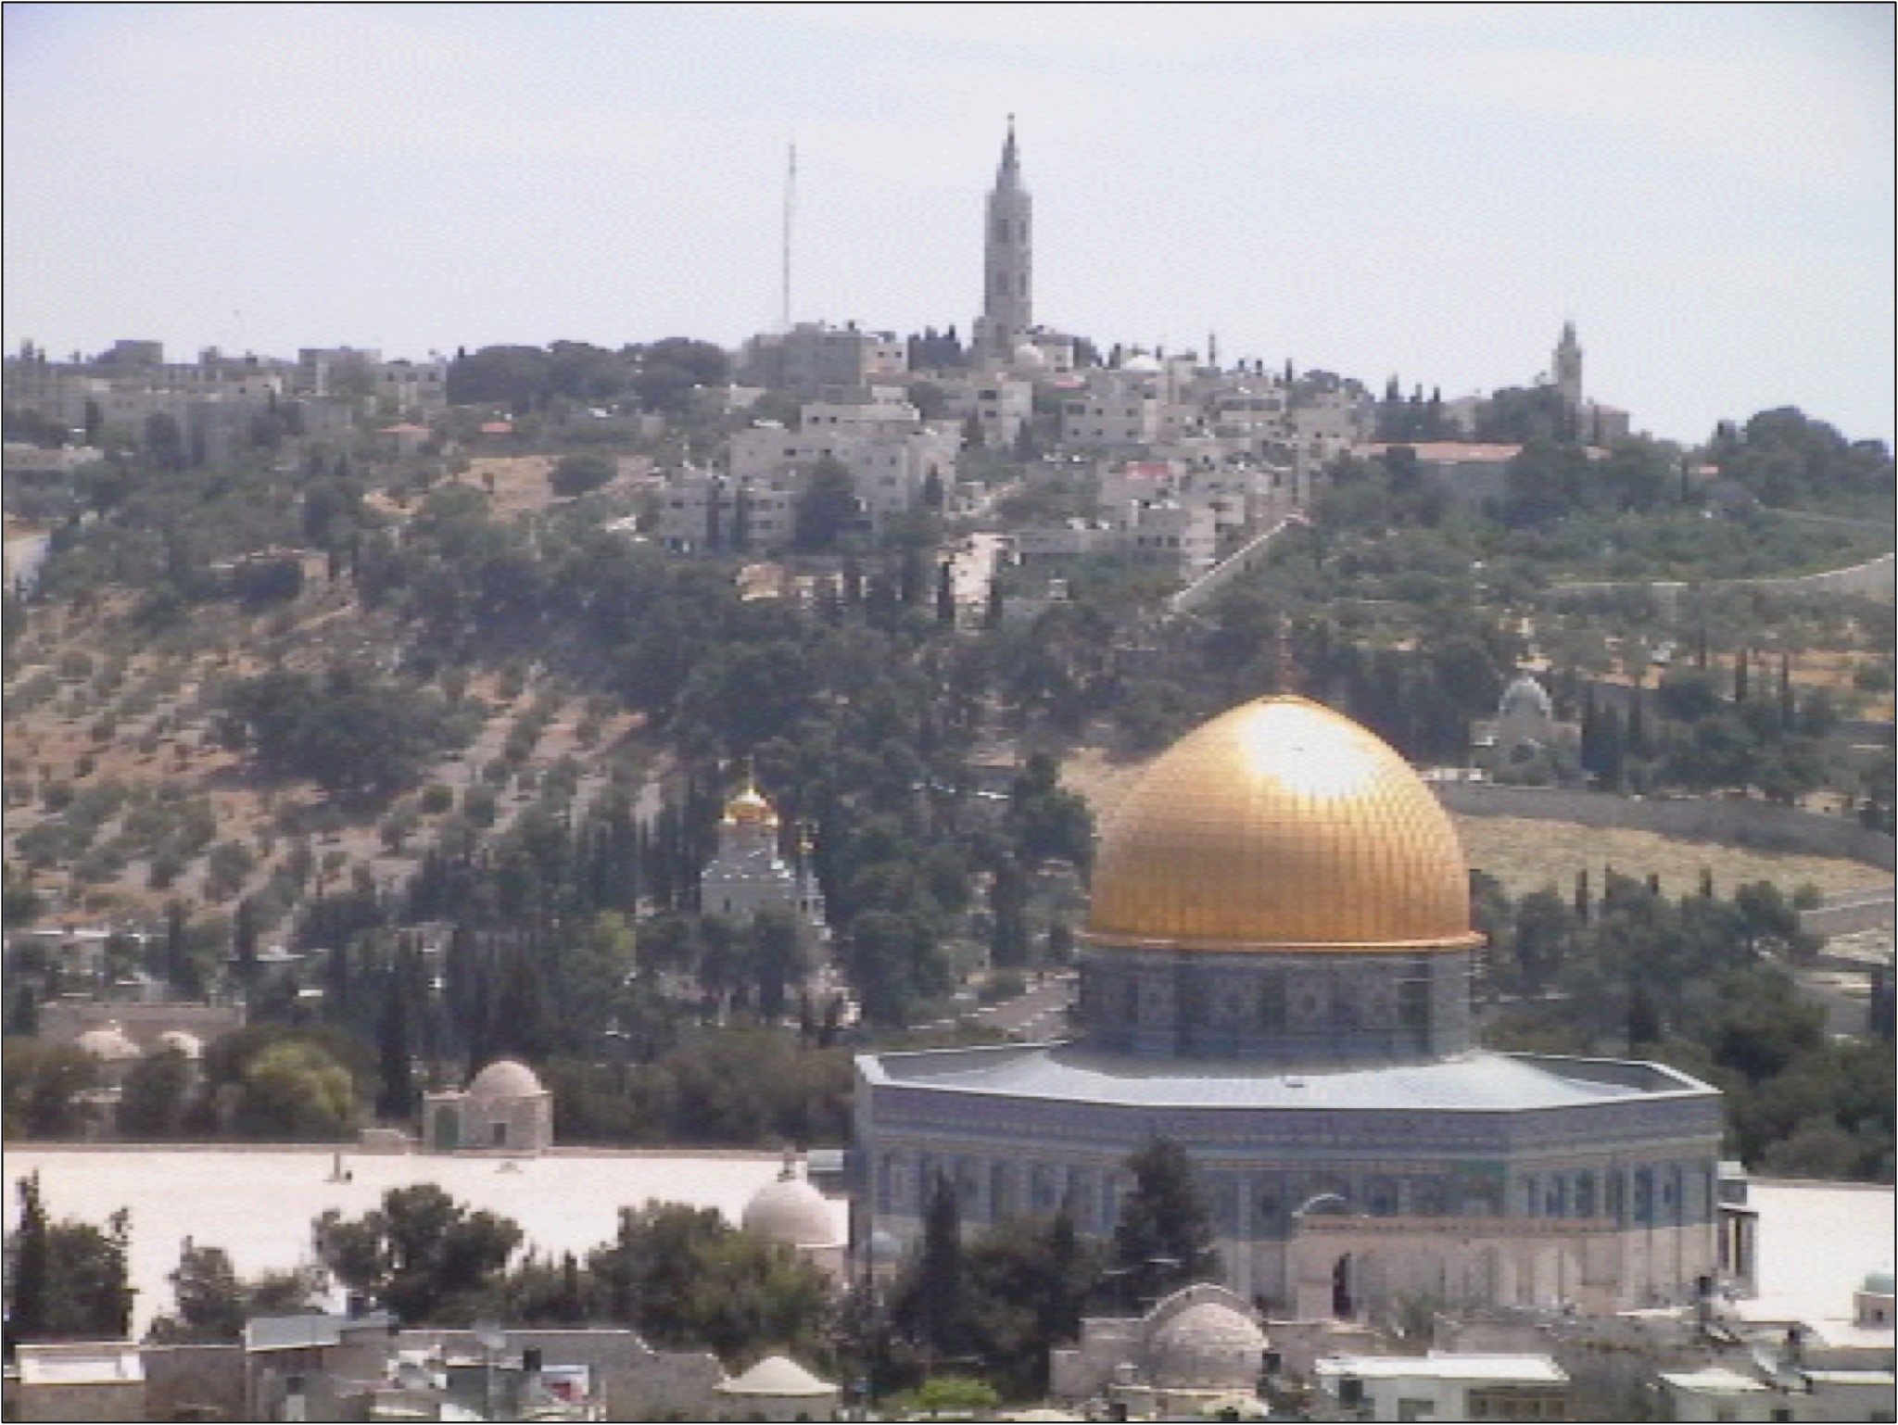
Next Year in Jerusalem

