Slide 1
Peaceful Passing Doulas
Conversations and support on the final journey

Slide 2
Peaceful Passing Doulas
Like a river that flows, one day we all become the ocean.
You may be familiar with the definition of a doula as a person trained to advise, inform and offer emotional and physical comfort.
The word ‘doula’ comes from the Greek word doulē, which translates to helper or maidservant. End-of-Life Doulas are trained care-givers offering support for a person’s end-of-life journey. For some, this journey can be a difficult experience and for others, it can be a time of great relief and even joy.
Each person needs to chart their own path and End-of-Life Doulas can help make this journey peaceful.

Slide 3
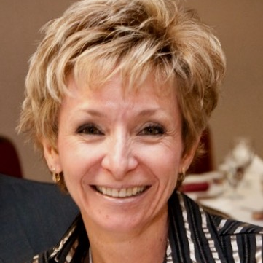
Who We Are
Certified End of Life Doulas
Anita Dickson – Licensed Practical Nurse with 25 years experience working in the Emergency Room, Palliative/Hospice, Tertiary Palliative and across all acute care units.
“I became an End-of-Life Doula in February 2022 to enhance my passion of caring for clients at the end of their lives.”
I currently work as a nurse and nursing educator and have practiced in the Lower Mainland, on Vancouver Island and in the Okanagan. I have taken several palliative courses in addition to my nursing education.
I have helped many clients palliate at home, helping them fulfill their final wishes.

Slide 4
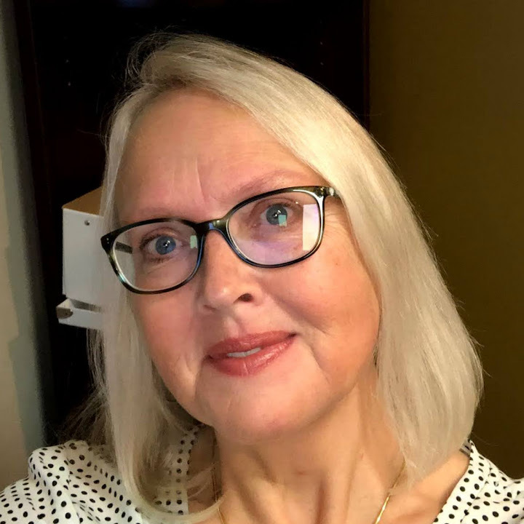
Who We Are
Certified End of Life Doulas
Iona Reitsma – Certified End-of-Life Doula. Iona has 5 years of experience working as a volunteer in Hospice and in the community.
“My passion for end-of-life care comes from the heart and knowing these hard conversations are a necessity.”
I took the Douglas College Doula course in 2019. I was already a COHA Volunteer. The latter has had me volunteering at Hospice House in many different capacities as well as connecting with clients in the Community.
I am a retired teacher from the UK and have supported both friends and family at end of life and when dealing with palliative diagnosis.

Slide 5
How we can help
We are here to help and offer a no-obligation, free 30-minute consultation.
We assist each person with their end-of-life planning.
We help navigate what can appear to be a confusing health care system and put them in touch with the appropriate professionals and resources.
We can help facilitate what can be difficult conversations with family and loved ones. We can help those involved understand what to expect as the journey unfolds.

Slide 6
What happens after the 30-minute consultation….
Peaceful Doulas will send a summary after the consultation providing:
A short summary of the main wishes expressed during the consultation.
A scale of the services which can be offered depending on the support network the person requires.

Slide 7
What we can help with…..
Anita Dickson – Health Care System Navigator
Her expertise is in understanding the workings of the Palliative/Hospice system. Setting up and reviewing care plans for clients, providing respite and vigils.
Iona Reitsma – Advance Care Planning
She is experienced in providing presentations and guidance through the process. Iona is also experienced in respite and vigils.

Slide 9
Contact us!
To book a FREE 30-minute consultation or for further information on the services we offer, please contact:
Anita Dickson: anita@peacefulpassingsdoula.ca
Iona Reitsma: iona@peacefulpassingsdoula.ca

