Slide 1
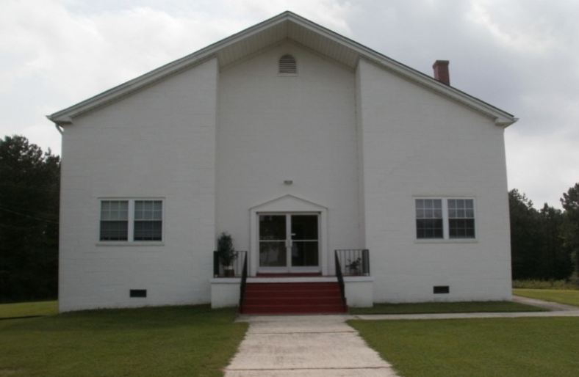
East Cedar Grove Missionary Baptist Association of North Carolina, Inc.
Celebrating 119 Years of God’s Amazing Grace
Moderator, Rev. J. Eric Morgan, III
Remembering: “Look Where He Brought Us From”
Rev. Joyce Daye Clayton, Presenter
Advisory/History/Archives Committees
1895 - 2013

Slide 2
Remembering: “Look Where He Brought Us From”
REMEMBERING
To Remind oneself of
To be mindful of
To call to Mind
To call to one’s mind
To remind again

Slide 3
Remembering, Reflecting and Praising Is a Good Thing… ECGMBA 1895 -2013
Deut. 8:18 “But you shall remember the LORD your God, for it is He who is giving you power to make wealth, that He may confirm His covenant which He swore to your fathers, as it is this day.”
Exod. 13:3 “And Moses said unto the people, Remember this day, in which ye came out from Egypt, out of the house of bondage; for by strength of hand the LORD brought you out from this place”
Jer. 2:2 “Go and proclaim in the hearing of Jerusalem: “This is what the Lord says: “I remember the devotion of your youth, how as a bride you loved me and followed me through the wilderness, through a land not sown.”
Numbers 15:39-40 “It shall be a tassel for you to look at and remember all the commandments of the LORD, so as to do them and not follow after your own heart and your own eyes … so that you may remember to do all My commandments and be holy to your God.”
Luke 22:19 "This is my body, which is for you; do this in remembrance of me.“
“On Aug. 10, 1895 at Ledge Rock Baptist Church in Wake County, where Rev. A. B. Wyche was pastor, a resolution was passed in the Cedar Grove Association dividing the Cedar Grove Association into two separate Associations, with the Lynchburg and Durham Railroad as the dividing line” … thus the East Cedar Grove Missionary Baptist Association was born.
Celebrating 119 Years of God’s Amazing Grace!

Slide 4
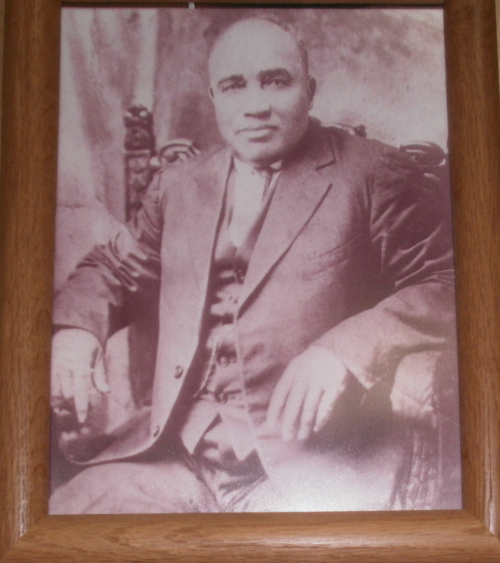
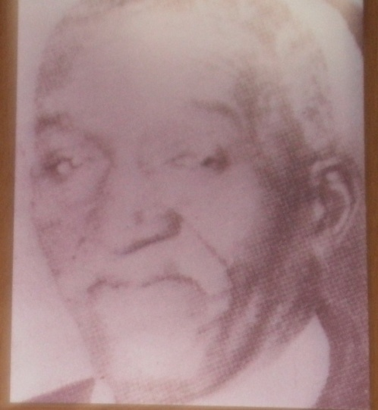
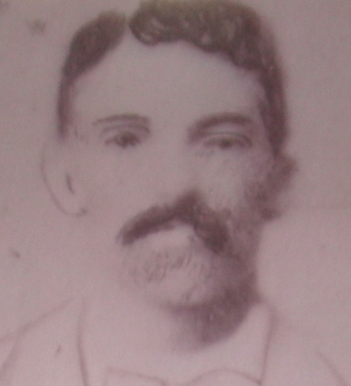
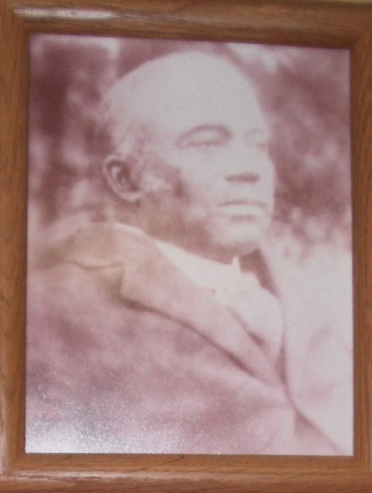
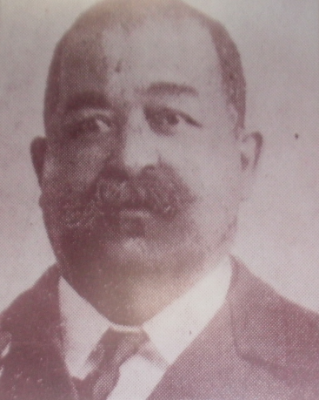
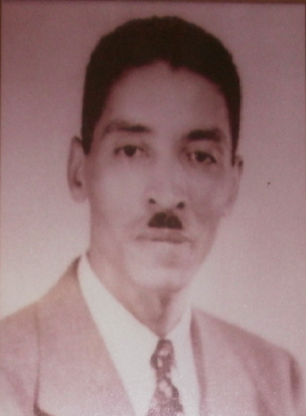
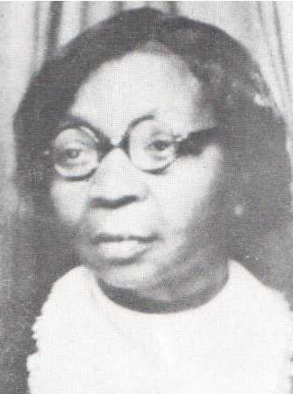
Remembering ECGMBA
“Celebrating 119 Years of God’s Amazing Grace”
“ Follow my example, as I follow the example of Christ. I praise you for remembering me in everything and for holding to the traditions just as I passed them on to you. But I want you to realize that … the head of the head of Christ is God.” (1 Cor. 11:1-3)

Slide 5
ECGMBA: Remembering, Reflecting and Praising Is a Good Thing
Remembering
what?
The Founder’s Faith, Vision and Courage
The Founders Purpose, mission, goals and objectives
The Founder's Calling to Action
The Founder’s Passion for Evangelism
The Founder’s Call for Unity
The Founder’s love for mission –in- action and ECGMBA

Slide 6
Remembering the Purpose: “To provide the arena and the instrumentality for member churches and auxiliaries to work corporately and cooperatively [ON] THE following concerns:”
To teach and preach the Gospel of Jesus Christ based on the Holy Bible and uphold Baptist doctrines, forms of worship and polity.
To develop and encourage Christian fellowship
To provide Christian Education to member churches
To provide spiritual assistance to member churches, congregations and auxiliaries
To enhance the quality of life in the community
To provide assistance to churches seeking counsel from the Association (upon request)
To provide support to the Ordaining Council
To support the General Baptist State Convention of NC, the Lott Carey Baptist Foreign Mission Convention and the National Baptist Convention, USA

Slide 7
Remembering, Reflecting and Praising Is a Good Thing… ECGMBA 1895 -2013
Motto: “Christian Diversity with Unity in Christ”
Vision: Salvation for all people; education for youth; peace on earth in every community.
Evangelism
Christian Education
Mission
Salvation
Service

Slide 8
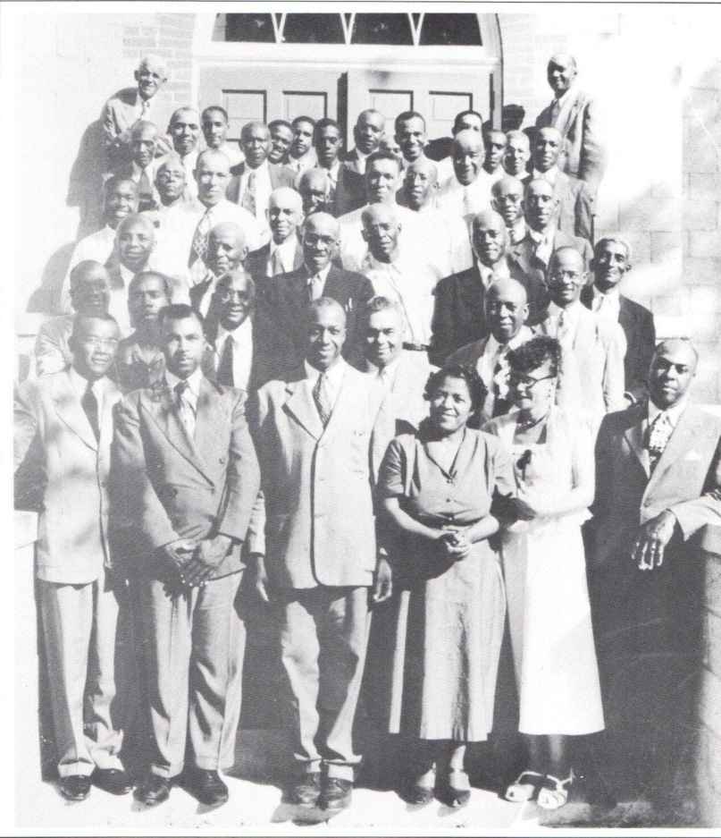
Remembering ECGMBA
“Celebrating 119 Years of God’s Amazing Grace”
Old Folks Rest Home , Creedmoor, NC, Former Headquarters of ECGMBA
Smith-Thomas Convention Center
Current Headquarters of ECGMBA

Slide 9
Remembering ECGMBA
“Celebrating 119 Years of God’s Amazing Grace”
Remembering The Mother Churches
Cedar Grove Missionary Baptist Church
Mt. Vernon Missionary Baptist Church
Union Grove Missionary Baptist Church
Union Baptist Missionary Baptist Church
Pine Grove Missionary Baptist Church

Slide 10
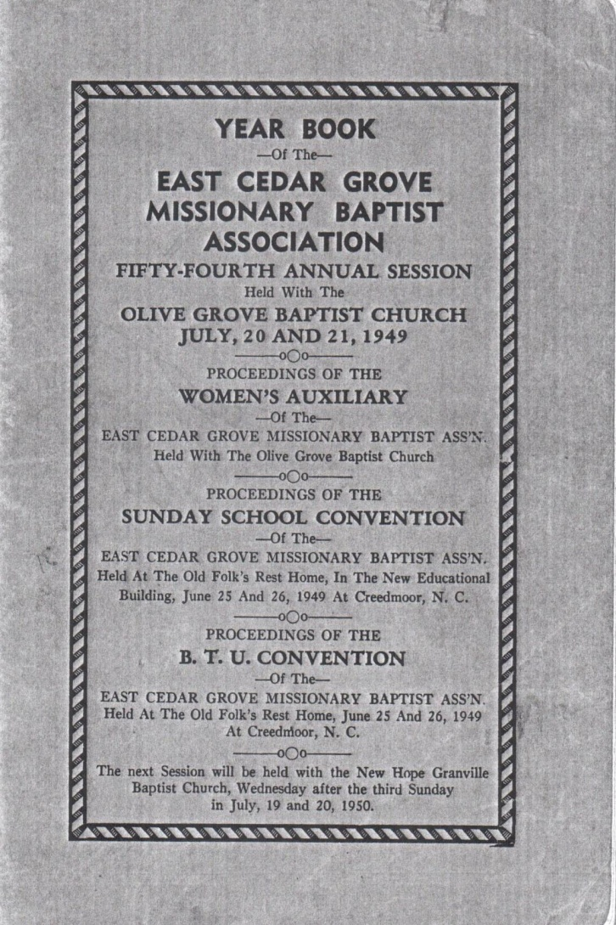
Remembering, Reflecting, and Praising
“ECGMBA Celebrating 119 Years of God’s Amazing Grace”
1949, 1952, 1987

Slide 11
Remembering Committee on Christian Education 1949 ECGMBA Annual Session(Ministerial Education)
“We your committee on Christian Education submit the following report:
  That since there is an increasing demand for Christian service that we encourage the church and Sunday School workers to take advantage of the training Conference offered at Shaw University each year.
  That in order to curtail juvenile delinquency that more of the pastors and churches conduct Daily Vacation bible Schools in their various communities.
  Because of the growing intelligence of our people that we urge our ministers to attend the six weeks course offered at Shaw University each summer, and that whereas, many of our ministers are not financially able to take advantage of the courses, that eh Association establish a fund or Scholarship to aid ministers taking the course. Further, since this is in keeping with the Moderator’s recommendations, we recommend that pastors and churches send up to the Association a special offering for this fund.”
  Committee: T.C. Graham, C. L. Faison, Ransom Thomas, J. R. Butler, Coy Thomas, Ernest Cadlett and Mrs. Pauline Love
  Proceedings of the 54th Annual Session, ECGMBA, Olive Grove Baptist Church

Slide 12
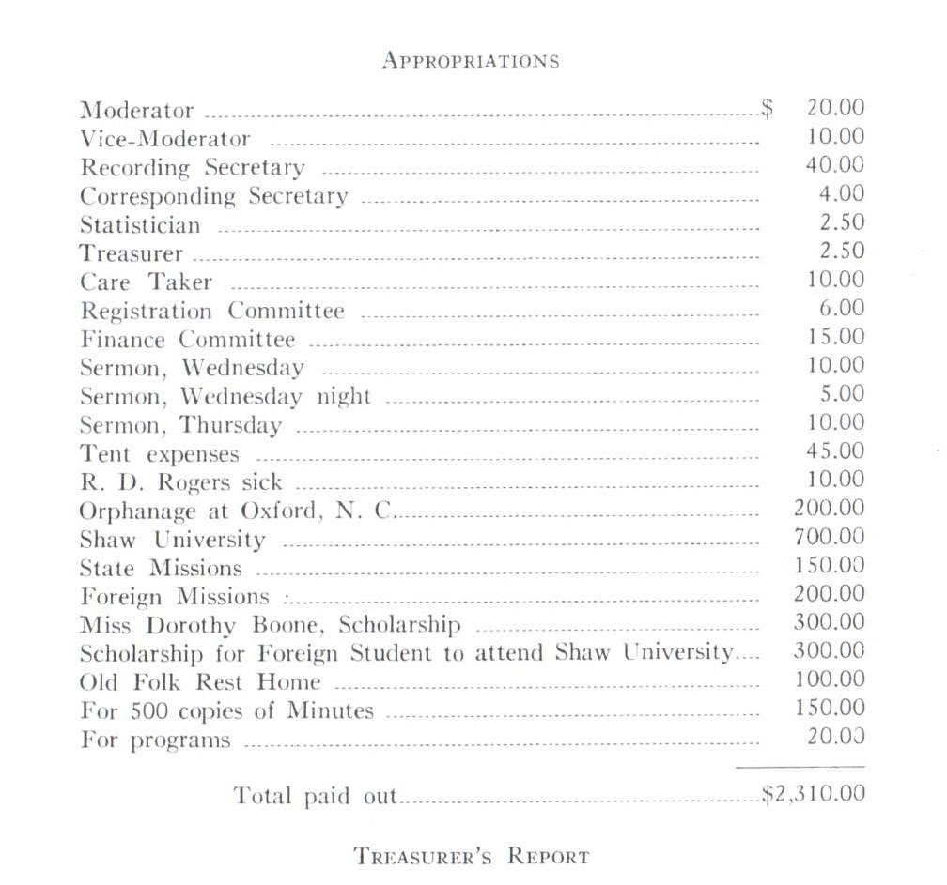
Remembering ECGMBA 1949
“Celebrating 119 Years of God’s Amazing Grace”
Source:
Year Book ECGMBA 54th Annual
Session
Minutes and Proceedings

Slide 13
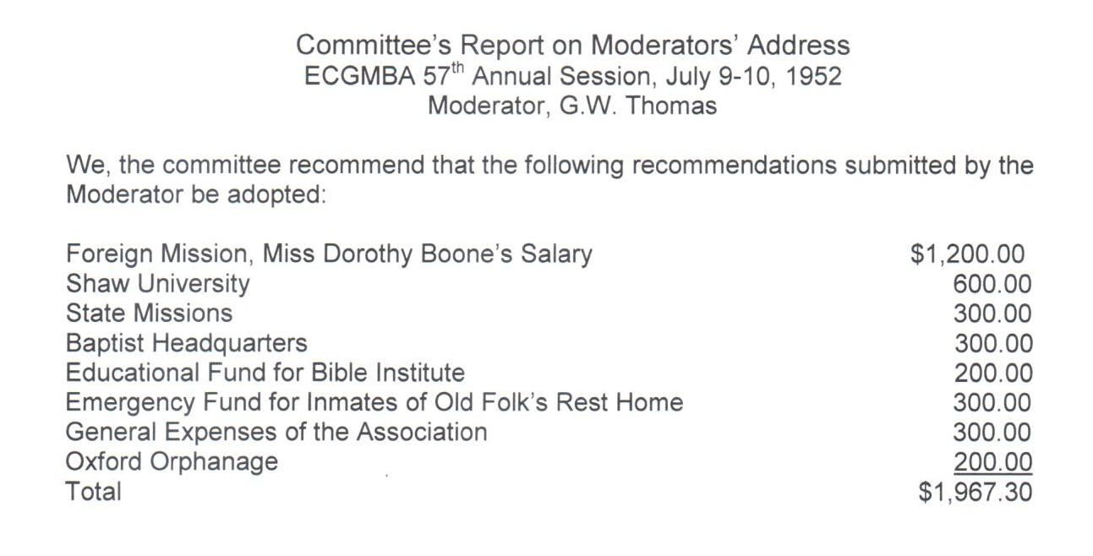

Slide 14
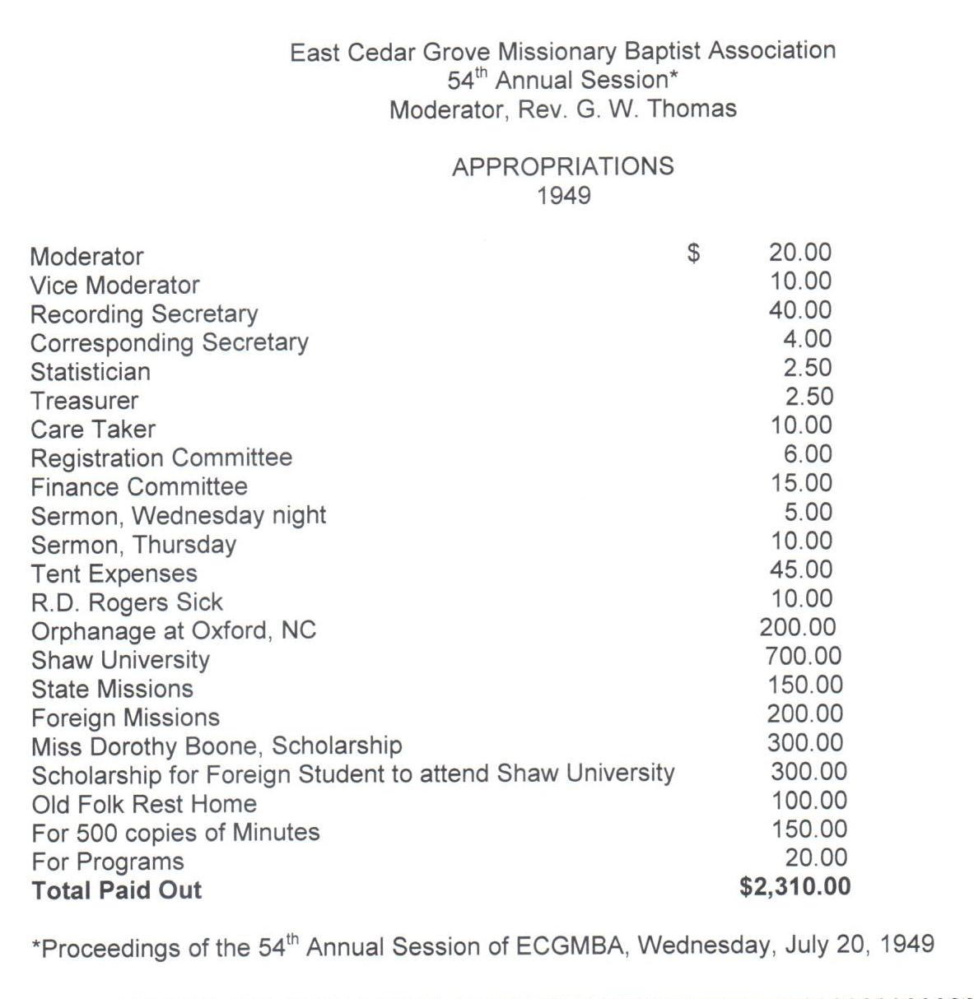
ECGMBA Year Book 1949
54th Annual Session Proceedings and Minutes

Slide 15
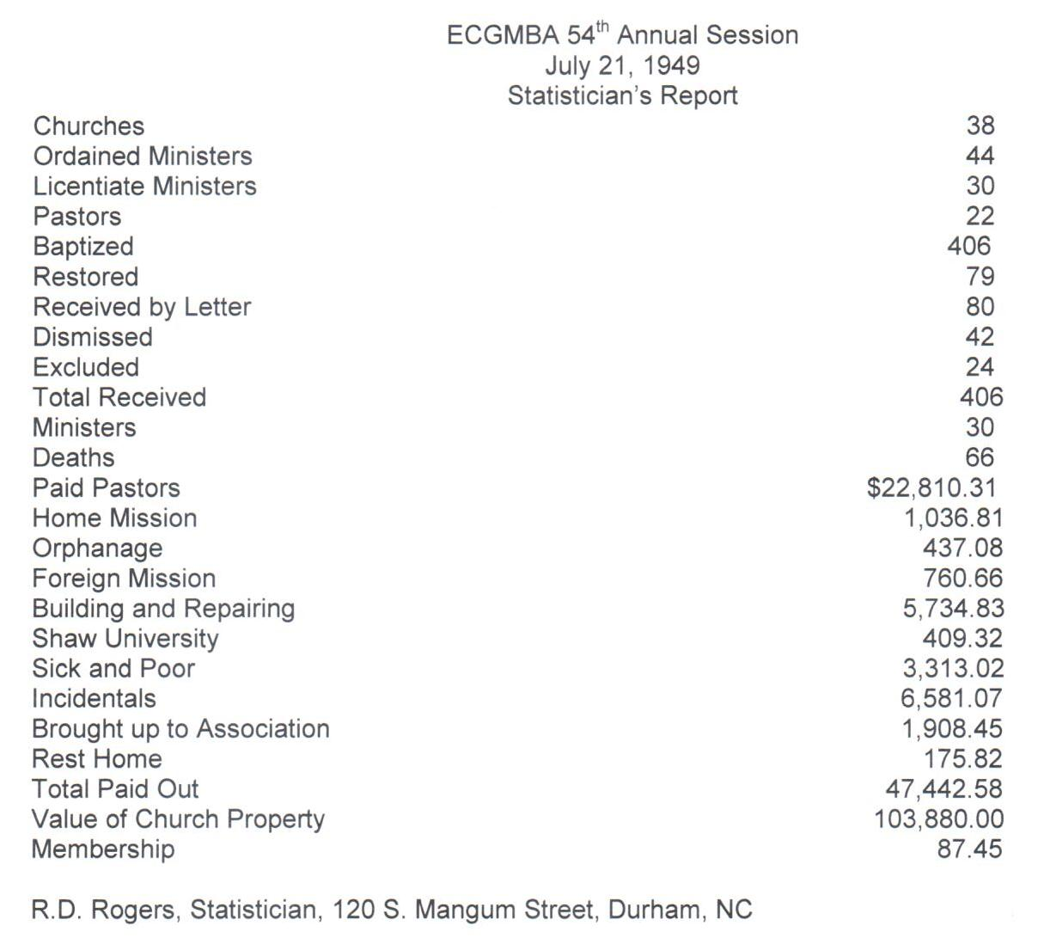

Slide 16
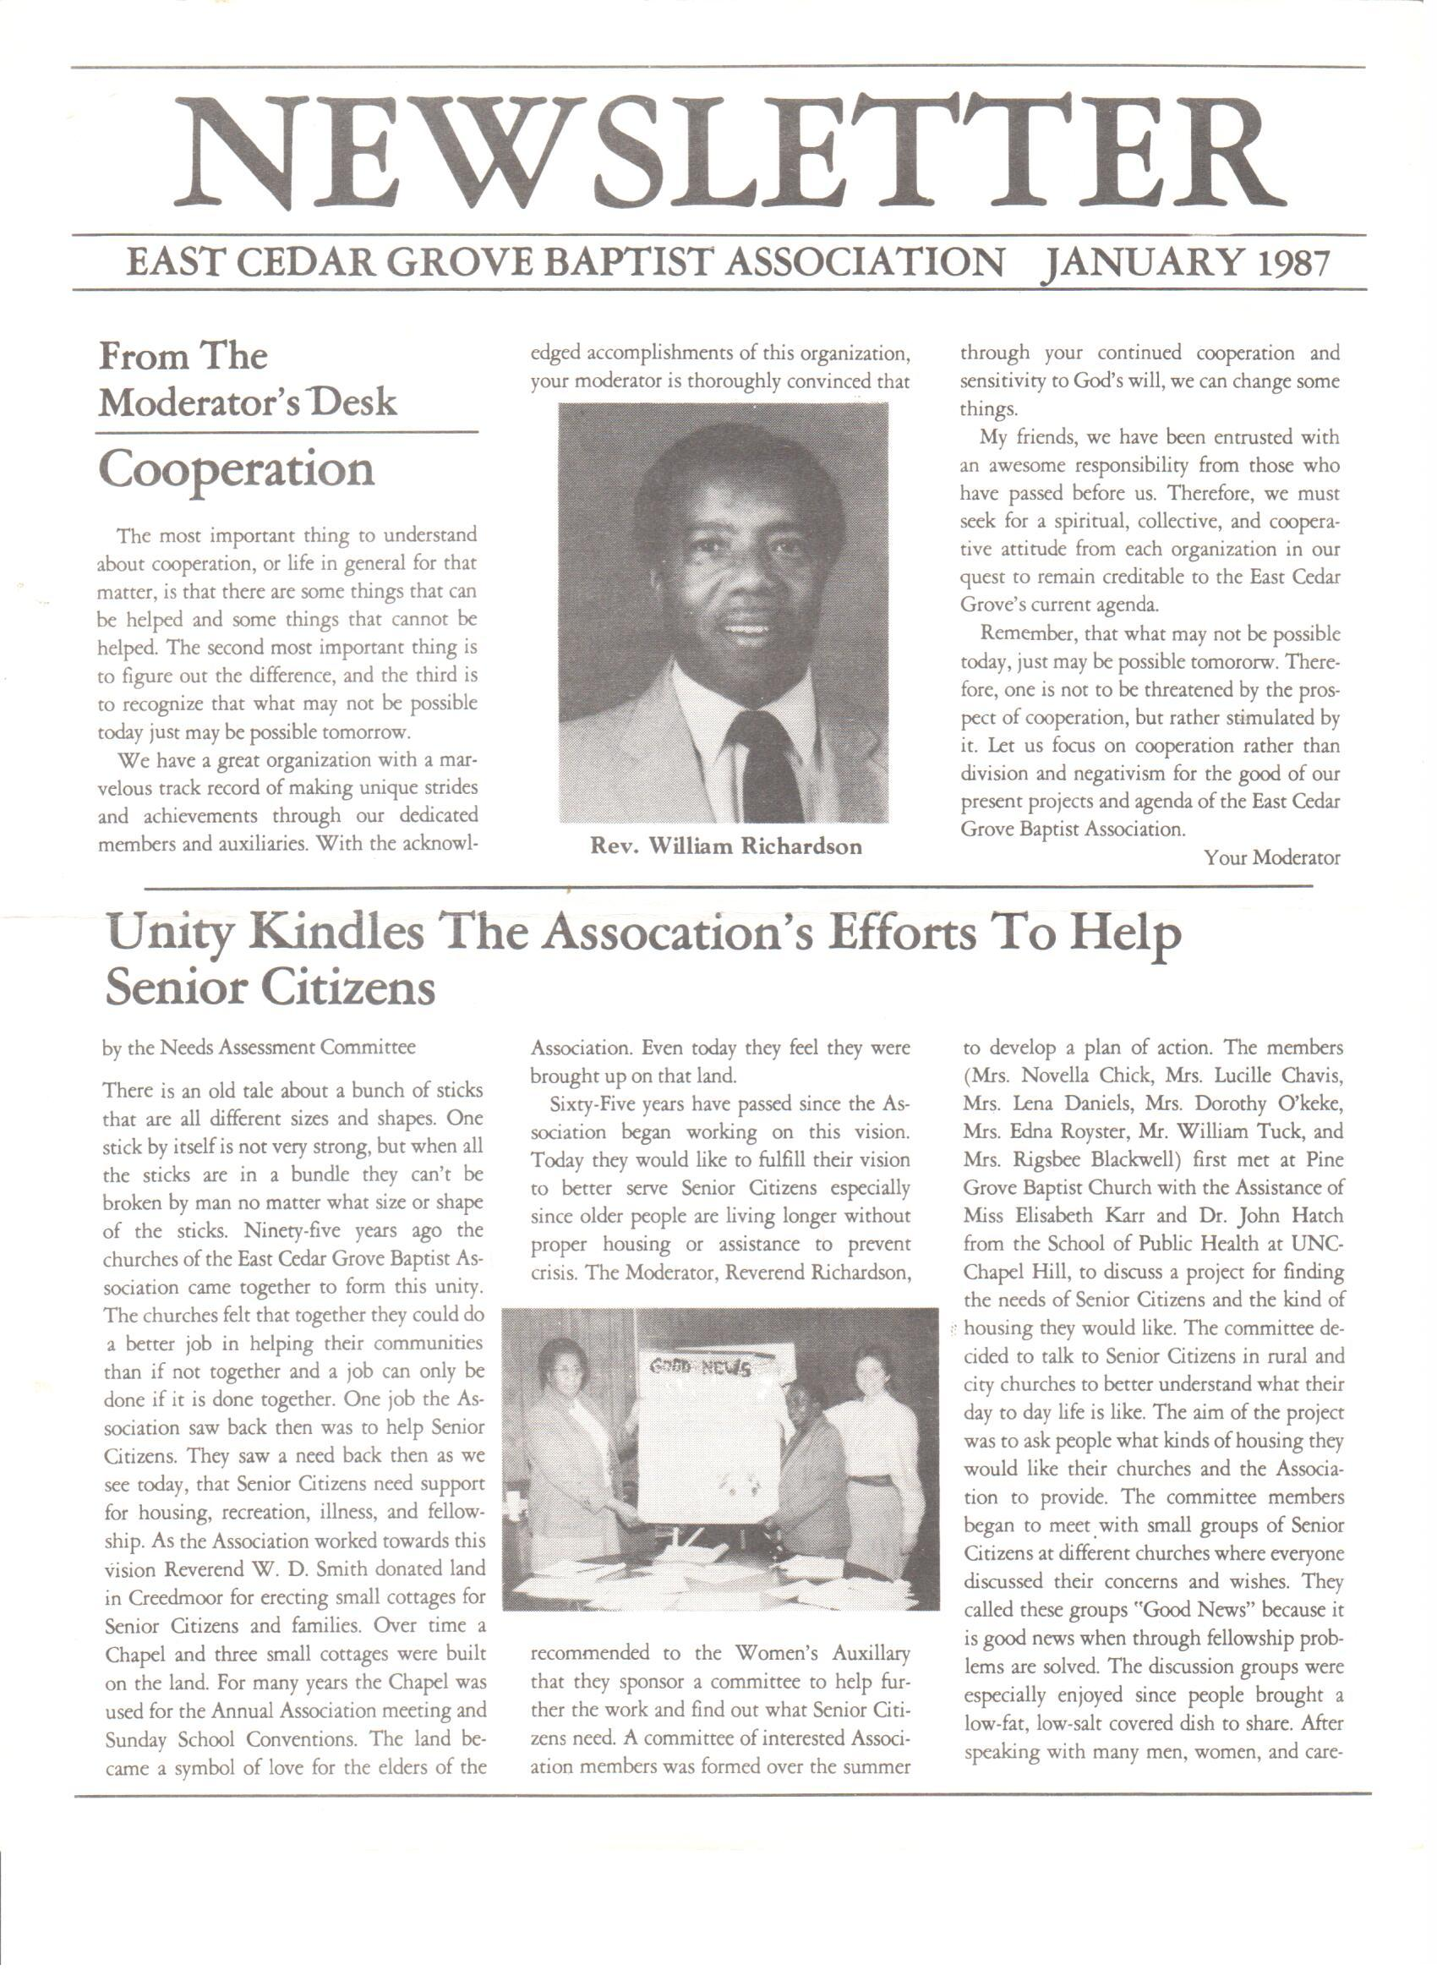

Slide 17
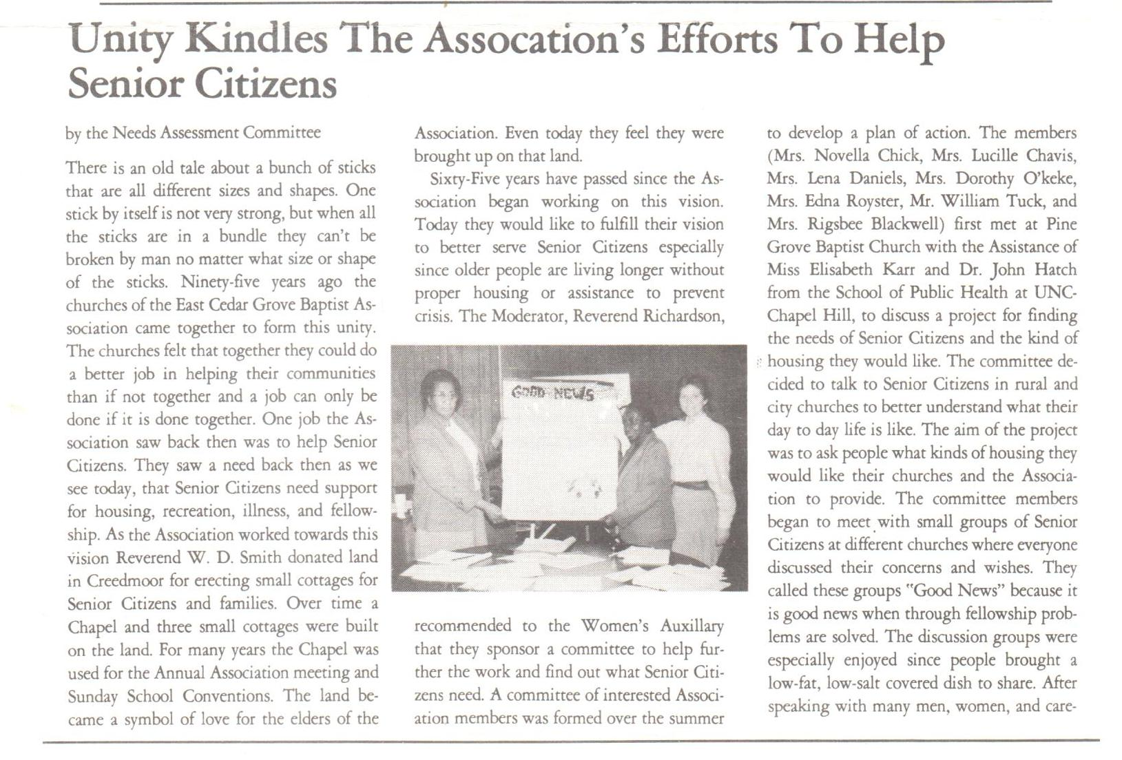
Member Church’s and Member’s Needs
ECGMBA Newsletter 1987

Slide 18
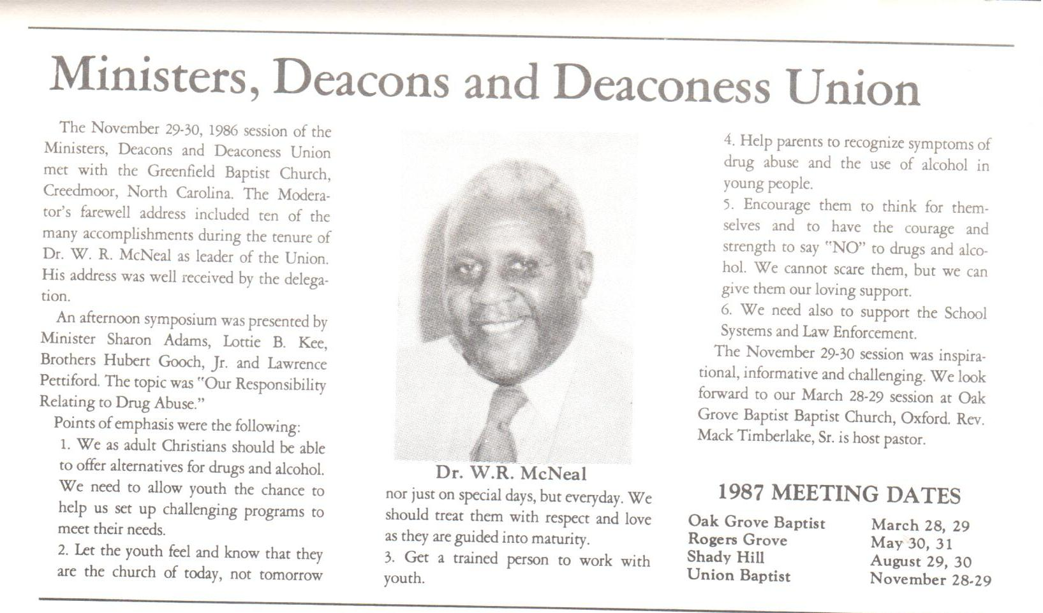
ECGMBA Newsletter 1987 with Focus on the Youth

Slide 19
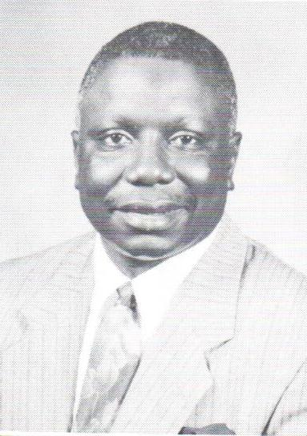
Remembering ECGMBA
“Celebrating 119 Years of God’s Amazing Grace”
“Look Where He Has Brought Us From…!”
1895 - 2013
Carryover Themes
Unity
Mission
Service
Evangelism
Praise and Worship
Christian Education
Fellowship
Love
“Standing on the Promises of God my Saviour”
“Using All the Parts to Make
the Whole”
(Ephesians 4:11-16)

