Slide 1
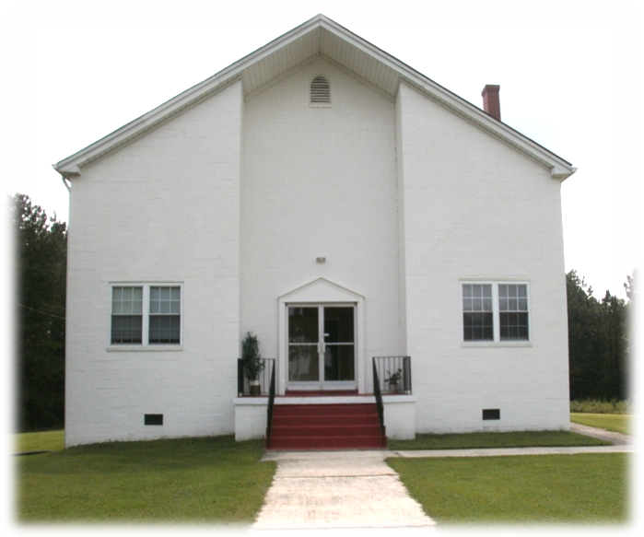
SALUTING
THE FIRST LADIES
OF EAST CEDAR GROVE MISSIONARY
AT ECGMBA FOUNDERS DAY
“Standing on The Promises…”
September 16, 2017
Presentation: Rev. Joyce Daye Clayton
Rev. James Isaac, III, Moderator
Rev. Dr. Langston Logan, Sr., Chair, Exec. Board

Slide 2
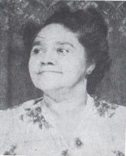
FROM YESTERYEAR A SALUTE TO FRIST LADY BESSIE BARNETT THOMAS
April 4 – April 22, 1968
Wife of Moderator George Washington Thomas

Slide 3
Saluting the Frist Ladies of East Cedar Grove Missionary Baptist Association

Slide 4
ECGMBA’S MISSION AND GOALS
“Standing on the Promises…”
The mission of the Association is to: “teach Christianity based on the Holy Bible, preach inspirational sermons for living, encourage wholesome family values, provide leadership training for members and support local and foreign missions.”
The objectives of the Association are: 1) To develop and encourage Christian fellowship, 2)To provide spiritual assistance to the member churches, congregations and auxiliaries, 3) To enhance the quality of life in the community, 4) To support the General Baptist State Convention of NC. Inc. and its objectives, 5) To provide support to the Ordaining Council and 6)To support the Lott Carey Baptist Foreign Mission Convention and the National Baptist Convention, USA.
“Therefore go and make disciples of all nations, baptizing them in the name of the Father, and of the Son, and of the Holy Spirit,” (Matt. 28:19)
“9Whatever you have learned and received and heard from me, and seen in me, put these things into practice. And the God of peace will be with you. “ (phil. 4:9)

Slide 5
Frist Lady: Spouses of Ministers
“Standing on the Promises…”
No
Yes
FIRST DEFINED, “above others, being before all others with respect to time, order, rank, importance, etc., used as the ordinal number of one: the first edition; the first vice president.
“So the last shall be first, and the first last: for many be called, but few chosen.” (Matt. 20:16)
Humble yourselves before the Lord, and He will exalt you. (James 4:1)

Slide 6

Honoring Spouses of Ministers- Why and for What?
To Show Appreciation
To Express Gratitude
To Say Thank You
Serving
Giving
Helping
Encouraging
Loving
Linking
Learning
Supporting
Working
“I beseech you therefore, brethren, by the mercies of God, that you present your bodies a living sacrifice, holy, acceptable to God, which is your reasonable service.” (Rom. 12:1)

Slide 7
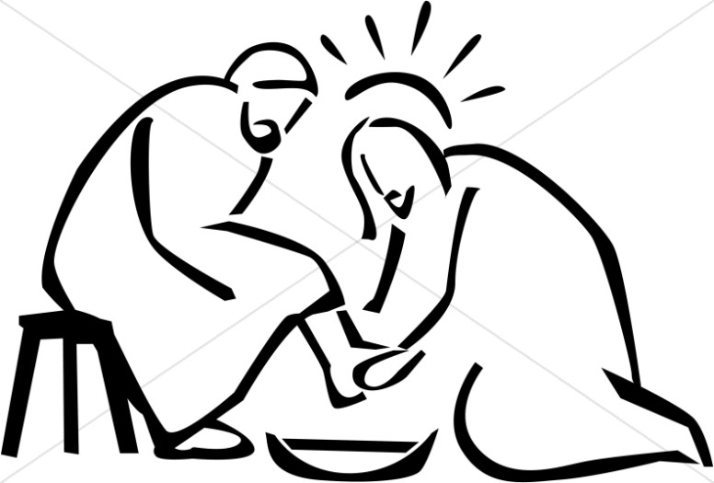
The First Ladies: “Spouses of Ministers”
14 If I then, your Lord and Master, have washed your feet; ye also ought to wash one another's feet. 15 For I have given you an example, that ye should do as I have done to you. 16 Verily, verily, I say unto you, The servant is not greater than his lord; neither he that is sent greater than he that sent him. 17 If ye know these things, happy are ye if ye do them.
“The greatest among you shall be your servant.” (Matt. 23:11)
Servant

Slide 8
Comments from Magdalene Ragland,
Former Frist Lady
“Standing on the Promises…”
“Being a pastor’s wife is a gift from God; it is a great blessing, but it is also a great responsibility.”
“ God places us into this position, not to fit a mold or other people’s expectations, but to be molded by Him and used for His glory.”
“I had to learn to stop… to be still so that I could hear and know the voice and the will of God.” It is in the quiet stillness, in our prayer rooms, in our war rooms, that God reveals His plans, our place and our purpose. In additional to listening to the voice of God, I also had to listen to the ideas, suggestions and yes, sometimes, the criticisms of others so that we could all work in unity to accomplish God’s plan for the church.”
As a pastor’s wife, I would have been lost without prayer.
A pastor’s wife must learn to love God, love others and self. A pastor’s wife must love God, love others and love herself.
A pastor’ wife’s heart must be filled with love.

Slide 9
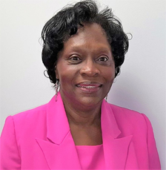
SPOUSES OF ECGMBA 1995
“Standing on the Promises…”
The Spouses of Ministers was organized December 1995, under the leadership of Dr. James Richmond, Moderator. Our mission is to provide spiritual, emotional and financial support to the ministers of the Gospel of Jesus Christ, the communities they serve and their spouses.
The Provisional Officers 1995
Sister Dorothy B. Corbett, President, Rock Spring
Sister Janice B. Alston, Vice President, Cameron Grove
Sister Doris Richmond, First Community
1st Vice President, Sister Kathleen Daniels, St. Johns
Secretary, Sister Diane Cash Greater Cleggs
Sis. Shirley Richmond, Financial Secretary, Shady Hill

Slide 10
SPOUSES OF MINISTERS 1995
“Standing on the Promises…”
Goals
To develop an outreach ministry for family members of spouses of ministers to visit and send cards to persons in the nursing home, hospital and home bound, who are unable to attend church
To establish a reference library for ministers of the East Cedar Grove Association
To set up audio visual equipment for recording the sermons of the ministers
To conduct a workshop for the spouses of ministers and other interested persons to develop knowledge, sensitivity and advocacy skills to those who support the life and work of ministers
To establish a food pantry at the Smith Thomas Center for the needy and
To adopt a college student and serve as a mentor, spiritually and financially, from their freshman through senior years in college.

Slide 11
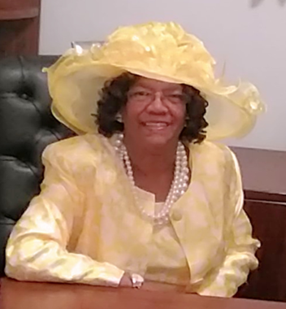
FRIST LADY JANICE ALSTON
“Standing on the Promises…”
Cameron Grove Missionary Baptist Church
Pastor, Rev. Jessie Alston

Slide 12
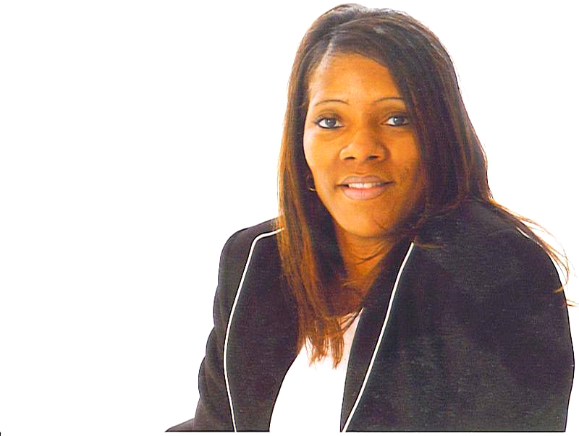
FRIST LADY PATRICIA A. BECTON
“Standing on the Promises…”
United Christian Missionary Baptist Church
Pastor, Quintis L. Becton, Sr.

Slide 13
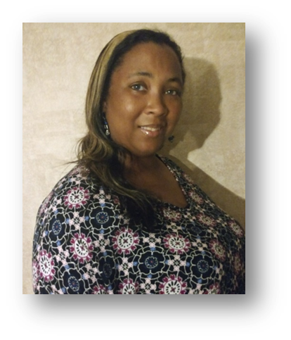
FRIST LADY DONNA R. BELL
“Standing on the Promises…”
Greenfield Missionary Baptist Church
Pastor, Rev. A. J. Bell

Slide 14
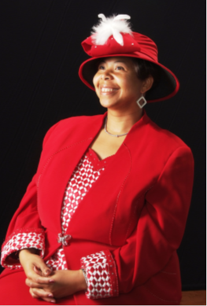
FIRST LADY YVETTE REEDE CREWS
“Standing on the Promises…”
Lattisville Grove Missionary Baptist
Pastor, Rev. George Crews, III

Slide 15
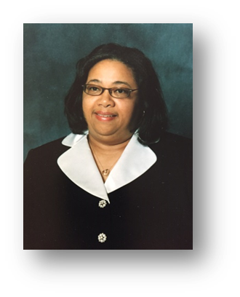
FIRST LADY REV. KATHLEEN DANIELS
“Standing on the Promises…”
St. Johns Missionary Baptist Church
Pastor, Rev. Robert Daniels

Slide 16
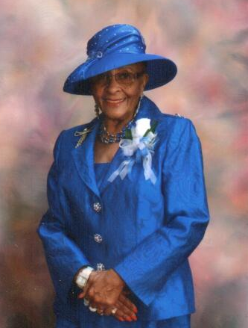
FIRST LADY JUANITA BARBEE DAVIS
“Standing on the Promises…”
Mount Zoar Missionary Baptist Church
Pastor, Rev. Norman Davis

Slide 17
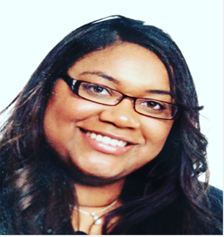
FIRST LADY CRYSTAL DOCK
“Standing on the Promises…”
  Rock Spring Missionary Baptist Church
  Pastor (vacant)

Slide 18
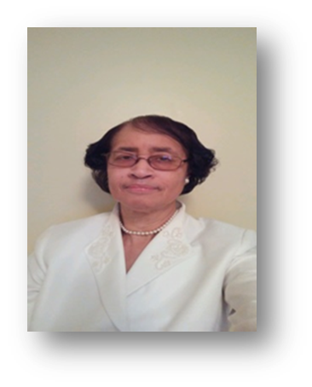
FIRST LADY HEDDIE FLETCHER
“Standing on the Promises…”
Tally Ho Missionary Baptist Church
Pastor, Rev. Moses Fletcher

Slide 19
FRIST LADY CHERYAL BLOUNT ISAAC
New Hope Granville Missionary Baptist Church
Pastor, Rev. James Isaac, III

Slide 20
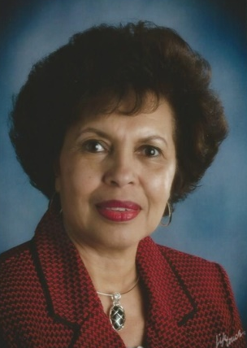
FIRST LADY JOYCE MARTING LOGAN
“Standing on the Promises…”
Lawson Chapel Missionary Baptist Church
Pastor, Rev Dr. Langston Logan, Sr.

Slide 21

FRIST LADY DIANNE JOHNSON RICHARDSON
“Standing on the Promises…”
New Hope Person Missionary Baptist Church
Pastor, Rev. Wilbert L. Richardson

Slide 22
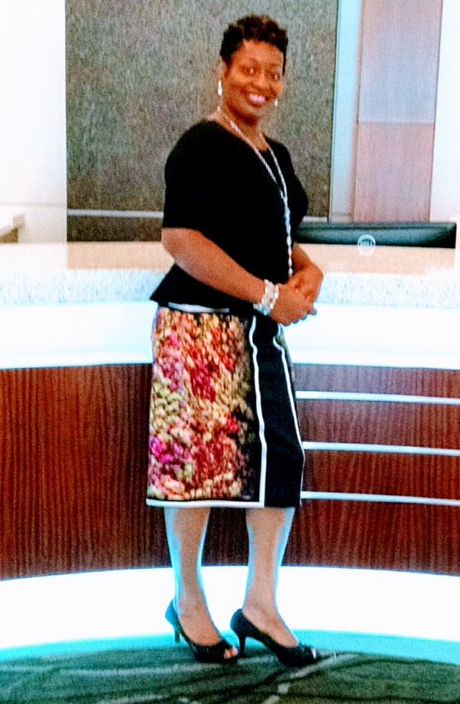
FIRST LADY FELICIA SMITH
“Standing on the Promises…”
Pettiford Grove Missionary Baptist Church
Pastor, Rev. Alvin Downing, Sr.

Slide 23
FIRST LADY CHAPLAIN AUDREY WILSON
“Standing on the Promises…”
New Red Mountain Missionary Baptist Church
Pastor, Rev. Dr. Larry Wilson

Slide 24
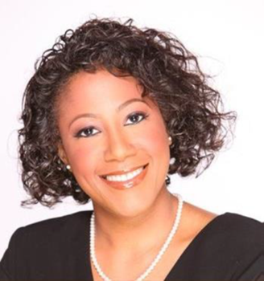
FIRST LADY MELCINA YANCEY
“Standing on the Promises…”
Olive Grove Missionary Baptist church
Pastor, Rev. Johnnie White

Slide 25
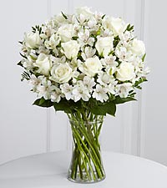
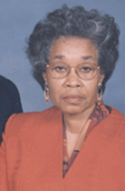
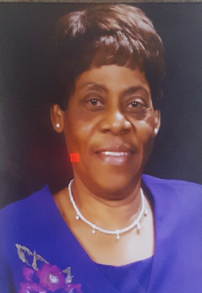
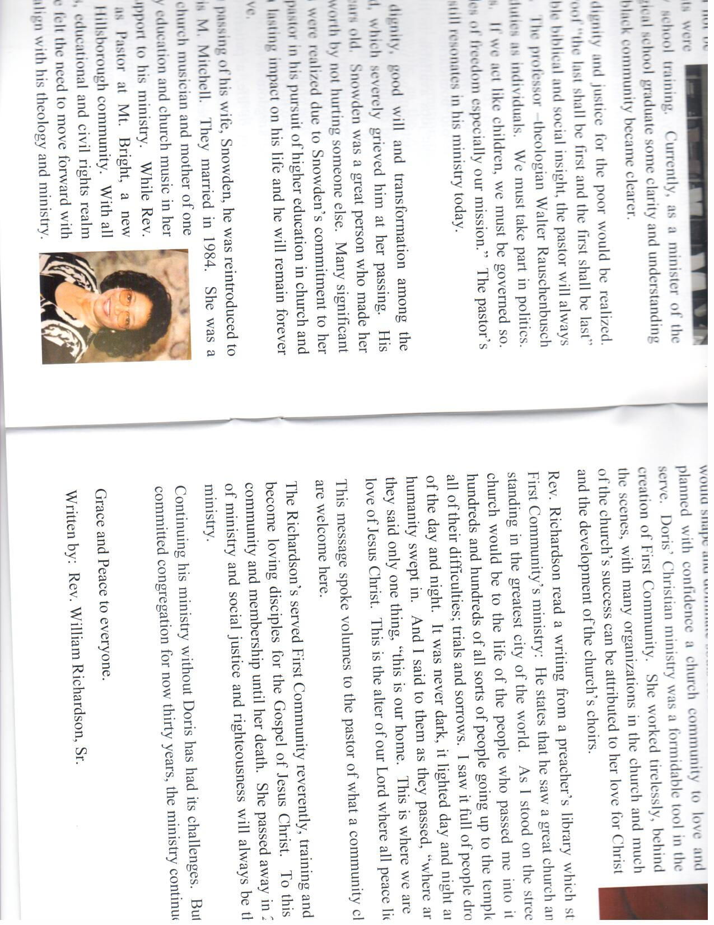
First Ladies
In Loving Memory
First Lady Doris Mitchell Richmond, Shady Hill Baptist Church Rev. Dr. James Richmond, Pastor
First Lady Eva Atkins Taylor
Lee’s Chapel Baptist Church
Rev. T. E. Taylor, Pastor
Sister Shirley Brown Richmond
Frist Lady, First Community Baptist Church
Rev. Dr. William Richardson, Pastor

Slide 26


Frist Lady: Spouses of Ministers
“Standing on the Promises…”
We salute you because of your servants heart, your kindness, humility and compassion!
“Carry each other’s burdens, and in this way you will fulfill the law of Christ.” (Gal. 6;2)
“37 Jesus said unto him, Thou shalt love the Lord thy God with all thy heart, and with all thy soul, and with all thy mind. 37 Jesus said unto him, Thou shalt love the Lord thy God with all thy heart, and with all thy soul, and with all thy mind. 38 This is the first and great commandment.39 And the second is like unto it, Thou shalt love thy neighbour as thyself.” (Matt. 22:37-39)
God
Family
Church Family
The Community
Self

Slide 27
Thank You for Being “Foot Washers!
ECGMBA “Never Would Have Made it Without You…”
Serving the Lord Will Pay Off After while!
“Standing on the Promises of God”
FRIST LADIES: SPOUSES OF MINISTERS
“STANDING ON THE PROMISES”

