Slide 1
East Cedar Grove Missionary Baptist Association CAPITAL GAINS INITIATIVE

Slide 2
A TWO YEAR PROJECT IN 4 PHASES
A

Slide 3
PHASE ONE ASSOCIATION-COMMUNITY
Every Church Contribute $3,000 (X42 Churches)$126,000
Every Family $1,000 (100 Families) 100,000
Each Individual $ 500 (200 Individuals) 100,000
Tree of Life ($500 In Memory Leaf)(X 100 Leafs) 50,000
Hall of Honor (Above $5,000) (X50) 250,000
Corporate Comm. Recognition ($10,000) (X10) 100,000
$726, 000
Construct Donor Wall in The Lobby for Contributors
All Pastors Receive an Association Gold Card
All Churches Receive an Association Gold Plate

Slide 4
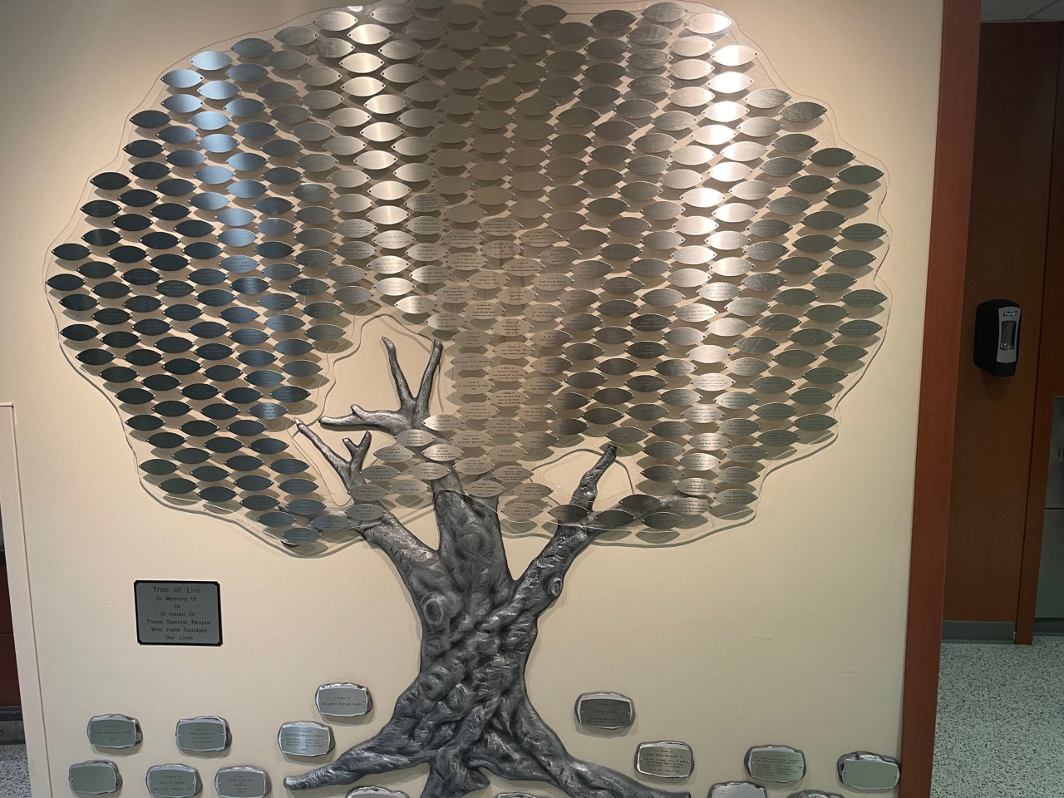
t
TREE OF LIFE “IN MEMORY OF” LEAFS

Slide 5
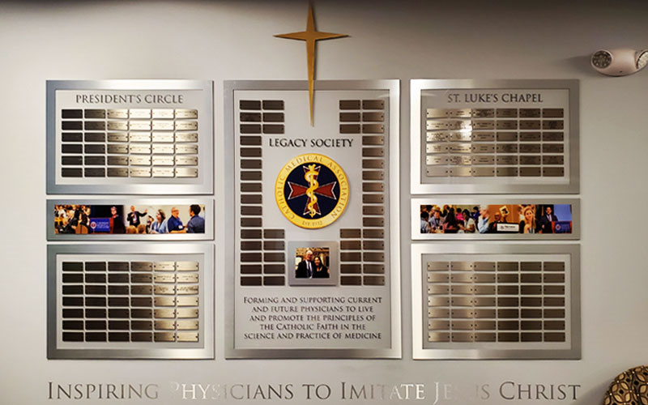
ECGMBA WALL OF HONOR

Slide 6
PHASE TWO GOSPEL CONCERT AT THE DEPAC
SEATING CAPACITY = 2,712
ONE DAY RENTAL = $22,000
BUDGET FOR EVENT= $20,000
CONCERT TICKETS $34.00 UP X 2,712 SEATS= $92,208.00
ESTIMATED PROFIT $50,208.00
USE THIS EVENT TO
CREATE AND GAIN ADDITIONAL AND AWARENESS
RECORD AND SELL THIS PRODUCT
TO BIRTH OR REESTABLISH A ECGMBA 100 VOICE CHOIR

Slide 7
PHASE THREE PHASE THREE BENEFIT DINNER
FEATURING NEW ECGMBA MASS CHOIR
RADIO PERSONALITY (FREE SERVICE)
SPECIAL RECOGNITIONS/SCHOLARSHIPS
KEYNOTE SPEAKER, GBSC
TICKETS $50 EACH (X500) = $25,000

Slide 8
PHASE FOUR GRANT INITIAVES
$200,000.00

Slide 9
PHASE 1= $ 726,000 PHASE 2= $ 50,208 PHASE 3= $ 25,000 PHASE 4= $ 200,000 GRAND $1,001,508

Slide 10
PHASE 5 BANKING INSTITUTION
PHASES 1 THROUGH 4
IS COLLATERAL TO APPLY FOR
MILLION(S) DOLLAR BUSINESS LOAN

Slide 11
ANNUAL SESSION
INITIAVE STAGE ONE
PLEDGE DRIVE

