Slide 1
The History of Wayland Area Emergency Medical Services

Slide 2
Ambulance availability in the Wayland area began as a service through the Archer-Hampel Funeral Home in 1974. The Community Ambulance Service was designed to help eliminate long wait times for ambulances that were located 30 miles away in Grand Rapids. George Hampel started the service using a Chevy Suburban vehicle with a raised roof (called a turtle top).

Slide 3
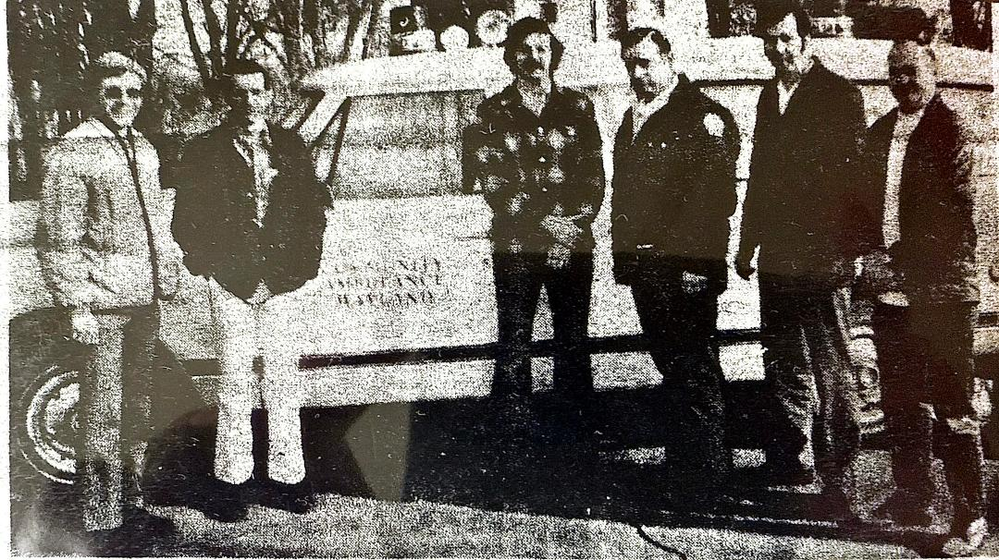
In January of 1975, nine local residents completed 140 hours of training and were licensed as Emergency Medical Technicians. Jake Inverso, Dave Whittredge, Rollie West, Neil Ellinger, Dick Baxter, Bill Baweja, Harold Ernst, Jeff Hampel and Kathy Hoekstra formed the first roster of the Community Ambulance Service.
Ralph Mallett, Sam Dykstra, Tom Randolph, Dan and Earl Miller and Harry Wykoski were also in training and awaiting testing and certification.

Slide 4
Through 1975, the townships of Dorr, Hopkins, Leighton and Wayland joined the Community Ambulance Service and paid $1000 yearly for services. The City of Wayland paid $1500.
In the summer of that year, the city applied for a grant through the Michigan State Highway Safety Planning Commission, but was turned down because of the low total of traffic related accidents in the area.

Slide 5
In August, County Commissioner Dennis Nickels approached the Commission a second time. This time, armed with statistics from Michigan State Police Lieutenant William Monroe, which showed a much higher total, the grant was re-evaluated and approved in October.
The grant allowed the city to purchase a new van style ambulance for $21,000. The vehicle would be equipped with the new Hospital Emergency Radio Network (HERN) radio which would allow EMT’s to talk directly to surrounding hospital emergency rooms for treatment instructions.

Slide 6
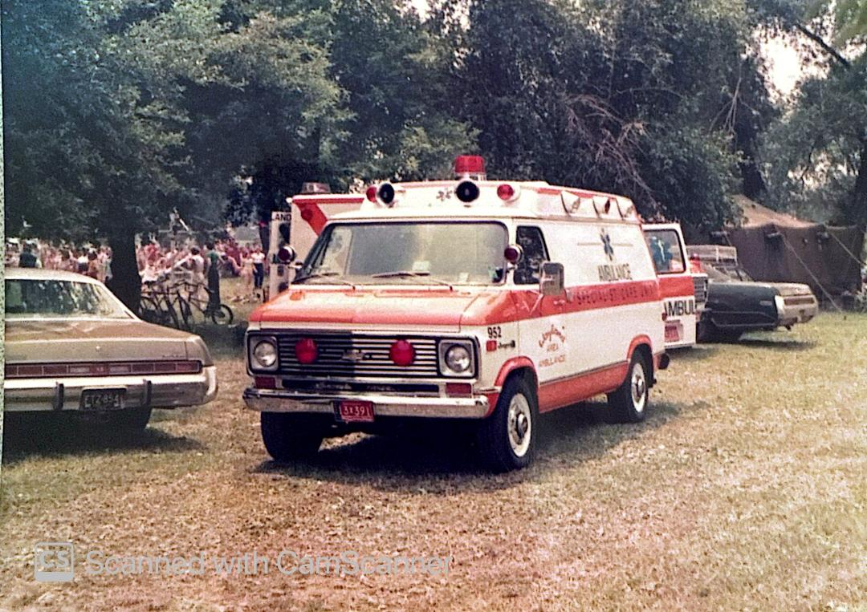
The new ambulance arrived November 17 and an agreement was worked out between the City of Wayland and George Hampel to lease the vehicle to the Community Ambulance Service in lieu of a city monetary contribution. The ambulance would be housed at the MSP post, which was also handling dispatch responsibilities.
It was at this meeting that Hampel informed the five governmental units that he was planning on getting out of the ambulance business in March. Part of his decision was based on the state’s development of standards for pre-hospital care (which would be adopted in 1976).

Slide 7
In January of 1976, officials from the city and four townships gathered to listen to a proposal to create and fund a non-profit corporation which would assume control of ambulance service in the area. The first proposal to fund the service based on population within the townships did not sit well with the government boards.
A second proposal, where each unit of government would pay an equal share, quickly caught favor, and on February 23, the Wayland City Manager and the supervisors of the four surrounding townships met and signed the new agreement.

Slide 8

Each unit would pay $2000 per year to be a member and each governmental participant would have two representatives on the new board of directors. The city would lease the new ambulance it had purchased last fall to the corporation.
And thus, Wayland Area Ambulance Service was born and officially began service March 1. The ambulances were moved into a quonset hut building being rented at the corner of Mill St and Clark St until the new fire station was constructed.

Slide 9
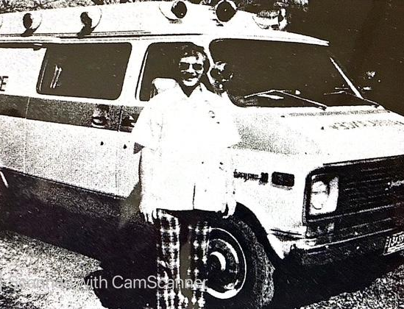
Soon after forming the corporation, the board hired Bill Bewaja of Wayland as it’s first director. Bewaja has medical experience as a navy corpsman, is a registered EMT and has worked for Mercy Ambulance Service in Grand Rapids for a year and a half.
The licensed EMTs that had been working for Hampel’s Community Ambulance Service also joined the new corporation as volunteers.

Slide 10
* On May 1, 1976, Monterey Township decides to end ties with the Allegan Ambulance Service and joins Wayland Area Ambulance, increasing the service to 6 governmental units. Monterey will also pay the $2000 fee per year and will have two representatives on the board.

Slide 11
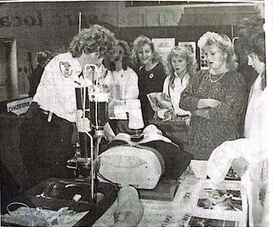
On February 15, 1977, the board adopts a budget of $29,985 for the fiscal year.
In early 1977, a fund drive is started to buy a heart defibrillator for the primary ambulance. Community support raises over $8,000 by April, enabling the purchase of both the defibrillator and a mechanical heart resuscitator.

Slide 12
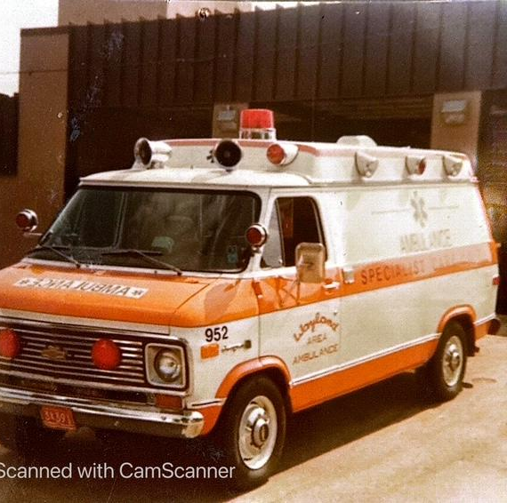
1978 – City of Wayland signs rental agreement with ambulance service giving them two bays and an office space within the new community safety building (Fire and Police) to move into.

Slide 13
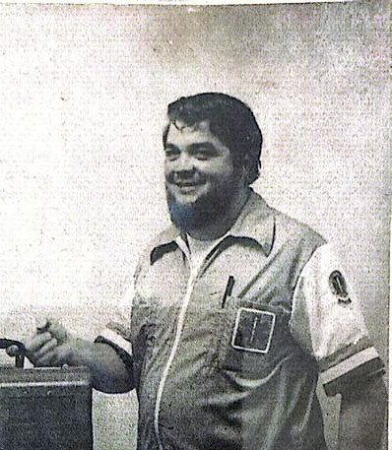
September 28, 1978 – board hires John LaCore of Wayland as it’s second manager. LaCore served 8 ½ years in the navy as a corpsman and was currently a Chief Respiratory Therapist at Ferguson Hospital.
Former director Bill Bewaja is leaving the position after serving for 2 ½ years.
When LaCore moves to Dorr the next year, he teams with new EMT and neighbor Joe Kramer in evenings to staff an ambulance out of their driveways, establishing first ambulance service in the “A” area. Evening crews in Dorr would begin to grow regularly.

Slide 14
March 20, 1979 – participating governments approve advancing $1,500 each to the ambulance service for the purchase of a new ambulance. A 3 year old modular unit from Mercy Ambulance in Grand Rapids is being placed on a new chassis selected from McCoy-Miller.
May 1 – fund drive started to purchase telemetry communications equipment. Goal set at $17,000
May 1 – State adopts new legislation requiring 3 personnel in each ambulance. An attendant to drive and at least one EMT and an attendant in the back.

Slide 15
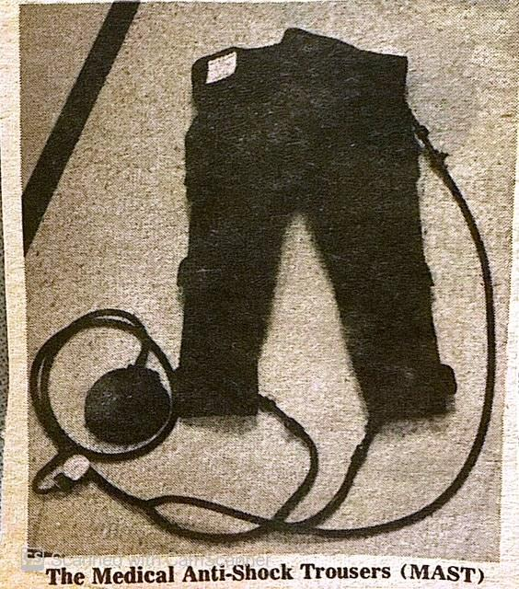
June 11, 1979 – Wayland Lions Club purchases and donates two pair of MAST trousers to the ambulance service. The anti-shock trousers became a mandatory requirement by the state on all ambulances on July 1.

Slide 16
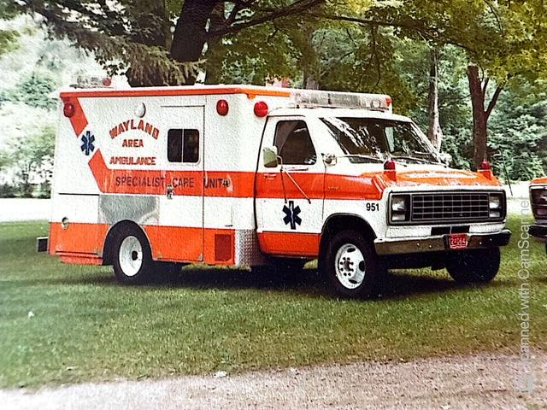
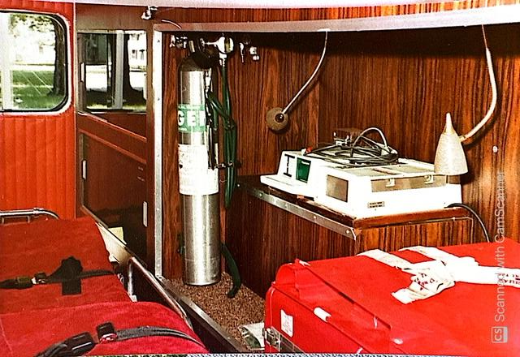
June 20, 1979 – new (first) modular ambulance arrives. The modular box had been part of the Mercy Ambulance fleet and was mounted on a new chassis. The modular box significantly increases work space within the unit.
The new ambulance replaces the original community suburban ambulance.

Slide 17
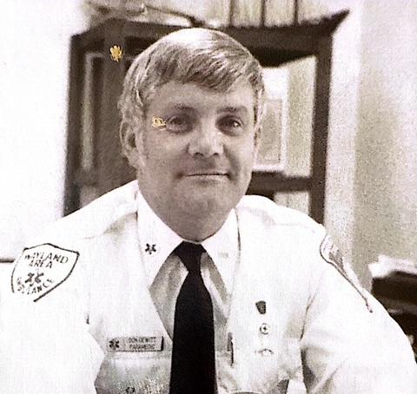
October 18, 1979 – Don DeWitt hired as third manager. He is a licensed paramedic and was the current director for Northwest Ambulance in Sparta and Kent City. DeWitt also is a licensed CPR instructor for the Michigan Heart Association. He inherits a staff of 11 volunteers.
DeWitt replaces resigning previous manager John LaCore.

Slide 18
March 13, 1980 – annual meeting for election of officers, budget approval. Fiscal budget of $57,000 adopted. Manager reports service did 412 calls during previous year.
March 25 – collaboration between GVSU and Wayland Community Education and the Wayland Area Ambulance Service brings an EMT class to Wayland for interested individuals.
April 22 – new fund drive begins to purchase advanced life support equipment Goal is $9,000.

Slide 19
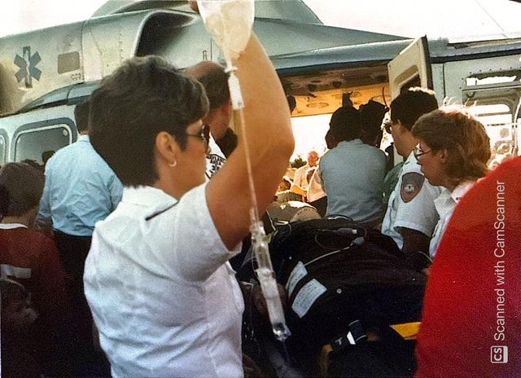
May 14, 1980 – Salem Twp joins ambulance service. Will have two seats on board, pay same fees as other governments.
June 24 – state announces pilot health program to teach EMT Specialist level. GVSU chosen as trainer and the college selects Wayland for it’s first class. Ambulance personnel enrolled include Donna Cosgrove, Barb Dreyer, Toni Fordham, Bob Hyde, Jake Inverso, Sharon Jackson, Judy Keizer, Clara Kelsey, Joe Kramer, Sonja Landauer, Ralph Mallett, Randy Merren, James Pitsch, Chris Reinhart, Maryanna Sternisha, Linda Stoepker, Dave VanEerden and Dave Whittredge.
Students will learn how to start IVs and intubation techniques in the five week program

Slide 20
November 12, 1980 – ambulance communication antenna is moved from MSP post in Wayland to top of Allegan County Sherriff Dept tower on 133rd Ave. Move eliminates “dead spots” on western side of service area.
The costs of moving the antenna were covered by surplus funds from the recent fund drive, and then a $2,000 grant from West Michigan Emergency Services.

Slide 21
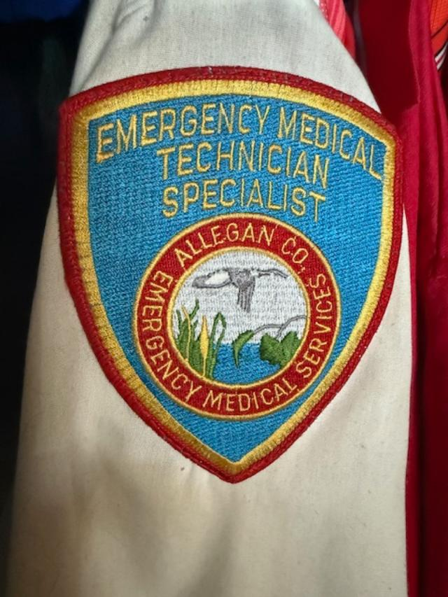
Aug 29, 1981 – ambulance receives Specialist Care license from State of Michigan. One of first services to acquire license. Of the current staff of 22 persons, 12 have completed and been licensed at the EMT-Specialist level and 2 are paramedics.

Slide 22
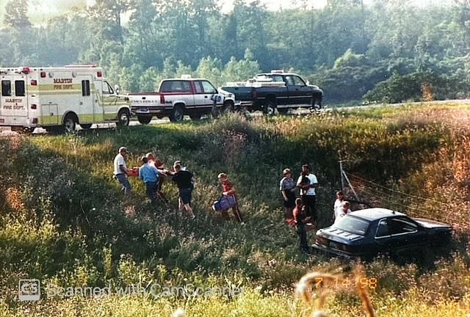
July 13, 1983 – Martin Twp joins the ambulance service. Township board voted not to renew a contract with Plainwell Ambulance. They will receive two positions on the Wayland board and will provide subsidy money equal to the other members.

Slide 23
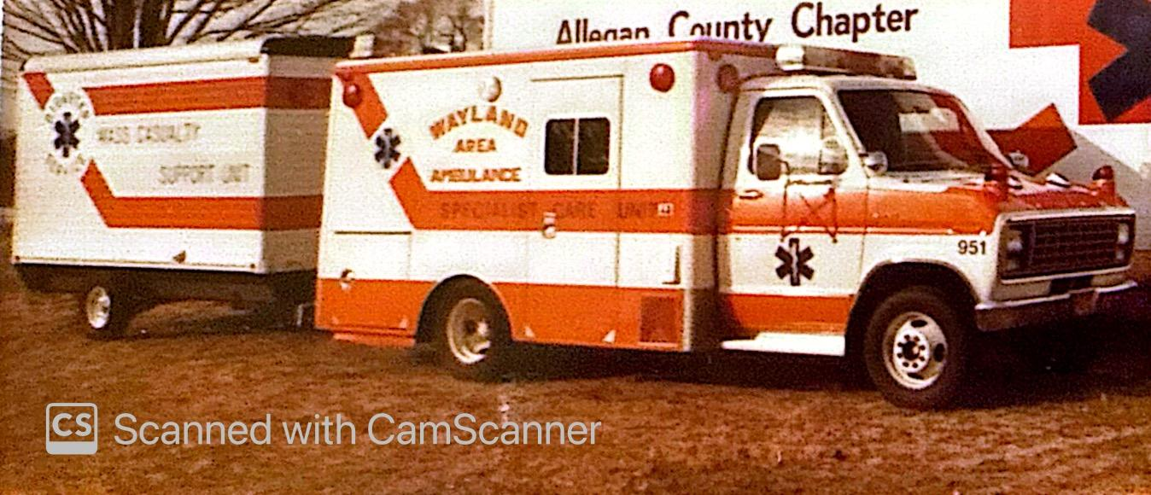
December 19, 1983 - WAEMS purchases a 12 foot Wells Cargo trailer, equipped with lighting, generators, first aid kits, splints, 60 cots, 150 blankets, 25 pillows, and 24 backboards. The disaster response vehicle is initially stored at Martin Fire Dept.

Slide 24
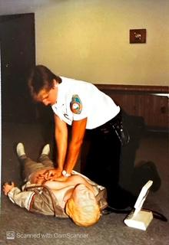
Feb 1, 1984 – State of Michigan chooses Wayland Area Ambulance to participate in a pilot program for HeartAid defibrillators. New invention allows rescuers to place electrode monitors on cardiac arrest victims and will shock the heart if a ventricular fibrillation rhythm is detected.
(EMDs as they would become known are now located in most large facilities and schools throughout the world).

Slide 25
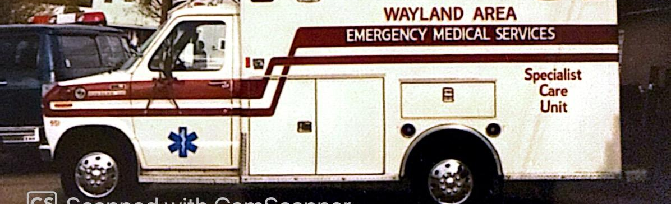
May 1984 – with the arrival of the newest ambulance to the fleet, the service has taken on a new look and a new name
Wayland Area Emergency Medical Services
is the new name adopted by the board. The new $45,000 modular ambulance prompted the changes to more clearly define the numerous services the agency provides. The old orange stripes have been replaced with maroon striping and the new name.

Slide 26
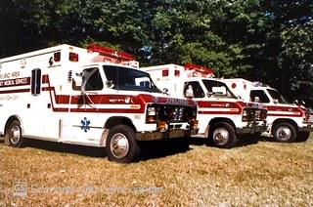
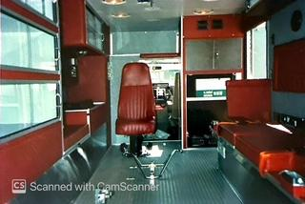
July 3, 1985 – WAEMS purchases another new modular ambulance. Board decides NOT to sell oldest unit, bringing fleet to three. Staff has grown to 27.

Slide 27
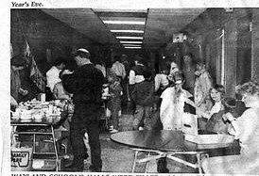
November 14, 1986 – a meeting to discuss a new fundraising project to help pay for schooling and licensing as a Paramedic service is held. 45 citizens attend in support. Schooling would start Feb 3.
December 31, 1986 – Paramedic Fundraising committee throws New Years Eve gala at high school. Events included swimming, an open gymnasium, auctions, food and music. More than $3,000 of $21,000 goal is raised and 400 people attend festivities.

Slide 28
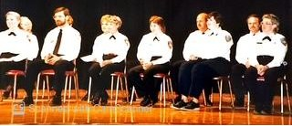
June 24, 1987 - 12 WAEMS volunteers graduate from their Paramedic program. Classes entailed 400 hours of training both in the classroom and local hospitals. A special ceremony was held at Wayland High School to honor those graduating.
Receiving their licenses were Lois Bush, Mike DeWeerd, Jeanne Ellis, Paula Guigelaar, Nancy Jager, Judy Keizer, Sharon Nottingham, Linda Stoepker, Lorraine VandenBerg, Dave VanEerden, Eugene VanPutten and Roger Wiersma.

Slide 29
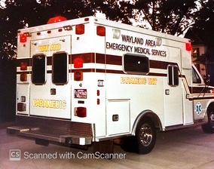
October 15, 1987 – State of Michigan presents WAEMS with Paramedic licensing for the service.
There are 13 paramedics and 15 EMT-Specialists currently volunteering with the service. Manager DeWitt also noted that 28 other people within the service area have started EMT training.

Slide 30
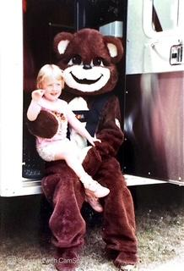
Fall 1987 – Ambulance Service introduces Buckle Bear. The mascot costume is used to visit school children to teach the safety of using seat belts while riding in vehicles. Buckle Bear becomes a regular attraction at schools and holiday events.
Buckle Bear and WAEMS will be presented a Distinguished Service Award by the Michigan Education Association in July of 1989. Besides the Buckle Bear campaign, the MEA recognized the ambulance service for community CPR and first aid classes, in-service demonstrations and commitment to being present at many school athletic functions, all performed with volunteer staff.

Slide 31
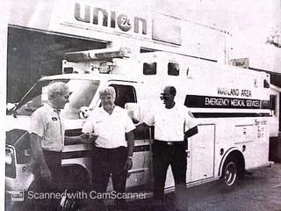
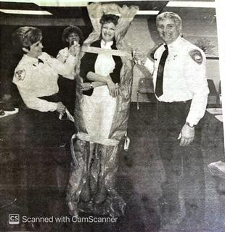
September 1987 – Dorr Union 76 offers service bay to ambulance to park unit in at night. “A” area crews get unit out of the weather. Will move into new fire station in June of 1989
December 31 – second New Years Eve Bash nets $3.500 in donations. Funds being used to assist fire departments with rescue equipment. 600 people attend.
Feb 17, 1988 - WAEMS becomes first EMS unit in Michigan to purchase and use new device called a vacuum mattress. Internal beads and a vacuum pump can completely immobilize an individual from head to toe.

Slide 32
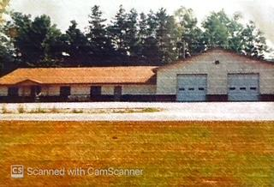
September 1988 – WAEMS Paramedic Gene VanPutten designs and presents the floor plan for a new ambulance facility. The new building will be located at 911 South Main St in Wayland. Wedeven Builders of Hamilton is selected to be the construction contractor after bidding.

Slide 33
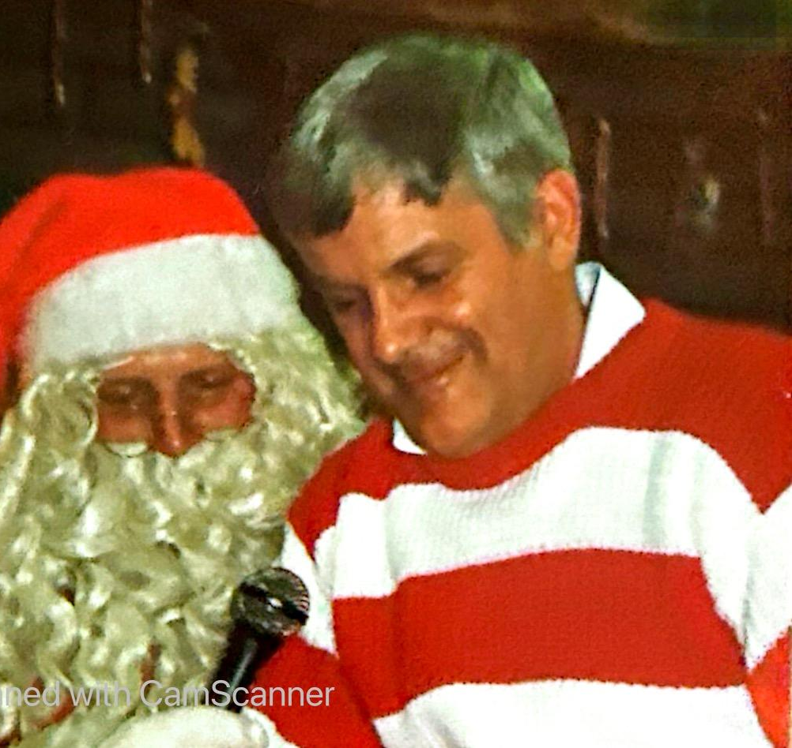
October 5, 1988 – Manager Don DeWitt announces that he will be leaving Wayland Area EMS. He will be assuming the position of Administrative Director of Emergency Medical Services at St Mary’s Medical Center in Saginaw.
DeWitt is credited with taking WAEMS from a young basic program to the Paramedic status during his tenure. His easy going personality made him very popular within the WAEMS community.

Slide 34
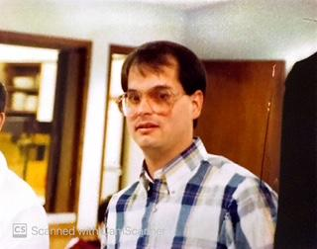
November 1988 – Bob Farrell hired as new manager. Farrell has been in EMS for several years, serving as a paramedic supervisor for Mercy Ambulance before moving over to AeroMed at Butterworth Hospital where he served as education coordinator and communications specialist.

Slide 35
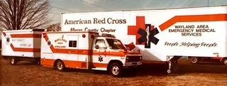
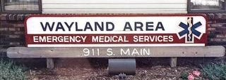
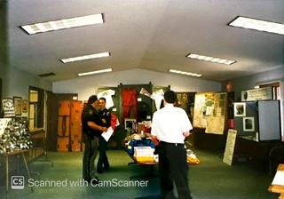
March 29, 1989 – WAEMS moves into it’s own facility on S Main St. Building costs $200,000 to construct and will house 44 volunteers and office staff and three ambulances. Facility gives working medics sleeping quarters on site for first time.
WAEMS purchased the land for the project from the City of Wayland for $10,000. The city accepted a deal to waive it’s $2,500 stipend for 4 years in lieu of a cash payment for the property.
The ambulance service’s mobile disaster response cargo trailer and a semi trailer loaded with emergency shelter equipment (a joint effort between WAEMS and the Red Cross) are both moved on site.
* An Open House for the general public to see the facility is held April 30.

Slide 36
January 15, 1990 – Orangeville Township in Barry County joins WAEMS corporation after previous ambulance service in Delton is disbanded. Wayland EMS had responded to 26 calls in the neighboring township the previous year.
Orangeville Twp agreed to a one year trial period and paid the yearly $2,500 subsidy. After completing the trial period, Orangeville would agree to the current capital outlay and subsidy and would be granted two seats on the ambulance board.
Watson Twp joins WAEMS, bringing total number of governmental units to 10. Watson puts two members on board and will pay current subsidy rates.

Slide 37
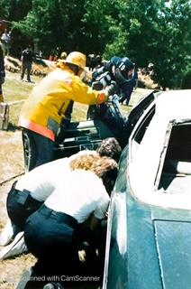
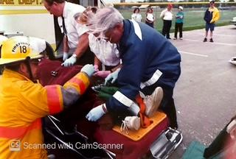
December 1990 – year end totals indicate WAEMS received 1,108 calls for service with 796 transports. It’s annual budget has stretched to $335,000. There are now 50 volunteers and employees, 20 members of the board and a service area encompassing 324 square miles with a population of approximately 30,000 people.
Allegan General Hospital ends it’s contract with WAEMS for transfers. Going to start using new ambulance service coming to Allegan. Loss to WAEMS budget is $20,000.
Allegan County commissioners vote to end subsidy payments to county ambulance services which previously covered costs of disregards. Setback to WAEMS in excess of $10,000.

Slide 38
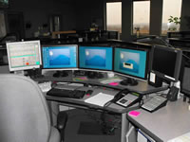
October 29, 1991 – Allegan County 911 goes on line. Residents within the WAEMS service area can now call the three digit emergency number for help, 24 hours a day, 7 days a week. The new 911 center will also assume dispatching responsibilities for WAEMS.

Slide 39
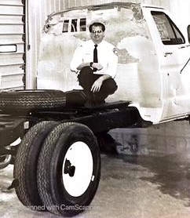
October 1991 – WAEMS purchase two new Ford ambulance chassis’ with diesel engines and will remount current modular boxes. The services’ third ambulance went through a remounting program earlier in the year, also to the new diesel engine configuration.

Slide 40
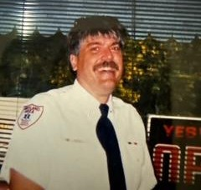
November 1991 – Manager Bob Farrell announces that he will be leaving WAEMS at the end of the year. He has taken on a new position as manager for EMS of Saginaw.
February 20, 1992 - Board hires Bob Hess as new manager. Hess is a paramedic with 14 years of experience in EMS. He is coming to Wayland after serving in management roles for Eaton Rapids EMS.

Slide 41
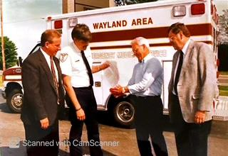
June 13, 1997 – final mortgage paid on new EMS building. Mortgage now free and clear and burned.

Slide 42
January 5, 2016 – Yankee Springs Twp in Barry County cuts ties with Thornapple Fire/EMS and joins Wayland Area Emergency Services. The new member will meet subsidy requirements and have representation on the board.

Slide 43
July 12, 2023 – Following Bob Hess retirement, WAEMS board agrees to divide roles within the agency and appoint two people to handle the administrative roles.
Brenda Mays is hired as the new General Manager
Kathy Grassmid-Smith is hired as the new Medical Officer in charge of personnel.
Both hires are current employees of WAEMS with several years of experience with the agency. They inherit staff of 5 full time and ## volunteers, and 5 ambulances.

Slide 44
January 9, 2025 – Yankee Springs Twp decides to renew contract with Thornapple EMS and leaves WAEMS corporation. All equipment associated with MFR licensing through Wayland will be returned.

