Slide 1

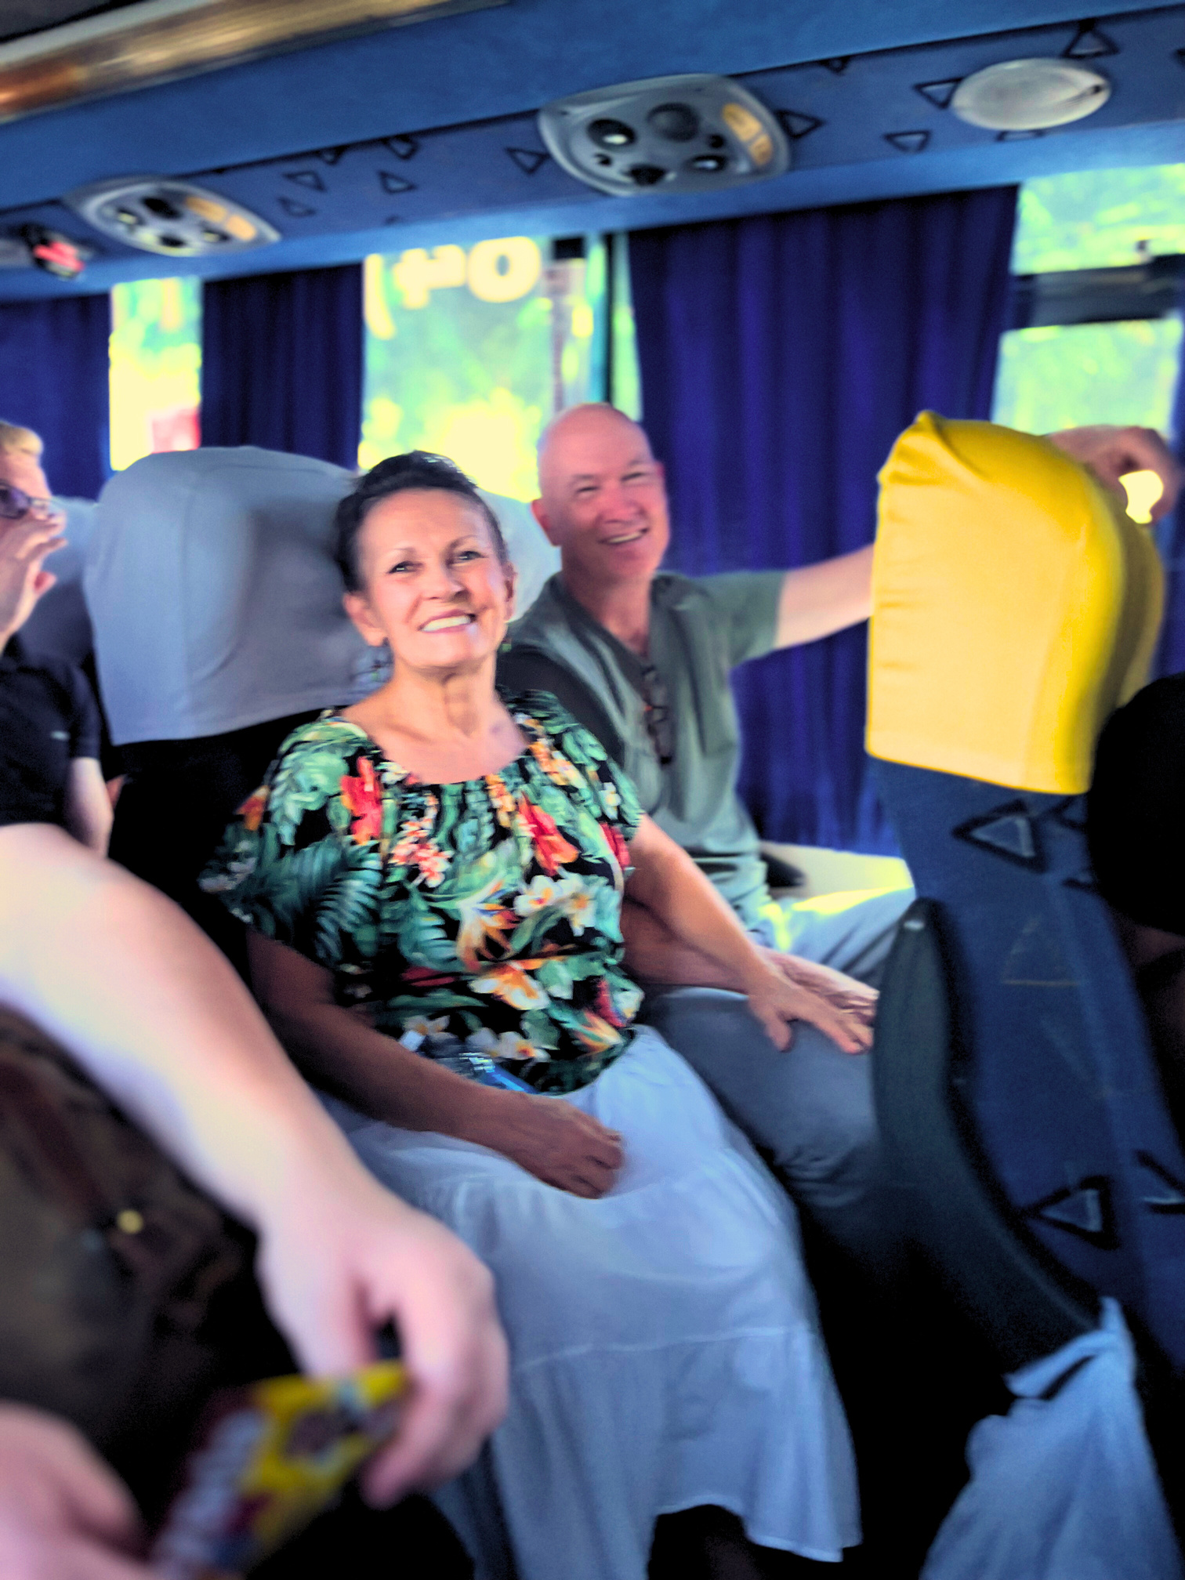




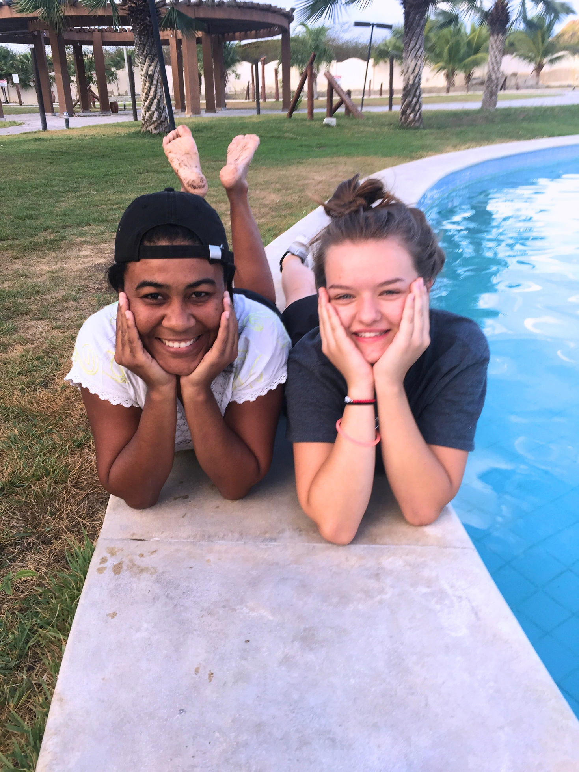


HAPPY BIRTHDAY,
Noreen and Em!

Slide 2

TESTIMONIES

Slide 3


Slide 4



UNDER THE INFLUENCE MINISTRIES
WHAT’S
HAPPENING
FOR 2024
opportunites
to make a difference

Slide 5
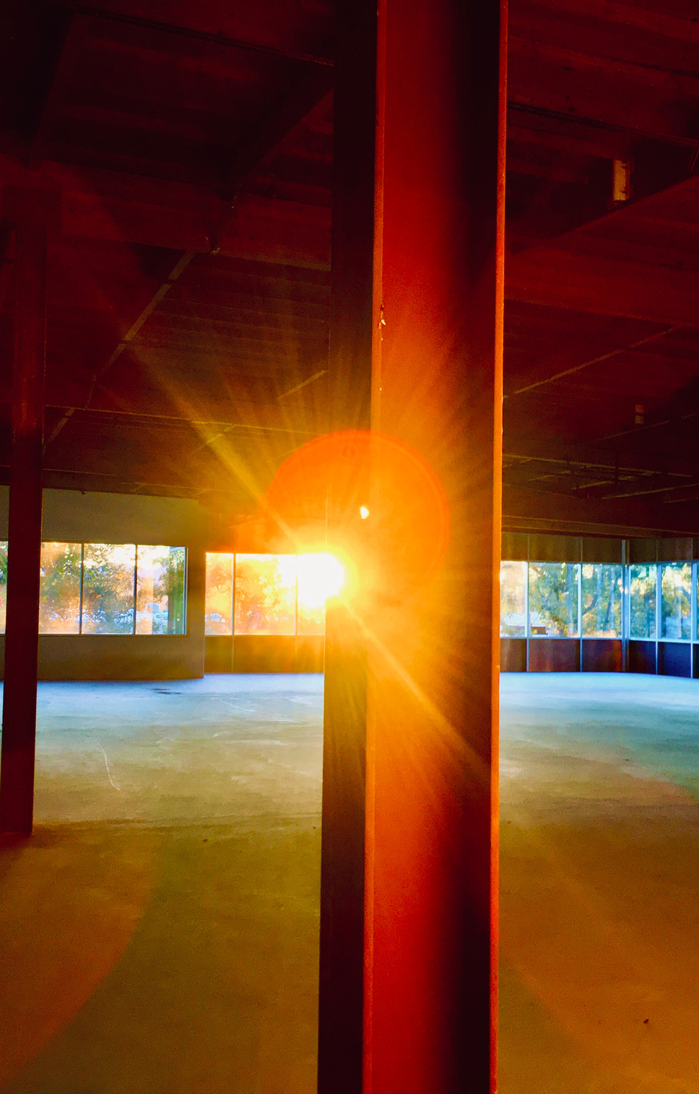
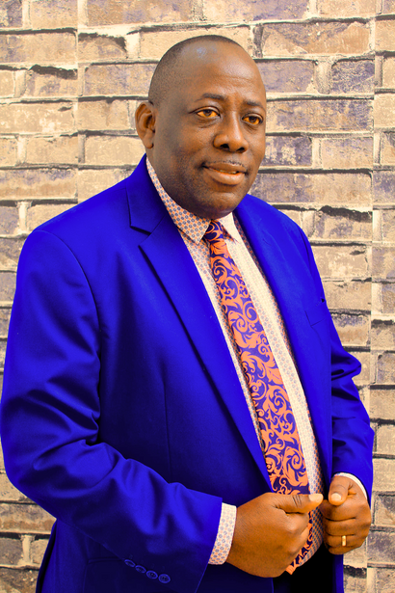
BUILD A CHURCH IN TANZANIA
Tanzania has a growing Christian population, and the need for gathering spaces is vastly unmet. We are partnering with our dear friend, Bishop John Oscar, to build a church for one of his congregations.
Will you please join us? If 36 people buy a beam for $50 each, we will have enough to construct the building. Yes, $50 apiece is all we need!
36 STEEL BEAMS: $50 EACH
BISHOP JOHN OSCAR
Bishop John Oscar trusts in Jesus as he brings hope and faith to the people of Tanzania through school, street, church, and festival events. God moves powerfully to save, heal, and transform lives. Bishop John has been instrumental in raising up churches throughout Tanzania and is a huge blessing to the Body of Christ. All glory to God!

Slide 6





emkindergarten.org
em.kindergarten
emkindergarten.org.br

Slide 8


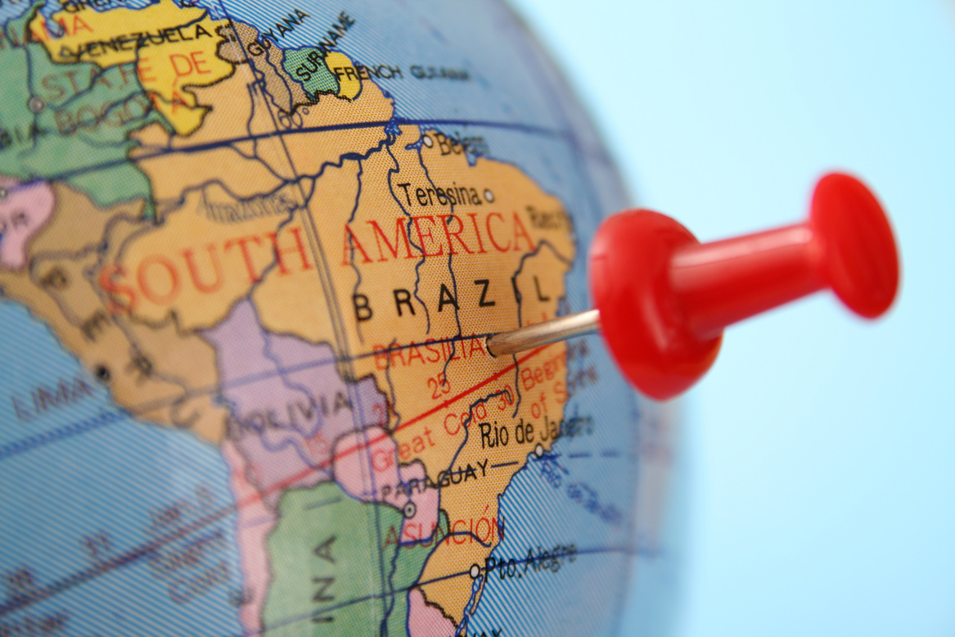
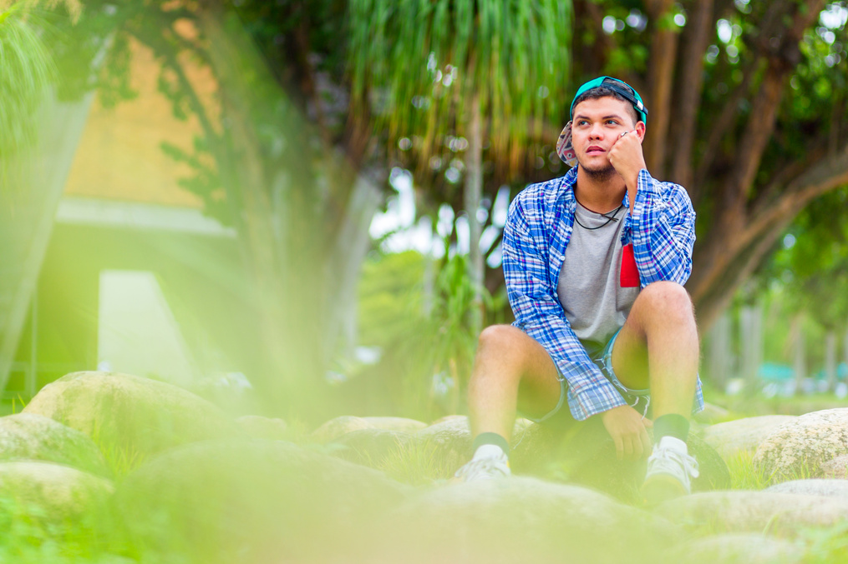

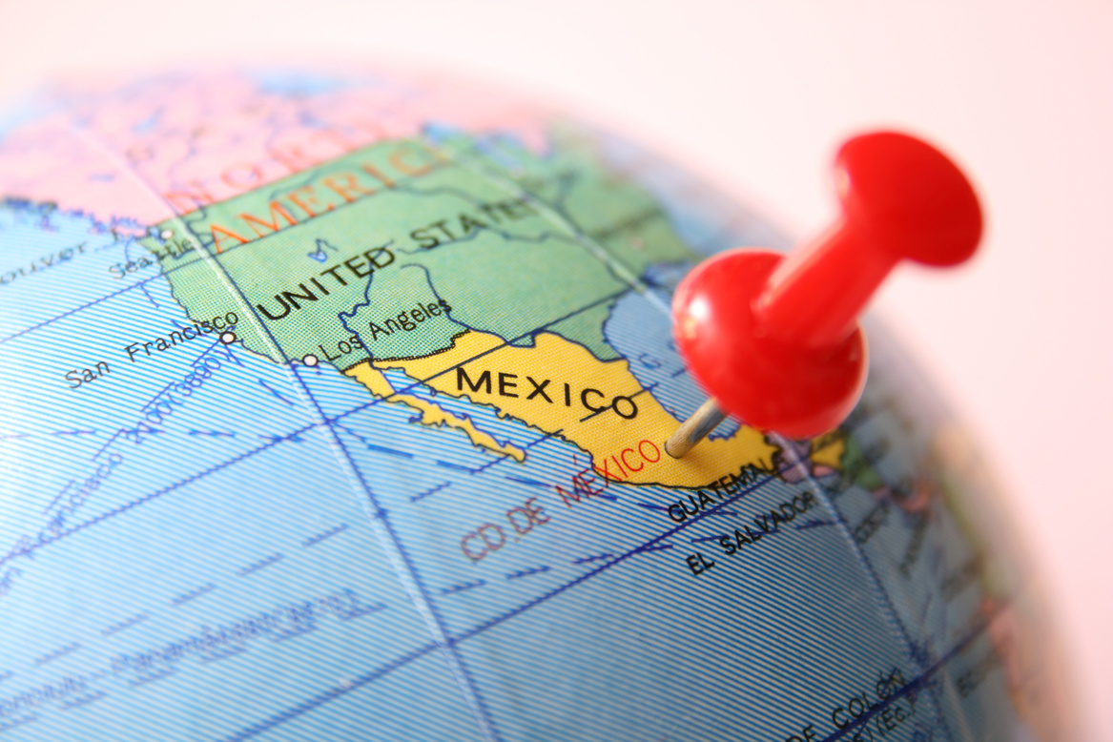



MISSIONS
FOR 2024
HONDURAS IN APRIL
BRAZIL IN
JUNE
BRAZIL YOUTH IN JULY
???
MEXICO IN SEPTEMBER

Slide 9
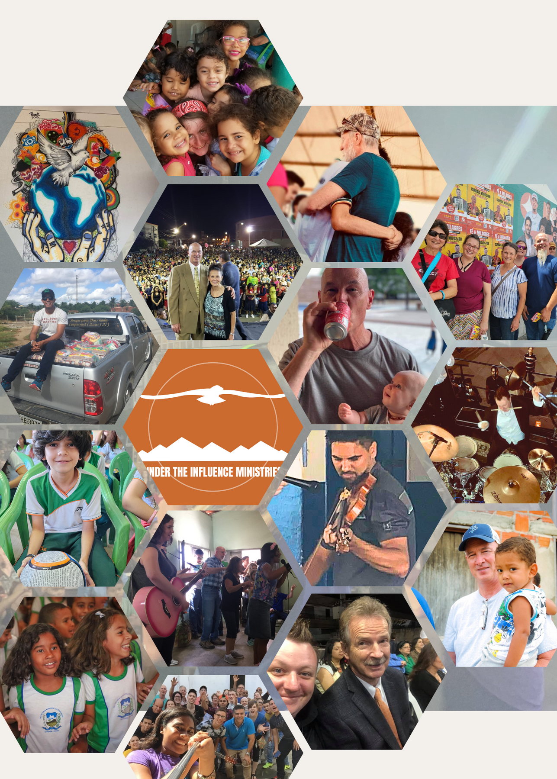
THANK YOU!

