Slide 1
Quantum Computing Basics
From bits and qubits to real-world quantum use cases — no advanced math.
Cyril Simone - President
Dimension Eleven LLC
https://www.dimensioneleven.com
Core message: quantum is becoming a hybrid accelerator stack, not a replacement for hyperscaler computing.

Slide 2
Updated July 2026
Not Magic Parallelism
Why quantum does not simply “try every answer at once”
Misleading statement
Reality
“Quantum tries all answers at once.”
• You only read one result when measured
• The algorithm must amplify useful results
• Bad paths are suppressed through interference
Speaker takeaway: The trick is not unlimited parallel readout; it is designing the computation so measurement is biased toward useful answers.

Slide 3
Updated July 2026
Basic Building Block
Bit vs Qubit
Classical Bit
Quantum Qubit
0 or 1
0 + 1 mix
VS
• One exact value at a time
• Think light switch: off or on
• Stable, easy to store, easy to copy
Probability-based information unit
Speaker takeaway: A bit stores a known answer; a qubit shapes probabilities before you look.
Simplified for non-technical audiences.

Slide 4
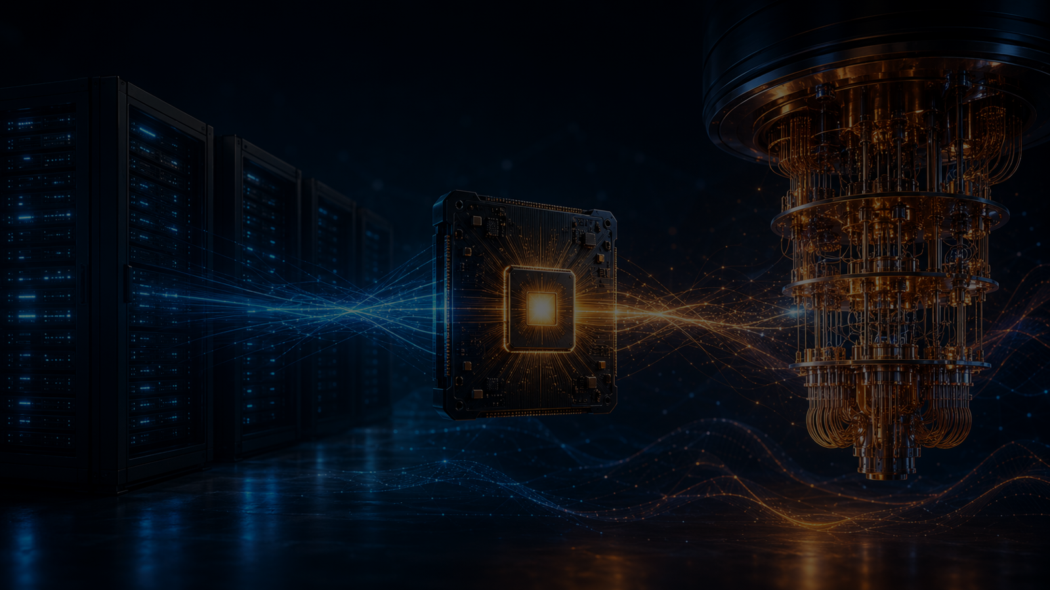
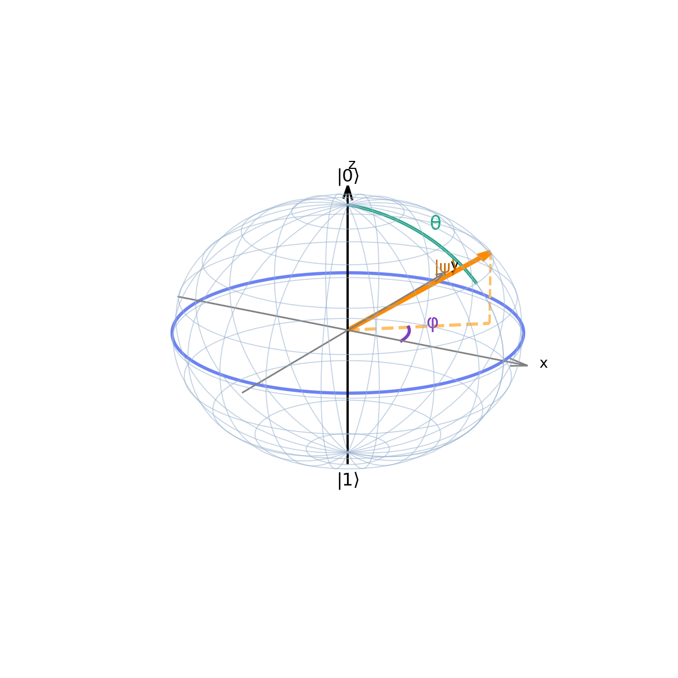
Qubit Visualization
Updated July 2026
A single qubit can be shown as a Bloch sphere
Bloch sphere definition
|ψ⟩ = cos(θ/2)|0⟩ + e^{iφ} sin(θ/2)|1⟩
Amplitude
Controls the probabilities of measuring |0⟩ or |1⟩. On the sphere, this is set by the tilt angle θ.
Phase
Captures the relative phase between the two basis states. On the sphere, this is the rotation angle φ.
Direction
The arrow direction represents the full qubit state before measurement, combining amplitude and phase.
Speaker takeaway: Use the Bloch sphere to explain that a qubit is not just “0 or 1” — it has both a probability balance and a phase relationship.
Quantum deck add-in slide • formatted to match the refreshed 2026 presentation style.

Slide 5
Updated July 2026
Quantum Behavior
Superposition, entanglement, and interference in plain language
Superposition
Entanglement
Interference
probability-based information unit
one combined state
water waves
A qubit can hold a blend of possibilities before measurement.
Qubits can become linked so the state of one is tied to the whole system.
Wrong answer paths can cancel while useful answer paths build up.
Speaker takeaway: Quantum power comes from using physics to tune the odds, not from reading every possible answer.

Slide 6
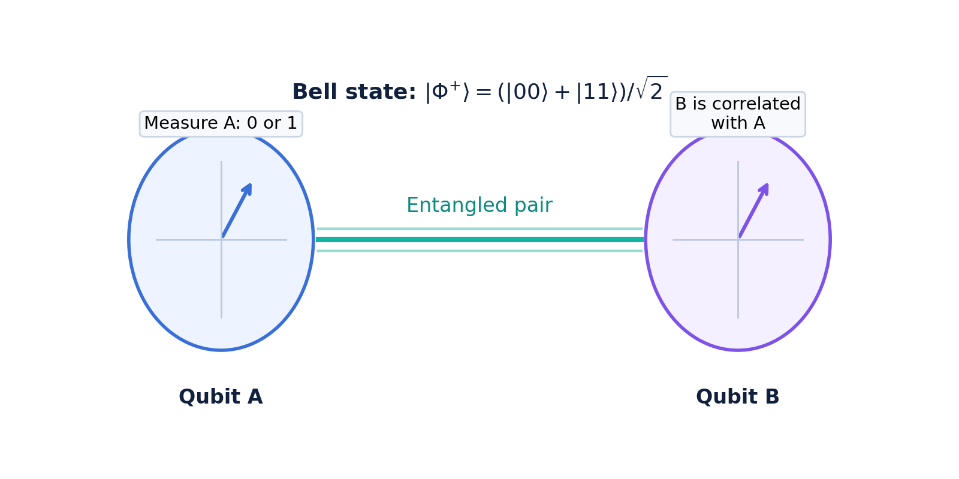
Entanglement
Updated July 2026
Two entangled qubits behave like one shared quantum system
Example Bell state
|Φ⁺⟩ = (|00⟩ + |11⟩) / √2
The pair must be described together as one combined state.
When one qubit is measured, its result is random — but the other qubit is correlated with it.
For this Bell state, the most likely outcomes are 00 and 11, not independent results.
Key idea
Entanglement creates powerful correlations that classical bits cannot naturally reproduce.
Speaker takeaway: Entanglement is one of the main sources of quantum advantage because the qubits must be treated as a single correlated state, not separate bits.
Quantum deck add-in slide • formatted to match the refreshed 2026 presentation style.

Slide 7
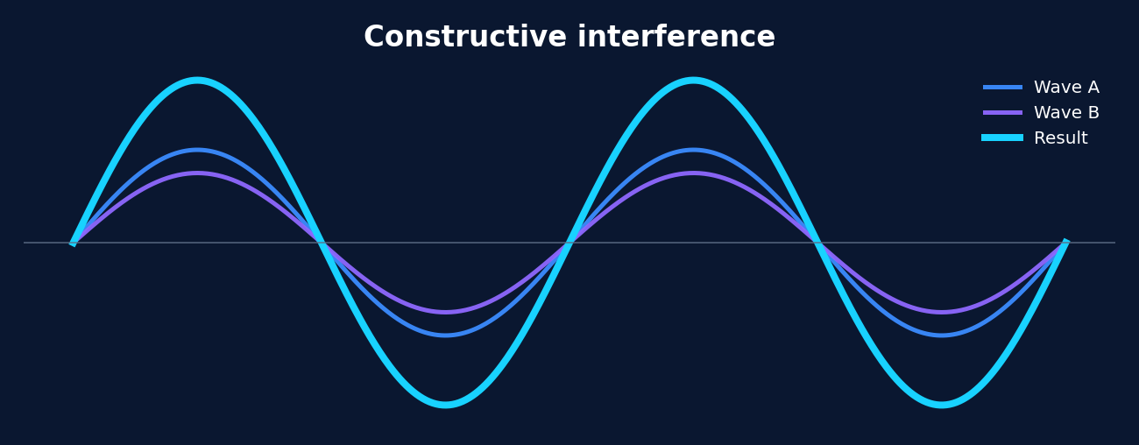
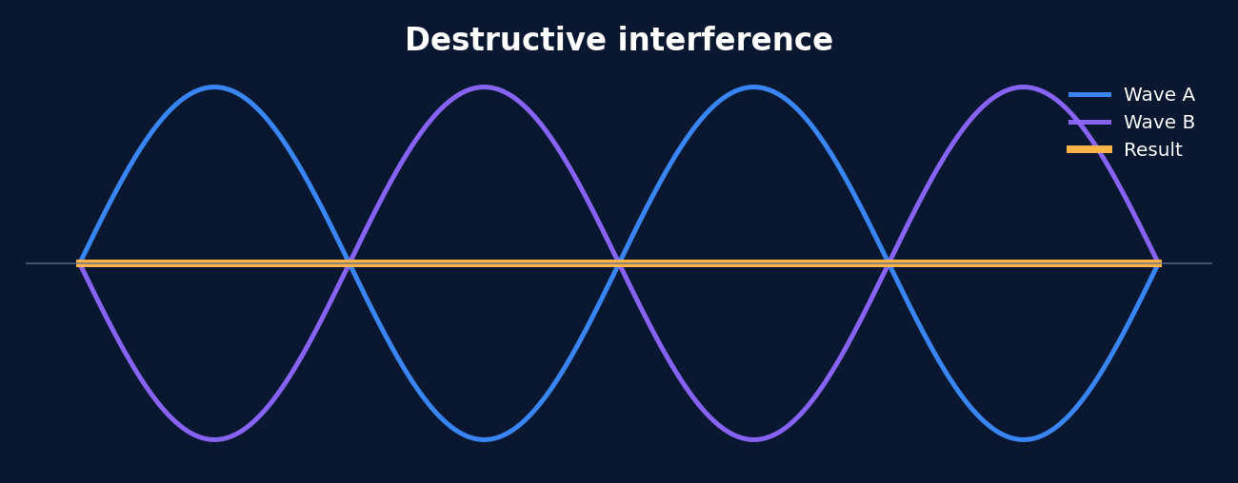
Quantum Behavior
Updated July 2026
Quantum interference amplifies useful answers and cancels bad ones
CONSTRUCTIVE
DESTRUCTIVE
What happens
What happens
Waves line up so amplitudes add together.
This makes a desired state more likely to appear when measured.
Quantum algorithms try to reinforce the paths that help the answer.
Waves are out of phase so amplitudes cancel out.
This suppresses unwanted states and reduces their measurement probability.
Quantum algorithms use this to make bad answers less likely.
Speaker takeaway: Quantum speedup does not come from reading every answer at once. It comes from using interference so useful answers build up while useless ones cancel out.
Quantum deck add-in slide • formatted to match the refreshed 2026 presentation style.

Slide 8
Gate Selection
Updated July 2026
Quantum interference depends on which gates are applied and in what order
How gates shape interference
What this means in practice
1. Hadamard or superposition gates
Create multiple quantum paths that can later interfere.
Hadamard-style gates create the paths that can interfere.
Phase and rotation gates decide whether paths add or cancel.
Entangling gates let interference happen across multiple qubits, not just one qubit at a time.
2. Phase gates and rotations
Shift phases so some paths line up and others cancel out.
3. Entangling gates
Spread interference across qubits so the whole state evolves together.
Why order matters
Applying the same gates in a different sequence can completely change the interference pattern.
Too many noisy gates can damage the phase relationships and weaken the intended result.
4. Final mixing + measurement
Convert phase differences into measurable probability differences.
Speaker takeaway: Gates are the steering wheel for interference: they create paths, shift phase, entangle qubits, and turn hidden phase differences into useful measurement bias.
Quantum deck add-in slides • formatted to match the refreshed 2026 presentation style.

Slide 9

Knowledge Check 1
Audience quiz
Which statement best explains why quantum computers can outperform classical systems on selected problems?
A
They can read every possible answer at once.
B
They use superposition, entanglement, and interference to make useful answers more likely.
C
They simply run at much higher clock speeds than GPUs.
D
They avoid the need for algorithms.
Audience checkpoint: choose the best answer, then discuss why the other three choices do not fit.
CTO quantum knowledge check • formatted to match the August 2026 refresh deck.

Slide 10
Gate Summary
Updated July 2026
Common quantum gates and what each category does
State-flip gates
Superposition
Phase gates
Rotations
Measure
X, Y, Z
H
S, T, RZ
RX, RY, RZ
M
Change a qubit’s state or phase. X acts like a bit flip.
Creates a balanced superposition so interference can begin.
Shift phase without directly changing measured probabilities right away.
Turn the qubit state by a chosen angle on the Bloch sphere.
Reads the qubit and collapses it to a classical result.
Entangling / controlled gates
How to think about them
CNOT, CZ, CP, SWAP
H creates the paths.
Phase/rotation gates tune alignment.
Controlled gates spread the effect across qubits.
Measurement turns the quantum state into a classical output.
Link qubits together so the state must be described as one combined system.
Essential for entanglement and multi-qubit interference.
Speaker takeaway: You do not choose gates at random. A quantum algorithm is a carefully designed sequence in which each gate category plays a distinct role in creating, steering, and reading the quantum state.
Quantum deck add-in slides • formatted to match the refreshed 2026 presentation style.

Slide 11
Quantum Software Stack
Updated 2026 context
From applications down to firmware that turns instructions into gates
Layered view of the stack
Application
Business logic, chemistry workflows, optimization apps
Quantum Compiler
Maps algorithms to circuits, optimizes them, and transpiles to native gates
Quantum Middleware
Job orchestration, runtime services, APIs, error mitigation, queueing, hybrid workflows
Quantum Firmware
Drives pulses, timing, calibration, readout, and low-level execution of gates
Speaker takeaway: Applications express the goal, the compiler rewrites it into gates, middleware manages execution, and firmware is the layer that physically makes those gates happen on the machine.
Quantum deck add-in slides • formatted to match the refreshed 2026 presentation style.

Slide 12
IBM Qiskit
IBM ecosystem
Qiskit is IBM’s open-source SDK for building, optimizing, and running quantum programs
What Qiskit is
What Qiskit provides
A Python-based software development kit for quantum computing.
Used to create circuits, simulate them, optimize them, and run them on IBM Quantum backends.
Widely used for teaching, research, algorithm development, and hybrid quantum-classical workflows.
Circuit design
Transpiler
Create quantum circuits with gates, measurements, and parameters.
Map abstract circuits to the native gate set and topology of a target backend.
Primitives / runtime
Simulators + hardware access
Typical Qiskit workflow
Run common tasks such as sampling and expectation evaluation more efficiently.
Test locally or connect to IBM Quantum systems for real execution.
Build circuit
Transpile
Simulate / run
Analyze results
Why it is important
Qiskit gives developers a practical entry point into the quantum software stack.
It connects high-level programming to lower-level compilation and execution on real systems.
Speaker takeaway: Qiskit is one of the most important software entry points in quantum computing because it lets developers move from algorithm ideas to real circuits, simulators, and hardware runs in one ecosystem.
Quantum deck add-in slides • formatted to match the refreshed 2026 presentation style.

Slide 13
Updated July 2026
Algorithmic Speedups
Why quantum can outperform hyperscalers in selected workloads
Grover
Shor
Simulation
N → √N
factoring
nature is
quantum
Quadratic search speedup
Cryptography impact at fault tolerance
Chemistry/materials advantage potential
Caution: no quantum algorithm gives a universal speedup over GPUs/hyperscalers. The workload must match the algorithm and the hardware.
Speaker takeaway: Quantum advantage is a math-structure advantage, not a generic hardware speed advantage.

Slide 14
Updated July 2026
The 2026 Context
Quantum is becoming a hybrid accelerator, not a cloud replacement
Classical cloud
Quantum accelerator
AI control layer
• CPUs, GPUs, TPUs
• Runs apps, AI, databases
• Scales by adding more machines
• QPU solves specialized subproblems
• Best for quantum simulation and optimization
• Accessed through cloud/HPC workflows
• Calibration
• Error correction
• Hybrid orchestration
Speaker takeaway: Quantum will likely live inside hybrid cloud and HPC platforms, not beside them as a standalone replacement.
Includes NVIDIA Ising/NVQLink, IBM Starling, Google Willow, D-Wave Advantage2 and FAU updates.

Slide 15
Updated July 2026
What Changed in 2026?
The story shifted from qubit count toward stability and hybrid control
NVIDIA Ising
AI models for quantum calibration and error-correction decoding; targets stability bottlenecks.
NVIDIA NVQLink / CUDA-Q
Connects GPUs and QPUs for hybrid quantum-classical supercomputing workflows.
IBM Starling
2029 roadmap target: 200 logical qubits and 100M gates.
Google Willow
Below-threshold error-correction milestone and benchmark speedup claim.
D-Wave / FAU
$20M FAU Advantage2 annealing system in Boca Raton.
D-Wave / AT&T
Expanded quantum optimization work across network operations.
Speaker takeaway: The main advance is the supporting stack: AI calibration, decoding, hybrid GPU-QPU control, and clearer fault-tolerant roadmaps.

Slide 16
Updated Aug. 18, 2026
CTO Quantum Update
August 2026: quantum operations are becoming autonomous
NVIDIA Ising 1.5
Commercial-ready 31B calibration VLM released July 20; calibration analysis is moving into the AI control plane.
NVIDIA QEC Decoder
At d=13, p=0.003: Fast model is 2.5× faster and 1.11× more accurate; Accurate model is 2.25× faster and 1.53× more accurate vs PyMatching.
Vibe Calibration
Autonomous bring-up calibrated 108 of 112 superconducting qubits in 4.7 hours — roughly 4–5× faster than estimated manual calibration.
Google RL + Willow
Continuous syndrome-driven control improved logical stability 3.5× under injected drift and cut logical error rate another 20% after expert calibration.
62-km Quantum Network
62 km of noisy aerial commercial fiber sustained ~1,500 entangled pairs/sec with 92.8% uptime in a 24-hour stress test.
SandboxAQ + Claude MCP
Physics-grounded scientific workflows are becoming agent-accessible: setup that previously took weeks can move to hours through Claude + LQM integration.
Speaker takeaway: Quantum progress is increasingly a systems-engineering story: AI calibration, real-time decoding, continuous control, network stabilization, and easier access to scientific models.
Sources: Quantum Acceleration 8-2026; NVIDIA Ising; Google Research/Nature; NIST/UMD/Qunnect; SandboxAQ; Vibe Calibration research.

Slide 17
Updated Aug. 18, 2026
CTO Implications
CTO impact: quantum readiness is becoming a full-stack system concern
1. AI becomes part of the QPU control plane
Treat GPU/AI calibration and feedback as core quantum infrastructure, not a human controlled analytics layer.
2. Quantum Error Correction becomes a real-time systems problem
Evaluate decoder latency, syndrome throughput, feedback-loop timing, and classical control capacity — not just qubit count.
3. Quantum networking moves onto the watchlist
The 62-km commercial-fiber test shows interconnect stability is becoming an engineering problem; track standards, repeaters, and distributed-QPU architecture.
4. Scientific access is becoming agentic
MCP/LLM interfaces can make advanced chemistry and materials models usable without specialist code; governance and validation become the new bottleneck.
Speaker takeaway: For CTOs, “quantum readiness” now means software, control loops, networks, data pipelines, skills, and vendor interoperability — not buying a standalone QPU.
Sources: Aug. 2026 project update; IBM Newsroom; Quantinuum/Quanta; NIST; NVIDIA; Google Research; SandboxAQ.

Slide 18
Knowledge Check 2
Audience quiz
What is NVIDIA Ising primarily meant to improve in the current quantum stack?
A
Replacing the quantum processor with an AI model.
B
Calibration and quantum error-correction decoding.
C
Consumer web applications running directly on qubits.
D
Classical cloud billing and storage.
Audience checkpoint: choose the best answer, then discuss why the other three choices do not fit.
CTO quantum knowledge check • formatted to match the August 2026 refresh deck.

Slide 19
Updated July 2026
Real-World Use Cases
Where quantum is most likely to matter first
Molecules & materials
Optimization
Cybersecurity
Very strong long-term fit: nature is quantum.
Strong fit for annealing and hybrid solvers, especially scheduling and routing.
Fault-tolerant quantum threatens some classical encryption; drives quantum-safe migration.
AI & ML
Finance & risk
Logistics & networks
Promising but not a near-term GPU replacement for large LLM training.
Potential speedups, but hardware requirements remain high.
Annealing and hybrid optimization may be practical earlier.
Speaker takeaway: Do not apply quantum everywhere; apply it where the problem structure matches the machine.

Slide 20
Business Impact
Industry use cases
Business areas where quantum can outperform or complement classical computing
Quantum advantage usually appears when the problem is either inherently quantum, like chemistry, or combinatorially complex, like routing and planning. Early value is most likely through hybrid cloud + AI + quantum workflows.
Chemistry / Drug Discovery
Routing / Logistics
Materials & Energy
Business problem
Business problem
Business problem
Finding promising molecules, catalysts, or battery materials with better properties.
Classical simulation becomes expensive as molecular systems and interactions grow in complexity.
Choosing the best routes, schedules, and resource assignments across many constraints.
Classical optimization works well, but complexity grows rapidly with scale and constraint combinations.
Designing better batteries, catalysts, semiconductors, fertilizers, and energy storage materials.
Classical methods struggle as material chemistry, quantum states, and process combinations scale up.
Quantum advantage
Quantum advantage
Quantum advantage
Quantum computers can model quantum behavior more naturally because molecules are quantum systems.
Potentially useful for electronic structure, binding behavior, and material-property exploration.
Quantum annealing and hybrid optimization can search large solution spaces for strong near-optimal answers.
Helpful when timing, capacity, distance, and sequencing constraints interact heavily.
Quantum simulation may better model material behavior, reaction pathways, and molecular interactions.
Potential business value in faster materials discovery, improved battery chemistry, and industrial process innovation.
Speaker takeaway: Chemistry and materials are the clearest examples of native quantum advantage, while routing shows how hybrid quantum optimization may improve difficult planning problems.
Quantum deck add-in slide • aligned to project themes on chemistry, routing, logistics, materials, energy, and hybrid enterprise deployment.

Slide 21
Business Impact
Industry use cases
Expanded commercial use cases, including a realistic view of large-LLM training
Not every use case will deliver the same value. For finance and manufacturing, quantum is more likely to help as a specialized optimizer. For large-LLM training, the near-term impact is expected to be limited and highly targeted rather than a full GPU replacement.
Financial Services
Manufacturing & Planning
Large-LLM Training (estimated)
Business problem
Business problem
Business reality today
Optimizing portfolios, scenario analysis, derivatives pricing, and selected risk workflows.
Classical systems are strong, but some search and combinatorial problems become expensive at scale.
Balancing plant schedules, inventory, workforce, maintenance windows, and production constraints.
As constraints multiply, classical search and planning can become slow or suboptimal.
Quantum computers are not expected to replace GPUs for end-to-end LLM training in the near term.
Data loading, tensor math, memory movement, and large-scale backprop remain overwhelmingly classical today.
Quantum advantage
Quantum advantage
Potential future acceleration
Most plausible role: targeted acceleration of optimization, sampling, feature-map subroutines, or selected linear-algebra kernels in hybrid workflows.
Reasonable estimate: no meaningful end-to-end speedup today; speculative 1.2x–3x workflow-level gains in selected hybrid stages in the 2030s; larger claims remain highly uncertain.
Quantum methods may help with portfolio optimization, constrained search, and selected Monte Carlo-style workflows.
The most likely commercial model is hybrid: classical risk engines plus quantum subroutines for hard optimization tasks.
Quantum optimization may help generate better schedules and allocations under tightly constrained conditions.
Potential value is in factory planning, supply allocation, digital twins, and hybrid operational decision support.
Best interpretation
If quantum helps LLMs, it will likely be as a niche accelerator inside a broader AI stack, not as a wholesale replacement for hyperscaler training clusters.
Speaker takeaway: Finance and manufacturing are strong hybrid-optimization candidates, while large-LLM training should be viewed realistically: near-term impact is limited, with only selective and still-speculative acceleration in future hybrid architectures.
Quantum deck add-in slides • aligned to project themes on finance, manufacturing, enterprise planning, AI optimization, and realistic quantum/LLM acceleration expectations.

Slide 22
Quantum Advantage: speed & power are workload-specific
Quantum does not replace hyperscalers. It becomes a specialized accelerator when the problem math favors quantum effects.
SPEED
POWER
Different scaling, not faster CPUs
The energy story depends on total time-to-solution
The win comes from superposition + interference + entanglement, not raw clock speed.
A QPU may use far less facility power than an exascale/AI cluster, but error correction and classical control still matter.
BENCHMARK SIGNAL
SEARCH SIGNAL
SIMULATION SIGNAL
HYPERSCALER / EXASCALE CLASSICAL
~10³⁰×
N → √N
natural fit
8–30 MW
Frontier-style supercomputer facility draw
Google Willow benchmark: <5 minutes vs ~10²⁵ years classical estimate. Benchmark only, not a business workload.
Grover: 1 trillion possibilities becomes about 1 million quantum-scale iterations.
Quantum matter is expensive to emulate classically; QPUs can model quantum systems directly.
QUANTUM SYSTEM / QPU CONTROL
15–25 kW
D-Wave / dilution-fridge-class system power; QPU itself is tiny, cooling dominates
Future acceleration map: how much faster depends on the problem class
Gate-model quantum
Annealing quantum
Shor
Grover
Simulation
Optimization / sampling
AI control layer
Hybrid cloud
crypto: infeasible → feasible
quadratic search speedup
chemistry/materials
routing, scheduling, portfolios
NVIDIA Ising: stability assist
GPU + QPU + AI
Caveat: quantum advantage must be measured end-to-end — data loading, error correction, classical pre/post-processing, and total energy used.
Sources: Google Willow benchmark; Nature/OLCF Frontier power range; D-Wave hosting specs/IEEE power estimate; IBM Starling roadmap; NVIDIA Ising.
Notes:
Presenter notes:
• The message is not that quantum computers are universally faster. They are faster when the problem can be expressed in a way quantum mechanics can exploit.
• The dramatic Willow benchmark is a real quantum advantage signal, but it is a benchmark workload, not a business workload.
• Energy advantage is also workload-specific: quantum systems may draw far less power than exascale clusters, but error correction, control electronics, and classical orchestration can dominate.
• Gate-model quantum is the path for Shor, Grover, and quantum simulation. Annealing is best framed as an optimization/sampling accelerator.
• Executive takeaway: treat quantum as a future accelerator inside hyperscaler/HPC architecture, not as a replacement for cloud.

Slide 23
The
The Murdoch Slide
or follow the money slide
Year | Country / government listed commitments | Corporate / private listed deals | Combined listed total | YoY change
2024 | ~$2.04B | ~$0.48B | ~$2.51B | —
2025 | ~$9.56B | ~$4.53B | ~$14.09B | ~+461%
2026 YTD | ~$4.61B | ~$6.14B | ~$10.75B | ~-24% vs full-year 2025
2026 YTD combined listed quantum investment: ~$10.75B
On a simple annualized run-rate basis, $10.75B through seven months implies roughly $18.4B for full-year 2026, which would be about +31% above 2025 if the pace holds. That is a rough run-rate, not a forecast.
Updated combined listed total
Notes:
The 2026 YTD country/government figure includes the U.S. Department of Commerce / NIST’s $2.013B
CHIPS quantum incentives and the UK’s £2B quantum package, rounded to about $2.6B. NIST says the
U.S. incentives cover two quantum foundry companies and seven quantum-computing companies, while the
UK package includes large-scale quantum-computer procurement plus more than £500M dedicated to quantum
computing.
The 2026 YTD corporate/private figure includes major disclosed transactions such as
IonQ/SkyWater ~$1.8B, Quantinuum IPO ~$1.68B, D-Wave/Quantum Circuits ~$550M, Infleqtion >$550M,
Pasqal ≥€340M / roughly $400M, Xanadu ~$302M, IQM ~$233.5M, plus smaller disclosed rounds such as
OQC and Nu Quantum.

Slide 24
Updated Aug. 18, 2026
2026 Roadmap View
What the leading roadmaps imply — updated August 2026
2026
2028
2029
2030–33+
Operationalization
Pre-fault-tolerant scale
Fault-tolerant inflection
Scale-out / utility
IBM targets first quantum-advantage examples with HPC; Nighthawk: 7,500 gates on up to 360 qubits. AI calibration, RL-QEC and real-world quantum networking move into operation.
IBM Nighthawk: up to 15,000 gates / 1,080 qubits. IonQ roadmap target: 20,000 physical / 1,600 logical qubits. Quantum-classical workflow acceleration expands.
IBM Starling: 200 logical qubits / 100M operations. Quantinuum Apollo is now scheduled for 2029 — one year earlier than the prior deck.
IonQ targets 2M physical / 80k logical by 2030. IBM Blue Jay: 2,000 logical / 1B operations in 2033+. Quantinuum Lumos targets utility-scale by 2033.
Speaker takeaway: The key date change is Quantinuum Apollo moving from 2030 to 2029. Vendor roadmaps now converge on 2029 as a major fault-tolerant inflection; utility-scale claims extend into 2030–2033+.
Roadmap sources: IBM Technology Atlas (Mar/Aug 2026); Quantinuum public roadmap + DARPA QBI; IonQ roadmap. All dates are vendor targets and may change.

Slide 25
Updated July 2026
Enterprise Adoption Playbook
How to start without overclaiming quantum advantage
1. Identify workloads
Optimization, chemistry, materials, scheduling, portfolio, network operations.
2. Benchmark classically
Compare against classical solvers, GPUs, heuristics, and cost constraints.
3. Prototype hybrid
Use cloud QPU access, simulators, and hybrid solvers before hardware commitments.
4. Validate value
Measure speed, accuracy, energy, cost, robustness, and integration complexity.
5. Build capability
Train developers on circuit coding and QUBO/Ising formulation.
Speaker takeaway: Treat quantum as a portfolio of targeted experiments, not a blanket replacement for existing cloud and AI infrastructure.

Slide 26
Knowledge Check 3
Audience quiz
Which of the following is one of the strongest near-term commercial fits for quantum computing?
A
Social media feed ranking for all users.
B
General office productivity software.
C
Molecular simulation and materials discovery.
D
Web page rendering in browsers.
Audience checkpoint: choose the best answer, then discuss why the other three choices do not fit.
CTO quantum knowledge check • formatted to match the August 2026 refresh deck.

Slide 27
Updated July 2026
Final Message
What non-technical leaders should remember
• A qubit is not just a faster bit — it is a probability-based information unit.
• Quantum speedups come from algorithmic structure: superposition, entanglement, and interference.
• Gate-based quantum and annealing quantum are different tools for different jobs.
• NVIDIA Ising matters because stability and error correction are the real blockers.
• The future stack is cloud + GPU + AI + QPU, not quantum replacing hyperscalers.
Speaker takeaway: Quantum is no longer science fiction, but practical broad adoption still requires stabilized, error-corrected systems.

Slide 28
Appendix

Slide 29
Updated July 2026
Technical Bottom Line
What changed in the refreshed view
• The 2026 story is stabilization: AI calibration, decoding, logical qubits, and hybrid GPU-QPU control.
• Gate-based quantum is the path to universal algorithms, chemistry, cryptography, and long-term fault tolerance.
• Annealing quantum is the more immediate model for optimization, scheduling, routing, and resource allocation.
• Enterprise adoption should start with benchmarking and hybrid pilots, especially where classical optimization is expensive.
• The realistic future is hyperscaler + GPU + AI + QPU, with quantum as a specialized accelerator.
Speaker takeaway: The “winner” is not a standalone QPU; it is the full hybrid system architecture.

Slide 30
Updated July 2026
Sources
Sources Used for Basic Deck Refresh
1. User-provided June 2026 Quantum Computing Overview PDF.
2. NVIDIA Newsroom — Ising open AI model family for quantum calibration and decoding, Apr. 2026.
3. NVIDIA — NVQLink and CUDA-Q real-time hybrid quantum-classical workflows, 2025–2026.
4. IBM Quantum — Starling roadmap: 200 logical qubits and 100M gates target in 2029.
5. Google Quantum AI / Nature — Willow below-threshold error-correction and benchmark milestone.
6. D-Wave / FAU — $20M Advantage2 annealing quantum computer agreement, Jan. 2026.
7. D-Wave / AT&T — expanded annealing quantum use in network operations, Jul. 2026.
8. Quantinuum and IonQ public fault-tolerant quantum roadmaps, 2024–2026.
Speaker takeaway: Roadmaps are vendor targets and milestones; treat them as directional rather than guaranteed delivery dates.

Slide 31
Google Willow
105-qubit processor
Willow combines high-fidelity superconducting qubits with two distinct quantum milestones
Willow is a 105-qubit superconducting transmon processor using microwave control, tunable couplers, resonator-based readout, cryogenic electronics, and classical decoding.
How Willow is built
Two achievements — do not combine them
Flux-tunable transmon qubits
Nearest-neighbor tunable couplers
Microwave single-qubit control
Two-qubit entangling operations
Fast readout + classical decoding
ERROR CORRECTION
QUANTUM ECHOES
Below-threshold surface-code memory
Beyond-classical correlation measurement
101 physical qubits formed a distance-7 logical memory.
Logical error rate ≈ 0.143% per cycle.
Larger code size reduced logical errors — the key milestone.
Used large random circuits and OTOC measurements.
Exercised up to 103 qubits; some beyond-classical tests used 65.
Not a fully fault-tolerant logical-qubit computation.
99.97%
single-qubit gate fidelity
99.88%
entangling-gate fidelity
99.5%
readout fidelity
68 / 89 μs
average T₁ / T₂,CPMG
Speaker takeaway: Willow’s error-correction result and Quantum Echoes result are both important, but they demonstrate different things: one advances logical reliability; the other probes complex quantum correlations beyond classical reach.
Sources summarized from the attached Willow analysis: Google Quantum AI, Google Research, and Nature publications cited in the source document.

Slide 32
Quantum Echoes
Forward + inverse gates
How Quantum Echoes works — and what the result does not mean
The “echo” is not a decoherence-free signal. It is an interference-sensitive correlation created by forward evolution, a local perturbation, inverse gates, and measurement.
The gate sequence
What it can and cannot do
1
Forward evolution U
Random X–Y rotations + iSWAP-like entangling gates
What it does
Refocuses selected coherent dynamics.
Reveals how a local disturbance spreads through entangled qubits.
Produces a reproducible, cross-checkable expectation value.
2
Local perturbation B
A Pauli-X gate inserts a controlled “butterfly-effect” disturbance
3
Inverse evolution U†
Reverse the gate order and replace each gate with its inverse
What it does not do
Does not reverse physical time or eliminate decoherence.
Cannot recover energy lost through T₁ decay or phase leaked into the environment.
Does not prove practical drug discovery or industrial materials modeling today.
4
Measurement M
A Pauli-Z observable detects the resulting echo / correlation
|ψ⟩ → U|ψ⟩ → BU|ψ⟩ → U†BU|ψ⟩ → measure echo
Speaker takeaway: Quantum Echoes demonstrates a reproducible beyond-classical measurement of many-body correlations. It is a major physics and verification milestone, but not a decoherence-free signal or a completed commercial chemistry solution.
Sources summarized from the attached Willow analysis: Google Quantum AI, Google Research, and Nature publications cited in the source document.

Slide 33
Updated July 2026
Two Quantum Models
Gate-based quantum vs quantum annealing
Question
Gate-Based Quantum
Annealing Quantum
What you build
A circuit of quantum gates
An optimization landscape
Plain analogy
Step-by-step recipe
Find the lowest valley
Best use
General algorithms, chemistry, cryptography research
Scheduling, routing, allocation, portfolio, logistics
Coding style
Qiskit / Cirq / Braket / PennyLane circuits
QUBO / Ising model with variables and penalties
Near-term business fit
Mostly research and pilots
Optimization pilots and practical hybrid workflows
Speaker takeaway: Gate-based quantum is the broader long-term model; annealing is more directly aligned with optimization problems.

Slide 34
Updated July 2026
Reference Architecture
The emerging quantum stack is hybrid by design
Application layer
Enterprise workflows, AI agents, scientific workflows, optimization workloads
Classical compute
CPUs, GPUs, TPUs, memory, orchestration, simulation, post-processing
Quantum programming
CUDA-Q, Qiskit, Cirq, Braket, PennyLane, Ocean SDK
Control & decoding
AI calibration, pulse control, error syndrome decoding, feedback loops
QPU hardware
Ion trap, superconducting, neutral atom, photonic, annealing systems
Speaker takeaway: Fault-tolerant quantum computing is as much a systems-integration problem as it is a physics problem.

Slide 35
Updated July 2026
Why Can Quantum Be Faster?
The advantage is algorithmic scaling, not just clock speed
Hyperscaler
Quantum
Result
More machines
more parallelism
Different
math model
Some problems
need fewer steps
Example: Grover search can reduce an unstructured search from roughly N checks to roughly √N checks. For one trillion possibilities, that is conceptually about one million quantum-scale search steps.
Speaker takeaway: A quantum advantage is strongest when the quantum algorithm changes the number of steps required.

Slide 36
Quantum Glossary
Appendix glossary
Foundational concepts
Quick reference 1 of 5 • concise definitions used throughout the CTO quantum presentation.
Bit
Classical information unit that stores one definite value: 0 or 1.
Amplitude
Complex-number weight of a quantum state; its squared magnitude determines measurement probability.
Qubit
Quantum information unit that can occupy a weighted combination of |0⟩ and |1⟩ before measurement.
Phase
Relative angular relationship between amplitudes; phase differences determine how states interfere.
Superposition
A qubit state containing multiple possible basis-state outcomes at the same time.
Measurement
Conversion of a quantum state into a classical result such as 0 or 1, sampled according to its probabilities.
Entanglement
A shared multi-qubit state whose correlations cannot be fully described by treating each qubit independently.
Bloch Sphere
Geometric picture of a single qubit showing its state direction, amplitude balance, and phase.
Interference
Combination of quantum amplitudes so some paths reinforce and others cancel.
Quantum State
The mathematical description of a quantum system, including all amplitudes and phase relationships.
Speaker takeaway: use this appendix as a common vocabulary reference when technical and business audiences discuss quantum together.
Quantum glossary • synthesized from the project’s core concepts, software stack, hardware/QEC material, and 2026 roadmap updates.

Slide 37
Quantum Glossary
Appendix glossary
Gates and algorithms
Quick reference 2 of 5 • concise definitions used throughout the CTO quantum presentation.
Quantum Gate
A controlled operation that changes qubit amplitudes, phase, or correlations.
Oracle
Circuit that recognizes desired states and usually marks them by changing their phase without measuring them.
Hadamard (H)
Gate commonly used to create an equal superposition and establish paths that can interfere.
Diffusion Operator
Grover step that performs inversion about the mean to amplify the oracle-marked state.
Pauli X / Y / Z
Basic single-qubit gates: X flips state, Y combines flip and phase, and Z flips relative phase.
Grover Algorithm
Quantum search algorithm that uses oracle marking and amplitude amplification for roughly √N search scaling.
Rotation Gates
RX, RY, and RZ rotate a qubit by a selected angle around axes of the Bloch sphere.
Quantum Fourier Transform
Quantum version of the discrete Fourier transform used to expose periodicity and phase structure.
Entangling Gates
Two-qubit operations such as CNOT, CZ, CP, iSWAP, or FSim that create or manipulate correlations.
Shor Algorithm
Fault-tolerant quantum algorithm for integer factoring that uses period finding and the QFT.
Speaker takeaway: use this appendix as a common vocabulary reference when technical and business audiences discuss quantum together.
Quantum glossary • synthesized from the project’s core concepts, software stack, hardware/QEC material, and 2026 roadmap updates.

Slide 38
Quantum Glossary
Appendix glossary
Hardware, noise, and error correction
Quick reference 3 of 5 • concise definitions used throughout the CTO quantum presentation.
Physical Qubit
An individual hardware qubit implemented with a transmon, ion, neutral atom, photon, or other physical system.
T1 / T2
T1 measures energy relaxation; T2 measures loss of phase coherence.
Logical Qubit
Error-corrected qubit encoded across many physical qubits to suppress hardware errors.
Gate Fidelity
Probability that a gate performs the intended quantum operation accurately.
QPU
Quantum Processing Unit: the hardware processor that executes quantum operations.
Syndrome Data
Ancilla measurement patterns used by quantum error correction to infer where errors occurred without reading logical data directly.
Coherence Time
How long useful quantum amplitude and phase information survive before environmental noise destroys them.
Surface Code
Leading quantum error-correction architecture using a 2-D lattice of data and measurement qubits.
Decoherence
Loss of quantum information through unwanted interaction with the environment.
Code Distance
Error-correction strength parameter; larger distance can tolerate more physical errors but requires more qubits.
Speaker takeaway: use this appendix as a common vocabulary reference when technical and business audiences discuss quantum together.
Quantum glossary • synthesized from the project’s core concepts, software stack, hardware/QEC material, and 2026 roadmap updates.

Slide 39
Quantum Glossary
Appendix glossary
Programming models and software stack
Quick reference 4 of 5 • concise definitions used throughout the CTO quantum presentation.
Gate-Based Quantum
General circuit model in which algorithms are built from ordered quantum gates and measurements.
Native Gate
Gate implemented directly by a specific QPU rather than synthesized from other operations.
Quantum Annealing
Optimization model that evolves a system toward low-energy states representing good candidate solutions.
Quantum Compiler / Transpiler
Software that optimizes an abstract circuit and maps it to the native gates and connectivity of target hardware.
QUBO
Quadratic Unconstrained Binary Optimization: a binary cost-function form commonly submitted to annealers and hybrid solvers.
Quantum Middleware
Runtime layer handling jobs, orchestration, APIs, error mitigation, feedback, and hybrid classical-quantum workflows.
Ising Model
Spin-based mathematical model equivalent to many QUBO problems and central to annealing optimization.
Quantum Firmware
Low-level control software that converts compiled gate instructions into pulses, timing, calibration, and readout actions.
Quantum Circuit
Ordered set of gates, qubits, parameters, and measurements representing a quantum program.
Qiskit
IBM open-source Python SDK used to build, transpile, simulate, and run quantum circuits.
Speaker takeaway: use this appendix as a common vocabulary reference when technical and business audiences discuss quantum together.
Quantum glossary • synthesized from the project’s core concepts, software stack, hardware/QEC material, and 2026 roadmap updates.

Slide 40
Quantum Glossary
Appendix glossary
2026 project and roadmap terms
Quick reference 5 of 5 • concise definitions used throughout the CTO quantum presentation.
Hybrid Quantum-Classical
Architecture where CPUs/GPUs handle orchestration and data while a QPU accelerates selected subproblems.
NVIDIA Ising
AI model family aimed at quantum calibration and quantum error-correction decoding workflows.
Quantum Advantage
Demonstrated performance benefit of a quantum system on a defined workload versus a relevant classical approach.
CUDA-Q / NVQLink
NVIDIA software and interconnect technologies for coordinating GPU and QPU workloads in hybrid systems.
Verifiable Quantum Advantage
Quantum result structured so it can be reproducibly checked or cross-compared rather than being only a one-off random sample.
Fault-Tolerant Quantum Computing
Operating logical qubits with error correction strongly enough to execute long algorithms reliably.
Quantum Echoes
Google protocol using forward evolution, a local perturbation, inverse evolution, and measurement to reveal many-body correlations.
Below Threshold
Regime where increasing the error-correcting code size reduces logical error rather than making it worse.
Distance-7 Quantum Memory
Logical surface-code memory with code distance 7; Willow used 101 physical qubits in its below-threshold memory experiment.
Shot
One complete execution of a quantum circuit from initialization through measurement; repeated shots estimate output probabilities.
Speaker takeaway: use this appendix as a common vocabulary reference when technical and business audiences discuss quantum together.
Quantum glossary • synthesized from the project’s core concepts, software stack, hardware/QEC material, and 2026 roadmap updates.

