Slide 1
Social License to Operate
Presented by Patrick Garland, P.G., CSP
on February 7, 2017
C-Scale Sound (Noise) Concerns

Slide 2
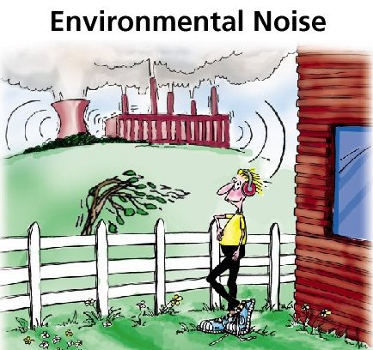
Overview
Introduction
Science of Sound
Regulation Overview
COGCC’s Technical Findings
Noise-vs-Sound
Science-vs-Perception
Case Studies
Mitigation Options
Source: http://www.nonoise.org/library/envnoise/

Slide 3
Introduction
Of 330 complaints that COGCC received in 2015, 123 (37%) were due to noise
COGCC conducted year long noise study
The COGCC is FOCUSED on Noise right now
Notes:
From October 2014 through December 2015 COGCC gathered an analyzed technical data related to noise to determine if current noise regulations should be updated:
C scale low frequency noise limits
A scale high frequency noise limits
Wind speed limits during noise readings

Slide 4
Recent COGCC Complaint
We have a veritable plethora of noises out here and we have sent e-mails … at odd hours of the morning (aka middle of the night), most I would put under HYDRAULIC FRACKING OPERATION We have been dealing with these noises, rattling of windows, vibration of floors and furnace. You may think this is funny, but for the first six months, I thought I was going crazy. I have a sleep number that has a vibration which I HAVE NEVER turned on, but this felt like one of the old beds where you inserted a quarter and the bed would vibrate. This, however, vibrated for hours on end.
32’ sounds walls on the east end of location
Operator conducted independent sound study
During complaint
During COGCC sound study
The noise heard came from the flowback process when excess gas was flared using an enclosed flare as a safety precaution
This increase was for only a short time and was a direct result of a safety procedure used during the flowback process
At the time of the inspection and the sound study no violations of COGCC rules were observed or heard.
Notes:
Doc Number 200439103
There was a complaint which resulted in a COGCC investigation, but there were no violations. What does this mean for you as operators and how you operate? Hopefully this talk will shed some light on how we can deal with similar issues…

Slide 5
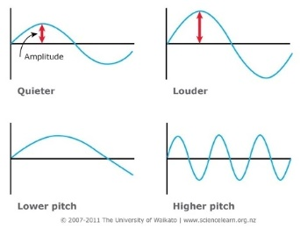
Science of Sound
Sound is a rapid variation of atmospheric pressure caused by some disturbance of the air
The vibrations associated with sound are detected as variations in pressure
Source: http://www.workingwithwaves.com/sound-waves/

Slide 6
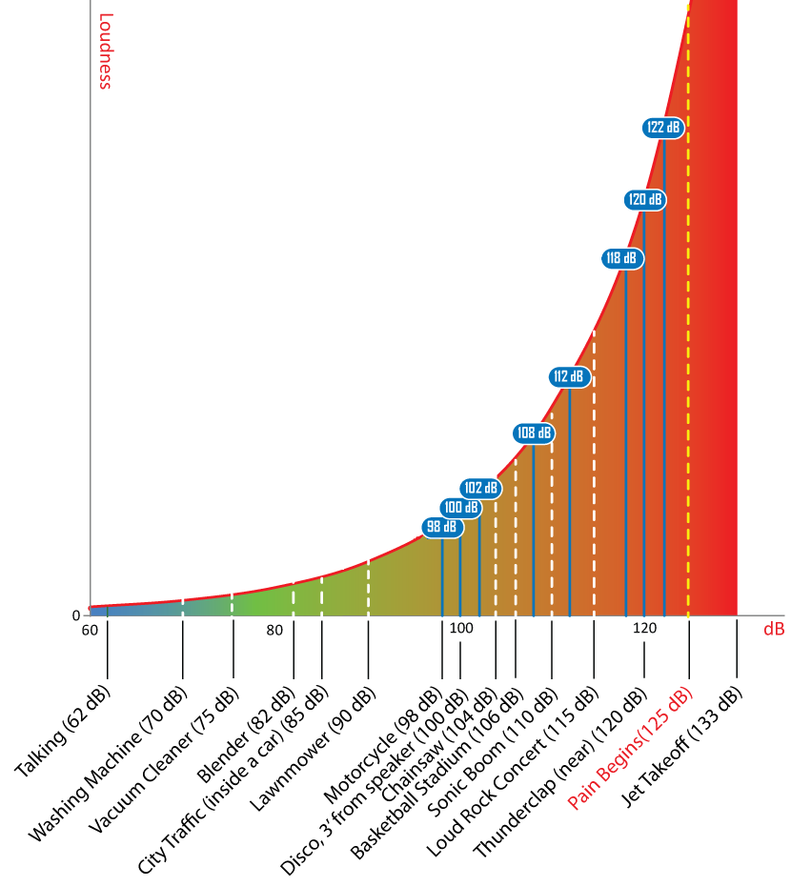
Science of Sound
Sound is measured in units of sound pressure called decibels (dB)
Decibels are measured on a logarithmic scale
For every 10 decibels the loudness doubles
Human Ear = 0-140 dB
Source: https://www.thunderpowermegaphones.com/dbratings
Notes:
a small change in the number of decibels indicates a huge change in the amount of noise
The threshold of hearing is the quietest sound that can typically be heard by a young person with undamaged hearing = 0 dB
The threshold of pain, or greatest sound pressure that can be perceived without pain is approximately 10 million times greater than the threshold of hearing = 140 dB

Slide 7
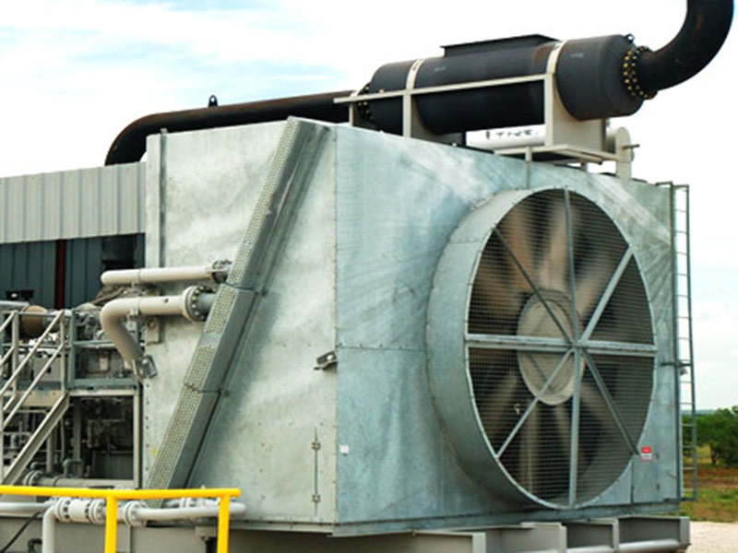
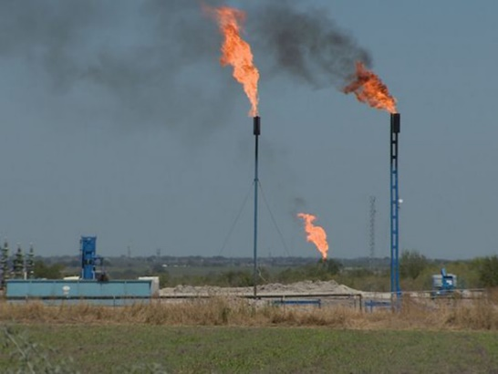
Science of Sound
A-Weighting dB(A) – sensitivity of the human ear
C-Weighting dB(C) – the sounds that you “feel”
Notes:
A-Weighting dB(A) – most similar to the frequency sensitivity of the human ear
C-Weighting dB(C) – low frequency – these are the sounds that you “feel”

Slide 8
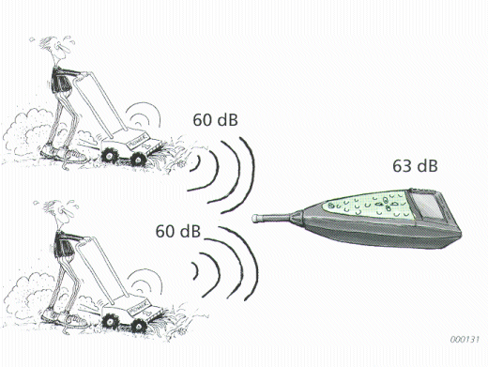
Science of Sound
Cannot simply add two or more sound pressure levels
Source: http://www.nonoise.org/library/envnoise/
Notes:
PASS AROUND NOSIE METER

Slide 9
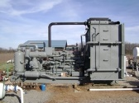
Science of Sound
Typical (unmitigated) measurements near the source:
Compressor = 110-125 dB(A)
Drill Rig = 100-120 dB(A)
Flaring = 110-120 dB(A)
ECD = 65-80 dB(A)

Slide 10
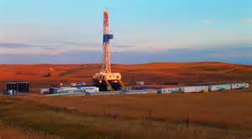
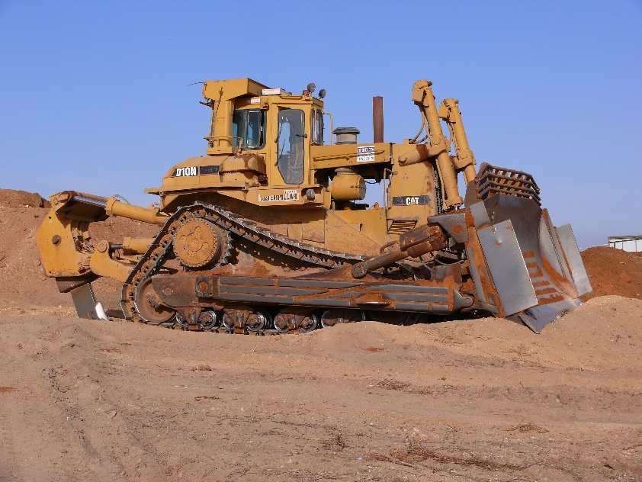
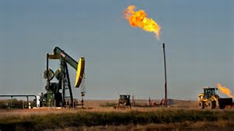
Noise During Pad Build-Out / Drilling
Primary sources of noise would be equipment (bulldozers, drill rigs, and diesel engines).
Other sources of noise include vehicular traffic, blasting and flaring

Slide 11
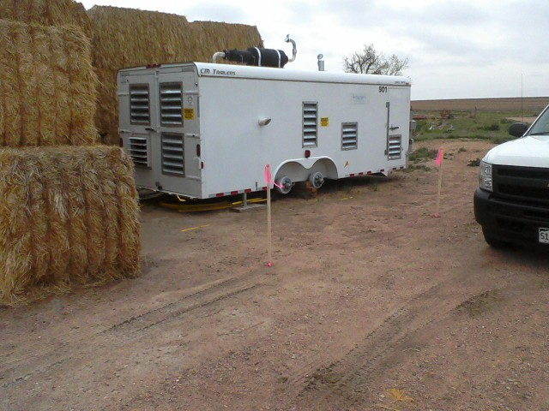
Noise Can Be A Remediation Issue As Well
Hay bales as a temporary / short term solution

Slide 12
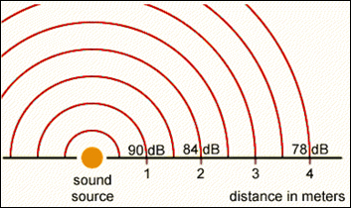
HOW FAR CAN SOUND TRAVEL?
Sound pressure level decreases 6 dB each time the distance from the point source is doubled
Free Field =>
No Reflected Sound Waves
COGCC equation [Rule 802.c(1)]
$${dB}_{2}= {dB}_{1}+20\log{\frac{d_{1}}{d_{2}}}$$
Source: https://www.osha.gov/dts/osta/otm/new_noise/

Slide 13
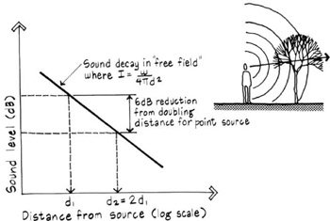
Free Field Example – 100 dB
Assume that you have a sound source that produces a sound pressure level of 100 dB at a distance of 10 feet
DISTANCE (assume feet) | dB (6 dB drop) | dB (equation)
10 | 100 | 100.00
20 | 94 | 93.98
40 | 88 | 87.96
80 | 82 | 81.94
160 | 76 | 75.92
320 | 70 | 69.90
640 | 64 | 63.88
1280 | 58 | 57.86
2560 | 52 | 51.84
5120 | 46 | 45.81
Source: http://www.globalspec.com/reference/41083/203279/chapter-2-sound-absorption

Slide 14
Free Field Example – 90 dB
Assume that you have a sound source that produces a sound pressure level of 90 dB at a distance of 10 feet
DISTANCE (assume feet) | dB (6 dB drop) | dB (equation)
10 | 90 | 90.00
20 | 84 | 83.98
40 | 78 | 77.96
80 | 72 | 71.94
160 | 66 | 65.92
320 | 60 | 59.90
640 | 54 | 53.88
1280 | 48 | 47.86
2560 | 42 | 41.84
5120 | 36 | 35.81

Slide 15
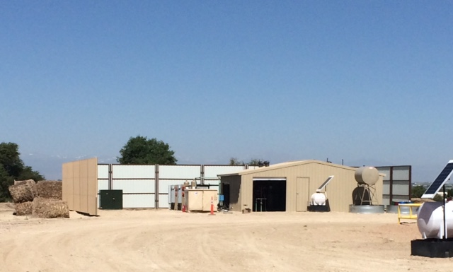
Free Field Example – 80 dB
Assume that you have a sound source that produces a sound pressure level of 80 dB at a distance of 10 feet
DISTANCE (assume feet) | dB (6 dB drop) | dB (equation)
10 | 80 | 80.00
20 | 74 | 73.98
40 | 68 | 67.96
80 | 62 | 61.94
160 | 56 | 55.92
320 | 50 | 49.90
640 | 44 | 43.88
1280 | 38 | 37.86
2560 | 32 | 31.84
5120 | 26 | 25.81

Slide 16
Current COGCC Noise Regulations
COGCC’s maximum permissible noise levels – dB(A)
Rule allows for short increases in noise levels above permissible levels
COGCC 800 Series Rules
802. Noise Abatement
ZONE | 7:00 am to next 7:00 pm | 7:00 pm to next 7:00 am
Residential/Agricultural/ Rural | 55 dB(A) | 50 dB(A)
Commercial | 60 dB(A) | 55 dB(A)
Light industrial | 70 dB(A) | 65 dB(A)
Industrial | 80 dB(A) | 75 dB(A)
Notes:
Oil and Gas operations at any well site, production facility, or gas facility shall comply with the following maximum permissible noise levels
Between 7:00 am and 7:00 pm, the noise levels permitted above may be increased 10 dB(A) for a period not to exceed fifteen minutes in any one hour period

Slide 17
In the Event of a Complaint
How the COGCC measures sound to comply with dB(A) regulation:
350 feet from the noise source
Wind screen on meter
Wind < 5 mph
4 feet above ground level
15-minute average (once per minute)

Slide 18
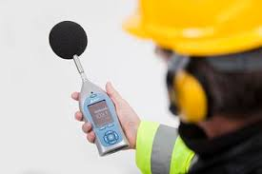
Current COGCC Noise Regulations
COGCC’s maximum permissible noise levels – dB(C)
Less than 65 dB(C) measured 25 feet from house / structure
COGCC 800 Series Rules
802. Noise Abatement
Notes:
If the complaint indicates that low frequency (C-scale) noise is a component of the problem
Using a noise meter calibrated to the dB(C) scale
The COGCC will obtain a sound level measurement 25 feet from the exterior wall of the residence or occupied structure nearest the noise source
If this reading exceeds 65 dB(C) the COGCC will require the operator to obtain a low frequency noise impact analysis by a qualified sound expert

Slide 19
COGCC’s (draft) Technical Findings
TYPE OF MITIGATION | DRILLING – Average C-Scale Noise measured 350’ from the Source or Wall | STIMULATION – Average C-Scale Noise measured 350’ from the Source or Wall
No Mitigation | 76.11 dB(C) | 80.19 dB(C)
~30-Foot Perimeter Sound Wall (Typical Mitigation Used Today) | 71.67 dB(C) | 76.23 dB(C)
Sound walls reduce A-scale by 9-11 dB
Sound walls reduce C-scale by 4-5 dB
Notes:
Results of a total of 27 noise surveys at O&G locations during drilling and completion operations (collected between 10/2014 – 12/2015)
COGCC believes that the increase in C-scale noise complaints results from:
O&G operations are getting closer to populated areas (and populated areas are getting closer to existing O&G operations)
C-scale noise travels farther than A-Scale noise
Sound barriers (typical noise mitigation) are less effective in mitigating C-scale noise
As A-scale noise is reduces, C-scale noise will start to dominate even though the C-scale levels remained unchanged

Slide 20
COGCC’s (draft) Technical Findings
65 dB(C) is the level that may consistently impact people
With 30 Foot Sound Wall
Drilling => 65 dB(C) at 750 feet
Stimulation => 65 dB(C) at 1,250 feet
No Mitigations
Drilling => 65 dB(C) at 1,250 feet
Stimulation => 65 dB(C) at >1,500 feet
Notes:
Results of a total of 27 noise surveys at O&G locations during drilling and completion operations (collected between 10/2014 – 12/2015)
COGCC believes that the increase in C-scale noise complaints results from:
O&G operations are getting closer to populated areas (and populated areas are getting closer to existing O&G operations)
C-scale noise travels farther than A-Scale noise
Sound barriers (typical noise mitigation) are less effective in mitigating C-scale noise
As A-scale noise is reduces, C-scale noise will start to dominate even though the C-scale levels remained unchanged
Typical setback minimum of 500 feet

Slide 21
COGCC Rule Changes
Baseline Ambient Sound Survey
Wind Speed
Changes to C-Scale
Changes to A-Scale
UNDER REVIEW
Mike Leonard – COGCC
(303) 894-2100 x5109

Slide 22
SOUND OR NOISE?
Noise is unwanted sound
Noise is subjective
Source: http://www.slideshare.net/AkashGupta70/environment-pollution

Slide 23
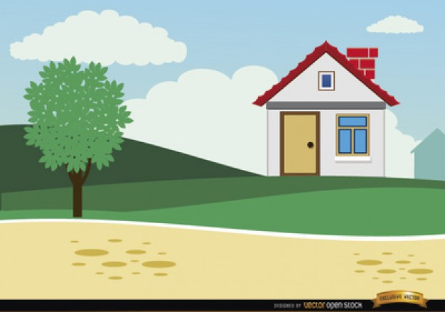
Science or Perception
Science can tell us if we meet the regulatory standards…BUT we still have to battle the perception of what is noise.

Slide 24
Recent COGCC Complaint
The site is about a half of a mile from my home across a corn field. They completed their drilling operation in August and the rig and fencing are gone. Now it is just tanks. Most nights there is a continuous droning noise of heavy machinery that is audible from a distance of about half mile away. I can hear it inside of my home at all hours.
Identified the noise as the compressors on the location
Compressors had temporary sound walls in place
Foreman indicated permanent sound walls were scheduled for install
Summary: Upon inspection no violations of COGCC rules were observed
Notes:
Doc Number 200438621

Slide 25
Case Study #1
Resident 1,250 feet SSE of the site
A-scale noise monitoring in accordance with COGCC Rule 802.c
Identified the location where the C-Scale was less than 65 dB(C)
Phase = Production
Notes:
The dB(C) location is approximately 570 feet NNE of the residence (approximately 680 feet from source), and is therefore in compliance with COGCC regulations

Slide 26
Case Study #2
Resident over 2,500 feet east of the site
A-scale noise monitoring in accordance with COGCC Rule 802.c
Identified the location where the C-Scale was less than 65 dB(C)
Phase = Production

Slide 27
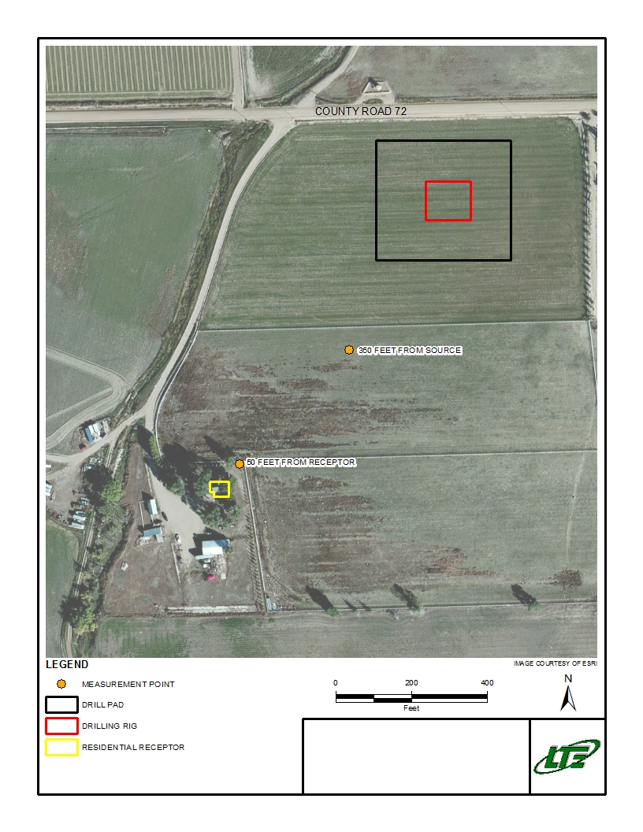
Case Study #3
Resident 850 feet SE of the site
A-scale noise monitoring in accordance with COGCC Rule 802.c
C-Scale over 65 dB(C) at 50 feet from receptor
Phase = Drilling
Mitigation = Hay bales
50’ East of Receptor = 71.41 dB(C)

Slide 28
Recent COGCC Complaint
Please fine them each day for each rule violated. THIS IS TOO LOUD for residential areas so close by. The sound echoes throughout our subdivision. There are many many repeated offenses, and I have complained many times. Please REVOKE THEIR PERMISSION TO OPERATE between 7pm and 7 am, as they have repeatedly broken regulations and cannot be counted on to comply. They abuse the rights of local homeowners, habitually and we rely on you, the regulators, to protect us by enforcing the regulations.
Three inspections were performed at the first pad
Four inspections were performed at the second pad
Five separate sound surveys were conducted by the COGCC
During all seven of these inspections it was determined that no violations were occurring related to noise or lights
Notes:
Doc Number 200422595

Slide 29
Mitigation Options
Do you need to mitigate?
Can it be resolved with a sound survey?
Are COGCC regulations being met?
Is it just a perception issue?

Slide 30
Mitigation Options
Design pad around existing topography
Hospital grade mufflers
Acoustical Panels
Rig Floor Blankets
Perimeter Walls
Perimeter Curtains
Vibration Isolation

Slide 31
THANK YOU
ALLISON S. WHITE, P.E.
awhite@ltenv.com
(303) 962-5529
PAT GARLAND, P.G., C.S.P.
pgarland@ltenv.com
(303) 962-5511
STEVE KAHN, P.E.
skahn@ltenv.com
(303) 962-5506

