Slide 1
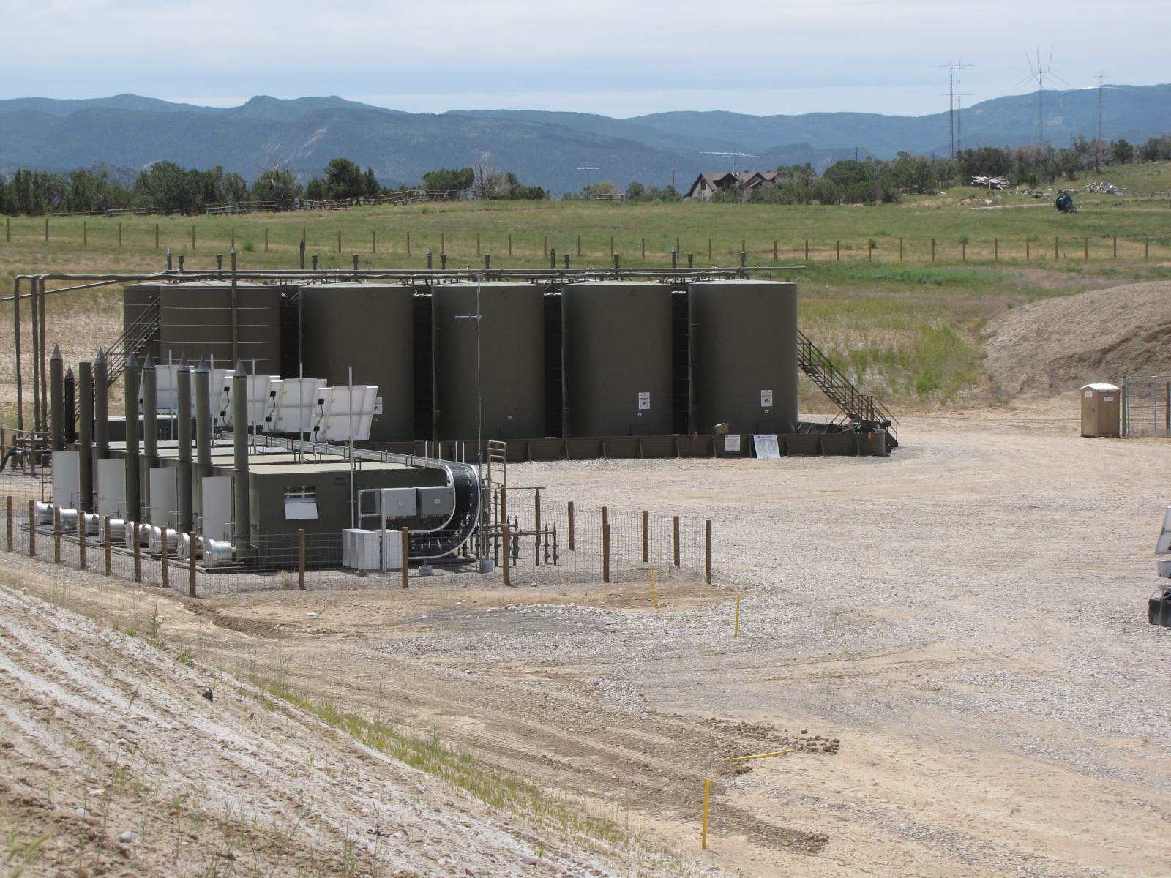

Evaluating
Oil and Gas
Community Health Concerns
  Tami McMullin, Ph.D. State Toxicologist
  Oil and Gas Health Information and Response Program Manager

Slide 2
2015 Governor’s Oil and Gas Task Force
O&G Task Force…“heard from many citizens who expressed concern and uncertainty about potential human health risks associated with exposure to emissions from oil and gas activities. The Task Force believes citizens deserve and need accurate, credible, peer-reviewed scientific information to help them evaluate risk” (Task Force Final Report, 2015)

Slide 3
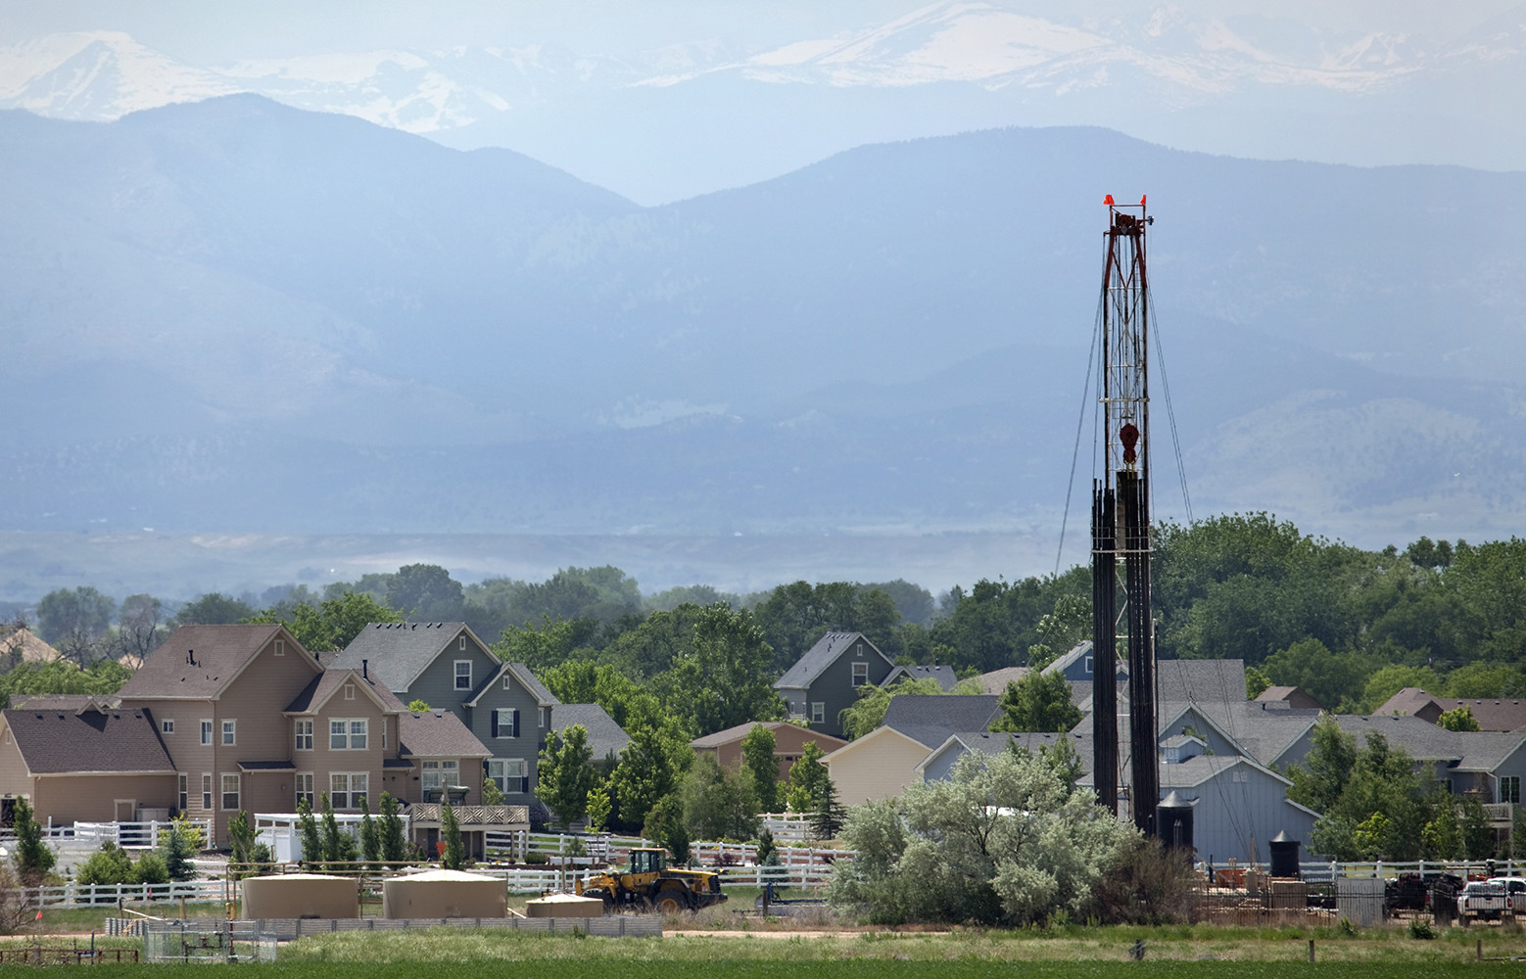
Objective
Do VOCs from UOGD result in exposures to Coloradoans living nearby at levels that may be harmful to their health?
Notes:
The OG boom along the front range came in parallel to massive population growth in the same area, resulting in… this situation as the typical landscape along the northern front range.
In Colorado, our state funded our program specifically to address the growing concerns by citizens and policy makers regarding the potential health effects to people living near UOGD.
Our focus and guiding question has been: Hit Next Slide

Slide 4
Objectives
Provide Health Science Information
Track and Investigate Health Concerns

Slide 5
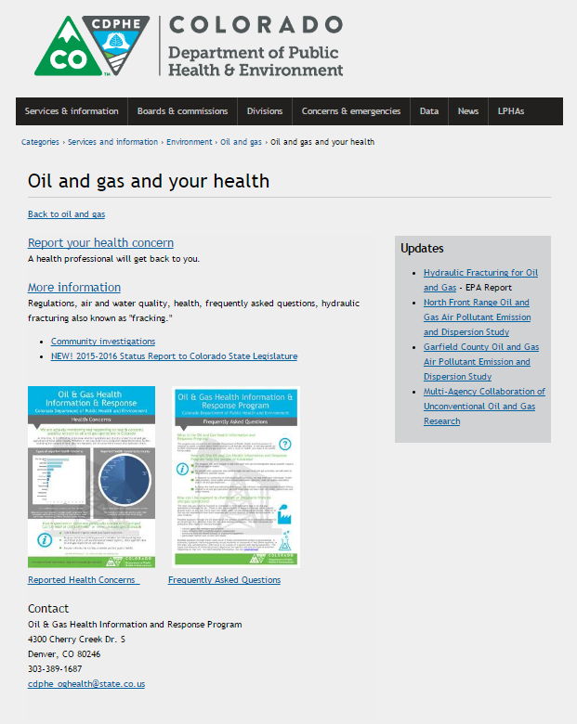
Oil and Gas Health Information and Response Program
Health concern hotline
Information clearinghouse
Community meetings
Community Investigations
Science evaluations
www.colorado.gov/oghealth

Slide 6
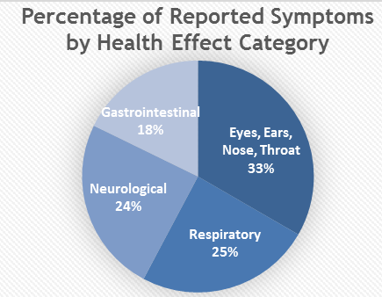
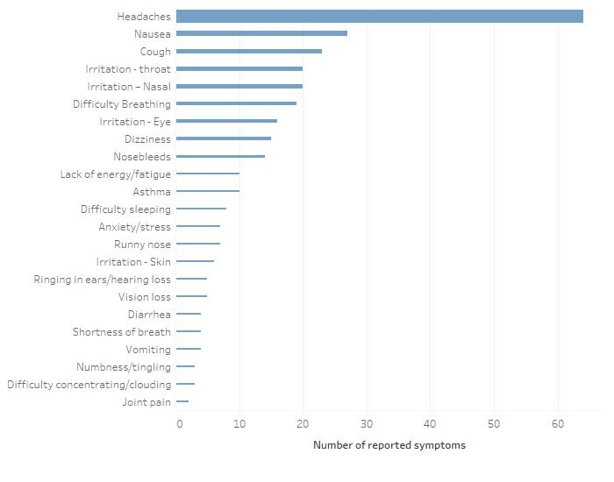
Health Symptoms Reported to OGHIR
300+ health complaints
80% of symptoms coincided with odors during drilling
Most complaints are localized in communities where
new UOGD is occurring.
Notes:
The health symptoms reported to our program primarily include:
respiratory symptoms such as eye, nose and throat irritation and difficulty breathing
acute neurological symptoms such as headaches and dizziness

Slide 7
OGHIR Questions
What UOGD related VOCs are present in communities near UOGD operations?
What VOCs are driving risk and/or reported health symptoms?
What exposure durations are driving risk and/or reported health symptoms?

Slide 8
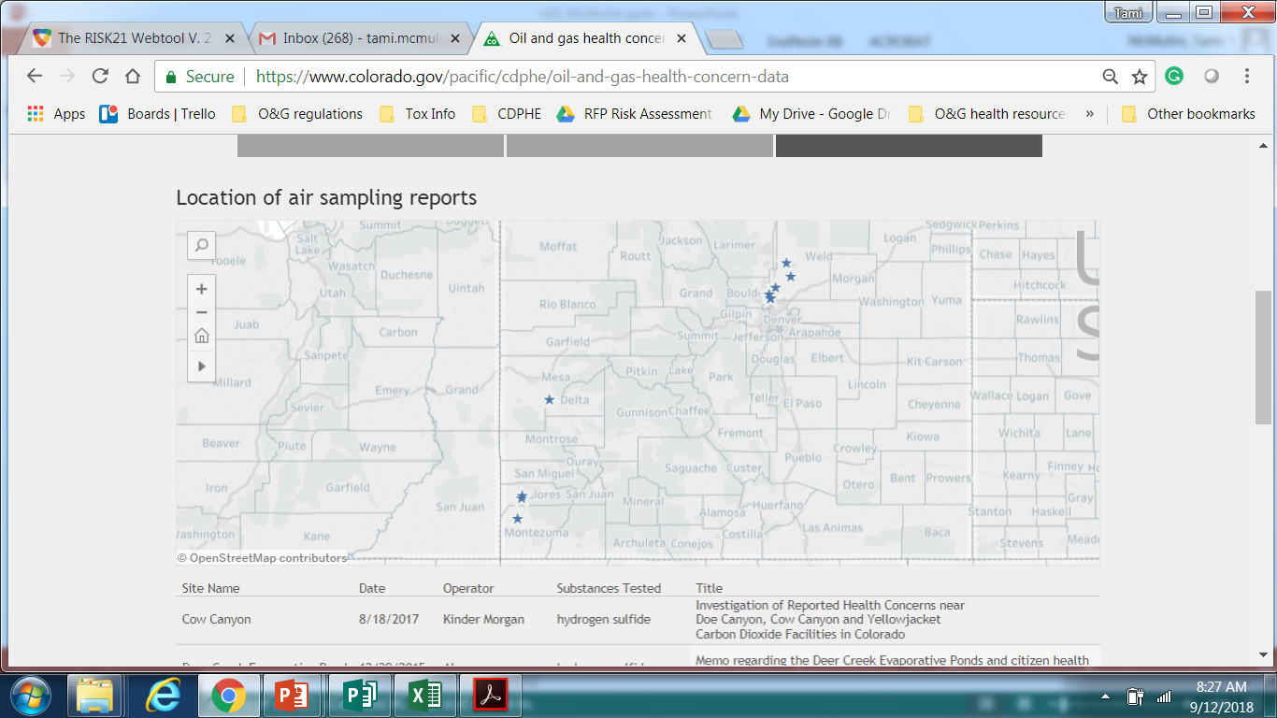
5 exposure investigations with mobile lab
Multiple single samples
~1200 hours of continuous air sampling
Notes:
Exposure Investigations in response to concerns.

Slide 9
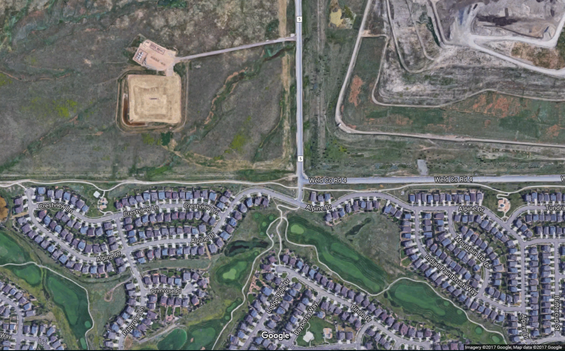
Exposure Investigation
Multiple grab samples during odor events
Mobile lab 1,000 feet downwind of wellpad
Notes:
Case study that supports our current conclusions
Location with new UOGD occurring, over 50 health complaints reported to our program by residents living in the community south of the wellpad shown on this map
We initially collected 5 grab samples during reported odor events as shown in with the yellow stars
Followed these grab sampling events with deployment of our mobile lab
The lab was placed ~1,000 feet generally downwind from the well pad between the well pad and neighborhood

Slide 10
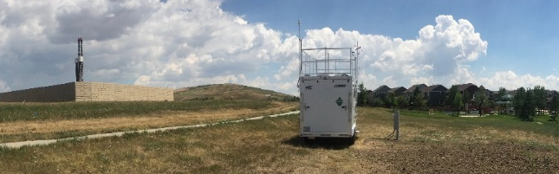
Colorado Air Monitoring Mobile Lab (CAMML)
64 UOGD related VOCs
Meterology
Drilling, Hydraulic Fracturing and Flowback
55 days
900 hours

Slide 11
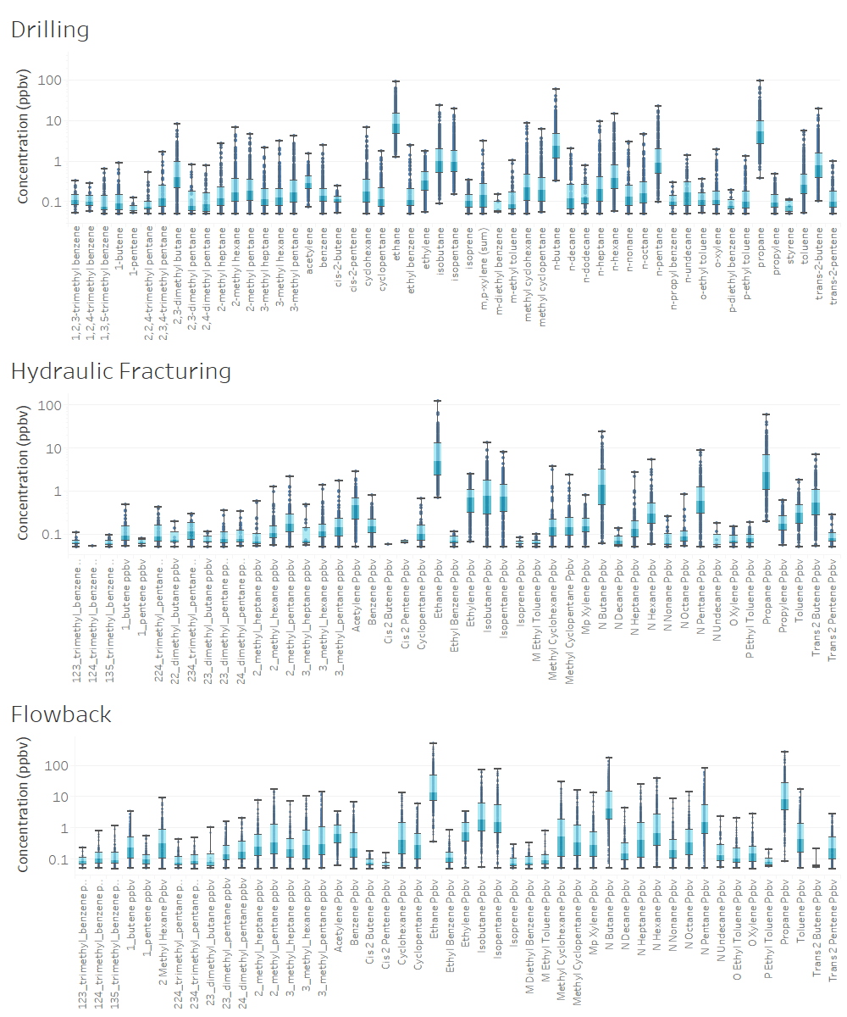
VOC air concentrations
Notes:
VOC air concentrations are highly variable
5-100-fold difference across individual VOCs

Slide 12
Screening Level Risk Assessment
MAX
AVERAGE
ACUTE (Short-term)
CHRONIC (long-term)

Slide 13
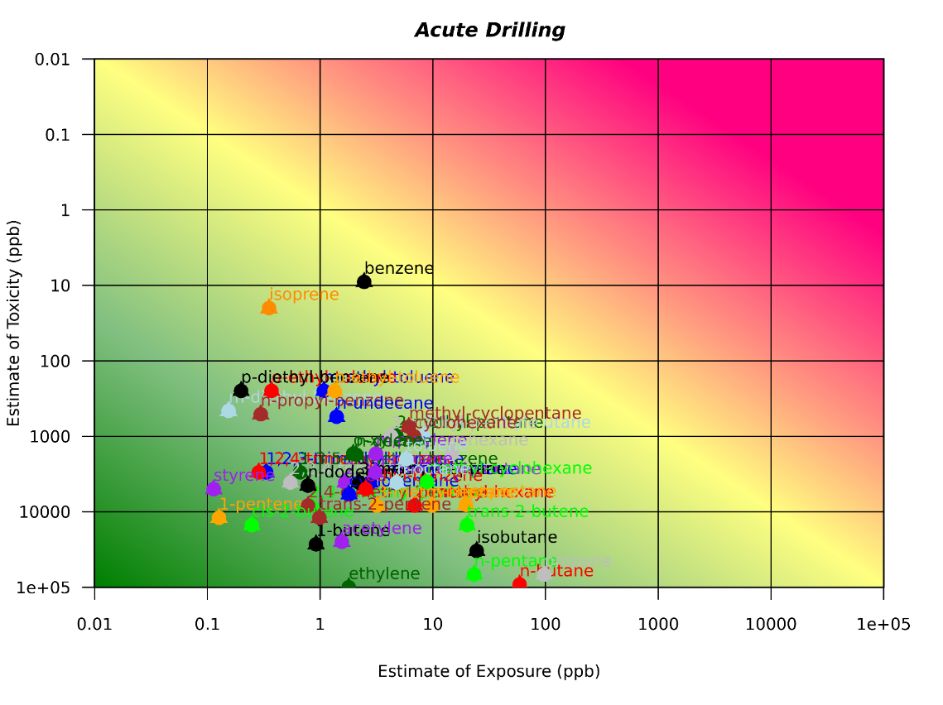
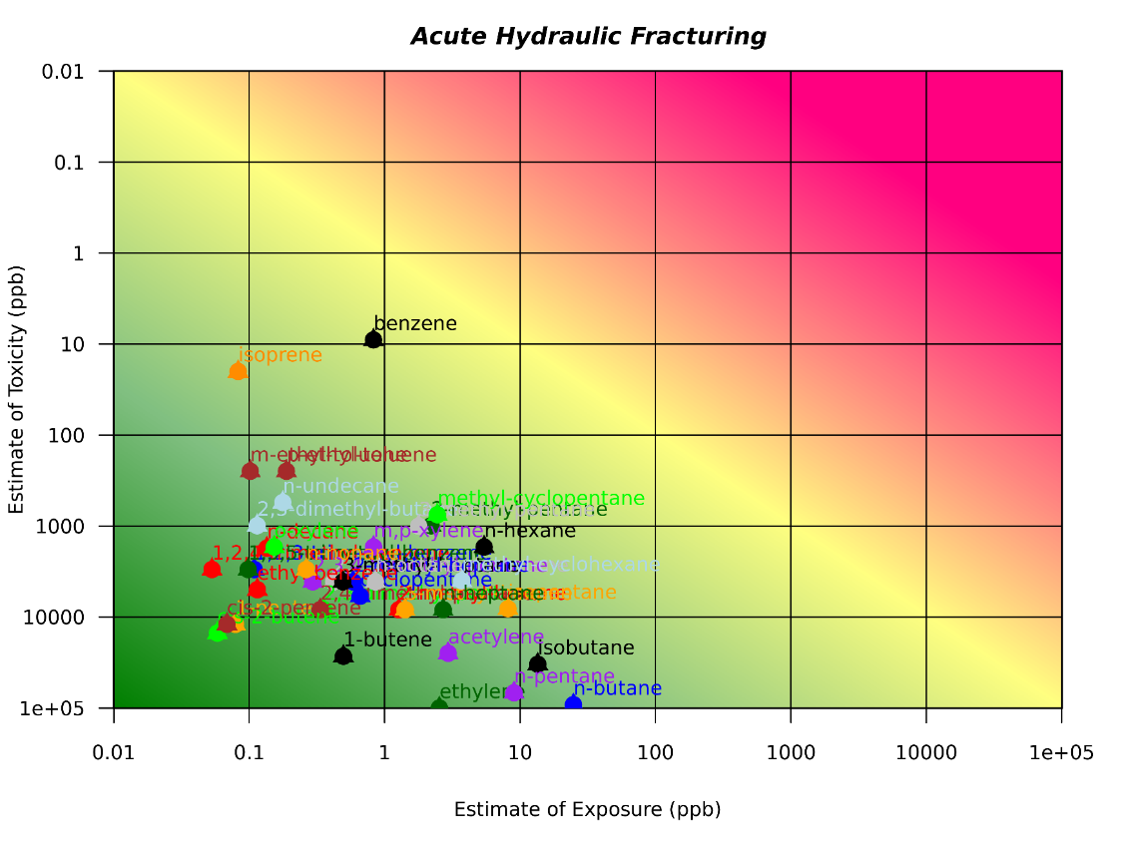
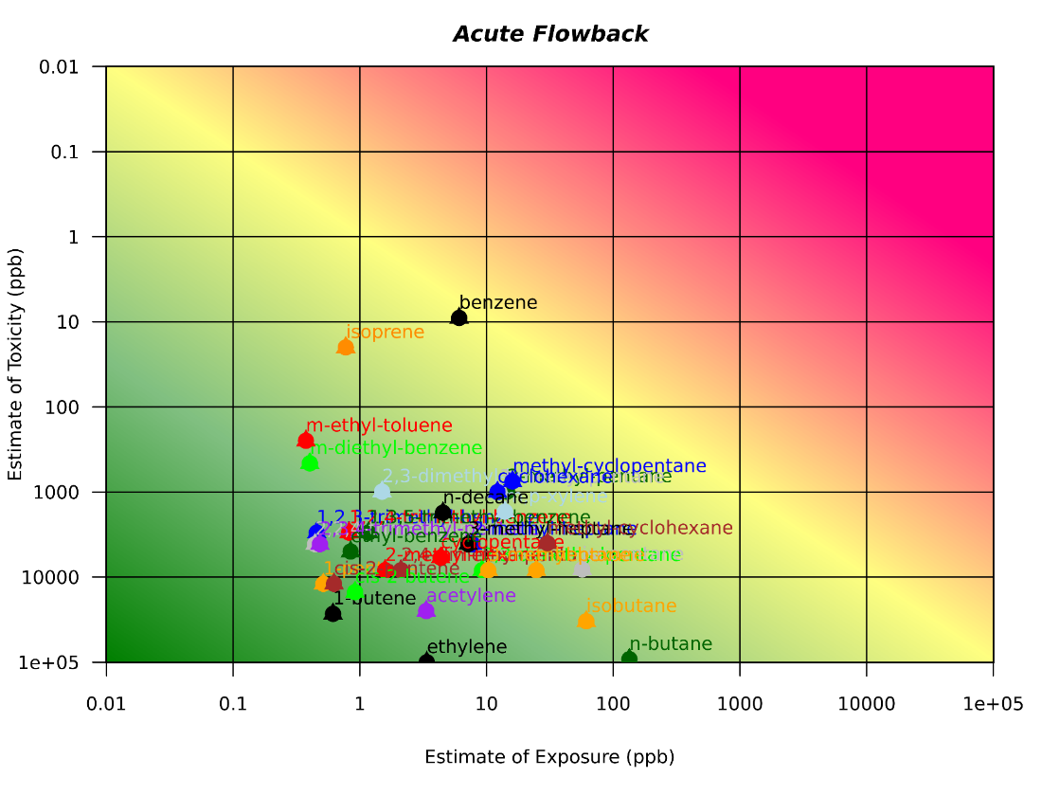

Slide 14
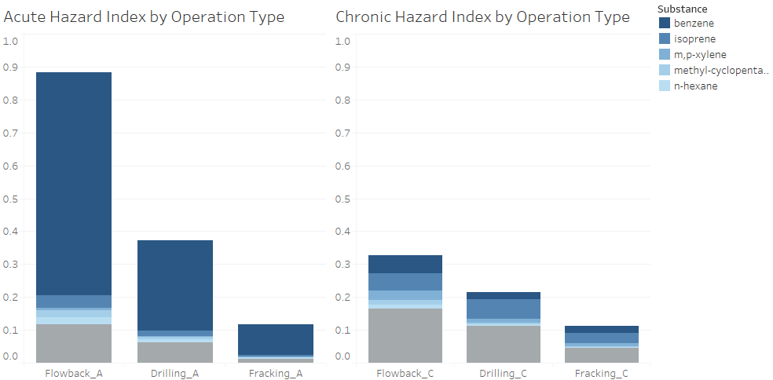
Combined Exposures
Notes:
See that even when we consider combined exposures to all 64 VOCs, the Hazard Index is below 1, which is a general guideline in the risk assessment world that below 1 suggest very low risk.
See that as I showed in the previous slides, benzene is the predominant risk driver
due to intermittent peak air concentrations
for all activities.
Air concentrations of VOCs during flowback result in the highest combined risk.

Slide 15

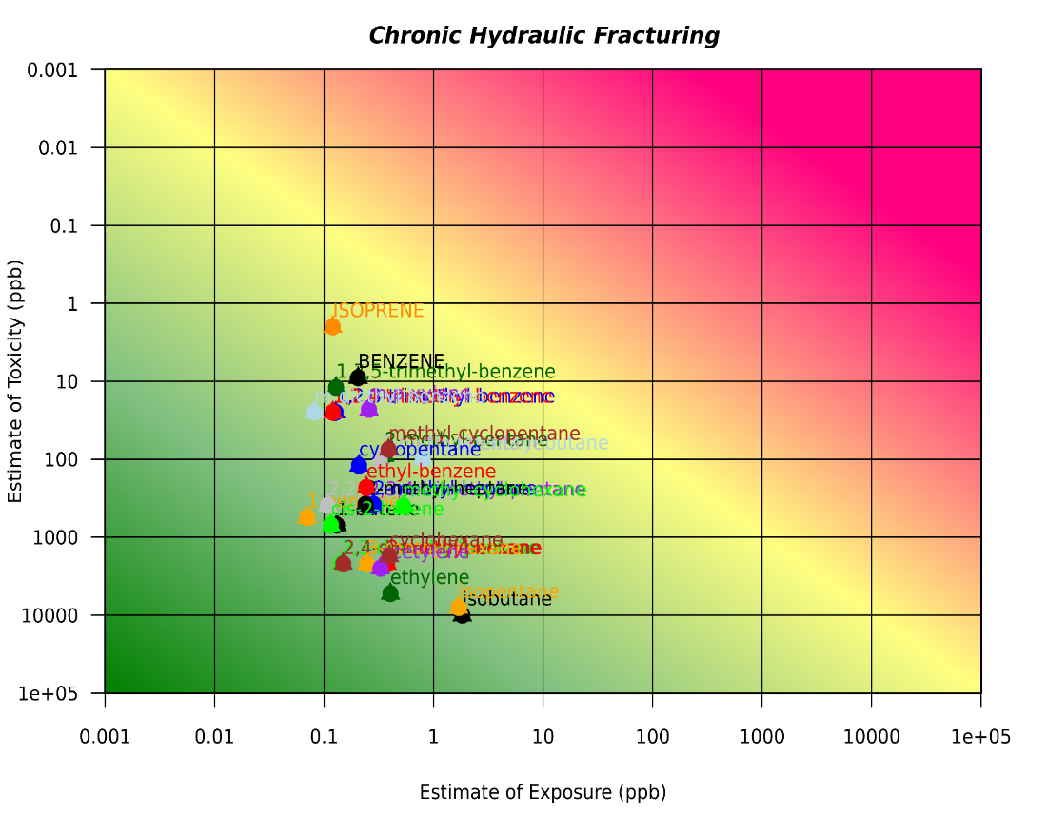
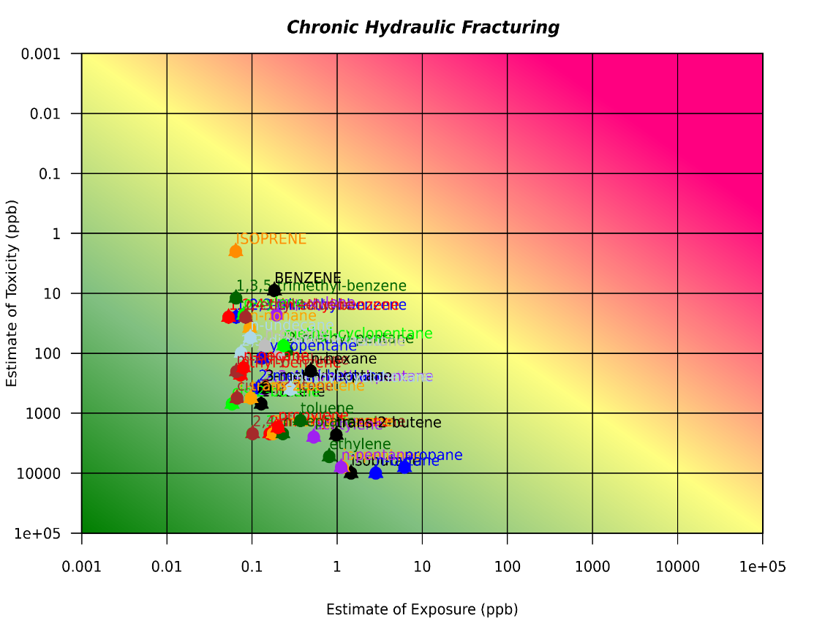
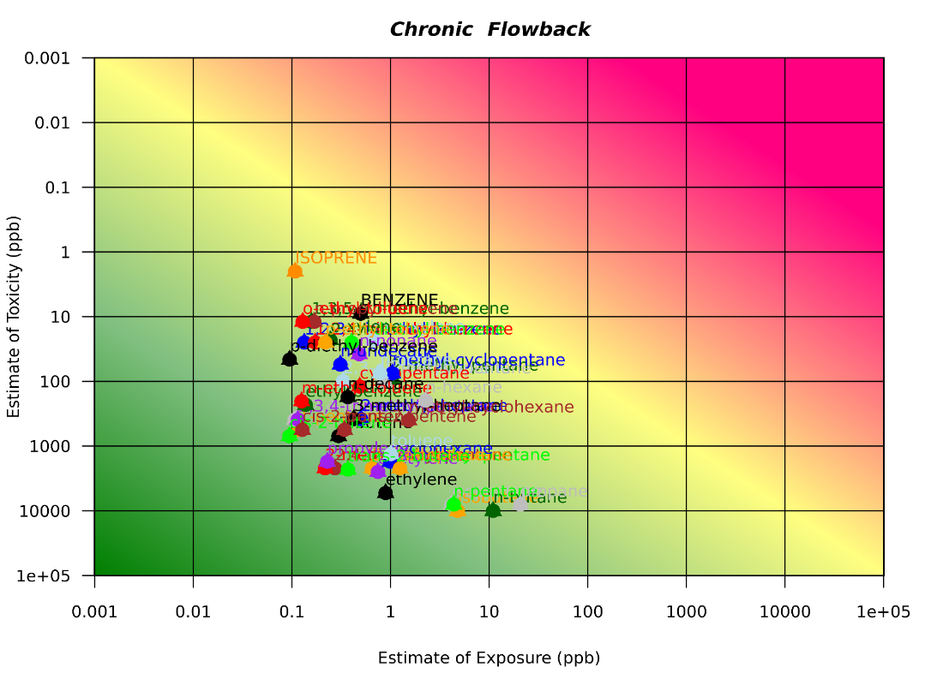
Notes:
Chronic –
All VOC’s are lower and a handful of VOCs predominate, rather than benzene and isoprene alone.
For example benzene is still about 16 times lower than the health guideline level

Slide 16
Chronic - Combined Exposures
Notes:
Unlike acute, benzene does not predominate the total hazard.
All other VOCs have negligible contributions.
Overall HI is low
Multiple Compounds contribute to HI, rather than mainly benzene
Flowback still highest risk phase

Slide 17
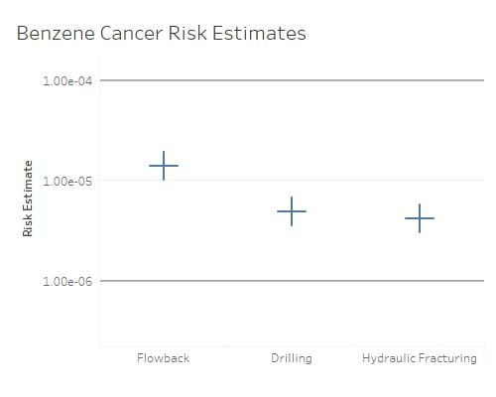
Notes:
Benzene is the only known carcinogen out of all the 64 VOCs we measure
The lines bracket the upper and lower bounds of US EPA’s “acceptable” cancer risk range

Slide 18
Summary of Exposure Investigations
All 64 VOCs are consistently below health guideline values
Flowback > Drilling > Hydraulic Fracturing
Benzene is a high priority VOC
Intermittent peak exposures that could lead to acute health risks

Slide 19
Ongoing Activities
Provide Health Science Information
Track and Investigate Health Concerns

Slide 20
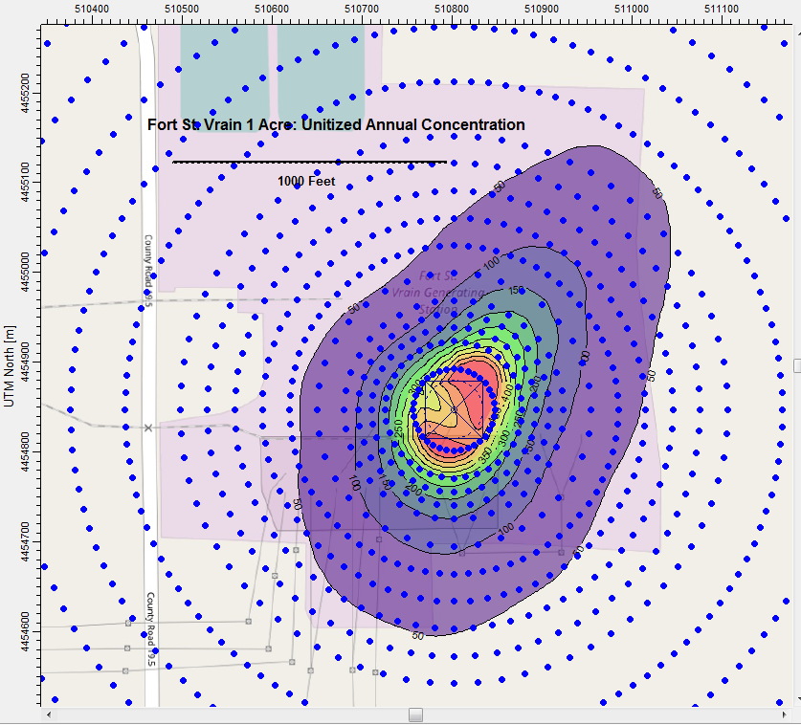

Health Risk Assessment
Notes:
studies conducted by CSU in partnership with the state and some UOGD operators
Conducted studies to generate rates of emissions of multiple VOCs directly emitted from different phases of operation
We have taken that information and conducted a probabilistic assessment to generate
distributions of air concentrations at different distances from a hypothetical wellpad of different sizes
And then the distribution of

Slide 21
Occupational Health Oil and Gas Safety Partnership
Roberta Smith, CDPHE and Kyla Retzer, NIOSH WSD
The findings and conclusions in this report are those of the author(s) and do not necessarily represent the views of the National Institute for Occupational Safety and Health or the Colorado Department of Public Health and Environment.
Notes:
We would like to talk to you about our recently developed group, the OG Occ Health Working Group. The idea was hatched by a few of us just prior to the WestON meeting, and we decided last year to invite everyone to this lunch, captured here, where representative from approximately nine states and several reps from NIOSH talked about their past OG work and also what they might hope to achieve in a working group formed.

Slide 22
Disclaimer
This presentation was supported by grant number 5 U60 OH 010917-02 funded by the Centers for Disease Control and Prevention. Its contents are solely the responsibility of the authors and do not necessarily represent the official views of the Centers for Disease Control and Prevention or the Department of Health and Human Services.

Slide 23
Occupational Health Program at CDPHE
Funded by extramural funding through NIOSH.
Responsible for collecting Occupational Health and Safety Indicators for NIOSH.
Within this current grant cycle had line item for focusing on Oil and Gas industry Safety.
Member of the Council for State and Territorial Epidemiologists
Notes:
As we looked at the program we found that our NIOSH partners were doing some of the injury and fatality research already and we figured to collect data it might be best to partnership with someone already doing some of the work.

Slide 24
Understanding the hazards from NIOSH research

Slide 25
Notes:
First, a little background on the oil and gas extraction workforce. The size of it’s workforce fluctuates dramatically based on crude oil and natural gas prices, but it currently employs about 440,000 workers, the majority of whom are contractors, male, and a significant proportion are Hispanic workers.

Slide 26
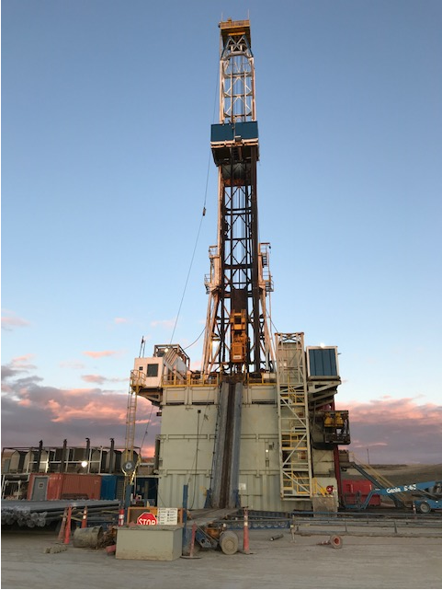
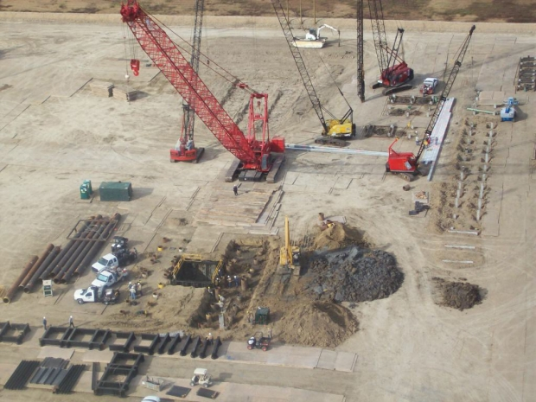
Site preparation
Drilling rig
Notes:
The oil and gas extraction industry is highly complex and occurs in well development stages. The work sites for each of these phases look very different, and thus pose different safety and health hazards throughout the well development process. Site preparation involves a good deal of dirt work and results in relatively few worker deaths. As the drilling process starts, numerous hazards must be controlled.

Slide 27
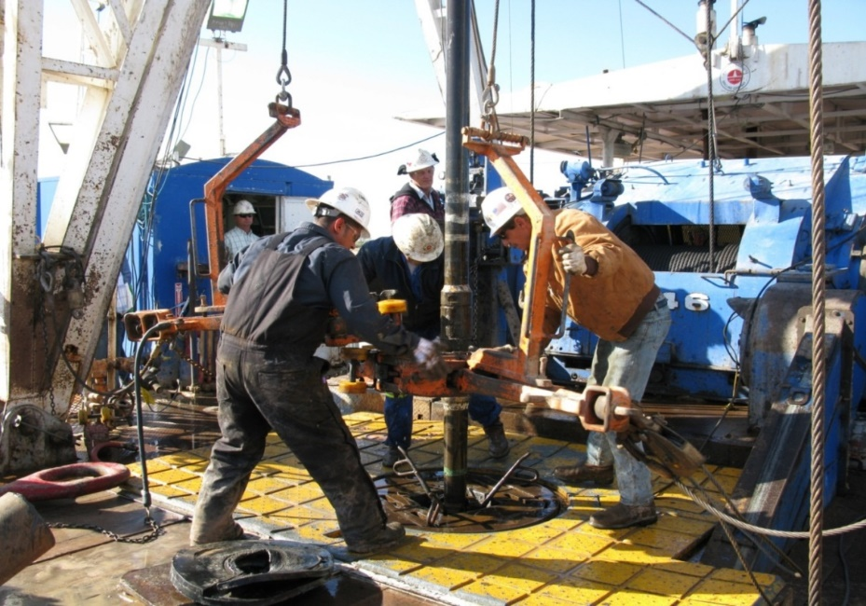
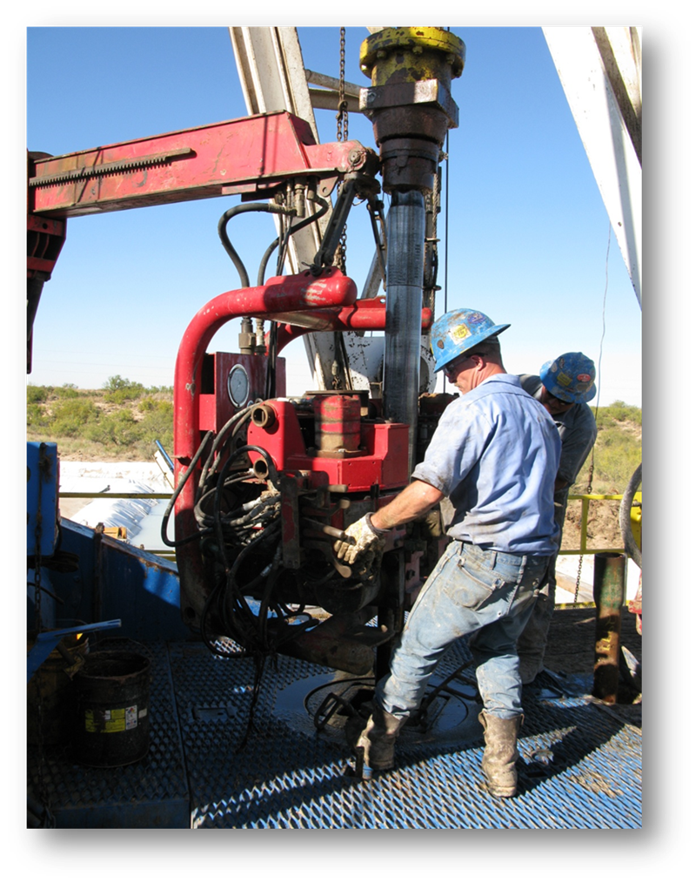
Notes:
These images illustrate two examples of workers on a drilling rig floor, both photos are of workers making connections of drill pipe. The left image is a more manual process and the right more automated, though workers have been struck by and severely injuried using both types of equipment. The most common type of fatal injury on well sites is fatalities due to being struck by equipment, and in particular falling equipment.

Slide 28
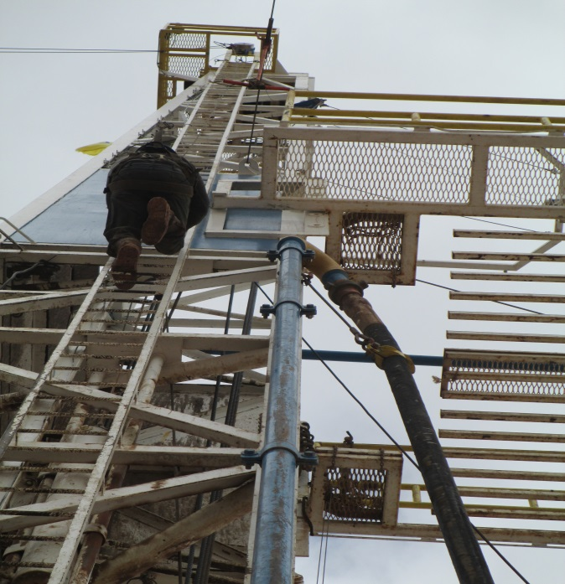
Notes:
Fall fatalities are also a leading cause of death. This worker is climbing a drilling rig and must attach to the monkey board with is the grated floor on the right when he reaches it. Some workers forget to tie off once they reach the monkey board and can fall up to 90 feet or more.

Slide 29
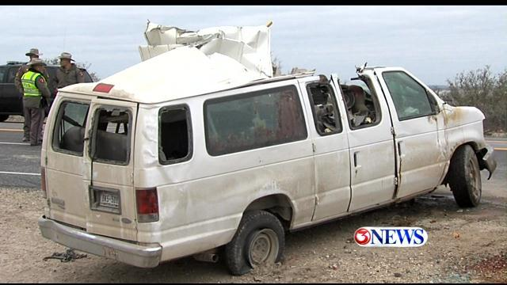
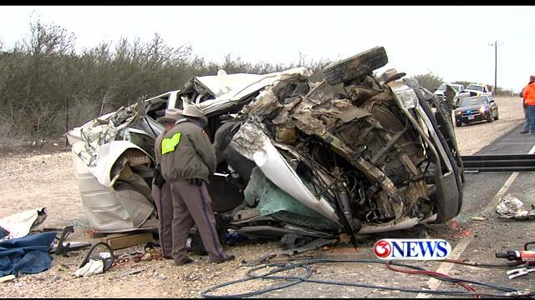
Notes:
Motor vehicle fatalities are the leading cause of death for OGE workers. As other types of fatalities are being controlled on well sites, the proportion of OGE worker deaths due to crashes continues. Some key factors noted in previous analysis include lack of seatbelt use, speeding, and falling asleep at the wheel. This van crashed during a long-distance commute in Texas after a crew of 7 had finished working a shift that lasted almost 24 hours. The driver was believed to have fallen asleep at the wheel when it crashed into a school bus. Four workers died.

Slide 30
Notes:
There are multiple exposures on well sites that can lead to both acute and chronic health effects. Hazardous gases and vapors, such as hydrogen sulfide and hydrocarbon gases and vapors have resulted in worker deaths while tank gauging or over an open tank hatch, like this workers.

Slide 31
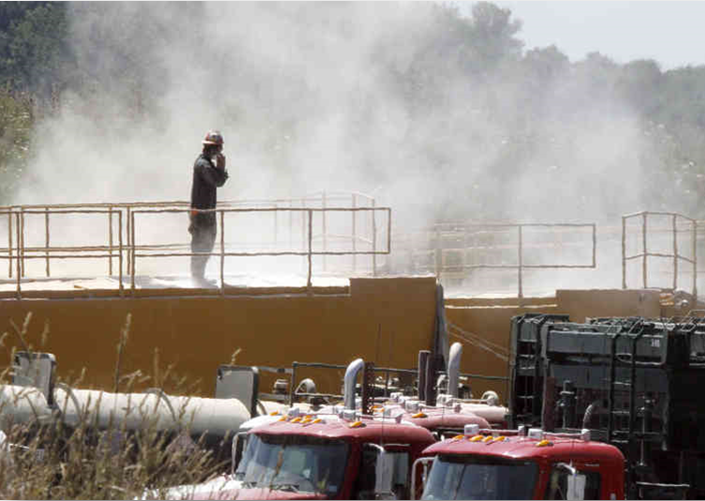
Respirable silica slide
Notes:
Past NIOSH research illustrated exposure to respirable silica from the use of silica sand for hydraulic fracturing. Exposures reached over 10 times occupational health criteria for certain occupations. Industry has responded with alternative methods for working with sand on site since this research that hold promise for reduced exposures.

Slide 32
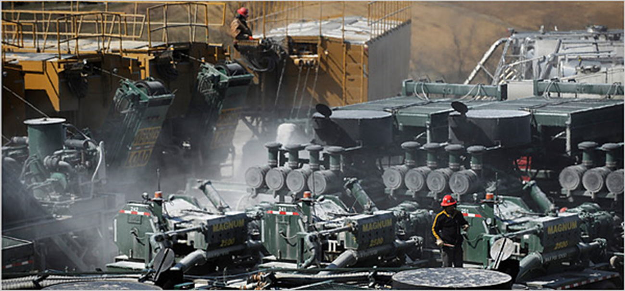
Notes:
Other research has documented elevated levels of diesel particulate matter as a result of large diesel engines on trucks and other pieces of equipment, essentially creating a diesel cloud around sites.

Slide 33
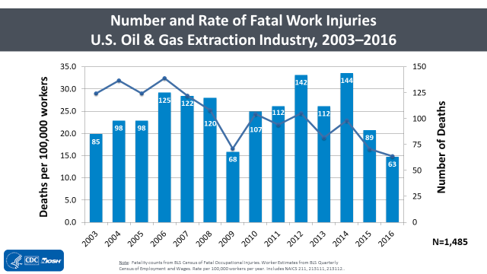
Notes:
The blue bars on this chart illustrate the number of fatalities each year in the oil and gas extraction industry, peaking at 144 in 2014, and at it’s lowest in the most recent year of data available in 2016, with 63 fatalities. The blue line represents the fatality rate, which demonstrates significant reduction over time.

Slide 34



A partnership began…….
Notes:
CSTE works to advance public health policy and epidemiologic capacity. We also provide information, education, and developmental support of practicing epidemiologists in a wide range of areas as well as expertise for program and surveillance efforts.
CSTE is an organization of member states and territories representing public health epidemiologists. CSTE works to establish more effective relationships among state and other health agencies. It also provides technical advice and assistance to partner organizations and to federal public health agencies such as the Centers for Disease Control and Prevention (CDC). CSTE members have surveillance and epidemiology expertise in a broad range of areas including occupational health, infectious diseases, environmental health, chronic diseases, injury, maternal and child health, and more. CSTE supports effective public health surveillance and sound epidemiologic practice through training, capacity development, and peer consultation.

Slide 35
GOAL
Work together to examine oil and gas extraction (OGE) worker injury and illness data and inform stakeholders on a state and national level
Notes:
Idea hatched at WestON; Launched in December 2017
Actively Participating states: Wyoming, New Mexico, California, Pennsylvania, Louisiana, Texas, Colorado, Montana
At least one state is not a NIOSH Grantee. (PA).

Slide 36
Active Oil and Gas Occupational Health
Working Group States
NH
0
WA
VT
ME
MT
ND
MN
OR
NY
MA
ID
SD
WI
MI
RI
WY
IA
PA
CT
NV
NE
IL
IN
OH
NJ
UT
CO
DE
KS
MO
WV
VA
DC
CA
KY
NC
MD
OK
AR
TN
AZ
NM
SC
MS
AL
GA
TX
LA
AK
FL
HI
Data Source: OSHA Severe Injury reports, accessible online at https://www.osha.gov/severeinjury/index.html
Notes:
The blue states are states who have representatives who have been actively participating in the group’s monthly calls or are working with us on projects. The orange states that have a large amount of oil and gas activity but do not have the resources to currently participate and we will continue to find ways to engage them in our projects.

Slide 37
WHY did we form this workgroup?
Consistency in oil and gas fatality reporting
Increase knowledge about occupational illness
Increase knowledge about non-fatal injuries
Share findings with key national stakeholders
Notes:
Ensure consistency of state occupational fatality reporting and NIOSH reporting (FOG Database).
Address questions about occupational illness cases by Council members.
Link NIOSH stakeholders (industry/OSHA/insurance/council) and state occupational health managers.
Create one of the first NIOSH/State working groups with industry focus

Slide 38

Notes:
Thus far, we have had a number of small successes we would like to share with you.

Slide 39

Silicosis among OGE workers
(Texas, 2010-2017)
0 reported silicosis
cases to date
Notes:
One of the biggest questions received by stakeholders was if OGE workers have been diagnosed with silicosis. We were able to work with Ketki who conducted a thorough review of their silicosis registry. be reported back to our NORA Oil and Gas Council, to a Colorado Oil and Gas Silica Forum, and to receive info also from CO that National Jewish also has not seen cases
Background:
Silicosis and asbestosis are reportable diseases (since 1985) to Dept. of Health
OHS program maintains database of physician reported cases (prone to underreporting)
OHS staff reviewed database to identify OGE workers
Findings:
Zero physician-reported silicosis cases related to oil and gas
Less than five* physician-reported asbestosis cases related to oil and gas†

Slide 40


Roundtable
(June 2018)
Notes:
We held a roundtable to share our goals and objectives and get feedback.

Slide 41
1st data project: Workers Compensation Claims
Created Claims data definition, Analysis plan
Data request to state bureaus
Key word search (phase 2)
OSHA Oil and Gas Conference, Dec. 2018

Slide 42
Other small successes
OGE OSHA severe injury data for all states
WY approval for public records sharing (with NIOSH)
Interest in NIOSH OGE survey by two states
Learning similarities across states (i.e. crash systems)

