Slide 3
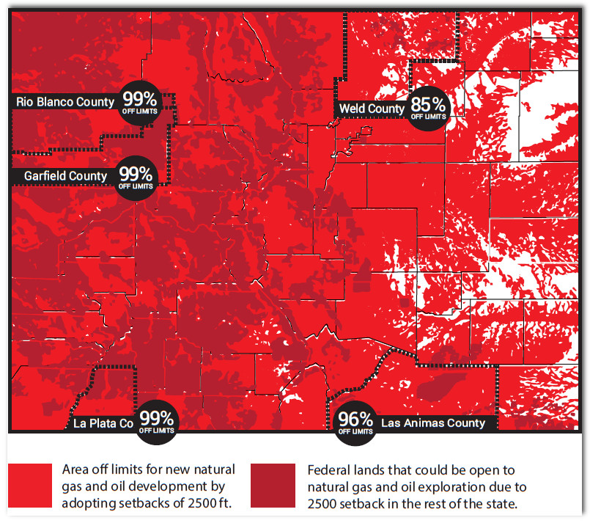

Slide 7
Text WIN2018 to 77948
Voter Resource Guide & Pledge to WIN

Slide 8
Register to vote!!
Sign-up to receive updates from COGA
Sign a letter to the editor
Sign an op-ed
Post on social media
Talk to coworkers and friends
Appear in a video testimonial
Attend a local city, county or statehouse
meeting to show support or testify

