Slide 1
All About
Industrial Technology and
Oil and Gas
at Aims
Amy McFarland,
Department Chair

Slide 2
Aims Community College
Located in Greeley, Colorado
Three satellite campuses: Windsor, Loveland and Fort Lupton
More than 200 degree programs
Affordable tuition (about $67 per credit hour for in-district students)
Day and evening classes
Online options

Slide 3
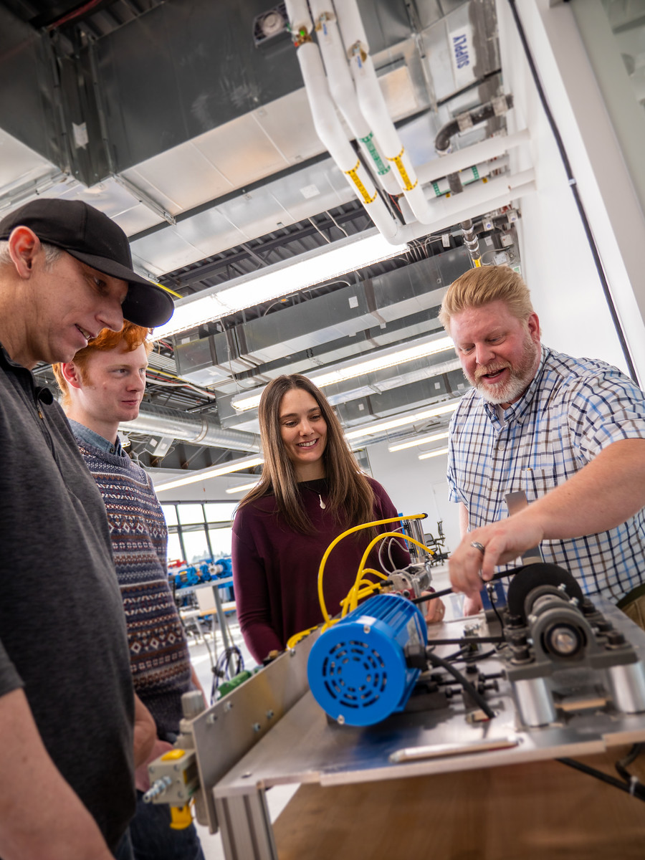
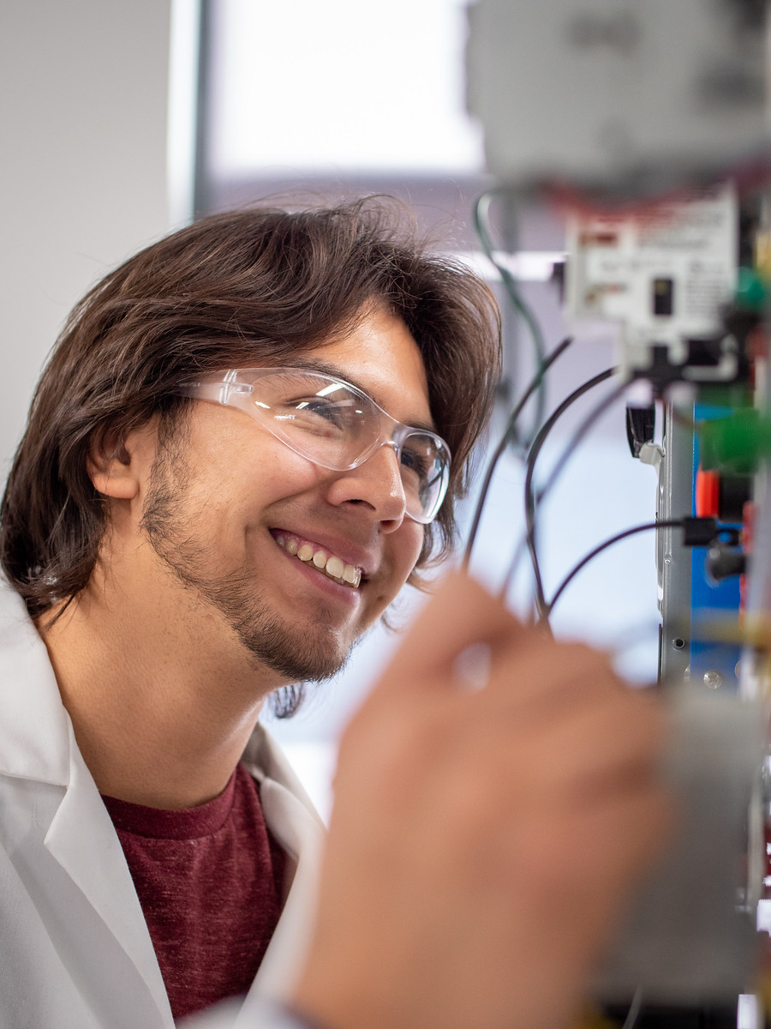
Aims Community College: Industrial Technology
Associate of Applied Science Degrees
Industrial Technology
Certificates
Advance Automation
Advanced Maintenance

Slide 4
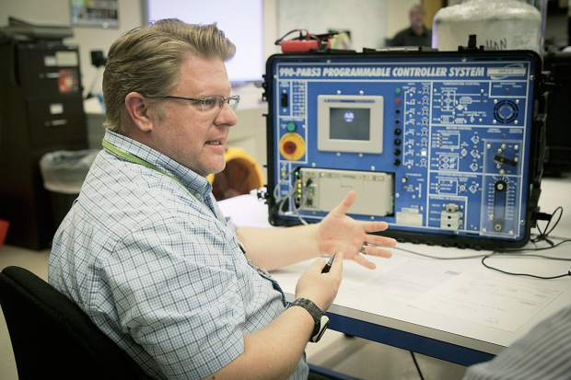
Aims Community College:
Oil & Gas
Associate of Applied Science Degree
Oil and Gas Technologies
Certificates
Introduction to Oil and Gas Technologies
Oil and Gas Production Technologies
“I was going to go straight into the oil field when I found out about the program at Aims. I saw it as an opportunity to get a degree in something I wanted to do. The technology and equipment that was available helped simulate real life things that could happen, and having instructors that had actual experience in the field was beneficial.”
- Derek, Aims Oil & Gas graduate

Slide 5
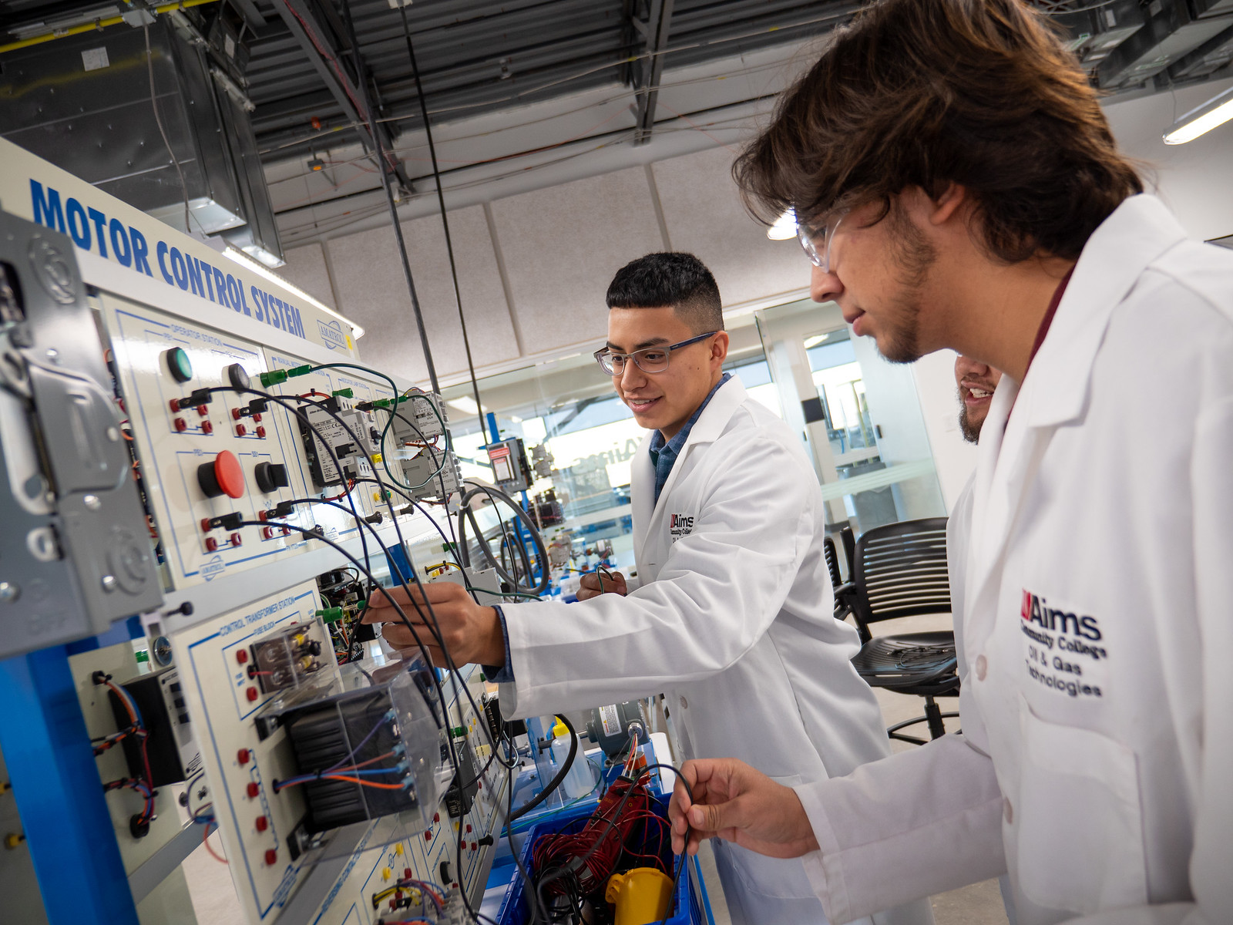
Aims Community College: Agricultural Sciences and Technology
Small classes
Hands-on and High Tech
Connected to industry
Internships
Availability of concurrent enrollment
Community Lab/ Work Study
Space Grant Program

Slide 6
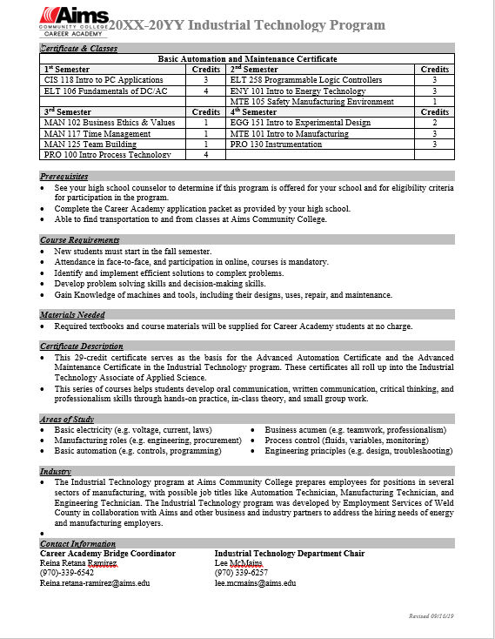
Career Academy

Slide 7
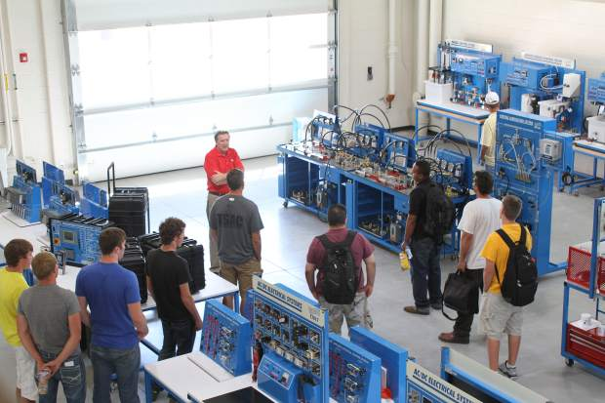
Industrial Technology
Careers in Industrial Technology:
Automation Technician
Manufacturing Technician
Planner/ Buyer
Energy Analyst
Engineering Technician
Manufacturing Designer

Slide 8
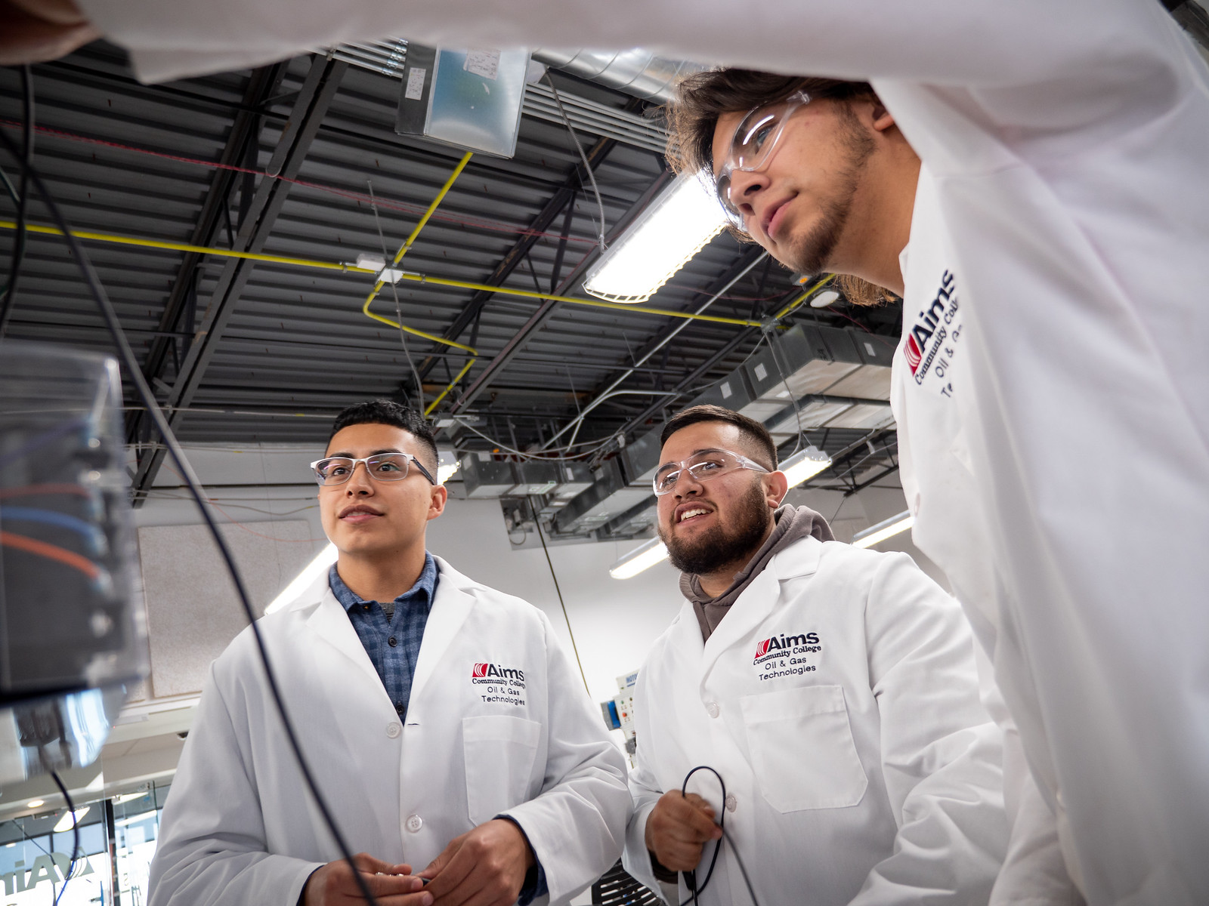
Oil and Gas
Careers in Oil and Gas:
Energy Trader
Engineering Manager
Environmental Advisor
Facility Operations and Maintenance Manager
Engineer
Field Worker
Geoscience Professional
Civil and Structural Engineering Technologist
Drafting Technologist
Energy Policy

Slide 9
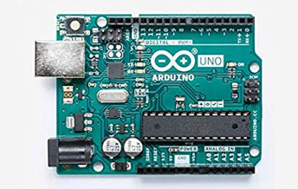
Aims Community College:
Space Grant Program
Space Grant Program
EGG 151
“We are taking responsibility of groundbreaking experiments for the present and for our future”
– Tia Nuanez, Aims EGG 151 student
https://www.youtube.com/watch?time_continue=3&v=iMOpqdhygcc&feature=emb_logo

Slide 10
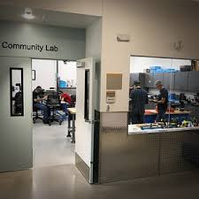
Community Lab
As a Community Lab our MISSION is to support academics as a space for hands-on, collaborative learning and to help our neighbors bring their ideas to reality. Even when a MakerSpace might not seem like a natural fit we help generate ideas and remove obstacles to discovery. We maintain a space where people can explore, expand, and discover elements of design, small-scale fabrication, electronics, craft work, and the fusing of seemingly-unrelated ideas.
Notes:
Work Study opportunity
Free
High Tech Equipment
Place to learn

Slide 11
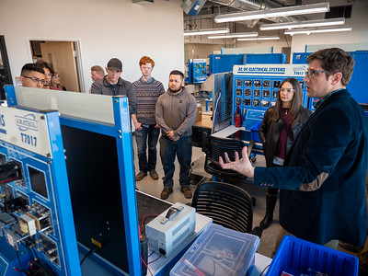
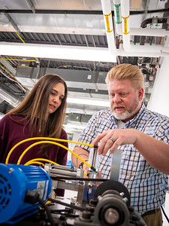
Faculty & Staff
Faculty:
Amy McFarland
Department Chair
Lee McMains
Full-time Faculty
Chris Schaumberg
Part-time Faculty
Jerry Edsall
Part-time Faculty
Staff:
Bill Bennett
Lab Coordinator
Megan Blaser
Program Coordinator

Slide 12
Questions?
Amy McFarland
Department Chair
amy.mcfarland@aims.edu
303-718-5911
Megan Blaser
Program Coordinator
megan.blaser@aims.edu
970-378-3746

Slide 13
Paper Circuits- https://www.youtube.com/watch?v=IZGWkCR7T6E
https://www.youtube.com/watch?v=7hb-9eUpfbQ
Team Building - Systems activity -

