Slide 1
Enhancing Well Site Safety
Via Tank Vapor Recovery
The most economical solution to
achieving your environmental goals.
January 2021

Slide 2


Our Presenters
Peter Mueller, Chief Executive Officer
EcoVapor
Casey Short, Rockies Regional Business Development Manager
EcoVapor
Notes:
Our panelists include:

Slide 3
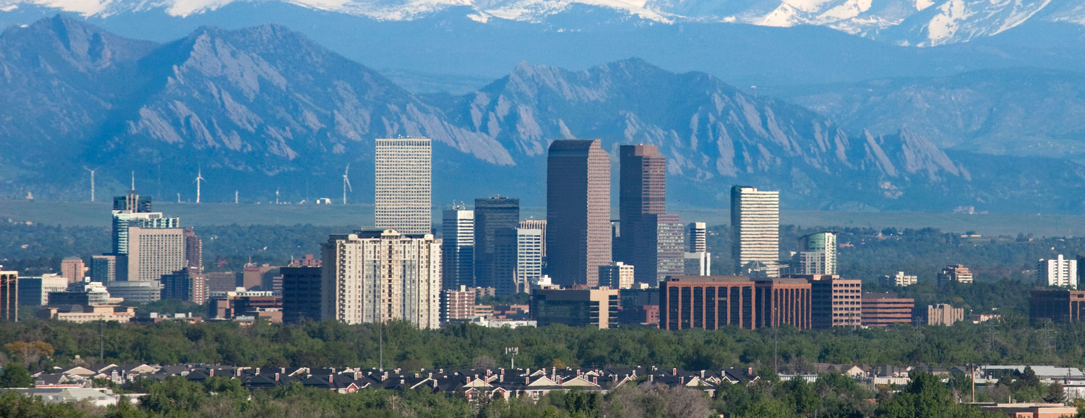


EXPERTISE
in Gas and Vapor Stream Management
11 years experience gas capture and treatment
100+ installations of ZerO₂ technology for full capture of produced vapors at O&G sites
Multiple patents and awards
Our solutions increase profitability, improve ESG performance and increase site safety
Notes:
Mike
- EcoVapor has focused on recovery and treatment of low-pressure gas streams since 2010.
- We create & provide technology & equipment to address the problems our clients face by using innovative approaches and new ways of thinking.
- Focused on products that enhance economic performance, safety, and significantly reduce environmental footprint (profitably).
- Vapor recovery directly from tank batteries and oxygen removal from gas streams has historically been where EcoVapor’s efforts have been concentrated, but I’m excited to discuss a complementary technology and service focused on gas sweetening / H2S scavenging.
James: Thank you, Jeff. Let’s open-up the panel discussion and start talking about H2S treatment.

Slide 4

Everyone, Everywhere Safe Every Day
1
Tank batteries are often maintained at pressures that can cause a rush of vapor when opening hatches to sample or gauge tanks.
2
Pulling gas directly off tanks helps to eliminate risk of flash gas incidents potentially preventing injury and saving millions.
3
Tank flash gas is heavier than air so minimizing leaks and venting improves site safety at ground level.
Notes:
Our panelists include:

Slide 5
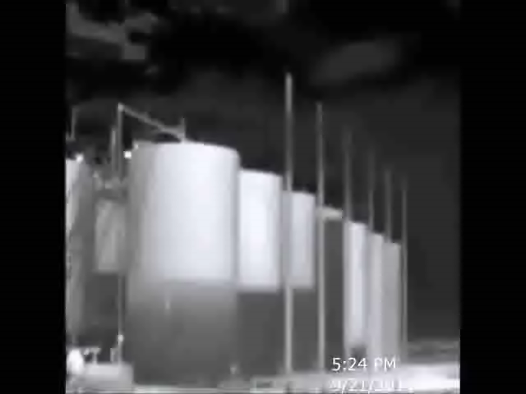
Notes:
Our panelists include:

Slide 6
What did you see?
Over-pressured tanks venting from hatches and PSVs
Vented gas was heavier than air and stayed close to the ground
Wind pushed the gas plume towards the combustors
Only one combustor was hot; other two combustors showed to be cool
Notes:
Our panelists include:

Slide 7
Safety issues and vapor recovery benefits
Well Site Storage Tank Safety Issues
Pressured tanks
Gas venting
Lighting strikes
Other Functions & Benefits of Vapor Recovery
Reduce emissions – CDPHE compliance
Reduce waste – COGCC compliance
Make $ - Corporate goal
Notes:
Our panelists include:

Slide 8




Flaring
Assumptions:
  300 Mcfd flash gas = 120 bpd oil energy equivalent
  Relatively low OPEX, high opportunity cost¹
  High VOC, NOx, GHG emissions
Separators
Oil Tanks
Flash Gas w/ O₂
Common Issues:
  Matching flare capacity to variable production
  Keeping hatches/reliefs closed – no active tank pressure control
Flare or Combustor
Natural Gas
Custody Meter
Gas Pipeline to Processing Plant
1. 300 mscfd at $1.50/mcf plus 2x Btu premium ($3/mcf) = $328,000 annually
Notes:
HANS

Slide 9
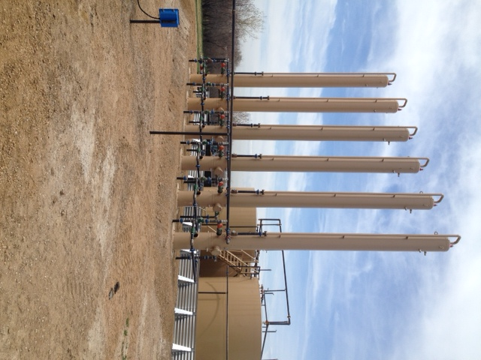
Vapor Recovery Towers (VRTs)
Primary function is to degas produced oil from separation before atmospheric storage, where oxygen is present
Immediately downstream of separation with flashing occurring at or near heated separator temperatures
  Lower RVP
  Lost oil sales
Efficiency typically 60% to 80%
  Inadequate pressure control & remaining pressure drop
  Sizing & standardization
  Variable oil production volume
  Installation and maintenance issues
Notes:
HANS

Slide 10
Partial Vapor Recovery
Assumptions:
  VRT captures 60-80% of flash vapor
  Oil lost with VRT vapor stream
  Still flaring generating VOC & NOx emissions
Separators
Oil Tanks
VRT
Flash Gas w/ O₂
Common Issues:
  Matching flare capacity to variable production
  Keeping hatches/reliefs closed – no active tank pressure control
  VRT uptime (paraffin loading, gas outlet freezing)
  VRU uptime
Flare or Combustor
Natural Gas
VRU
Custody Meter
Gas Pipeline to Processing Plant
Notes:
HANS

Slide 11
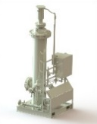

Complete Oil Tank Vapor Recovery
Assumptions:
  No VRT (or in conjunction w/ VRT)
  All vapor captured for sale
  Active tank pressure monitoring & control
  Additional oil sales $$
  Flaring only occurs if/when VRU is not operating
Separators
Oil Tanks
Flash Gas w/ O₂
Flare or Combustor OUT
(All gas to sales)
Natural Gas
Custody Meter
O2 removal
Scrubber
VRU
Notes:
HANS

Slide 12
Oil Storage Tank Pressures
Vapor recovery system startup
Notes:
HANS

Slide 13
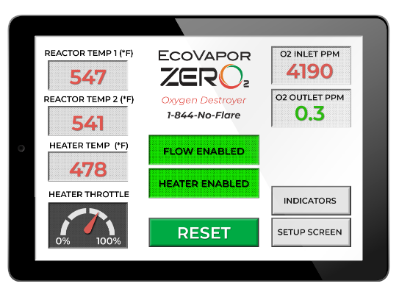
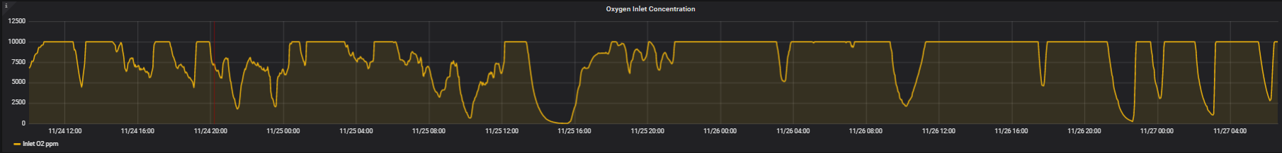
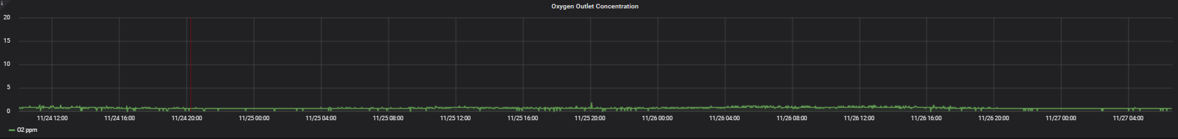
Knowledge is Power - Continuous Monitoring
Provides continuous monitoring of unit performance
Reporting data on vapor capture and O₂ concentration
Can monitor and record tank pressures from pressure sensors
OXYGEN Inlet Concentration (pre ZerO₂)
Inlet
Typical oxygen limit of 10ppm
Note: oxygen scale maximum at 10,000 ppm (per customer), however spikes went up to 25,000ppm.
OXYGEN Outlet Concentration (post ZerO2)
Typical oxygen limit of 10ppm
Outlet
“Some engineers refuse to admit oxygen is present, but in my 35 years of production operations I can say that there is always oxygen present and it presents a serious safety, corrosion and shut down risk.”
– Former Oxy Production Operations Team Leader
Source: EcoVapor remote data monitoring of inlet and outlet oxygen monitoring systems.
Notes:
JEFF

Slide 14
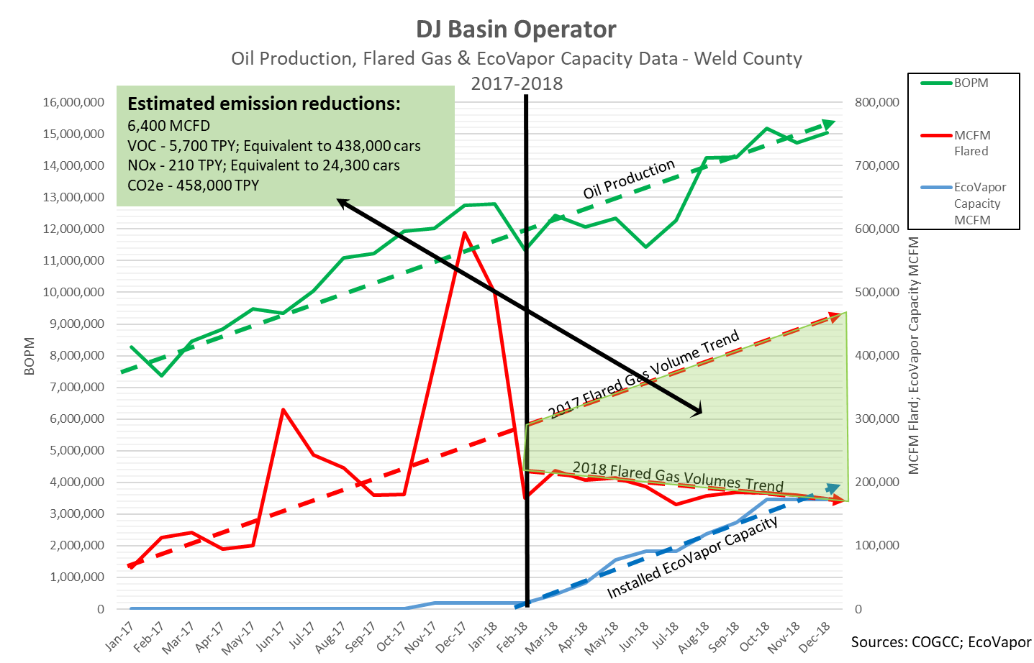
Impact of Company-Wide Flash Gas Capture Program
Sources: COGCC, EcoVapor Emissions Calculator*
NOx, VOC, and CO – API 42, Section 13, Table 13.5
GHG – CH4 and CO2 densities: 40 CFR 98 Subpart W, Section V
Notes:
JEFF

Slide 15
+1% OIL
Illustrative Economic Results | Current Product Prices
Tank Capture using ZerO₂ generates over
better economics than a VRT
3x

Slide 16
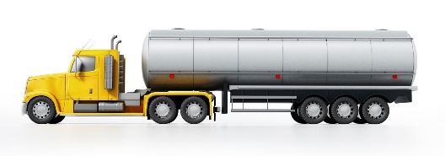
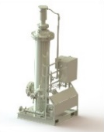
Truck Loading
Additional CAPTURE
(All gas to sales)
Oil Tanks
Separators
Flash Gas w/ O₂
  Truck loading emissions account for 10% - 15% of site emissions.
  High O2 in truck vapor can require addition of produced gas to dilute O2 content for removal.
Flare or Combustor OUT
(All gas to sales)
Natural Gas
Custody Meter
O2 removal
Scrubber
VRU
Gas Pipeline to Processing Plant
Notes:
HANS

Slide 17

Similar Functionality | But Some Differences
Function | Vapor Tower Recovery | Tank Vapor Recovery
Capture flash vapors from oil – generate revenue from waste
Prevent oxygen from fouling recovered gas stream
Separation of liquids from gas
Require use of VRU
Reduce emissions
100% Oil Tank Vapor Capture
Produced Water Tank Vapor Capture
Tank Truck Vapor Capture
Simultaneous Recovery from Tanks And Other Low-pressure Vessels (i.e. ULPS, H/T, etc.)
Active control of tank pressures
Notes:
[Add tagline – the most economic solution to achieving an environmental goal]

Slide 18
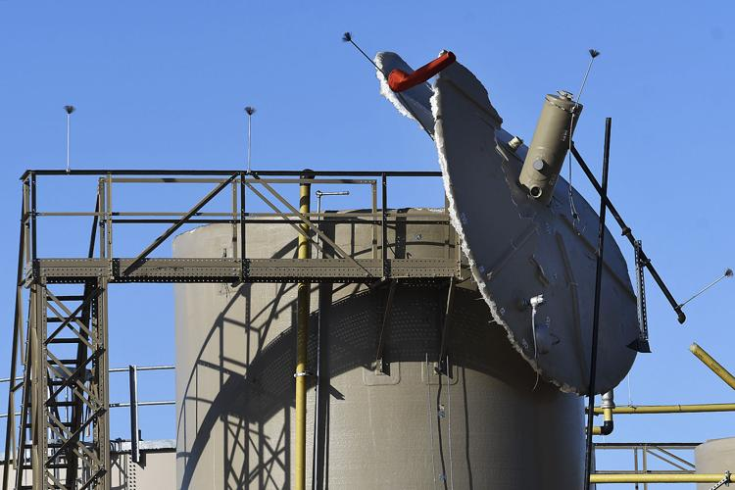
Tank Safety
Lightning Arrestors
Notes:
HANS

Slide 19
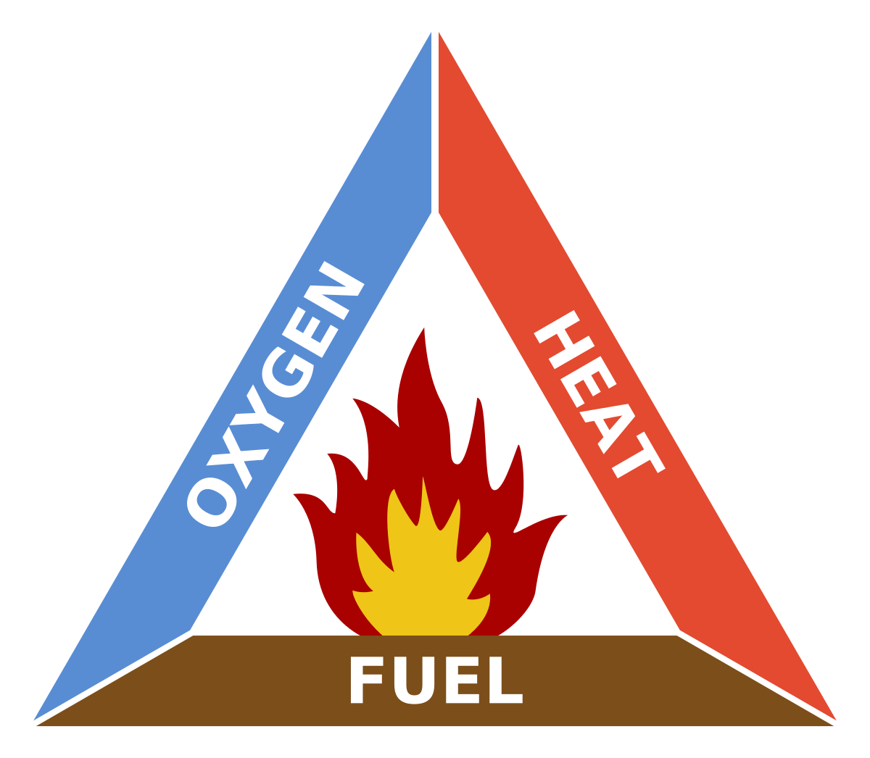
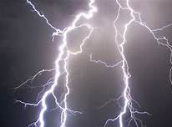
The Fire Triangle for Water / SWD Tanks
Atmospheric
Tanks
Lightning
Hydrocarbon Vapors
Entrained in Water
Notes:
HANS

Slide 20
Lightning Arrestors Prevent Fires / Explosions
  The temperature of a lightning bolt is around 50,000 degrees F, or 5 times hotter than the sun.
  The ignition temperature of natural gas components range from 800 to 1300 degrees F, so even a nearby strike of lightning is capable of sparking a fire or explosion.
  Are there additional measures that can be taken to prevent SWD tank explosions?
To ground
To ground
Notes:
HANS

Slide 21
Simple Alternative Explosion Prevention Technology
  Remove oxygen from the headspace in the tank(s), either as a standalone process or in conjunction with lightning arrestors.
To ground
Notes:
HANS

Slide 22


Oxygen Removal
Water Tanks
Water Tanks
Makeup
Natural Gas
Gas w/o O₂
Combustor Out
Makeup
Natural Gas
Gas w/ O₂
Custody Meter
Blower
Custody Meter
To ground
Gas Pipeline
Gas Pipeline
Notes:
HANS

Slide 23
Summary | Tank Vapor Capture
Actively control tank pressure
Reduces / prevents gas venting
Alternative protection method for water tanks
1
Reduces emissions
Reduces waste
Generates incremental revenue from sale of high Btu gas
2
3
Increases site safety
Notes:
Our panelists include:

Slide 24
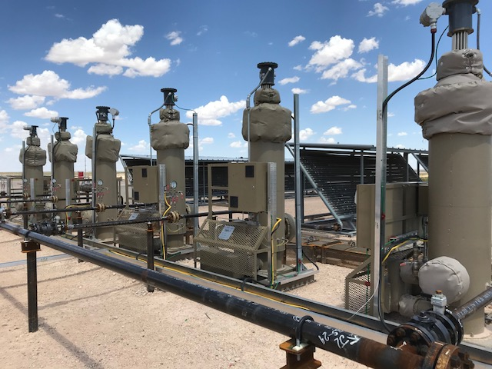

Contact Us
Casey Short
Rockies Regional Business Development Manager
CaseyShort@EcoVaporRS.com
(303) 915-6848
Notes:
[NEED TO UPDATE THIS SLIDE]

