Slide 1
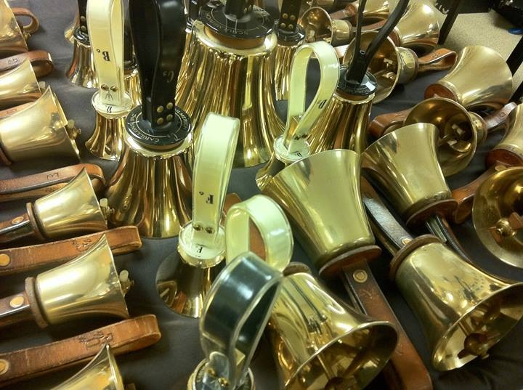
Introduction to Handbells/Chimes
Marcia Brantley
Education Chair Area 4 HMA
Director of Palmetto Bronze

Slide 2
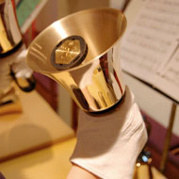
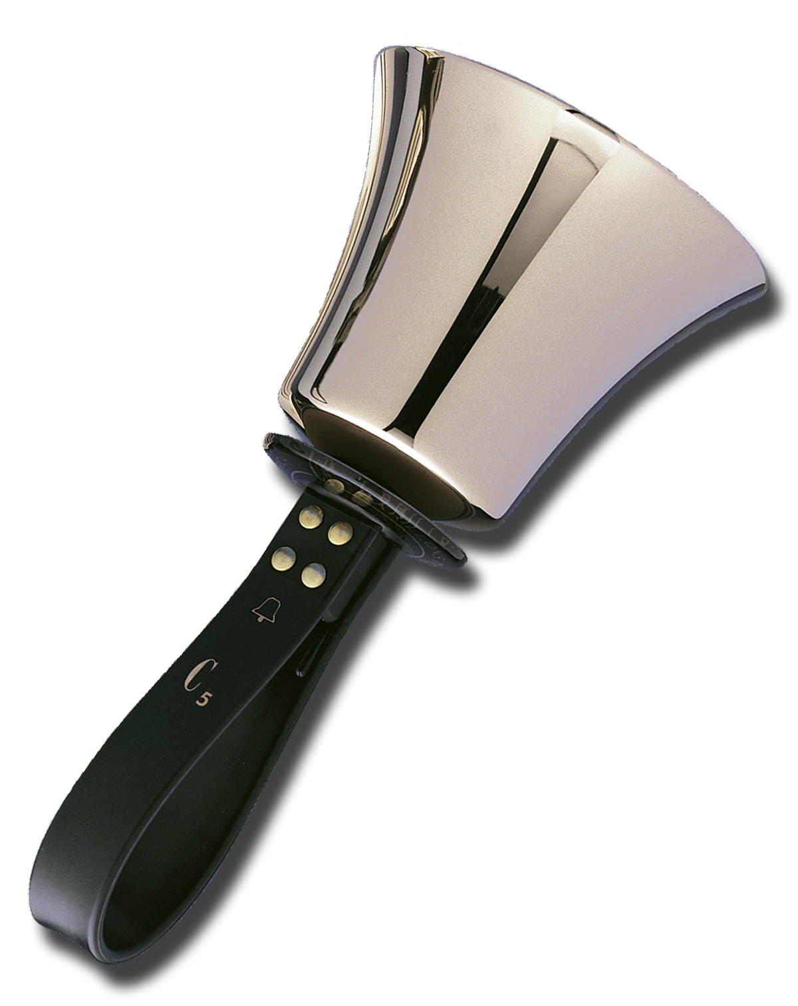
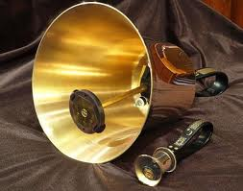
Parts of a Handbell
Bell Body – Casting
Hand Guard
Handle
Clapper Head
Clapper Mechanism
Note name and octave

Slide 3
Parts of a Handchime
Clapper head
Clapper shaft
Chime body
Note name and octave
Clapper assembly, not for thumb!!
Hand grip

Slide 4
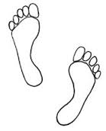
Check Mark Stance
Stand with your feet shoulder width apart and one foot slightly in front of the other
✓

Slide 5
Holding a Handbell/Handchime Properly
Shake hands with your neighbor
Look at how your hand is gripping your neighbor’s hand
Pick up a bell or chime with your left hand and place the bell in your right hand with the bell picture facing your hand.
Lift the bell/chime up parallel to your shoulder! The bell should balance on your open hand.
Gently close your index finger and thumb around the handle/chime – no tight grip – just enough pressure to hold on to bell/chime!!

Slide 6
Ring that Bell or Chime!
Preparation
Imagine a letter “D” in front of you with the straight part of the letter next to your body. Raise and lower your bell/chime down the straight part of the D and see how it moves. Just above eye level and until your hand is parallel to the floor. Don’t ring. What happens to the bell/chime?
D

Slide 7
Strike
D
As you slowly lower the bell/chime to parallel, gently close your other three fingers around the handle to ring the bell/chime.
Close fingers

Slide 8
Follow-Through
D
After the bell/chime rings, open the three fingers and follow the curved part of the D back to the top of the straight part of the D.

Slide 9
Where does the sound come from!
What makes the bell or chime make a sound?
What part of the bell or chime does the sound come from?
Exercise 1:
Ring the bell and listen to the end of the bell where the clapper is
Turn the bell upright and listen to the body of the bell
Do the same with the chime.
Where does the majority of the sound come from?

Slide 10
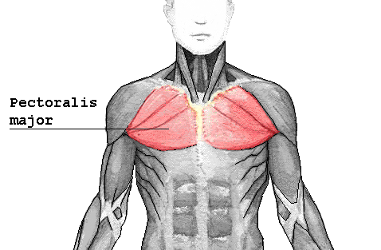
Damping – Stopping the Sound
After the follow-through, at the top of the “D” touch the rim and body of the bell to your pectoral muscle, the soft tissue between your shoulder and your collar bone.
You must roll chime to it’s side in order to damp.
D

Slide 11
Practice Damping

Slide 12
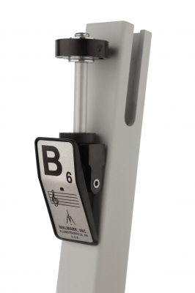
Find the note names on your bells or chimes
Note Name

Slide 13
Now find your note names in the chord chart below
1 = All C’s E’s and G’s
2 = All G’s B’s D’s and F’s
3 = All F’s A’s and C’s
4 = All D’s F#’s A’s and C’s
5 = All G’s B’s and D’s

Slide 14
Chord Songs
Row, Row, Row Your Boat
q1 1 1 1 | 1 1 1 1 | 1 1 1 1 | 2 2 1 -]
Mary Had a Little Lamb
q1 1 1 1 |2 2 1 1 | 1 1 1 1 |2 2 1 1]
Skip to My Lou
q1 1 1 1 | 2 2 2 2 | 1 1 1 1 | 2 2 1 1 ]
1 = All C’s E’s and G’s
2 = All G’s B’s D’s & F’s

Slide 15
1 = All C’s E’s and G’s
2 = All G’s B’s D’s and F’s
He’s Got the Whole World in His Hands
Intro Song
q1 1 1 2 | 1 1 1 1 | 1 1 1 1 | 1 1 1 1 |
2 2 2 2 | 2 2 2 2 | 1 1 1 1 | 1 1 1 1 |
2 2 2 2 |1 1 1 1 | 1 - - - ]
Kum Ba Yah
_{Intro} _{Song}
q1 1 1 3 | 1 1 1 1 | 1 1 1 3 | 1 1 1 1 |
1 1 1 1 | 2 2 2 1 | 1 1 1 3 | 1 1 1 3 |
1 1 1 2| 1 1 1 _]

Slide 16
1 = All C’s E’s and G’s
2 = All G’s B’s D’s and F’s
3 = All F’s A’s and C’s

Slide 17
More Chord Songs
1 = All C’s E’s and G’s
2 = All G’s B’s D’s and F’s
3 = All F’s A’s and C’s
4 = All D’s F#’s A’s and C’s
Jingle Bells
q1 1 1 1 | 1 1 1 1 | 3 3 1 1 | 4 4 2 2 |
1 1 1 1 | 1 1 1 1 | 3 3 1 1 | 2 2 1 - ]
This Old Man
h1 – 1 - | 1 – 1 - | 3 – 3 - | 2 – 2 - | 1 – 1 - | 1 – 1 – | 2 – 2 - | 1 2 1 - ]

Slide 18
1 = All C’s E’s and G’s
2 = All G’s B’s D’s and F’s
3 = All F’s A’s and C’s
4 = All D’s F#’s A’s and C’s
5 = All G’s B’s and D’s
This Old Man
h1 – 1 - | 1 – 1 - | 3 – 3 - | 2 – 2 - | 1 – 1 - | 1 – 1 – | 2 – 2 - | 1 2 1 - ]

Slide 19
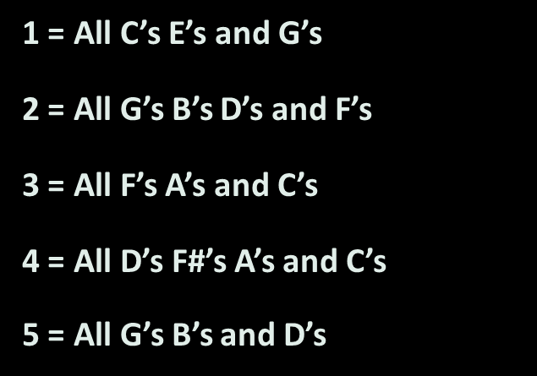

Slide 20
1 = All C’s E’s and G’s
2 = All G’s B’s D’s and F’s
3 = All F’s A’s and C’s
4 = All D’s F#’s A’s and C’s
5 = All G’s B’s and D’s
America the Beautiful
h1 – 1 - | 5 – 5 - | 2 – 2 - | 1 – 1 - | 1 – 1 - | 5 – 5 - |
5 – 4 - | 2 – 2 - | 1 – 1 - | 2 – 2 - | 2 – 2 - | 1 – 1 - |
3 – 3 - | 1 – 1 - | 3 – 2 - | 1 - - - ]

Slide 21
Your bell/chime on the Grand Staff
Look at your bell/chime and find the Letter name and the Octave number
Find your letter and number on the Grand Staff

Slide 22
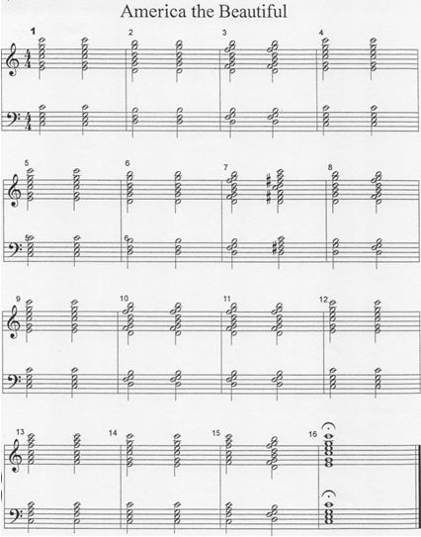
Chord Songs on the Grand Staff

Slide 23
America the Beautiful continued

Slide 24
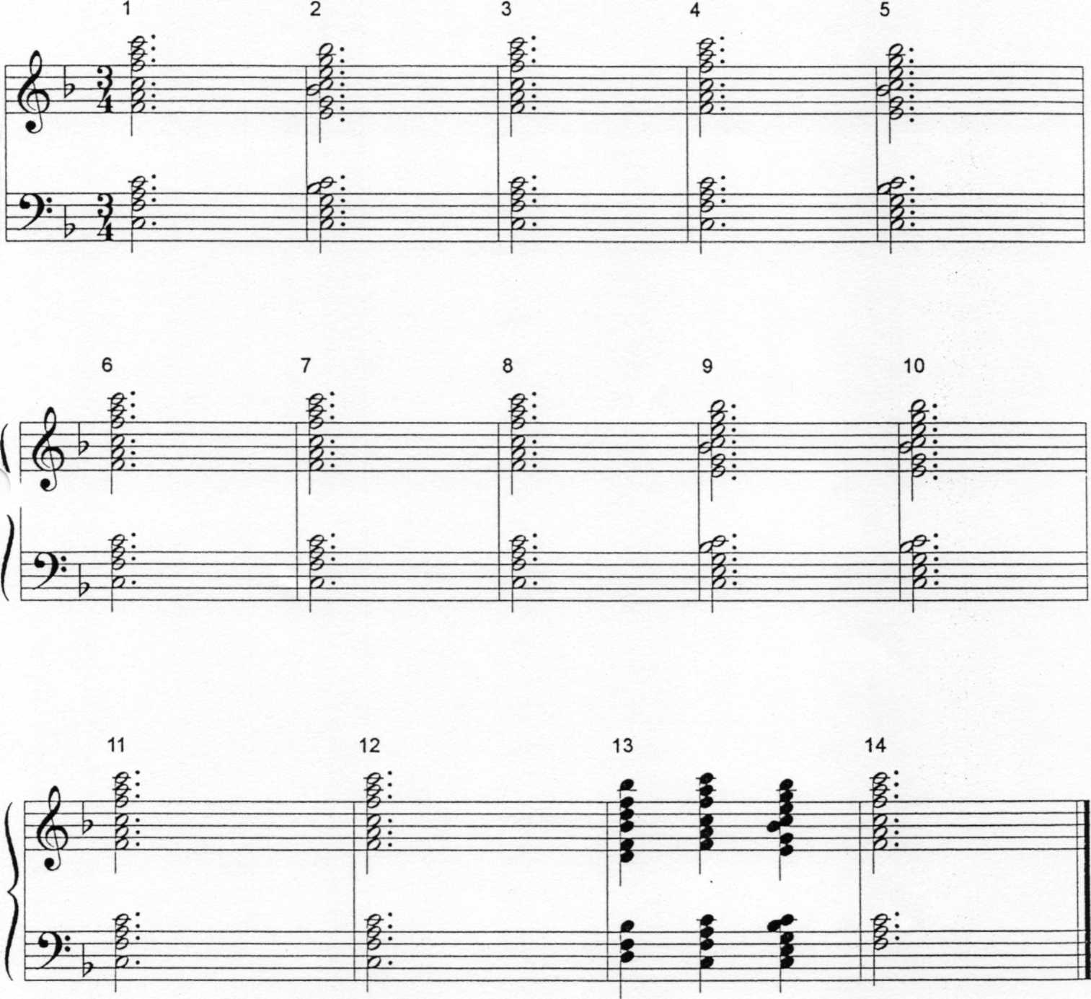
My Country
Tis of Thee

Slide 25
Some Resources for Handchimes and Handbells
Handbell Musicians of America Area 4 website
Chime Loan Application and Information
Chime Resources List
Chimeworks.com – a new website for teaching chimes
Instructions on “How to”
Downloadable lesson plans for using chimes in the classroom
An alphabetized and leveled list of published songs suitable for chimes
Jeffers Handbell Supply- handbellworld.com
All your needs for bells or chimes!

Slide 26
Have a great time incorporating bells or chimes into your classroom!! Get in touch if you have questions.
Marcia J. Brantley, Director of Palmetto Bronze
Summerville, SC
bellwoman@yahoo.com
www.palmettobronze.com
education.area4@handbellmusicians.org
843-729-6275

