Slide 1

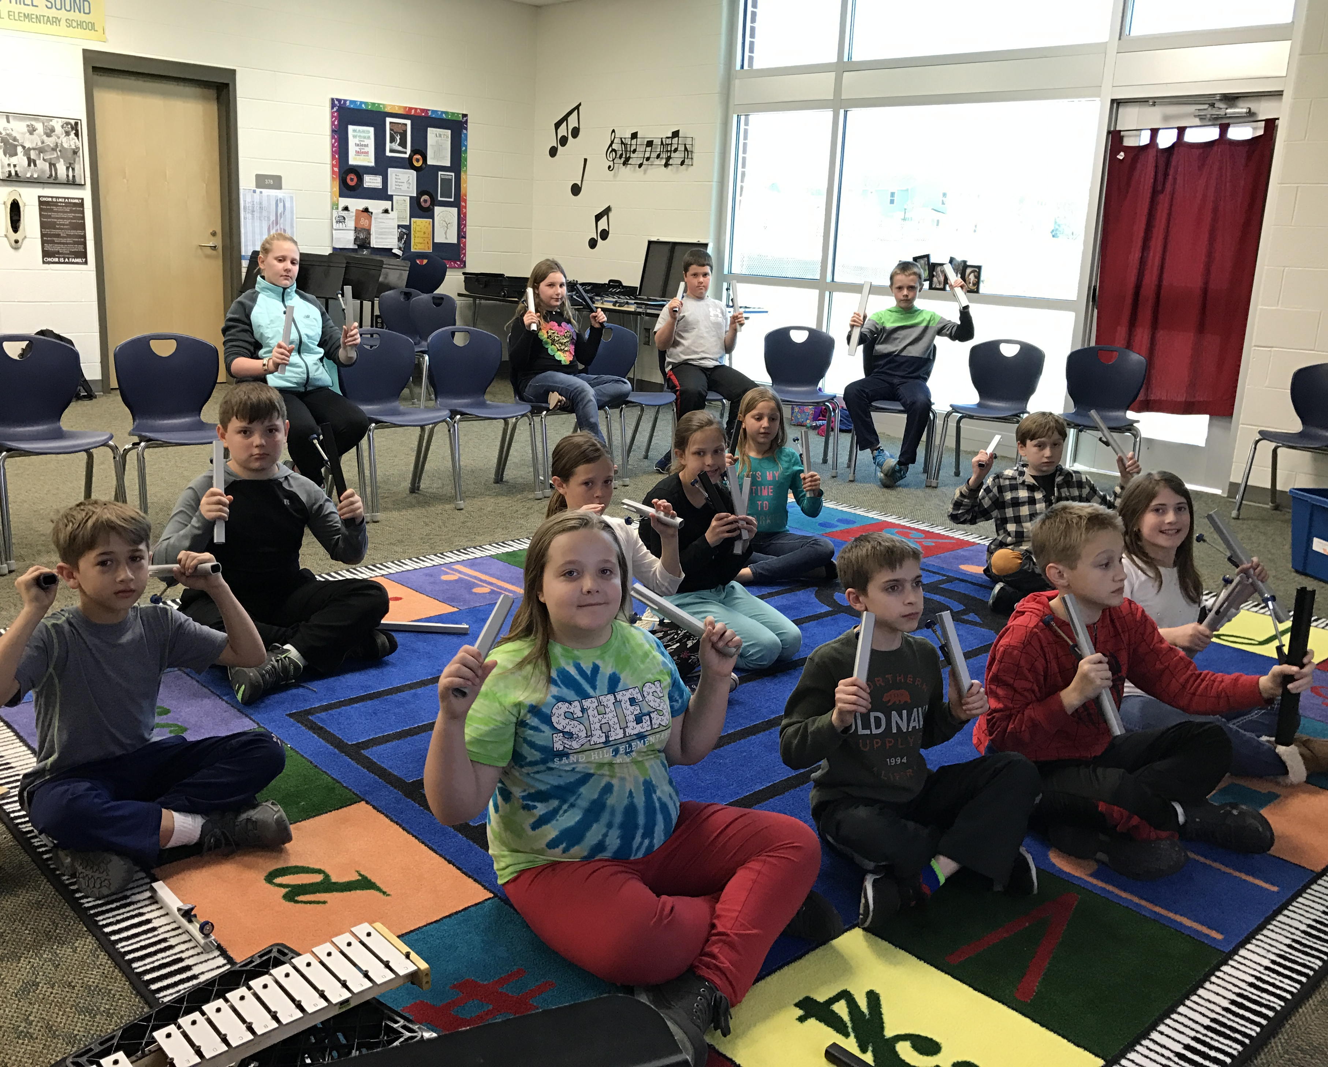
Introducing Handbells/Chimes in your Music Classroom
Marcia Brantley
Education Chair Area 4 HMA
Director of Palmetto Bronze

Slide 2

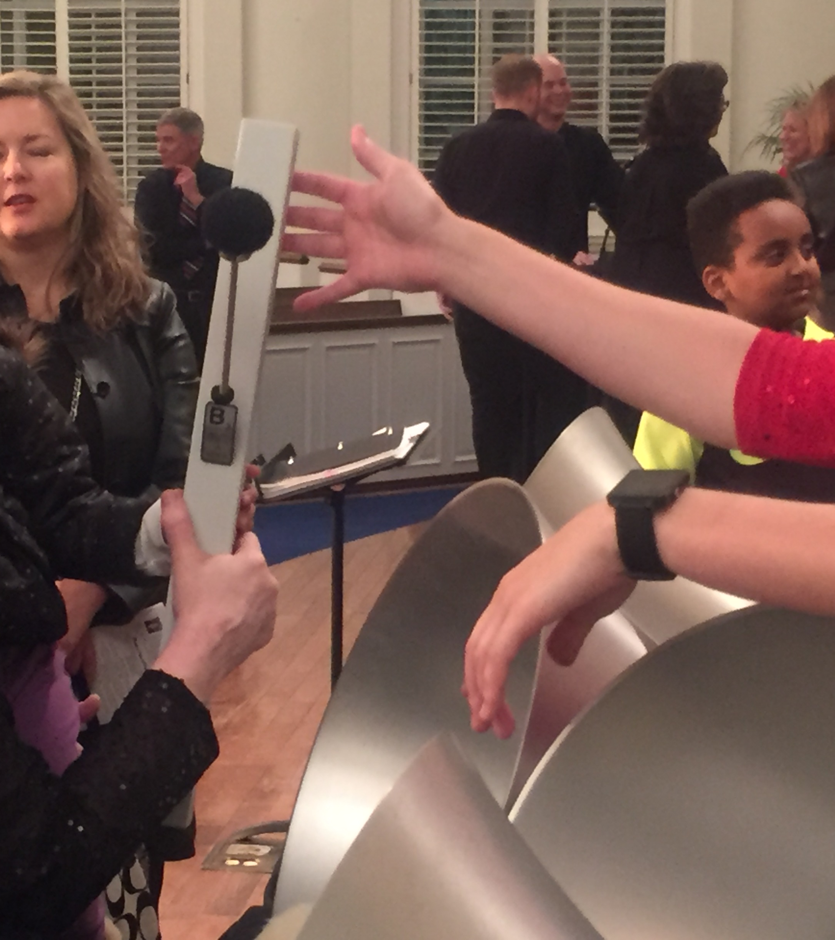
Handchimes and Handbells are wonderful tools for teaching music!
Easy to learn how to ring
Hands on music experience
Teaches music reading
Teaches team and cooperation
Builds confidence
Beautiful sound and fun to ring!
Even though the initial expense may scare you – the instruments hold their value and last a long time

Slide 3
This is an Introductory Lesson for teachers
This PowerPoint Presentation should take several days to complete in a music classroom.
You may want to skip some slides or modify the presentation for use with your students

Slide 4
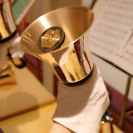
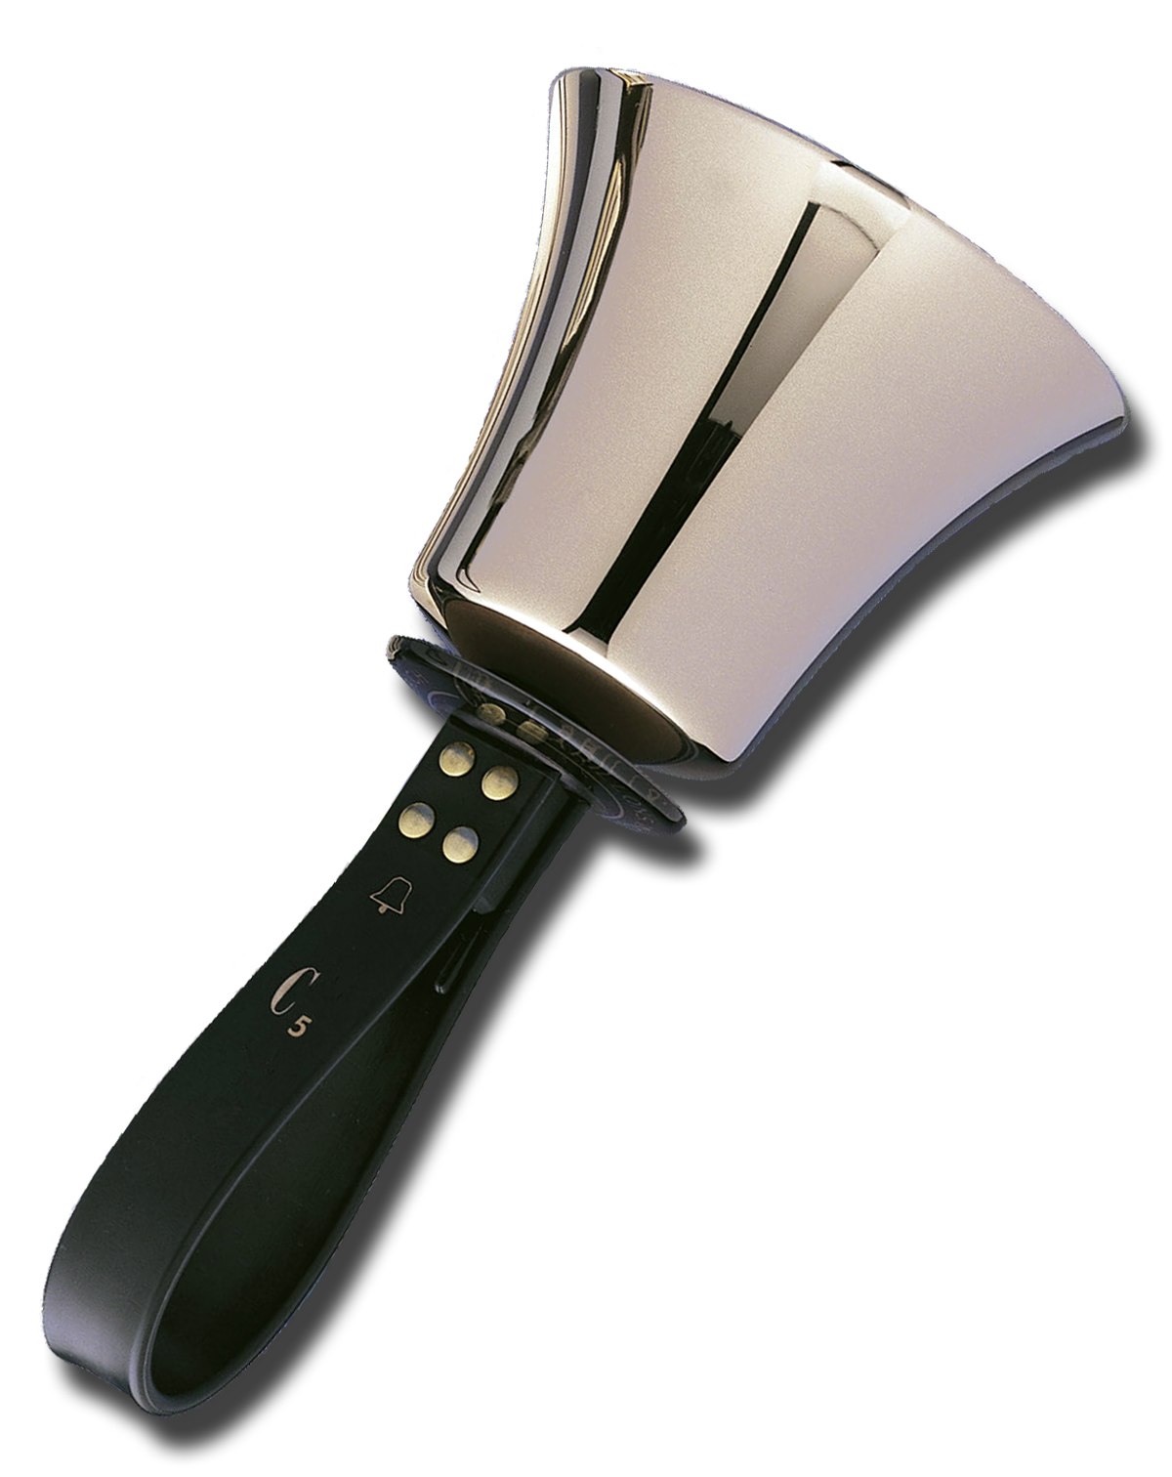
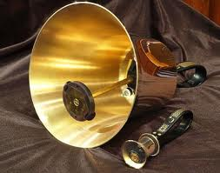
Parts of a Handbell
Student Lesson starts here
Bell Body – Casting
Hand Guard
Handle
Clapper Head
Clapper Mechanism
Note name and octave

Slide 5
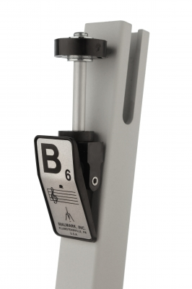
Parts of a Handchime
Clapper head
Clapper shaft
Chime body
Note name and octave
Clapper assembly, not for thumb!!
Hand grip

Slide 6
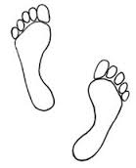
Check Mark Stance
Stand with your feet shoulder width apart and one foot slightly in front of the other
✓

Slide 7

Holding a Handbell/Handchime Properly
Shake
Shake hands with your neighbor
Look
Look at how your hand is gripping your neighbor’s hand
Pick up
Pick up a bell or chime with your left hand and place the bell in your right hand with the bell picture facing your hand.
Lift
Lift the bell/chime up parallel to your shoulder! The bell should balance on your open hand.
Close
Gently close your index finger and thumb around the handle/chime – no tight grip – just enough pressure to hold on to bell/chime!!

Slide 8

Let’s Ring That Bell or Chime
Wait!!
Let’s look at the three elements of ringing a bell or chime
Preparation
Strike
Follow Through
Each part is very important!

Slide 9



Yes!!

Slide 10
Preparation
Imagine an upper case letter “D” in front of you with the straight part of the letter next to your body.
Lower and then raise your bell/chime down the straight part of the D and see how it moves.
Hold your instrument just above eye level and lower until your hand is parallel to the floor. Don’t ring.
What happens to the bell/chime?
D

Slide 11
Strike
D
As you slowly lower the bell/chime to parallel, gently close your other three fingers around the handle and squeeze to ring the bell/chime.
Close fingers

Slide 12
Follow-Through
D
After the bell/chime rings, loosen the three fingers and follow the curved part of the D back to the top of the straight part of the D.

Slide 13
Where does the sound come from!
What makes the bell or chime make a sound?
Exercise: Ring the bell and listen to the end of the bell where the clapper is
Turn the bell upright and listen to the body of the bell.
Do the same with the chime.
What part of the bell or chime does the sound come from?

Slide 14

You are right!
The sound comes from the body not the clapper!
The Body of the bell or chime

Slide 15
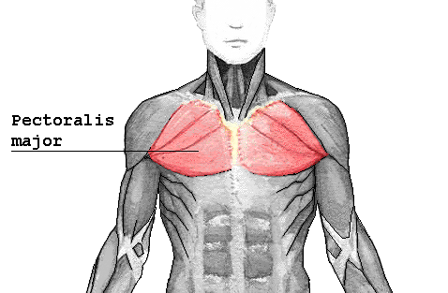
Damping – Stopping the Sound
After the follow-through, at the top of the “D” touch the rim and body of the bell to your pectoral muscle, the soft tissue between your shoulder and your collar bone.
You must roll chime to its side in order to damp.
D

Slide 16
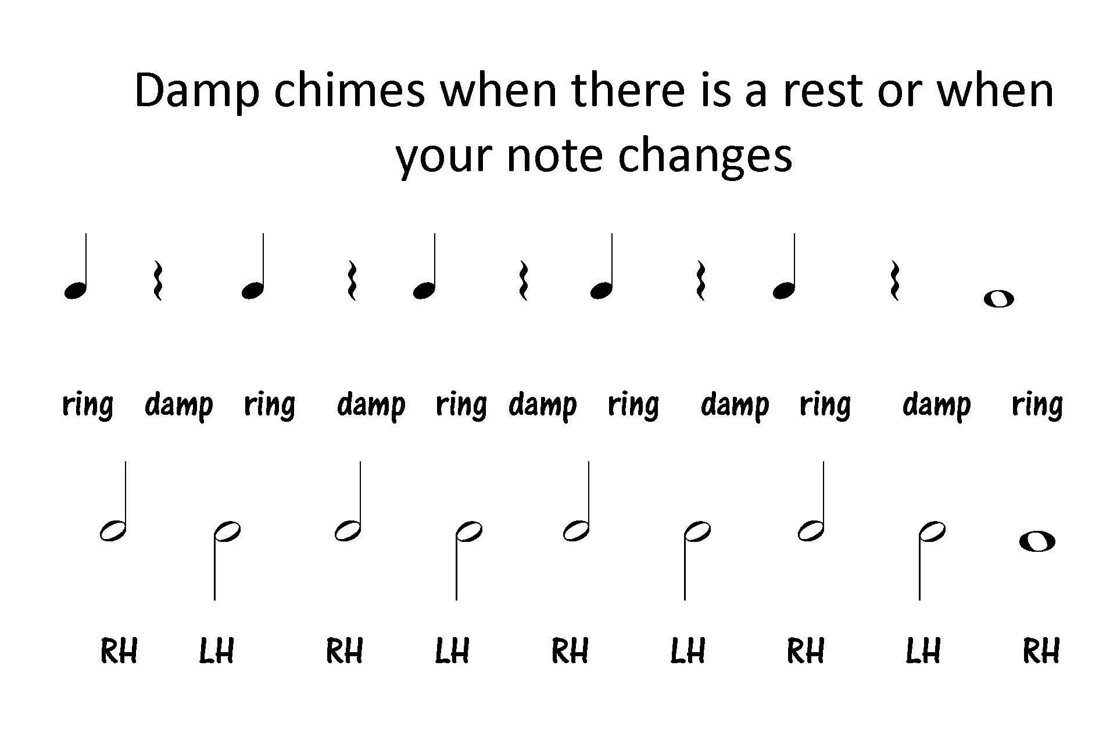
Practice Damping

Slide 17
Find the note names on your bells or chimes
Note Name

Slide 18
Now find your note names in the chord chart
1 = All C’s E’s and G’s
2 = All G’s B’s D’s and F’s
3 = All F’s A’s and C’s
4 = All D’s F#’s A’s and C’s
5 = All G’s B’s and D’s

Slide 19


Introduction of note values
The quarter note at beginning of each chord song indicates playing on each beat or pulse.
A half note at the beginning means that you play on every two beats or pulses
Remember to “damp” as your note changes

Slide 20
Chord Songs
1 = All C’s E’s and G’s
2 = All G’s B’s D’s & F’s
End of Day 1

Slide 21

Start Day 2 with a review of Day 1 then move on to this slide
Intro
Song
1 = All C’s E’s and G’s
2 = All G’s B’s D’s and F’s
3 = All F’s A’s and C’s

Slide 22
More Chord Songs
1 = All C’s E’s and G’s
2 = All G’s B’s D’s and F’s
3 = All F’s A’s and C’s
4 = All D’s F#’s A’s and C’s
Jingle Bells
q1 1 1 1 | 1 1 1 1 | 3 3 1 1 | 4 4 2 2 |
1 1 1 1 | 1 1 1 1 | 3 3 1 1 | 2 2 1 - ]
This Old Man
h1 – 1 - | 1 – 1 - | 3 – 3 - | 2 – 2 - | 1 – 1 - | 1 – 1 – | 2 – 2 - | 1 2 1 - ]
Jingle bells, Jingle bells

Slide 23
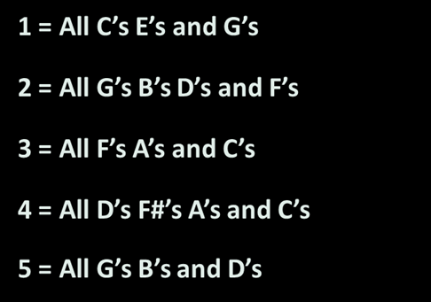


Slide 24

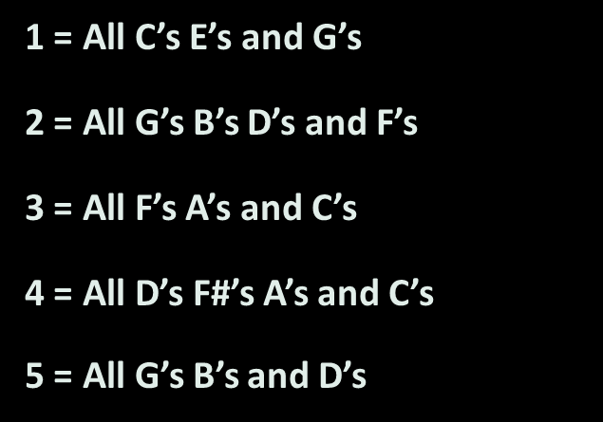
Twink le, Twink le Li t - tle Star
End Day 2

Slide 25
1 = All C’s E’s and G’s
2 = All G’s B’s D’s and F’s
3 = All F’s A’s and C’s
4 = All D’s F#’s A’s and C’s
5 = All G’s B’s and D’s
Start Day 3 with earlier songs and review then move on.
America the Beautiful
1 – 1 - | 5 – 5 - | 2 – 2 - | 1 – 1 - | 1 – 1 - | 5 – 5 - |
5 – 4 - | 2 – 2 - | 1 – 1 - | 2 – 2 - | 2 – 2 - | 1 – 1 - |
3 – 3 - | 1 – 1 - | 3 – 2 - | 1 - - - ]
Oh Beautiful for …

Slide 26
Move to reading notes on staff
At this point, when trying to remember which hand for 5 different chords, you can move to finding their notes on the Grand Staff
Once the students find their note names and octave number indication, you can move to music written on the staff.
The sky is the limit!!!

Slide 27
Find the note name and octave on your bells or chimes
Note Name
Octave designation

Slide 28
Your bell/chime on the Grand Staff
Look at your bell/chime and find the Letter name and the Octave number
Find your letter and number on the Grand Staff below

Slide 29
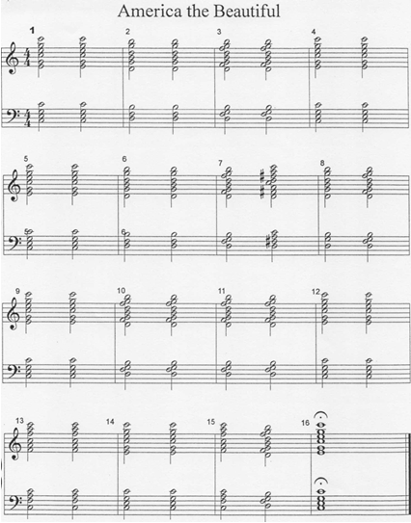
Chord Songs on the Grand Staff
The same song we played with the 5 chords!

Slide 30

America the Beautiful continued
Start Day 4 by playing chord songs for fun then reviewing notes on the staff and playing America the Beautiful
End Day 3

Slide 31
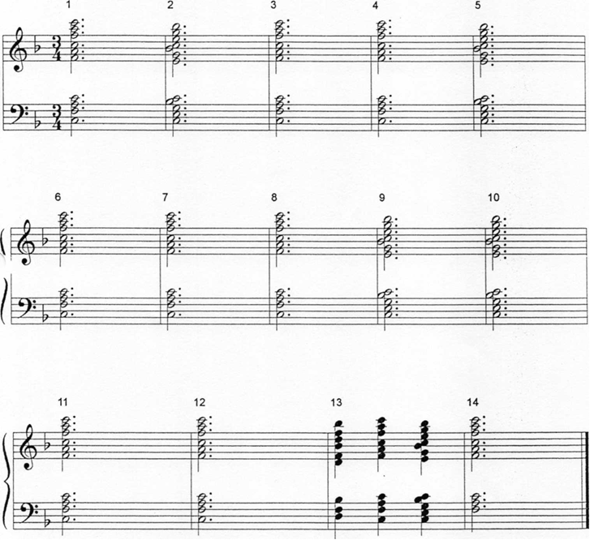
My
Country ‘tis
of Thee

Slide 32


This is the end of the student’s lessons. Here is where you can begin reading music from any source. Chordal songs that move together rhythmically work best to begin with. Then you may branch out to melodies accompanied by chords and other music that you have prepared the students for.

Slide 33
Create your own chord songs
Find
Find simple songs with just a few chords.
Use
Use your music writing software or pencil and staff paper to create music for your group.
Be
Be aware of copyright laws

Slide 34

Resource List for beginner bell/chime material
You can find a Resource List on the Area 4 Handbell Musicians of America website under the Chime Loan Program tab.
https://area4handbells.weebly.com/chime-loan-program.html

Slide 35
Some Resources for
Handchimes and Handbells
Handbell Musicians of America Area 4 website
Chime Loan Application and Information
Chime Resources List
Chimeworks.com – a new website for teaching chimes
Instructions on “How to”
Downloadable lesson plans for using chimes in the classroom
An alphabetized and leveled list of published songs suitable for chimes
Jeffers Handbell Supply- handbellworld.com
All your needs for bells or chimes! Music, games, awards, supplies, etc.
StevieBeMusic.com – Stevie Berryman has a wealth of knowledge, insights, rehearsal ideas and games on her website.

Slide 36


Check out the many resources for using chimes or bells in the classroom and see what Handbell Musicians of America has to offer.
Our Chime Loan Program offers the loan of a 3-octave set of chimes for an entire school year. Fill out the application by March 30
The QR code below takes you directly to a Google Form Application that
can be filled out on your computer!
Chime Loan Application

Slide 37

Have a great time incorporating bells or chimes into your classroom!!
Get in touch if you have questions
Marcia J. Brantley, Director of Palmetto Bronze
Summerville, SC
bellwoman@yahoo.com
www.palmettobronze.com
education.area4@handbellmusicians.org
843-729-6275

