Slide 1
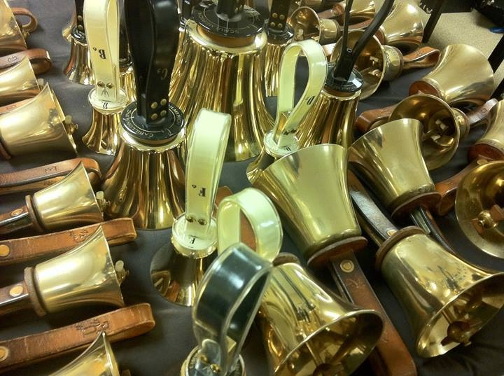
Introduction to Handbells/Chimes For your Music Classroom
Marcia Brantley
Education Chair Area 4 HMA
Director of Palmetto Bronze

Slide 2
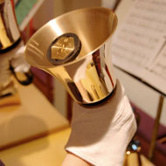
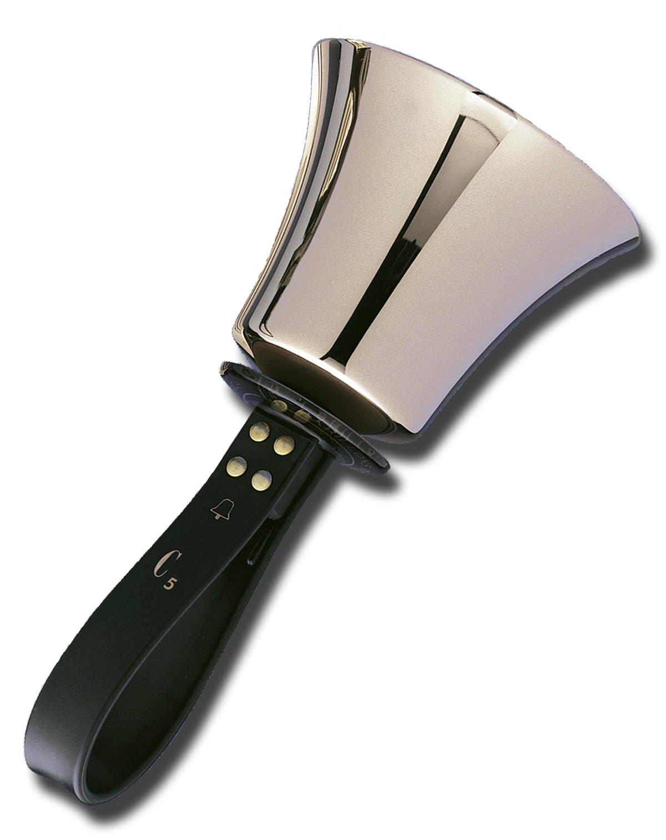
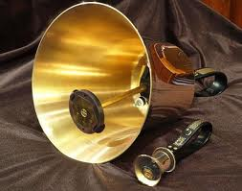
Parts of a Handbell
Bell Body – Casting
Hand Guard
Handle
Clapper Head
Clapper Mechanism
Note name and octave

Slide 3
Parts of a Handchime
Clapper head
Clapper shaft
Chime body
Note name and octave
Clapper assembly, not for thumb!!
Hand grip

Slide 4
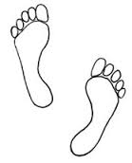
Check Mark Stance
Stand with your feet shoulder width apart and one foot slightly in front of the other
✓

Slide 5
Holding a Handbell/Handchime Properly
Shake
Shake hands with your neighbor
Look
Look at how your hand is gripping your neighbor’s hand
Pick up
Pick up a bell or chime with your left hand and place the bell in your right hand with the bell picture facing your hand.
Lift
Lift the bell/chime up parallel to your shoulder! The bell should balance on your open hand.
Close
Gently close your index finger and thumb around the handle/chime – no tight grip – just enough pressure to hold on to bell/chime!!

Slide 6
Let’s Ring That Bell or Chime
Wait!! Let’s look at the three parts of ringing a bell
Preparation
Strike
Follow Through
Each part is very important!

Slide 7
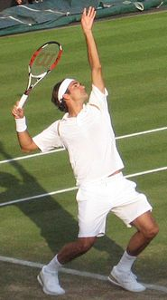
Yes!!

Slide 8
Preparation
Imagine an upper case letter “D” in front of you with the straight part of the letter next to your body.
Lower and then raise your bell/chime down the straight part of the D and see how it moves.
Hold your instrument just above eye level and lower until your hand is parallel to the floor. Don’t ring.
What happens to the bell/chime?
D

Slide 9
Strike
D
As you slowly lower the bell/chime to parallel, gently close your other three fingers around the handle and squeeze to ring the bell/chime.
Close fingers

Slide 10
Follow-Through
D
After the bell/chime rings, open the three fingers and follow the curved part of the D back to the top of the straight part of the D.

Slide 11
Where does the sound come from!
What makes the bell or chime make a sound?
What part of the bell or chime does the sound come from?
Exercise :
Ring the bell and listen to the end of the bell where the clapper is
Turn the bell upright and listen to the body of the bell
Do the same with the chime.
Where does the majority of the sound come from?

Slide 12
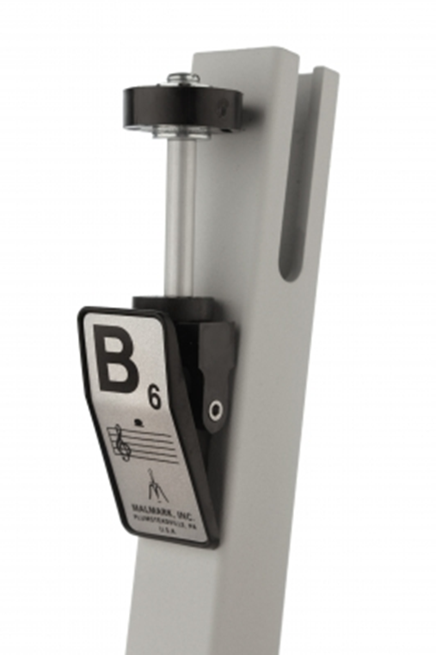
You are right! The sound comes from the body not the clapper!
The Body of the bell or chime

Slide 13
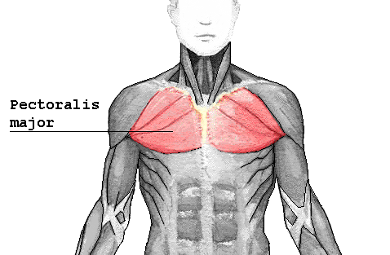
Damping – Stopping the Sound
After the follow-through, at the top of the “D” touch the rim and body of the bell to your pectoral muscle, the soft tissue between your shoulder and your collar bone.
You must roll chime to it’s side in order to damp.
D

Slide 14
Practice Damping

Slide 15
Find the note names on your bells or chimes
Note Name

Slide 16
Now find your note names in the chord chart
1 = All C’s E’s and G’s
2 = All G’s B’s D’s and F’s
3 = All F’s A’s and C’s
4 = All D’s F#’s A’s and C’s
5 = All G’s B’s and D’s

Slide 17
Introduction of note values
The quarter note at beginning of each chord song indicates playing on each beat or pulse.
A half note at the beginning means that you play on every two beats or pulses
Remember to “damp” as your note changes

Slide 18
Chord Songs
Row, Row, Row Your Boat
q1 1 1 1 | 1 1 1 1 | 1 1 1 1 | 2 2 1 -]
Mary Had a Little Lamb
q1 1 1 1 |2 2 1 1 | 1 1 1 1 |2 2 1 1]
Skip to My Lou
q1 1 1 1 | 2 2 2 2 | 1 1 1 1 | 2 2 1 1 ]
1 = All C’s E’s and G’s
2 = All G’s B’s D’s & F’s

Slide 19
1 = All C’s E’s and G’s
2 = All G’s B’s D’s and F’s
He’s Got the Whole World in His Hands
Intro Song
q1 1 1 2 | 1 1 1 1 | 1 1 1 1 | 1 1 1 1 |
2 2 2 2 | 2 2 2 2 | 1 1 1 1 | 1 1 1 1 |
2 2 2 2 |1 1 1 1 | 1 - - - ]
Kum Ba Yah
_{Intro} _{Song}
q1 1 1 3 | 1 1 1 1 | 1 1 1 3 | 1 1 1 1 |
1 1 1 1 | 2 2 2 1 | 1 1 1 3 | 1 1 1 3 |
1 1 1 2| 1 1 1 _]

Slide 20
1 = All C’s E’s and G’s
2 = All G’s B’s D’s and F’s
3 = All F’s A’s and C’s

Slide 21
More Chord Songs
1 = All C’s E’s and G’s
2 = All G’s B’s D’s and F’s
3 = All F’s A’s and C’s
4 = All D’s F#’s A’s and C’s
Jingle Bells
1 1 1 1 | 1 1 1 1 | 3 3 1 1 | 4 4 2 2 |
1 1 1 1 | 1 1 1 1 | 3 3 1 1 | 2 2 1 - ]

Slide 22
1 = All C’s E’s and G’s
2 = All G’s B’s D’s and F’s
3 = All F’s A’s and C’s
4 = All D’s F#’s A’s and C’s
5 = All G’s B’s and D’s
This Old Man
1 – 1 - | 1 – 1 - | 3 – 3 - | 2 – 2 - | 1 – 1 - | 1 – 1 – | 2 – 2 - | 1 2 1 - ]

Slide 23
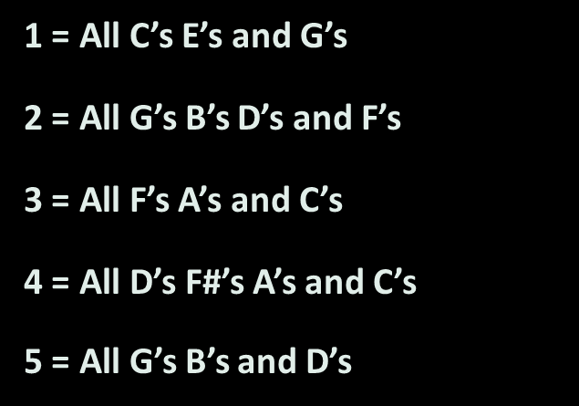

Slide 24
1 = All C’s E’s and G’s
2 = All G’s B’s D’s and F’s
3 = All F’s A’s and C’s
4 = All D’s F#’s A’s and C’s
5 = All G’s B’s and D’s
America the Beautiful
1 – 1 - | 5 – 5 - | 2 – 2 - | 1 – 1 - | 1 – 1 - | 5 – 5 - |
5 – 4 - | 2 – 2 - | 1 – 1 - | 2 – 2 - | 2 – 2 - | 1 – 1 - |
3 – 3 - | 1 – 1 - | 3 – 2 - | 1 - - - ]

Slide 25
Your bell/chime on the Grand Staff
Look at your bell/chime and find the Letter name and the Octave number
Find your letter and number on the Grand Staff

Slide 26
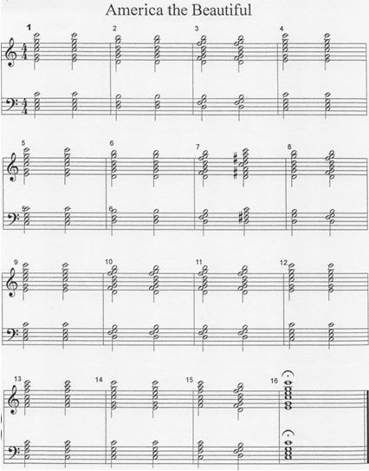
Chord Songs on the Grand Staff

Slide 27
America the Beautiful continued

Slide 28
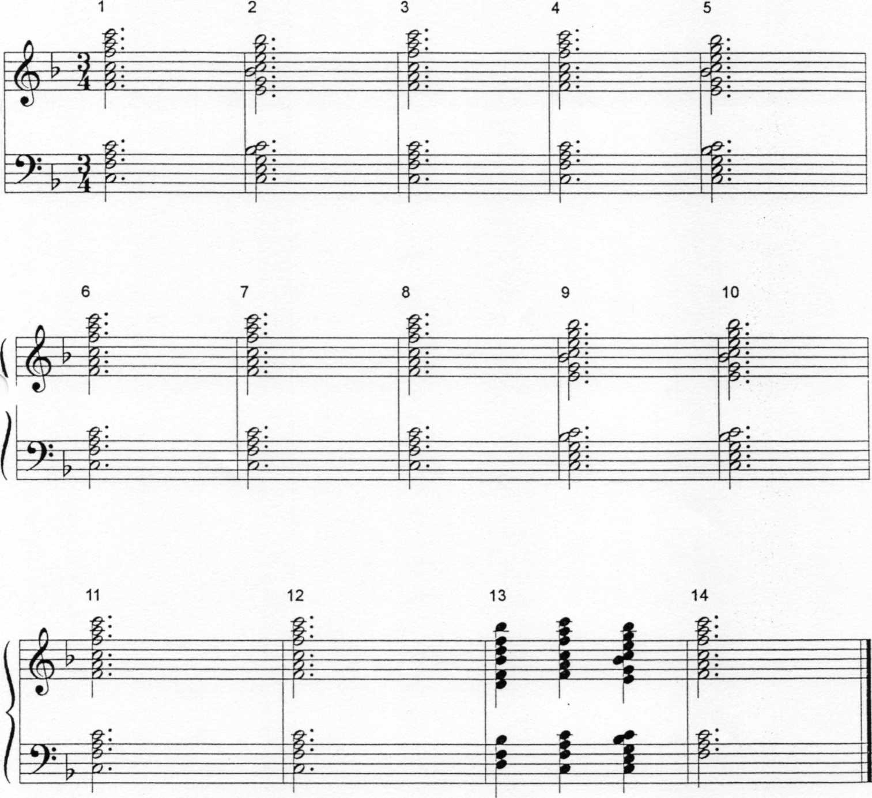
My Country
Tis of Thee

Slide 29
Some Resources for Handchimes and Handbells
Handbell Musicians of America Area 4 website
Chime Loan Application and Information
Chime Resources List
Chimeworks.com – a new website for teaching chimes
Instructions on “How to”
Downloadable lesson plans for using chimes in the classroom
An alphabetized and leveled list of published songs suitable for chimes
Jeffers Handbell Supply- handbellworld.com
All your needs for bells or chimes!

Slide 30
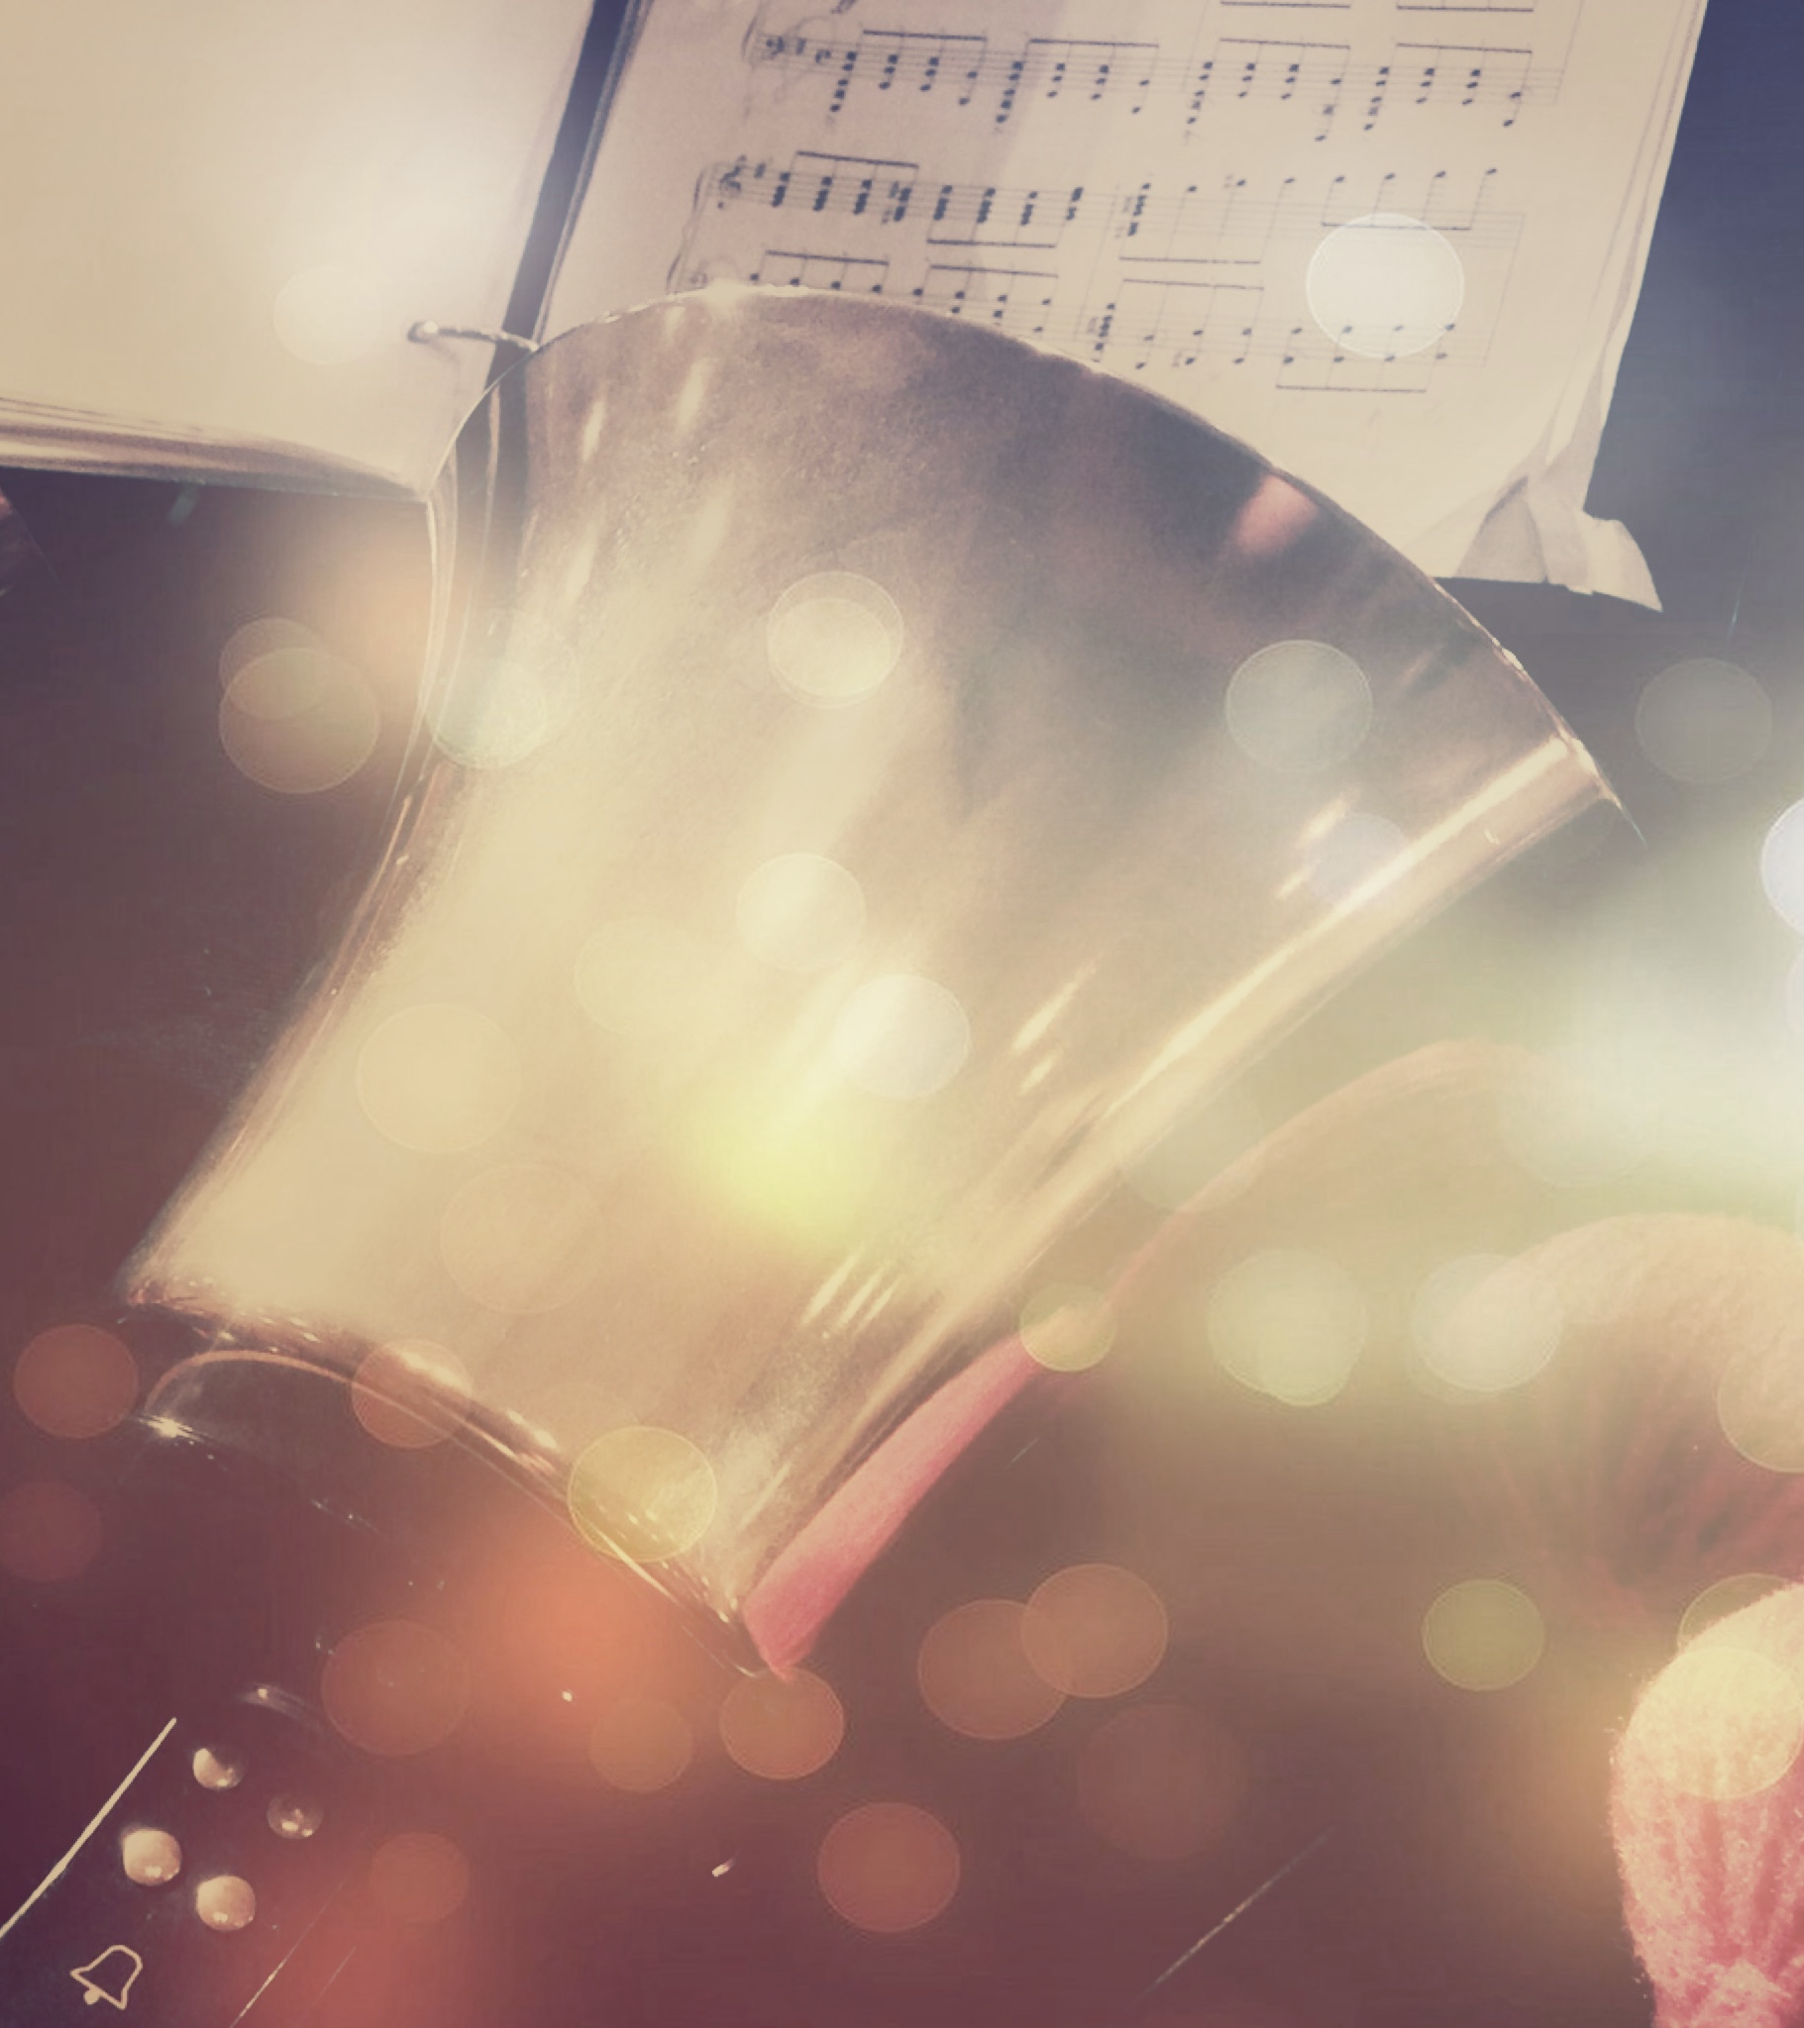
Have a great time incorporating bells or chimes into your classroom!! Get in touch if you have questions.
Marcia J. Brantley, Director of Palmetto Bronze
Summerville, SC
bellwoman@yahoo.com
www.palmettobronze.com
education.area4@handbellmusicians.org
843-729-6275

