Slide 1
The Littoral Theory :
early-Pleistocene Homo
Diving for Shellfish ? Marc Verhaegen
AAT@groups.io
WHAT talk
13 February 2022

Slide 2
This is not about australopithecines
(Lucy was no direct ancestor or ours),
only about archaic Homo & diving :
Savanna-running/-hunting ideas are unscientific.
What did they eat? shell-fish? sea-weed? … ?
How exactly did archaic Homo dive?
When? early-Pleistocene? already Pliocene?
Where? coastal dispersal? Indian Ocean?
Late-Pleistocene transition diving → wading?

Slide 3
Traditional Assumptions were Afro- & anthropo-centric
bipedalism
less fur
sweating 
meat-eating
tool use  …
ill. Bender, Verhaegen & Oser 1997
Anthropologische Anzeiger 55 : 1-14
Der Erwerb menschlicher Bipedie
aus der Sicht der Aquatic Ape Theory

Slide 4
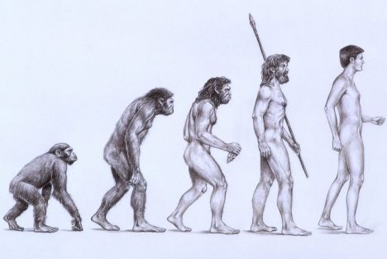
We don’t descend from chimps,
nor from knuckle-walkers.

Slide 5
Traditional Assumption “Bipedal hominid = human ancestor”
non-human primates forest 4-legged
⬇ ⬇ ⬇
human ancestors plain 2-legged
= Afro- & anthropo-centric interpretation
(frequent logical fallacy
‘post hoc, ergo propter hoc’-mistake
after this, therefore because of this)

Slide 6
Human Locomotion = bi-pedal (on 2 legs) e.g. kangaroo, ostrich + vertical (upright spine) e.g. gibbon in tree, bonobo, lowland gorilla, orang in swamp, Miocene ‘apes’, australopiths, ‘habilis’?

Slide 7
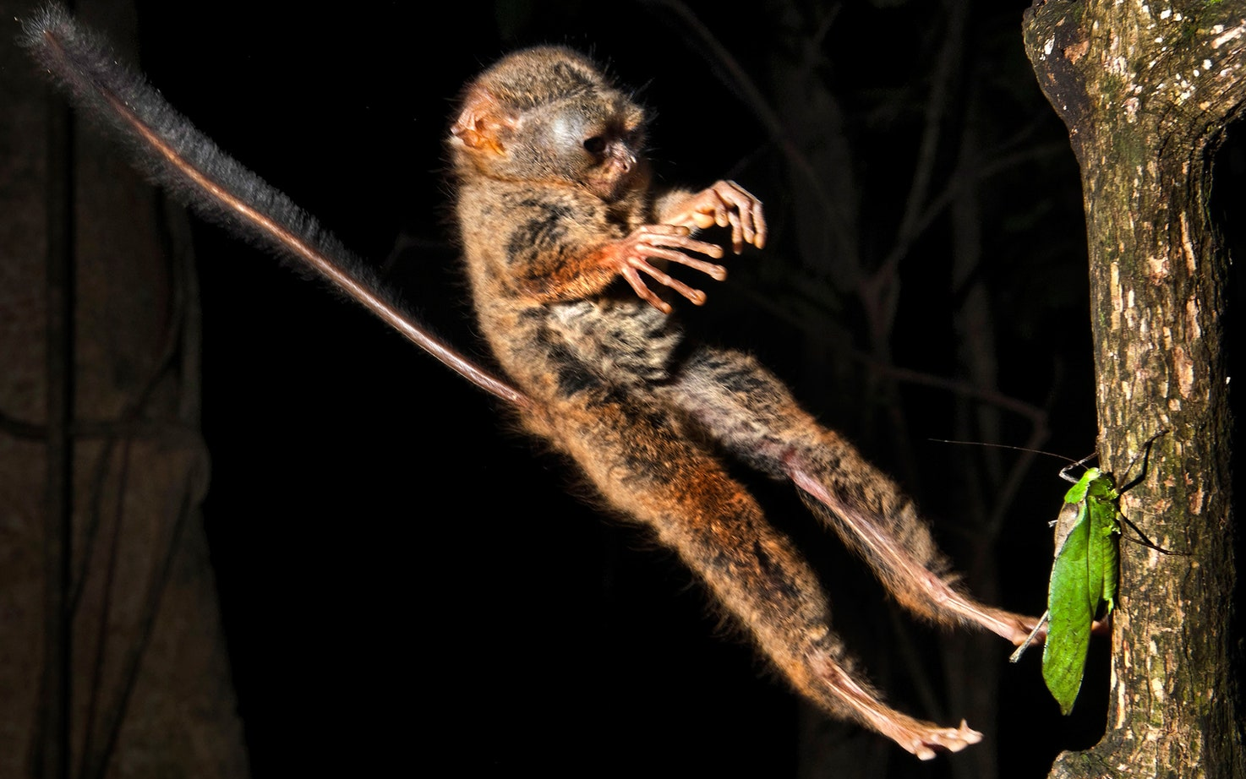
* Bipedal savanna-runners have horizontal spines e.g. kangaroo ostrich, emu * Vertical + Bipedal e.g. humans wading penguin outside water tarsier, gibbon in tree ... gorilla, chimp, bonobo wading in forest swamp ...

Slide 8
Open Plain hypotheses problems, problems, problems
Homo erectus cs
fossil data
archeology
paleo-environment
dispersal
malacology
nutrition
physiology
anatomy
etc. etc.
examples, e.g.
very heavy bones = slow
stone tools: sea-otter, capuchin...
fossilization at coasts, rivers...
to Eurasia + offshore islands
fossilization with edible shellfish
DHA, taurine, iodine... needs
sweat = water + salt needs
flat feet in wading / swimming, not in running animals

Slide 9
Dispersals along Coasts & Rivers
◆
◆
◆
◆
◆
??
Ice Age
Homo fossils/tools
? ≥ 1.8 Ma
-Shangchen
-Aïn-Hanech
-Turkana
-Dmanisi
-Mojokerto
◆
◆
◆
◆
early-Pleistocene
◆ mid-Pleistocene
◆
Dispersals over Open Plains ??

Slide 10
After ~2 Ma (Pleistocene Ice Ages) we find Homo in China, Java, Africa, Georgia… - Running over Plains to Java, Flores etc.?? impossible : mountains, open sea... - Following African-Eurasian Coasts → Rivers of course : why not? how else??

Slide 11
Human Ancestors were
no Open Plain dwellers
no Endurance Runners
no specialized Meat Eaters
no Rodeo Cowboys
no Top Carnivores
= far-fetched & unnecessary just-so speculations!
“The nowadays popular ideas about Pleistocene human ancestors running in open plains (‘endurance running’, ‘dogged pursuit of swifter animals’, ‘born to run’, ‘le singe coureur’, ‘Savannahstan’) are among the worst scientific hypotheses ever proposed.” 2013 Hum.Evol.28:237-266

Slide 12
Pleistocene Homo Endurance-Running ??
ER hypothesis is unnecessary & anthropo-centric :
it’s not because ER exists in a few inland populations today,
that archaic Homo must have done this.
ER is unlikely physiologically, nutritionally etc.
- too fat & heavy : pachy-osteo-sclerosis (POS),
- sweat = water + salt (overheated furseals on land sweat),
- hunting mammals have excellent olfaction.
Cursorial animals run on toes or hooves,
none are planti-grade.
Running over seas to Mojokerto, Flores etc.??
Bramble & Lieberman 2004 Nature 432:345 did not even consider wading or diving, which much better than ER explain bipedalism etc.!

Slide 13
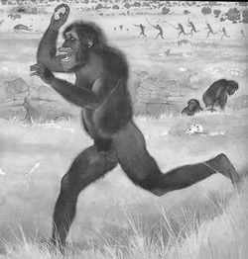

Slide 14
Early-Pleistocene Homo dispersed inter-continentally, not running over open plains, but along Eurasian & African coasts, islands, rivers, lakes… = Coastal Diaspora = Littoral Theory

Slide 15
When Homo followed African & Eurasian coasts, the diet included waterside & shallow–aquatic littoral foods, collected by bipedal walking-wading & shallow-diving.

Slide 16
Sea-foods, esp. shellfish, are richest in brain-specific nutrients - poly-unsaturated fatty acids e.g. DHA (docosa-hexaenoic acid) - oligo-elements - iodine - taurine etc. Savanna foods are poor in brain-specific nutrients. Shell-fish = stone use - to fracture the shell (at surface), - to prevent closure (underwater).

Slide 17
Littoral Diaspora of Homo - when?
after ~2.5 Ma?? H.erectus : larger brain & POS
during the Ice Ages? (Pleistocene epoch)
not 10 or 5 Ma? (as Hardy & Morgan thought)
probably after Homo & Pan split ~5 Ma
Ice Age coasts are ~100 m under sea-level today :
were the continental shelves shellfish-rich & tree-poor?
Verhaegen & Munro 2002 Nutr. Health 16:25-27
The Continental Shelf Hypothesis
What happened to Homo during the Pliocene 5 - 2 Ma ?
Did regular diving (H.erectus) begin with the Pleistocene ?
Was shellfish more abundant during ice ages?

Slide 18
Pachy-osteo-sclerosis POS = PO + OS = heavy = early adaptation of slow divers Evolution of Sirenian Pachyosteosclerosis Vivian de Buffrénil cs 2010 J.Mammal.Evol.17:101–120 Pachy-ostosis (PO, outer hyperplasy of bone cortex) & Osteo-sclerosis (OS, inner bone compaction) are typical of tetrapods secondarily adapted to life in water ... spectacularly exemplified by the ribs of extant & extinct Sirenia ... 1) PO evolved 1st (mid-Eocene), is a basal feature of Sirenia, but subsequently regressed in some taxa. 2) OS was only incipient in Pezosiren portelli ~50 Ma, its full development occurred later (end-Eocene). These 2 structural specializations of bone are variably pronounced in extinct & extant Sirenia, PO & OS are rel. independent from each other, although frequently associated. ... Incipient acquisition of aquatic habits by the earliest forms induced the need for ballast, allowing a passive control of buoyancy & trim ... This evolutionary process was rapid, already completed in animals that basically remained terrestrial anatomically. (!! --mv) OS also occurred early in sirenian evolution, but as a progressive, somewhat slower process, not closely synchronous with PO. Pezosiren typifies an initial adaptive stage, combining advanced PO + incomplete OS + nearly non-existent gross morphological specializations for life in water, at least for the bones involved in locomotion (the nasal region suggests some aquatic adaptation) … PO & OS are by no means unique to the Sirenia. They are also encountered in the long bones of most, if not all, other aquatic tetrapods at incipient stages of their adaptation to life in seas ... The OS or POS stages thus seem to be mandatory passages in the history of marine tetrapods. In semi-aquatic forms or fresh-water dwellers, there is just a limited increase in bone density … (IOW, H.erectus was littoral –mv) All authors consider that OS and/or PO have a hydrostatic role, and contribute, as ballast, to regulating buoyancy & trim in tetrapods incipiently adapting to life in water, or specialized in feeding on fixed or slow-moving prey in shallow waters.

Slide 19
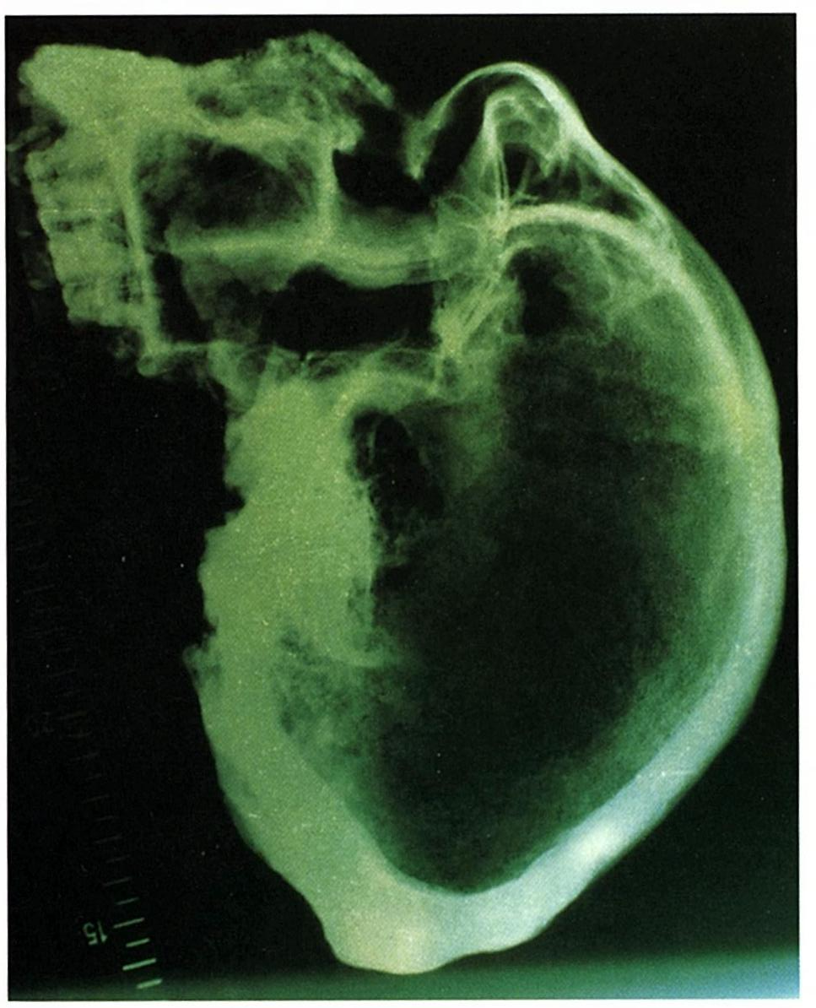
Petralona Mtn Katsika cave discov.1959 17°C 10.000 m² 300 m ASL 300 ka? sea-level ­~–1m/ky? 1 km E of Chalkidiki 50 km from Thessaloniki Aristotelian Museum Very large para-nasal air sinuses & very dense occiput & skull-base (POS) suggest frequent back-floating (cf. sea-otter?)
air
bone

Slide 20
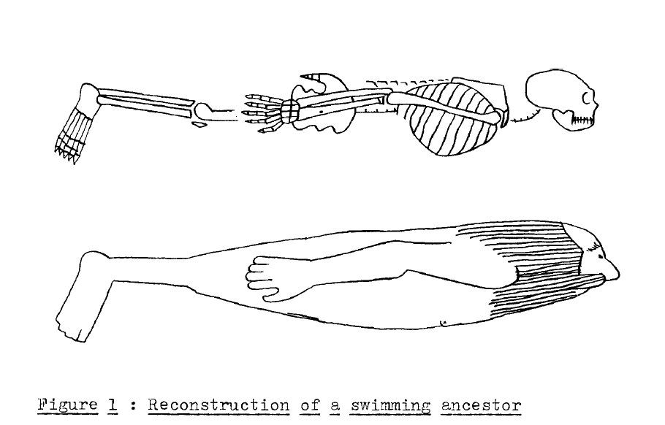
based on what we know of Homo erectus : - brain size ~800 – 900 cc - no basi-cranial flexion as in H.sapiens - foramen magnum more dorsally - mid-facial pro-gnathism + big nose - receding forehead, heavy supra-orbital torus (SOT) - platy-cephaly : long low skull - large, esp. wide thorax - platy-pelloidy : broad pelvis + flaring iliac blades - rel. long & horizontal femoral neck - platy-meria : dorso-ventrally flattened femora - tibia a bit shorter - planti-grady : flat feet + rel. long 1st toe - thick sub-cutaneous fat layer (SC) - male hair distribution + sebaceous skin glands
The Aquatic Ape Theory :
evidence and a possible scenario
Marc Verhaegen 1985
Med.Hypoth.16:17-32
copied by Timo von Burg 1994

Slide 21
Sleep floating ??
“The Littoral Theory is wrong, because humans can’t sleep floating” :
e.g. dangerous predators on the beach? Sleeping amid kelp??
Perhaps most of us can’t, but H.erectus & even H.neanderth. had - shorter tibiae – legs are rel.heavier than the rest of or body - more SC fat – we’re still much fatter than apes & most terrestrial mammals - no basi-cranial flexion – BCF turns the nose more ventrally - platy-cephaly – long & low skulls, bring the face & nose forward
- projecting mid-face – still no chin - large nose – google Oi, big nose!
Early-Pleistocene Homo dispersed intercontinentally in salty waters.
Para-nasal sinuses Hn > Hs > He = fresh vs salty water? POS He > Hn > Hs.

Slide 22
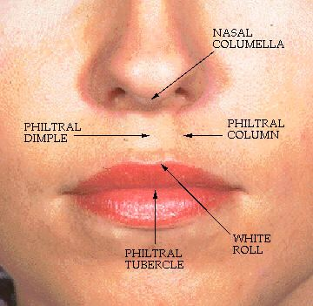
Philtrum & Columella Homo erectus was prognathic Pro-gnathism + nose was bigger + water pressure : did the upper lip ‘automatically’ close the nostrils when diving?

Slide 23
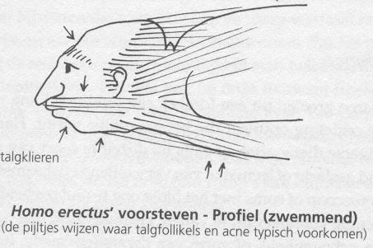
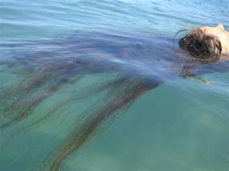
Female head hairs grow longer, and are less rich in sebum, hence float better, cf. Elaine Morgan’s idea on floating babies grasping mother’s hairs?
Dermatology:
Head Hair distribution in men (DHT)
- scalp hairs grow shorter than in women,
- beard & moustache,
- localization of sebaceous glands (acnea),
- baldness & longer brows in older men
= perfect streamlining.
Back-floating is also seen
in polar bear, sea-otter ...

Slide 24
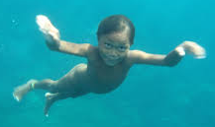
Bajau & Moken kids with Great Underwater Vision
https://theaquaticape.org/2012/01/11/bajau-kids-with-great-underwater-vision/
http://aquatic-human-ancestor.org/books.html

Slide 25
Littoral Dispersal of archaic Homo is confirmed by
anatomy, e.g.
- Brain larger : very frequent in aquatic mammals: DHA…?
- Lungs very large : typical of littoral animals.
- POS : thick, dense & ?brittle bones in H.erectus : pachy-osteo-sclerosis is only seen in slow+shallow divers.
paleo-environment, e.g.
- AFAWK all archaic sites had large bodies of water + shellfish (e.g. Munro 2010).
- All “butchery” sites are waterside : bones & stones leave more archeological traces >> plants, wood, fish …
- Mojokerto child (Java ?1.8 Ma) was found with shellfish & barnacles = river-delta.
- Paleolithic whale butchering (Angola ?>1 Ma) at Dungo V, Baia Farta, Benguela.
- Shell engravings Eugène Dubois collection (Joordens cs 2015) Etc.
Refs Google, see last pages

Slide 26
Did Neandertals hunt ???
Poor olfaction : even scavenging ??
Cattails, waterlily, shellfish, salmon...
Skeleton brittle? : no rodeo cowboy !!
Heavy & broad build : slow
Big projecting nose (also vulnerable)
C & N isotopes : fresh > salt water foods
Only 1 case of hunting is likely : lake-side
Gaudzinski-Windheuser 2018 Nature Ecol Evol 2:1087

Slide 27
Neandertal Lifestyle
pachy-osteo-sclerosis < H.erectus POS, large lungs, big projecting nose : part-time diving,
ear exostoses, small gut & large brain (DHA) : not “meat”, but diet with shallow-aquatic foods,
C & N isotopes : no “super-carnivores”, no “top predators” but diet between fresh & salt water,
coprostanol & 5β-stigmastanol in coprolites (El Salt), e.g. shellfish & plants (Atlantic < Mediterranean?).
etc.
All evidence suggests : European Neandertals were diving + wading wetland omnivores, who seasonally followed the river to the coast (Atlantic, e.g. La Cotte, Jersey, or N-Mediterranean coasts).
(With soft foot-soles, they might have preferred sandy rather than rocky substrates?)

Slide 28
δ¹⁵N
18
16
14
12
10
8
6
4
2
0
marine
mammals
fish piscivore
consumers fish
fresh-water marine
piscivore Homo sapiens fish
fish H. neanderthalensis
= “super??carnivores”
fish
carni-
shellfish
omni-
terrestrial
herbi-
vores
between
fresh-water ---------------------------- coast
MP Richards 2007 pp.223-234 in Diet shift at the Middle/Upper Palaeolithic transition in Europe?
The stable isotope evidence W Roebroeks ed. Guts and Brains Leiden UP Fig.1 & 2
Same results in e.g.
C Wißing cs 2016 Quat Internat 411:327-345
Isotopic evidence for dietary ecology of late Neandertals in NW-Europe
C Wißing cs 2019 Scient Reports 9:4433
-24 -22 -20 -18 -16 -14 -12 -10 δ¹³C

Slide 29
MP Richards 2007: C & N suggest that H. neanderthalensis & H. sapiens were “super-carnivores” (but you can’t be more carnivorous than felids !!): instead, their diets were intermediate between fresh-water & marine, but nearer to fresh-water, neanderthal. more so than sapiens, in agreement with fossil & archeological evidence. K Jaouen, M Richards cs 2019: Exceptionally high δ15N values in collagen single amino acids confirm Neandertals as high-trophic level carnivores ?? :-DD the same results, but they still didn’t consider the IMO obvious solution: seasonal travel between river & coast, e.g. salmon trek? or trade?? Small Gut + Large Brain = Sea-Food

Slide 30
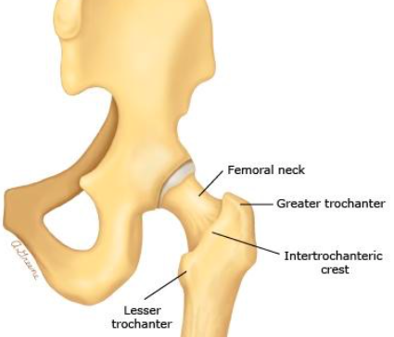
From diving erectus to wading sapiens = from early- to late-Pleistocene ?
LEGS - we have
longer legs, esp. tibias
less valgus knees
narrower pelvis (less flaring ilia)
shorter, less horizontal femoral neck
smaller lungs
SKULL - we have
basi-cranial flexion (directing eyes looking ventrally)
foramen magnum more inferiorly
flat face (vs. mid-facial prognathism)
larger chin, smaller nose
no supra-orbital torus + high skull (vs. platy-cephaly)
brain more above (rather than behind) the eyes

Slide 32
Conclusions
The endurance-running ideas are bogus.
H.erectus regularly dived in sea-water (POS),
likely mostly for shellfish (DHA, stone tools),
in a diving-cycle of ~90 seconds (Cheyne-S)?
opening shells sea-otter-wise back-floating?
H.neand. seasonally followed rivers inland?
H.sapiens wade $→$ walk?

Slide 33
Waterside Hypotheses
As compared to other hominids (bonobo & common chimp, low- & high-land gorilla), humans show more characteristics typical of (semi)aquatic mammals: fur loss, more subcutaneous fat, more linear build, projecting nose, poor olfaction, voluntary breathing etc. This led many students to suggest waterside hypotheses: Giuseppe Sera, Max Westenhöfer, Alister Hardy, Elaine Morgan, Stephen Cunnane, Michael Crawford, Renato & Nicole Bender, Marc Verhaegen, Stephen Munro, Algis Kuliukas, Phillip Tobias, Brunetto Chiarelli, David Attenborough, Mario Vaneechoutte, Pierre-François Puech, Marcel Williams, Erika Schagatay, Josephine Joordens, Peter Rhys-Evans, Francesca Mansfield etc.

Slide 34
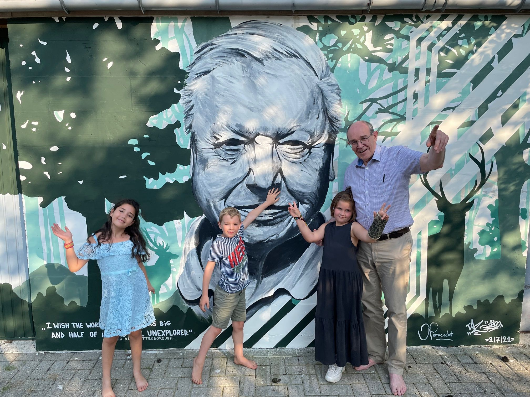
Thanks, Algis !
google
Jan Poncelet
Putte

Slide 35
Remaining Questions
Pleistocene archaic Homo = diving,
esp. during Ice Ages? cold water = shellfish? sea-level?
sexual differences in diving? beard… monogamy?? …
Pliocene Homo in Gulf – Red Sea? diving?? Danakil??
Homo/Pan split ~5 Ma Red Sea? $→$Francesca Mansfield
Miocene hominids Oreopithecus & Trachilos in Mediterr.Sea
hominid/pongid split ~15 Ma Mesopotam.Seaway Closure?
early Hominoidea in Tethys Ocean coastal forests = Lati-sternalia: broad thorax (lungs) & pelvis (lateral limbs) + central spine = vertical $→$aquarboreal + tail-loss, flat feet?, large size = also diving?? ape/OWMonkey split ~29 Ma? glaciations?

Slide 36
Stone Tool making $→$ Fire making $→$ Re-colonization of the Land ??
Sir Alister Hardy 1960 New Scient.7:642–5 Was Man more aquatic in the past?
"... Man learnt his tool-making on the shore ... Californian sea-otter … dives to the bottom, brings up a large sea-urchin in one hand … a stone in the other … it floats on its back, breaks the sea-urchin against its chest with the stone ...
it was but a step to split flints into more efficient tools ... learnt how to strike together flints to make fires, perhaps with dried sea-weed, on the sea-shore ..."

Slide 37
Butchering Sites
Waterside access to carcasses = less competition with vultures & hyenas?
Bones & stones are over-represented archeologically. ⬅➔ Wood, plant & fish remains rarely preserve.
Stone tools were not for hunting originally: sea-otters, chimps, capuchins open hard-shelled foods with stones : palm-nuts, shell-, crayfish…
Chimps & bonobos hunt on 4 legs, without stone tools.
Poor olfaction ⬅➔ All hunting, scavenging animals have keen olfaction.
All sites of archaic Homo are waterside : coasts, deltas, river valleys etc.
Fossilization of coastal sites is poor, hindered by waves, tides, tsunamis, tectonics, ice ages : sea-levels were ~100 m lower than today.
Paleolithic whale butchering + mollusc shells & Acheulian tools > 1 Ma.
Hunting? In shallow water? reed? mud? late-Pleistocene?
Scavenging? Occasionally? Less important than plants, littoral foods etc.?

Slide 38
Beneath Still Waters - Multistage Aquatic Exploitation of Euryale ferox during the Acheulian Naama Goren-Inbar cs 2014 Internet Archaeol 37 doi 10.11141/ia.37.1
… early Mid-Pleistocene hominins implemented multi-stage procedures: underwater gathering & subsequent processing (drying, roasting & popping) of E.ferox nuts.
Pleistocene footprints show intensive use of lake margin habitats by Homo erectus groups Neil Roach cs 2016 Sci Rep 6:26374
... The geology & associated vertebrate fauna place these tracks in a deltaic setting, near a lake-shore bordered by open grasslands. Hominin footprints are disproportionately abundant in this lake margin environment, relative to hominin skeletal fossil frequency in the same deposits ... Such reliance on near-water environments & possibly aquatic-linked foods may have influenced hominin foraging behavior & migratory routes across & out of Africa.
Human exploitation of a large stranded whale in the Lower Palaeolithic site of Dungo V at Baia Farta Manuel Gutierrez cs 2001 CR Acad Sci 332:357-362
The almost complete skeleton of a large whale was found closely associated with 57 Lower Palaeolithic artefacts, at an altitude of 65 m, 3 km from the present shoreline. … (2010) burying age of 1 to 2 Ma for some artefacts of Dungo IV …
Homo erectus at Trinil on Java used shells for tool production and engraving José Joordens ... Stephen Munro cs 2015 Nature 518:228-231
... evidence for freshwater shellfish consumption ... minimum age of 0.43 ± 0.05 Ma ...
Were bears or lions involved in salmon accumulation in the Middle Palaeolithic of the Caucasus? An isotopic investigation in Kudaro 3 cave
... Middle Palaeolithic Hominins, probably Neandertals, were able to consume fish when it was available. Hervé Bocherens cs 2014 Quat Internat 339-340:112-8
The archaeology of persistent places: the Palaeolithic case of La Cotte de St Brelade, Jersey Andrew Shaw cs 2016 Antiquity 90:1437-53
… mid-Pleistocene … throughout temperate, cooling & cool conditions … from at least 240 until after 40 ka … the temperate climate occupation recorded in Layer E reflects repeated short-term occupations … the people who discarded the material present in Layer 5 stayed for longer within this area … the transported & re-sharpened toolkits of the final Layer A occupation & the curated flint tools from Layer 5 attest to extended journeys, some >20 km.
Plant foods and the dietary ecology of Neanderthals and early modern humans Amanda Henry cs 2014 J hum Evol 69:44-54
The calculi from Spy … 1/3 of the starches ... is from a USO of the Nympheae waterlily family.
Neanderthal exploitation of marine mammals in Gibraltar Chris Stringer cs 2008 PNAS 105:14319-24
… Vanguard Cave provides evidence of marine food supply: mollusks, seal, dolphin, fish … suggests that such use of marine resources was not a rare behavior, and represents focused visits to the coast & estuaries.
Afterthoughts about the Neanderthal insulation hypothesis Duncan Caldwell 2008 AURA Newsletter 25:17-22
… starchy USOs are at their maximum energy storage in late fall/winter throughout the Neandertal range, even during the coldest periods Mid-Paleolithic ... starchy material occurs on the working area of tools at both sides ... food residue ... Lanceolate bifaces in the Yonne, concentrated around clay bogs, often bear so much soil sheen from digging in silica-rich soils ... used as trowels for digging up & processing cattail Typha latifolia rhizomes.
Robert Walter cs 2000 Nature 405:65-69 etc.etc.etc.

Slide 39
Pleistocene Homo : shallow-water foods : Java, Israel, S-Africa etc.
Homo erectus at Trinil on Java used shells for tool production and engraving
José Joordens … Stephen Munro … 2015 Nature 518:228-231
Beneath Still Waters – Multi-stage aquatic exploitation of Euryale ferox (Salisb.) during the Acheulian
N. Goren-Inbar cs 2014 Internet Archaeol.37 doi 10.11141/ia.37.1
On the origins and significance of Pleistocene coastal resource use in southern Africa with particular reference to shellfish gathering
Antonieta Jerardino 2016 J.anthropol.Archeol.41:213-230
etc. etc. etc.

Slide 40
Corrections of so-called “savanna” habitats, e.g.
Revised stratigraphy of Area 123, Koobi Fora, Kenya, and new age estimates of its fossil mammals, including hominins
PN Gathogo & FH Brown 2006 J.hum.Evol.51:471-9
… all hominins … from Paleontol.Coll.Area 123 derive from levels between the KBS Tuff (1.87 Ma) & the Lower Ileret Tuff (1.53 Ma) :
53 m of section below the Lower Ileret Tuff, an interval in which beds vary markedly laterally, esp. those units containing molluscs & algal stromatolites.

Slide 41
Beneath Still Waters - Multistage Aquatic Exploitation of Euryale ferox during the Acheulian Naama Goren-Inbar cs 2014 Internet Archaeol 37 doi 10.11141/ia.37.1
… early Mid-Pleistocene hominins implemented multi-stage procedures: underwater gathering & subsequent processing (drying, roasting & popping) of E.ferox nuts.
Pleistocene footprints show intensive use of lake margin habitats by Homo erectus groups Neil Roach cs 2016 Sci Rep 6:26374
... The geology & associated vertebrate fauna place these tracks in a deltaic setting, near a lake-shore bordered by open grasslands. Hominin footprints are disproportionately abundant in this lake margin environment, relative to hominin skeletal fossil frequency in the same deposits ... Such reliance on near-water environments & possibly aquatic-linked foods may have influenced hominin foraging behavior & migratory routes across & out of Africa.
Human exploitation of a large stranded whale in the Lower Palaeolithic site of Dungo V at Baia Farta Manuel Gutierrez cs 2001 CR Acad Sci 332:357-362
The almost complete skeleton of a large whale was found closely associated with 57 Lower Palaeolithic artefacts, at an altitude of 65 m, 3 km from the present shoreline. … (2010) burying age of 1 to 2 Ma for some artefacts of Dungo IV …
Homo erectus at Trinil on Java used shells for tool production and engraving José Joordens ... Stephen Munro cs 2015 Nature 518:228-231
... evidence for freshwater shellfish consumption ... minimum age of 0.43 ± 0.05 Ma ...
Were bears or lions involved in salmon accumulation in the Middle Palaeolithic of the Caucasus? An isotopic investigation in Kudaro 3 cave
... Middle Palaeolithic Hominins, probably Neandertals, were able to consume fish when it was available. Hervé Bocherens cs 2014 Quat Internat 339-340:112-8
The archaeology of persistent places: the Palaeolithic case of La Cotte de St Brelade, Jersey Andrew Shaw cs 2016 Antiquity 90:1437-53
… mid-Pleistocene … throughout temperate, cooling & cool conditions … from at least 240 until after 40 ka … the temperate climate occupation recorded in Layer E reflects repeated short-term occupations … the people who discarded the material present in Layer 5 stayed for longer within this area … the transported & re-sharpened toolkits of the final Layer A occupation & the curated flint tools from Layer 5 attest to extended journeys, some >20 km.
Plant foods and the dietary ecology of Neanderthals and early modern humans Amanda Henry cs 2014 J hum Evol 69:44-54
The calculi from Spy … 1/3 of the starches ... is from a USO of the Nympheae waterlily family.
Neanderthal exploitation of marine mammals in Gibraltar Chris Stringer cs 2008 PNAS 105:14319-24
… Vanguard Cave provides evidence of marine food supply: mollusks, seal, dolphin, fish … suggests that such use of marine resources was not a rare behavior, and represents focused visits to the coast & estuaries.
Afterthoughts about the Neanderthal insulation hypothesis Duncan Caldwell 2008 AURA Newsletter 25:17-22
… starchy USOs are at their maximum energy storage in late fall/winter throughout the Neandertal range, even during the coldest periods Mid-Paleolithic ... starchy material occurs on the working area of tools at both sides ... food residue ... Lanceolate bifaces in the Yonne, concentrated around clay bogs, often bear so much soil sheen from digging in silica-rich soils ... used as trowels for digging up & processing cattail Typha latifolia rhizomes.
Robert Walter cs 2000 Nature 405:65-69 etc.etc.etc.

Slide 42
Alister Hardy 1960 Was Man more aquatic in the past ? NS 7: 642–5
Elaine Morgan 1982 The Aquatic Ape Souvenir
Marc Verhaegen 1997 In den Beginne was het Water Hadewijch
Peter Rhys Evans 2020 The Waterside Ape CRC Press
Stephen Munro 2010
Molluscs as Ecological Indicators in PA Contexts thesis Austr Natl Univ
Stephan Cunnane & Kathy Stewart eds 2010
Human Brain Evolution : Freshwater and Marine Food Resources John Wiley NJ
Mario Vaneechoutte cs eds 2011
Was Man More Aquatic in the Past ? Fifty Years after Alister Hardy Bentham Sci Publ eBook
Peter Rhys Evans cs eds 2013 + 2014
Human Evolution conference London 8–10 May 2013 proceedings Hum Evol vol 28 + 29
Marc Verhaegen 1987 Origin of human bipedalism Nature 325 : 305–306
2002 Oi, big nose! New Scient 2782 : 69
M Verhaegen, S Munro & P-F Puech 2002 Aquarboreal Ancestors? Trends Ecol Evol 17 : 201–217
Google
Attenborough Schagatay Brenna reply
original econiche Homo
Australopiths = African ape ancestors 2017
not Homo but Pan naledi 2017 Verhaegen PPT
unproven assumptions so-called aquatic ape hypothesis
Lucy was no human ancestor 2020 Verhaegen
aquarboreal

Slide 43
Parallel Evolution // schematic Australopiths : relatives of African Apes ?
australopiths | East Africa | South Africa
gracile Pliocene “Australopithecus” | afarensis | africanus
robust Pleistocene “Paranthropus” | boisei | robustus
fossil subgenus | Prae-anthropus | Australo-pithecus
genus ? | Gorilla | Pan
M.Verhaegen 1994 Hum.Evol.9:121-139 Australopithecines: Ancestors of the African Apes?
1996 Hum.Evol.11:35-41 Morphological distance between australopithecine, human and ape skulls
Human-like australopith traits (orthogrady, low ilia, thick enamel ... ) are not human-derived, but hominid-primitive,
e.g. all hominoids have centrally-placed spines : they had more vertical ancestors, i.e. without knuckle-walking.
East-African australopiths are generally more gorilla-like. South-African australopiths are more bonobo-/chimp-like.

