Slide 1
Welcome to WHAT Talks
WHAT Talks? Humans, right? But why are we so different from the chimps and gorillas? Time to consider Waterside Hypotheses of Human Evolution
Notes:
Hello. I’m Algis Kuliukas and I’m here to introduce a series of monthly discussions, called WHAT talks. Like TED Talks, they’re ideas worth spreading but only on evolution, and specifically, waterside hypotheses of human evolution.
If that sounds like mumbo jumbo, hang on. All will be explained in the next twenty minutes or so.
Now it’s no coincidence that they start today, on 7th November, as this the birthday of a brilliant woman who is the inspiration behind all of this… Elaine Morgan.
Elaine was a pioneer of television playwriting, winning several BAFTAs and the like. She wrote for hundreds of TV dramas including How Green Was My Valley and The Onedin Line and many docu-dramas about famous scientists such as Russel Wallace, Gregor Mendel and Madame Curie. She was also a pioneer of the second wave of feminism.
But most importantly, from my perspective, she almost single-handedly championed a controversial idea about human evolution that, I believe, may turn out to be the most brilliant idea pertaining to human evolution since Darwin. Don’t scoff. She was made a Fellow of the Linnean Society, following in the footsteps of Darwin and Wallace.
If you stay patient and keep your mind open, you never know, you might come to agree with me over the following minutes or months.

Slide 2
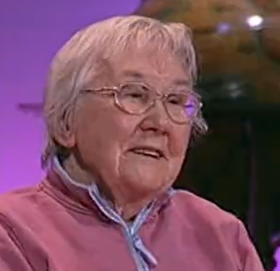
I want to start where Elaine Morgan left off.
Notes:
My dream is to finish what Elaine started… to try to take this idea out of the rubbish bin of pseudoscience and bring it into the mainstream.
But tonight, I’m going to start where she finished… with the last three minutes of her last public talk. Elaine’s TED talk in Oxford in 2009. This, note, was at the age of 89.
She’s waxing lyrical about her 41 years effort to get anthropology to see the sense of her ideas. She’s just told the audience about her ideas and is reflecting about why the “aquatic ape theory” hasn’t been accepted yet and what might happen in the future.
They’ll keep ignoring it.
Some genius will come along and show it wasn’t the savannah, it wasn’t water, it was THIS!
A coming together – a new synthesis

Slide 3
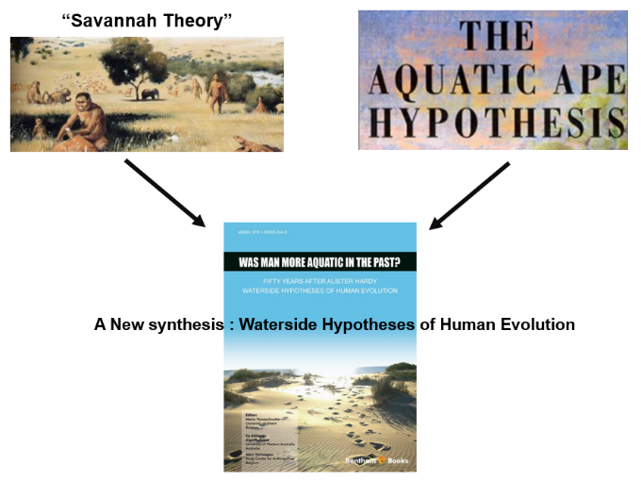
“A Very Beautiful Thing”
Notes:
Right! I’ll go along with that too.
And so I hope you will. See, that? A beautiful thing. I think so too.
But, unlike Elaine I don’t see it as a hybridisation of the ideas of Darwin and Hardy, but between the savannah and aquatic ideas… into waterside.
See, right from the beginning I’ve thought that the term “aquatic ape” was problematic. ‘Aquatic’ mammals are most often thought of as whales, dolphins and the like. It seems to have set off all sorts of bizarre triggers in the minds of mainstream anthropologists making it a taboo.

Slide 4
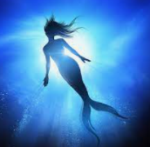
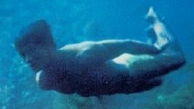
Please, forget mermaids!
Mermaids?
The Man from Atlantis?
x
x
Notes:
Notions of mermaids and the man from Atlantis seem to have come to mind.
Please let’s dispel those notions forever.
No need for mermaids here.

Slide 5
Waterside Hypotheses of Human Evolution
Even very slight
“Waterside hypotheses of human evolution assert that selection from wading, swimming and diving and procurement of food from aquatic habitats have significantly affected the evolution of the lineage leading to Homo sapiens as
distinct from that leading to Pan.”
Kuliukas AV, Morgan E, (2011 p 259). Aquatic scenarios in the thinking on human evolution: What are they and how do they compare? In: Vaneechoutte M, Verhaegen M, Kuliukas AV, (eds.), (2011). Was Man More Aquatic In The Past? Fifty Years After Alister Hardy: Waterside Hypotheses Of Human Evolution. Bentham (Basel)
Notes:
“Aquatic Ape” proponents are like a herd of cats and can’t agree to very much at all, so I tried to come up with an umbrella term that would include every possible specific idea they might have.
‘Waterside’ sets the right tone for me. It does not suggest living in the water, but by it, on land. At the same time it does not set any limits on how much wading, swimming or diving our ancestors could have done, or specify where.
I am proud that I persuaded Elaine to co-author a chapter in the 2011 book on this where we came up with this new (plural) label definition. The key point is that the degree of selection need not have been very much.
Again… forget mermaids.

Slide 6
Waterside Hypotheses Aquatic Theory ?
Pick your own acronym…
Notes:
So, we’ve of TED Talks. So I wondered if we might use a silver lining from these dark clouds of COVID and find a way to hear the case put for the ideas Elaine works so hard for so long to promote.
Free. Virtual. Public. Global. Talks and Discussions. Waterside Hypotheses most certainly do not belong with the UFOs and the Yettis, and although it’s not easy to change the minds of academics and their journals won’t touch it with a barge pole. We have to have faith in the scientific method and believe that the truth will come out sooner or later.
So Waterside Hypotheses provide the first two letters of the acronym WHAT. What about AT? Aquatic Theory? Well take your pick. I wanted to make the acronym open and inclusive, like ‘waterside’ itself.

Slide 7
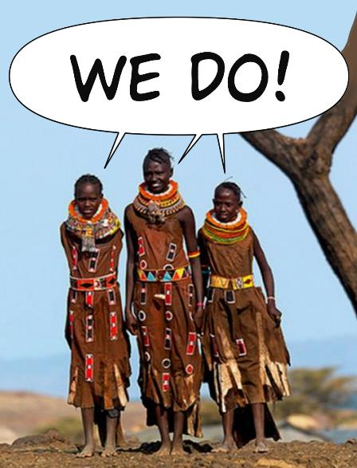
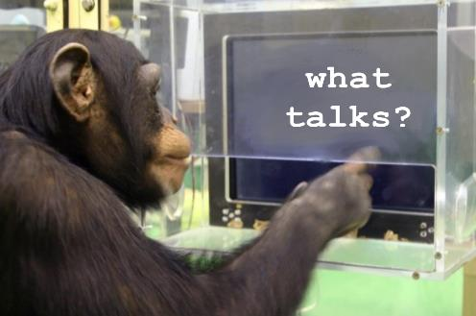
Notes:
The other way of thinking of the series and website name is to ask it as a question…. What Talks?
The answer, is not chimpanzees. Humans are the only species that actually can talk.
The questions we should immediately be thinking is “Why?” “How?” and “When?””
These are the thought being this initiative. I’m going to start the ball rolling tonight – Elaine’s 101st birthday. On the 2nd/3rd Sunday every month, someone else will present a 20 minute talk to anyone interested in why we are so different from the chimpanzees followed by half an hour or so of open discussion.

Slide 8
How would Elaine approach this?
She always started her books on the “aquatic ape” in the same way…
Notes:
Elaine had a simple, consistent way of starting her books on this topic.
And I will follow her lead here.

Slide 9
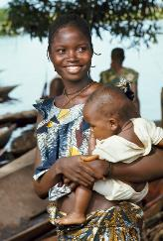
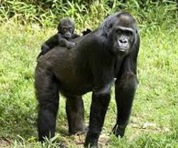
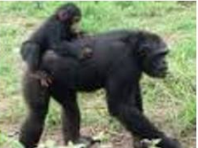
She always posed the key question
So what, exactly, happened here?
More closely related
Gorilla
Chimpanzee
Human
Notes:
Everyone knows that we are genetically close to chimpanzees. What is it? 98.5% in common, right? Well an even more fascinating and important fact is that they share LESS DNA with gorillas than they do with us, and a LOT less than with orang utans.
So, if we’re so close to them genetically, how come we’re the odd man out?
No one questions this. As Elaine put it so eloquently in her Scars of Evolution book, no-one wonders why these traits were not shared out more evenly, such as a bipedal gorilla, a large brained orang utan and a naked chimpanzee. We have all the unique traits, they have none.
So what are the traits?

Slide 10
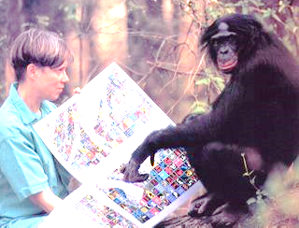
Ape-Human Physical Differences: What are they?
“Language”
speech
I have
a remarkable talent for understanding complex symbols but I have a real difficulty expressing myself vocally. I think it might be to do with my poor voluntary breath control.
http://newfoundlandnews.blogspot.com/2006/07/tom.html
10
Notes:
As I talk to you now, my nervous system is acting like the conductor of a very sophisticated orchestra, controlling the many muscles of my mouth, lips, tongue, vocal cords diaphragm, ribs etc to make the sounds I hope you can understand.
The chimpanzee lacks a key component of that control, particularly in the area of fine voluntary breath control.
They’re literally dumb, not metaphorically. They’re very capable of communicating, and quickly, using very complex symbolic language. But no chimpanzee or bonobo has been taught to utter even a few words.
Here, Sue Savage-Rumbaugh is communicating with the famous Kazi, a 41 year old bonobo.
10

Slide 11
Walking with a striding gait.
Image from : Inman, Verne Thomson; Ralston, Henry J; Todd, Frank N (1981). Human Walking.
11
Notes:
I’ll talk more about bipedalism later.
11

Slide 12
Ape-Human Physical Differences: What are they?
speech
12
Notes:
12

Slide 13
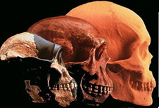
Bigger Brains, Smaller Teeth
Relative brain size increase.
Relative dental /masticatory reduction.
Requires high energy foods – meat?
Implies less tough foods... cooking meat?
Notes:
We have brains 3x bigger than chimps but teeth and masticatory power that is greatly reduced.
The dilemma is almost certainly accounted for, to some extent, by cooking but this process was going on long before there was any evidence of controlled fire use.
Migration to the coast, where a three year old could be taught to take a pebble to crack open a shellfish and help themselves to a very brain nutrient rich morsel of food without the need of any chewing makes perfect sense too.

Slide 14
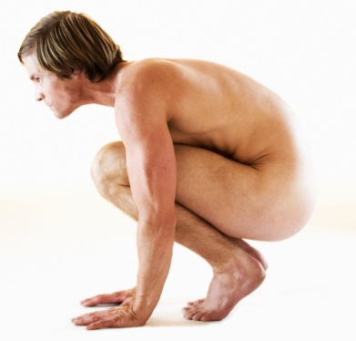
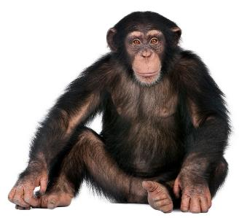
Body Hair Pattern
Notes:
The human body hair pattern is another peculiarity which caused Desmond Morris to write his famous book the Naked Ape.
I think the pattern is exactly as one would expect to reduce the drag in a hominin that regularly swam in coastal shallows.

Slide 15
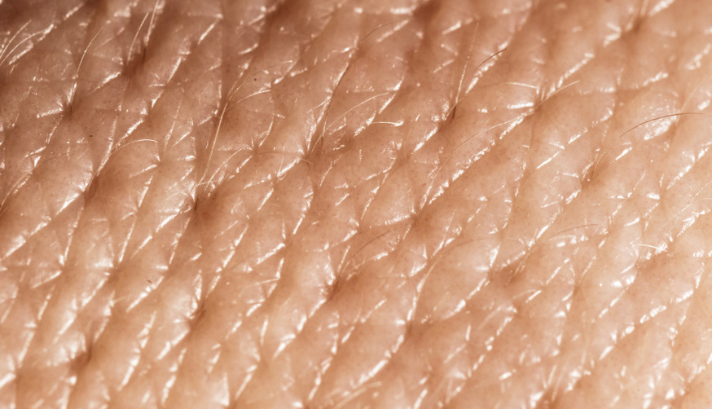
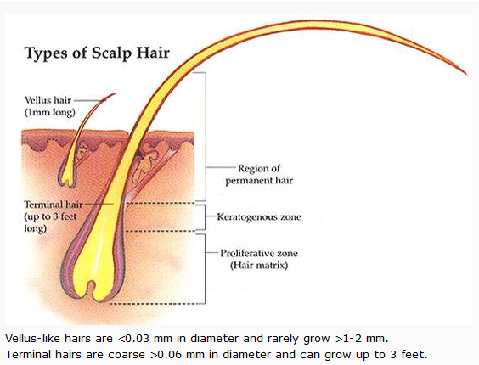
Body Hair Pattern
Notes:
Of course we do have as many hair follicles as chimpanzees, but there is a big difference is the nature of the hair itself.
Vellus hairs are tiny. Some don’t even reach the surface. They appear vestigial, as if they no longer are functional as are terminal hairs.

Slide 16
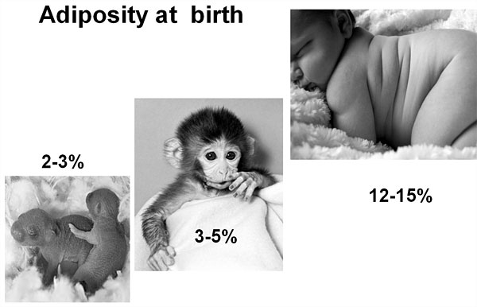
Infant Adipocity
“Fat Tissue: The Good, the Bad, and the Ugly” 2011
http://www.nyas.org/Publications/Ebriefings/Detail.aspx?cid=cf77a0f1-f9f9-4268-a8db-85c8e45b8720
Notes:
Another aspect of our skin that is unique among the primates is our subcutaneous fat layer.
This was the phenomenon that first triggered Alister Hardy to take an interest in these ideas.
It make be argued that adult humans might be fat simply due to a high energy diet but this cannot be said of infants which are born with 5x as much fat as chimpanzees or other primates.
Having a fat baby makes no sense walking over the savannah or climbing trees but it does make sense by the water’s edge where it might help a baby to float and therefore avoid a near-drowning experience.

Slide 17
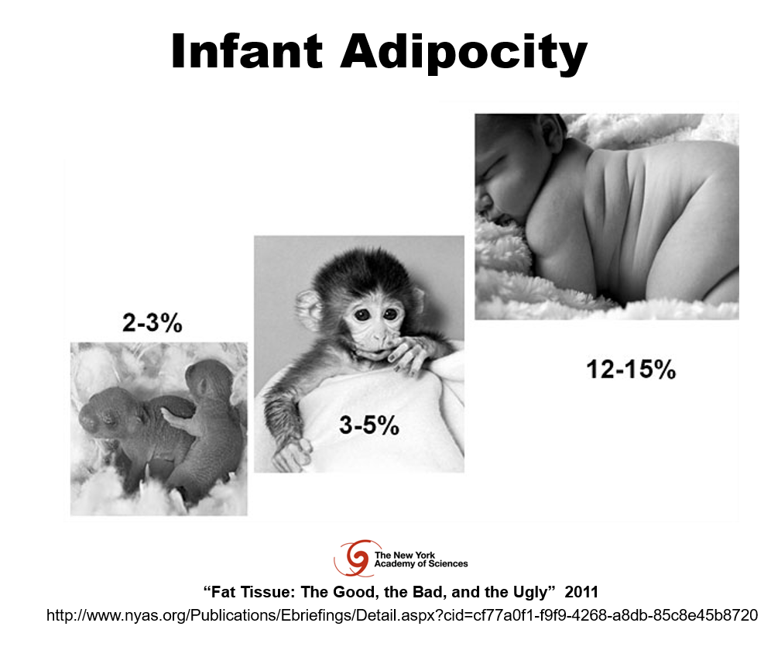
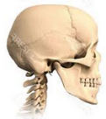
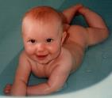
Ape-Human Physical Differences: What are they?
speech
17
Notes:
17

Slide 18
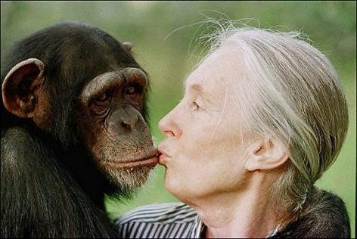
Differences in the Respiratory System
Bigger nose with inferiorly oriented nostrils.
But reduced olfaction.
Notes:
There are also strange differences in our respiratory apparatus.
We ha a hood-like nose with inferiorly orientated nostril, as if to deflect water from entering the nostrils whilst swimming.

Slide 19
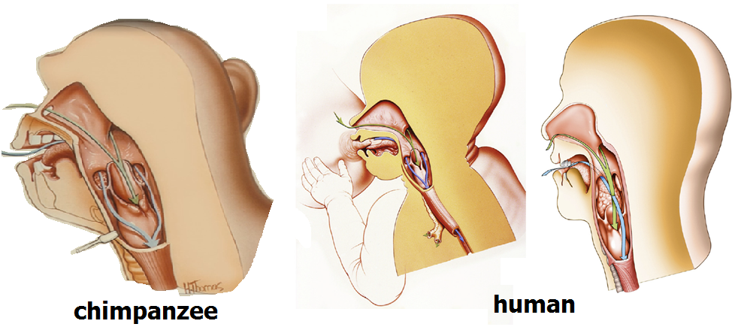
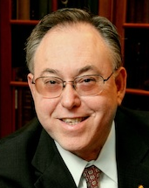
Descended Larynx
“For the first time in evolution, always, always, always the airway and the food-way must cross in the supra-laryngeal space…” Jeff Laitman. “Human Evolution Past, Present & Future” Symposium, London 8-9 May 2013.
Laitman J, Reidenberg J, The Evolution and Development of Human Swallowing: The Most Important Function We Least Appreciate. Otolaryngologic Clinics of North America 46:923-935, (2013).
Notes:
Then there is the bizarre phenomenon of the descended larynx.
When you were a baby, you could suckle your mother’s nipple and drink her milk whilst breathing through you nose at the same time. Adult chimps, and almost all other mammals can too.
But after a few months, the larynx start to descend lower such that every time you swallow you risk choking to death. If it wasn’t for the epiglottis and a very powerful reflex many people would die this way. So, if this is the price we pay, what is the benefit? The idea that it helps us produce a broader range of sounds never satisfied me. Talking “like an aussie” with a high-pitched nasal twang might not be very pleasant but It hardly seems worth this potentially lethal trait.
Whilst swimming, though, it makes perfect sense. With a descended larynx it is no longer a problem if water entered the nostrils. The trachea can be blocked automatically.

Slide 20
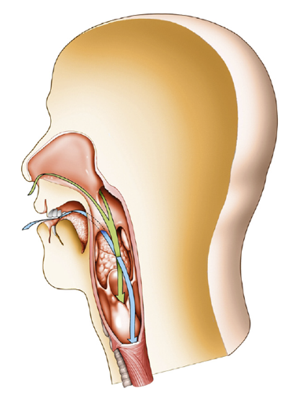
Ape-Human Physical Differences: What are they?
speech
20
Notes:
20

Slide 21
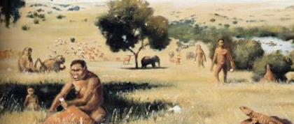
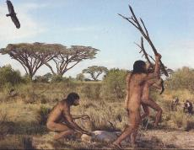
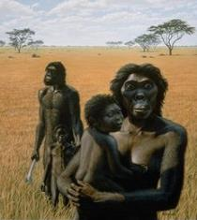
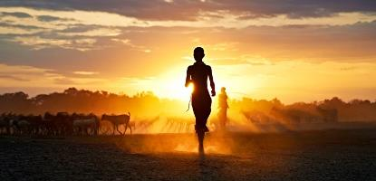
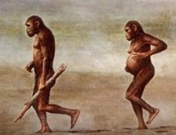
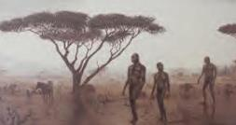
Models of Human Evolution
“Savannah Theory”
Notes:
Traditionally, for generations, the most accepted model to explain the human condition can be labelled the “savannah theory”.
Some have tried to suggest that this term was an invention by Elaine Morgan as a kind of “straw man” to knock down. But as she so eloquently stated, although it’s true no-one ever coined the term before she did, the same is true of the “God theory”. People’s belief in that, similarly, was so strong it didn’t need a label.
As someone who returned to academia 25 years ago, I can confirm that it is still taught as strongly today as ever.

Slide 22
Savannah
speech
Hunting collaboration
Upright Efficiency for long-distance foraging and Endurance Running
Eating Meat, cutting with stone tools
Sweat Cooling Keeping warm at night
Humidification. Larynx for speech
22
Notes:
These are typical savannah-based explanations for the 5 major ape-human differences.
22

Slide 23
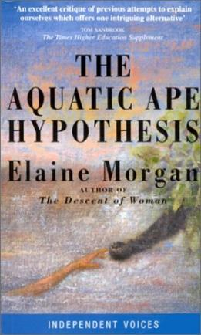
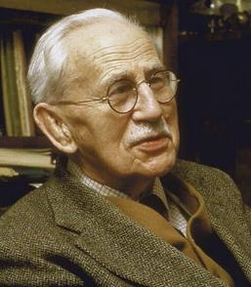
Models of Human Evolution
“Aquatic Ape Theory”
Elaine Morgan
Sir Alister Hardy FSR
Notes:
The first serious alternative to the idea was first proposed by Max Westenhöfer in 1942 and, independently, by Sir Alister Hardy and 1960.
But the person that championed the idea most, almost single-handedly for 41 years, was Elaine Morgan.

Slide 24
Savannah
“Aquatic”
speech
Voluntary Breath Control
Hunting collaboration
Upright Efficiency for long-distance foraging and Endurance Running
Wading
Eating Meat, cutting with stone tools
Marine Food Chain Iodine / DHA
Drag Reduction, Buoyancy & Thermoregulation in water
Sweat Cooling Keeping warm at night
Humidification. Larynx for speech
Nasal “Hood” & Tracheal “Shutter” for Swimming
24
Notes:
Here are a summary of ‘more aquatic’ explanations.
I think they’re at least as good, if not better, and more parsimonious as long as you allow that heretical thought in you head that our ancestors waded, swam and dived a little more than those of chimps did.
24

Slide 25
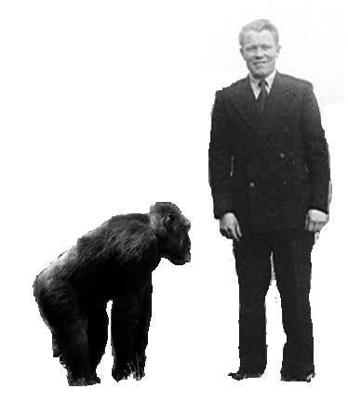
I chose bipedalism. It was the most obvious one for me.
Bipedalism
(exhibited by my dad)
Notes:
Of all these human traits, I chose bipedalism, perhaps subconsciously because my father lost his when I was three. He spent the last 37 years of his life in a wheelchair.

Slide 26
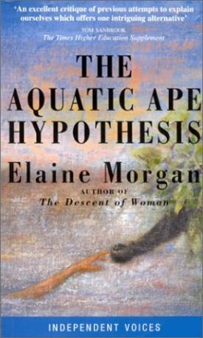
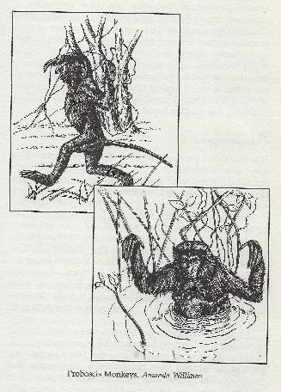
“The Aquatic Ape Hypothesis” Elaine Morgan 1997
Four Chapters on Bipedalism.
But the best evidence she could cite were third-hand stories of proboscis monkeys wading bipedally through swamps in Borneo.
Notes:
Now I want to emphasise this point.
When I was getting into all this I had just read Elaine Morgan’s 1997 book ‘The Aquatic Ape Hypothesis’.
It has four chapters on bipedalism and Elaine makes a brilliant case for the wading hypothesis.
But at the time, the best evidence she could come up with was third-hand, anecdotal stories about proboscis monkeys in Borneo which were apparently often seen wading through swamps.
I remember seeing these drawings and thinking there must be better evidence than this in great apes.
Of course, in the twenty years since, this evidence has flowed copiously.

Slide 27
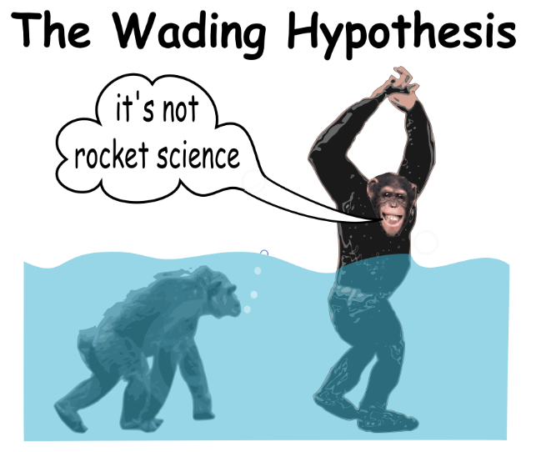
It was the Biggest Elephant in the Room
Notes:
So, for me, this was the biggest of several elephants in the room.

Slide 28
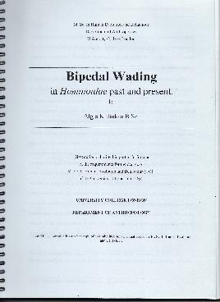
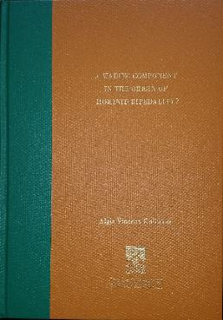
MSc: Bipedal Wading in Hominoidae Past and Present (2000).
PhD: A Wading Component in the Origin of Hominid Bipedality? (2016).
Notes:
I had to return to academia to find out what the problem was with this idea.
I remember my first day at University college London where we had a kind of welcoming party for the students. I spent almost all of it talking to Professor Leslie Aiello. I asked her straight to her face what was wrong with Elaine Morgan’s idea and it was clear she didn’t have a good answer. She pointed my to John Langdon’s “Parsimony” paper published a couple of years before not knowing that I’d already read and written a counter-critique. Next, astonishingly, she pointed me to an amateur web site (www.aquaticape.org) by a guy called Jim Moore which is really nothing more than an attempted character assassination of Elaine Morgan.

Slide 29
Literature Review:
42 bipedal origins models in 8 categories...
Forelimb pre-emption (Carrying) |  | Infant carriage, food carriage, Tool carriage, Tool/weapon throwing.
Social Behaviour |  | Threat display, Aggression, Evasion, Vigilance, Sexual Display, Nuptial gifts, ‘fashion.’
Feeding |  | Postural (Arboreal) Feeding, Terrestrial Gathering, Arboreal Predation, Terrestrial Predation, Terrestrial Scavenging.
Efficiency of Locomotion |  | Slow, long-distance walking, Endurance Running or Biomechanical inevitability.
Selection for better thermoregulation |  | Savannah sweat cooling.
Habitat Compulsion |  | Walking on snow or mud, “hand-hand” bipedalism or… wading.
Dietary factors |  | Iodine deficiency and/or overly rich Calcium diet.
Combination of factors |  | Combination of factors.
?
?
Notes:
My PhD is about the aquatic ape theory – at least part of it – the idea that wading through shallow water was a key factor in our bipedality. When you do a PhD you’re supposed to do a lit. review and my first draft was massive – 150,000 words. You should have seen Nick Milne’s face. It’s a huge subject and I wanted to tackle it in a new way… by trying to evaluate and compare some of these ideas.
In a nutshell, my Lit. Review evaluated all the 40+ models of bipedalism against a kind of “marking rubric”. I found that the wading models were, at the very least, as good as any and probably far better.
29

Slide 30
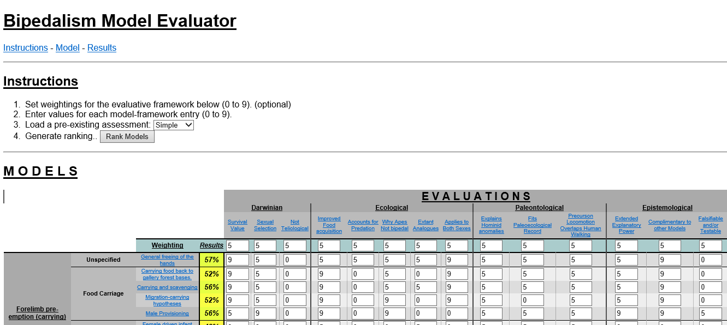
www.tinyurl.com/BipedalModels
Notes:
I bent over backwards to be fair and not biased to the wading idea.
If you don’t believe me please type in this URL and it’ll take to a web page set up by my son in which you can see all my evaluations and justifications.
Please go there and enter your own evaluations. See if you can make the wading models among the worst as is their usual ranking in terms of popularity in university textbooks.

Slide 31
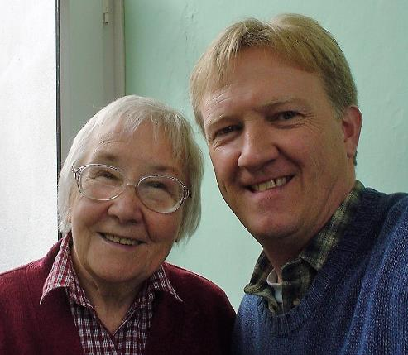
When I first met Elaine in 1999 it seemed the idea was on the verge of a breakthrough.
Notes:
I first met Elaine in the summer of 1999 at her home in Mountain Ash.
I recorded an interview with her which is on line.
Elaine, at the time was really optimistic about the idea making a breakthrough any time soon and she had good reason to be optimistic.

Slide 32
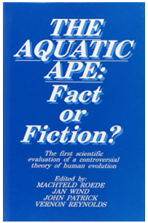
Roede et al (1991)
Valkenburg Symposium: Aquatic Ape Fact of Fiction
11 Mainstream Scientists
Vernon Reynolds Summary…
“Overall, it will be clear that I do not think it would be correct to designate our early hominid ancestors as ‘aquatic’. But at the same time there does seem to be evidence that not only did they take to the water from time to time but that the water (and by this I mean inland lakes and rivers) was a habitat that provided enough extra food to count as an agency for selection.”
Reynolds (1991:340)
Notes:
In recent years there had been a couple of “proper” scientific symposia where mainstream scientists debated the subjects with proponents.
The first, in Valkenburg, Holland, in 1987 had about a dozen established scientists there, clearly taking the idea very seriously indeed.
The proceedings were published in Roede et al, still the most balanced book on the subject in the literature.
Chairing the committee was the famous primatologist Vernon Reynolds. He had the unenviable task of summarising the whole thing. I’ve included the text her.
When I read it I felt a real sense of relief that, at last, someone had written some common sense about this.
Of course no-one thought our ancestors were ever fully aquatic in the past, did they? I certainly didn’t. I just thought that our ancestors were exposed to more selection from wading, swimming and diving than the ancestors of the other great apes.

Slide 33
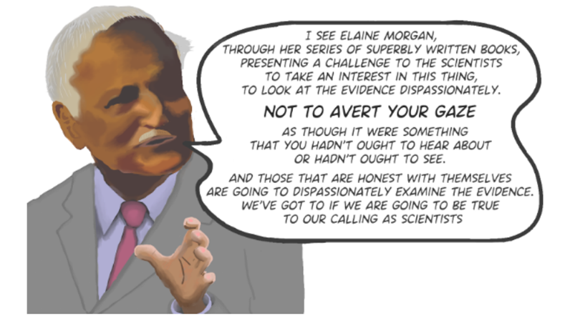
BBC / Discovery Documentary (1998)
Notes:
When I went to see Elaine she was still buzzing about a BBC / Discovery Channel documentary that had just been made.
It’s still probably the best doco on the subject even today. It has many fantastic interviews with key people on both sides of the divide, including Sir Alister Hardy, Desmond Morris and Leslie Aiello.
Here’s a beautiful clip from the great man himself, Phillip Tobias, a true scientist who wasn’t afraid of being wrong and who always gave generous praise to Elaine Morgan’s work.

Slide 34
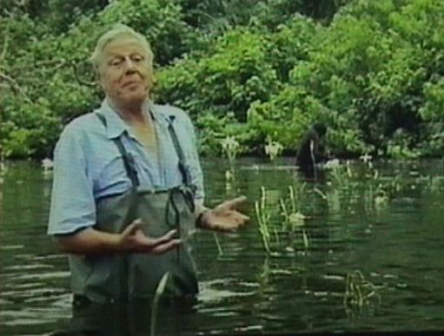
Life of Mammals (2002)
“Suddenly an image from our remote past comes vividly to light. The time when our distant ancestors, in order to keep up with the changing environment, had to wade and keep their heads above water in order to find food; that crucial moment when our far distant ancestors took a step away from being apes and a step towards humanity.”
David Attenborough.
BBC’s Life of Mammals ‘Food for Thought’ 2003.
1:53
Notes:
And a just few years later, the BBC did a series called Life of Mammals hosted by none other than Sir David Attenborough.
The final episode, “Food for Thought” was about human evolution.
Sir David managed to get a crew out to the Congo to film him standing in waist deep water in front of bipedally wading chimpanzees specifically to say these most beautiful words.
Music to my ears.

Slide 35
So what happened?
For twenty years, it’s been… “we don’t talk about that”.
As Elaine said in 2009, that’s “very sad.”
Notes:
So what has happened since?
Well, it breaks my heart to say that it seems to be going down the first of the three alternatives Elaine considered in 2009.
For twenty years it’s just been “we don’t talk about that”. As she said, that’s very sad.
It’s really why I decided to start this initiative. Somebody is going to talk about it and those talks are going to be on line for posterity.
We will hear the case for it here. And, if anyone from the aquaskeptic side would like to try to defend this situation, I’m all ears.

Slide 36
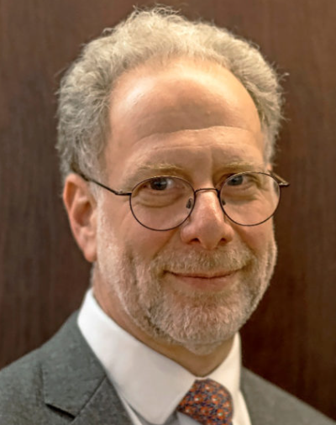
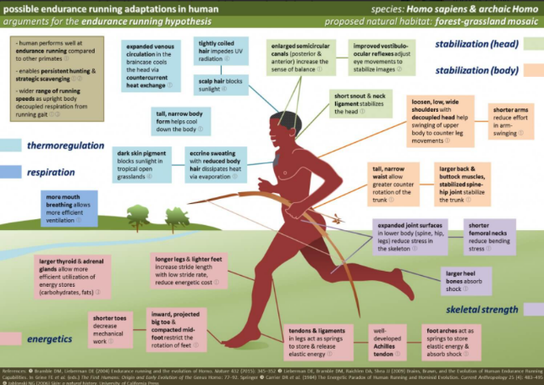
Endurance-Running Hypothesis
https://www.goodreads.com/author/show/3186364.Daniel_E_Lieberman
Notes:
Bizarrely, to me, the idea that has become de rigeur over the last twenty years, is Dan Lieberman’s Endurance Running Hypothesis. This is the idea that our ancestors were able to do persistence hunting, chasing down antelope over the hot, dry savannah plains, by following their tracks. Even though they are much faster than us over short bursts, humans are apparently can out run them over marathon like distances.
It’s seems incredible to me that Elaine Morgan railed so successfully against the “Man the Mighty Hunter” model in 1972 with her best seller “Descent of Woman” only for have the idea re-imagined today as “Man the Mighty Marathon Runner”.
Whatever, holes and inconsistencies waterside models may have, and there are a few, they pale into insignificance compared to this. For example, what exactly was the band of young athletic men supposed to do with the carcass once they’ve finally chased down the poor beats some 20 km from base where, presumably, the women were waiting with the kids practicing wobbling their hips to look sexy?

Slide 37
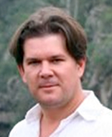
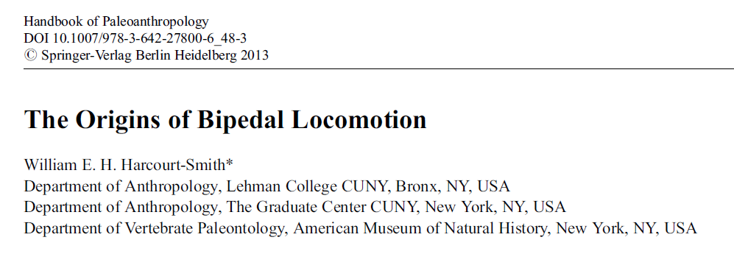
Harcourt-Smith’s Bipedalism Update
https://www.archaeological.org/tour_leader/william-harcourt-smith/
36 pages. 20,000 words. Wading not mentioned once.
Notes:
Most heart-breaking for me is the review paper published in the Handbook of Palaeoanthropology by Will Harcourt-Smith in bipedal origins in 2013.
Will was completing his PhD at UCL as I was there doing my masters so I know he is aware of the wading idea as I gave at least one talk that he attended.
The paper has 36 pages, contains around 20,000 words but wading is not mentioned once. I find that absolutely incredible.

Slide 38
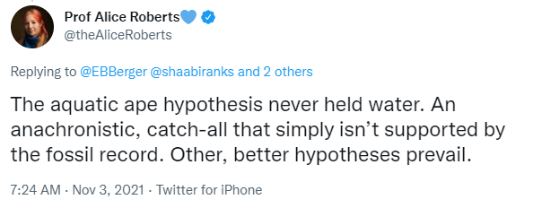
Move on. Nothing to see here!
Notes:
Recently, on the social media, several “big wigs” in academia have been very outspoken against Elaine Morgan and these ideas.
Henry Gee, chief editor of Nature wrote an astonishing diatribe in 2013 and Alice Roberts and Mark Maslin criticised the BBC for producing a two-part Radio Documentary called “The Waterside Ape” in 2016, narrated by Sir David Attenborough.
I finally managed to tempt her to reply to a tweet I made about that just the other day.
Here it is. Typically, it’s full of errors. Now don’t get my wrong. I have massive respect for Alice. I think she’s a great presenter and shows such enthusiasm. She’s also a brilliant anatomist and a highly skilled technical artist. It’s so sad that, on this, she’s so narrow minded.
Alice, the idea held enough water in 1987 to attract a dozen mainstream scientists to debate it at a symposium. And since then, there has been more evidence than ever in favour of waterside ideas, as the BBC radio documentary reported.

Slide 39
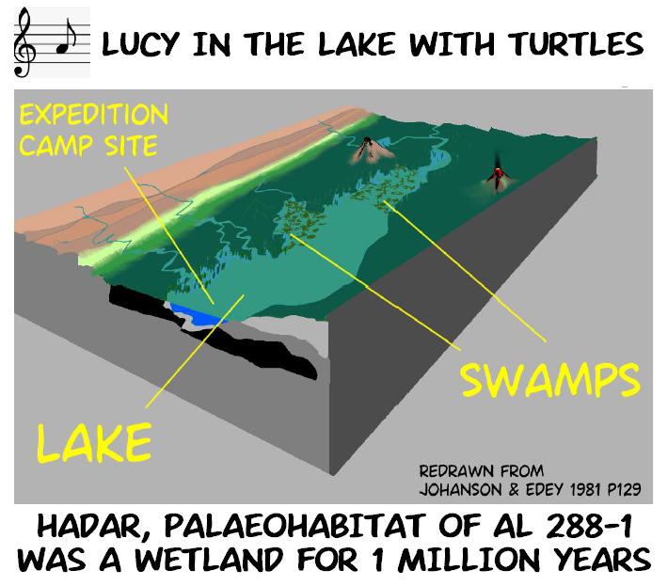
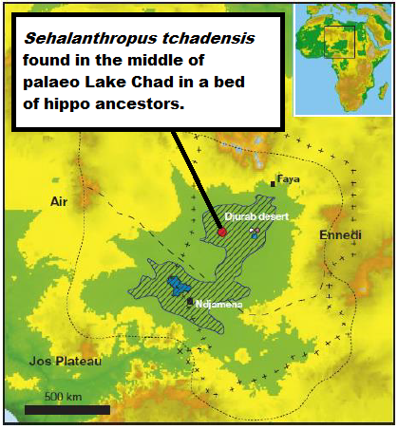
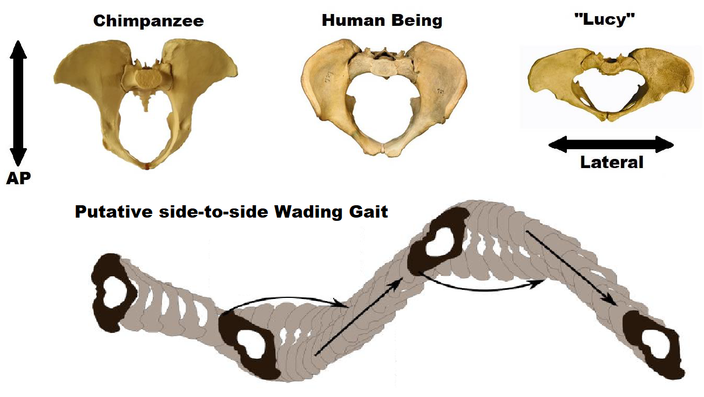
THE WADING HYPOTHESIS OF HOMINID BIPEDALITY
Algis V Kuliukas PhD¹ ¹ Human Sciences, University of Western Australia
Contact: algis.Kuliukas@uwa.edu.au
Abstract
Extant Great Ape Locomotor Repertoire
Putative Gait for Australopithecines
There is one, and only one, scenario guaranteed to induce bipedal locomotion in an otherwise quadrupedal extant great ape. Unlike postural bipedalism and bouts of forelimb pre-emption, it will induce it indefinitely, for as long as the conditions prevail. Unlike arboreal bipedalism, this is unsupported locomotion, not supported posture. Not only does it not require the use of upper limbs, it actually precludes it. Indeed, it is the only scenario that would theoretically kill a determined quadruped. It is entirely consistent with the palaeohabitats of all the supporting fossil evidence yet found. And yet, despite the occasional brief mention on TV and radio documentaries, the Wading Hypothesis appears to have been almost totally ignored by the field of palaeoanthropology for over sixty years. It would appear its historically close association with the so-called “aquatic ape hypothesis” (better labelled “waterside hypotheses of human evolution”) has made it somewhat a taboo subject.
Until recently there was very little evidence, anecdotal or otherwise, of large primates engaged in bipedal wading behaviour. Elaine Morgan’s (1997) four chapters on the subject could only cite stories of wading in the proboscis monkey (Nasalis larvatus) to back her arguments up.
However, in the last twenty years there has been a stream of photographic and video evidence repeatedly showing that whereas on land, chimpanzees, bonobos, gorillas and orangutans are largely quadrupedal, they all switch to bipedalism in waist-deep water very predictably.
The platypelloid pelvis of Australopithecus afarensis (AL 288-1 or “Lucy”) has rarely been studied from the point of view of a putative gait. Clearly, many characteristics indicate a kind of bipedality but as it’s so unlike the modern human form it begs the question – what mode of locomotion could they have been engaged in? As it’s not intermediate between that of Pan/Gorilla and Homo, it seems to suggest it’s bipedality was not a vestige of climbing, but something completely different.
A 3D geometric morphometric analysis of the pelvic shape from the point of view of relative load arms of the main muscle blocks showed that Lucy’s pelvis was adapted to more powerful abduction/adduction and rotation of the hip, consistent with a putative side-side, wading gait. (Kuliukas 2016)
A Wading-Climbing Last Common Ancestor?
A wading-climbing locomotor repertoire for the Last common Ancestor (LCA) is an ideal potential precursor to two unique modes of locomotion: knuckle-walking of Pan and Gorilla and the striding, extended lower limb bipedalism of Homo.
The long-standing assumption that bipedality was a unique human-trait that evolved after the split with the chimpanzee was seriously challenged by the discoveries of Orrorin in 2000 and Sahelanthropus in 2001 dated at 6 Ma and 7 Ma, respectively.
Molecular evidence suggests the LCA of the Pan/Homo lived ca 7-5 Ma suggesting that it could have already exhibited some mode of bipedality, if not our own striding, energy-efficient form.
Other putative bipedal hominids (e.g. Oreopithecus, Danuvius etc. are even older.)
From top left: Pan troglodytes; Gorilla gorilla; Pongo pygmaeus; Pan paniscus. BBC Life of Mammals, Breuer et al. 2005, OrangUtan Foundation; Kuliukas 2001.
Energy Efficiency
It is very unlikely that very first hominid terrestrial bipeds were preadapted to walking as efficiently as later Homo palaeospecies seem to have been. Scenarios should therefore be considered where the cost of bipedal locomotion in a hominid not yet anatomically adapted to doing so efficiently might have been “cushioned.”
IT’S NOT ROCKET SCIENCE!
… But High Scoring
… but despite their lack of coverage, wading models rank among the highest in terms of an evaluative framework (a kind of marking rubric) designed to assess the strengths of wading models.
(see tinyurl.com/BipedalModels for details and a chance to enter rankings.)
A study of human volunteers engaged in bipedal wading in different depths of shallow water and walking on dry land, with varying hip and knee flexion, showed that in water 1m deep the cost differential of bipedal locomotion with a 50⁰ hip flexion was reduced from 55% to 19% and eliminated completely at 70^{0.} (Kuliukas 2016.)
Low Popularity…
Palaeohabitats
Wading models are rarely given much attention in university level texts about the evolution of bipedality. (Kuliukas 2016)….
The palaeohabitats of the earliest putative bipedal hominids are consistent with the wading hypothesis. All are associated with swampy, wetland, riverine or other waterside niches or at least were found in lacustrine or fluvial deposits.
Selected References
Breuer, T. et al (2005) First Observation of Tool Use in Wild Gorillas. Plos Biology 3(11)e380:1-3.
Hardy, A. (1960) Was Man More Aquatic in the Past? New Scientist 7:642-645.
Kuliukas AV. (2016) PhD Thesis : A Wading Component in the Origin of Hominid Bipedalism.
Morgan E. (1997) The Aquatic Ape Hypothesis. Souvenir Press (London).
Niemitz, C. (2002) A Theory on the Evolution of the Habitual Orthograde Human Bipedalism - The “Amphibische Generalistentheorie”. Anthropologischer Anzeiger 60:3-66.
Sauer, C. (1962) Seashore - Primitive home of man?. Proc. APA. 106(1):41-47.
Westenhöfer, M. (1942) Der Eigenweg des Menschen. Mannstaedt & Co (Berlin).
Wrangham R. (2005) The Delta Hypothesis: Hominoid Ecology and Hominin Origins.
Danuvius
Oreopithecus Sahelanthropus
Australopithecus afarensis
Riverine.
Swamp. Lake.
Wetland.
Palaeo Lake Chad (from Vignaud et al 2002)
Hadar
HISTORY
Max Westenhöfer (1942) “The shape of the human foot, broadening towards the front, could indicate a paludine habitat...”
Alister Hardy (1960)
“I imagine him wading, at first perhaps still crouching almost on all fours groping about in the water, digging for shell fish…
Carl Sauer (1962) “A riparian location is indicated for his [early hominid] earliest living.”
Elaine Morgan (1972, 1982, 1990, 1991, 1993, 1994, 1995, 1997, 2002, 2008, 2011)
“Professor Hardy wrote that wading in water would explain not only our erect walk…” (1972) 1 Chapter on bipedalism (1980)
2 Chapters (1990) & 4 Chapters (1997).
41 years promoting the wading hypothesis and other waterside hypotheses of human evolution.
Carsten Niemitz (2000, 2002, 2004, 2007, 2008, 2010)
Amphibische Generalisten-theorie (2002).
Algis Kuliukas (2000, 2002, 2008, 2011 2013, 2016, 2018)
MSc (UCL, 2000)
PhD UWA (2016)
12 Papers, 3 Book Chapters. Biography of Elaine Morgan (2020).
Marc Verhaegen (2002)
Aquarboreal Ancestors? Verhaegen, Puech, Munro 2002).
David Attenborough (2002)
[on wading] “… when our distant ancestors took a step away from being apes and a step towards humanity.” Life of Mammals Documentary.
Richard Wrangham (2005, 2009, 2021)
“Delta Hypothesis” (2005)
"That's what we come from... a water-walking wading ape."
H₂O Documentary E2 (2021).
Notes:
The idea that the fossil evidence does not support waterside models is a myth. Actually the exact opposite is true.
And all my 25 years work trying to scientifically test various hypotheses of the wading idea have been completely ignored.
Here are a few.
I cannot honestly say whether other, mainstream, ideas are better than waterside hypotheses in other areas but having studied bipedal origins for 25 years I am absolutely certain that none comes anywhere near the wading hypothesis of bipedal origins.

Slide 40
The best evidence one could possibly wish for…
Notes:
Remember, in 1997 the best evidence Elaine could come up was third hand reports and a sketch of proboscis monkeys wading in Borneo.
Since then there has been a steady flow of photographic and video evidence showing that great apes too are most predictably bipedal in shallow water. This is locomotion, not posturing. This is unsupported by the upper limbs. In fact it could kill an ape to try to support itself with its upper limbs in some depths.
One simply could not wish for better evidence than this and yet it’s all but ignored even today.

Slide 41
Richard Wrangham’s Support of the Wading Hypothesis
"That's what's so wonderful about the wading hypothesis...“
"This is a wonderfully ecological argument for how we became bipedal".
"That's what we come from... a water-walking wading ape."
https://www.goodreads.com/photo/author/206398.Richard_W_Wrangham
6:02
Notes:
I say “all but ignored”.
There is one mainstream anthropologist who seems to have decided it’s a very good hypothesis and that’s Richard Wrangham.
Here’s a beautiful clip from a documentary he was part of a few months ago.
Again this is music to my ears….

Slide 42
Wading into Anthropology? Hopefully, but it’s surely time all these ideas were tested thoroughly.
Notes:
So, perhaps wading is soon to take it’s rightful place among the models of hominid bipedal origins that mainstream anthropologists will now be open to discuss.
But if so, and surely it is long overdue it was, then the same must be true of all the other ideas Elaine so brilliantly researched and eloquently explained.

Slide 43
Lots of ideas to hear the case for… The WHAT talks program aims to do so.
www.whattalks.com
Subscribe to the YouTube Channel
Notes:
WHAT talks will try to cover all these ideas and more over the forthcoming months.
I am so grateful to these people for agreeing to participate in the program.
Please keep an eye on the web site www.whattalks.com and subscribe to the YouTube channel so you don’t miss out.
Thank you for your attention.
And now I’m going to invite Simon Bearder to say a few words if he’s here.
Anything to add Simon?

