Slide 1

CY 2026 Budget
Presented by Hunter L. Ahrens, MPA, SHRM-SCP

Slide 2
Budget Objectives
Policy Document
Financial Plan
Operations Guide
Communication Tool
Policy Document – The budget outlines the governing policies of the Borough, including its Fund Balance objectives, legal requirements, and other policy choices.
Financial Plan – The budget provides a strategic plan for the Borough’s finances in CY 2026 and provides long-term insight into its finances.
Operations Guide – The budget’s financials are attached to the operations and goals the Borough Council sets for the next year and the resources provide support their accomplishment.
Communication Tool – The document acts as a detailed overview of the Borough’s policies, financials, and operations which can be accessed by Borough personnel and the public to understand the use of funds and other details.
Notes:
GFOA Standards and Objectives.

Slide 3
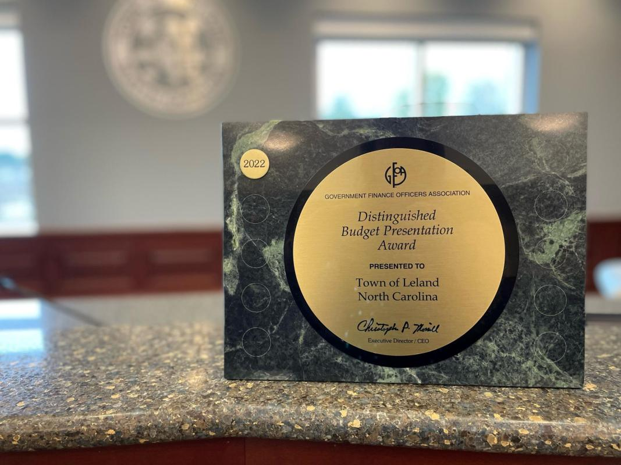
GFOA Goals
GFOA (Government Finance Officers Association) is a professional organization dedicated to public finance and the professionals in that area.
Their objective is to create standards and best practices for municipal, county, and state governments in the US and Canada.
Innovations to the budget that were included in this budget include detailed explanation of financial operations, a community and regional profile, strategic and tactical goals, operations guide, and detailed explanations of each budget line-item.
Meeting the GFOA goals demonstrates the Borough’s adherence to industry best-practice and creates a higher standard of the budget’s construction.

Slide 4
Fund Balances
In 2025, the Borough created two more funds to carefully track expenses for Trash & Recycling and Capital Projects.
While the General Fund balance appears large in 2024, many of those funds were restricted or committed.
The actual “savings” the Borough is holding is approximately $400K.

Slide 5
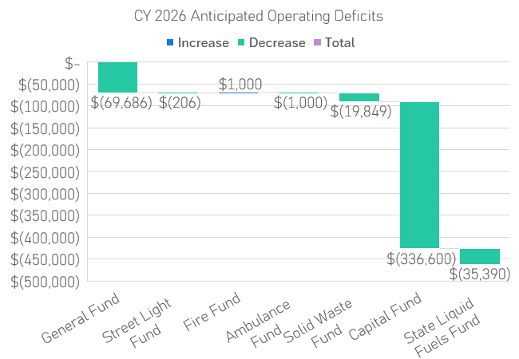
Operating Difference
The Borough’s operating differences show a significant decrease in funds.
The Capital Fund is the largest decrease, but this is due to the construction of a new Streets Garage with state grand money. That grant money is currently on the Borough’s accounts and cannot be expended for anything else.
The two areas where operating deficits must be addressed are the General Fund and Solid Waste Fund.

Slide 6
Expenses Breakdown
Public Safety expenses are clearly the largest portion of the Budget. This year also includes several grant projects that inflate the Borough’s functional areas.
  Road Projects with excess grant funds: $521,738.02
  Road Crew Building: $490,000.00

Slide 7
Breakdown of Expenses w/o Grants
Withdrawing the grant money from the larger budget framework reveals a more accurate picture of the Borough’s expenditures.
Public Safety expenses takes the most prominent role, which is spread over the General, Fire Tax, and EMS Tax funds.
Sanitation and Environmental expenses are almost completely encompassed within the trash and recycling bid.

Slide 8
Public Safety Function
The public safety area of the budget is divided over three funds but is primarily made up by the Police Expenditures in the General Fund.
The other major expenses are related to Permits and Code Enforcement, which the Borough invests significant resources.
Support for Fire and EMS Services has risen since last year with increased taxes but remain significantly lower than paid services in other municipalities.

Slide 9
Sustainability of Solid Waste Fee
The current solid waste fee, compared to the bid expenses, leaf recycling fees, and fund balance buildup, creates a $50,183.62 shortfall on operations.
The anticipated budget deficit is only $19,848.80 because additional revenue for prior year fees, delinquent fees, and interest reduces the net difference and does not include a funds buildup.
The Solid Waste Fund already has an operating loan from the General Fund of $146,775.90 and any deficit or borrowing would expand.
Description | Calculations
Number of Dwelling Units | 1,341
Current Fee ($450) x Dwelling Units | $611,160.80
Fund Balance Buildup (+ 3%) | $18,334.82
Collection Rate | 96.00%
Proposed Breakeven Rate | $488.98
THE CURRENT FEE $450.00 IS UNSUSTAINABLE

Slide 10
Sustainability of Solid Waste Fee
The timeframe that revenue is collected for the Solid Waste Fund is primarily March – June each year, on cycle with real estate taxes.
This creates cash flow issues that need to be tended to in the January to March timeframe as the first payments are collected.
Potential options are looking at short-term financing or delaying payment with the hauler. The pace of collections depends on folks’ ability to pay and the disbursement by the our collector.
The best solution is to have funds to cover the first three months of bills prior to revenue coming in.

Slide 11
General Fund Deficit (CY 2025)
The deficit for the CY 2025 Budget is projected to be $233,673.48.
The two significant drivers of that deficit is the loan from the General Fund to the Solid Waste Fund and the unexpected major projects from the Summer.
On paper, the $400K transfer to the Capital Improvement Fund creates a much larger deficit, but that is on-paper, not in reality. Practically you can consider that a bank transfer.
The staff is looking at short-term methods to reduce the anticipated deficit, including shifting costs to the Liquid Fuels Fund.
Expenditure | Amount
Solid Waste Fund Loan | $146,775.90
Sinkhole Project on Friedensburg Rd. | $96,999.22
Street Crew Garage Design Fees | $37,251.75
Unpaid 2022 MMO | $22,051.34
N. 25th Street Repairs | $21,787.00
Additional Auditing Fees | $19,200.00
Health Insurance Enrollees | $6,626.36
Sum: | $350,691.57

Slide 12
Short-Term Methods for Deficit
Reimbursable Item(s) | Account No. | Amount ($)
GF January 2025 Solid Waste Bill with TRAN | 427.45 | $ 48,425.30
GF Reimbursement for Stormwater Project | 436.67 | $ 25,000.00
GF Snow & Ice Removal Payroll | 430.12 | $ 4,749.69
GF Fuel Purchases | 430.33 | $ 3,252.65
GF Repair and Maintenance Services | 437.37 | $ 2,752.69
GF Vehicle Maintenance Supplies | 437.24 | $ 1,620.09
GF Leaf Recycling Services | 427.45 | $ 1,500.00
GF Road Crew Operating Supplies | 430.24 | $ 1,357.44
GF Capital Equipment Purchase | 437.74 | $ 1,162.51
GF Street Signs | 433.24 | $ 1,121.17
GF Rental Equipment & Vehicles | 430.38 | $ 445.50
GF Electric for Traffic Signals | 433.36 | $ 289.99
Total Reimbursable: | - | $ 91,677.03
 | General Fund | Solid Waste Fund | Liquid Fuels Fund
Current Projected EOY Balance | $ 463,081.25 | $ 139,308.30 | $ 129,807.43
+/- Change by Fund | $ 91,677.03 | $ (49,925.30) | $ (41,751.73)
Revised Projected EOY Balance | $ 554,758.28 | $ 89,383.00 | $ 88,055.70
The Borough can look at short-term methods in order realize greater savings to the General Fund to maintain the fund balance; the General Fund has the greatest flexibility to respond to new needs while also being funded by property taxes.
This would be accompanied by seeking a tax anticipation note (TAN) in order to pay expenses in January to March without utilizing too much cash on hand.

Slide 13
General Fund Deficit (CY 2026)
The Borough’s CY 2026 Budget deficit is predominantly driven by personnel expenses.
Police expenses are projected to increase by $95,488.92 (7.50% increase). Regional Codes expenses are increasing by $15,778.75.
Borough Staff expenses increased by $59,107.54 from the CY 2025 Budget; including benefits and wages.
The Borough’s increased costs have been offset by increased revenue and decreased expenditures elsewhere creating the est. deficit of $69,686.

Slide 14
Budget Problems
Decision Points
Adjust solid waste fees. | Pay deficit of solid waste fund from General Fund.
Adjust tax rates for General Fund. | Reduce expenditures in General Fund.
The General Fund deficit stands at $(69,686.07). This had been reduced somewhat by transferring $18,000.00 in Street Crew wages to the Liquid Fuels fund.
The Solid Waste Fund deficit stands at $(19,848.80) which needs to be resolved. The loan from the General Fund should also be addressed.
The other fund deficits are expected or required, so they do not need to be resolved in the short-term and don’t present long-term challenges.

Slide 15
Strategic Goals
Operational Excellence: Deliver efficient, transparent, and accountable government services through data-driven management, staff development, and adherence to best practices.
Financial Stewardship & Accountability: Ensure long-term fiscal sustainability by maintaining balanced budgets, preserving fund balance reserves, and aligning all spending with adopted financial policies.
Sustainable Infrastructure & Environment: Invest in the Borough’s physical assets—streets, stormwater, and public spaces—through preventive maintenance, capital planning, and environmental compliance.
Community Well-Being & Public Safety: Promote a safe, healthy, and connected community through high-quality public safety partnerships, code enforcement, and responsive resident services.
Placemaking & Economic Vitality: Support neighborhood reinvestment, small-business growth, and beautification initiatives that enhance Mount Penn’s character and sense of place.

