Slide 1


Slide 2

FOUNDATION IN
20 MINUTES OR LESS!
Gavin Walker
District Rotary Foundation Chair
It’s all about Give & Take

Slide 3

Foundation works with a little Give & Take
Giving
Achieving the $100 per member per year target
Sustaining Membership
Major Donors & Endowments
PolioPlus
Taking
Applying for a District Grant
Applying for a Global Grant
Peace Fellowships
A dedicated webinar will be announced for November

Slide 4
What is Foundation
Foundation is our charity - embrace the opportunity.
Supported entirely by voluntary contributions from Rotary members, friends, and the general public
Foundation helps fund local projects with District Grants, and humanitarian, educational, and cultural exchange projects with Global Grants
Established in 1917 by Arch C. Klumph, the sixth president of Rotary International with an initial contribution of $26.50

Slide 5
How the sums work
District donates $100,000 to Rotary Foundation in the Rotary Year 2023-24
Rotary Foundation invests the total for three years in the Annual Fund
In 2026-27 District claims approximately 50% of the original amount: $50,000
Up to 50% of the amount claimed can be allocated to District Grants: $25,000
The remaining 50% - plus any money not allocated to District Grants – is available for Global Grants
Global Grants attract an additional 80% funds from the Rotary World Fund, ie $25,000 + $20,000 = $45,000
*figures used are for example only and do not reflect actual funds either collected or available

Slide 6

What Foundation asks from your Club
Foundation asks each Rotary Club to donate the equivalent of $100 per member per year
Have a plan in place early in the year to achieve the target
Individual members who are Sustaining Members (ie donate $100 individually) are included in the Club total
Last year 39 Rotary Clubs in Ireland achieved or exceeded the $100 per member target

Slide 7
Celebrating our Sustaining Clubs
Athlone
Ballycastle
Ballymoney
Belfast
Coleraine
Comber
Cork Bishopstown
Cork
Donaghadee
Drogheda
Dublin Central
Dublin
Dublin-Fingal
Dun Laoghaire
Dundalk
Dungannon
Enniskillen
Lagan Valley
Larne
Letterkenny
Limavady
Limerick Central
Limerick Shannon
Lisburn
Lurgan
Monaghan
Mullingar
Naas
Navan
Newbridge
Newtownabbey
Omagh
Portadown
Raheny
Strabane/Lifford
Tralee
Wexford
Wicklow
Youghal

Slide 8
Sustaining Membership
It’s all about Give & Take

Slide 9
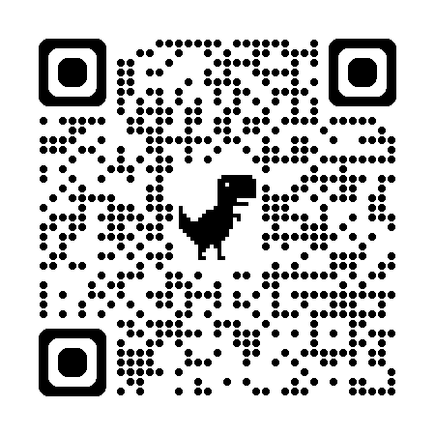
Sustaining Membership
A Foundation Sustaining Member is one who donates $100 or more during the Rotary Year
Donations can be made as a one-off payment, or by monthly Direct Debit
Individual Rotarians in Northern Ireland can benefit from Gift Aid which provides a 25% premium on donations. Gift Aid is not available to Clubs
Individual members who are Sustaining Members are included in your Club total
Scan your screen - you can become a Sustaining Member right now!

Slide 10
Major Donors
and Endowments
It’s all about Give & Take

Slide 11

For further information on making an Endowment or becoming a Major Donor, please contact Dave Murray dmurray@enua.ie

Slide 12
PolioPlus
It’s all about Give & Take

Slide 13


POLIOPLUS · DISTRICT 1160
The last mile is a fork in the road
99.9% is not a finish line. It is the most dangerous point on the route.
ACCEPT ‘CONTAINMENT’
Funding falls, surveillance goes dark, the virus escapes the Afghanistan–Pakistan block
1 in 200 infections paralyses; the other 199 board planes unseen — Malawi 2021 was Sindh 2019
Outbreak response and lifelong care are paid for indefinitely
Within a decade: up to 200,000 paralysed children a year (Gates Foundation)
Other vaccine-preventable diseases, such as measles, will increase too
FINISH THE JOB
99.9%
Polio becomes the second human disease ever eradicated
No child paralysed by wild polio, anywhere, ever again
Pay now to finish, not forever to manage
Every Rotary euro or pound still becomes three (Gates 2:1 match)
Containment is impossible in a connected world.
We eradicate it, or we start again
Sources: GPEI Polio This Week, 9 Sept 2026; GPEI 2026 Action Plan; Gates Foundation; WHO
Notes:
Bring up at 2:15. Script: 'Which brings me to the question I'm hearing at clubs...' through '...and it has Rotary's name on it.'

Slide 14
District Grants
It’s all about Give & Take

Slide 15
The District Grant
District Grants are an ideal way to help fund a locally based Rotary project. The project must fit into one of the Rotary Areas of Focus.
Grants will ideally be match-funded by the Club and will provide both membership and public image dividends.
Clubs can work together to apply for a District Grant
Before applying, the Project Lead must complete the online Grant Management Seminar
The District Grant Application Forms and advisory notes will be distributed in October. Grant Applications should be made by May 2027.
Grants must be used during the Rotary year and for the agreed Project
Download ‘A Guide to District Grants’ on My Rotary

Slide 16
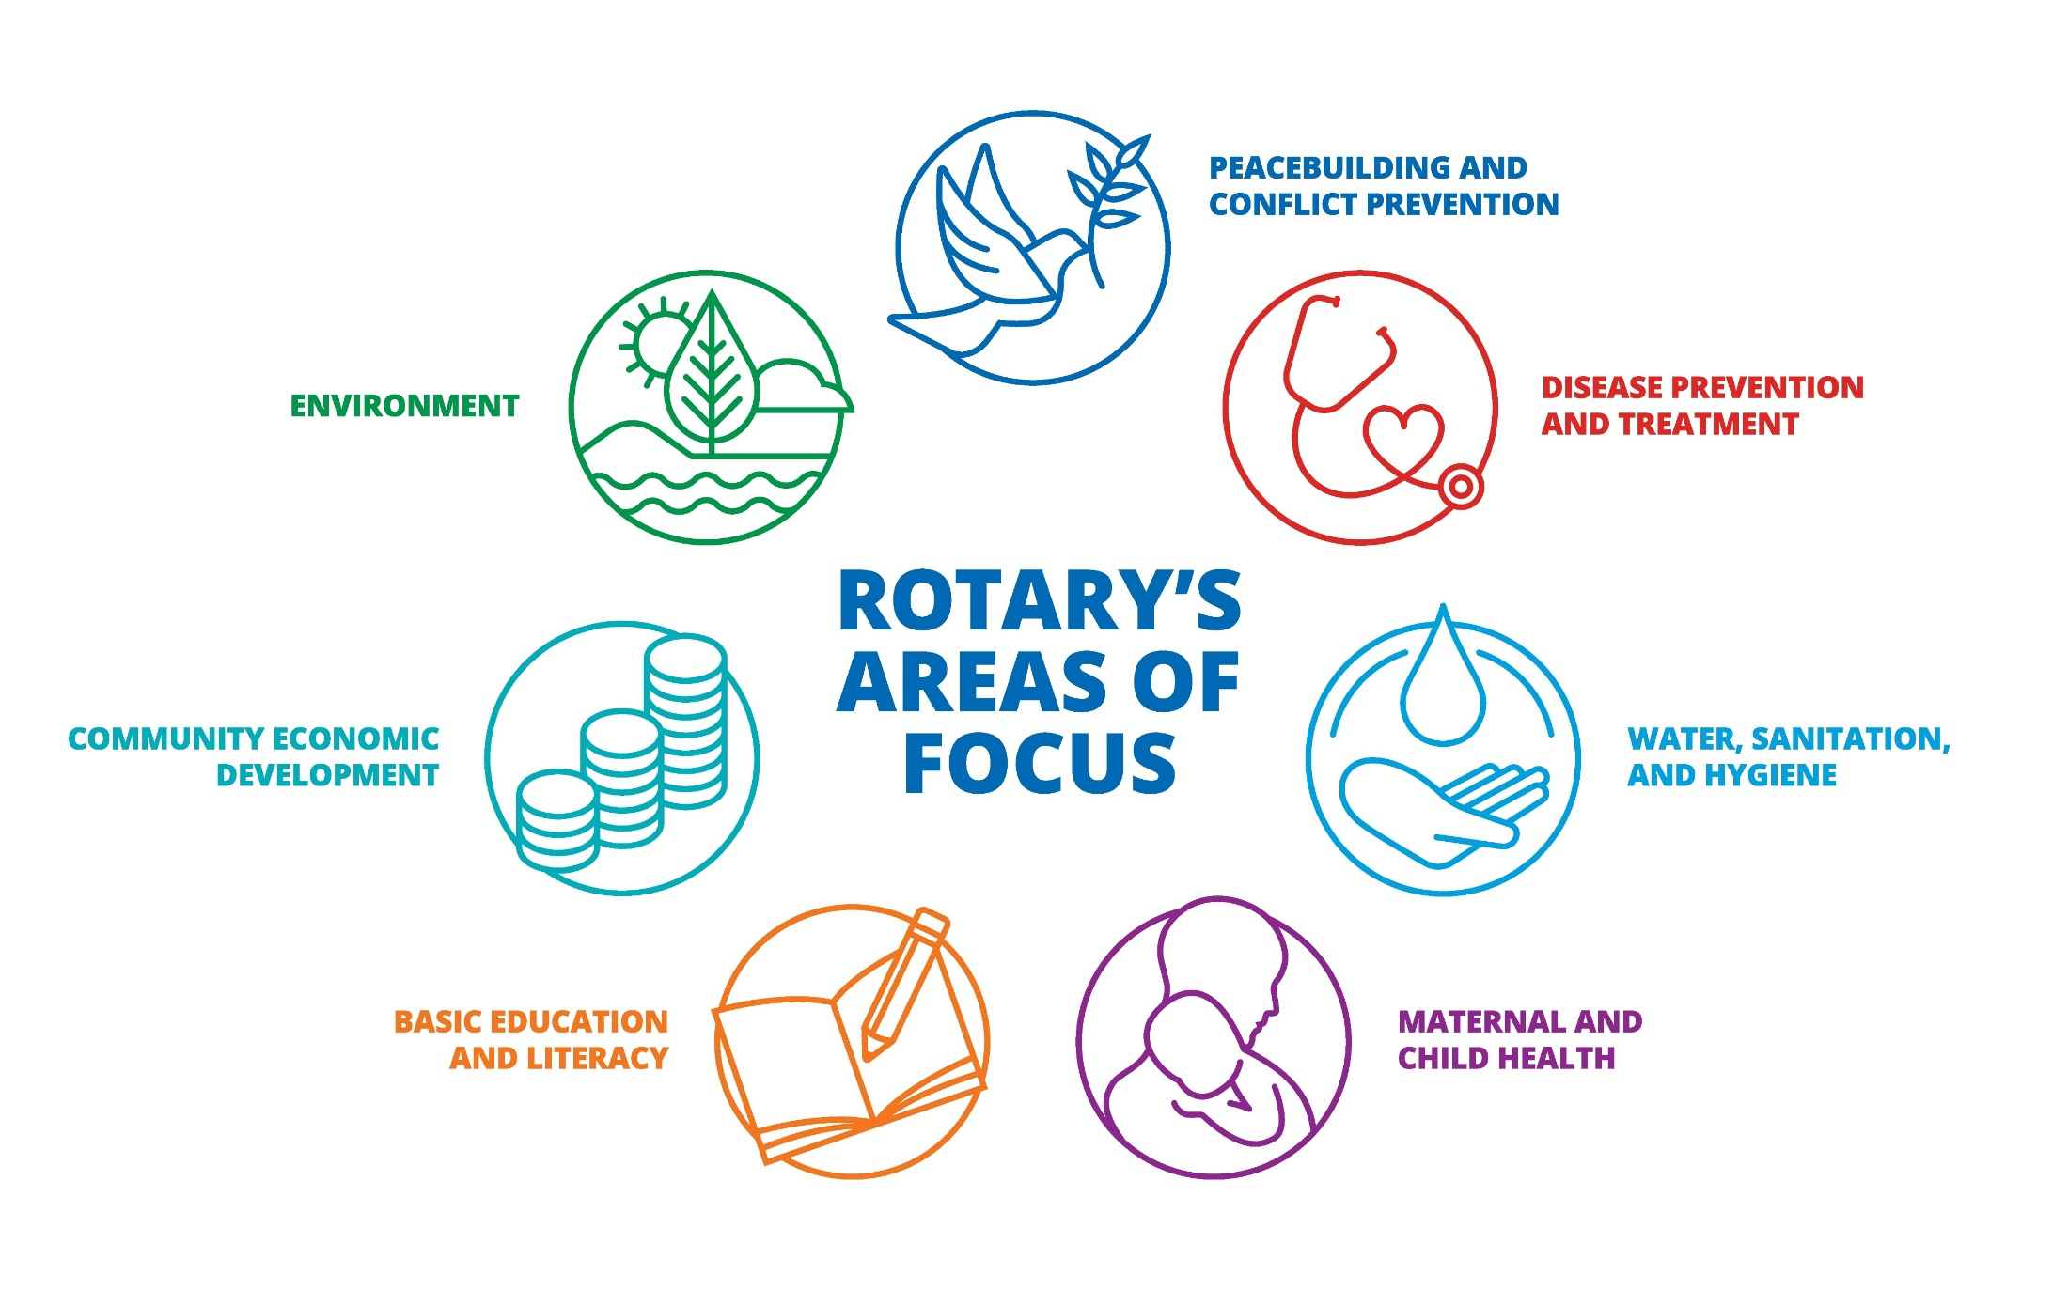

Slide 17
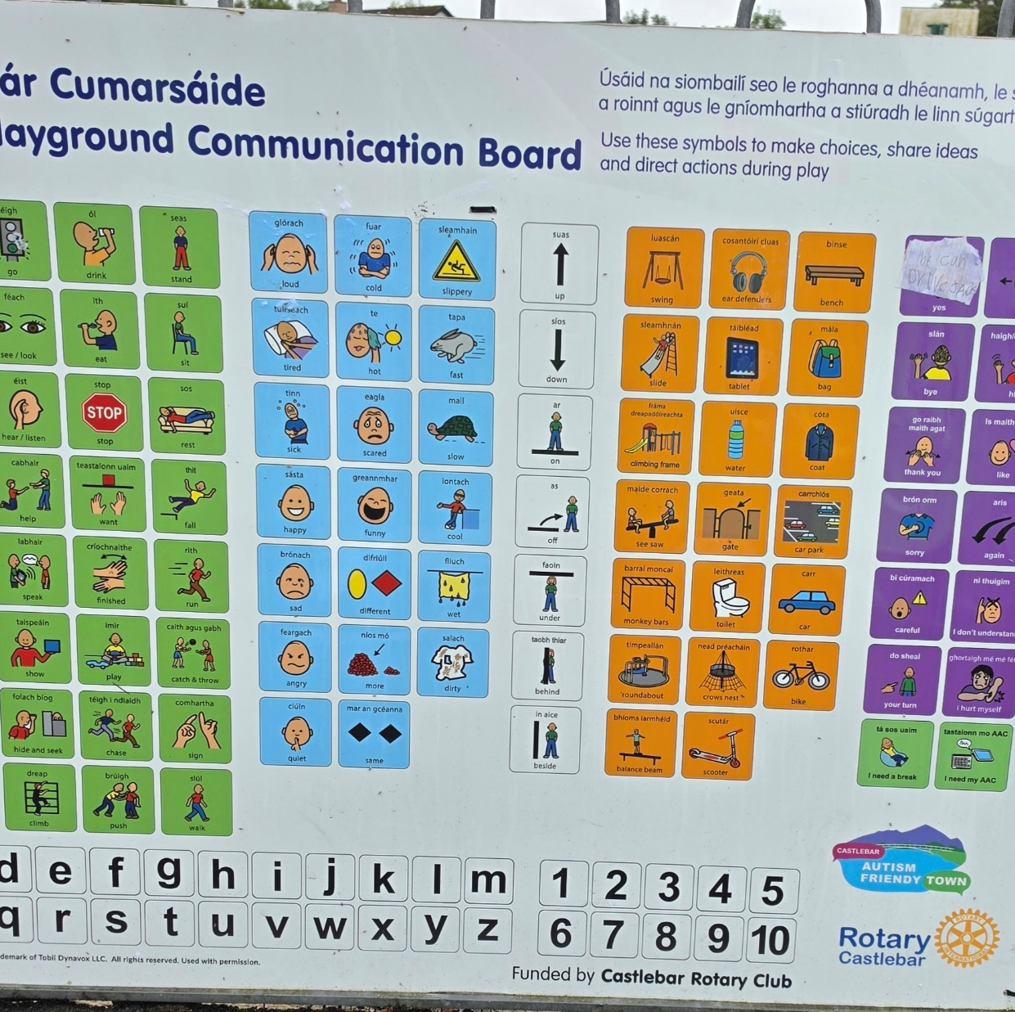
Rotary Club Castlebar Communication Boards
Finding Charlie's Voice supports children and young adults with speech and language communication needs in Ireland.
Castlebar Rotary partnered with the charity in 2025 to install inclusive communication boards.
The result was a project that met a need, made an impact in the local community and highlighted the work of Castlebar Rotary Club.

Slide 18
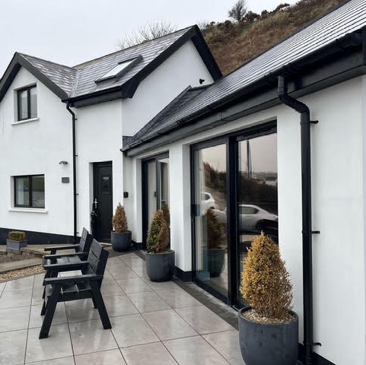
Rotary Club Belfast Refurbishing Glebe House
Rotary Belfast bought Glebe House in 1975 to provide programmes for children, young people and adults.
The house required a full upgrade and Belfast RC applied for £5000 grant to match-fund it’s own fundraising efforts.

Slide 19
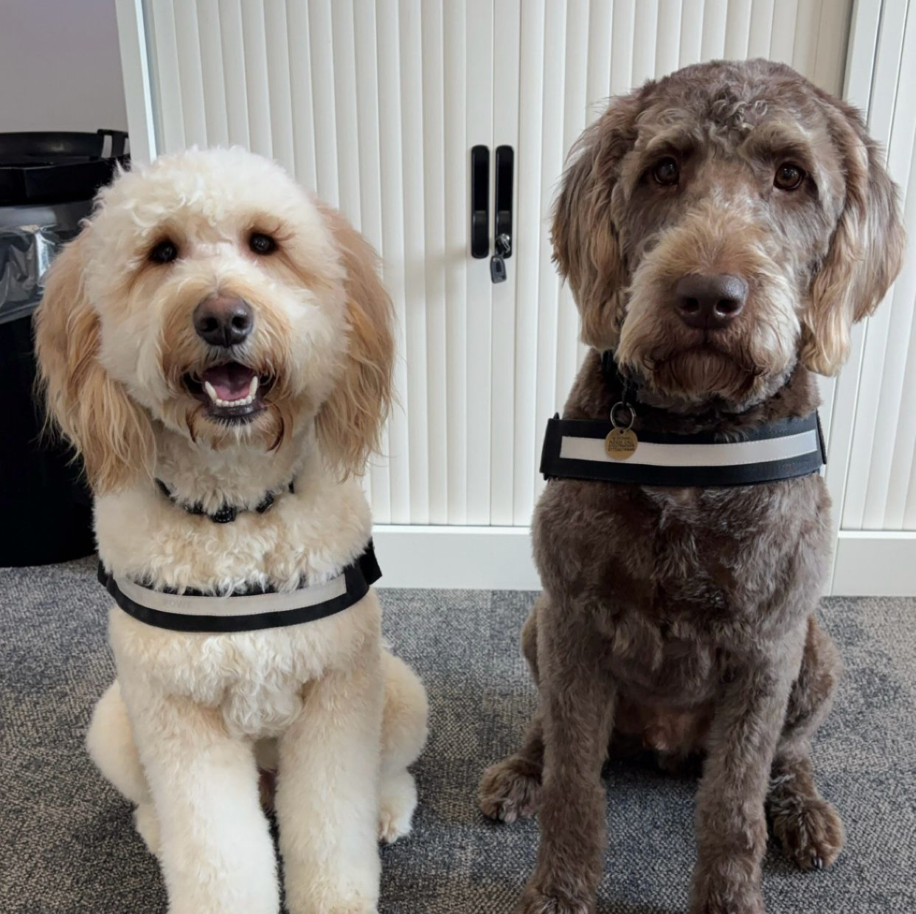
Rotary Club Ballymena
Therapy Dog
Sponsoring a Therapy Dog at Castle Tower Special School, Ballymena.
District Grant of £3,000 along with their own fundraising, enabled the Club to sponsor Nico for 3 years.

Slide 20
Global Grants
It’s all about Give & Take

Slide 21
Why Global Grants
Help your Club fund large-scale, sustainable, and high-impact international activities that address critical community needs.
Looking for an international project to support?
Go to the Service Project Center on My Rotary
International does not mean not in Ireland.

Slide 23
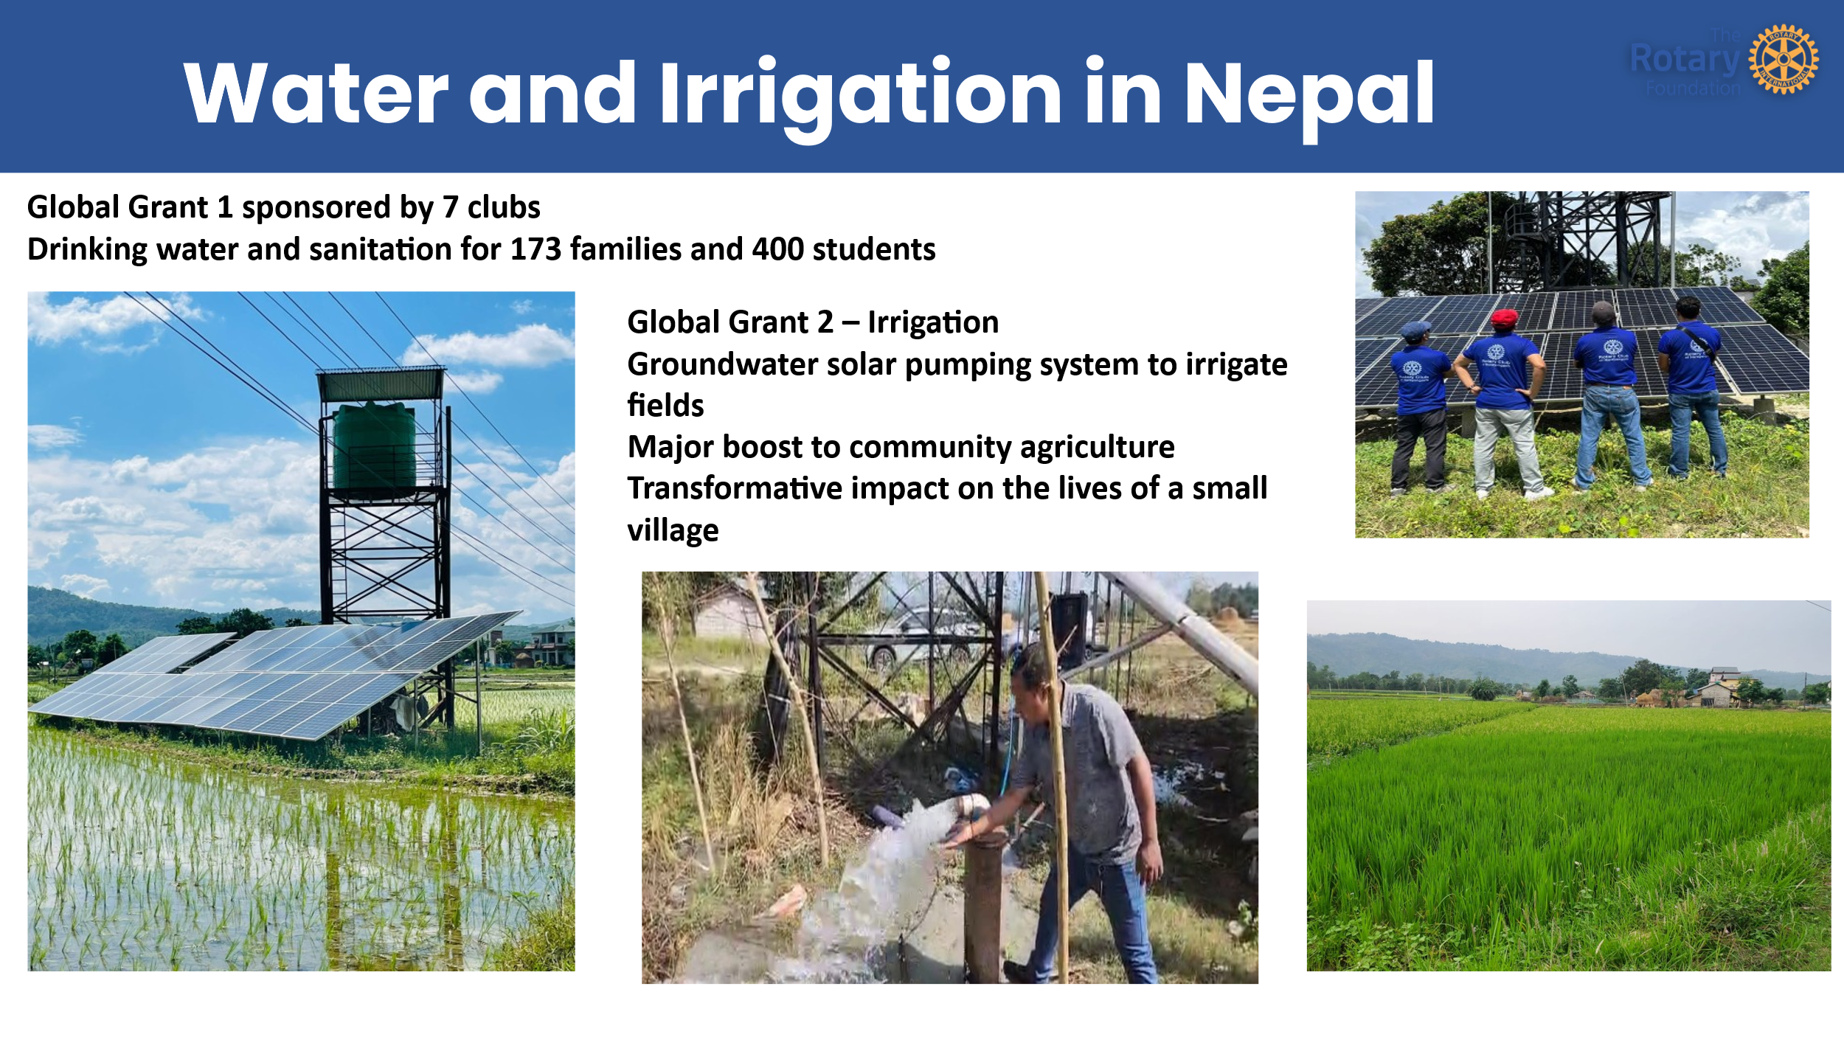

Slide 24
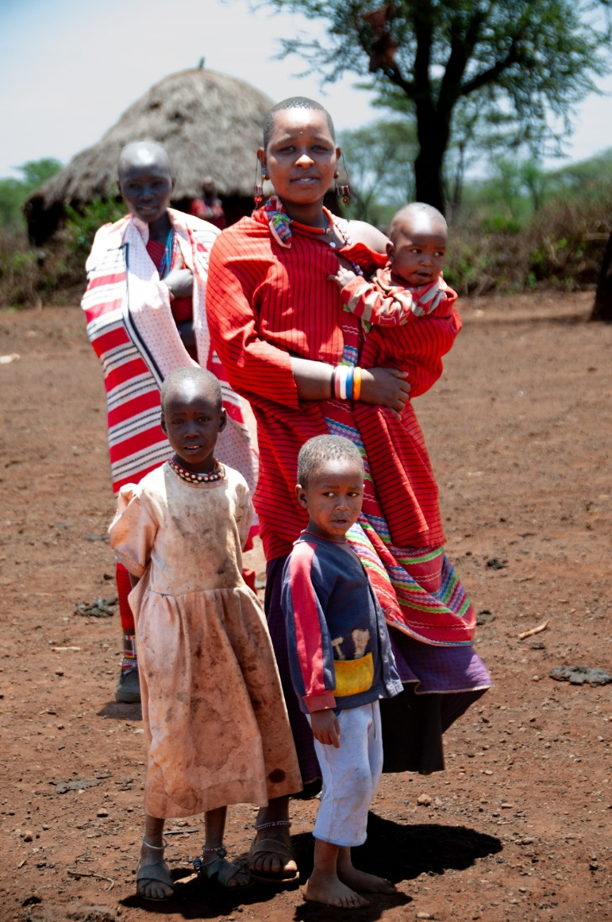
Rombo, Kenya - Summary of Projects:
  Water – to 10,000 people:
    20 shallow wells
    20km water pipeline
    2 Sand Dams
    5 deep boreholes
  Education – to 8,000 children:
    50 classrooms
    2,000 desks
  Medical – to 15,000 people:
    3 medical clinics fitted out
    1 eye clinic built and fitted out (6,500 people tested so far)
    1 ultrasound and x-ray machine

Slide 25
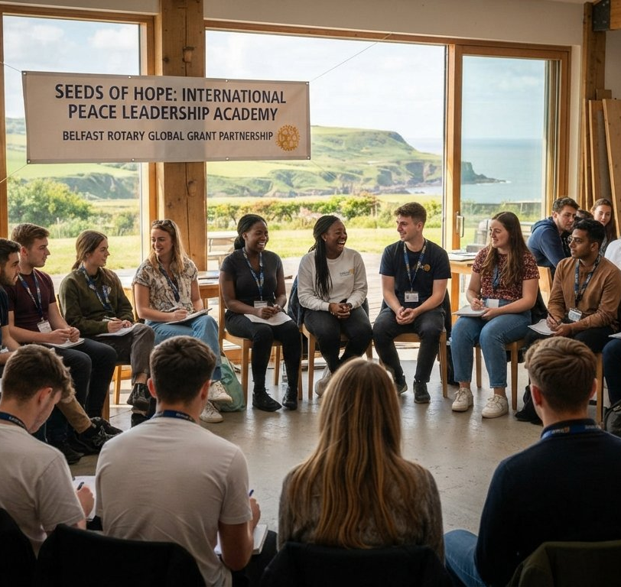
Seeds of Hope International Peace Leadership Academy
A peace-building programme funded by a $158,000 Global Grant from Rotary International and supported by more than 40 Rotary clubs across 12 countries.
Purpose: Trains young adults from marginalized and divided communities in conflict resolution, peace-building, and civic leadership.
Founding Partners: Created by six core Rotary clubs Rotary Club of Belfast, Londonderry/Derry, Dublin, Clonmel, The Hague (Netherlands), and San Antonio
Location: Hosted at the Corrymeela Community Campus in Ballycastle on the North Antrim coast
Programme Details
Participants: Features cohorts of around 30 young adults.
Education: Students learn from international experts and faculty members from institutions like Ulster University, Trinity College Dublin, and Waseda University in Japan.

Slide 26
Global Grant criteria
Grant applications must adhere to strict criteria
Be sponsored by two Clubs
  Host Club
  International Club
Address a need identified by Host country
Be Sustainable
Have Measurable Outcomes
Have a Minimum Budget of $30,000
Adhere closely to at least one of the 7 x Areas of Focus
Download ‘A Guide to Global Grants’ on My Rotary

Slide 27
Global Grant Funding
Global grants rely on a combination of local fundraising and The Rotary Foundation (TRF) World Fund matches.
District Designated Funds (DDF): Matched 80% by the World Fund.
Rotary Cash Contributions: No World Fund match
Non-Rotarian Cash: No World Fund match
Maximum Match: The World Fund can contribute up to $400,000 per grant.
Clubs are encouraged to work with together in groups and apply for allocation of District Designated Fund to help supplement their own cash contributions.
If your Club has identified a suitable project & is thinking of applying for a Global Grant, chat with the District Foundation Committee, right at the start.
Previous experience can help avoid pitfalls

Slide 29
Thank you
Questions!
It’s all about Give & Take

