Slide 1
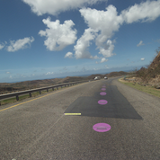
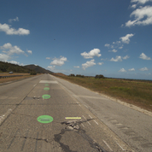
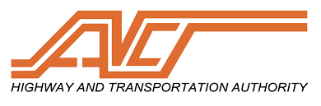
High Level Maintenance Patch Program
August 2018 – Project Managers for Puerto Rico Highway and Transportation Authority, High Level Maintenance Patch Program at South region of the Island. Emergency roads repair program for damages caused by Hurricane María on 2017.

