Slide 1
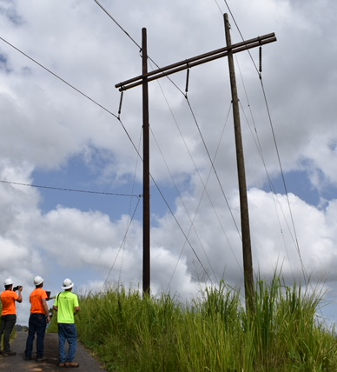
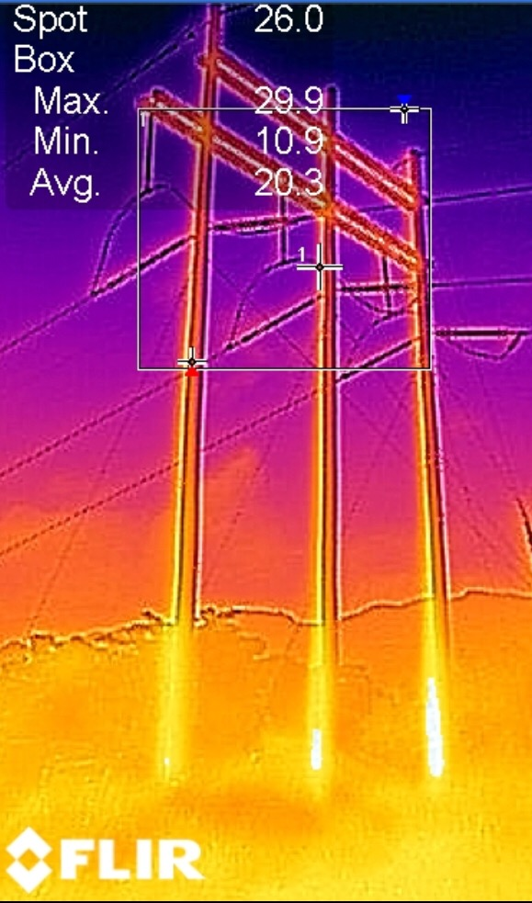
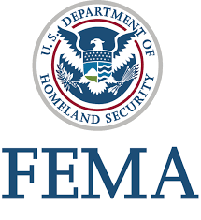

FEMA Power Lines Assessment for PREPA
July 2017 – Liaison Coordinators for tower lines assessments on Puerto Rico Electric Power Authority Transmission Grid, damaged by Hurricane María. Assessments include ultimate technology techniques.

