Slide 1
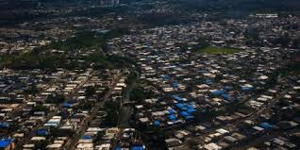
Blue Roof Operation – Hurricane María
October 2017 – Proud to be part of the Puerto Rico Recovery Effort. Providing Project Management Services for the USACE Blue Roof Operation in the following regions: Aguadilla, Mayagüez, Ponce and Humacao.

