Slide 1
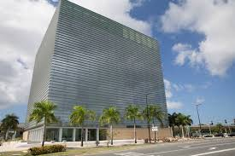
University of Puerto Rico Molecular Sciences Research Center – Levels 6th & 7th, Interior Fit-Out
November 2017 – This scientific research center project includes facilities in Level 6 for Neuroplasticity and Chemical Synthesis and in Level 7, for a Vivarium. It is a challenging project due to all its sophisticated equipment, and exciting for all the future scientific research that will be carried out in these facilities.

