Slide 1
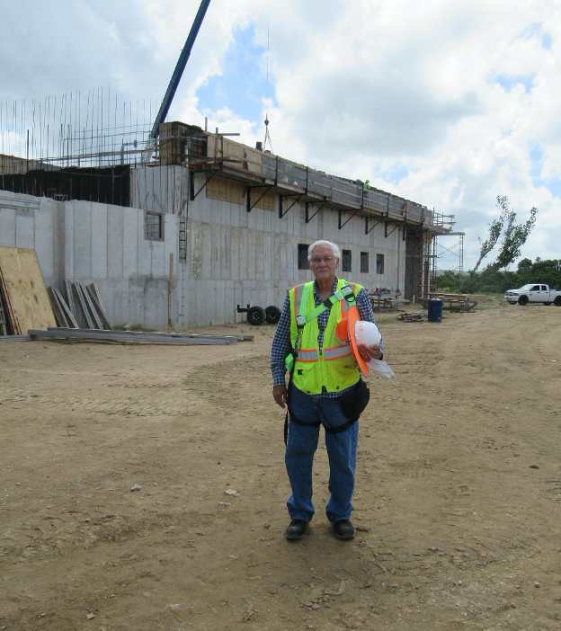
Juan M Gonzalez, PE, BSCE,ME,MBA,PMP, EdD
We are proud to announce that engineer Juan M. Gonzalez Juarbe, PE, MCE, MBA, PMP, has joined our organization as a new member of our team. He has been appointed as MDE/CPM team resident inspector engineer for Quality Assurance services, at the New Veterans Administration National Cemetery construction project, at Morovis, Puerto Rico. We wish Juan all the success in this new endeavor and hope to have him with us, for many years to come.

