Slide 1
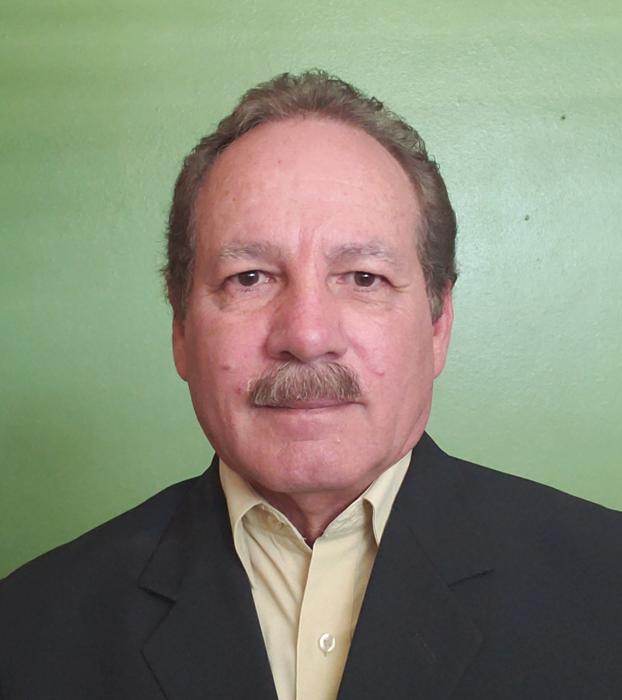
Iván Negrón Irizarri, PE,
MD companies welcomes and announces the integration of Ivan Negron Irizarri, PE, to our team. He will be working as Construction Inspection Engineer. We wish Ivan all the success in this new endeavor and hope to have him with us, for many years to come.

