Slide 1
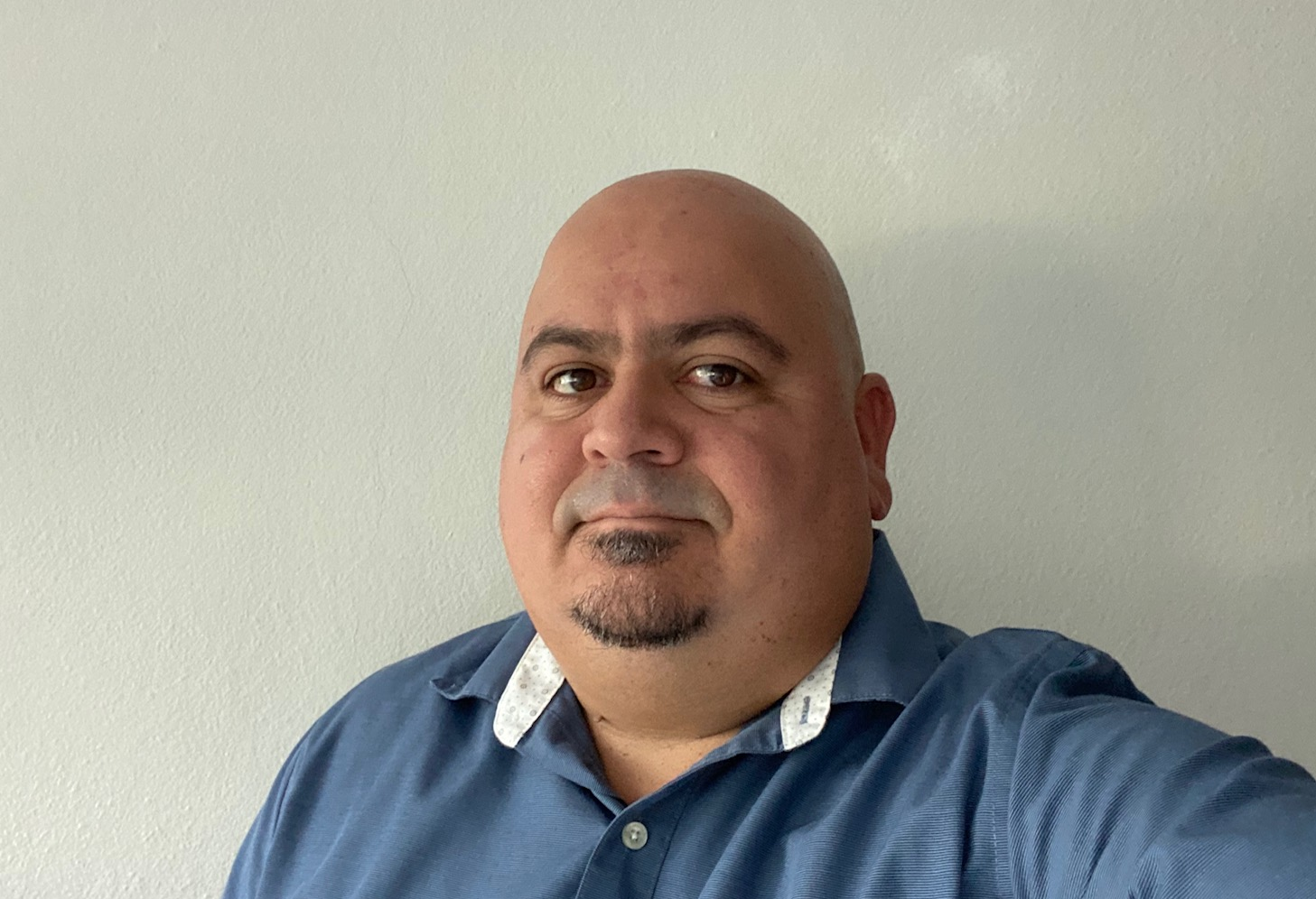
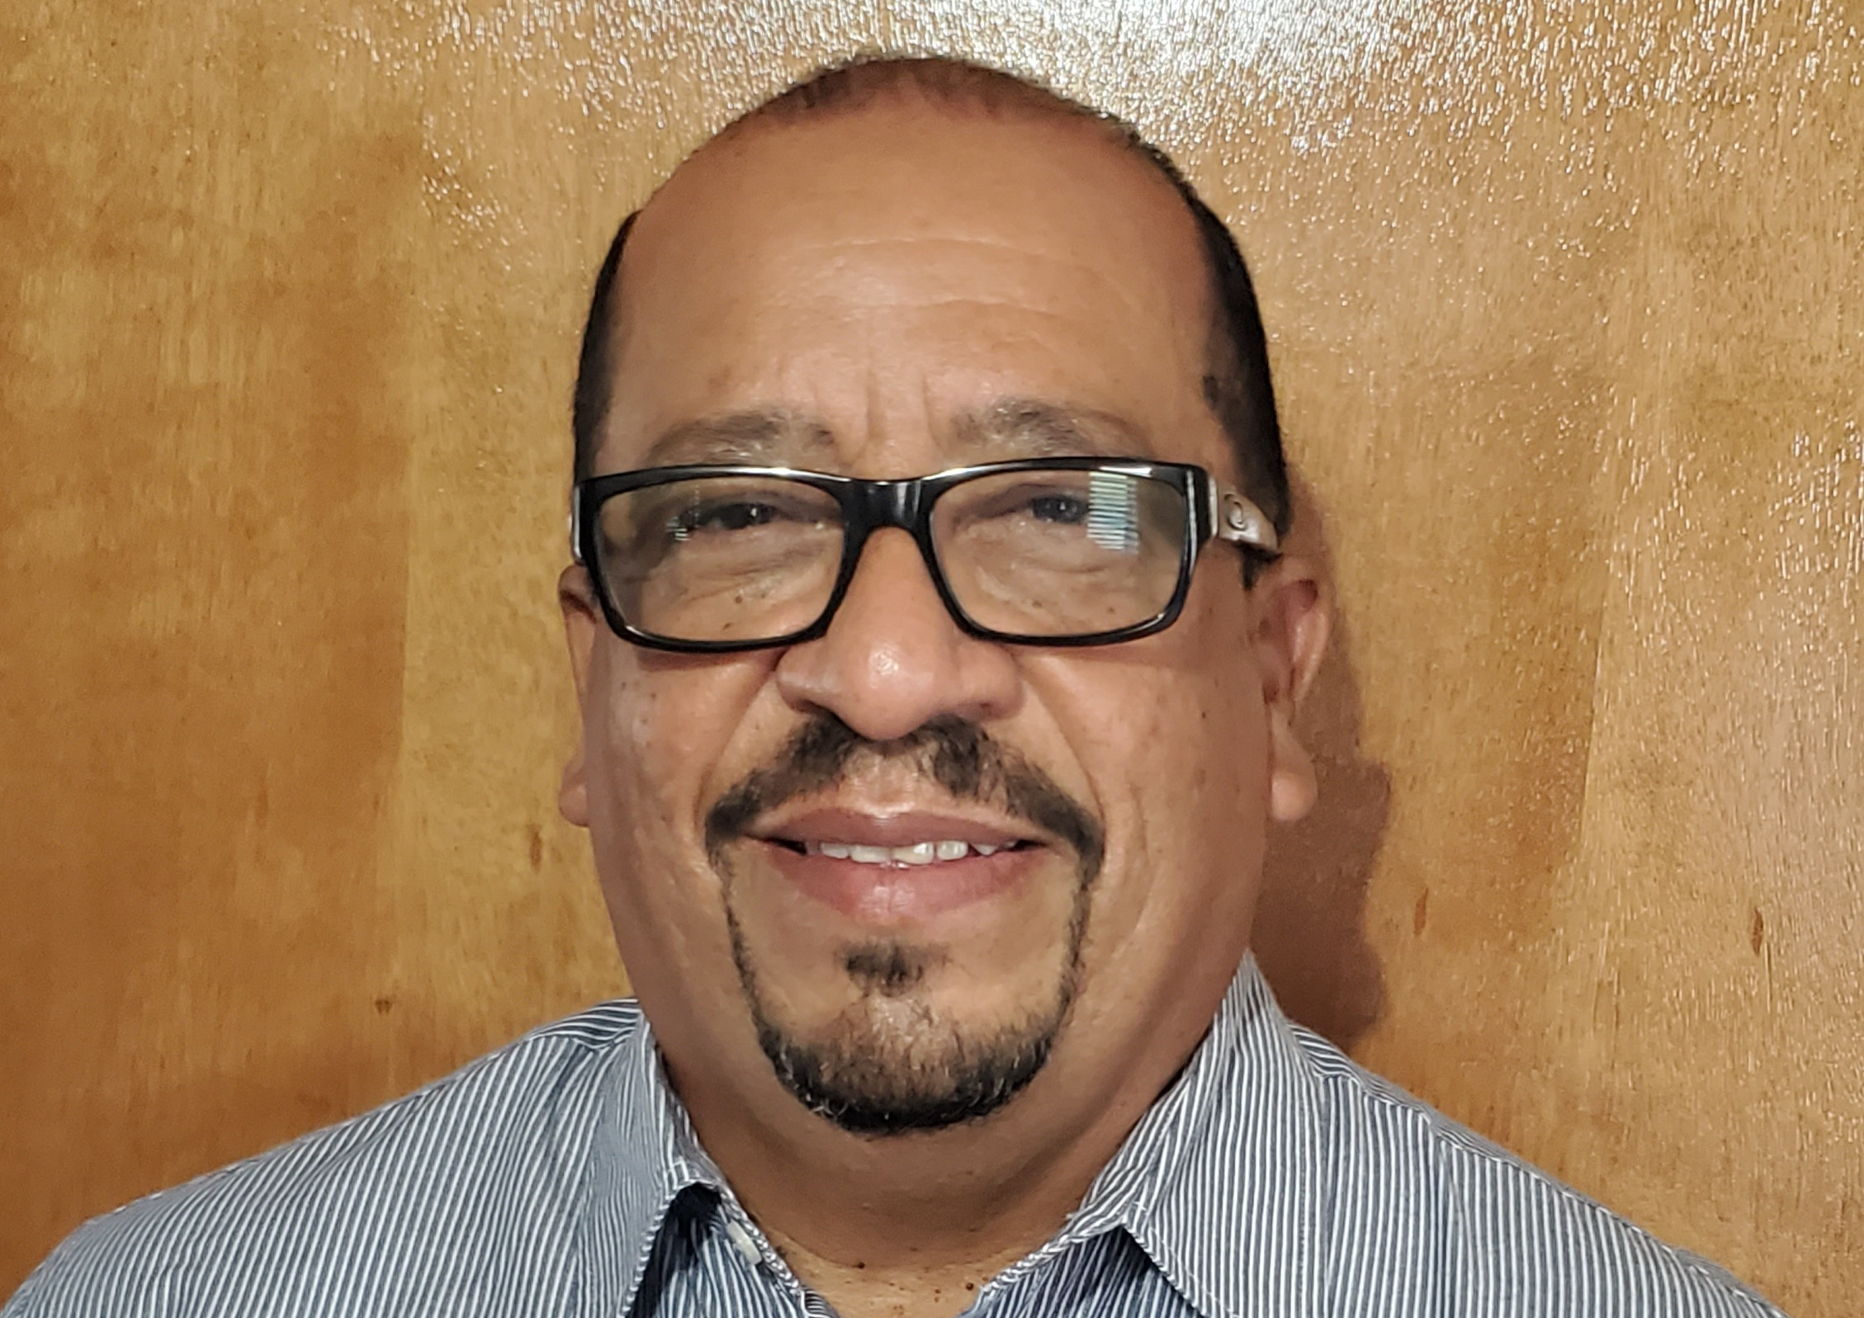
Enrique Méndez, Juan Sepúlveda, Kervin Freytes, and Carlos Centeno
MD companies welcomes and announces the integration of Enrique Méndez (BSCE, MSME), Juan Sepúlveda (BSCE, MME), Kervin Freytes, PE, and Carlos Centeno to our team. Enrique, Juan and Carlos, will be working as assistant project inspectors at the Puerto Rico Highway and Transportation Authority High Quality Maintenance projects, in the South Region of the Island. Kervin, as Inspection project manager at the Relocation of the Borinquen Potable Water Transmission Pipeline at El Caño Martin Peña in San Juan, PR.

