Slide 1
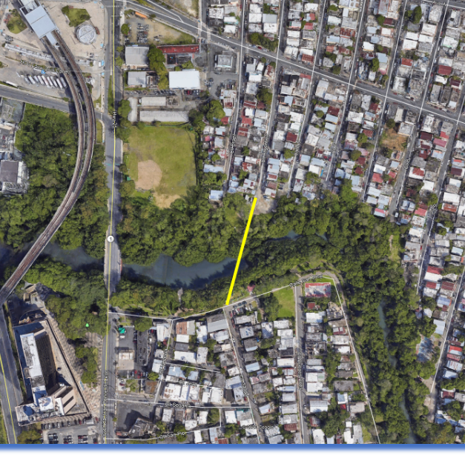
New 42" Water Supply Trunk Under Martín Peña Channel
July 2020 - Project management and field inspection for the New 42" Water Supply Trunk Under Martín Peña Channel in San Juan, Puerto Rico, for the Puerto Rico Aqueduct and Sewer Authority.

