Slide 1
Use of Stocking in the Management of Recreational and Commercial Fisheries: the Good, the Bad, the Ugly Lou D’Abramo
St. James Fishing Club
September 6, 2022

Slide 2
“Descriptors” of fish stocking as a method for fisheries management
Disruptive
Public Relations
Stunt
Successful
Haphazard
Adaptive
Political
Conservation
Not scientific
Ecological disaster
Indiscriminate
Opportunities

Slide 3
Areas of Focus
Current status of Recreational/Commercial Fisheries
Historical Background of Fisheries Management
Stocking as a Management Tool for Recreational and Commercial Fisheries
Other Potential Non-Stocking Solutions – Blue Corridors/Marine Protected Areas (MPAs)

Slide 4
The Status of Capture Fisheries (lb) -2020
Global US NC
Commercial 199 bil 8.4 bil 42.3 mil
Recreational 1.9 bil 353 mil 24.9 mil

Slide 5
NORTH CAROLINA DIVISION OF MARINE FISHERIES Annual Fisheries Bulletin, 2021
Commercial
42.3 mil lb
Hard blue crabs 12.0
Shrimp (heads on) 9.2
Striped mullet 2.1
Summer flounder 2.1
Catfishes 2.0
64.8%
Recreational
24.9 mil lb
Spotted seatrout 3.6
Yellowfin tuna 2.4
Dolphin 2.2
Bluefish 2.1
Spanish mackerel 1.8
48.6%

Slide 6
Recreational Fishing (freshwater and marine) in North Carolina and the US -2018
North Carolina
US
Economic Output $2.5 billion $129 billion
License Sales $752 million
Excise taxes $650 million
Anglers 2.26 million 52.4 million
Hatchery produced trout stocked from March through June annually
2022 – 964,000 (96% at least 10 inches in length)
Brook, Brown, and Rainbow

Slide 7
Florida
1980 2006 2019
Population of FL (mil) 10 18 20.9
Recreational fishing 15 47.5 72.0
trips (million)
Catch (million lb) 127.6
Economic Impact - $ 13.2 billion annually ($ 9.2 billion marine)
Past stock enhancement endeavors:
Red drum, snook, sea urchin
Limited assessment

Slide 8
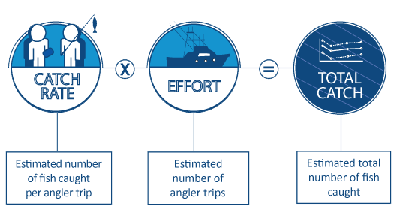
Recreational Fishing Catch

Slide 9
Historical perspective of hatchery produced and released fish
Mid 1800s – brook trout –east to west; rainbow trout –west to east
1831- common carp introduced into US
1871 – US Fish Commission established
1872 - First federal fish hatchery (provide fish for the food market) augment wild populations San Francisco Bay

Slide 10
Historical perspective of hatchery produced and released fish
1872 – First federal fish hatchery established (CA)
1872-1880 8 million shad fry released into CT River; US Fish Commission
1879 and 1881, transfer of striped bass from Atlantic coast (NJ) and stocked into San Francisco Bay

Slide 11
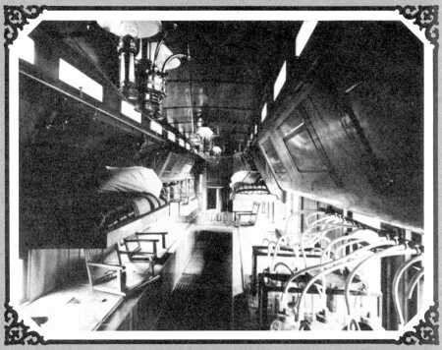
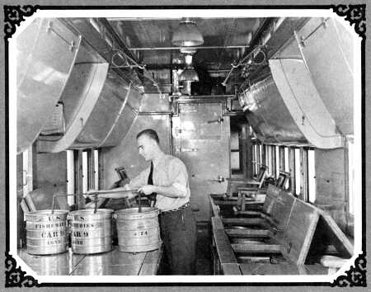
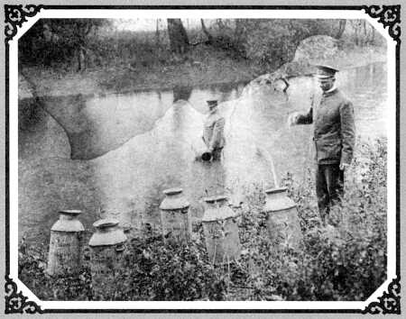
Fish Car Era
1874-1940

Slide 12
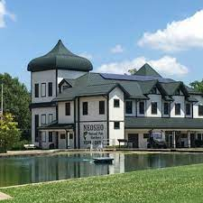
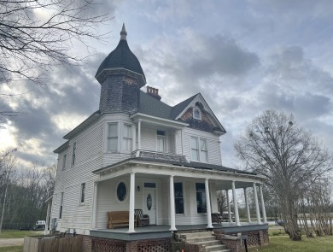
70 National Fish Hatcheries raise and stock over 100 million fish every year to support recreational fishing, tribal subsistence
fisheries, and the recovery and restoration of imperiled species
Private John Allen National
Fish Hatchery, 1901-
Gulf Coast Walleye Restoration
Neosho National Fish
Hatchery, 1888-
June 10th, 2022, marked the 150th anniversary of the U.S. Fish and Wildlife National Fish Hatchery System!

Slide 13
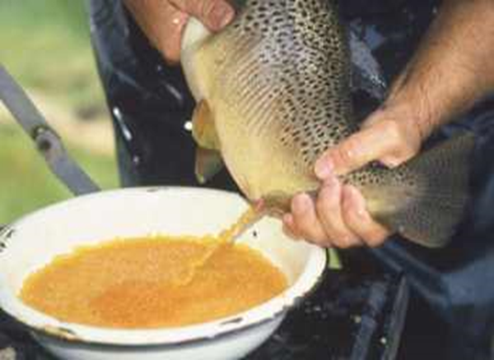
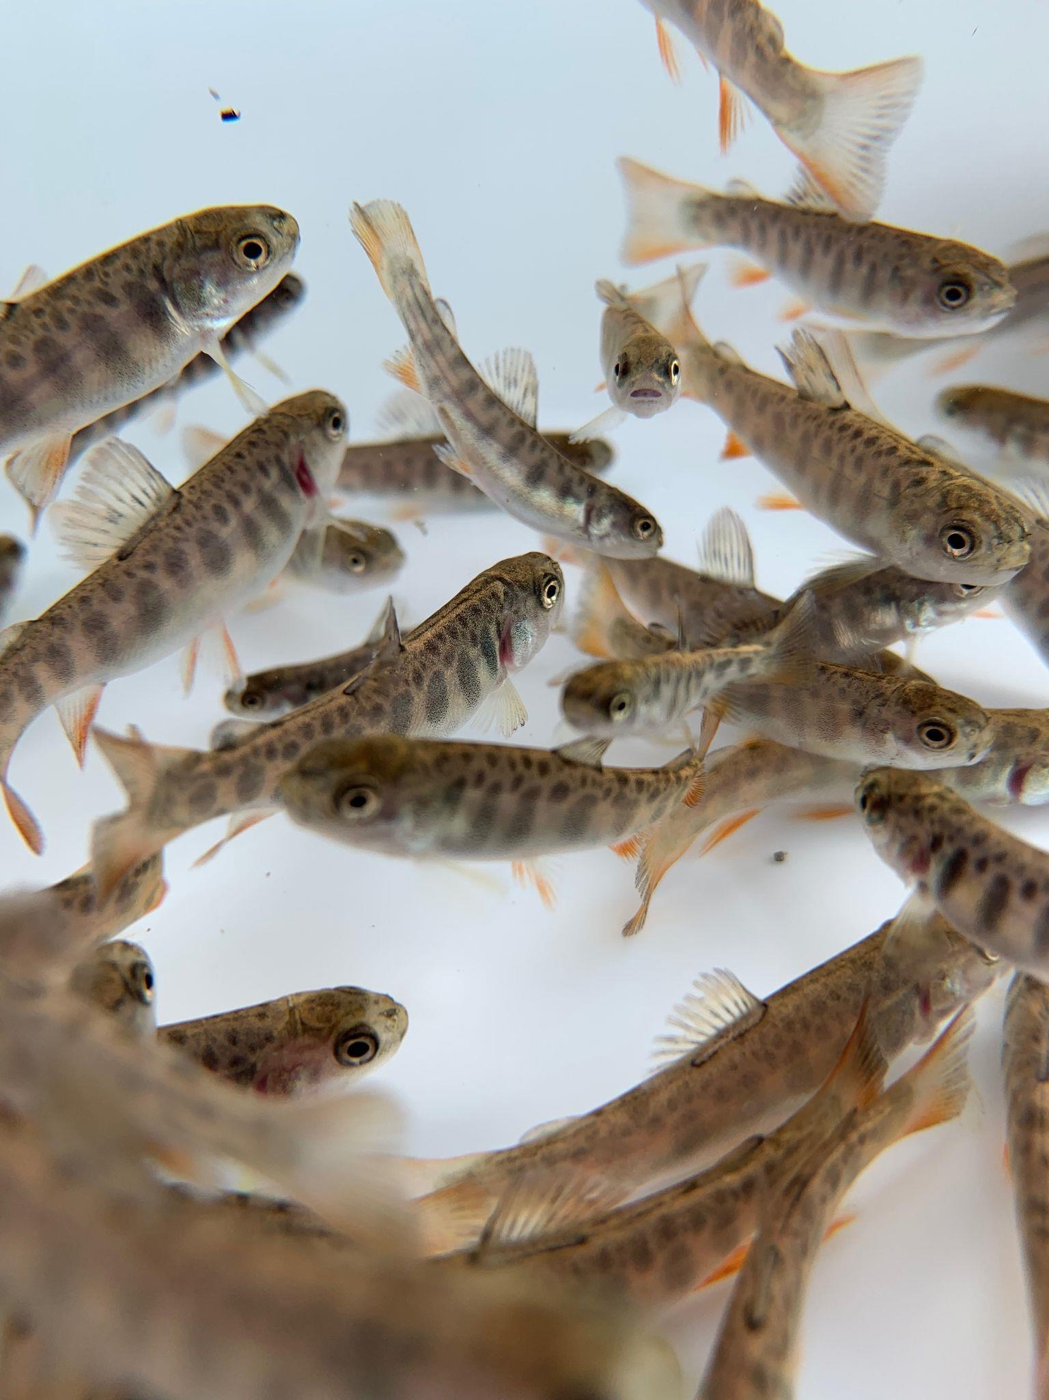
Historical perspective of hatchery produced and released fish
1950 - Dingell Johnson Sport Fish Recreation Act - $$$ for recreational fisheries management
1970s - Renewed Interest- aquatic resources are part of the public domain; the rise of aquaculture

Slide 14
And then along comes aquaculture
The knowledge & technology to mass produce juvenile fish!!

Slide 15
Historical perspective of hatchery produced and released fish
1990s – experiments to determine whether cultured marine fish actually contribute to fishery landings
21st century - Globally 35-150 billion fish are raised in captivity to be released into the wild every year
US - 1700 million stocked (94.1% state hatcheries/5.9% federal hatcheries

Slide 16
The Global State of Marine Fishery Enhancement - 2020
Annually, over 20 countries release 26 billion juveniles of 180 marine species into the wild
Economically unprofitable
Hatchery fish fitness reduced
Fitness of wild population is decreased

Slide 17
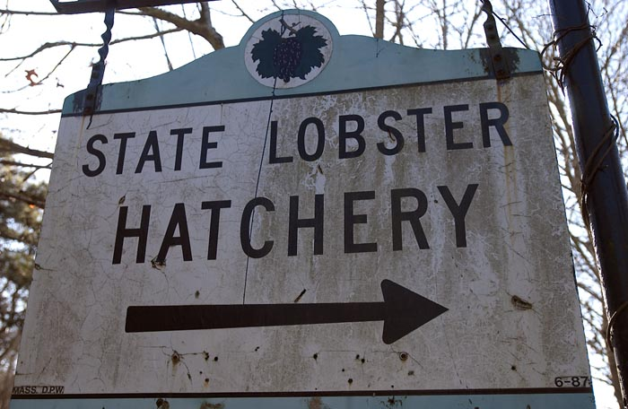
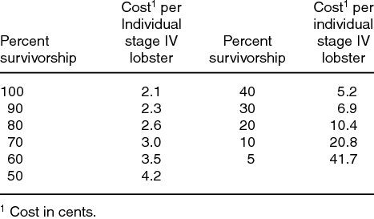
1951-1984
80% survival = $13,000 X 30 =~ $ 0.390 million

Slide 18
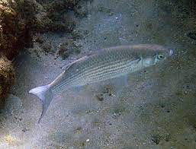
STRIPED MULLET - HAWAII
Stock enhancement in a commercial/recreational fishery
Kaneobe Bay 1990-1993 - by 1994, stocked fish= 13.0 % in commercial catch
Hilo Bay 1990-2000 (20,000
fingerlings/yr – 21.7 % increase in recreational catch
Is it worth it? ….the cost per fish.

Slide 19
What drives the need?
Overfishing inadequate recruitment
Habitat degradation loss of resource
Poor fisheries management - ineffective policy
Need to provide availability of aquatic resources as part of the public domain

Slide 20
Hatchery knowledge and technology
Fisheries Management Tool
Stocking
Establishment
(New Opportunity)
Re-establishment
(Reclaimed
Habitat)
Balance
(Community
Stability)
Replenish
(optimize
harvests)

Slide 21
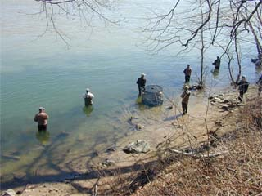
Recreational fishing
pressure on public waters is increasing dramatically
How is the need for the fishing experience to be satisfied ?

Slide 22
Sustainable Recreational Fisheries Management
Control of harvest
Maintenance of habitat
Stocking

Slide 23
Develop a Species Management Plan
(Adaptive management)
Production and Management
Objectives with
Targets
Assessment Effects/ Economics
+

Slide 24
Management Factors for consideration
Target species
Relationship to other members of the fish community
Release – when, where, how much, what size
Contribution to the fishery (economic impact)
Policy guidelines (fishery managers, scientists, NGOs) - implementation, education, enforcement
Impact on or reaction of society (public perception)

Slide 25
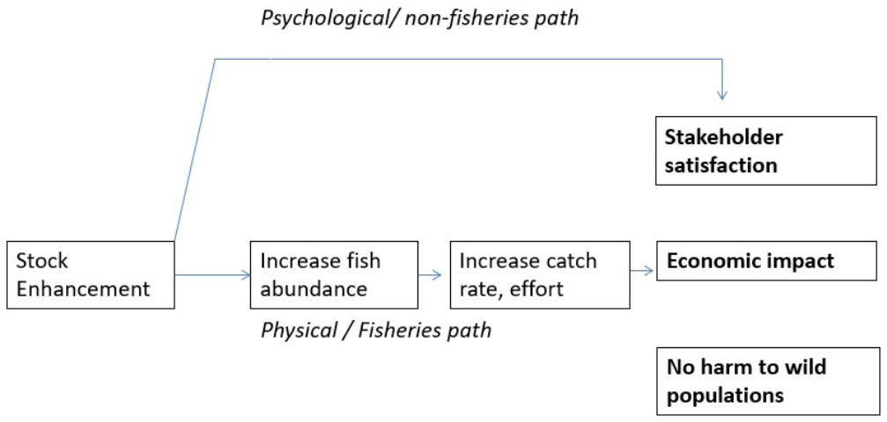

Slide 26
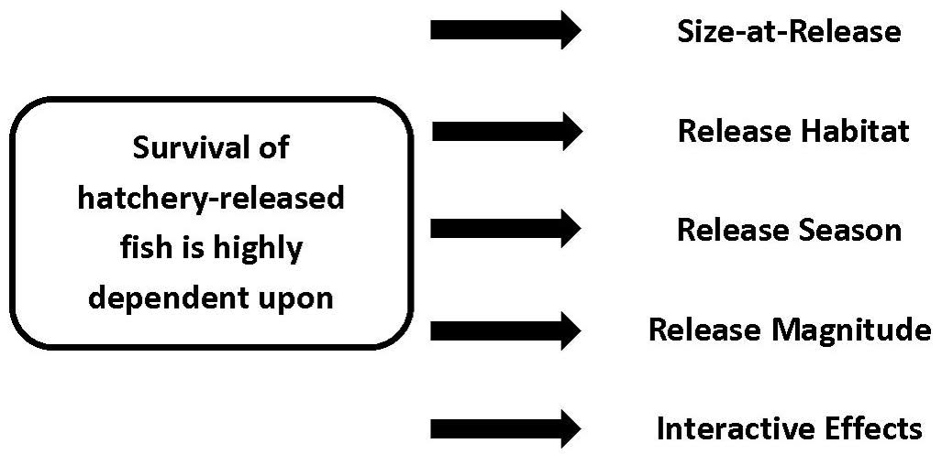
Variables affecting stocking success

Slide 27
POST STOCKING ASSESSMENT (Cost vs. Benefit)
Population levels and structure
Genetic status/composition of the stock
Survival, growth, behavior of the stock that originated from the hatchery
Interspecific and intraspecific interactions (ecological balance)
Increased landings
Economics
Societal value

Slide 28
Trout- Colorado Division of Wildlife
Policy – “Maintaining habitat productivity for human benefit”
Justification-”many of Colorado’s accessible waters cannot sustain natural sport fisheries which are acceptable to the public”
Anglers - one million
Economic impact - $932 million

Slide 29
RESPONSE
Stocking of trout (rainbow, brook, brown, cutthroat) to meet the angler demand

Slide 30
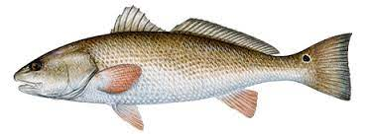
RED DRUM IN TEXAS
1850 – Commercial fishery began
1919 – Regulatory controls
Size Limits
Bag Limits
Net Restrictions

Slide 31
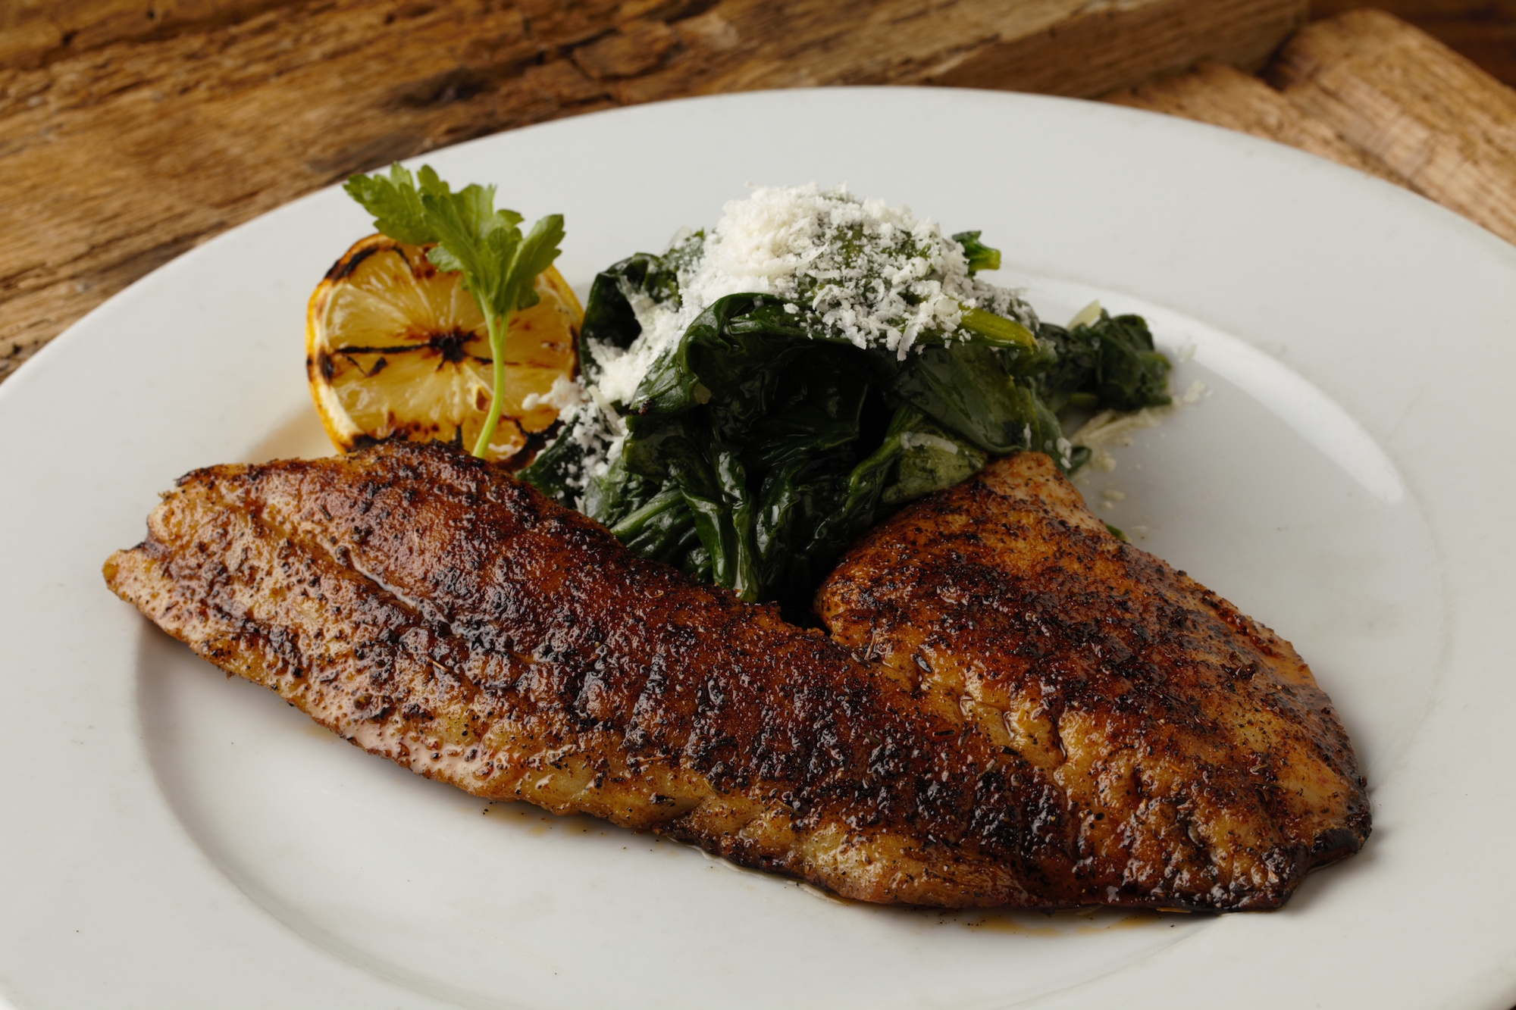
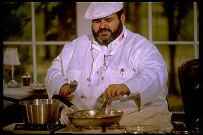
Red Drum in Texas
1976-1979 – Commercial harvest decreased by 65%
Blackened redfish craze (1980)
Chef Paul Prudhomme

Slide 32
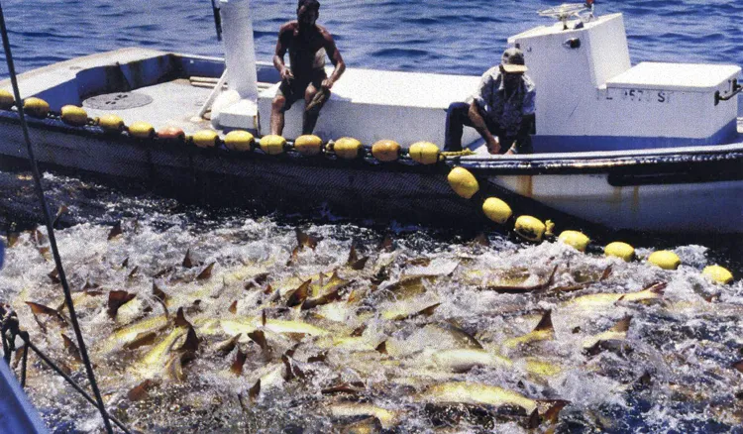
Why? Poor Fisheries Management

Slide 33
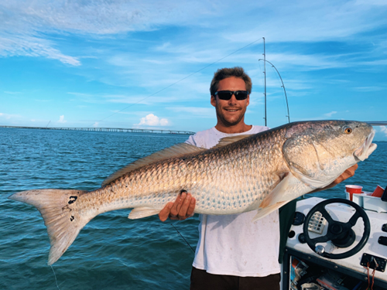
1981 - Texas Legislature banned the sale of red drum from Texas waters
Eliminated commercial harvest; limited recreational harvest
Designated as a gamefish
1983 – Large scale restocking of juveniles into bays; 25-30 million juveniles released annually
(1993 – 2004) 1990 – 100 % increase over historic mean

Slide 34
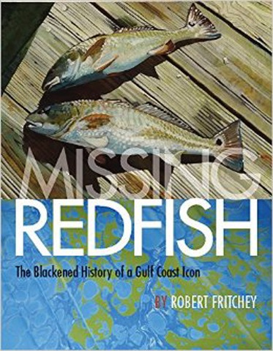
2017

Slide 35
A Fisheries Management Program
Joint recognition of
THE VALUE OF HATCHERY PRODUCED FISH
VERSUS
THE VALUE OF WILD STOCKS

Slide 36
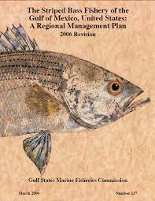
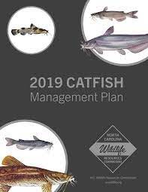

Slide 37
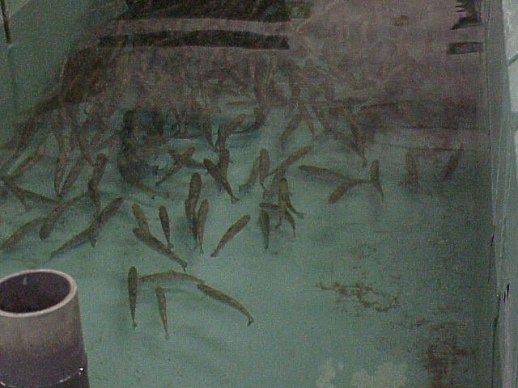
Should hatchery produced fish be used for natural resource management?
“To be a wild fish or not to be a wild fish”
Is a fish produced in a hatchery a wild fish?
When does a hatchery produced fish cease to be a wild fish?

Slide 38
Concerns relative to the impact/fate of hatchery fish
Reduction in genetic diversity
Introduction of parasites or pathogens from infected hatchery fish
Loss of adaptive behavior
- Reduced competitiveness
- More susceptible to predation

Slide 39
Responsible Use of Hatchery Stock
Maintain genetic integrity (avoid outbreeding depression)
Health management (certified inspections)

Slide 40
Notables – Stock Enhancement
A TOOL…..but effects remain inconclusive, still difficult to assess
NOT ALWAYS APPROPRIATE for all management situations
SCIENCE BASED – NOT political/public pressure based (maintain integrity)
Clear MEASURABLE RESPONSES to assess cost benefit

Slide 41
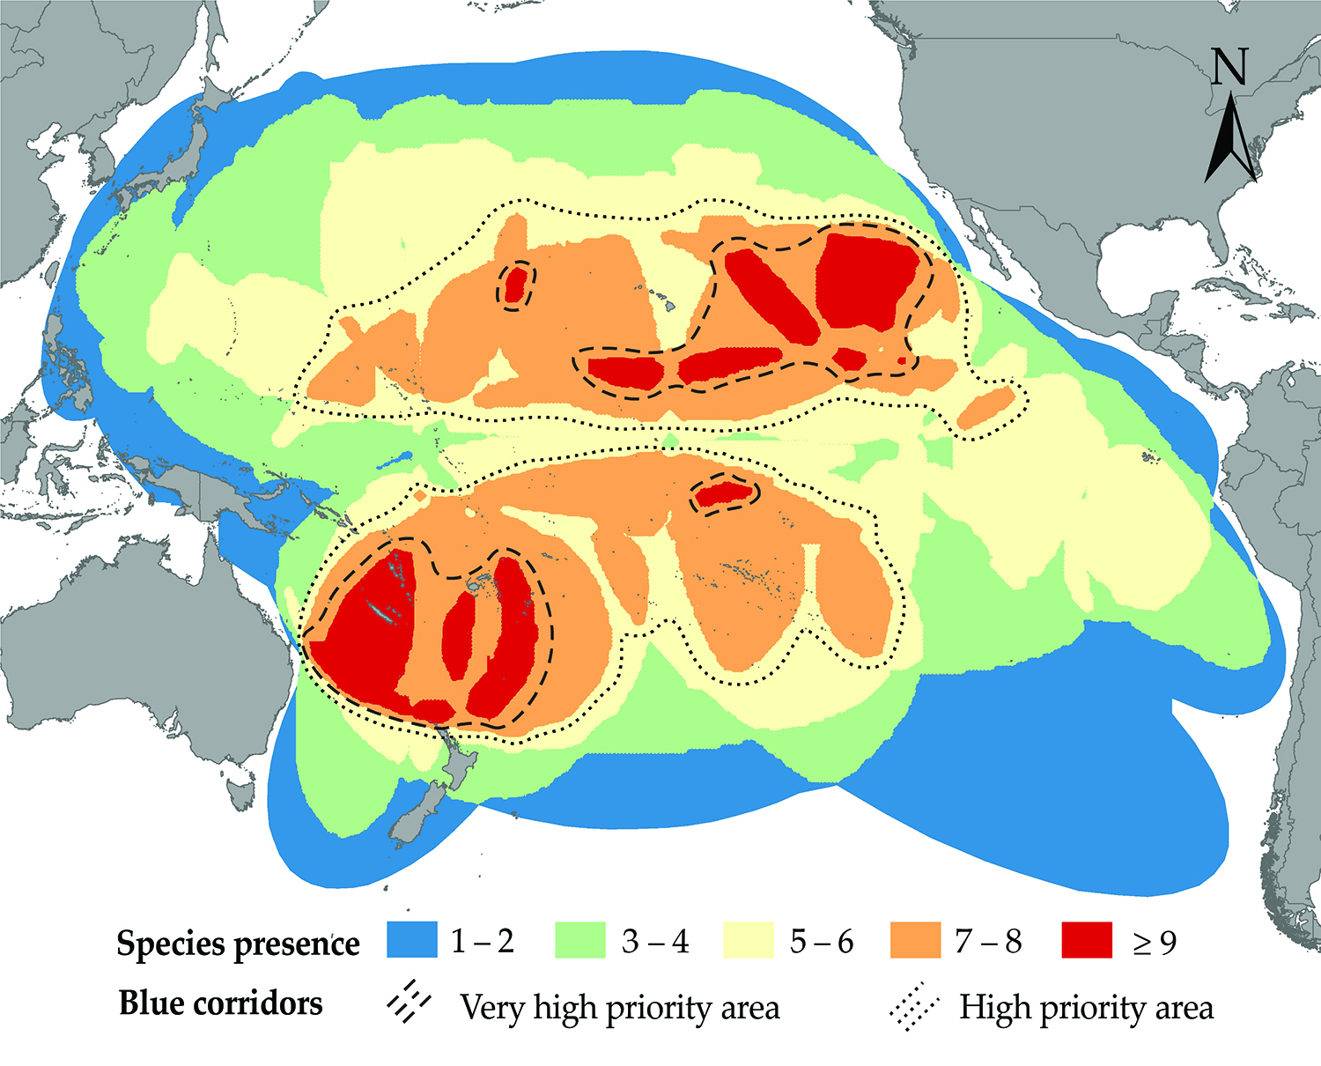
But, what about marine commercial and recreational fisheries?
Philopatry-Fish return to their natal site to
produce offspring

Slide 42
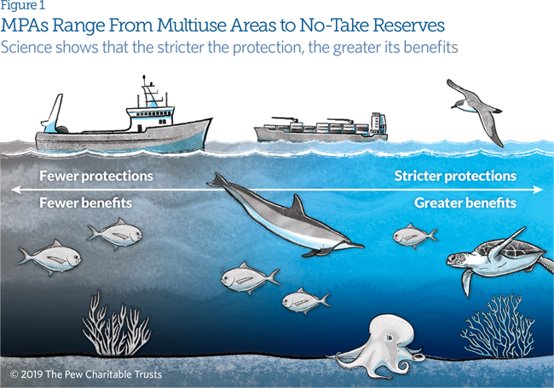
Marine Protected Areas (MPAs)

Slide 43
“Ecological Conscience”
The value of wild stock
Biological feasibility - Ecosystem approach
Adaptive Management approach
Accountability (Benefit vs. Risk)

Slide 44
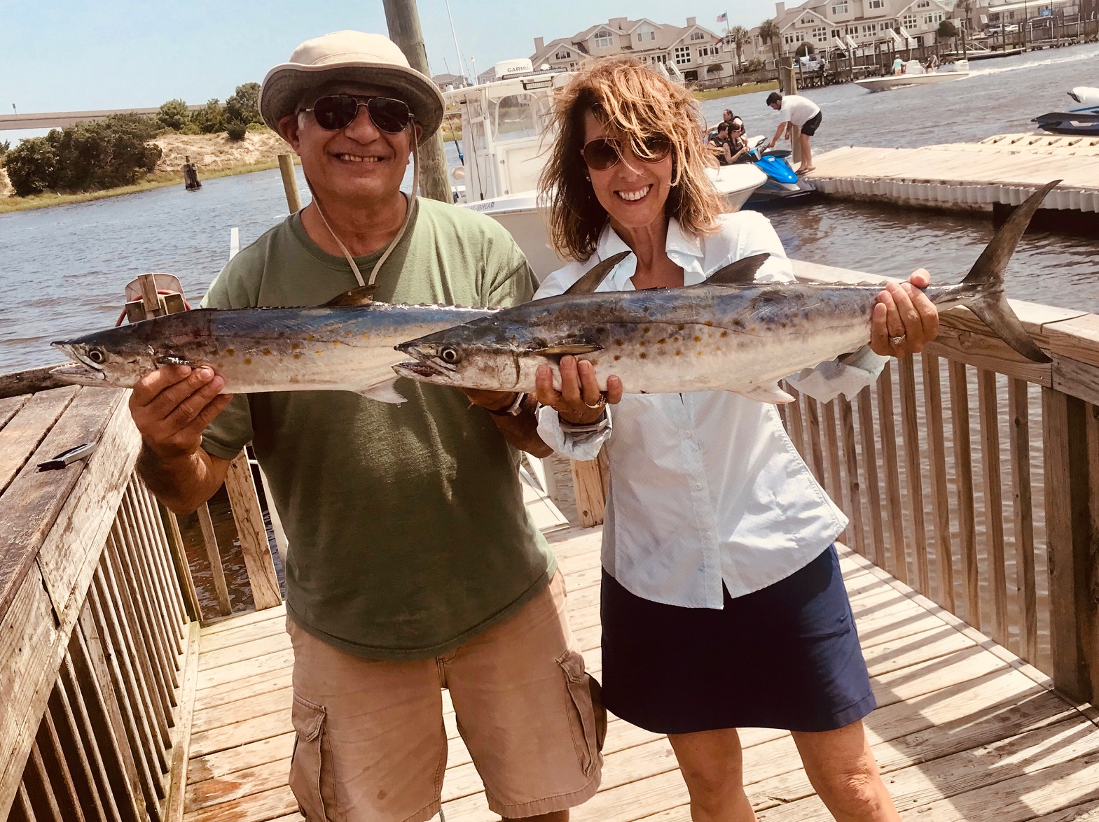
QUESTIONS/COMMENTS

