Slide 1
PORWAL TEA COMPANY
www.porwalteacompany.com

Slide 2
Welcome to Porwal Tea Company " We Believe Quality Tea , Reasonable Rates and Fair Dealing "
About Us
Established in the year 1980, at Indore (Madhya Pradesh, India), we, “Porwal Tea Company”, are an experienced and accredited organization engaged in the domain of Wholesaler, Trader and Retailer rich in taste Loose Tea and Packet Tea. Our offered tea is widely demanded for its mesmerizing aroma, high nutritional content, delectable favor, briskness, less amount of caffeine and essential nutrients. With an aim to ensure the presence of aforementioned features, our quality processors process this tea by making use of the best grade fresh and hand-picked tea leaves. Prior to dispatch, our quality controllers check this tea by using modern machines so as to ensure its synchronization with the established quality standards.
Under the efficient guidance of our mentor, “Mr. Shreyansh Jain”, who has rich experience in this domain, we have established a strong foothold in the market.
TESTING FACILITIES
Quality does not only begin with a letter Q , It must be followed by U.
We have experts for best tea testing and perfect reviews, so that our customer can depend with full trust and confidence

Slide 3
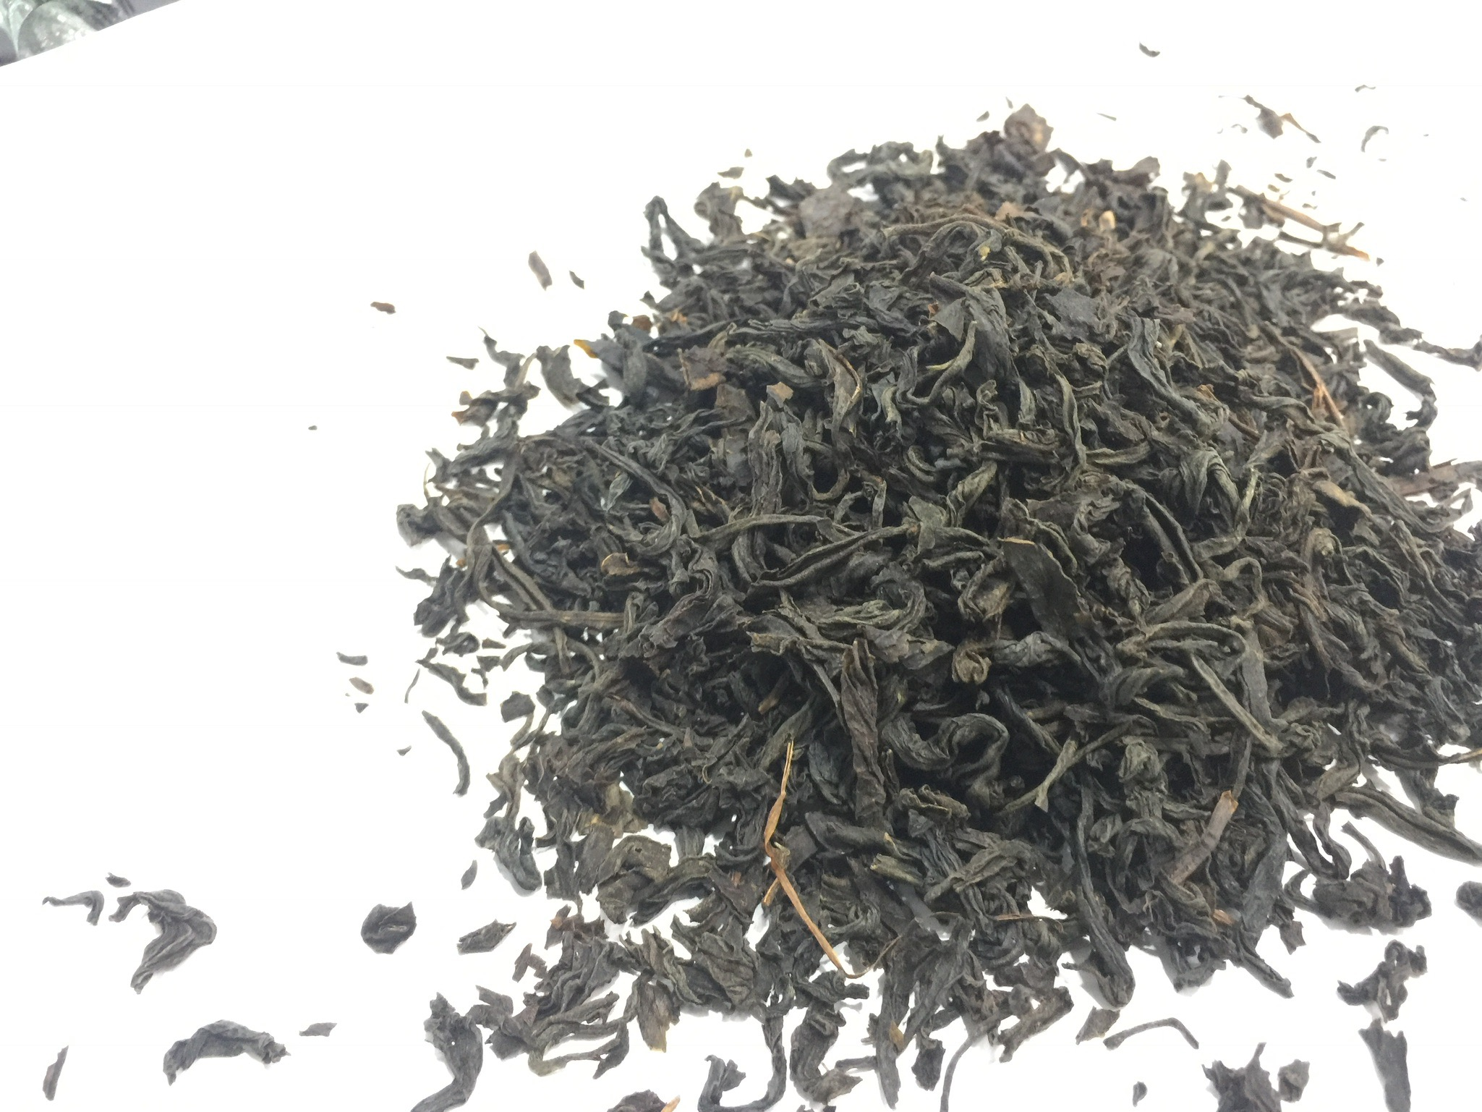
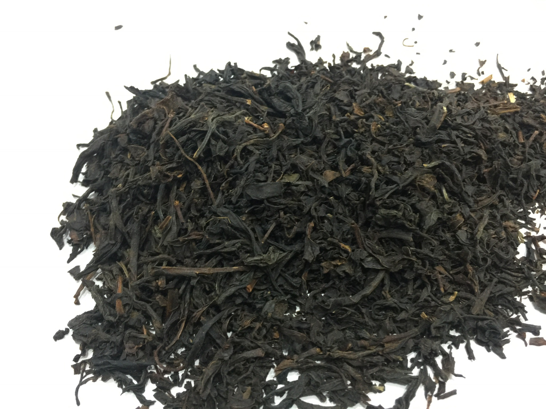
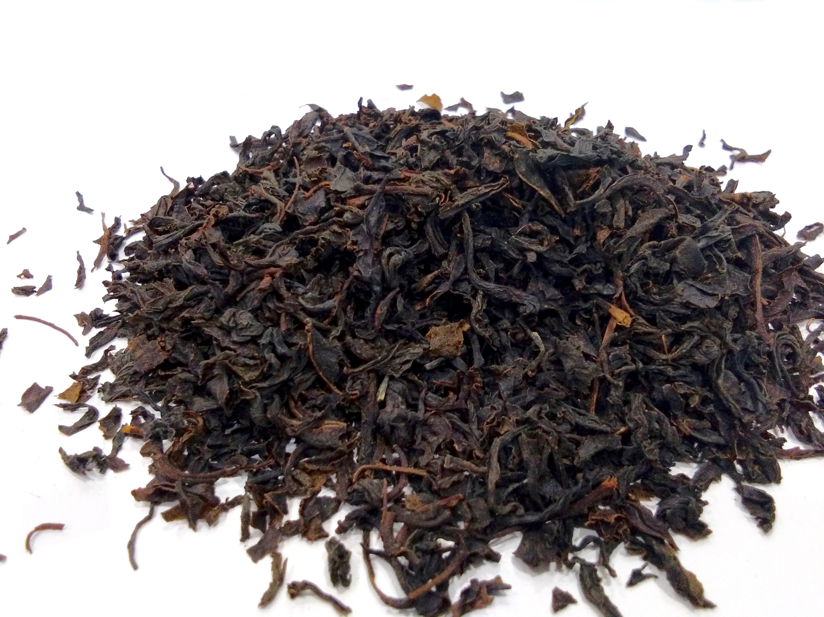
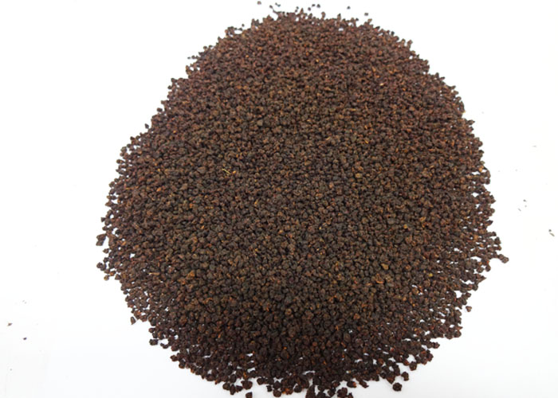
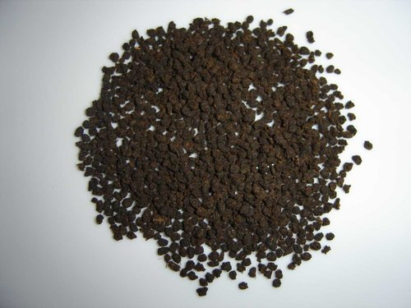
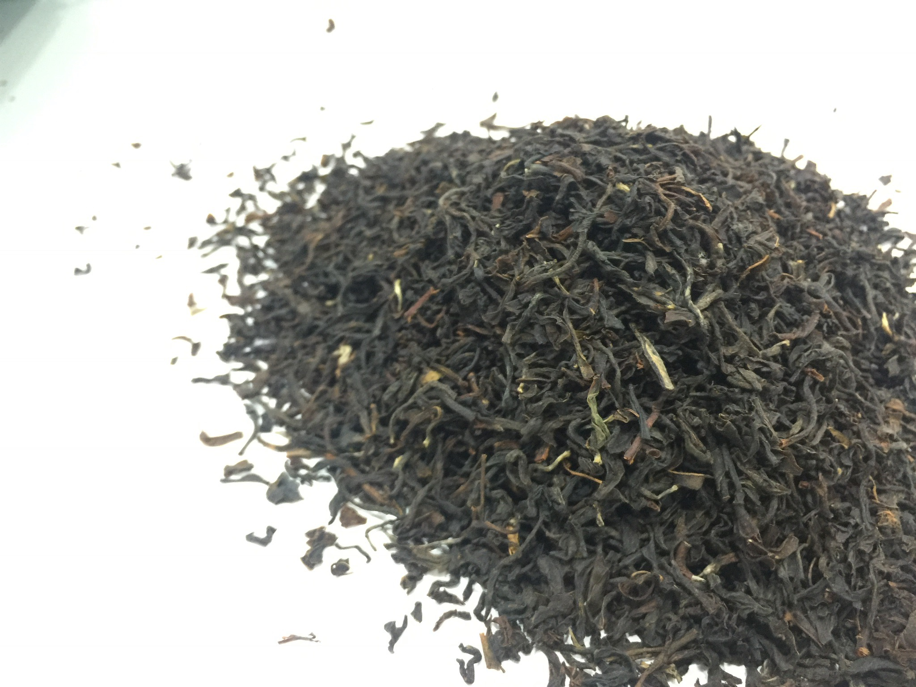
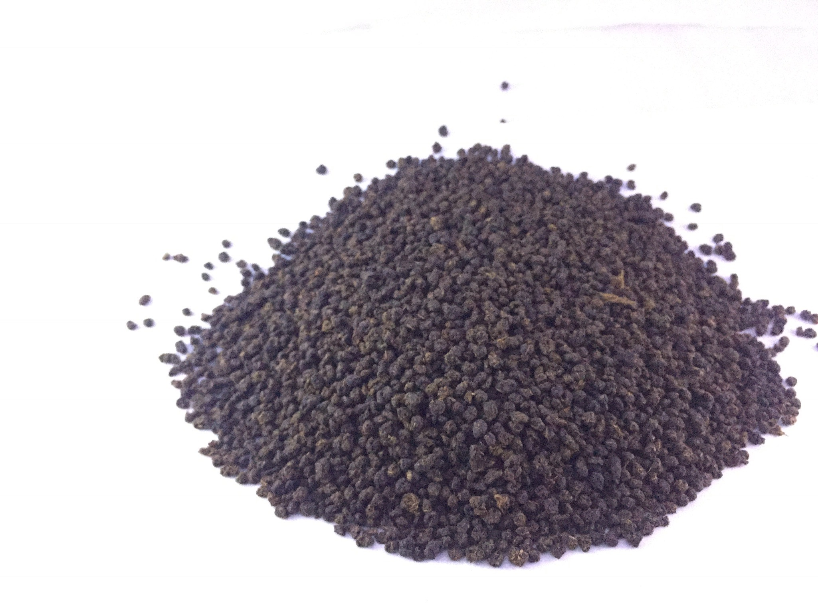
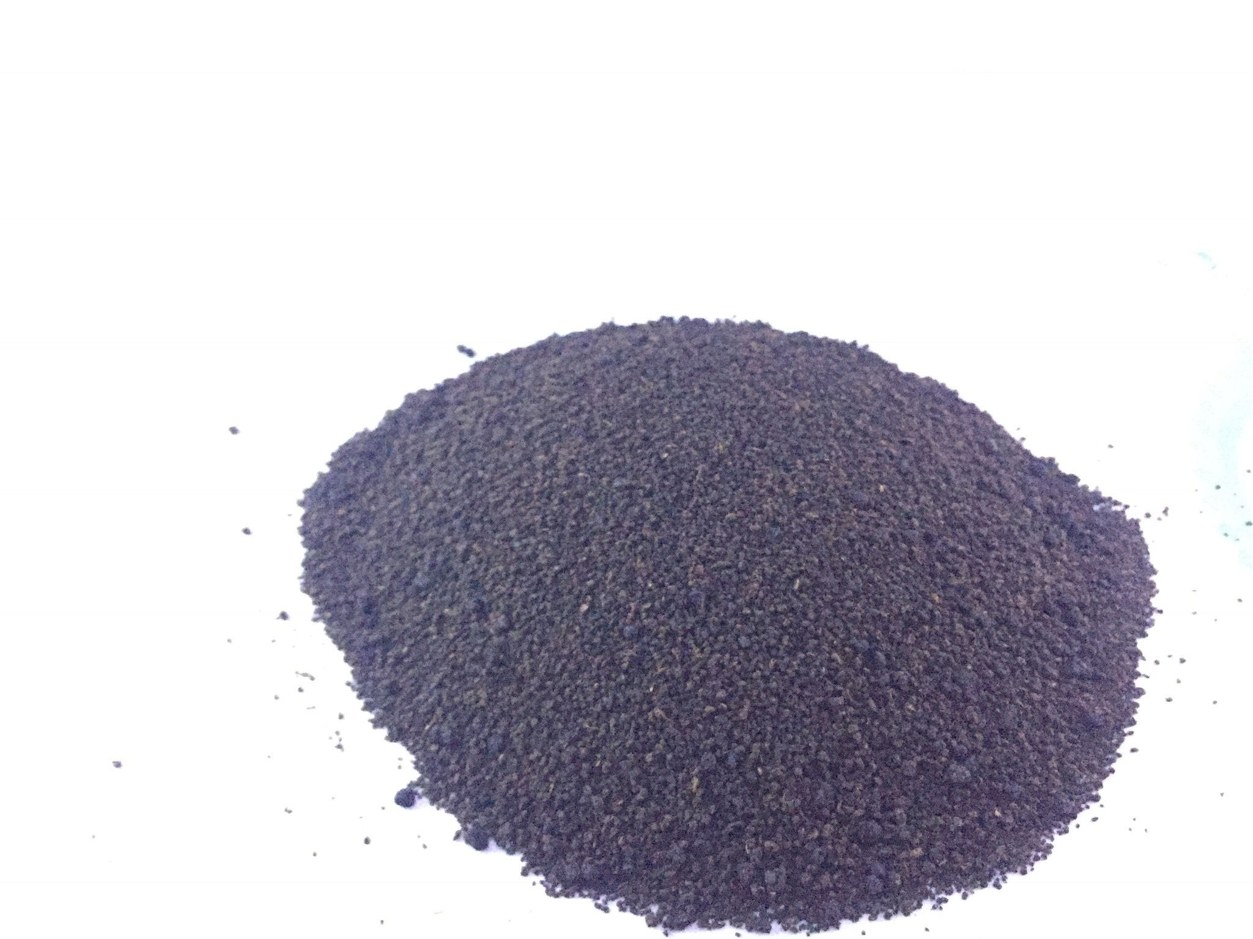
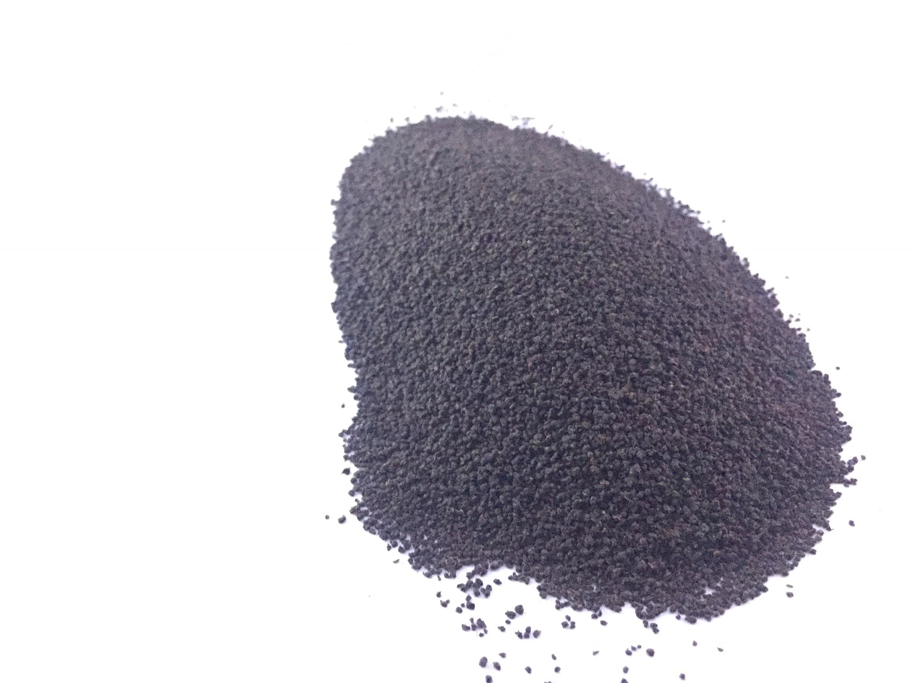
CTC Granules and LEAF
PF—Pekoe Fannings
OF—Orange Fannings
BP—Broken Pekoe
BPS—Broken Pekoe Souchong
BOP—Broken Orange Pekoe
PD—Pekoe Dust
D1—Dust
FOP—Flowery Orange Pekoe
GFOP—Golden Flowery Orange Pekoe
TGFOP—Tippy Golden Flowery Orange Pekoe
FTGFOP^{[a]}—Finest Tippy Golden Flowery Orange Pekoe
Single Grade CTC
Single Grade LEAF

Slide 4
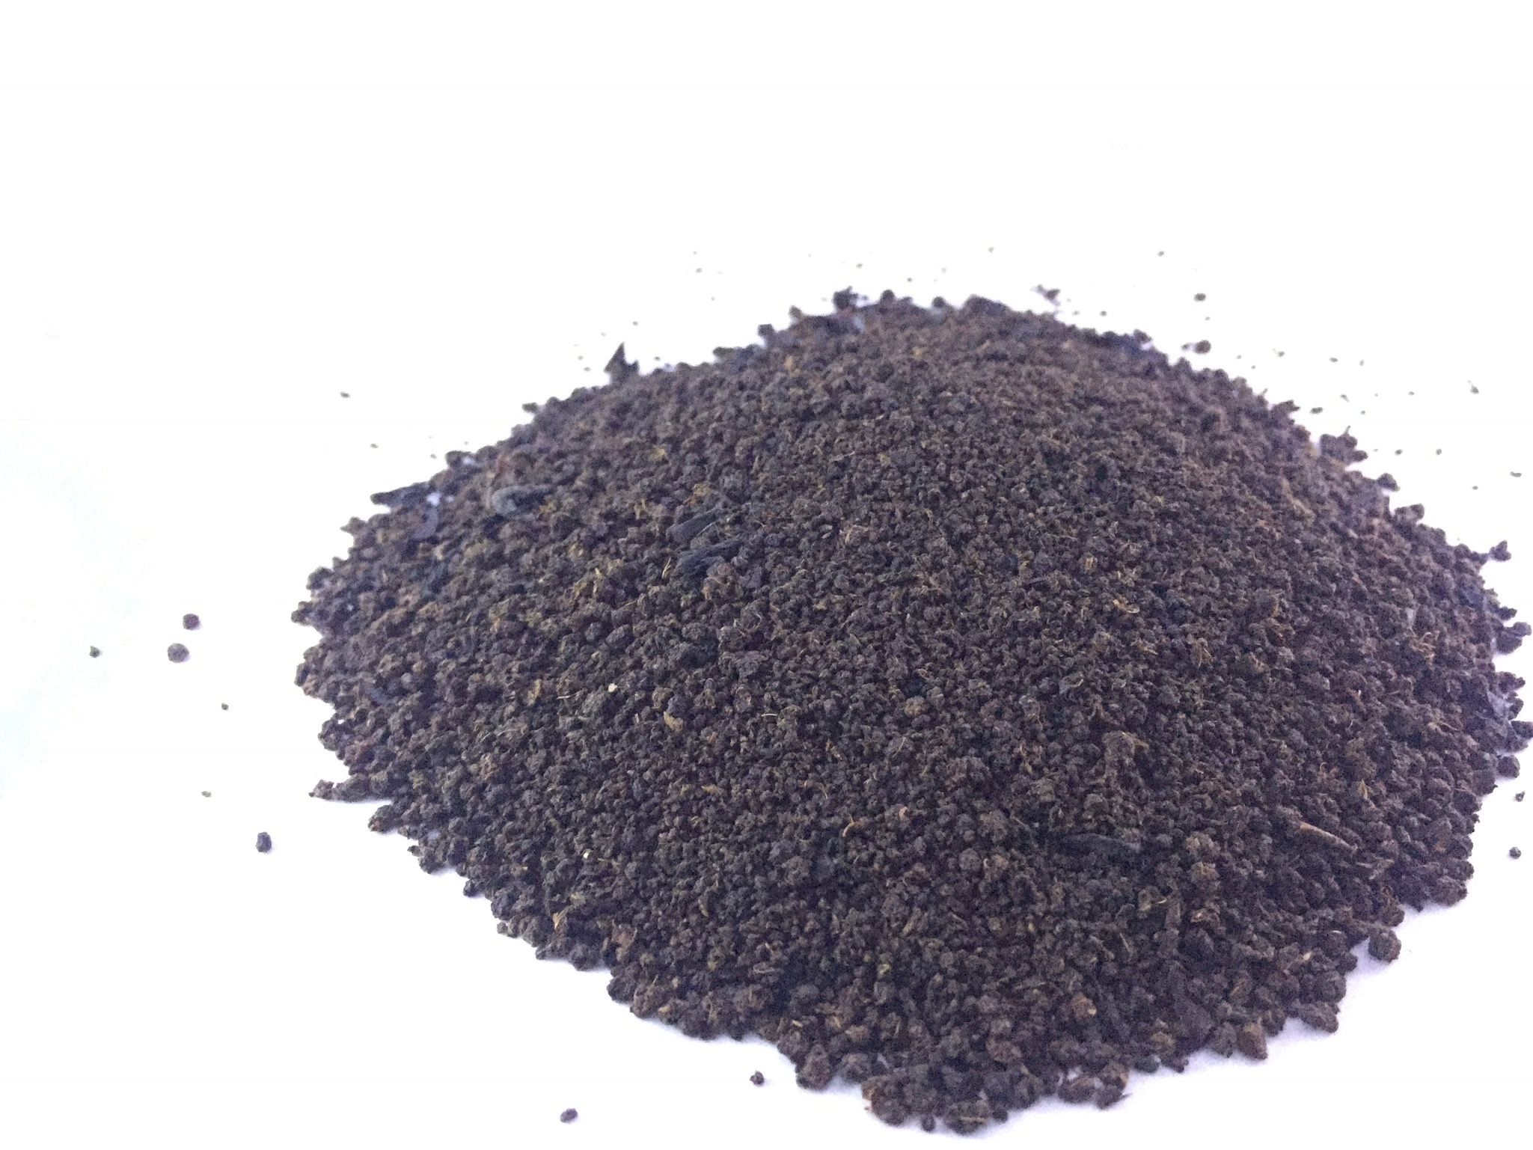
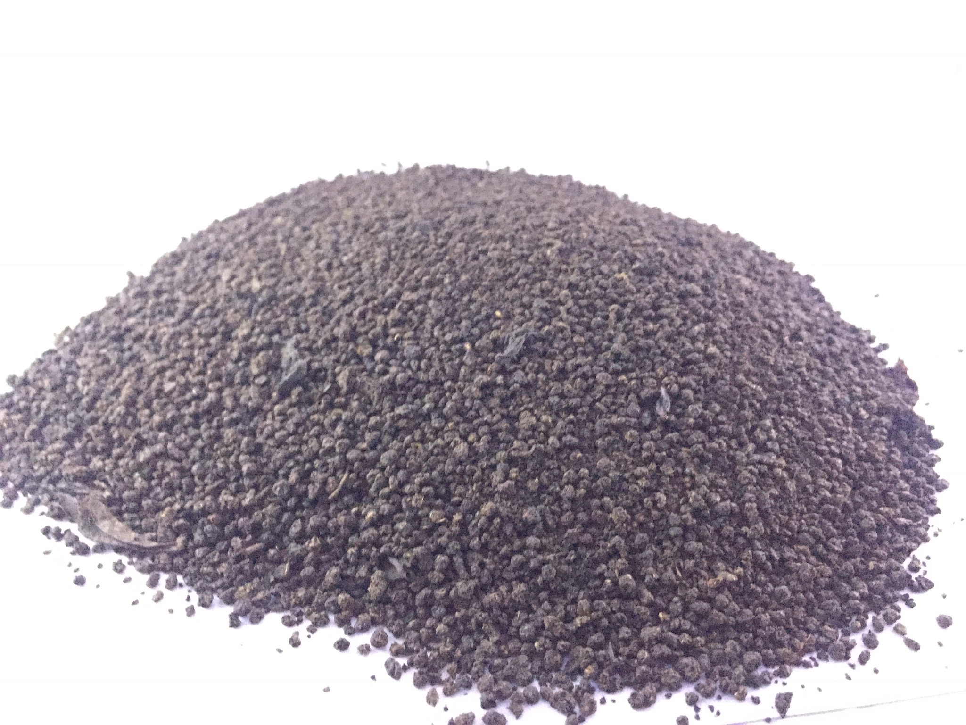
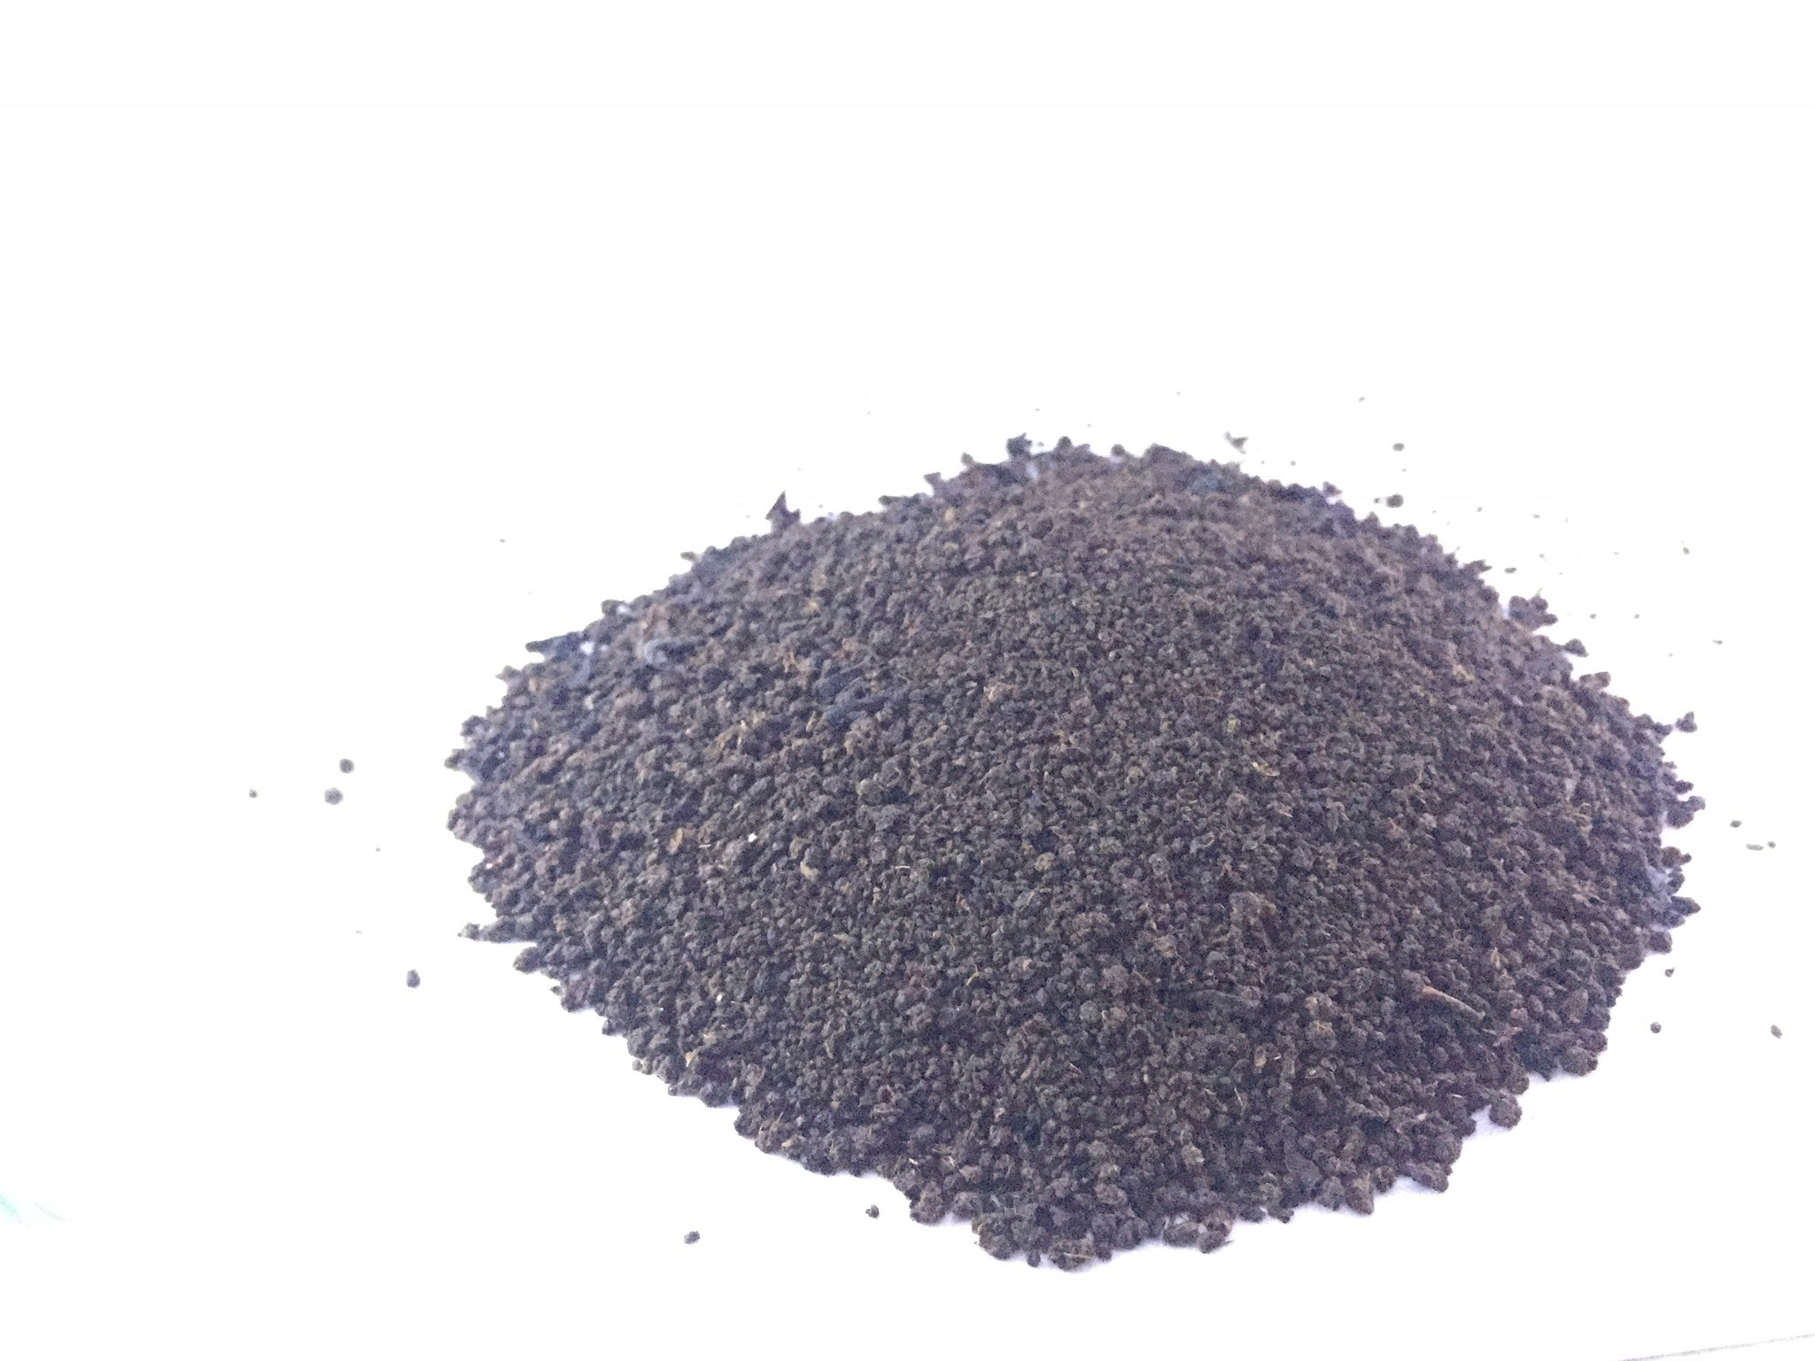
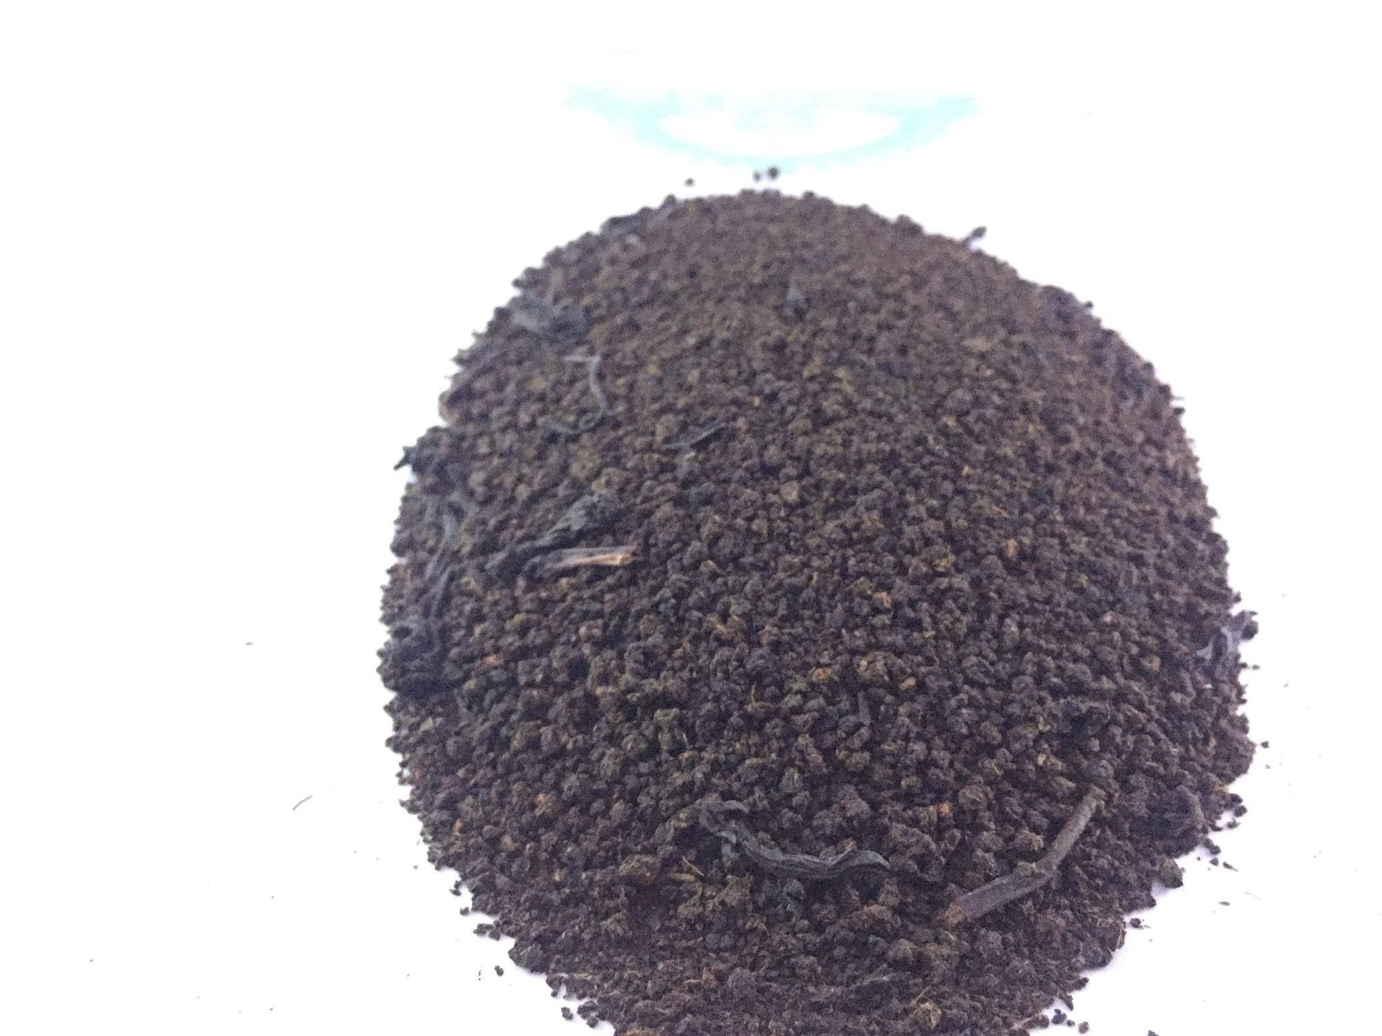
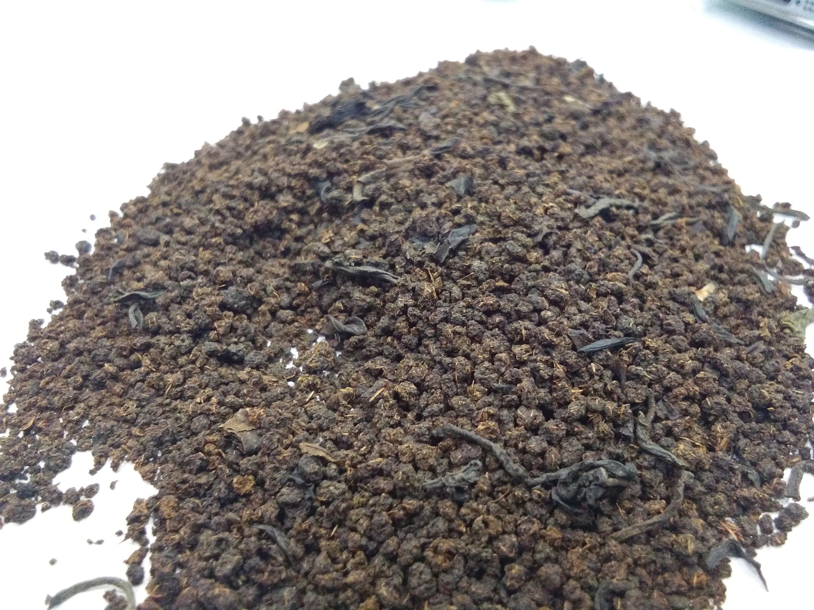
PORWAL TEA PREMIUM BLENDS
JANSEVA RED (30% small and 70% big granules with appropriate grades)
JANSEVA GOLD (90% small and 10% big granules with appropriate grades)
CHEETAH GOLD (equal proportion of appropriate grades)
SUNDER NAGAR (equal proportion of appropriate grades)
JANSEVA GOLD 2 (mix of red and gold with appropriate grades)
SPECIAL MIX (taste of several Assm and Darjeeling)
BLENDS
In order to maintain our already set benchmarks,
we provide for our clients, Blend Loose Tea.
These blends are made by experts with a
higher blending knowledge and experince
of ASSAM & DARJEELING

Slide 5
PORWAL TEA COMPANY
Premium Black tea in India
*Our Tea are widely spread in different states of India
*We only Deal in Assam and Darjeeling Pure Tea
*We have the largest storage capacity and we have all types of black tea ,CTC or Leaf Tea etc
*Our export clients are always satisfy with the reasonable rates.

Slide 6
Rules & Formalities
Every grades have their different type of rates
Rates will be depending on your order
Order will be Free On Board
After the deal is confirmed the company will send you details and certificates regarding the order
Only advance payment will be entertained
Freight, insurance, and transportation (from stock to port) will be included in rates
No other chargers will be taken
2nd party country customs will not be paid by the company
Thank you

Slide 7
If you are interested sir/madam to know more about our company please visit our website our you can contact us on :- +917999991925 Porwal Tea Company ,56/b Annapurna Nagar, 60ft road 452009, Indore, Madhya Pradesh, India Mali-porwalteacompany@gmail.com Website - www.porwalteacompany.com Google - Porwal Tea Indore" We believe in quality tea : Reasonable rates and fair dealing "We will be happy getting connected with you !

