Slide 1
School-Ness
Wince Glory, Philemon Kim, Cromwell Nzouakeu, Besufikad Tasissa, Chen Wang

Slide 2
Our Goal
While the University of Maryland provides all of the information students need to transfer, most students have had at least one bad experience during this process. Our goal was to come up with a solution to help alleviate this problem.

Slide 3
Final Concept Statement
Our concept statement is to propose a transfer mobile app specifically tailored to UMD. This proposed app will let any intended user have everything they need when it comes to the transferring to UMD. Our app will allow students, parents and educators to have access to the information, anywhere and anytime.

Slide 4
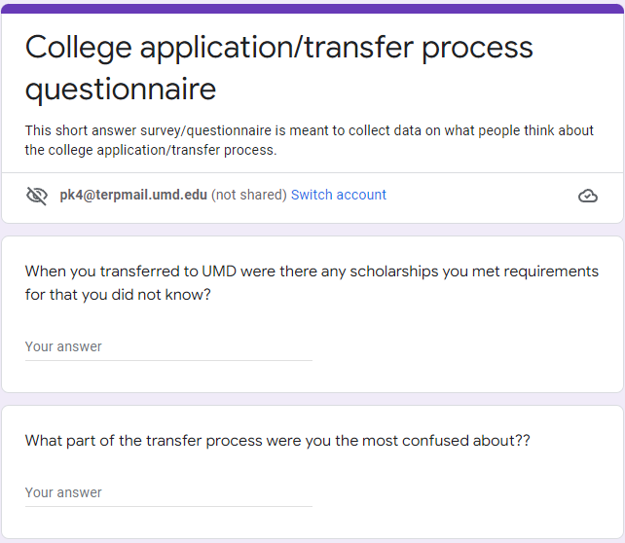
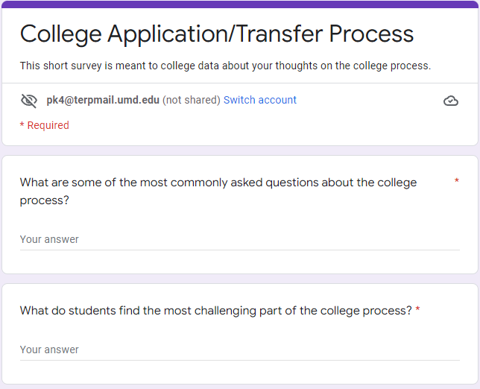
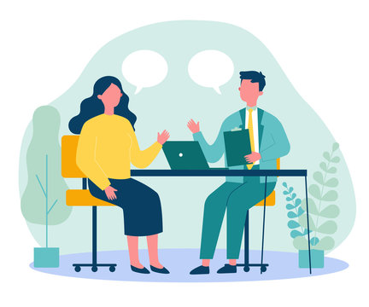
Data Collection Methods
Interviews
Survey for students
Survey for educators

Slide 5
Interviews/Surveys
Q:
Q:
A:
A:
Q:
A:

Slide 6
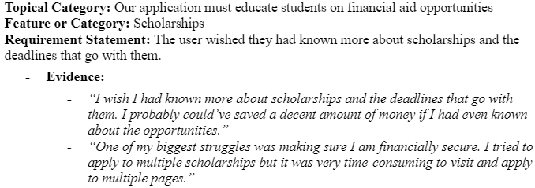
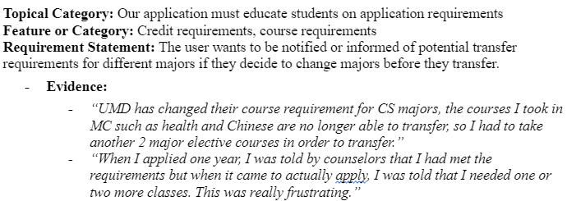
Requirements

Slide 7
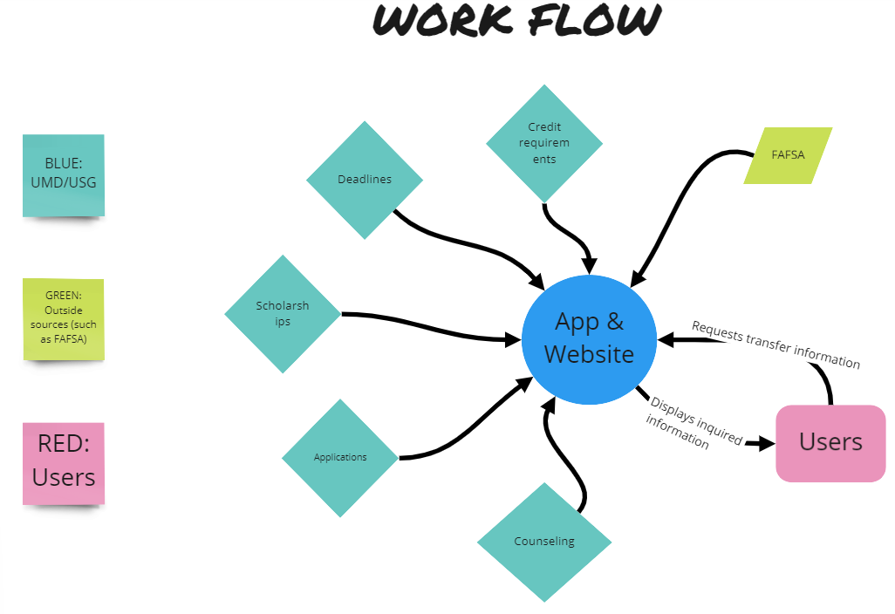
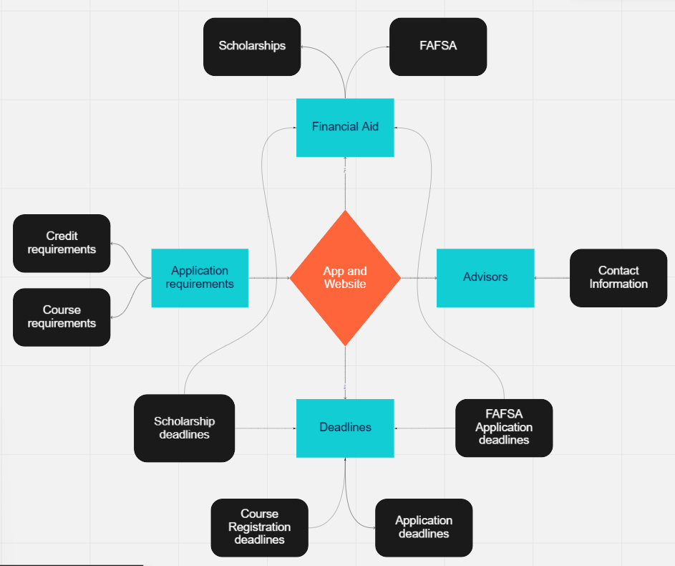
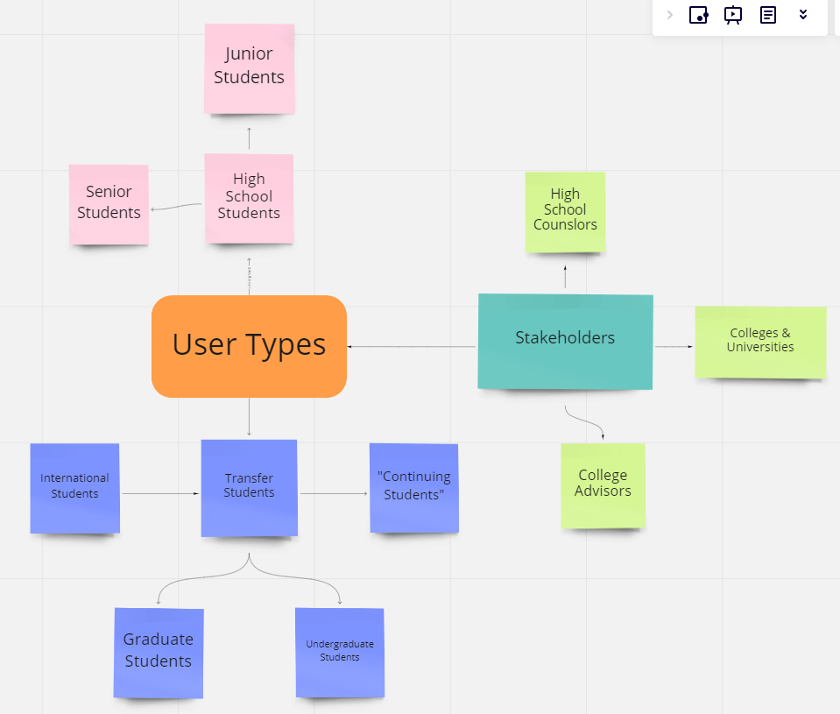
Diagram

Slide 8
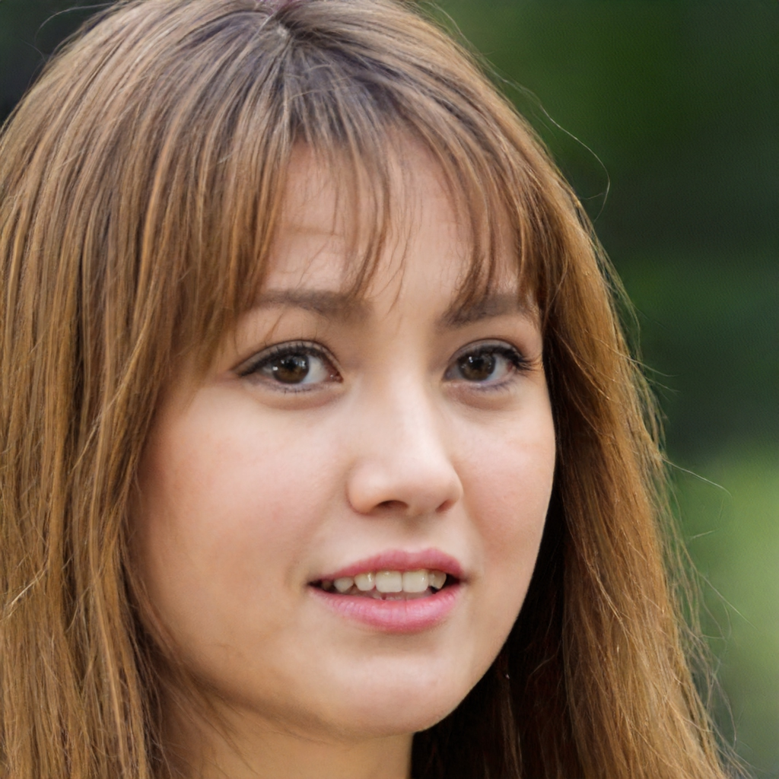
Personas
Kelly Austin 20, Junior Information Sciences Major at the University of Maryland at Shady Grove
Key Characteristics
Junior with a 4.0 GPA, in the information science major
Has been working a full-time job to pay for tuition
Is a full-time student
Overwhelmed by deadlines
Goals
Finding scholarships that would help her with paying for college.
Meet with advisors to talk about available scholarships to be able to work less and focus more on internships.

Slide 9
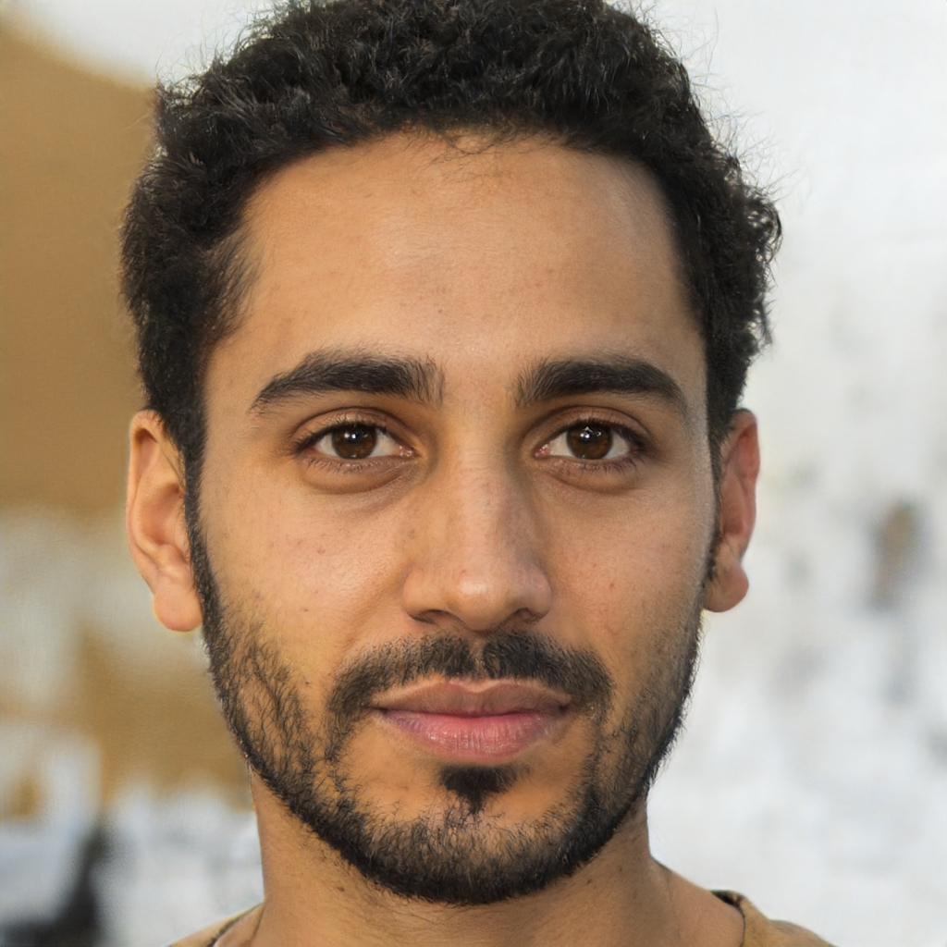
Personas
Ali Carson 22, Sophomore Computer Science Major at Montgomery College
Key Characteristics
Sophomore with a 3.2 GPA, in the computer science major
Interested in transferring into the information science program offered at the University of Maryland at Shady Grove
Has been working a part-time job to pay for tuition
Overwhelmed and Inexperienced
Goals
Find a scholarship that would help him with paying for college
Meet with advisors
Questions about Pre-requirements for transferring into the Information Sciences Program

Slide 10
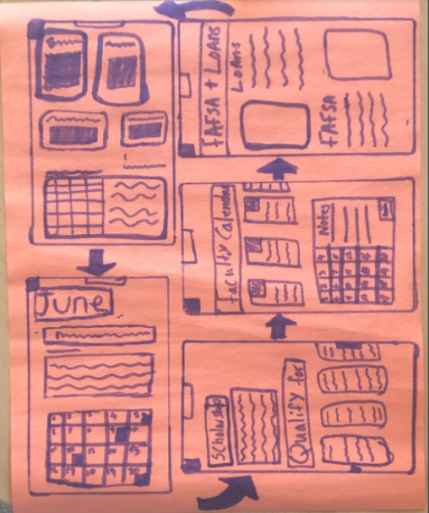
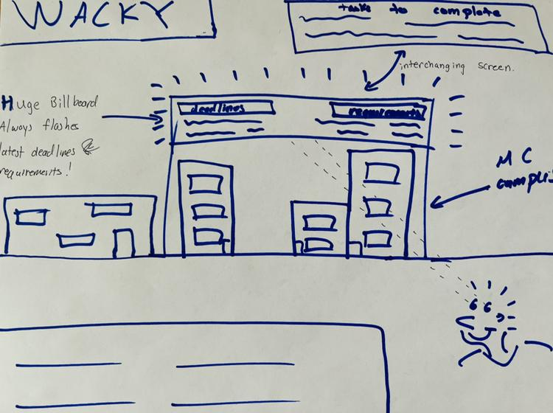
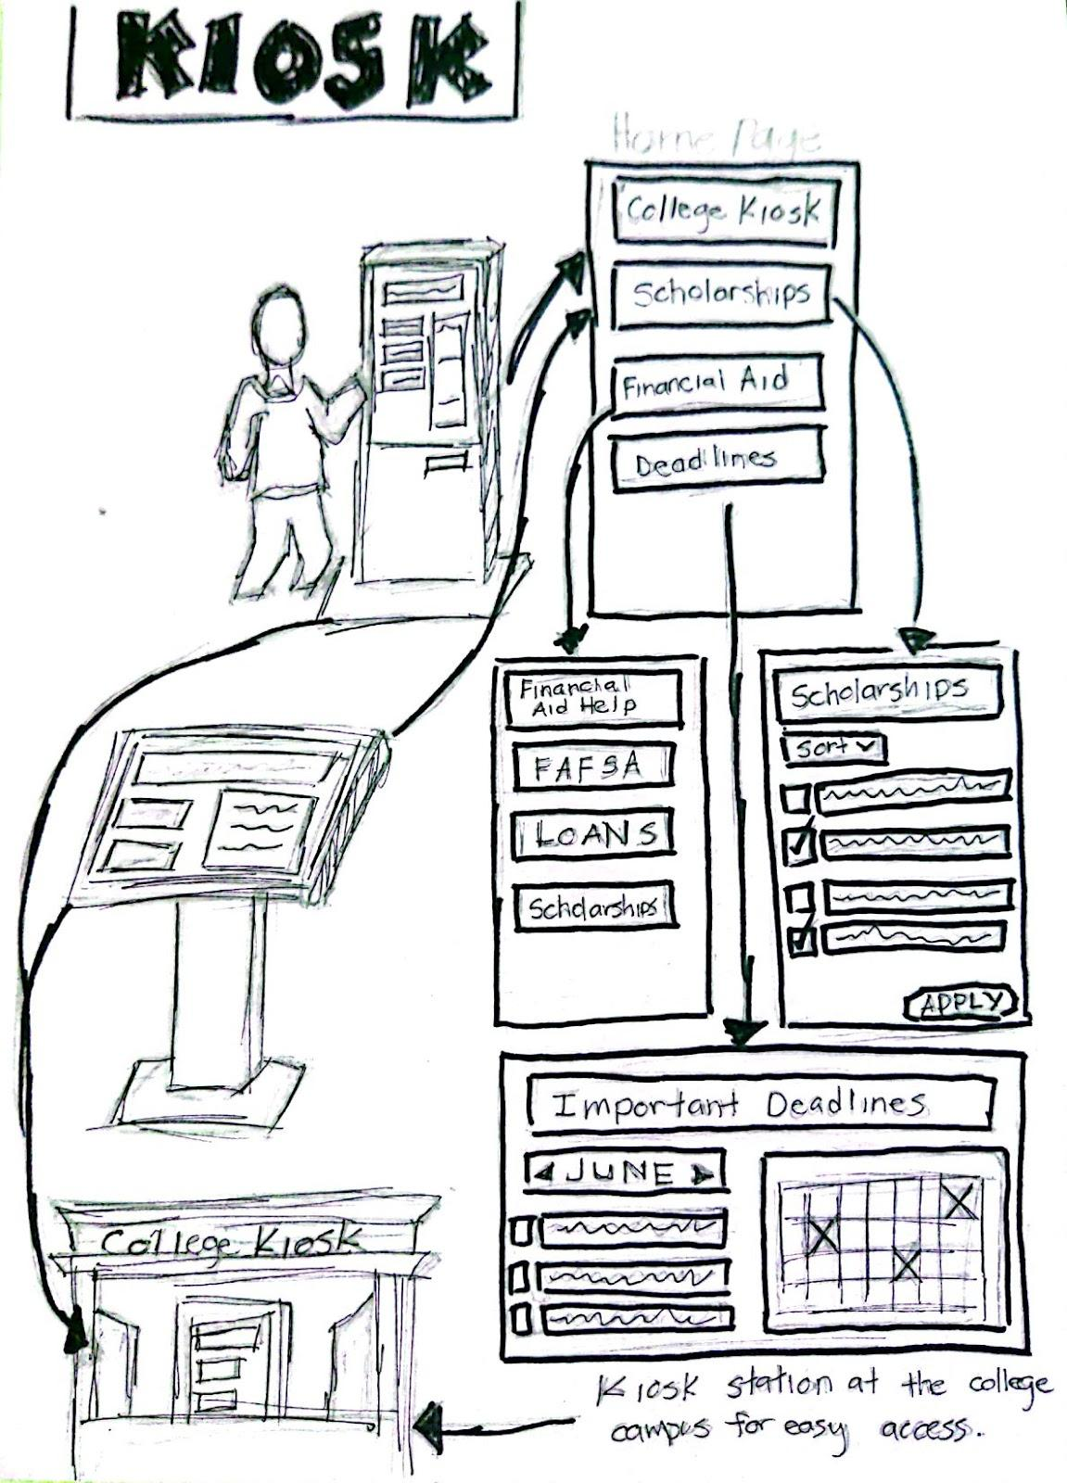
Sketches

Slide 11
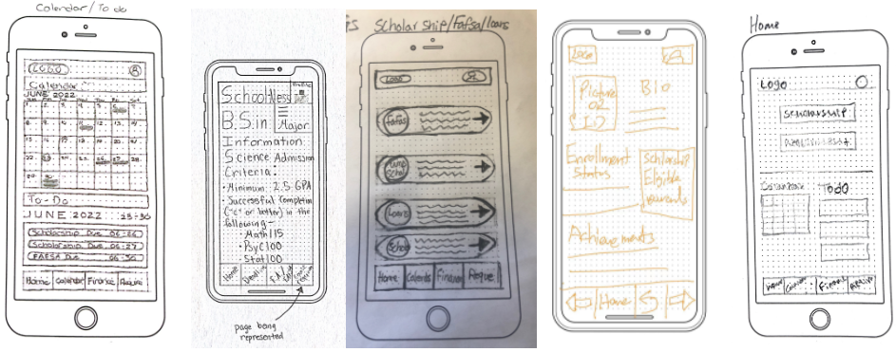
Paper Prototype

Slide 12
Paper Prototype
Main components:
Calendar/To-do
Transfer requirements
Financial Aid help
Some feedback:
“not to clutter the page”, “keep it simple” and “having links would be nice”.

Slide 13
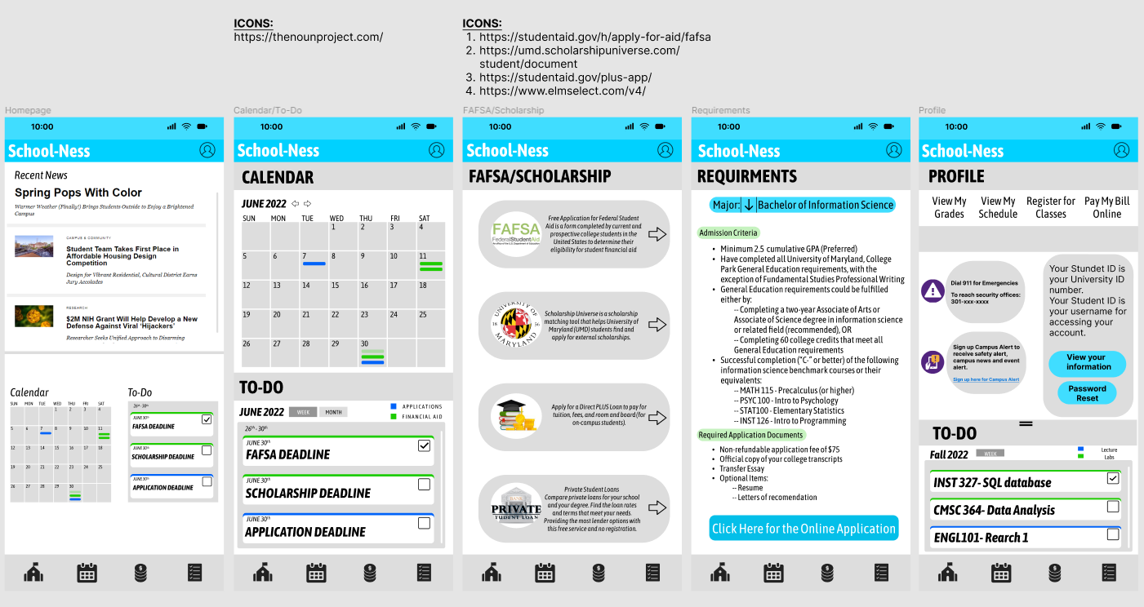
Digital Prototype

Slide 14
Digital Prototype
Main components:
Calendar/To-do
Transfer requirements
Financial Aid help

Slide 15
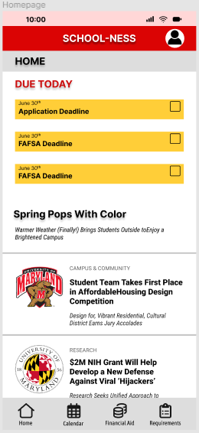
Evaluations
Colors didn’t represent UMD
Consistency of design (buttons especially)
Homepage wasn’t relevant
More whitespace
Change font/size
Less clutter
Redesign of profile page

Slide 16
Final Design
Link to our Final Figma Design

