Slide 1

Typical Cell Examples

Slide 2
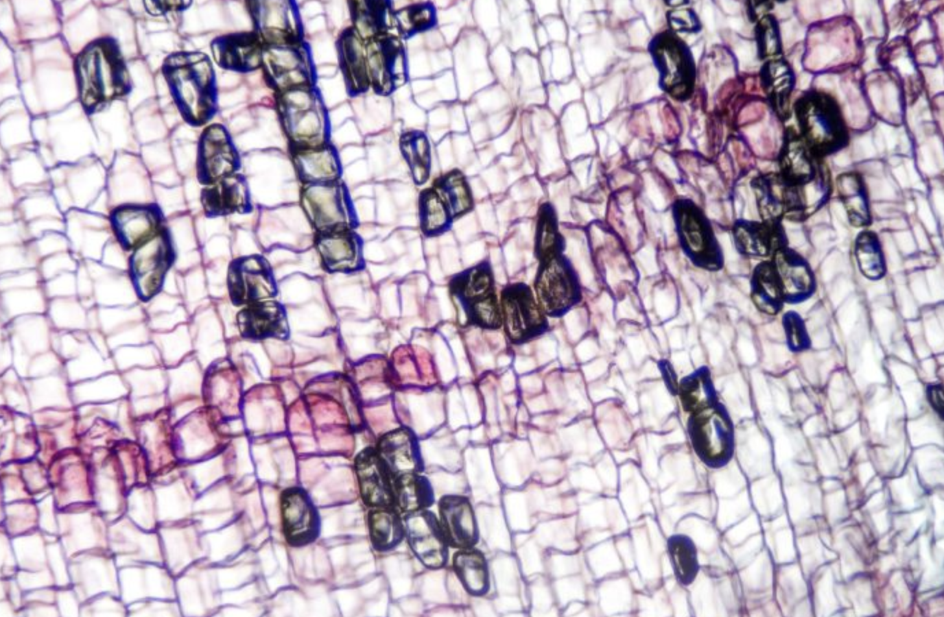
Cork Cells 40x

Slide 3
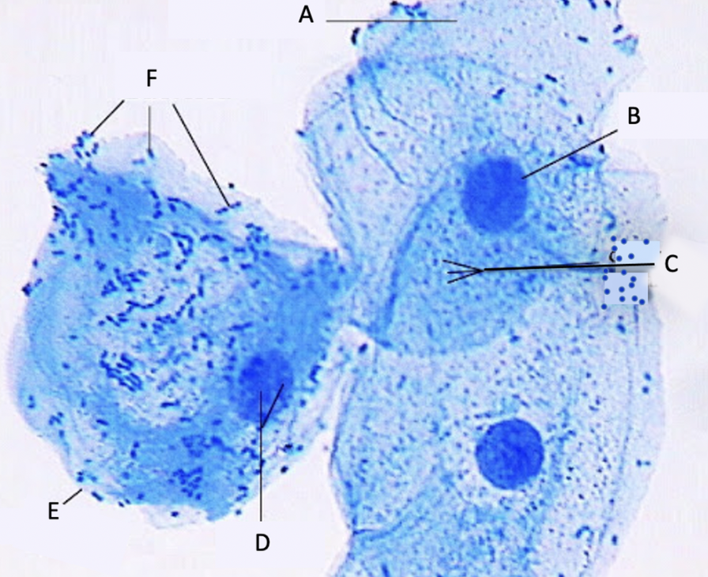
Human Cheek Cells 40x

