Slide 1
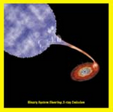
Artist version of a black hole

